Slide 1
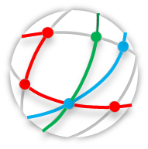
Cisco VTS
Cisco Virtual Topology System
Enabling the Software Defined Data Center
Jim Triestman – CSE Datacenter USSP
jtriestm@cisco.com

Slide 2
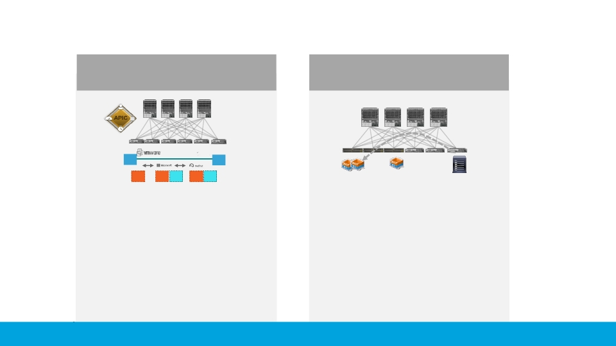
VXLAN Fabric: Choice of Automation and Programmability
Application Centric
Infrastructure
Programmable Fabric
DB
DB
Web
Web
App
Web
App
ACI solution
APIC as controller
App & Security Profiles,
automate translation into
network language
Mass Market
(commercial, enterprises, public sector)
VXLAN BGP EVPN
standards-based
VTS Integration with VMM
Automated overlay provisioning
Service Providers & Enterprise
© 2017
Multitenant Cisco and/or its affiliates. All rights reserved.
Cisco Public

Slide 3
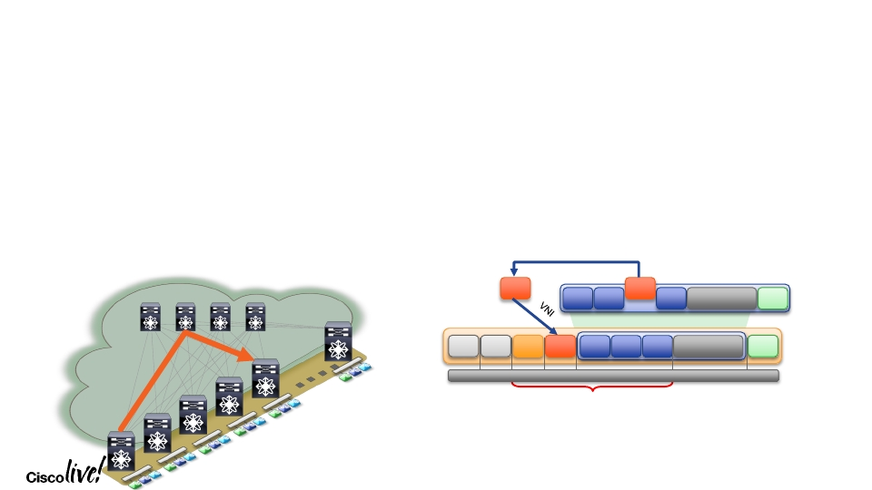
VXLAN Overview
Enter VXLAN...
•
VXLAN leverages the VXLAN
Network Identifier (VNI/VNID) field
• Total address space of 24 bits
• Support of ~16M segments
•
Uses Layer 3 Data Center Fabric
• No need for Spanning-Tree Protocol
• Equal-Cost Multi-Path (ECMP)
Uses IP/UDP header (MAC in IP/UDP)
•
•
Divided into Underlay and Overlay(s)
802.1Q header removed
802.1Q
802.1Q
Classic Ethernet
Frame
DMAC SMAC
Etype
Payload
CRC
Original Layer 2 Frame
VXLAN
Frame
Outer Outer
MAC IP
UDP VXLAN DMAC SMAC Etype
Payload
CRC
(new)
14B
20B
8B
8B
14B
4B
20B + 8B +8B + 14B* = 50 Bytes
of total overhead
LTRDCN-2001
© 2017 Cisco and/or its affiliates. All rights reserved. Cisco Public
9

Slide 4

VXLAN EVPN Overview
•
•
Workload MAC and IP Addresses learnt by VXLAN Edge Devices (NVEs)
Multi-Protocol BGP (MP-BGP) based Control-Plane using EVPN NLRI (Network
Layer Reachability Information)
•
Forward based on MAC or IP address learnt via Control-Plane (MP-BGP EVPN)
•
Make Forwarding decisions at VTEPs for Layer-2 (MAC) and Layer-3 (IP);
Integrated Route/Bridge (IRB)
•
•
Bridge – L2 VNI
Route – L3VNI
•
•
•
Reduce impact of ARP on the Network using ARP Suppression
Leverage Distributed Anycast Gateway capabilities
Host/IP Mobility – Location (VTEP), Identifier (MAC, IP of End-Host)
LTRDCN-2001
© 2017 Cisco and/or its affiliates. All rights reserved. Cisco Public
11

Slide 5
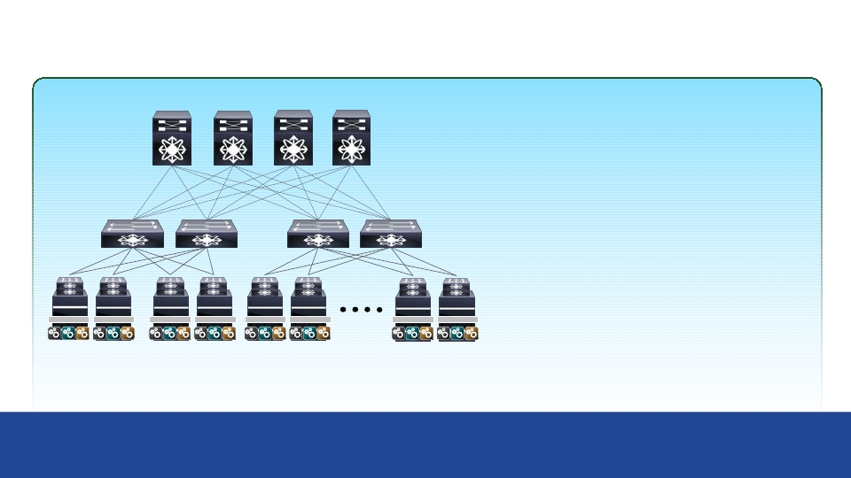
VXLAN Fabric
•
Any Network Anywhere
VM Mobility
VLAN Extensibility
Any Subnet Anywhere
Spine
•
Resiliency
Leaf
Smaller failure domains
•
Multi-tenant and Scale
Horizontal Scale
Minimize Bottlenecks
Simplified Networking with Flexibility and Efficiency at Scale
© 2017 Cisco and/or its affiliates. All rights reserved. Cisco Public

Slide 6

VTS Overview
Need for a Programmable Fabric

Slide 7

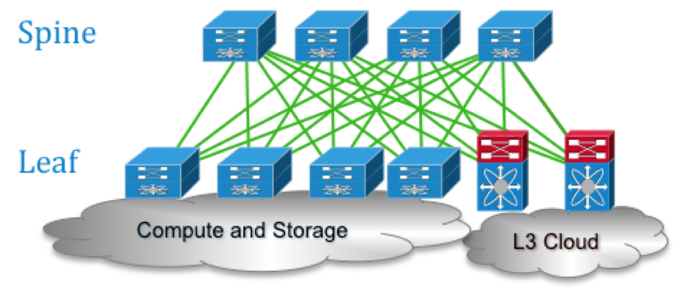
Network Virtualization and Multi-Tenancy using Overlays
Network virtualization: ability to separate, abstract and decouple the physical infrastructure & topology from a ‘logical’ topology or infrastructure typically by creating overlay networks. Network overlays helps disassociates applications from physical networks infrastructure & topology, allowing a transition to cloud based multi-tenanted & scalable networks.
Overlay Service Definition
App
Zone1
Firewall
App
Zone2
App
Zone1
Firewall
App
Zone2
External Network
External Network
Network
Segment A
Network
Segment B
Network
Segment C
Network
Segment A
Network
Segment B
Network
Segment C
Mapping
Function
Tenant A - Topology 1
Tenant B - Topology 1
Physical Infrastructure i.e. Underlay Network
Notes:
Network Virtualization through overlays - benefits
How networks are constructed today -
Complications with vlans - creating vlans - setting up STP - setting up router and then to scale we might have to set up multiple routers - once multiple routers enable routing protocol - you know how two loop avoidance mechanism. If overlays constructed well, we'll have a single protocol for ecmp style reachability.
a. Efficiency - Distributed routing/switching, single protocol for control plane, single protocol for data plane.
b. Best in class underlay devices
c. Vertical versus Horizontal scale - if properly constructed we will have no choke points in the network. Fabric used uniformly – no choke points. No traffic trombonning or duplicate round-trips in the fabric. At the same time the workloads should not have extra knowledge to function in such a network. No change in the workloads. Simply a better way of designing networks.
d. Location independence - important in virtualized world
e. Topology independence/protocol independence - allows one to switch protocols in the underlay without affecting the service layer

Slide 8
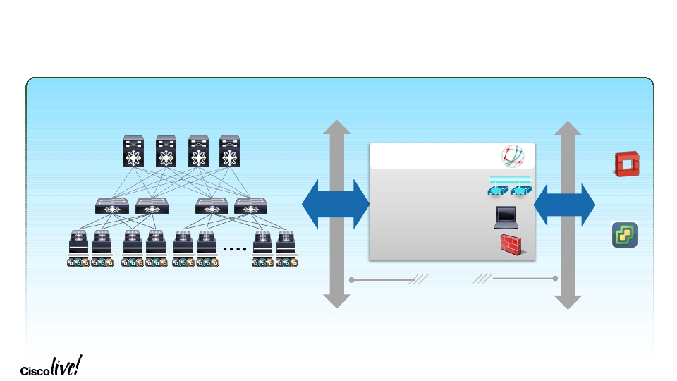
Programmable Fabric
On-Demand Provisioning Overview
Spine
VTS
Overlay Provisioning
& Visibility
Openstack
NX-API
Rest
API
Leaf
Physical to Virtual
Switch# show vlan
Vlan
--------------------
L4-L7 Service Chaining
vCenter
Open APIs
LTRDCN-2001
© 2017 Cisco and/or its affiliates. All rights reserved. Cisco Public
21

Slide 9
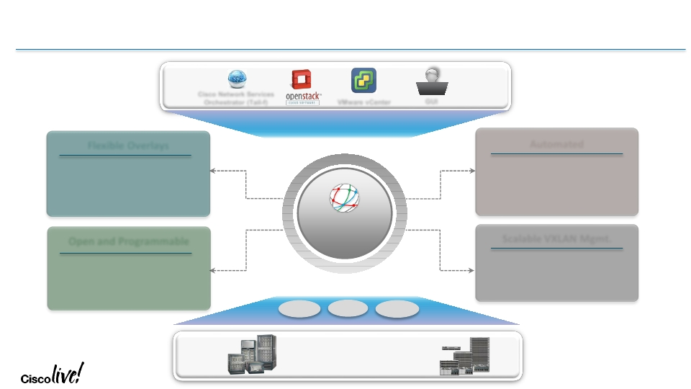
Cisco Virtual Topology System (VTS)
Overlay Provisioning & Management System
Cisco Network Services
Orchestrator (Tail-f)
VMware vCenter
REST API
GUI
Flexible Overlays
Physical and Virtual Overlays
Bare-metal and Virtualized Workloads
Open and Programmable
REST-Based Northbound APIs
Multi-hypervisor Support
Automated
Seamless Integration with Orchestrators
Automated Overlay Provisioning
Automated DCI/WAN Integration
Scalable VXLAN Mgmt.
MP-BGP EVPN Control Plane
High Performance Virtual Forwarder
Cisco Virtual Topology
System
YANG
CLI
NX-API
Nexus Portfolio
Nexus 2k – 9k, ASR
© 2017 Cisco and/or its affiliates. All rights reserved. Cisco Public

Slide 10
Service Provider Datacenter SDN Strategy
Open & standards based (EVPN-VXLAN / MPLS / Segment Routing / IPv6)
Controller based design for centralized policy and management
Model driven, overlay architecture for maximum deployment flexibility
Hybrid networking for variety of tenant workloads – physical, baremetal, VMs, containers
E2E automation of SP DC networking across multi-site, multi-DCs
High performance Software Overlays to support NFV in multi-vendor environments

Slide 11
VTS highlights
Overlay SDN system for SP Datacenter & NFVI. Based on EVPN/VXLAN fabric design
Model driven design for hardware and network abstraction
Automates Overlay provisioning across entire Nexus family (Nexus9k, Nexus 5k, Nexus7k) as well as ASR9k DCI
Supports Software overlays for SDDC (Software VXLAN VTEP based on VPP)
Scalable to multi-site overlays
Roadmap for MPLS Segment Routing in ToR (Fretta/NCS5k) and Virtual Leaf
Programmable using Northbound REST APIs
Tight Integration with VMMs such as Openstack, and vCenter
Containers

Slide 12
Unique challenges of SP Datacenters driven by NFV
Need to support a multi-vendor environment and optimized for high performance NFV (SDDC)
Datacenters are highly distributed (CORD: Central Office Re-architected as a datacenter) and logical networks need to span multi-site & multi-DC
Data centers have moved from flat layer 2 networks to tenanted layer 2 / 3 networks
Traditional challenges such as network flooding must be overcome (needs a control plane for L2)
BGP EVPN interworking with WAN MPLS L2/L3 VPN
Services and tenants must be abstracted from physical underlay
  1000s of tenants, virtual networks and hosts require agility and configuration precision
High degree of automation to reduce service provisioning to seconds

Slide 13
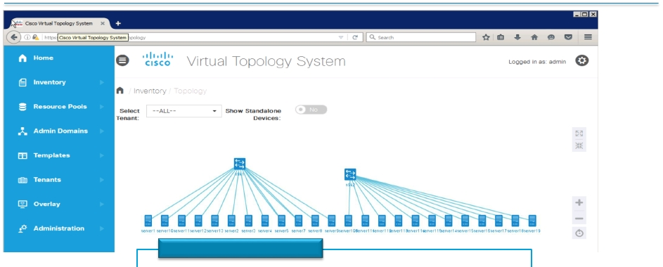
VTS Functionality: Fabric import & Discovery
Fabric Import & Discovery
Performing Topology Auto Discovery using LLDP
Import devices using inventory CSV file
Adding Device (Host and Network Devices) using VTS WebUI
1.
2.
3.
LTRDCN-2001
© 2017 Cisco and/or its affiliates. All rights reserved. Cisco Public
29

Slide 14
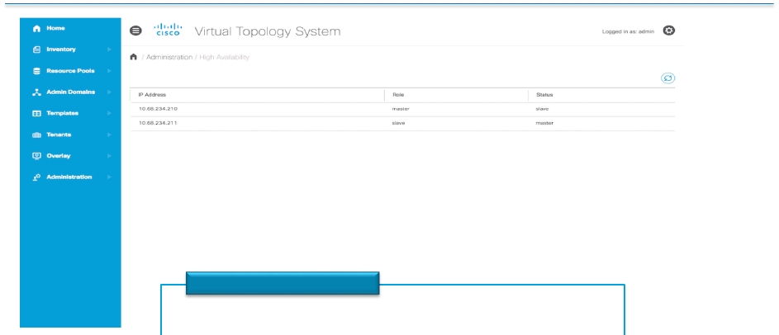
VTS Functionality: HA
HA
Two instances of VTC
Require 3x IP Addr for VTCs - 1x VIP, 1x VTC1, 1x VTC2
Setup HA through VTS CLI interface
1.
2.
3.
LTRDCN-2001
© 2017 Cisco and/or its affiliates. All rights reserved. Cisco Public
30

Slide 15
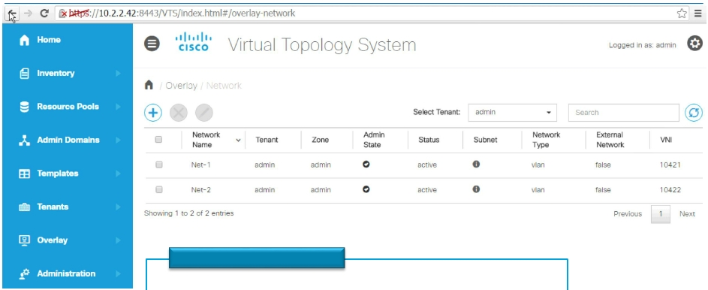
VTS Functionality: Programming the Fabric
Programming the Fabric
OpenStack /VMware
VTS GUI
NSO
1.
2.
3.
LTRDCN-2001
© 2017 Cisco and/or its affiliates. All rights reserved. Cisco Public
31

Slide 16
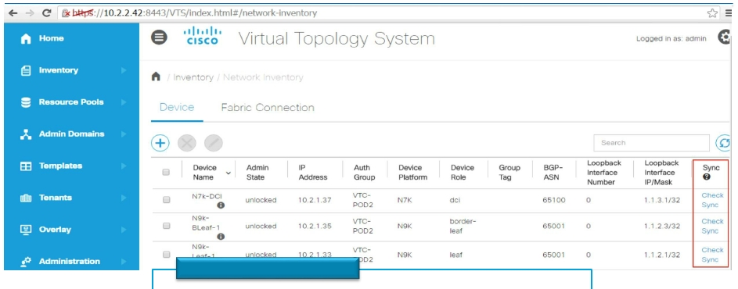
VTS Functionality: Fabric Synchronization
Fabric Synchronization
Sync before programming
Multiple VTS per fabric
1.
2.
LTRDCN-2001
© 2017 Cisco and/or its affiliates. All rights reserved. Cisco Public
32

Slide 17
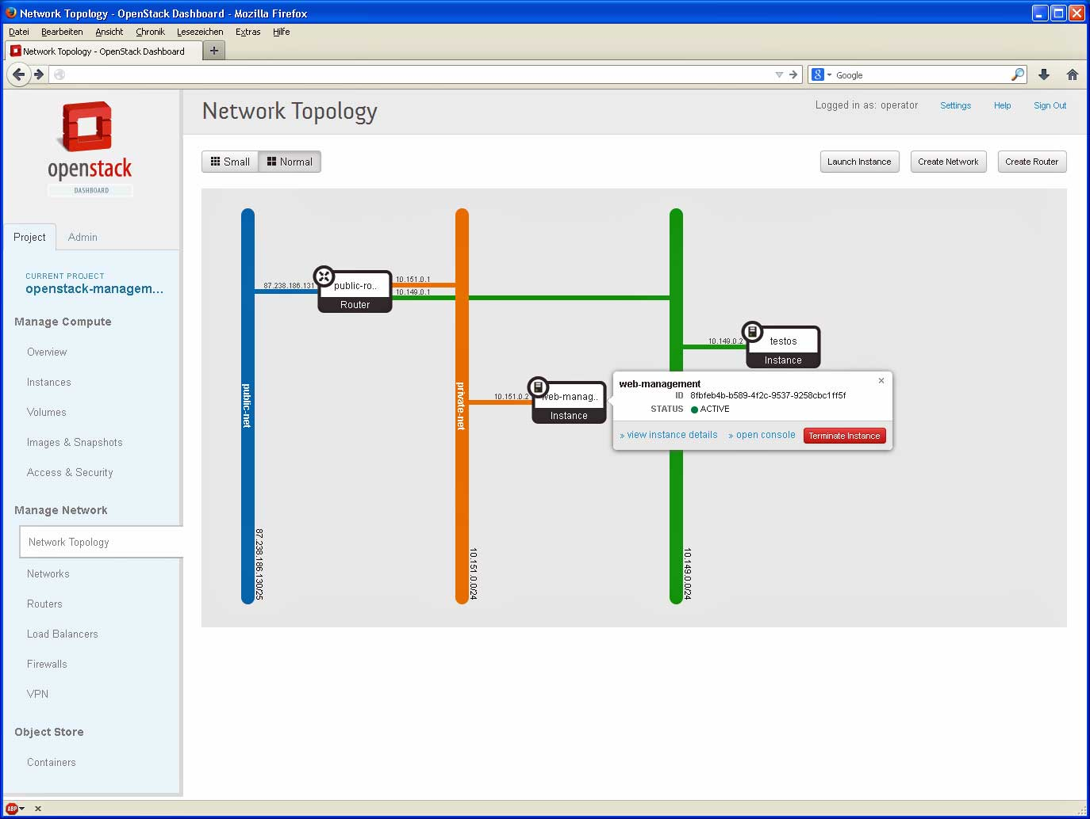
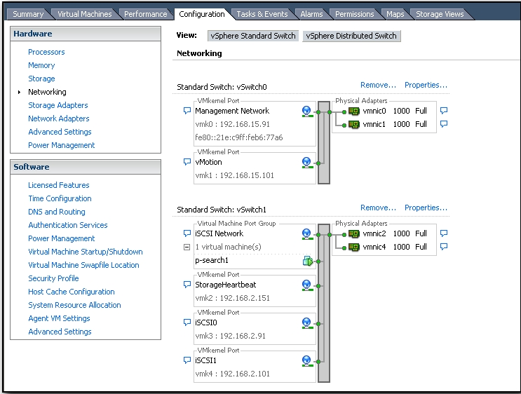
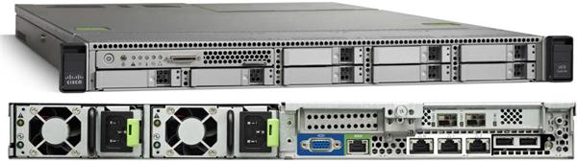
VTS – The Value to the Server and Cloud Team’s
Server Teams can continue to use their own tools without waiting on the network…
OpenStack Admins continue using Neutron
Vmware Admins continue using Distributed vSwitches
GUI or REST API for Bare Metal Deployments
VTS Plugins enable the existing server based networking tools to coordinate and integrate with the network seamlessly.

Slide 18






Virtual Topology Forwarder
User space, Multi-tenant, line rate packet forwarder
VM/Container
VM/Container
VM/Container
Uses Vector Packet Processing technology
VPP
Fully integrated with Intel DPDK
Guest 1
Guest 2
virtio
virtio
virtio
Supports VXLAN, MPLSoGRE, L2TPv3, MPLSoUDP, native MPLS and SR
vhost-user
User Space
Programmed by VTS
PCI Pass through/SR-IOV
Kernel Space
Open Sourced at http://www.fd.io
NIC
Multi-threaded and 64-bit clean
Server
Supports for IPv4 & IPv6
Notes:
By increasing cores,
VPP can run as both as use space virtial machine or as host process

Slide 19
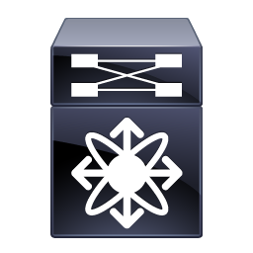



VTS Architecture – supports multiple workload types & orchestration systems
Openstack, Vmware, Kubernetes, Cliqr, PaaS, NSO, etc
Border Leaf
&
DCI
(Combo or
Separated)
REST API
VTEP
VTEP
VTEP
VTEP
VTEP
VTEP
OVS/DVS
Tenant
Bare
Metal
Workload or
Service
VTF
VTF
For containers, integrated with Cisco Container Networking
VTEP
VTEP
Tenant VM
Appliance VM
Appliance Container
Tenant VM
Tenant VM
Tenant Container
Service VM
Tenant VM
Tenant Container
Host
Host
Host
Host
Virtual Machines
Physical Appliance or Bare Metal
VM with SW Overlay
Containers

Slide 20
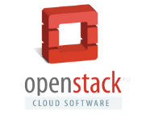




Cisco VTS Operational models
VTS GUI based
VMM Initiated
Multi VMM
VTS
VTS
VTS
vCenter
vCenter
The Network segments are shared across VMMs
Network objects can be created at VMMs or at VTS
Network and Compute groups work in Silos
Port-group and vlan information are exchanged offline as the VMs are attached.
VTS Plugin in VMM initiated workflow.
Network objects creation is initiated in VMM
Degree of Automation

Slide 21
Why Cisco VTS?
Scale
Performance
Efficiency
Scale-Out PODs
Open
Interoperability
(MPLS/VPN, OTV)
Seamless Integration
Multi-Hypervisor
Multi-VMM
Heterogeneous
Workloads
Automated
DCI/WAN
Service Assurance
Agility and Automation
Network as a
Service
Investment Protection
Policy Driven
Infrastructure
Fabric Efficiency
Multi-POD &
Multi-DC
Programmable
Architecture
(NB & SB)
Bare metal
Apps/Services
N2k-N9k, ASR
Support
Integration with
Orchestrators
Host Based
Overlays
Network
Connectivity
Control &
Data Plane
Custom NB
Integration
Group Based
Policies
Multi-Tenancy
Services
Integration (P&V)
Interoperability
Notes:
Investment Protection - VTS supports the entire Nexus portfolio, thus bringing the benefits of automation and operational simplicity to the entire Nexus family.
Faster Network Provisioning - through an automated policy-driven approach across both virtual and physical workloads.
Seamless Integration - through open APIs with cloud orchestration systems like OpenStack and vCenter
Improved Resource Utilization - through the creation of a flexible pool of resources which can be securely allocated and re-allocated on demand maximizing the return on infrastructure investment and reducing capex
Scalability - using standards based BGP-EVPN based control plane to manage VXLAN overlays extending workload placement and mobility diameter seamlessly without compromising performance.
Multi-Vendor support – Extensible to multi-vendor environments by leveraging Cisco Tail-f technology

