Slide 1
Introduction to Cisco Virtual Topology System (VTS)
Vijay Arumugam Kannan - Product Manager, VTS

Slide 2
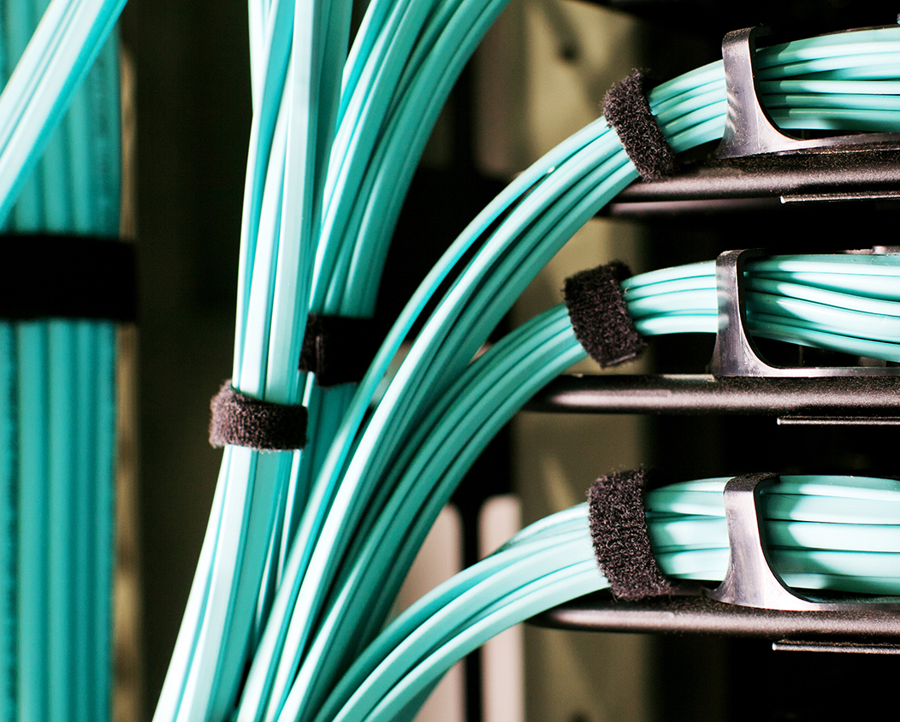
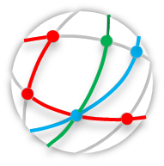
Agenda
Cisco Data Center SDN Strategy
Cisco Virtual Topology System (VTS)
VTS Use Cases
Cisco Virtual Topology System
VTS Functionality & Workflows
VTS Demo
Q & A

Slide 3
Data Center Trends
+
+
+
Today’s App
Scale: Connectivity, Tenancy,
Secure Access
Integration: APIs,
IOT, M2M, Cloud
Social Media
Data: Volume,
Streaming & Predictive Analytics
Agile: CI/CD, Devops,
Scale Out, Containers,
Microservices
Traditional Applications
Cloud-native applications
Monolithic Model
Multi-tier Apps
Business Agility with cloud model
Micro-services / Bi-Modal IT / DevOps
Application Shift
Physical and Manual
Distributed and Automated
Single Tenant, L2 based Data Center
Limited Mobility, Bare metal workloads
”
Multi-tenant,.
Dynamic and virtual workloads
Cloud Shift
Manual Interaction
Policy Driven Automation
Static Networks, L2 based Data Center
Complex, Custom & Closed
L3 Fabric Data Center, SDN Framework for cross-domain automation, and abstraction, analytics (visibility) and programmability
Networking Shift
Application and Server migration towards virtualization & cloud create requirements for agile networks
Notes:
Today’s applications are changing
They are moving away from monolithic model to micro-services model and are becoming highly distributed in nature.
The way these applications are delivered and consumed have also changed.
With the trends such as BYOD, IOT, Big Data, enterprise customers are constantly looking to cloud based development and delivery models for these applications so that they can be provisioned made available to their users in a matter of seconds irrespective of location of these end devices
The huge growth in traffic driven by video, mobile and cloud usage are overwhelming current SP networks and SPs are looking o transform their networks
As a part of this transition, SPs are using cloud technology to support network functions to provide agility on delivering services to customers with greater agility and operational efficiency. The motivation here is to realize CAPEX reduction and OPEX benefits.
Cloud computing has become relevant to enterprise and SP customers. Because this enables them able to provide on-demand automated provisioning of applications and services for their end users irrespective of the location or devices and also enable rapid elasticity of these services.

Slide 4



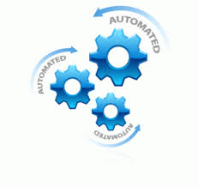
Service Orchestration velocity hindered by manual network process
Service Orchestration
Compute Orchestration
Network Orchestration
Spine
Spine
Compute is completely Virtualized
Compute Request completed in Seconds
Network is partially Virtualized
Network Change Request completed in days/weeks
ToR
ToR
ToR
Manual Network Change Request
IP Configuration
Firewall Configuration
VLAN configuration
Hypervisor
Hypervisor
Hypervisor
Automated Compute Request
Virtualized Compute
Auto Instantiation
VM
VM
VM
VM
x86 Server
x86 Server
x86 Server
Notes:
Cloud enabled Modern day Datacenter
For an application environment or data center to be ready for cloud environment, data center infrastructure should support scale out architectures based on compute and network
The data center infrastructure that includes computes, network and storage should be virtualized and automated
CLOS fabric scales out based on compute and network, to cater to distributed nature of these applications.
Server Virtualization advancements over the last decade has not only helped to avoid high capex by reducing the server footprint in datacenters
but have also have helped to reduce OPEX by enabling automated provisioning of compute nodes in a matter of seconds.
But there are bottlenecks
The network that connects the physical and virtual nodes are not completely virtualized. It has to provisioned manually and it takes weeks/days to complete and are prone to human configuration errors.

Slide 5
Technology Trends
Each addressing an aspect of challenges and opportunities
  Scalable Fabric
  Data Center CLOS Fabric to scale out based on Network and Compute
Scalable Fabric
  Network Virtualization
  Abstract network connectivity and services in to logical virtual networks that are decoupled from underlying physical infrastructure
  (abstraction, multi-tenancy and agility)
SDN
Network
Virtualization
  SDN
  Control & Data Plane separation…Centralized Control (automation & programmability)
  Open APls
  Distributed control plane components, Bare Metal, Physical network entities, all exposing APIs (programmability)
Open APIs

Slide 6



Service Orchestration velocity increased by Network Overlays/SDN in the data center
Service Orchestration
SDN Controller for automation, programmability and NVE management
Compute Orchestration
Network Orchestration
Network Overlays based Network Virtualization provides flexibility ], tenant isolation and allows for resources to be dynamically provisioned
Compute is completely Virtualized
Compute Request completed in Seconds
Network is completely Virtualized
Network Change Request completed in seconds
App
Zone1
Firewall
App
Zone2
App
Zone1
Firewall
App
Zone2
External Network
External Network
NX-API, CLI, YANG
Network
Segment A
Network
Segment B
Network
Segment C
Network
Segment A
Network
Segment B
Network
Segment C
Tenant A – Topology1
Tenant B - Topology 2
Automated Network Change Request
Policy based Configuration
Abstraction & Programmability
Virtualized L2/L3 networks
L3 CLOS fabric that scales out based on compute and network to cater to distributed nature of applications is the foundation of business agility
Automated Compute Request
Virtualized Compute
Auto Instantiation
SDN Based Overlays introduces agility and automation to Network Orchestration

Slide 7
Network Virtualization and Overlays
Network virtualization: ability to separate, abstract and decouple the physical infrastructure & topology from a ‘logical’ topology or infrastructure typically by creating overlay networks..
Network overlays disassociates applications from physical networks infrastructure & topology, allowing a transition to cloud based multi-tenanted & scalable networks.
App
Zone1
Firewall
App
Zone2
App
Zone1
Firewall
App
Zone2
External Network
External Network
Network
Segment A
Network
Segment B
Network
Segment C
Network
Segment A
Network
Segment B
Network
Segment C
Tenant A - Topology 1
Tenant B - Topology 1
Application and Server migration towards virtualization & cloud are driving the current network transition to the SDN/Network Overlays in the data center
Notes:
Network Overlays provides flexibility and cater to scale and elasticity of Virtualized datacenters which is defined by extreme dynamism of VM orchestrators for the rapid creation, modification, and deletion of virtual networks
Network Overlays provides topology independence and location independence. Decoupling from physical infrastructure provides agility and Operational efficiency, thereby transforming data center economics

Slide 8
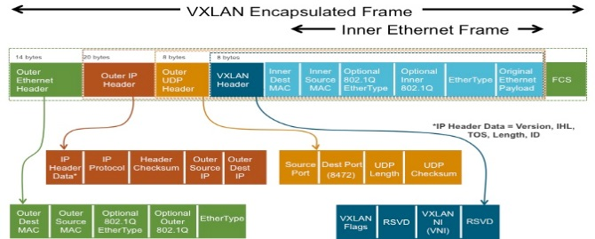

MPBGP-EVPN &VXLAN based Overlays
Overlay Forwarding Table
T1,S1 | MAC, IP Address | P1/2
T1,S2 | MAC, IP Address | VTEP2
T2,S3 | MAC, IP Address | VTEP3
T2,S4 | MAC, IP Address | VTEP4
EVPN
Layer-2 MAC and Layer-3 IP information distribution by Control-Plane (BGP)
VXLAN
Built in multi-tenancy (at scale)
IP routing – proven, stable, scalable
Integrated Routing/Bridging (IRB) for Optimized Forwarding
ECMP – utilize all available network paths
Minimize flooding through ARP suppression
Flexible placement of multitenant segments
Fast convergence upon network failures and host movements
Better utilization of network paths
Security through VTEP peer-authentication
Scalable network domain (16M VNI vs. 4K VLANs)
BGP-EVPN/VXLAN based overlays provides flexibility, manageability, isolation, multi-tenancy, scalability & convergence.
Notes:
Industry standard protocol for multi-vendor interoperability
Build-in multi-tenancy support
Leverage MP-BGP to deliver VXLAN with L3VPN characteristics
Truly scalable with protocol-driven learning
Host MAC/IP address advertisement through EVPN MP-BGP
Fast convergence upon host movements or network failures
MP-BGP protocol driven re-learning and convergence
Upon host movement, the new VTEP will send out a BGP update to advertise the new location of the host
Optimal traffic forwarding supporting host mobility
Anycast IP gateway for optimal forwarding for host generated traffic
No need for hair-pinning to to reach the IP gateway
ARP suppression
Minimize ARP flooding in overlay
Head-end Replication with dynamically learned remote-VTEP list
Head-end replication enables multicast-free underlay network
Dynamically learned remote-VTEP list minimizes the operational overhead of head-end replication
VTEP peer authentication via MP-BGP authentication
Added security to prevent rogue VTEPs or VTEP spoofing

Slide 9





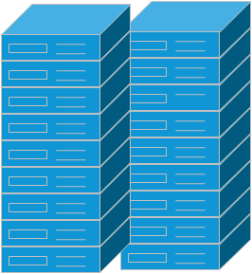
Cisco SDN: Providing Choice in Automation and Programmability
Application Centric Infrastructure
Programmable Fabric
Programmable Network
VTS
DB
DB
Web
Web
App
Web
App
Modern NX-OS with enhanced NX-APIs
Automation Ecosystem
(Puppet, Chef, Ansible etc.)
Common NX-API
across N2K-N9K
Turnkey integrated solution with security, centralized management, compliance and scale
Automated application centric-policy model with embedded security
Broad and deep ecosystem
VxLAN-BGP EVPN
standard-based
3rd party controller support
VTS for software overlay provisioning and management across N2K-N9K
Mass Market
(commercial, enterprises, public sector)
Service Providers
Mega Scale Datacenters
9
Notes:
Application and Server migration towards virtualization & cloud create requirements for agile and scalable networks. This is driving the current network transition to the SDN. With SDN, there is a migration from intelligent hardware platform components to a more centralized software intelligence. A centralized software helps customers improve their operational efficiencies at cloud scale and also enhance troubleshooting capabilities in the network. This helps the customer better align their network to meet their business goals.
SDN also changes the paradigm on how customer buy products, what features matter in the product. SDN is also shaping a new ecosystem build around SDN applications.
Software Defined Networking and OpenDaylight is transforming how we look at the network. The opportunities it creates are endless, we know some of them and will discuss few in the presentation. What Cisco is doing with OpenDaylight is taking the Open Source SDN Platform and putting capabilities around it to make it the best SDN platform in the market to help you win with customers
The discussion agenda is as above:
[1] What OpenDaylight is from the organization view and the OpenDaylight product
[2] Get into Cisco’s commercial distribution of OpenDaylight -- Cisco Open SDN Controller -- this will sold and supported as any other Cisco product.
[3] How we are enabling developers on the platform. As an open platform it has number of developer and integration opportunities and we are building a developer ecosystem
[4] A quick view of targeted use cases that we see today. Not an exhaustive list but a sample list of use cases we are focusing on initially
[5] Talk about how we are using Open SDN controller in the WAE. An example of an SDN application.
[6] Call to action.

Slide 10
Flexible Overlays with VTS

Slide 11
Cisco Virtual Topology System (VTS)
Open standards based Overlay Provisioning and Management System
Automates Overlay provisioning across Cisco Datacenter Top of Rack Nexus switches (Nexus 2000- Nexus 9000), Virtual Switches & DCI routers
Automates fabric provisioning for both virtual and bare metal workloads.
Programmable using North Bound REST APIs
Tighter Integration with Orchestration systems such as Openstack, vCenter and Cisco NSO
  Simplified Management for Ease of Operations

Slide 12

VTS : Realizing the Cloud Enabled Data Center
Flexible, on-demand EVPN/VXLAN based overlays with underlay awareness.
Abstracted & Virtualized
Network As A Service
Support Scale out architectures in terms of network and compute
Scalable
Fabric
Service Aware Overlay
Automation of fabric provisioning for physical and virtual workloads.
Deployment Flexibility, Visibility, management & Troubleshooting
Cisco Virtual Topology System
Policies
Declarative, transactional, granular policies
for instantiation of overlays &
secure connectivity
Orchestration
Scale & Automation Drives Business Success
Cisco Virtual Topology System (VTS) is the cornerstone of Cisco SP DC SDN strategy with increased investment and customer deployment across Worldwide Tier 1 Service Providers

Slide 13




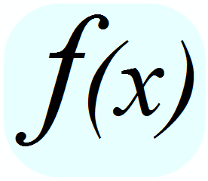
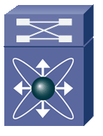
Model based provisioning – What does the user see?
User Policy – Conceptual, Simple & Abstract
Border Leaf
&
DCI
(Integrated or
Separated)
App
Zone1
App
Zone2
DCI Router
Firewall
Virtual Topology
Controller
External Network
Border Leaf
Provisioning
Actions
Network
Segment A
Network
Segment B
Network
Segment C
DC Fabric
(OSPF or BGP as the
Underlay Protocol)
Spine
SPINE
Policy & Models
to
Infrastructure
Mapping
Network Based
VTEPs
LEAF
Host Based VTEPS
OVS/DVS
SR-IOV
VTF
Bare Metal
Appliance
(Eg, Firewall)
Bare Metal
Application
VNFs
Appliance VM
Appliance VM
Tenant VM
Tenant VM
Tenant VM
Tenant VM
Inventory (Devices, Software, Capabilities, Groups & Topology)
Tenant VM
Tenant VM
Tenant VM
Host
Host
Host
Host
OVS/DVS
TOR/Leaf
Services
DCI
VTF
Physical Network Appliances
Notes:
Input two the system is stuff on the left – policies/user-intent + devices and their software/capabilities

Slide 14
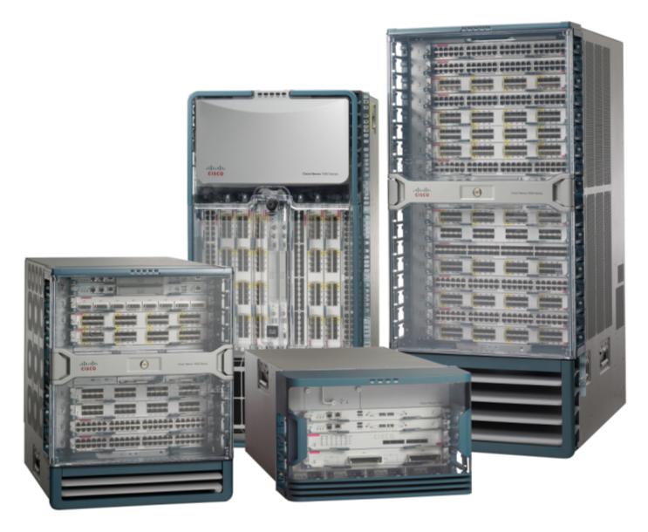
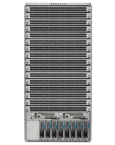
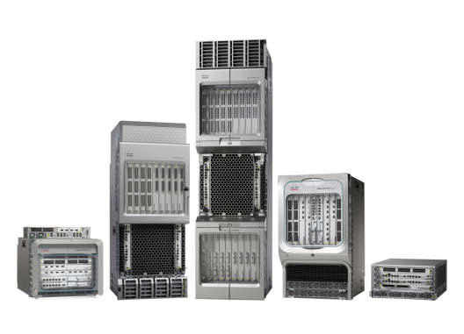

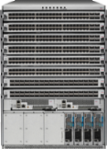

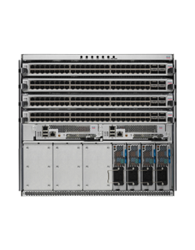
VTS Architecture
REST API
NETCONF/YANG – CLI – NXAPI – SNMP – REST API
Cisco Nexus 2000, 3000,
5000, and 7000 Series
Cisco Nexus 9000 Series
Cisco ASR 9000 Series
Virtual Compute Environment
VTF
DVS
Notes:
If you double click on VTS you can break it down as the policy and control plane.
VTS offers a robust policy plane and a control plane.
The policy plane helps you provide service definitions and infrastructure polices. It also houses an inventory of devices.
The control plane is used for device management using one of the southbound protocols and it also used to understand and distribute reachability information using MP-BGP protocols.

Slide 15


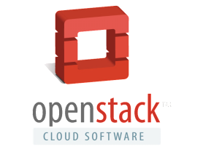

VTS Architecture – Hardware VTEP
Hardware Switches
DCI
Nexus 9200/9300/5600/7x00 – ToR
Border Leaf
VTEP
VTEP
Nexus 9300/9500/5000/7x00– Spine (RR)
Spine
Spine
ASR9000, Nexus 7x00– DCI
REST API
Cisco VTS
NX-API, CLI, YANG
ToR
ToR
ToR
VTEP
VTEP
VTEP
Hypervisor
Hypervisor
Hypervisor
VMware vCenter
VM
VM
VM
VM
x86 Server
x86 Server
x86 Server

Slide 16
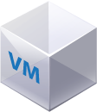
VTS Architecture – Software VTEP
Virtual Topology Forwarder
DCI
Border Leaf
VTEP
Spine
Spine
REST API
Cisco VTS
NX-API, CLI, YANG
ToR
ToR
ToR
VTEP
VTEP
VTEP
VTF
VMware vCenter
Hypervisor
VTF
Hypervisor
Hypervisor
Hypervisor
VM
VM
VM
VM
x86 Server
x86 Server
x86 Server

Slide 17
VTS Architecture – Virtual Topology Forwarder
DCI
Border Leaf
VTEP
User space, Multi-tenant, line rate packet forwarder
Uses Vector Packet Processing technology
Spine
Spine
Fully integrated with Intel DPDK
REST API
Cisco VTS
NX-API, CLI, YANG
Supports VXLAN, can be extended to support MPLSoGRE, L2TPv3, MPLSoUDP, native MPLS and SR
Programmed by VTS using Restconf/YANG
ToR
ToR
ToR
VTEP
VTEP
VTEP
VTF
VMware vCenter
Hypervisor
VTF
Hypervisor
Hypervisor
VM
VM
VM
VM
x86 Server
x86 Server
x86 Server
Cisco US Patent 7,931,636 (filed 2004)

Slide 18






Virtual Topology Forwarder
User space, Multi-tenant, line rate packet forwarder
VM/Container
VM/Container
VM/Container
Uses Vector Packet Processing technology
VPP
Fully integrated with Intel DPDK
Guest 1
Guest 2
virtio
virtio
virtio
Supports VXLAN, MPLSoGRE, L2TPv3, MPLSoUDP, native MPLS and SR
vhost-user
User Space
Programmed by VTS
PCI Pass through/SR-IOV
Kernel Space
Open Sourced at http://www.fd.io
NIC
Multi-threaded and 64-bit clean
Server
Supports for IPv4 & IPv6
Notes:
By increasing cores,
VPP can run as both as use space virtial machine or as host process

Slide 19
VPP vs OVS Performance Benchmarking

Slide 20
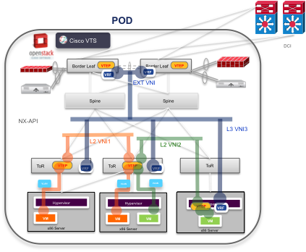
VTS – Flexible Network Overlays
Hardware based Overlays
Hardware VTEP
(TOR Leaf Switch)
Software (VTF) based Overlays
Hybrid Overlays
Software VTEP
(Virtual Topology Forwarder / Fd.io)

Slide 21
VTS – Forwarding North-South Traffic (DCI, WAN)
DCI
Border Leaf
L2 or L3 default route to BL/DCI
VTEP
Spine
Spine
Extend L3 VXLAN to DC-gateways
Associate L3 VNID to VRF
Configure external VRF peering on DC-gw
Optionally, configure DCI VRF peering, VPN
Default route-policy
Configure internal subnets attached to Router as aggregates on DC-gw (Towards DCI)
Configure default-originate on DC-gw or DCI (Towards overlay)
REST API
Cisco VTS
NX-API, CLI, YANG
L2/L3 VxLAN
ToR
ToR
ToR
L2 (VLAN)
VTEP
VTEP
VTEP
VMware vCenter
VTF
Hypervisor
Hypervisor
VTF
Hypervisor
VM
VM
VM
VM
x86 Server
x86 Server
x86 Server
Notes:
Application and Server migration towards virtualization & cloud create requirements for agile and scalable networks. This is driving the current network transition to the SDN. With SDN, there is a migration from intelligent hardware platform components to a more centralized software intelligence. A centralized software helps customers improve their operational efficiencies at cloud scale and also enhance troubleshooting capabilities in the network. This helps the customer better align their network to meet their business goals.
SDN also changes the paradigm on how customer buy products, what features matter in the product. SDN is also shaping a new ecosystem build around SDN applications.
Software Defined Networking and OpenDaylight is transforming how we look at the network. The opportunities it creates are endless, we know some of them and will discuss few in the presentation. What Cisco is doing with OpenDaylight is taking the Open Source SDN Platform and putting capabilities around it to make it the best SDN platform in the market to help you win with customers
The discussion agenda is as above:
[1] What OpenDaylight is from the organization view and the OpenDaylight product
[2] Get into Cisco’s commercial distribution of OpenDaylight -- Cisco Open SDN Controller -- this will sold and supported as any other Cisco product.
[3] How we are enabling developers on the platform. As an open platform it has number of developer and integration opportunities and we are building a developer ecosystem
[4] A quick view of targeted use cases that we see today. Not an exhaustive list but a sample list of use cases we are focusing on initially
[5] Talk about how we are using Open SDN controller in the WAE. An example of an SDN application.
[6] Call to action.

Slide 22
VTS - EVPN Control Plane Reachability information
Border Leaf
VTEP
Cisco VTS
RestConf
REST API
DCI
NX-API, CLI, YANG
RR
Spine
Spine
VMware vCenter
MP BGP
2
MP—BGP propagates routes for hosts to all other VTEPs
2
VTEPs advertise host routers (IP+MAC) to local hosts
2
VTS is used to deploy the RR at the Spines or in VTS Control plane
Hostt routes are installed in the RIB
ToR
ToR
ToR
TOR
VTEP1
VTEP2
VTEP3
Use MP-BGP with EVPN Address Family on Nexus ToR and VTS to distribute reachability information
VTEP4
VTS then provisions VTFs with information through RestConf interface
VTF
Hypervisor
Hypervisor
Hypervisor
VTF
Hypervisor
VM1
VM2
VM4
VM3
x86 Server
x86 Server
x86 Server
VM5
Overlay Forwarding Table
VM4 | MAC, IP Address | VTEP2
x86 Server

Slide 23
VTS Use Cases

Slide 24
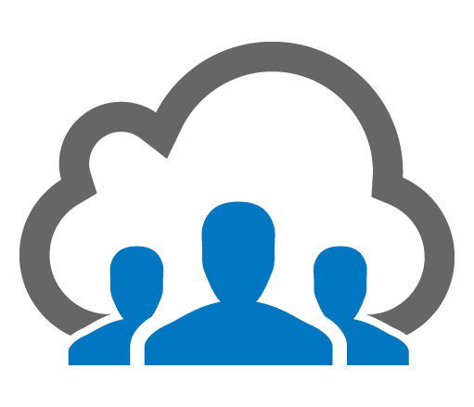

VTS Use Cases
Network-Function
Virtualization
Multi-Tenant
Data Centers

Slide 25




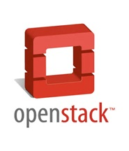

Multi Tenant Data Center
US Tier1 Service Provider
OTNGN
(CORE MPLS)
Multi VMM environment with different trust zones
Tenancy based on IPv4/IPv6(dual stack) capable overlay networks
Hybrid overlays
Redirect select traffic to the services connected to the BL
PE
PE
Border / Services Leaf
Border Leaf
Underlay Manager
Spine
VTS
Leaf
Bare
Metal
VM
DCNM
VTS
Bare
Metal
Bare
Metal
UCSD
BMA
VTF
Vcenter
vRR
Host
Host
Host
Host
Host
Host
Rack1
Rack2
Business Unit1
Business Unit2
Business Unit3
Business Unit4
POD1
POD2
POD3
POD4

Slide 26
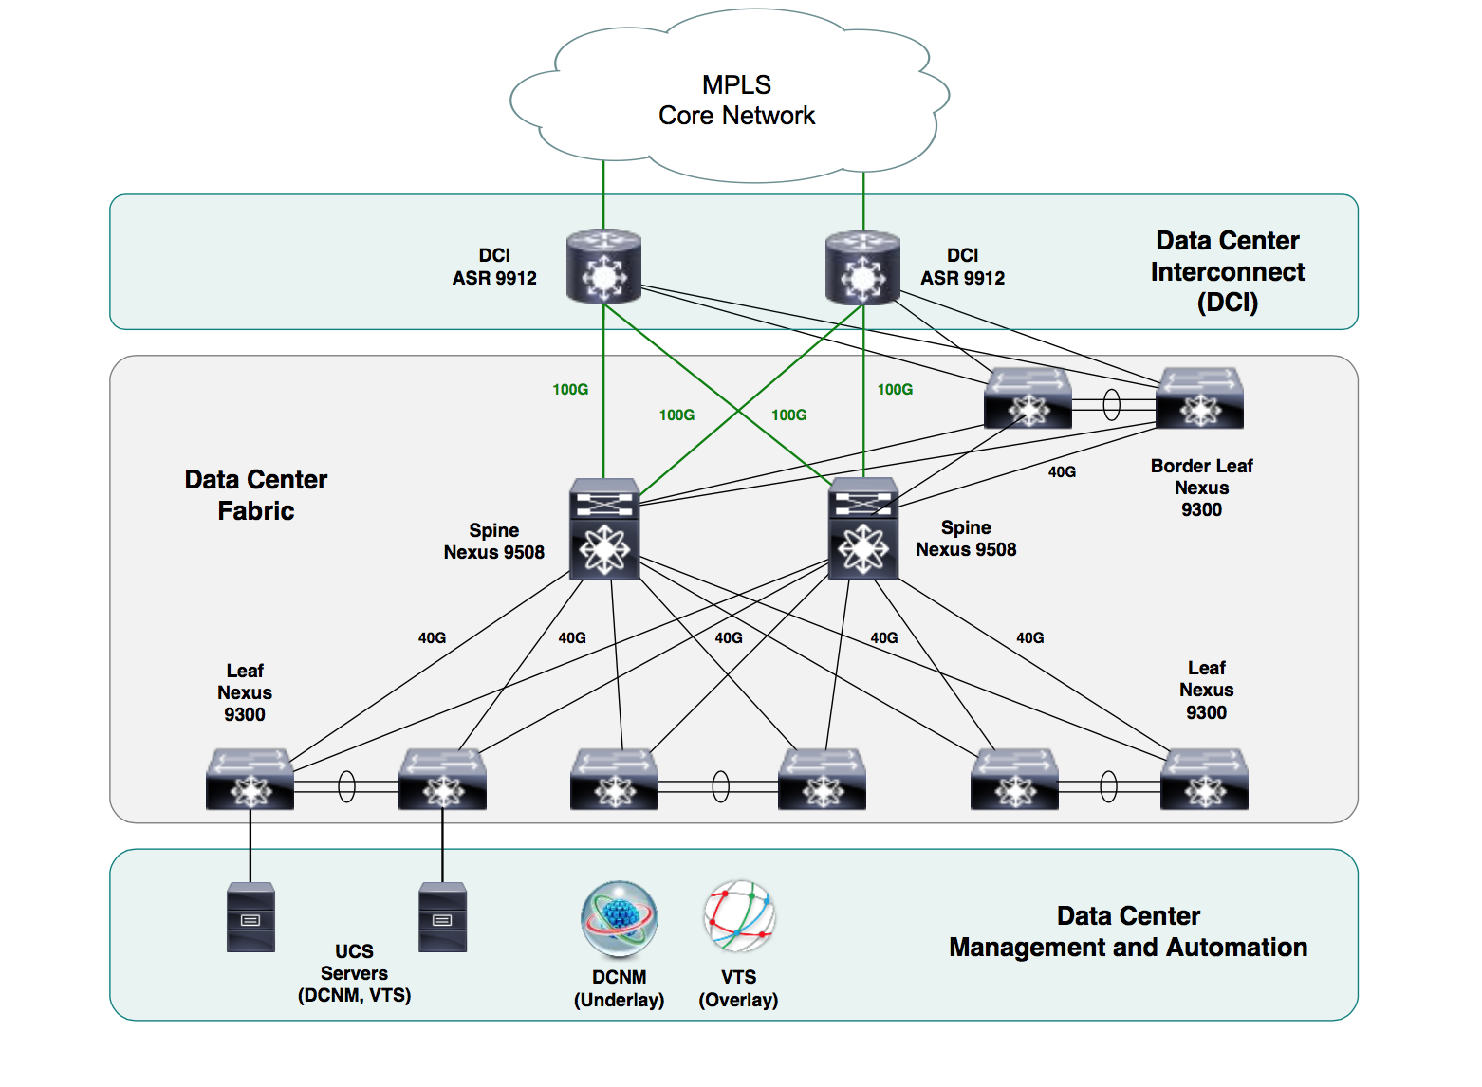
Multi Tenant Colocation Environment
Service Provider in Europe
Internet and VPN as service offerings
End Customers attached directly via Baremetal to Fabric
Ability to connect the same customers across multiple Data Center.
FW and LB within the Fabric.

Slide 27
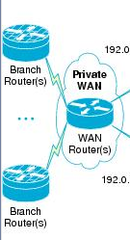
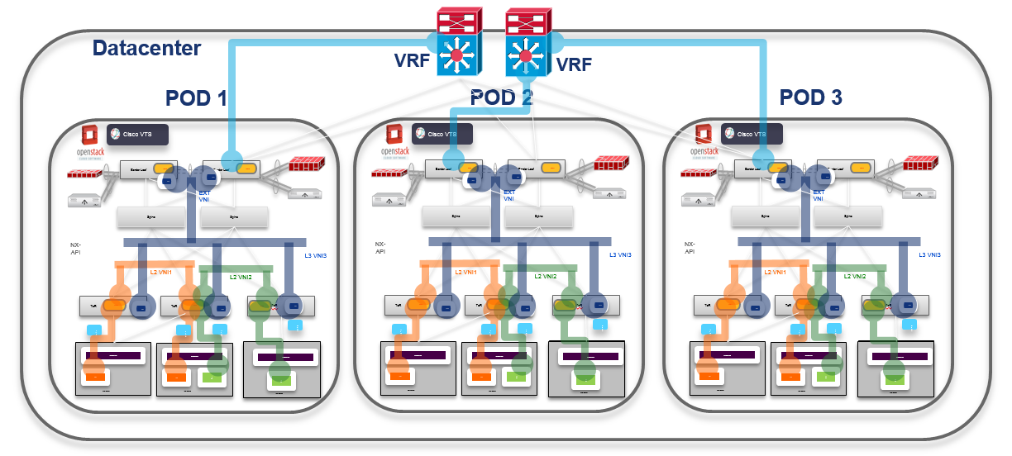
Multi Site Data Centers
For Disaster recovery, High Availability
Integrate EVPN/VXLAN to MPLS-L3VPN
Community Cloud Provider in Asia
IP/MPLS WAN

Slide 28
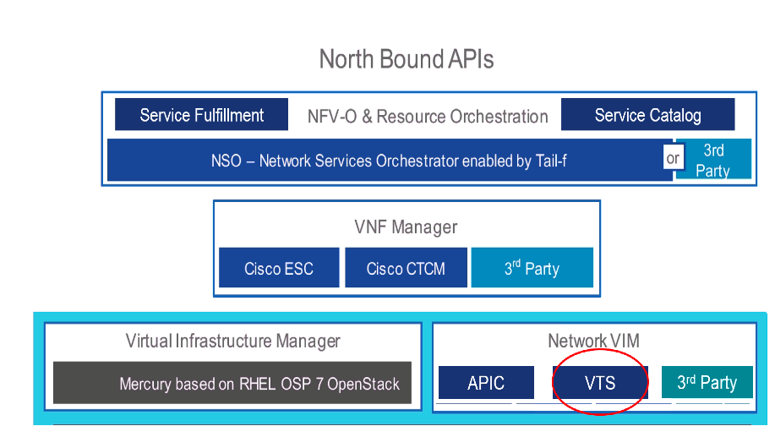
Cisco NFV Integration with VTS
Spine
Spine
VXLAN
ToR
ToR
ToR
VTEP
VTEP
VTEP
VTF
Hypervisor
VTF
Bare Metal Network
Function
Hypervisor
NFV VM
NFV VM
x86 Server
x86 Server
x86 Server

Slide 29
NFV Use case
Service Provider in Asia
Admin Tools
Customer Portal
OSS/BSS
NSO: Network Service Orchestrator
VTS: Virtual Topology System
VTS: Virtual Topology System
ToR: Top of Rack switch
PNF: Physical Network Function
VNF: Virtual Network Function
dVS: distributed Virtual Switch
PE: Provider Edge
REST API
Orchestration & Controllers Layer
NSO
ESC
vCenter
VTS
VTS
Plug-in
Virtual Overlay Networking Layer
BGP-EVPN
MPLS VPN Network
VXLAN
VPN PE
& VXLAN
Gateway
Nexus 9300 (ToR)
Nexus 9300 (ToR)
VLANs
VLANs
VLANs
VLANs
PNF1
dVS
dVS
PNF2
Virtual Infrastructure, VNF & PNF Layer
VNF1
VNF2
VNF1
VNF2
Notes:
1. Building Virtual IP-based overlay network over multiple DC sites to provide virtual networking services offered by current MGW.
This is the Scope of this RFI
2. Building End-user portal through which end users can request add/delete/change network services on-demand.
3. The end-user portal should also be able to configure gateway routers(PEs) connecting MGW network to existing L2/L3 VPN or public Internet.

Slide 30
VTS Functionality & Workflows

Slide 31
VTS Functionality: Discovery & Topology
DCI
Border Leaf
VTEP
VM Discovery
VMM Integration
Dynamic Provisioning
Spine
Spine
Device Topology Discovery
LLDP
Import configuration file
REST API
Cisco VTS
NX-API, CLI, YANG
ToR
ToR
ToR
VTEP
VTEP
Server Discovery
LLDP
Import Server to TOR Connection
VTEP
VTF
VMware vCenter
Hypervisor
VTF
Hypervisor
Hypervisor
VM
VM
VM
VM
x86 Server
x86 Server
x86 Server

Slide 32
VTS Functionality - Resource Pools
DCI
Manual resources management leads to errors and misconfigurations
Border Leaf
VTEP
Automated Resource Allocation and de-allocation on provisioning
Automated VLANs to VNIs to ensure connectivity
Spine
Spine
REST API
Cisco VTS
NX-API, CLI, YANG
Global Resource Pools
VNI (VXLAN Network Identifier)
Multicast IP Pool
Local Device Resource Pools
VLAN
ToR
ToR
ToR
VTEP
VTEP
VTEP
VTF
VMware vCenter
Hypervisor
VTF
Hypervisor
Hypervisor
VM
VM
VM
VM
x86 Server
x86 Server
x86 Server

Slide 33
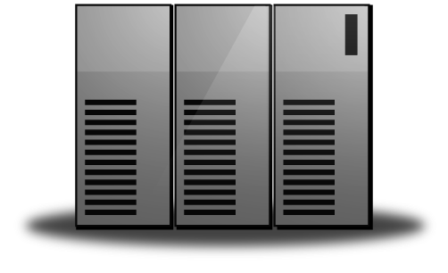
VTS Functionality: Infrastructure Policy
Cisco VTS
DC POD A
[L3GW – DCI]
DC POD B
[L3GW – DCI]
[L3GW – DCI]
[L3GW – DCI]
[L3GW – BL]
[L3GW – BL]
Border Leaf
Border Leaf
[L3GW – BL]
[L3GW – BL]
Spine
Spine
Spine
Spine
[L3GW – L3]
[L3GW – L3]
Distributed L2/L3 gateway Mode
Centralized L3 Gateway
ToR
ToR
ToR
ToR
ToR
[L2GW]
[L2GW]
[L2GW]
[L2GW]
[L2GW]
VTF
VTF
VTF
VTF
VTF
VTF
VM
VM
VM
VM
VM
VM

Slide 34
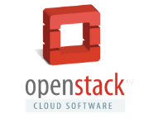
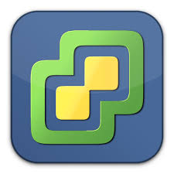



Cisco VTS Operational models
VTS GUI based
VMM Initiated
Multi VMM (Roadmap)
VTS
VTS
VTS
vCenter
vCenter
The Network segments are shared across VMMs
Network objects can be created at VMMs or at VTS
Network and Compute groups work in Silos
Port-group and vlan information are exchanged offline as the VMs are attached.
VTS Plugin in VMM initiated workflow.
Network objects creation is initiated in VMM
Degree of Automation

Slide 35
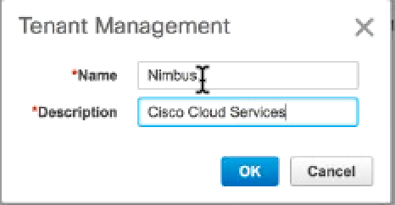
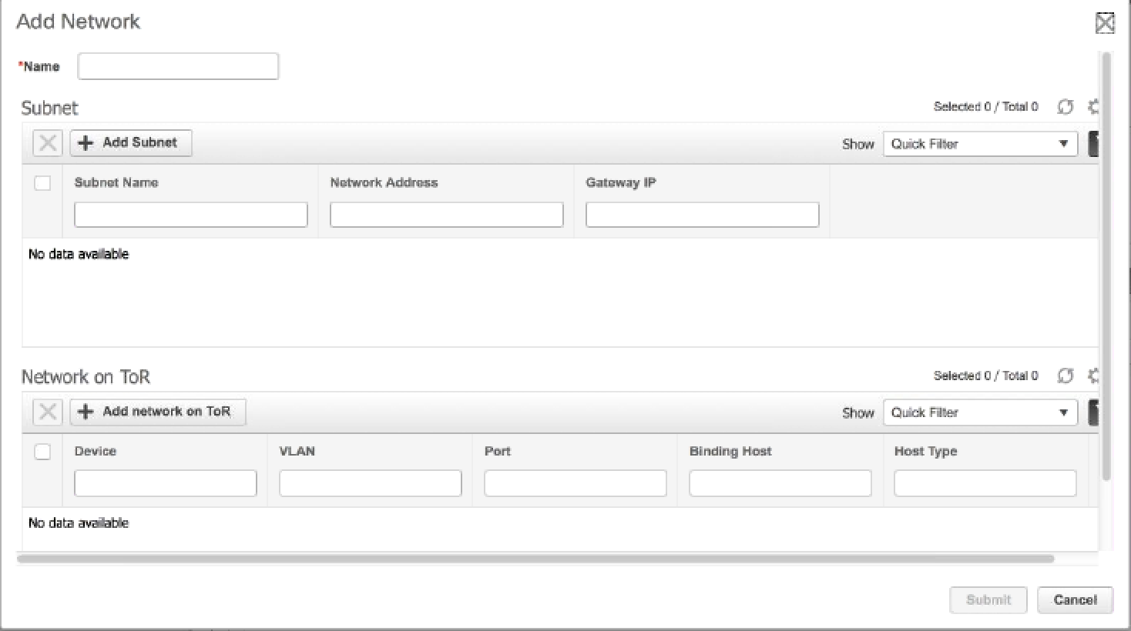
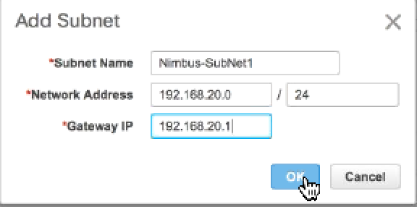
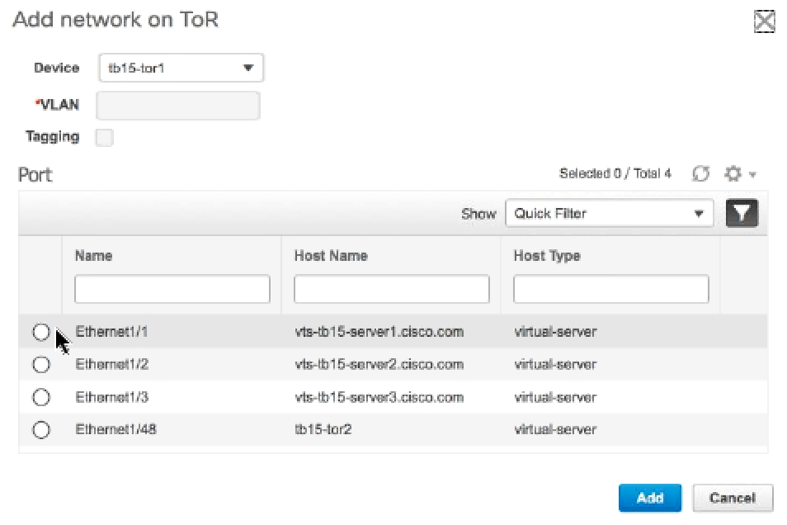
VTS Functionality: Overlay Configuration through GUI
Create a Tenant
Add Network to the Tenant
  Add Subnet
  Select the ToR and host facing ports
VLAN and VNID is automatically allocated
Layer-2 VXLAN segment is configured on the ToR switches

Slide 36
VTS : OpenStack Workflow
Spine
Spine
1
2
Tenent and Tenant Networks Created
Create Tenant Networks
NX-API, CLI, YANG
REST API
Cisco VTS
VXLAN
3
VNID assigned for each network
5
VM Host info captured by VTS and mapped to the right ToR & ToR port using topology database
OpenStack Project View
ToR
ToR
ToR
VTEP
VTEP
4
Attach VM to Network
VTEP
VTF
Hypervisor
VTF
Hypervisor
Hypervisor
VM
VM
VM
VM
x86 Server
x86 Server
x86 Server

Slide 37
VTS : OpenStack Workflow
VTS provisions VTEP, VLAN for each VTEP and EVPN on ToR/VTF
vlan 1,1700-711,2000
vlan 1706
vn-segment 46006
evpn
evi 46006 vni
bgp
rd auto
route-target import auto
route-target export auto
interface nve1
no shutdown
source-interface loopback0
member vni 46006
host-reachability protocol bgp
mcast-group 224.1.1.1
6
Spine
Spine
1
2
Tenent and Tenant Networks Created
Create Tenant Networks
NX-API, CLI, YANG
REST API
Cisco VTS
3
VNID assigned for each network
VXLAN
VXLAN
5
VM Host info captured by VTS and mapped to the right ToR & ToR port using topology database
OpenStack Project View
ToR
ToR
ToR
VTEP
VTEP
4
Attach VM to Network
VLAN
VLAN
VLAN
VTEP
7
VTF
Neutron agent modified to request VLAN information from VTS before programming vSwitch
Hypervisor
VTF
Hypervisor
Hypervisor
VLAN
VM
VM
VM
VM
x86 Server
x86 Server
x86 Server

Slide 38
VTS : OpenStack Workflow
VTS provisions VTEP, VLAN for each VTEP and EVPN on ToR/VTF
9
VTS provisions L3 VXLAN (distributed L2/L3) , Anycast gateway with EVPN
6
vlan 1708
vn-segment 46008
vrf context vni-46008
vni 46008
rd auto
address-family ipv4 unicast
route-target both auto
fabric forwarding anycast-gateway-mac 0002.0002.0002
#Anycast Gateway MAC, identically configured on all VTEPs
interface Vlan1706
no shutdown
vrf member vni-46008
ip address 192.168.4.1/24 ---> Anycast GW Address
fabric forwarding mode anycast-gateway
interface Vlan1708
no shutdown
vrf member vni-46008
ip forward
router bgp 23
router-id 4.4.4.4
address-family ipv4 unicast
address-family l2vpn evpn
retain route-target all
…..
vrf vni-46008
address-family ipv4 unicast
advertise l2vpn evpn
evpn
evi 46008 vni
bgp
rd auto
route-target import auto
route-target export auto
Spine
Spine
1
2
Tenent and Tenant Networks Created
Create Tenant Networks
NX-API, CLI, YANG
REST API
Cisco VTS
3
VNID assigned for each network
VXLAN
VXLAN
5
VM Host info captured by VTS and mapped to the right ToR & ToR port using topology database
OpenStack Project View
ToR
ToR
ToR
VTEP
VTEP
4
Attach VM to Network
VLAN
VLAN
VLAN
VTEP
7
VTF
Neutron agent modified to request VLAN information from VTS before programming vSwitch
Hypervisor
VTF
Hypervisor
Hypervisor
8
VLAN
Create router and attach interfaces to tenant networks
VM
VM
VM
VM
x86 Server
x86 Server
x86 Server

Slide 39
Demo: VTS Functionality & Workflow

Slide 40
Summary

Slide 41
Why Cisco VTS?
Seamless Integration
Multi-Hypervisor
Multi-VMM
Heterogeneous
Workloads
Automated
DCI/WAN
Service Assurance
Agility and Automation
Network as a
Service
Investment Protection
Policy Driven
Infrastructure
Bare metal
Apps/Services
N2k-N9k, ASR
Support
Integration with
Orchestrators
Host Based
Overlays
Network
Connectivity
Custom NB
Integration
Group Based
Policies
Multi-Tenancy
Services
Integration (P&V)
Interoperability
Scale
Performance
Efficiency
Scale-Out PODs
Fabric Efficiency
Multi-POD &
Multi-DC
Open
Control &
Data Plane
Programmable
Architecture
(NB & SB)
Interoperability
(MPLS/VPN, OTV)
Notes:
Investment Protection - VTS supports the entire Nexus portfolio, thus bringing the benefits of automation and operational simplicity to the entire Nexus family.
Faster Network Provisioning - through an automated policy-driven approach across both virtual and physical workloads.
Seamless Integration - through open APIs with cloud orchestration systems like OpenStack and vCenter
Improved Resource Utilization - through the creation of a flexible pool of resources which can be securely allocated and re-allocated on demand maximizing the return on infrastructure investment and reducing capex
Scalability - using standards based BGP-EVPN based control plane to manage VXLAN overlays extending workload placement and mobility diameter seamlessly without compromising performance.
Multi-Vendor support – Extensible to multi-vendor environments by leveraging Cisco Tail-f technology

Slide 42
Cisco Differentiation
NFV Ecosystem
Full stack NFV solution
Integration with NSO and VNF life-cycle manager ESC
Dynamic service chaining capabilities
Virtual Topology System
(Policy Plane & Control Plane)
Transactional policy models; ability to flag transaction errors & rollback
Architecture to easily integrate third party network elements
Virtual Topology Forwarder
User space without any kernel modifications
Multi-tenanted, L2/L3 capable including VXLAN & MPLS
Line rate packet forwarder
Network Endpoint
Ecosystems
Enabling SW and HW overlays in bare-metal and virtualized environment
N2k-N9k, ASR 9K, and Virtual forwarder support

Slide 43

For More Information
http://www.cisco.com/go/vts

Slide 45
Backup

Slide 46
VTS VM Requirements
VM | Memory | CPU
VTC | 16 Gb (16777216) | 8 cores
VTF | 16 Gb (16777216) | 2 cores
XRVR | 32 Gb (33554432) | 6 cores

Slide 47
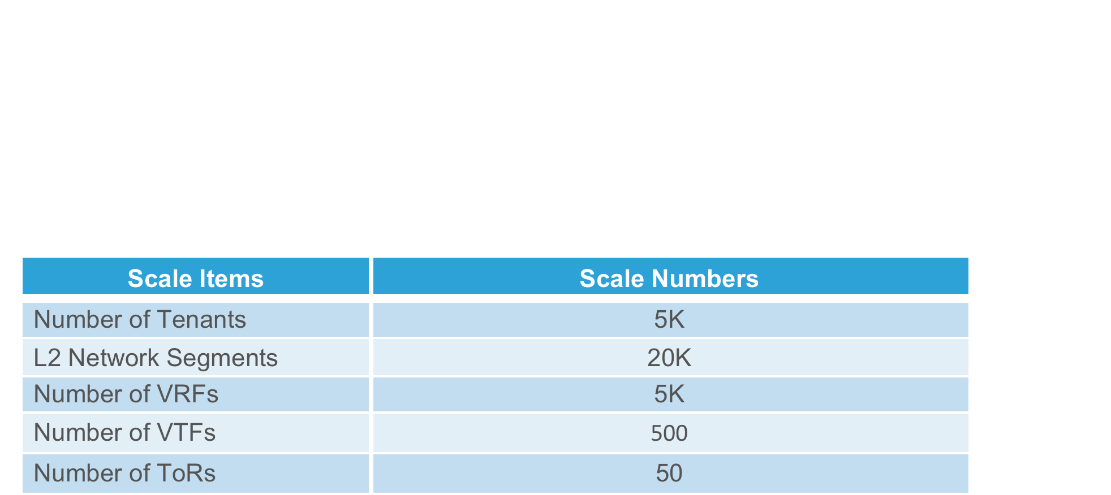
VTS Scalability Numbers

