Slide 1
VXLAN the Cisco Way:
Why, Where, When, What, How
Darren Marinko – DC Consulting Systems Engineer
Phil Lowden – DC Consulting Systems Engineer

Slide 2
Why?

Slide 3
VXLAN provides a Network with Segmentation, IP Mobility, and Scale
“Standards” based overlay
Leverages Layer-3 ECMP with all links forwarding
Increased name space from 4K to 16M Layer-2 identifiers
Segmentation and multi-tenancy
Integration of physical and virtual
It’s SDN: centralized controller separate from data plane

Slide 4
Business Outcomes
Flexibility: Layer-2 everywhere; physical and virtual
Simplicity: Centralized controller (Virtual Topology System)
Scalability: Increased name space from 4K to 16M Layer-2 identifiers; one spine or leaf at a time
Security: Segmentation and multi-tenancy

Slide 5
Where?

Slide 6
Large Cloud Provider (Top 10)
Use Case
Customer Ask :
Any workload anywhere in their large fabric
Scale to support a 188 Rack Data Center !
Workload Placement using VXLAN Extension
Connect to External Network through WAN

Slide 7
Large Cloud Provider (Top 10)
Implementation
N9508
N9508
N9508
N9508
L3 Boundary
In-Rack VLANs
VXLAN Extended VLANs
Routed Link
Distributed Anycast Gateway
SVIs
N9300
N9300
N9300
N9300
N9300
N9300
Rack 1
VLAN 10
Rack 188
VLAN 10
IT Core
App
App
OS
OS
App
App
OS
OS

Slide 8
When?

Slide 9
Ethernet VPN is Standards-Based
Control-
Plane
EVPN MP-BGP - RFC 7432
(draft-ietf-l2vpn-evpn)
Data-
Plane
Multi-Protocol Label Switching (MPLS)
draft-ietf-l2vpn-evpn
Provider Backbone Bridges
(PBB)
draft-ietf-l2vpn-pbb-evpn
Network Virtualization Overlay (NVO)
draft-sd-l2vpn-evpn-overlay
EVPN over NVO Tunnels (VXLAN, NVGRE, MPLSoE) for Data Center Fabric encapsulations
Provides Layer-2 and Layer-3 Overlays over simple IP Networks

Slide 10
Cisco Supported VXLAN IETF Drafts
ID | Title | Ver | Category | Comments
RFC 7348 | Virtual eXtensible Local Area Network |  | Data Plane | Flood and Learn based implemented
RFC 7432 | BGP MPLS based Ethernet VPNs |  | EVPN Control Plane | Control Plane is based on this RFC
draft-ietf-bess-evpn-overlay | A Network Virtualization Overlay Solution using EVPN | 0 | EVPN Control Plane | Implemented
draft-ietf-bess-evpn-inter-subnet-forwarding | Integrated Routing and Bridging in EVPN | 0 | EVPN Control Plane | Implemented
draft-rabadan-l2vpn-evpn-evpn-prefix-advertisement | IP Prefix Advertisement in E-VPN | 2 | EVPN Control Plane | Implemented
Draft-tissa-nvo3-oam-fm | NVO3 Fault Management | 1 | Mgmt Plane | How much of this are we implementing in 2015 ? Vs ICMP based ? Vs Jain draft ?

Slide 11
VXLAN Evolution
Multicast Independent
External Connectivity
Protocol Learning
IP Services
Overlay Control-Plane provides dynamic VTEP discovery
Head-End Replication enables Unicast-only mode (aka ingress Replication)
VXLAN Hardware Gateway Redundancy (VPC)
Integrated physical and virtual Overlays (Hybrid Overlays)
Inter-Pod Connectivity
VXLAN Gateway to other Encaps/Networks
Workload MAC and IP Addresses learnt by VXLAN Edge Devices (NVEs)
Advertises Layer-2 and Layer-3 Address-to-VTEP Association (Overlay Control-Plane)
Flood Prevention
Optimized ARP forwarding
VXLAN Routing
Distributed Anycast Gateway (requires Overlay Control-Plane)
Multi-Tenancy
VXLAN Hardware Gateway Redundancy (VPC)
Integrated physical and virtual Overlays (Hybrid Overlays)
Inter-Pod Connectivity
VXLAN Gateway to other Encaps/Networks

Slide 12
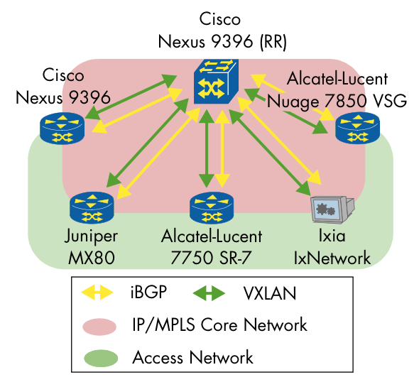

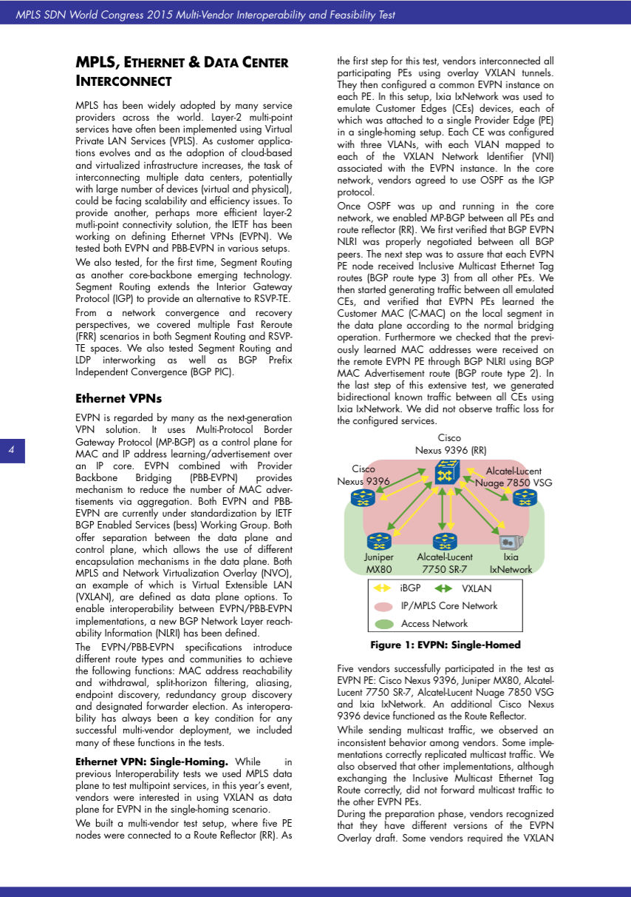
VXLAN/EVPN - Interoperability & Feasibility
APPROVED
VXLAN/EVPN interoperability demonstrated during MPLS/SDN World Congress in Paris
Participating Vendors are Cisco, Juniper, Alcatel Lucent & Ixia
Independently Tested at EANTC with public available Whitepaper
http://www.eantc.de/showcases/mpls_sdn_2015/intro.html

Slide 13

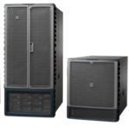

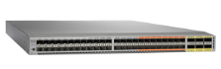
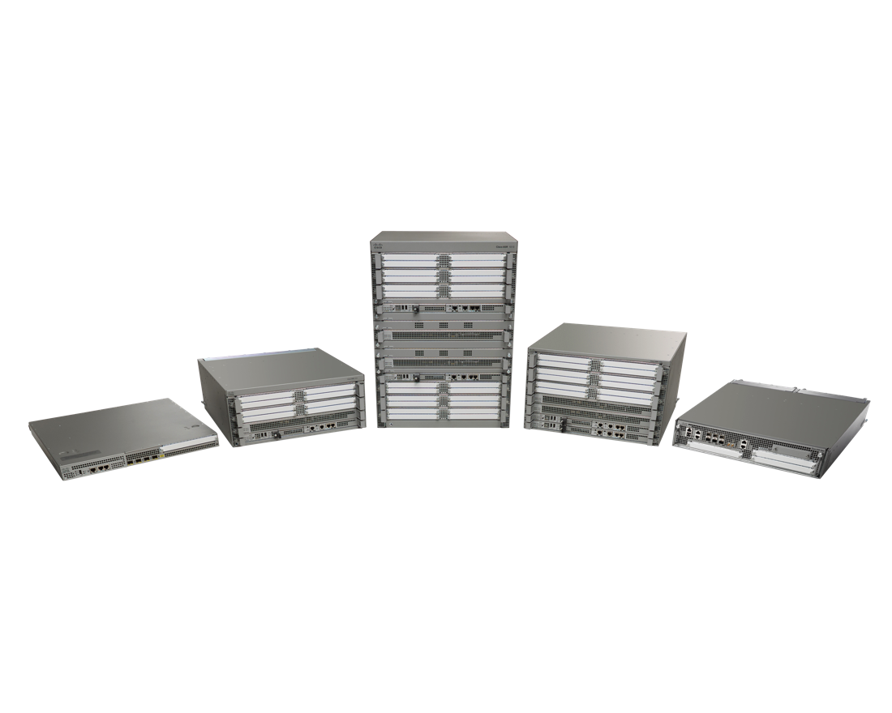
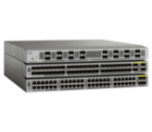
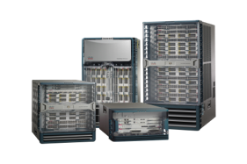
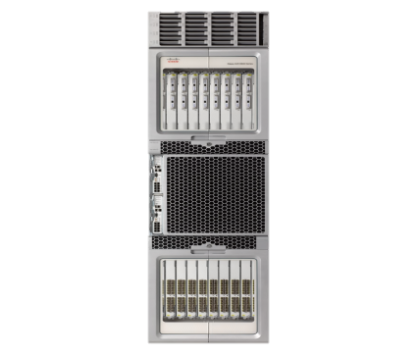


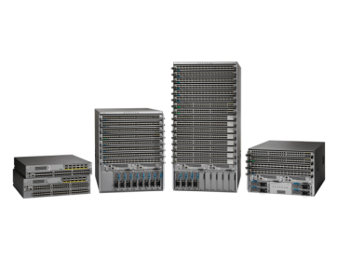

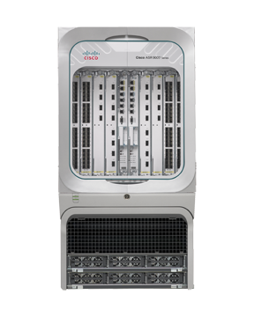

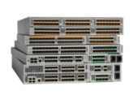
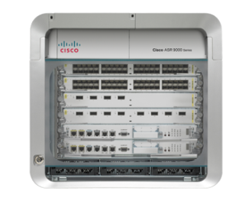

Cisco VXLAN Portfolio
Cisco VXLAN Solutions
Scale
Secure
Multi-tenancy
Workload Mobility
Workload Anywhere
ASR1000
CSR1000
Nexus 1000
Nexus 2000
Nexus 3100
Nexus 5600
Nexus 7000
Nexus 9000
ASR9000
L2 Gateway
L3 Gateway
BGP EVPN Control Plane
Anycast Gateway
Head End Replication

Slide 14
What?

Slide 15
VXLAN/EVPN = Ingress Replication
VXLAN with BGP EVPN Control-Plane still requires a technology for Broadcast/Unknown Unicast/Multicast (BUM) replication
Cisco provides 2 Options
  Multicast – Efficient way of sending multi-destination traffic to all participating VTEP (1 Copy per Link)
  Unicast – Sending a copy of multi-destination traffic to all participating VTEP (1 copy per VTEP)

Slide 16
VXLAN/EVPN was build for Data Center Interconnect (DCI)
VXLAN with BGP EVPN Control-Plane uses the control-plane for integrated Route and Bridge (IRB) decisions
VXLAN has now a Control-Plane like OTV but …
  VXLAN was built for Local Area Network (LAN)
  There are missing features/functions which are not there (we will talk about it)
  VXLAN could be used for Inter-Pod communication

Slide 17
What is VXLAN/EVPN?
VXLAN is a network overlay technology
  Layer-2 & Layer-3 overlay network on top of an IP routed network
  MAC in UDP encapsulation (UDP destination port 4789)
Standards based overlay (VXLAN) with standards based Control-plane (BGP)
Layer-2 MAC and Layer-3 IP information distribution by Control-Plane (BGP)
Forwarding decision based on Control-Plane (minimizes flooding)
Integrated Routing/Bridging (IRB) for Optimized Forwarding in the Overlay

Slide 18

VXLAN Gateway Types
VXLAN Taxonomy
Ingress VXLAN packet
on RED segment
Egress packet is IEEE 802.1q tagged interface. packet is BRIDGED to new VLAN
VXLAN to VLAN Bridging
  (Layer-2 Gateway)
VXLAN-to-VXLAN Routing
  (Layer-3 Gateway)
VXLAN-to-VLAN Routing
  (Layer-3 Gateway)
V
VXLAN Layer-2 Gateway
Ingress VXLAN packet
on RED segment
Egress VXLAN packet is ROUTED to new segment
V
VXLAN Router
Ingress VXLAN packet
on RED segment
Egress packet is IEEE 802.1q tagged interface. packet is ROUTED to new VLAN
V
VXLAN Router

Slide 19


VXLAN Overview (1)
IP Network
(Underlay)
Edge Device
Edge Device
Local LAN Segment
IP Interface
Local LAN Segment
Physical Host
Edge Device
Physical Host
Local LAN Segment
Virtual Switch
Virtual Hosts

Slide 20
VXLAN Overview (2)
VXLAN
(Overlay)
VTEP
VTEP
V
V
Local LAN Segment
Local LAN Segment
Encapsulation
Physical Host
VTEP
V
Physical Host
Local LAN Segment
Virtual Switch
VTEP – VXLAN Tunnel End-Point
VNI/VNID – VXLAN Network Identifier
Virtual Hosts

Slide 21
VXLAN Frame Format
Next-Hop MAC Address
Dest. MAC Address
Src VTEP MAC Address
48
Src. MAC Address
MAC-in-IP Encapsulation
48
VLAN Type
0x8100
16
14 Bytes
(4 Bytes Optional)
Outer MAC Header
IP Header
Misc. Data
72
VLAN ID
Tag
16
Protocol 0x11 (UDP)
8
Ether Type
0x0800
16
Header
Checksum
16
20 Bytes
Outer IP Header
Underlay
Source IP
32
Src and Dst addresses of the VTEPs
Source
Port
16
Dest. IP
32
UDP Header
VXLAN Port
16
Hash of the inner L2/L3/L4 headers of the original frame.
Enables entropy for ECMP Load balancing in the Network.
50 (54) Bytes of Overhead
UDP Length
8 Bytes
VXLAN Header
16
Checksum 0x0000
UDP 4789
16
Original Layer-2 Frame
Overlay
VXLAN Flags RRRRIRRR
8
Allows for 16M possible Segments
Reserved
24
VNI
8 Bytes
24
Reserved
8

Slide 22

VXLAN Flood&Learn
MAC | VNI | VTEP
MAC_A | 30000 | E1/12
MAC | VNI | VTEP
MAC_B | 30000 | E1/4
Destination Group
239.1.1.1
(01:00:5E:01:01:01)
V¹
V²
MAC | VNI | VTEP
MAC_C | 30000 | E1/8
Host A
MAC_A / IP_A
V³
Host B
MAC_B / IP_B
Virtual Switch
Host C
MAC_C / IP_C

Slide 23
VXLAN Packet Forwarding
VXLAN Flood&Learn
MAC | VNI | VTEP
MAC_A | 30000 | E1/12
MAC_B | 30000 | V2
MAC | VNI | VTEP
MAC_B | 30000 | E1/4
MAC_A | 30000 | V1
SMAC: MAC_A
DMAC: MAC_B
SMAC: MAC_A
DMAC: MAC_B
SIP: IP_A
DIP: IP_B
V¹
V²
SIP: IP_A
DIP: IP_B
1
2
3
4
SMAC: MAC_V1
DMAC: hop-by-hop
SMAC: hop-by-hop
DMAC: MAC_V2
Underlay
Underlay
SIP: IP_V1
DIP: IP_V2
SIP: IP_V1
DIP: IP_V2
Host A
MAC_A / IP_A
UDP
V³
Host B
MAC_B / IP_B
UDP
VXLAN VNID: 30000
VXLAN VNID: 30000
SMAC: MAC_A
DMAC: MAC_B
SMAC: MAC_A
DMAC: MAC_B
Overlay
Overlay
SIP: IP_A
DIP: IP_B
SIP: IP_A
DIP: IP_B

Slide 24
VTEP Discovery (1)
Multicast Independent
RR
RR
1
1
1
V¹
V²
Host A
MAC_A / IP_A
V³
Host B
MAC_B / IP_B
1
VTEPs advertise their VNI
membership within the Control-Plane
Virtual Switch
Host C
MAC_C / IP_C
Host Y
MAC_Y / IP_Y

Slide 25
VTEP Discovery (2)
Multicast Independent
3
3
RR
RR
Peer | VNI | VTEP
V2 | 30000 | V2
V3 | 30000 30001 | V3
Peer | VNI | VTEP
V1 | 30000 | V1
V3 | 3000030001 | V3
2
2
2
V¹
V²
3
Peer | VNI | VTEP
V1 | 30000 30001 | V1
V2 | 30000 | V2
Host A
MAC_A / IP_A
V³
Host B
MAC_B / IP_B
2
BGP consolidates and
propagates VTEP list for VNI
Virtual Switch
3
VTEP obtains list of VTEP
neighbors for each VNI
Host C
MAC_C / IP_C
Host Y
MAC_Y / IP_Y

Slide 26
Head-End Replication
4
SMAC: MAC_V1
DMAC: MAC_V2
Multicast Independent
SIP: IP_V1
DIP: IP_V2
Underlay
2
RR
RR
UDP
Peer | VNI | VTEP
V1 | 30000 | V1
V3 | 3000030001 | V3
Peer | VNI | VTEP
V2 | 30000 | V2
V3 | 30000 30001 | V3
VXLAN VNID: 30000
ARP Request
Overlay
SMAC: MAC_A
DMAC: FF:FF:FF:FF:FF:FF
ARP Request for IP_B
Src MAC: MAC_A
Dst MAC: FF:FF:FF:FF:FF:FF
3
V²
ARP Request for IP_B
Src MAC: MAC_A
Dst MAC: FF:FF:FF:FF:FF:FF
V¹
1
4
5
SMAC: MAC_V1
DMAC: MAC_V3
Peer | VNI | VTEP
V1 | 30000 30001 | V1
V2 | 30000 | V2
SIP: IP_V1
DIP: IP_V3
Underlay
Host A
MAC_A / IP_A
UDP
V³
Host B
MAC_B / IP_B
VXLAN VNID: 30000
ARP Request for IP_B
Src MAC: MAC_A
Dst MAC: FF:FF:FF:FF:FF:FF
ARP Request
5
Overlay
SMAC: MAC_A
DMAC: FF:FF:FF:FF:FF:FF
Virtual Switch
Host C
MAC_C / IP_C

Slide 27
How?

Slide 28
Deployment Considerations
Underlay
MTU and Overlays
Unicast Routing Protocol and IP Addressing
Multicast for BUM* Traffic Replication

Slide 29
MTU and VXLAN
No Fragmentation Needed
Underlay
Outer MAC Header
VXLAN adds 50 Bytes to the Original Ethernet Frame
Avoid Fragmentation by adjusting the IP Networks MTU
Data Centers often require Jumbo MTU; most Server NIC do support up to 9000 Bytes
Using a MTU of 9216* Bytes accommodates VXLAN Overhead plus Server max. MTU
Outer IP Header
Underlay
UDP Header
50 (54) Bytes of Overhead
VXLAN Header
Original Layer-2 Frame
Overlay
*Cisco Nexus 5600/6000 switches only support 9192 Byte for Layer-3 Traffic

Slide 30
Building your IP Network – Interface Principles
Underlay
Know your IP addressing and IP scale requirements
  Best to use single aggregate for all underlay Links and Loopbacks
  IPv4 only
  For each Point-2-Point (P2P) connection, minimum /31 required
  Loopback requires /32
Routed Ports/Interfaces
  Layer-3 Interfaces between Spine and Leaf (no switchport)
VTEP uses Loopback as Source-Interface
V¹
V²
V³

Slide 31
Building your IP Network – Routing Protocols; OSPF
Underlay
OSPF – watch your Network type
  Network Type Point-2-Point (P2P)
    Preferred (only LSA type-1)
    No DR/BDR election
    Suits well for routed interfaces/ports (optimal from a LSA Database perspective)
    Full SPF calculation on Link Change
  Network Type Broadcast
    Suboptimal from a LSA Database perspective (LSA type-1 & 2)
    DR/BDR election
    Additional election and Database Overhead
OSPF Area 0
V¹
V²
V³

Slide 32
Building your IP Network – Routing Protocols; IS-IS
Underlay
IS-IS – what was this CLNS?
  Independent of IP (CLNS)
  Well suited for routed interfaces/ports
  No SPF calculation on Link change; only if Topology changes
  Fast Re-convergence
  Not everyone is familiar with it
IS-IS
V¹
V²
V³

Slide 33
Building your IP Network – Routing Protocols; iBGP
Underlay
iBGP + IGP = The Routing Protocol Combo
  IGP for underlay topology & reachability (e.g. IS-IS, OSPF)
  iBGP for VTEP (loopback) reachability
  iBGP route-reflector for simplification and scale
  Requires two routing protocols
  Separates Links (IGP) from VTEPs (iBGP)
    End-Host information are still in iBGP but different address-family

Slide 34
Building your IP Network – Routing Protocols; eBGP
Underlay
eBGP
  eBGP Peer is IP interface
    Loopback would require additional IGP and eBGP multi-hop
  Multiple Autonomous-Systems (AS)
    Minimum amount of AS is two
  Many BGP Neighbors
    For each neighboring p2p interface
  AS Path
    Src and Dst AS might be same
  No Route-Reflector
    But next-hop needs to be unchanged

Slide 35
Multicast Enabled Underlay
FYI
Underlay
May use PIM-ASM or PIM-BiDir (Different hardware has different capabilities)
Spine and Aggregation Switches make good Rendezvous-Point (RP) Locations in Topologies
Reserve a range of Multicast Groups (Destination Groups/DGroups) to service the Overlay and optimize for diverse VNIs
In Spine/Leaf topologies with lean Spine
  Use multiple Rendezvous-Point across the multiple Spines
  Map different VNIs to different Rendezvous-Point for simple load balancing measure
  Use Redundant Rendezvous-Pint
Design a Multicast Underlay for a Network Overlay, Host VTEPs will leverage this Network
 | Nexus 1000v | Nexus 3000 | Nexus 5600 | Nexus 7000/F3 | Nexus 9000 | ASR 1000 CSR 1000 | ASR 9000
Multicast Mode | IGMP v2/v3 | PIM ASM | PIM BiDir | PIM ASM / PIM BiDir | PIM ASM | PIM BiDir | PIM ASM / PIM BiDir

Slide 36
Multicast Enabled Underlay – PIM ASM
Underlay
PIM Sparse-Mode (ASM)
Redundant Rendezvous-Point using PIM Anycast-RP or MSDP
Source-Tree or Unidirectional Shared-Tree (Source-Tree shown)
  Shared-Tree will always use RP for forwarding
1 Source-Tree per Multicast-Group per VTEP (each VTEP is Source & Receiver)
Example from depicted topology
  3 VTEPs sharing same VNI and Multicast-Group mapping (single Multicast-Group)
  3x Source-Tree (1 per VTEP per Multicast-Group)
PIM ASM
RP
RP
V¹
V²
RP
Rendezvous-Point
V³

Slide 37
Multicast Enabled Underlay – PIM ASM
Underlay
PIM Sparse-Mode (ASM)
Redundant Rendezvous-Point using PIM Anycast-RP or MSDP
Source-Tree or Unidirectional Shared-Tree (Source-Tree shown)
  Shared-Tree will always use RP for forwarding
1 Source-Tree per Multicast-Group per VTEP (each VTEP is Source & Receiver)
Example from depicted topology
  3 VTEPs sharing same VNI and Multicast-Group mapping (single Multicast-Group)
  3x Source-Tree (1 per VTEP per Multicast-Group)
PIM ASM
RP
RP
V¹
V²
RP
Rendezvous-Point
V³

Slide 38
Distributed IP Anycast Gateway*
VXLAN/EVPN
Distributed Routing with IP Anycast Gateway (Integrated Route/Bridge IRB)
  Routing between VNI (Different Subnet)
  Bridging within VNI (Same Subnet)
Inter-VXLAN Routing Leaf/Access Layer
  All Leafs share gateway IP and MAC for a Subnet (No HSRP)
  A Host will always find its Gateway directly attached anywhere it moves
V²
V³
V¹
Host Y
VNI 30001
*Requires EVPN Control-Plane.
Host A
VNI 30000

Slide 39
VXLAN/EVPN Fabric External Routing
Overlay
The Border Leaf/Spine provides Layer-2 and Layer-3 connectivity to external Network
eBGP and OSPF are Layer-3 Routing Protocols available for external routing
Today, VRF-lite allows to extend VRF outside of the fabric
With Nexus 7000/7700 and F3, LISP & MPLS L3VPN becomes available for fabric extension
V²
V³
V^{BL}
V¹
WAN

Slide 40

Nexus 9300/9500
External Connectivity
Nexus 9300/9500
  VRF-lite (Layer-3 Classic Ethernet)
  VPC (Layer-2 Classic Ethernet)
core
BGP AS X
Border Leaf
Border Spine
RR
RR
V
BS
BS
V
VXLAN FABRIC
Nexus 9300/9500 as Border Leaf or Border Spine

Slide 41
Nexus 7000/7700 (F3)
Flexible External Connectivity
Nexus 7000/7700 (F3)
  VRF-lite (Layer-3 Classic Ethernet)
  VPC (Layer-2 Classic Ethernet)
  LISP*
  MPLS L3VPN*
core
BGP AS X
Border Leaf
Border Spine
RR
RR
V
BS
BS
V
VXLAN FABRIC
Nexus 7000/7700 as Border Leaf or Border Spine

Slide 42
VXLAN/EVPN Fabric External Routing
Overlay
VRF
A
VRF
B
VRF
C
VRF for External Routing
need to exist on Border Leaf
V^{BL}
V²
V³
Interface-Type Options:
Physical Routed Ports
Sub-Interfaces
VLAN SVIs over Trunk Ports
V¹
Peering Interface can
be in Global or Tenant VRF
WAN

Slide 43
Interconnecting Classic Ethernet Networks (Layer-2)
Inter-Pod Connectivity
Interconnecting Classic Ethernet Pods with VXLAN/EVPN is possible
  EVPN Control-Plane provides ARP suppression and avoids Flood&Learn
Ingress Replication to avoid Multicast requirement in Underlay
  Depends on various communication requirement factors (traffic requirements, amount of Sites, etc)
Multi-Homing requires VPC(!)
Loop in one Classic Ethernet Pod can influence the other Pod(s)
Core
(Layer-3)
VXLAN/EVPN
VNI 30000
eBGP
Classic Ethernet
Classic Ethernet
vpc
vpc
V
V
V
V

Slide 44
Interconnecting VXLAN Networks (Layer-2)
Inter-Pod Connectivity
Interconnecting VXLAN/EVPN Pods with VXLAN/EVPN is possible
  Control-Plane Domains (EVPN) can be separated (iBGP/eBGP)
Data-Plane Encapsulation is End-to-End!
  Leaf/TOR knows about all VTEP across the two Data Centers
  BUM Traffic is across Pods
Decision on Ingress Replication (Unicast) or Multicast is across all Pods being interconnected
Use Shared Route-Target to ensure Route Exchange!
Core
(Layer-3)
eBGP
Layer-3
Underlay
Layer-3
Underlay
VXLAN/EVPN
VNI 30000
VXLAN/EVPN
VNI 30000
V
V
V
iBGP
V
V
V

Slide 45
Interconnecting VXLAN Networks (Layer-3)
Inter-Pod Connectivity
Interconnecting VXLAN/EVPN Pods with VXLAN/EVPN is possible
  Control-Plane Domains (EVPN) can be separated (iBGP/eBGP)
With Layer-3 interconnect, Data-Plane Encapsulation is separated
  Routing decision at DC-Edge results in Decapsulation
  Requires a Transit VNI between Sites
No Layer-2 Interconnect!
Core
(Layer-3)
VXLA/EVPN
VNI 99000
Layer-3
Underlay
Layer-3
Underlay
vpc
vpc
V
V
VXLAN or VXLAN/EVPN
VNI 30000
V
V
VXLAN or VXLAN/EVPN
VNI 31000
V
V
V
V
V
V

Slide 46

VXLAN/EVPN Designs
OSPF/PIM for Underlay Control-Plane
iBGP for Overlay Control-Plane
eBGP for External Connectivity (vrf-lite)
BGP AS X
Spine
RR
RR
RR
RR
VXLAN Overlay
VPC
L2/L3
V
L2/L3
V
L2/L3
V
L2/L3
V
L2/L3
V
BL
V
BL
V
Leaf
eBGP
Border
Nexus 9300 or 9500 as Spine (RP/RR)
Nexus 9300 or 9500 as Leaf (VTEP)
Nexus 9300 or 9500 as Border Leaf (VTEP)
core

Slide 47
VXLAN/EVPN Designs
OSPF/PIM for Underlay Control-Plane
iBGP for Overlay Control-Plane
eBGP for External Connectivity (vrf-lite)
BGP AS X
Spine
RR
RR
RR
RR
VXLAN Overlay
VPC
L2/L3
V
L2/L3
V
L2/L3
V
L2/L3
V
L2/L3
V
BL
V
BL
V
Leaf
eBGP
Border
Nexus 7000/7700 as Spine (RP/RR)
Nexus 9300 or 9500 as Leaf (VTEP)
Nexus 7000/7700 with F3 as Border Leaf (VTEP)
core

Slide 48
VXLAN/EVPN Designs
OSPF/PIM for Underlay Control-Plane
iBGP for Overlay Control-Plane
eBGP for External Connectivity (vrf-lite)
BGP AS X
Spine
RR
RR
RR
RR
VXLAN Overlay
VPC
L2/L3
V
L2/L3
V
L2/L3
V
L2/L3
V
L2/L3
V
BL
V
BL
V
Leaf
eBGP
Border
Nexus 5600 as Spine (RP/RR)
Nexus 5600 as Leaf (VTEP)
Nexus 7000/7700 with F3 as Border Leaf (VTEP)
core

Slide 49
VXLAN/EVPN Designs
OSPF/PIM for Underlay Control-Plane
iBGP for Overlay Control-Plane
eBGP for External Connectivity (vrf-lite)
core
BGP AS X
Border Spine
RR
RR
V
BS
BS
V
VXLAN Overlay
VPC
L2/L3
V
L2/L3
V
L2/L3
V
L2/L3
V
L2/L3
V
L2/L3
V
L2/L3
V
Leaf
Nexus 7000/7700 as Border Spine (VTEP/RP/RR)
Nexus 9300 or 9500 as Leaf (VTEP)

Slide 50
VXLAN/EVPN Designs
OSPF/PIM for Underlay Control-Plane
iBGP for Overlay Control-Plane
eBGP for External Connectivity (vrf-lite)
core
BGP AS X
Border Spine
RR
RR
V
BS
BS
V
VXLAN Overlay
VPC
L2/L3
V
L2/L3
V
L2/L3
V
L2/L3
V
L2/L3
V
L2/L3
V
L2/L3
V
Leaf
Nexus 7000/7700 as Border Spine (VTEP/RP/RR)
Nexus 5600 as Leaf (VTEP)

Slide 51
VXLAN/EVPN Designs
OSPF/PIM for Underlay Control-Plane
iBGP for Overlay Control-Plane
eBGP for External Connectivity (vrf-lite)
BGP AS X
Spine
RR
RR
RR
RR
VXLAN Overlay
VPC
L2/L3
V
L2/L3
V
L2/L3
V
L2/L3
V
L2/L3
V
BL
V
BL
V
Leaf
eBGP
Border
Nexus 7000/7700 as Spine (RP/RR)
Nexus 9300 or 9500 as Leaf (VTEP)
Nexus 7000/7700 with F3 as Border Leaf (VTEP)
core

Slide 52
VXLAN/EVPN Designs
OSPF/PIM for Underlay Control-Plane
iBGP for Overlay Control-Plane
eBGP for External Connectivity (vrf-lite)
BGP AS X
Spine
RR
RR
RR
RR
VXLAN Overlay
VPC
L2/L3
V
L2/L3
V
L2/L3
V
L2/L3
V
L2/L3
V
BL
V
BL
V
Leaf
eBGP
Border
Nexus 5600 as Spine (RP/RR)
Nexus 5600 as Leaf (VTEP)
Nexus 7000/7700 with F3 as Border Leaf (VTEP)
core

Slide 54
Questions?

