Slide 1
下载专业化认证证书

Slide 2
通知邮件
合作伙伴在成功取得专业化认证后会收到一封通知邮
From：do-not-reply
Date: YYYY-MM-DD
To: XX partner
Subject: XX partner achieves XXXX Specialization in China
Effective MM DD, YYYY
Congratulations to XX partner for meeting all criteria to become XXXX Specialization in CHINA.
By achieving the XXXX Specialization, XX partner has proven they have the ability to provide sophisticated, value-added Cisco solutions through their in-depth sales capabilities, technology skills and service offerings.
In recognition of this achievement, your company will be recognized as having achieved this specialization in the Cisco Partner Locator.
You may receive a PDF certificate via email
As part of this elite group of XXXX Specialization Partners, XX partner will have greater opportunities for competitive differentiation, branding, and may be eligible to qualify for one of Cisco's prestigious Certifications, view the requirements and benefits of attaining a Certification here.
Please also be sure to visit the Channel Partner Program Welcome Kit. This online partner resource contains tools to help you take full advantage of your partner benefits, as well as a full range of partner enablement assets to help you build and promote your business. Your XXXX Specialization renewal application is due by your next specialization anniversary date, July 24, 2017.
We value the ongoing commitment and expertise that XX partner has demonstrated and look forward to a successful partnership.
Sincerely,
Cisco Channel Specialization Team

Slide 3
通知邮件
邮件的中文翻译
From：do-not-reply
Date: 年-月-日
To: XX 合作伙伴邮箱
Subject: XX 合作伙伴在中国取得XXXX专业化认证
于XXXX年XX月XX日生效，
恭喜XX合作伙伴满足所有要求，在中国取得XXXX专业化认证。
取得XXXX专业化认证，XX合作伙伴已经证明他们具有通过深入的销售能力，技术能力和服务产品提供成熟的、增值的思科解决方案的能力。
为承认这一成就，贵公司取得的专业化认证将在思科合作伙伴定位工具上体现。
贵公司将会通过邮件收到一份PDF版本的证书。
作为XXXX专业化认证精英团队的一员，XX合作伙伴将在竞争、差异化、品牌化中拥有更多的机会，并且有资格晋升思科的认证之一，在此查看所需条件和取得该认证的益处。
同时也请浏览渠道合作伙伴计划欢迎套件。这个在线的合作伙伴资源包含帮助把合作伙伴的利益充分利用的工具，以及帮助合作伙伴构建和促进业务发展的全方位能力提升评估。贵公司的XXXX专业化认证续期申请是下一个专业化周年日，也就是XXXX年XX月XX日。
我们珍视XX合作伙伴已经证明的承诺和专业知识，并期待未来成功的合作关系。
真诚的，
思科渠道专业化团队

Slide 4
思科合作伙伴定位工具
点击邮件中Cisco Partner Locator，进入合作伙伴定位工具，可以查询到贵公司的认证以及专业化认证信息。

Slide 5
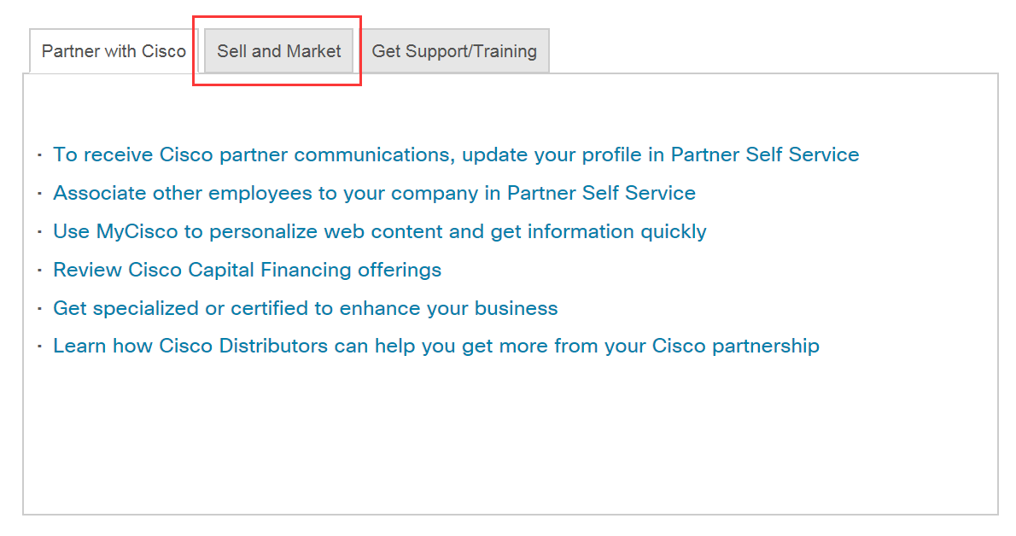
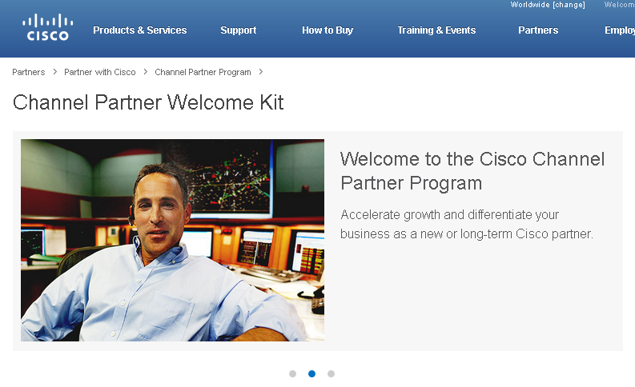
下载证书-Channel Patner Welcome Kit

Slide 6
下载证书-Channel Patner Welcome Kit

Slide 7
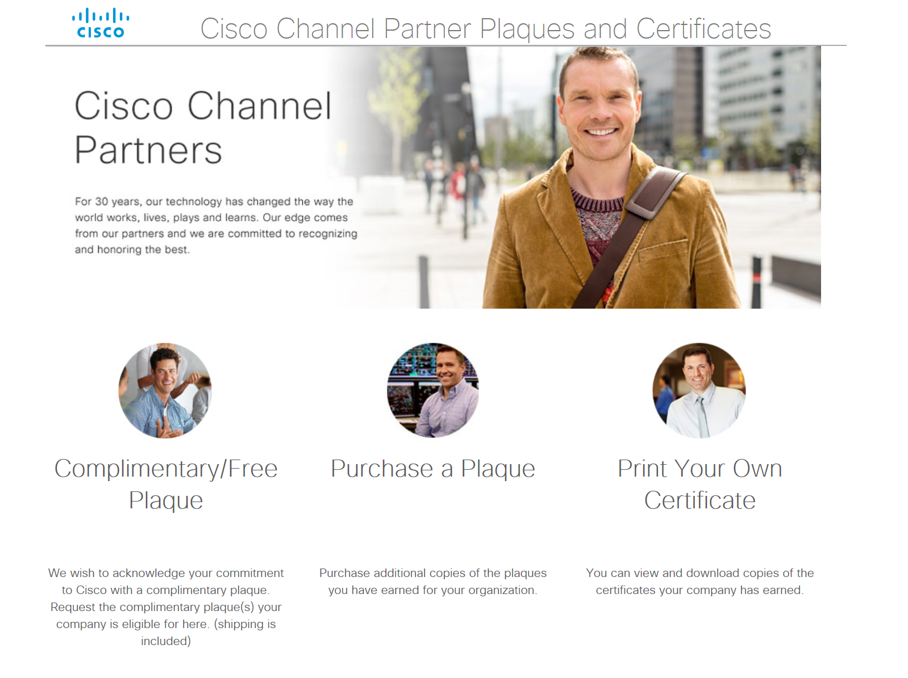
下载证书-Channel Patner Welcome Kit

Slide 8
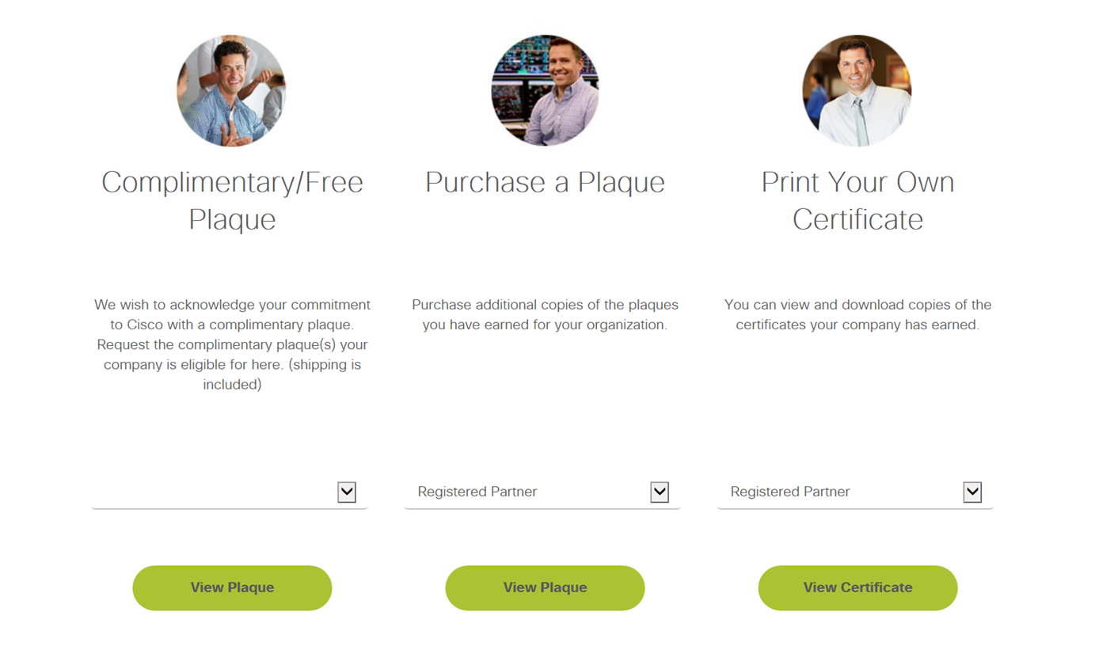
下载证书-Channel Patner Welcome Kit

Slide 9
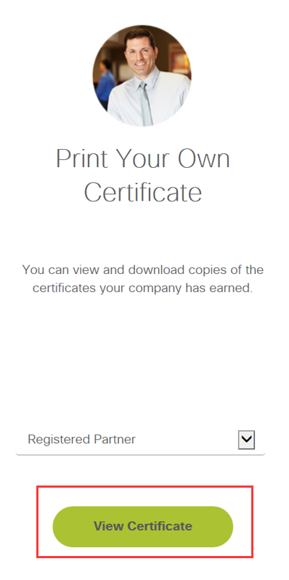
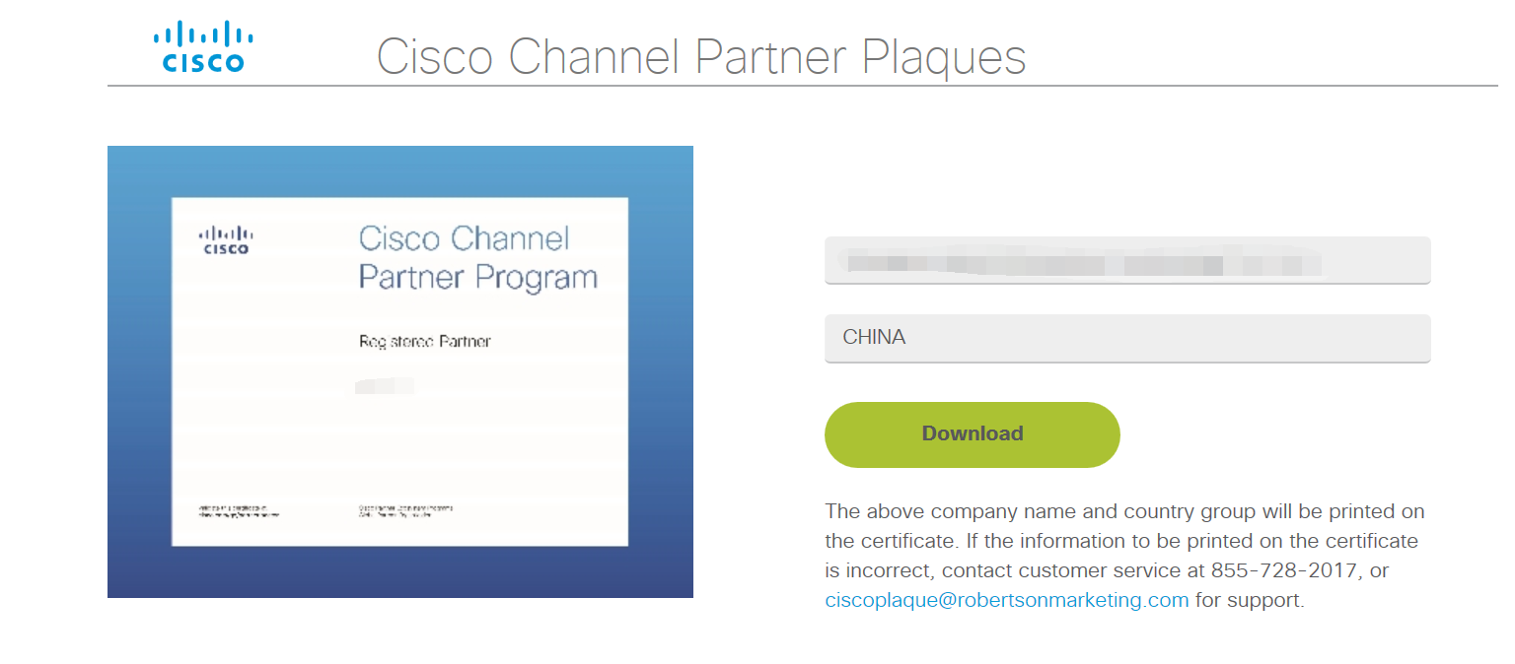
下载证书-Channel Patner Welcome Kit

