Slide 1
Welcome to this session and thank you for your attendance. To allow everyone to dial in, we will start the presentation at 5 minutes past the hour.
Do you have problems joining the teleconference? 1. Click on COMMUNICATE 2. Click on TELECONFERENCE 3. Click on JOIN TELECONFERENCE 4. Fill in your telephone number (make sure you fill in “Country/Region” only to the required box) 5. Click on OK 6. The system will call you back on your phone

Slide 2
Partnership. Rewards. Results.
Drive Profitability with Cisco Channel Programs
Cisco Value Incentive Program (VIP) 29
January 29, 2017 through July 29, 2017

Slide 3
VIP 29 Agenda
Executive Summary
VIP 29
Architecture Track
New Business Track
Operational Details and Summary
VIP 28 Payout Information
Q&A

Slide 4
Executive Summary

Slide 5
Current VIP 29 At-a-Glance
Goal | The Cisco Value Incentive Program (VIP) rewards partners that have a comprehensive business practice focused on major architectures. Participating partners receive a semiannual payment when they meet program requirements.
Program Period | January 29, 2017 to July 29, 2017 Enrollment dates: January 29, 2017 to March 10, 2017 (6 months)—April 30, 2017 to May 26, 2017 (3 months) Enrollment is required for each VIP period
Tracks | Architecture Track: Enterprise Networks, Express Enterprise Networks, Security, Express Security, Data Center, Collaboration, Express Collaboration, and Service Provider Technology New Business Track: Security SaaS ^{NEW}, Collaboration SaaS, Meraki Cloud Networking (U.S. and EMEAR pilot), IoT
Payout Requirements | Minimum bookings requirements Associated specializations, certifications, designations or ATPs Certification maintenance or completed follow-up activities on all low scores received for the current fiscal year within the PAL tool
Additional Details | Enrollments are done at the track level Enrollments to Architecture and New Business track can be combined—no mutually exclusivity rules Eligible SKUs and orders from both Resale and Cloud and Managed Service (Title Held and Title Transferred) order types recognized, cloud services itself (cloud POS submissions) not included CMSP Simplified Pricing, Not For Resale (NFR) and other specific promotions excluded Payments are based on net shipments on eligible SKUs except for Collaboration SaaS and Security SaaS

Slide 6
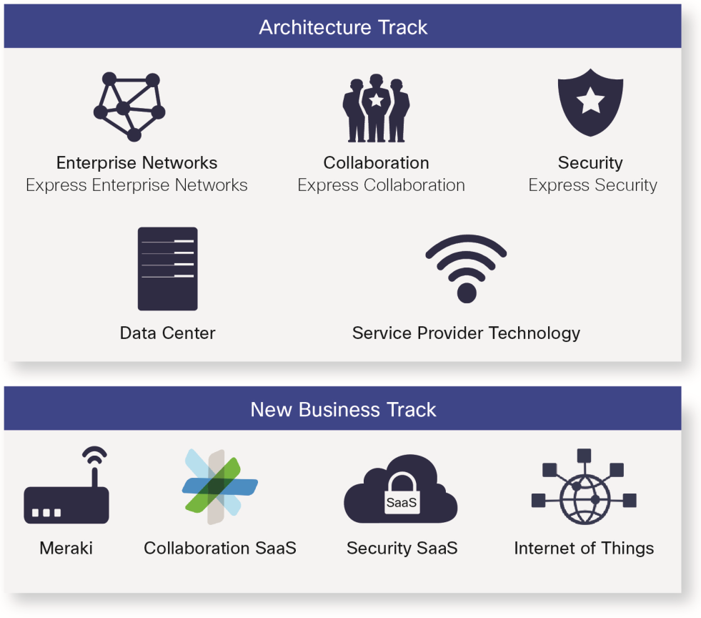
VIP 29 Architectural Design

Slide 7
VIP 29: Summary of Changes
What’s New | Description | Impact | Your Action
UCS/HX Account Breakaway Bonus in Data Center subtrack | VIP bonus on UCS/HyperFlex Account Breakaway deals, offered for the entire VIP 29 period | The bonus rewards new accounts acquisition and dormant accounts reactivation in UCS/HyperFlex It is addition to the significantly higher upfront discounts offered through the UCS/HX Account Breakaway program | Identify new accounts, reactivate dormant accounts in UCS/HyperFlex and register them as Account Breakaway deals in Cisco Commerce Workspace Visit for more info www.cisco.com/go/ab
FTD Account Breakaway Bonus in Security subtrack | New VIP bonus on Firepower Threat Defense Account Breakaway deals | The bonus rewards new accounts acquisition in Firepower Threat Defense It is addition to the significantly higher upfront discounts offered through the FTD Account Breakaway program | Identify new accounts in Firepower Threat Defense and register them as Account Breakaway deals in Cisco Commerce Workspace Visit for more info www.cisco.com/go/ab
Cisco ONE ELA 2.0 | Cisco ONE Software ELA 2.0 SKUs are included in VIP 29 | ELA 2.0 gives customers an enhanced buying, fulfillment, and management experience for enterprisewide software licenses | Position Cisco ONE ELA 2.0, a multiyear agreement providing organizations with enterprisewide entitlement to pre-defined software suites

Slide 8
VIP 29: Summary of Changes
What’s New | Description | Impact | Your Action
New Security SaaS subtrack | New subtrack incenting healthy security SaaS practices for Cisco Umbrella offers | Opportunity to be rewarded for growing the security SaaS business and monthly recurring revenue (MRR) over the VIP period | Promote Cisco Umbrella offers and recurring revenue streams within your security practice
Broader scope of Collaboration SaaS subtrack | Additional offers added to Collaboration SaaS subtrack like Cisco Spark Flex Plan | Increased opportunity to win new customers, and extend collaboration capabilities for existing ones with higher VIP rebate than for traditional offers | Promote the power of the full collaboration portfolio with new offers Focus on recurring revenue—growing the business and churn management/ customer success
Additional highlights: Simplification—we’re increasing your productivity with a simplified rebate structure, enrollment, VIP management and tracking, and fewer exception and support cases 2-months Transition period—protects all SKUs from changes before the SKU is removed or reduced in payout New VIP SKUs list URL—www.cisco.com/go/vipskus

Slide 9
Continuing from VIP 28
What’s New | Description | Impact | Your Actions
Architectural design | VIP 29 continues to embrace an architectural approach and is structured at the architectural level | Simplified enrollment, payout eligibility criteria defined at the architectural level, easier tracking of VIP payout requirements | Sell architectural solutions, include as many technologies from one architecture as possible in each deal
Architectural minimum bookings requirements | Minimum thresholds remain the same as in VIP 28, reflecting market conditions in each country group and the new architectural design of VIP | Recognition of all VIP eligible bookings in one architecture against one architectural minimum threshold requirement | Review architectural minimum bookings requirements in the Program Rules
Cloud and Managed Services bookings recognized for everyone | Cloud and Managed Services are in demand by end customers—bookings from these type of orders continue to be recognized for every VIP partner | Opportunity to earn VIP payments not only on standard resale orders but also on cloud and managed services orders, both title held and title transferred Cloud services/cloud POS submissions and CMSP Simplified Pricing bookings continue to be ineligible | Order VIP eligible SKUs even as Cloud or Managed Service order types without concerns about the impact to your VIP rebate

Slide 10
VIP 29 SKU Structure
Architecture Track
Enterprise Networks, Security, Data Center, Collaboration
Gold/ CMSP Master bonus *
1%
Master Specialization/ Cisco Powered Bonus **
1%-3%
Enterprise Networks DNA Accelerator
1%, 2%, 4%
Account Breakaway Bonus
2%
Architecture Track
Service Provider Technology, Express Collaboration, Express Enterprise Networks, Express Security
B = 15%
C = 10%
D = 8%
E = 6%
F = 5%
G = 4%
H = 3%
I = 2%
J = 1%
New Business Track
Meraki, IoT
Gold/ CMSP Master bonus *
1%
New Business Track
Collaboration SaaS
Recurring Revenue Growth Component 15%/23%
Churn Management Component
7%
New Business Track
Security SaaS
Recurring Revenue Growth Component 20%
* Gold/CMSP Master bonus: paid on 6% and 8% rebate category products only in Enterprise Networks and Meraki Cloud Networking subtracks, and on 5% and 10% rebate category products only in IoT subtrack
** Master Specialization/Cisco Powered Bonus: 1% in Data Center, 2% in Security and 3% in Collaboration subtracks (paid only on TP SKUs for TP ATP Master), no Master Specialization/Cisco Powered bonus available in Enterprise Networks subtrack
*** Account Breakaway Bonus: UCS/HX Account Breakaway Bonus in Data Center and FTD Account Breakaway Bonus in Security

Slide 11
Cisco Powered Bonus Eligibility
VIP Subtrack | Cisco Powered Services Designation | Cisco Powered Bonus
Collaboration | Cisco Powered Managed Business Communications or Cisco Powered UC as a Service based on HCS or Cisco Powered Contact Center as a Service based on HCS or Cisco Powered Unified Contact Center or Cisco Powered Managed Business Video or Cisco Powered Video and TelePresence as a Service | 3%
Security | Cisco Powered Managed Security or Cisco Powered Hosted Security as a Service | 2%
Data Center | Cisco Powered Infrastructure as a Services or Cisco Powered Desktop as a Service or Cisco Powered Disaster Recovery as a Service or Cisco Powered Cloud Cell Architecture for SAP HANA or Cisco Powered Architecture for the Microsoft Cloud Platform | 1%

Slide 12
VIP 29: Architecture Track

Slide 13
Enterprise Networks and Express Enterprise Network
Notes:
Per notes on slide 3, this needs to be in the new “uber transition” slide design.

Slide 14
Enterprise Networks
Enterprise Networks
Express Enterprise Networks
Think Digital Network Architecture (DNA), think Cisco ONE™: Sell DNA SKUs with Cisco ONE to achieve the highest rebates
The DNA Accelerator for Cisco Gold Certified Partners is now exclusively offered for eligible Cisco ONE DNA hardware
Cisco ONE Software is now at an 8 percent rebate
Increase your profitability with the Gold/CMSP Master bonus paid on SKUs in the 6 and 8 percent rebate categories
Cisco Gold Certified or CMSP Master Partners selling eligible DNA Accelerator SKUs with Cisco ONE can earn a rebate as high as 13 percent: 8 percent base rebate + 4 percent DNA Accelerator + 1 percent Gold/CMSP Master bonus
Sell 10-Gbps (10G), 40G, 100G, and Multigigabit Cisco Catalyst, 4000 Series ISRs, and wireless 802.11ac Wave 2 solutions to capture the highest Enterprise Networks VIP hardware rebates
Learn more in the VIP playbook at www.cisco.com/go/vip
Notes:
You can intersperse these content template slides, or put them after all the transition slides. See my email input document.

Slide 15
VIP 29 Enterprise Networks and Express Enterprise Network Overview
Subtrack | EN | Express EN
Enrollment Requirement | Advanced Core and WAN Services and/or Advanced Unified Access and/or Advanced Enterprise Networks Architecture Specialization and/or CMSP Master or Advanced or Express | Express Foundation and/or Small and Midsize Business Specialization
Specialization Requirement | Maintain Advanced Core and WAN Services and/or Advanced Unified Access and/or Advanced Enterprise Networks Architecture Specialization and/or CMSP Master or Advanced or Express (throughout the entire VIP period) | Maintain Express Foundation and/or Small and Midsize Business Specialization (throughout the entire VIP period)
Minimum Booking (6 Month/3 Month) | 400,000 / 200,000 | 50,000 / 25,000
SKU Categories | 2%, 4%, 6%, 8% | 2%
CSAT Requirement | Maintain Gold/Premier certification or Completed follow-up activities on all low scores received for the current fiscal year within the PAL tool
Master Specialization/ Cisco Powered Bonus % | N/A | N/A
Gold/CMSP Master Bonus % | 1%* | N/A
DNA Accelerator ** | 1%, 2%, 4% | N/A
Precedence | Over Express EN, IoT and SPT | –
* On 6% and 8% rebate category products only
** Gold Certified Partners only, complete list of eligible SKUs available at www.cisco.com/go/vipskus

Slide 16
Enterprise Networks: DNA Accelerator Think Digital Network Architecture (DNA), Think Cisco ONE
Applicable only to Gold partners
Offered exclusively on eligible Cisco ONE DNA hardware SKUs
Cisco wireless access points are not offered as Cisco ONE SKUs and are not eligible, the Accelerator rebate for Wave 2 controllers though has now doubled to 4 percent
Eligible Cisco ONE DNA SKUs include:
Complete list of eligible SKUs available at www.cisco.com/go/vipskus
1%
C3560CX, C3650, C3850
2%
4200ISR, 4300ISR, 4400ISR
4%
Cisco Wireless Wave 2 controllers

Slide 17
Enterprise Networks and Express EN
Enterprise Networks | VIP 28 Rebate | VIP 29 Rebate
Cisco Catalyst Switching
All modular chassis, 1 Gigabit Ethernet | 2% | 2%
Catalyst 2960-X and 2960-XR 10 Gigabit | 4% | 2%
Catalyst 3650, 4500-X, and 6000 Series 10/40/100 Gigabit Catalyst 6000 Series latest-generation supervisors (6T) | 4% | 4%
Catalyst 3850, 4500E Series 10/40/100 Gigabit Multigigabit solutions Catalyst 4500 latest-generation supervisors (8-E, 8 L-E) | 6% | 6%
Wireless
802.11ac Wave 1 | 4% | 2%
802.11ac Wave 2 Aironet 1800 Series | 6% | 6%
802.11ac Wave 2 controllers, Aironet 2800 and 3800 Series | 8% | 8%
Enterprise Networks | VIP 28 Rebate | VIP 29 Rebate
Routing
1900 Series ISRs | 2% | -
4200 Series ISRs | - | 2%
4300 Series ISRs | 4% | 4%
4400 Series ISRs | 8% | 8%
ASR 1000 Series | 2% | 2%
ASR 1000 Series (40 Gigabit Ethernet) | 4% | 4%
WAAS, 800 Series (4G Ready), 4G LTE WWAN Card, Cisco UCS E-Series | 2% | 2%
Cisco ONE, Cisco ONE ELA 2.0
Cisco ONE Software suites and Cisco ONE ELA 2.0 | 10% | 8%
Express Enterprise Networks | VIP 28 Rebate | VIP 29 Rebate
All eligible SKUs | 2% | 2%
Not all SKUs are eligible for VIP. Enterprise Networks track typically does not include older-generation products, accessories, and third-party solutions.
For a complete list of VIP-eligible SKUs, go to www.cisco.com/go/vipskus.

Slide 18
Security and Express Security
Notes:
Image is ok

Slide 19
Security
Security
Express Security
Benefit from rebates on next-generation security solutions, including most of the Cisco ASAs with FirePOWER, Firepower Threat Defense, FirePOWER NGIPS, AMP, and ISE
Focus on multiyear solutions to secure a 8 percent rebate on most software licenses, as opposed to 4 percent for one-year licenses
Take advantage of rebates up to 8 percent and additional up-front savings by selling the Security Software Volume Purchasing Program, Enterprise License Agreements and Security Advantage products
Register and book Next Generation Firewall opportunities with Cisco Firepower Threat Defense (FTD) Account Breakaway Program to earn an additional 2 percent VIP rebate
See Security SaaS details in the New Business track section
Learn more in the VIP playbook at www.cisco.com/go/vip
Notes:
You can intersperse these content template slides, or put them after all the transition slides. See my email input document.

Slide 20
VIP 29 Security and Express Security Overview
Subtrack | Security | Express Security
Enrollment Requirement | Advanced Security Architecture Specialization and/or CMSP Master or Advanced or Express | Express Security Specialization Next-Generation Firewall module and/or Email module and/or Web module and/or IPS module* and/or Cisco Welcome Program
Specialization Requirement | Maintain Advanced Security Architecture Specialization and/or CMSP Master or Advanced or Express (throughout the entire VIP period) | Maintain Express Security Specialization Next-Generation Firewall module and/or Email module and/or Web module and/or IPS module* and/or Cisco Welcome Program (throughout the entire VIP period)
Minimum Booking (6 Month/3 Month) | 50,000 / 25,000 | 15,000 / 7,500
SKU Categories | 4% HW/1yr SW/Perpetual, 8% 3/5 yrs and ELA SW | 3% HW/SW
CSAT Requirement | Maintain Gold/Premier certification or Completed follow-up activities on all low scores received for the current fiscal year within the PAL tool
Master Specialization/ Cisco Powered Bonus % | 2% (revised from 3%) | N/A
Gold/CMSP Master Bonus % | 1% | N/A
FTD Account Breakaway Bonus % ^{NEW} | 2% | N/A
Precedence | Over Express Security | –
* Express Security SKUs eligibility and payouts are based on possession of particular module(s) of Express Security Specialization. More details about SKUs adherence to particular Express Security Specialization modules are available at www.cisco.com/go/vipskus.

Slide 21
Security: FTD Account Breakaway Bonus
Partners can receive VIP rebate bonus on approved Firepower Threat Defense (FTD) Account Breakaway deals in VIP 29
Acquire new accounts through Firepower Threat Defense Account Breakaway program, receive significantly higher upfront discounts, and now also get rewarded with 2 percent of additional VIP bonus
FTD Account Breakaway bonus will be paid to eligible partners on the top of the base rebate
It can be combined with Gold/CMSP Master Bonus (1 percent) and Master Specialization/Cisco Powered Bonus (2 percent)
Register Account Breakaway deals in Cisco Commerce Workspace by identifying new FTD accounts, for more info visit www.cisco.com/go/ab

Slide 22
Security and Express Security
Security | VIP 28 Rebate | VIP 29 Rebate
All hardware | 4% | 4%
1-year and perpetual software licenses | 5% | 4%
3-, 5-year and ELA software licenses | 10% | 8%
Express Security | VIP 28 Rebate | VIP 29 Rebate
All eligible hardware and all eligible software | 4% | 3%
For a complete list of VIP-eligible SKUs, go to www.cisco.com/go/vipskus.
For a complete list of VIP-eligible SKUs, go to www.cisco.com/go/vipskus.

Slide 23
Data Center
Notes:
Image is OK

Slide 24
Data Center
Data Center
Capture data center switching transition with Cisco Application Centric Infrastructure (ACI), a future-ready solution with purpose-built open, programmable software-defined networking (SDN)
Lead with Cisco Nexus 9000 Series platform to deliver the best price/performance, with Cisco ACI ready, Cisco Tetration ready, and multi-speed (10/25/40/50/100G) ports
Sell Cisco UCS SmartPlay bundles for best customer bundle pricing and VIP rebate for partners
Introduce Cisco HyperFlex to customers with hyperconvergence requirements
Leverage Cisco UCS Account Breakaway registration to boost UCS VIP profitability by 50 to 66 percent
Win new accounts with Cisco Tetration Analytics, engage security stakeholders with always-on, real-time network and security analytics solutions
Learn more in the VIP playbook at www.cisco.com/go/vip
Notes:
You can intersperse these content template slides, or put them after all the transition slides. See my email input document.

Slide 25
VIP 29 Data Center Overview
Subtrack | Data Center
Enrollment Requirement | Advanced Data Center Architecture and/or Unified Fabric Technology and/or Unified Computing Technology Specialization and/or CMSP Master or Advanced or Express
Specialization Requirement | Maintain Advanced Data Center Architecture and/or Unified Fabric Technology Specialization and/or Unified Computing Technology Specialization and/or CMSP Master or Advanced or Express (throughout the entire VIP period)
Minimum Booking (6 Month/3 Month) | 100,000 / 50,000
SKU Categories | 2%, 3%, 4%, 5%, 10%
CSAT Requirement | Maintain Gold/Premier certification or Completed follow-up activities on all low scores received for the current fiscal year within the PAL tool
Master Specialization/ Cisco Powered Bonus % | 1%
Gold/CMSP Master Bonus % | 1%
UCS/HX Account Breakaway Bonus % | 2%
Precedence | –

Slide 26
Data Center: UCS/HyperFlex Account Breakaway Bonus
Partners can receive VIP rebate bonus on approved UCS/HyperFlex Account Breakaway deals in VIP 29
Acquire new accounts, reactivate dormant accounts through UCS/HyperFlex Account Breakaway program, receive significantly higher upfront discounts and also get rewarded in VIP
2 percent of additional VIP bonus increases the UCS and HyperFlex VIP rebate by 50-66 percent
UCS/HX Account Breakaway Bonus can be paid to eligible partners on the top of Gold/CMSP Master Bonus (1 percent) and Master Specialization/Cisco Powered Bonus (1 percent)
Register Account Breakaway deals in Cisco Commerce Workspace by identifying new accounts and reactivating dormant accounts in UCS/HyperFlex, for more info visit www.cisco.com/go/ab
Product Category
All UCS HW (excl. CPUs)
HyperFlex
Base Rebate
3%
4%
+2% UCS/HX Account Breakaway Bonus
5%
6%
Profitability Impact
+66% Increase
+50% Increase

Slide 27
Data Center
Data Center | VIP 28 Rebate | VIP 29 Rebate
Data Center—Cisco UCS
All Cisco UCS hardware, including SmartPlay bundles (except processors) | 3% | 3%
Cisco HyperFlex and fabric interconnects | 4% | 4%
Enterprise Cloud Suite (Cisco ONE) | 10% | 5%
Data Center Switching and Software
All eligible Cisco Nexus 1000, 3000, 6000, 7000 platforms | 2%, 5% | 2%
All eligible Cisco Nexus 2000, 5000 platforms | 2%, 5% | –
All eligible Cisco Nexus 9000 platforms | 5% | 5%
Cisco Tetration Analytics | 5% | 5%
Cisco ACI Software | 10% | 10%
Cisco CloudCenter (CliQr) | 10% | 5%
For a complete list of VIP-eligible SKUs, go to www.cisco.com/go/vipskus.

Slide 28
Collaboration and Express Collaboration
Notes:
Image is ok

Slide 29
Collaboration
Collaboration
Express Collaboration
Sell across the Cisco collaboration portfolio: On-premises, cloud, and hybrid solutions with a full range of customer consumption models
Focus on the full lifecycle—land, adopt, expand and renew: Create predictable recurring revenue streams by selling lifecycle services resulting in customer intimacy, increased lifetime revenue value and increased profitability
Lead every sale with the next generation meetings experience that encompasses cloud and video collaboration with Cisco Spark—Message, Meet, Call—and Cisco’s award-winning desktop, group, and immersive endpoints
Promote the power of the full collaboration portfolio with Cisco Spark Flex Plan, a user-based subscription offer for Message, Meet and Call with cloud, on-premises, and hybrid deployment flexibility
Deliver next-generation advanced video and voice collaboration endpoints with the Cisco IP Phone 8800 Series, and the Cisco TelePresence DX, and MX Series
Learn more in the VIP playbook at www.cisco.com/go/vip
Notes:
You can intersperse these content template slides, or put them after all the transition slides. See my email input document.

Slide 30
VIP 29 Collaboration and Express Collaboration Overview
Subtrack | Collaboration | Express Collaboration
Enrollment Requirement | Advanced Collaboration Architecture Specialization and/or TelePresence Video ATP Master (incl. Multinational and Global) and/or Express Video and/or Advanced Video Specialization and/or CMSP Master or Advanced or Express | Express Collaboration Specialization
Specialization Requirement | Advanced Collaboration Architecture Specialization and/or TelePresence Video ATP Master (incl. Multinational and Global) and/or Express Video and/or Advanced Video Specialization and/or CMSP Master or Advanced or Express (throughout the entire VIP period) | Maintain Express Collaboration Specialization (throughout the entire VIP period)
Minimum Booking (6 Month/3 Month) | 80,000 / 40,000 | 20,000 / 10,000
SKU Categories | 1%, 3%, 5%, 8%, 10%, 15% | 1%, 5%, 10%
CSAT Requirement | Maintain Gold/Premier certification or Completed follow-up activities on all low scores received for the current fiscal year within the PAL tool
Master Specialization/ Cisco Powered Bonus % | 3%* | N/A
Gold/CMSP Master Bonus % | 1% | N/A
Precedence | Over Express Collaboration | –
* Master Specialization/Cisco Powered bonus for being TP Video ATP Master is paid only on TP SKUs

Slide 31
Collaboration and Express Collaboration
Collaboration | VIP 28 Rebate | VIP 29 Rebate
Endpoints
8800 Series, non-3PCC (newer models): 8845, 8851, 8861, 8865 DX Series: DX70, DX80 Expressway C & E | 8% | 8%
8800 Series non-3PCC (older models): 8811, 8821, 8841 IX Series: IX5000, IX5200 MX Series: MX200, MX300, MX700, MX800 | 5% | 5%
SX Series: SX10, SX20, SX80 | 5% | 3%
Software
Business Edition 6000 Midmarket Cisco Unified Workspace Licensing Professional (CUWL Meeting) Midmarket Cisco Unified Workspace Licensing Standard (CUWL Standard) | 15% | 15%
Business Edition 6000 Midmarket Unified Communications Licensing (UCL): UCL Enhanced, UCL Enhanced Plus, UCL Basic, UCL Essential | 15% | 15%
Contact Center Cisco Unified Contact Center Enterprise (IPCCE), Cisco Unified Customer Voice Portal (CVP), Contact Center Express (IPCCX) 10.x, 11.x | 15% | 15%
Cisco Unified Workspace Licensing CUWL Meetings CUWL Pro (included in CUWL Meetings) CUWL Standard | – 10% 10% | 10% – 10%
Enterprise Agreements EAUC Suite, EATP Suite, EAHCS Suite, EAWBX Suite | 10% | 10%
Collaboration | VIP 28 Rebate | VIP 29 Rebate
UCL UCL Enhanced, UCL Enhanced Plus | 10% | 10%
UCL UCL Basic, UCL Essential | 5% | 5%
Hosted Collaboration Solution (HCS) HCS Foundation—Standard and Room HCS LE Foundation—Standard and Room | 10%, 15% | 10%
Cisco Unity Connection 10.x, 11.x | 10% | 10%
SP View | 10% | 10%
Advantage Program | 10% | 10%
Emergency Responder | 10% | 10%
Cisco Prime Collaboration | 10% | 10%
Virtual Cisco TelePresence Server | 10% | 10%
Conductor | 10% | 10%
TelePresence Room license | 10% | 10%
Cisco TelePresence Management Suite (TMS) | 10% | 10%
Shared Multiparty (SMP) | 10% | 10%
Personal Multiparty (PMP) | 10% | 10%
Cisco WebEx GPL Cisco WebEx and CMR new sales Cisco WebEx and CMR add-ons Cisco WebEx and CMR renewals | 5% 5% 0% | – – –
Server Hardware | 1% | 1%
For a complete list of VIP-eligible SKUs, go to www.cisco.com/go/vipskus.

Slide 32
Collaboration and Express Collaboration
Express Collaboration | VIP 28 Rebate | VIP 29 Rebate
Endpoints
8800 Series Endpoints: 8811, 8841, 8845, 8851, 8861, 8865 (non-3PCC) | 5% | 5%
8800 Series Endpoints: 8831 (non-3PCC) | 1% | 1%
7800 Series Endpoints: 7811, 7821, 7841, 7861 (non-3PCC) | 1% | 1%
SPA Series: SPA232, SPA300 level, SPA500 level, SPA8000 | 1% | –
DX Series: DX70, DX80 | 5% | 5%
SX Series: SX10, SX20, SX80 | 1% | 1%
MX Series: MX200, MX300, MX700, MX800 | 1% | 1%
Software
BE6000 Cisco Unified Workspace Professional Licensing (CUWL Pro) | 10% | 10%
BE6000 Cisco Unified Workspace Standard Licensing (CUWL Standard) | 10% | 10%
BE6000 User Connect Licensing (UCL) | 10% | 10%
Cisco Unity Connection 10.x, 11.x | 5% | 5%
Virtual Cisco TelePresence Server | 5% | 5%
Conductor | 1% | 1%
TelePresence Room license | 5% | 5%
Cisco TelePresence Management Suite (TMS) | 1% | 1%
Shared Multiparty (SMP) | 5% | 5%
Personal Multiparty (PMP) | 1% | 1%
Expressway (non-VCS) | 1%, 5% | 1%, 5%
Cisco WebEx GPL | 1%, 5% | –
Server Hardware | 1% | 1%
For a complete list of VIP-eligible SKUs, go to www.cisco.com/go/vipskus.

Slide 33
Service Provider Technology
Notes:
Image is OK

Slide 34
Service Provider Technology
Service Provider Technology
Partner with Cisco on service provider technology to open new sales opportunities and new, profitable revenue streams
Sell the Cisco service provider portfolio to help customers transition into the new world of software-defined networking (SDN) and network functions virtualization (NFV)
Deliver new-generation and advanced service provider network products to telcos, over-the-top (OTT) vendors, multimedia and web players, enterprise, and public sector
Promote the transition to SDN, NFV, 5G, dense wavelength division multiplexing (DWDM), and more with the Cisco service provider core, edge, optical, access, and software portfolio
Position Evolved Programmable Network (EPN) Manager to deliver the new-generation network management solution
Learn more in the VIP playbook at www.cisco.com/go/vip
Notes:
You can intersperse these content template slides, or put them after all the transition slides. See my email input document.

Slide 35
VIP 29 Service Provider Technology Overview
Subtrack | Service Provider Technology
Enrollment Requirement | Advanced Service Provider Architecture Specialization and/or CMSP Master or Advanced or Express
Specialization Requirement | Maintain Advanced Service Provider Architecture Specialization (throughout the entire VIP period)
Minimum Booking (6 Month/3 Month) | $1,000,000 for AMER, $250,000 for EMEAR, APJ, GC (excluding China)
SKU Categories | 1%
CSAT Requirement | Maintain Gold/Premier certification or Completed follow-up activities on all low scores received for the current fiscal year within the PAL tool
Master Specialization/ Cisco Powered Bonus % | –
Gold/CMSP Master Bonus % | –
Precedence | –

Slide 36
Service Provider Technology
Service Provider Technology | VIP 28 Rebate | VIP 29 Rebate
SP Core Network Convergence System (NCS) 5500, 6000 Series | 1% | 1%
SP Edge ASR 9000 Series (Typhoon line cards excluded) NCS 5000 Series Cisco IOS XRv | 1% | 1%
SP Access ASR 903, 920, 901 ME 1200 Series | 1% | 1%
SP Optical NCS 2000, 1000 Series ONS 15216 ONS Pluggable Optics Series | 1% | 1%
SP Optical NCS 4000 Series | 1% | –
SP Network Management Solution Evolved Programmable Network Manager (EPN-M) 2.0 | 1% | 1%
Cisco WAN Automation Engine (WAE) | – | 1%
For a complete list of VIP-eligible SKUs, go to www.cisco.com/go/vipskus.
For a complete list of VIP-eligible SKUs, go to www.cisco.com/go/vipskus.

Slide 37
VIP 29: New Business Track

Slide 38
Collaboration SaaS (pilot)
Notes:
Per notes on slide 3, this needs to be in the new “uber transition” slide design.

Slide 39
Collaboration SaaS (pilot)
Collaboration SaaS
Evolved incentive to build and embrace Software-as-a-Service (SaaS) business model in Collaboration
Benefit from VIP as you sell cloud, hybrid, and on-premises Cisco collaboration solutions—where available, place cloud collaboration subscriptions on the Cisco’s Annuity platform in CCW for higher incentives and simplified transactions
Focus on land, adopt, expand, and renew within your collaboration practice and with your customers, and earn additional incentives by driving revenue growth and maintaining revenue steams and reducing churn (loss)
Accelerate recurring revenue streams with Cisco Spark services (Message, Meet, Call, and Hybrid Services), video room systems, and Cisco WebEx as well as the new offers—Cisco Spark Board, Cisco Spark Flex Plan, Endpoints as a Service, and Cisco Business Edition 4000 (BE4000)
Align with market transitions and earn higher rate on the new subscription offers (including Cisco Spark Board, Cisco Spark Flex Plan, BE4000, and Endpoints as a Service)
Learn more in the VIP playbook at www.cisco.com/go/vip
Notes:
You can intersperse these content template slides, or put them after all the transition slides. See my email input document.

Slide 40
VIP 29 Collaboration SaaS Overview
 | Collaboration SaaS
Enrollment Requirement | SaaS Subscription Resale Program—Simple Resale or Resale with Lifecycle management track (including passing the COLT test that is required as per SaaS Subscription Resale Program Terms and Conditions)
Component | Churn Management Component | Recurring Revenue Growth Component
Designation Requirement | Become approved for SaaS Subscription Resale Program—Resale with Lifecycle management track (including transition of entire customer base to partner) and Lifecycle Advisor for WebEx and Spark before the end of period | Maintain SaaS Subscription Resale Program—Simple Resale or Resale with Lifecycle management track (throughout the entire VIP period)
Revenue Requirement | Retain 92 percent of initial recurring revenue within VIP period across all customers, placed on Annuity | Reach Minimum Total Monthly Recurring Revenue (MRR) Growth of $1,000 in qualified offers across GPL, GRA, and Annuity
VIP Payout | 7% on 6 month retained value of subscriptions placed on Annuity | Rebate % associated to particular offer, paid on incremental value* of eligible subscriptions
*Net Monthly Recurring Revenue (MRR) Growth on Annuity within VIP period
Notes:
Step 1 LC mgmt – step 2 LC advisor role
Lifecycle management – global track, global program
LC Advisor – by Region

Slide 41
Collaboration SaaS
General Requirements
Enabled on Cisco’s Annuity platform in CCW—subject to availability in your particular country
Able to contractually sell eligible offers (SKUs details available at VIP SKUs list)
Approved for SaaS Subscription Resale Program—Simple Resale or Resale with Lifecycle management track (including passing the COLT test that is required as per SaaS Subscription Resale Program Terms and Conditions)
No CSAT requirements
Eligible partners receive payments only on orders placed on Annuity
Migrations, Internal Business Use, NFR, Simplified pricing deals are excluded (incremental revenue on the top of migrations is duly recognized—see VIP rules for specific details)
Churn Management Component 7%
Recurring Revenue Growth Component 10%/15% (+1.5x multiplier for VIP 29)

Slide 42
Collaboration SaaS: Two Payout Components
Requirements and Details
Become approved for SaaS Subscription Resale Program—Resale with Lifecycle management track (including passing the COLT test + transition of entire customer base to partner) and Lifecycle Advisor for WebEx and Spark before the end of period
Retain 92 percent of initial recurring revenue within VIP period across all customers, placed on Annuity
Net Growth in Monthly Recurring Revenue (MRR) from one VIP period can become part of the base for the Churn Management component in the following VIP period provided partner enrolls
Payment of 7 percent on 6 month retained value of subscriptions placed on Annuity
Churn Management Component 7%
Recurring Revenue Growth Component 10%/15% (+1.5x multiplier for VIP 29)

Slide 43
Collaboration SaaS: Two Payout Components
Requirements and Details
Maintain approved status in SaaS Subscription Resale Program—Simple Resale or Resale with Lifecycle management track (including passing the COLT)
Maintain your recurring revenue base across Cisco Global Price List (GPL) and Webex Global Reseller Agreement (GRA), while focusing on growing your Collaboration revenue on the Annuity—reach Minimum Total Monthly Recurring Revenue (MRR) Growth of $1,000 in qualified offers across GPL, GRA, and Annuity
Rebate structure simplified, multiple payout tiers removed and replaced with two payout rates—for existing WebEx offers and New offers
Align with market transitions to earn higher rate on New offers
Grow SaaS offers now to receive 1.5 multiplier, applied to the payout rates only in VIP 29 (i.e. 10% or 15% = 15% or 23% only in VIP 29)
Paid on Net Monthly Recurring Revenue (MRR) Growth of eligible subscriptions on Annuity within VIP period
Churn Management Component 7%
Recurring Revenue Growth Component 10%/15% (+1.5x multiplier for VIP 29)

Slide 44
Recurring Revenue Growth Component Collaboration SaaS: Calculation Detail
Minimum Total MRR Growth of $1,000 across GPL, GRA, and Annuity
Net Monthly Recurring Revenue (MRR) Growth on Annuity within VIP Period
Net MRR Growth on Annuity 2,000 (in M3) + 3,000 (in M5) + 3,000 (in M6) = $8,000
--------------------------
$2,000 in WebEx
$6,000 in New offers
--------------------------
TOTAL PAYOUT
$2,000 x 15% + $6,000 x 23%
= $1,680
Total GPL GRA Annuity | $10,000 10,000 0 0 | $12,000 10,000 2,000 0 | $13,000 9,000 2,000 2,000 | $13,000 9,000 2,000 2,000 | $16,000 9,000 2,000 5,000 | $19,000 9,000 2,000 8,000
Annuity Carried over Net MRR | $0 0 0 | $0 0 0 | $2,000 0 2,000 | $2,000 2,000 0 | $5,000 2,000 3,000 | $8,000 5,000 3,000
End—Start Revenue across GPL, GRA, Annuity on qualified orders (see VIP rules for details)
$19,000 – $10,000 = $9,000 > $1,000 → Eligible for payout
 | Payout %
Traditional: WebEx (A-WBX) | 10% + 5% (1.5x multiplier only for VIP 29)
New: Flex Plan, Spark, BE4000, Endpoints as a Service | 15% + 8% (1.5x multiplier only for VIP 29)

Slide 45
Security SaaS (pilot)
Notes:
Per notes on slide 3, this needs to be in the new “uber transition” slide design.

Slide 46
Security SaaS (pilot)
Security SaaS
New incentive to build and embrace Software-as-a-Service (SaaS) business model in Security
Promotes healthy security SaaS practices for our exciting new offer, Cisco Umbrella to profitably grow your business
Focus on land, adopt, expand, and renew within your security practice and with your customers—grow your Security SaaS revenue, earn additional incentives for such recurring revenue growth (piloted for VIP 29) and for retaining the Security SaaS business revenue steams (planned for VIP 30)
You have to be able to contractually sell Cisco Umbrella on Cisco’s Annuity platform in CCW
Learn more in the VIP playbook at www.cisco.com/go/vip
Notes:
You can intersperse these content template slides, or put them after all the transition slides. See my email input document.

Slide 47
VIP 29 Security SaaS Overview
 | Security SaaS
Enrollment Requirement | Advanced Security Architecture Specialization and/or Express Security Specialization Next-Generation Firewall module and/or Email module and/or Web module and/or IPS module and/or Cisco Welcome Program
Component | Recurring Revenue Growth Component
Designation Requirement | Maintain Advanced Security Architecture Specialization and/or Express Security Specialization Next-Generation Firewall module and/or Email module and/or Web module and/or IPS module and/or Cisco Welcome Program (throughout the entire VIP period)
Revenue Requirement | Reach Minimum Monthly Recurring Revenue (MRR) Growth of $1,000 in qualified offers on Annuity
VIP Payout | 20% paid on Net Monthly Recurring Revenue (MRR) Growth of eligible subscriptions on Annuity within VIP period
No CSAT requirements
Internal Business Use, NFR, Simplified pricing deals are excluded

Slide 48
Recurring Revenue Growth Component Security SaaS: Calculation Detail
Minimum MRR Growth of $1,000 on Annuity
Net Monthly Recurring Revenue (MRR) Growth on Annuity within VIP Period
Net MRR Growth on Annuity 1,000 (in M2) + 500 (in M3) +
300 (in M4) + 400 (in M5) + 800 (in M6) = $3,000
--------------------------
TOTAL PAYOUT
$3,000 x 20% = $600
Annuity | $0 | $1,000 | $1,500 | $1,800 | $2,200 | $3,000
Annuity Carried over Net MRR | $0 0 0 | $1,000 0 1,000 | $1,500 1,000 500 | $1,800 1,500 300 | $2,200 1,800 400 | $3,000 2,200 800
Monthly Recurring Revenue (MRR) calculated on the Total Contract Value (TCV)
Deal TCV will be split based on its term to calculate MRR (e.g. 3 years deal value divided by 36 months)
End—Start Revenue on Annuity and qualified orders
$3,000 – $0 = $3,000 > $1,000 → Eligible for payout
 | Payout %
Cisco Umbrella | 20%

Slide 49
Meraki (U.S. and EMEAR pilot)
Notes:
Per notes on slide 3, this needs to be in the new “uber transition” slide design.

Slide 50
Meraki Cloud Networking
Meraki Cloud Networking (U.S. and EMEAR pilot)
For VIP 29, the Meraki Cloud Networking subtrack is limited to the United States and regions in EMEAR in which Meraki is on the GPL at the start of the VIP period
Achieve even more profitability by selling more of the Cisco Meraki stack
Win in performance-critical campus environments with 802.11ac Wave 2 access points and new stackable, multigigabit, and fiber aggregation switches
Capitalize on the overall growth in the SD-WAN market while continuing to take advantage of the security and ease-of-use benefits of the Meraki MX family
Learn more in the VIP playbook at www.cisco.com/go/vip
Notes:
You can intersperse these content template slides, or put them after all the transition slides. See my email input document.

Slide 51
VIP 29 Meraki Cloud Networking Overview
Subtrack | Meraki Cloud Networking (U.S. and EMEAR pilot)
Enrollment Requirement | Advanced Unified Access and/or Advanced Enterprise Networks Architecture Specialization and/or CMSP Master or Advanced or Express
Specialization Requirement | Maintain Advanced Unified Access and/or Advanced Enterprise Networks Architecture Specialization and/or CMSP Master or Advanced or Express (throughout the entire VIP period)
Minimum Booking (6 Month/3 Month) | $150,000/$75,000 (USA and EMEAR only)
SKU Categories | 2%, 4%, 6%, 8%
CSAT Requirement | Maintain Gold/Premier certification or Completed follow-up activities on all low scores received for the current fiscal year within the PAL tool
Master Specialization/ Cisco Powered Bonus % | N/A
Gold/CMSP Master Bonus % | 1%*
Precedence | –
* On 6% and 8% rebate category products only

Slide 52
Meraki Cloud Networking
Meraki | VIP 28 Rebate | VIP 29 Rebate
MX Security Hardware
Small branch security and SD-WAN | 2% | –
Medium branch security and SD-WAN | 4% | 4%
Campus and data center security and SD-WAN | 2% | 2%
MS Switching Hardware
1 Gigabit Ethernet switches | 2% | 2%
10 Gigabit Ethernet switches | 4% | 4%
Multigigabit switches | 6% | 6%
MR Wireless Hardware
802.11ac Wave 1 access points | 4% | 2%
802.11ac Wave 2 high-performance access points | 6% | 6%
802.11ac Wave 2 highest-performance access points | 8% | 8%
MC Communications Hardware
Meraki phone | 10% | 8%
Systems Manager
All software SKUs | 4% | 4%
For a complete list of VIP-eligible SKUs, go to www.cisco.com/go/vipskus.

Slide 53
Internet of Things (IoT)
Notes:
Per notes on slide 3, this needs to be in the new “uber transition” slide design.

Slide 54
Internet of Things (IoT)
IoT
Access new markets and buying centers by selling the entire IoT portfolio of industrial security and Ethernet switching, ruggedized routing and mobility, and Cisco ONE Software, as well as Connected Safety and Security
Capture line-of-business (LoB) budgets with IoT business outcomes in markets such as manufacturing, energy, transportation, and smart cities
Security is one of the top IoT customer concerns, address it by selling the Cisco 3000 Series Industrial Security Appliances (ISA) and software
Attach Cisco ONE Software in Industrial Ethernet and industrial routing opportunities
Learn more in the VIP playbook at www.cisco.com/go/vip
Notes:
You can intersperse these content template slides, or put them after all the transition slides. See my email input document.

Slide 55
VIP 29 IoT Overview
Subtrack | IoT
Enrollment Requirement | Advanced Internet of Things—Connected Safety and Security and/or Advanced Internet of Things—Industry Expert and/or Advanced Internet of Things—Manufacturing Specialization and/or CMSP Master or Advanced or Express
Specialization Requirement | Maintain Advanced Internet of Things—Connected Safety and Security and/or Advanced Internet of Things—Industry Expert and/or Advanced Internet of Things—Manufacturing Specialization and/or CMSP Master or Advanced or Express (throughout the entire VIP period)
Minimum Booking (6 Month/3 Month) | 15,000 / 7,500
SKU Categories | 3%, 5%, 10%
CSAT Requirement | Maintain Gold/Premier certification or Completed follow-up activities on all low scores received for the current fiscal year within the PAL tool
Master Specialization/ Cisco Powered Bonus % | N/A
Gold/CMSP Master Bonus % | 1%*
Precedence | –
* On 5% and 10% rebate category products only

Slide 56
Internet of Things (IoT)
IoT and Connected Safety and Security (CSS) Software and Hardware | VIP 28 Rebate | VIP 29 Rebate
IoT Cisco ONE Software rebate category | 10% | 10%
Top rebate: IoT SW and HW IE 4000, 4010, and 5000 Series Embedded Services Routers Connected Grid Routers 809 and 829 Industrial ISRs 3000 Series Industrial Security Appliances HW and SW | 6% | 5%
Base rebate: IoT and CSS SW and HW IE 1000, 2000, and 3000 Series LoRa modem Industrial Wireless 3702 access point CGS-2520 Connected Grid Switch 3620, 3630, 6620, and 6630 IP cameras CSS software | 4% | 3%
For a complete list of VIP-eligible SKUs, go to www.cisco.com/go/vipskus.

Slide 57
Operational Details and Summary

Slide 58
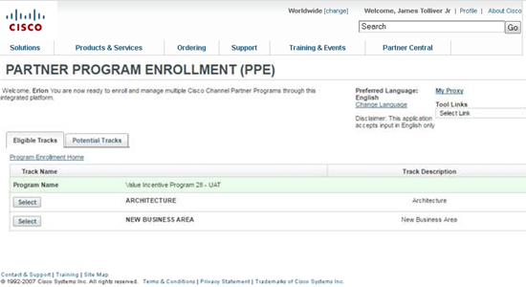
VIP 29 Enrollment
To Enroll in VIP 29, go to: www.cisco.com/go/ppe
Click on Select next to track for which you wish to enroll

Slide 59
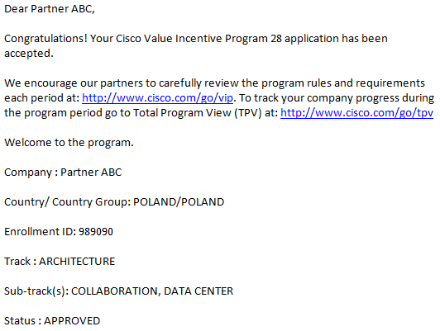
Ensure You Are Enrolled in the Right Track

Slide 60
VIP 29 Key Dates Program Period 29: January 29, 2017–July 29, 2017
Enrollment Windows Re-Enrollment Required
CSAT Survey Period
Payout Dates
January 29, 2017—March 10, 2017 for 6 months
April 30, 2017—May 26, 2017 for 3 months
Q4 CSAT period ends July 29, 2017
First payment: October 2017
Second payment: December 2017
Claim payment within 90 days to avoid its expiry
Partners and PAMs should only use the Partner Program Enrollment tool to track enrollment status: www.cisco.com/go/ppe
Partners and PAMs can also use the Partner Access onLine (PAL) to track CSAT at: www.cisco.com/go/pal
Partners should set their rebate coordinators in Partner Self Service at:
www.cisco.com/go/pss

Slide 61
VIP 29 Customer Satisfaction Process
Gold, Premier Have Two Chances for Base Payout
Select or Registered
Customer Satisfaction Details and Resources
Maintain certification
Complete follow-up activities on all low scores received for the current fiscal year within the PAL tool
Complete follow-up activities on all low scores received for the current fiscal year within the PAL tool
Take advantage of standardized Cisco CSAT process to obtain the feedback from your customers
Meeting CSAT is a very important requirement for VIP payment
Collaboration SaaS and Security SaaS sub-tracks are not subject to the CSAT requirement
TPV tool and Partner Access online (PAL) tool provide visibility to CSAT requirements to Partners and PAMs
Need more information on CSAT process? Go to www.cisco.com/go/csat

Slide 62
VIP 29 Critical Booking Dates
Direct Orders
Standard Orders Placed Through Distribution
CBN Orders Through Distribution
Must book* with Cisco by July 29, 2017 and be shipped before October 28, 2017
Product must ship and invoice from the distributor by July 27, 2017
Order must book* with Cisco by July 29, 2017 and be shipped before October 28, 2017
Booking Discrepancy Cases All Booking Discrepancy Cases Must Be Received via CSC Case by September 1, 2017
* Cisco Booked: Order which has been entered into Cisco’s ordering system, has passed the initial hold/credit check, and complies with Cisco’s internal booking acceptance policy.

Slide 63
VIP 29 Resources
VIP home page : www.cisco.com/go/vip
Select geographical drop down based on your location
Includes:
VIP Playbook
VIP presentation
VIP rules
Link to SKUs list
Links to PPE, TPV tools + trainings
How to open CSC case for any inquiries
Don’t know where to find the answer? Go to the VIP website.

Slide 64
VIP 28: Payout Information

Slide 65
VIP 28 Key Dates Program Period 28: July 31, 2016–January 28, 2017
Enrollment Windows Re-Enrollment Required
CSAT Survey Period
Payout Dates
July 31, 2016—September 9, 2016 for 6 months
October 30, 2016—November 25, 2016 for 3 months
Q2 CSAT period ends January 28, 2017
First payment: April 2017
Second payment: July 2017
Claim payment within 90 days to avoid its expiry
Partners and PAMs should only use the Partner Program Enrollment tool to track enrollment status: www.cisco.com/go/ppe
Partners and PAMs can also use the Partner Access onLine (PAL) to track CSAT at: www.cisco.com/go/pal
Partners should set their rebate coordinators in Partner Self Service at:
www.cisco.com/go/pss

Slide 66
VIP 28 Critical Booking Dates
Direct Orders
Standard Orders Placed Through Distribution
CBN Orders Through Distribution
Must book* with Cisco by January 28, 2017 and be shipped before April 29, 2017
Product must ship and invoice from the distributor by January 26, 2017
Order must book* with Cisco by January 28, 2017 and be shipped before April 29, 2017
Booking Discrepancy Cases All Booking Discrepancy Cases Must Be Received via CSC Case by March 3, 2017
* Cisco Booked: Order which has been entered into Cisco’s ordering system, has passed the initial hold/credit check, and complies with Cisco’s internal booking acceptance policy.

Slide 67
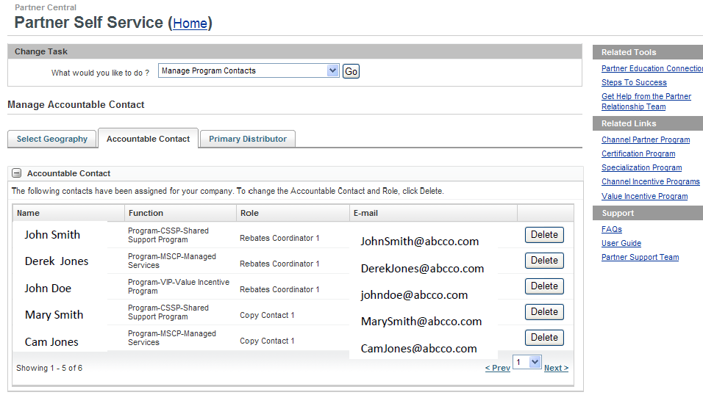
Partner Self Service (PSS) Payment Contact
To set your Rebate Coordinator, please go to www.cisco.com/go/pss
Click on Manage Program Contacts
to assign coordinators and copy contacts
If you qualify for payment but do not have your VIP Rebate Coordinator set up in PSS, you risk the expiry of your payments. For step-by-step instructions, please go to www.cisco.com/go/gep. Where required, remember also to submit the invoice for each VIP payment.

