Slide 1
Cisco Medical Grade Network v2.0
Business Overview

Slide 2








Change Is Everywhere
Aging Population/
Chronic Disease
Shortages
in Key Specialties
Affordability Crisis
New Uses
of IT
Privacy and Security Concerns
Focus on Wellness
Federal IT Investment
R&D Productivity and Innovation
Notes:
At Cisco, we are committed to transforming and evolving with the healthcare industry throughout the world. Everywhere you look there are significant changes at work. In fact…across all geographies we’ve identified seven key trends that individually and collectively are redefining the world of healthcare. Some are these trends are having a positive impact, others are having a destabilizing effect. But in combination, we believe these trends will redefine the way that healthcare works for many years to come.
[Click to build]
First is an aging population. Longer life spans are placing greater demands on the healthcare industry…with an age-related rise in chronic diseases such as Diabetes and Congestive Heart Failure.
[Click]
As a corollary to aging demographics, the industry is also experiencing shortages in key medical specialties and high demand services including chronic diseases.
[Click]
Meanwhile, healthcare is experiencing an affordability crisis, driven by rising healthcare costs and the ongoing instability in healthcare coverage.
[Click]
In response, there is a growing trend to use IT across the entire continuum of care…in order to reduce costs while overcoming barriers to communication, collaboration and productivity.
[Click]
With the rise of electronic files and digital devices, both privacy and security concerns are expanding… including the need for greater compliance as doctors, nurses and patients access sensitive files and bring their own devices with them.
[Click]
The health marketplace itself is changing, too. Along with a growing consumer preference for preventative medicine, there is a trend towards promoting wellness versus treating illness and relying on acute care intervention.
[Click]
Finally, the advent of approximately $40 billion in federal funding in the U.S. is stimulating healthcare to explore new ways of working, exchanging electronic health information, and remaining relevant and competitive in an increasing digital world.

Slide 3
Cisco Transforming Healthcare
Federal IT Investment
New Models of Patient Care
Patient
Transforming the Patient Experience
Clinical Process Improvement
Notes:
As we look to address real business problems and market demands, our strategy has settled on four focused areas where we have proven that we can transform healthcare.
Initiatives such as the patient medical home, accountable care organizations or patient-centered care create a need to bring information, services and expertise across the patient continuum. That, in turn, drives the demand for Cisco’s core capabilities and positioning the network as the platform. We are working with our customers and technology partners to make the most of these four business imperatives.
For example, many of the countries where we do business are investing in health, wellness and IT in the form of economic stimulus funding. As thousands of new users are introduced into the network via Meaningful Use goals, infrastructure and network expansion become critical to success.
Efforts to attract new patients or care plan members are also driving the desire to create positive and personalized patient experiences so that users continue to access your services. Cisco’s video and collaboration solutions have helped to make new models of patient care feasible.
Since doctors, nurses and ancillary staff are both the life blood and largest workforce in healthcare, we offer solutions and technologies to improve the clinical process…by streamlining workflow and enabling more efficiencies in all aspects of care delivery.
Finally, as the demand for equal access to care services and high value specialists continues to grow, new models of care delivery are evolving quickly to transform the patient experience. As we expand on these four areas of healthcare focus today, we will discuss how Cisco can help you to address—and make the most—all of these strategic initiatives

Slide 4
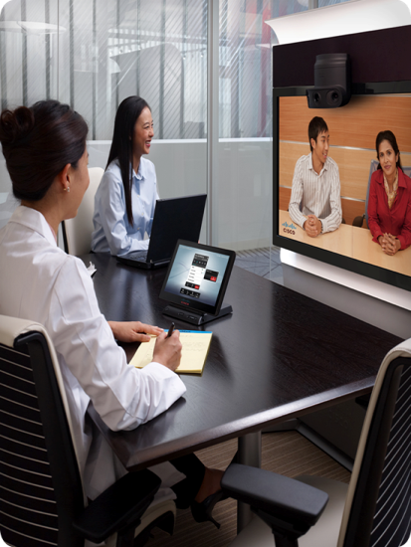
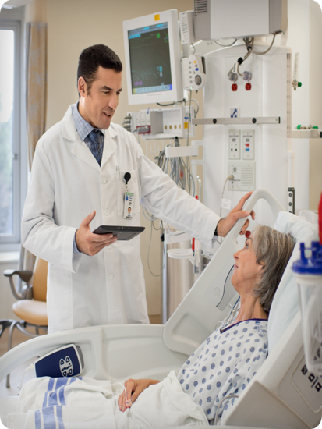
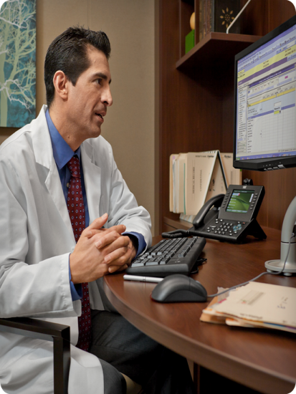
Three Solution Portfolios.
One Secure Foundation.
Care-at-a-Distance and Clinical Workflow
Compliance and Medical Device Management
Continuing Health Education and Collaboration
Cisco Medical-Grade Network
Notes:
With a vast, diverse ecosystem supporting global healthcare it’s clear that interoperability, security, availability, productivity and flexibility are essential elements for success. We believe the answer is having a single, secure foundation that acts as the framework for all of our healthcare solution portfolios and, in turn, can support any and all of our partners.
Cisco’s Medical Grade Network is the foundation for reliable, safe, secure health data exchange and communications among patients, providers and key stake holders. It simple terms, it keeps the continuum of care working more easily, seamlessly and safely in a number of ways.
For example:
By allowing nurses and doctors to deliver patient care anyplace through secure wireless
Enabling secure, automated connectivity of biomedical devices
And staying in compliance with government mandates and industry regulations
The depth and breadth of our healthcare solutions continues to grow across our entire portfolio of offerings. In response, Cisco now organizes our healthcare solutions into three distinct portfolios designed to align directly with the continuum of care and support clear, specific benefits.

Slide 5
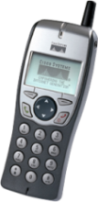
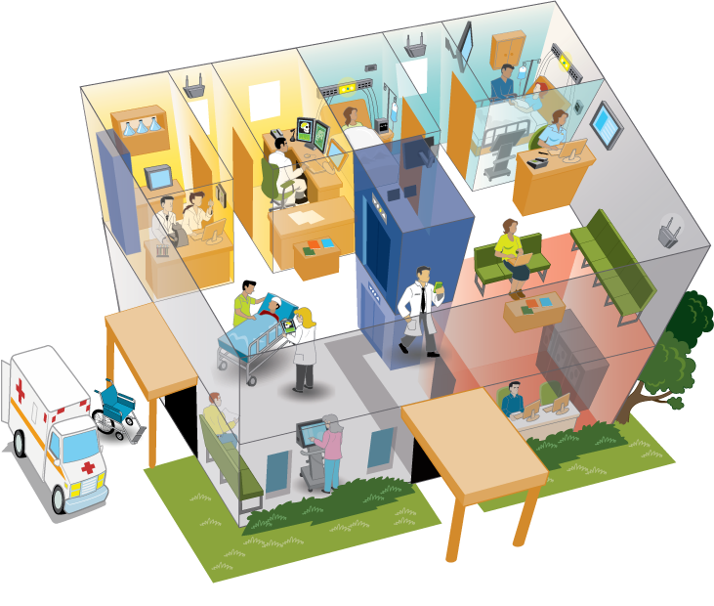

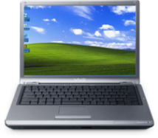


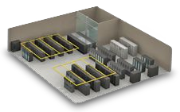
Secure Foundation:
Cisco Medical Grade Network Framework
Allow Nurses and Doctors to Administer Patient Care from Anyplace, Anytime Through Secure Wireless Capabilities
Bring Connectivity
to the Hospital’s Infrastructure Through Automated Biomed Devices
Enable Patients
and Guests to Stay Connected Through Secure Connectivity
Meet Government
and Industry Mandates
Through A Regulatory Compliant Architecture
(ex: PCI)
Enable an Interoperable Healthcare Ecosystem Through a Flexible and Scalable Network Framework
Data Center
Notes:
The Cisco Medical Grade Network Portfolio for Healthcare provides an infrastructural foundation throughout the continuum of care.
The solutions within the MGN portfolio will:
CLICK Allow nurses and doctors to administer patient care from anyplace, anytime through secure wireless capabilities
CLICK Enable patients and guests to stay connected through secure connectivity
CLICK Meet government and industry mandates through a regulatory compliant architecture (ex: PCI – Payment Card Industry mandates)
CLICK Bring connectivity to the hospital's infrastructure through automated biomed devices
CLICK Enable an interoperable healthcare ecosystem through a flexible and scalable network framework
Secure Wireless capabilities enabling nurses & doctors to administer patient care from anyplace, anytime
Secure guest user connectivity enabling patients to stay connected
Regulatory compliant architecture (ex: PCI) to meet government and industry mandates
Automate biomed devices connectivity to hospital's infrastructure
Flexible and scalable framework enabling interoperable healthcare ecosystem

Slide 6
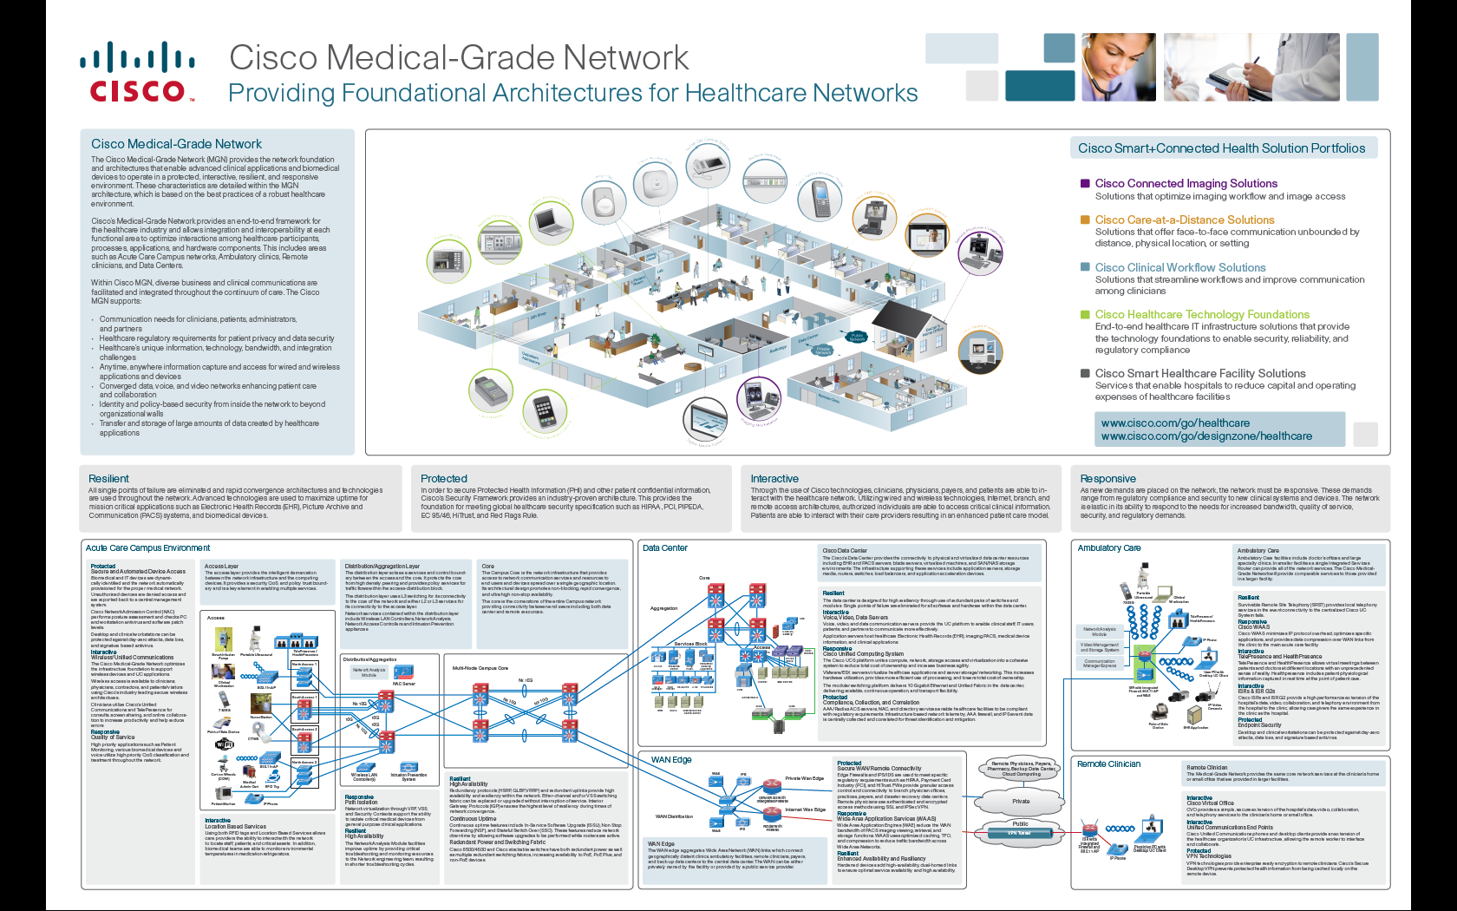
MGN—Architecture Overview Poster
Notes:
6

Slide 7
Healthcare Wireless Industry Trends
Solutions that Enable:
Wireless connectivity for real-time collaboration
A resilient, protected, interactive, and responsive architecture throughout the continuum of care
Highly mobile workforce
Increasing usage of mobile applications and products
Greater information access at point of care
Secure EHR access from various endpoint devices
Converging networks—clinical, IT, guest
Growing patient consumerism of healthcare

Slide 8
Cisco MGN 2.0—
Wireless Architectures
Business Challenges
Cisco MGN 2.0
Asset Monitoring and Tracking
Provides room level accuracy and
facilitates JCAHO compliance
Clinical Access
Provides secure access to clinical
Network resources
HIPAA and PCI Compliance
Cisco
MGN v2.0
Keeps PHI and PCI data
secure today and tomorrow
Leverage RTLS to monitor
environmentally sensitive
pharmaceuticals and specimens
Environmental Monitoring
Improve patient care
VoWLAN provides instant
care provider communication
Security
Rogue AP detection and prevention,
802.1X EAP authentication with strong
WPA2 AES encryption
Cisco MGN 2.0—Wireless Architectures provide best possible wireless deployment, giving healthcare providers with a truly capable wireless network ready for today’s modern healthcare environment.

Slide 9
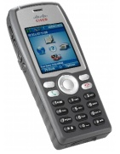

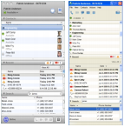
Voice over Wireless LAN
Wireless Challenges
Tighter Specifications than Data Wireless
  More overlap required
  Site survey essential
Pervasive Coverage
  Including: Elevators, Stairways, Building walkways, campus grounds, parking garages
Fast Roaming
  Poor roaming performance may drop or impair active voice calls
Quality of Service
  Call Quality Impacted by jitter, delay, and signal quality
Wireless IP Phones
Wireless IP Phones
802.11a/b/g/n phones for mobile communications and integrated applications.
Multimode Phones
Dual Mode Phones
Cellular phones with 802.11a/b/g/n capabilities. Typically smart phones that are capable of data applications.
Laptops w/ Voice Clients
Laptops/PDAs with Voice Clients
These are primarily data devices with an application giving them voice call functionality. Applications run from Cisco Unified Personal Communicator to Skype or Fring.

Slide 10
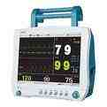
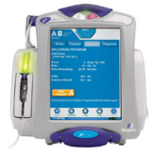
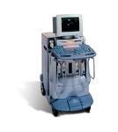
Biomedical Devices
Wireless Challenges
Special RF Requirements
  Vendor specific requirements for 802.11 a/b/g/n usage
  Dedicated SSIDs interference elimination recommendations, etc.
Varying Authentication/Encryption Methods
  WEP, WPA, WPA2
  802.1x not common on today's biomedical devices
Unique Layer 2 (L2) and Layer 3 (L3) requirements
  Many vendors require separate parallel Layer 2 VLANs
  Layer 3 and multicast functionality may be limited
  A 1:1 SSID/VLAN mapping generally required or recommended
Traffic Flows Vary
  Patient monitors: Small (300 byte), but frequent (4x/sec) broadcasts, multicasts or unicast (vendor-specific)
  IV pumps: Formulary and firmware updates are usually small and not a daily occurrence
  Biomedical devices often communicate back to central monitoring station
  Portable radiology devices store studies on the PACS while the device is in use at the point of care
Patient
Monitors
Patient Monitors
Provides real time monitoring of vital signs (blood pressure, oximetry etc) on continuous basis.
IV Pumps
Infusion (IV) Pumps
Administers medication to patients and requires formulary and drug library updates on an intermittent basis.
Radiology Devices
Portable Radiology Devices
Provide wireless connectivity to the RIS and PACS system. Eliminate delays in storing studies acquired at point
of care.

Slide 11
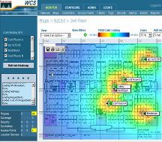

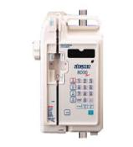
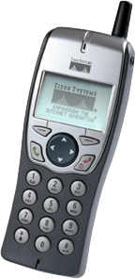
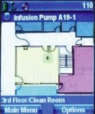

Real Time Location Services (RTLS)
RTLS Challenges
Accuracy
  Achieving room-level accuracy is essential in many, if not all, healthcare organizations
  Healthcare organizations are beginning to use RTLS to trigger billing systems for pumps used by a patient
Often 802.11 networks are not designed with RTLS in mind
  Often 802.11 site surveys are focused on voice and data deployments with no consideration for RTLS, frequently resulting in poor accuracy
Many different standards and techniques available from multiple vendors
  Different technologies use different deployment models or hardware and provide varying levels of service
Notes:
11

Slide 12
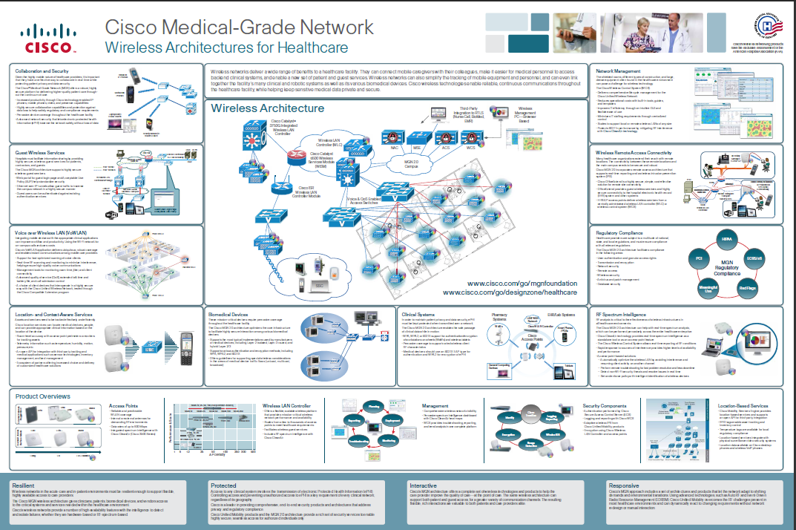
MGN – Wireless Architecture Overview Poster
Notes:
12

Slide 13

CIO Top Security Concerns
HIMSS 2010 CIO Leadership Survey
2010
2009
Healthcare Information and Management Systems Society
Notes:
Your peers internationally see the following threats as their biggest risks. Notice that an Internal Breach of Security is a recurring top concern, and rightfully so in light of the various high-profile breaches reported at major healthcare institutions recently. New to the list as of this year is Data Leakage and Inadequate security process, underscoring the cause of many of these problems.
Next your peers consider being out of HIPAA Compliance (once again) as a relevant threat, especially in light of recent news that several federal agencies have begun audits of health organizations which have had consumer complaints of data breaches, insurance fraud, and false prescriptions.

Slide 14



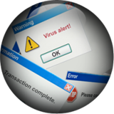
The Growing Need for Security Solutions
Regulatory Compliance
Data Loss
Threat Management
A Systems Approach to Streamline IT
Risk Management for Security and Compliance
Notes:
This environment has driven the need for true security solutions. For some time, “products” have been called solutions, often misrepresenting the term as products alone are not solutions. If a worm was the threat you were concerned about, you might deploy an intrusion prevention system to stop the propagation of the worm, the single product (or solution as it may have been called) may successfully address this problem.
The security challenges faced today require a solution not just a product. For instance to meet compliance requirements, or in this case PCI, there are 12 specific requirements that must be addressed, requiring a system or solution and not a single product. For the increasing problem of data loss, information may leave the enterprise through many different points (user PC storage media, email, backup media, malware).
A system or solution is needed to address data leakage and the many aspects of how and where leakage may occur. The same holds true for managing threats. For instance, malware is often shared or propagated through a multi-step process, email used to deliver an initial attempt to begin malware installation, followed by links it efforts to drive traffic to a malware hosting site, and subsequent activities across the network or on an endpoint that may carry out the attack, such as connecting systems to a botnet, loading trojans on endpoints for key logging or data capture, or sending intellectual property or critical information outside the organization.
This all highlights the need for a systems approach that can streamline IT Risk Management for security and compliance.

Slide 15
Cisco MGN 2.0—Security Architectures
Business Challenges
Cisco MGN 2.0
Regulatory
Provides Architecture to Meet
Various Regulatory Requirements
HIPAA and PCI Compliance
Integrate Security into
Network to Meet Audits
Securing ePHI
Cisco MGN 2.0
Keeps ePHI and PCI Data
Secure Today and Tomorrow
Data Loss Prevention
Leverage SAFE Architecture
to Prevent Data Loss
Securing Clinical and Biomedical
Devices and Systems
Provides Secure Access to
Clinical Network Resources
Securing Voice, IT Devices and Systems
Utilize Best Practices in
Securing IT and Voice Systems
Cisco MGN 2.0—Security Architectures Meet Security Needs for Regulatory and Compliance, Data Loss Prevention and Threat Mitigation, Giving Healthcare Providers a Secure Network Ready for Today’s
Modern Healthcare Environment

Slide 16
HIPAA: Security Rule
HIPAA
Health Insurance Portability and Accountability Act of 1996
Title I
Title II
Title III
Title IV
Title V
Health Care Access, Portability, and Renewability
Preventing Health Care Fraud and Abuse
Medical Liability Reform
Administrative Simplification
Tax-Related Health Provision
Group
Health Plan Requirements
Revenue Offsets
Electronic Data Interchange
Privacy
Security
Security standards: general rules
Administrative safeguards
Technical safeguards
Physical safeguards
Organizational requirements
Policies and procedures and documentation requirements
Transactions
Identifiers
Code Sets
Notes:
16

Slide 17
Technology Categories for
Healthcare Compliance
Category 1 | User authentication, access rights, termination
Category 2 | Transmission and encryption
Category 3 | Network security
Category 4 | Logging, tracking, monitoring
Category 5 | Remote access
Category 6 | Wireless security
Category 7 | Anti-virus and patch management
Category 8 | Database security
Notes:
17
There are common security technology requirements in both HIPAA and PCI. Working to be compliant to one also makes progress to become compliant with others.
HIPAA and PCI both focus on the above list for security requirements.

Slide 18
Security Compliance Mapping Table
Security Coverage Areas | MGN Products | HIPAA ReQ | HIPAA Audit | PCI DSS | Meaningful Use EHR Req
1. User Authentication, Access Rights, Termination | ACS, ISE, Cisco TrustSec, Host Intrusion Prevention | * WP | 1, 3, 14, 29, 34, 42 | 7
2. Transmission and Encryption | VPN, Iroport Email (Encryption), Cisco MDS/ 3rd Party Disc Encryption | *WP | 7, 14, 19, 20, 28, 31 | 4 | 2, 3
3. Network Security | ASA, Firewall, IPS, IronPort Web Appliance, Cisco Security Manager, ACE XML | * WP | 4, 8, 13, 17 | 1, 10 | 5, 7
4. Logging, Tracking and Monitoring | Cisco Security Manager, Cisco / EMC Network Configuration, Cisco Identity Services Engine, Cisco Prime NCS | * WP | 9, 10, 11, 25 | 10
5. Remote Access | Cisco ASA VPN, Firewall, IPS, CSM, Cisco AnyConnect | * WP | 14, 23 | 1 | 9, 10
6. Wireless Security | WCS, WLC, Host Intrusion Prevention, ISR, ISR-G2, Trust-Sec ACS | * WP | 16 | 6, 10
7. Antivirus and Patch Management | Host Intrusion Prevention, ASA-CSC, NCM, Anti-Viruse Software | * WP | 22, 24, 36, 38 | 5, 6
8. Database Security | Firewall, Host Intrusion Prevention | * WP | 4, 13, 21, |25, 40 | 3
* WP—Refer to MGN 2.0 Security Whitepaper Table X
Notes:
18

Slide 19
Cisco Connected Health
better
CARE-AT-A-DISTANCE AND CLINICAL WORKFLOW SOLUTIONS
COMPLIANCE AND MEDICAL DEVICE MANAGEMENT SOLUTIONS
CONTINUING HEALTH EDUCATION AND BUSINESS COLLABORATION SOLUTIONS
Provide Better Care and Wellness
Reduce Costs and
Improve Productivity
Collaborate to Innovate
Care-at-a-Distance
  Cisco HealthPresence™/
  Cisco TelePresence®
  WebEx® for Healthcare
  Expert on Demand
Clinical Workflow
  Cisco 7925 IP Phones
  Context-Aware Healthcare
  Digital Media Suite
Secure Wireless
Medical Data Exchange Solution
Data Center for Healthcare
Context-Aware Healthcare
BioMed NAC
Cisco TelePresence
WebEx for Healthcare
Digital Media Suite
Expert on Demand
Cisco WebEx Social for Healthcare
Cisco Medical-Grade Network Enables Reliable, Seamless, and Secure Health Data Communications Among the Healthcare Community

Slide 20
Compliance and Medical Device Management Solutions
Provide Security, Interoperability, Device Connectivity, and Regulatory Compliance Through Integration and Management of Medical Device Data in an Open Yet Secure Environment

Slide 21
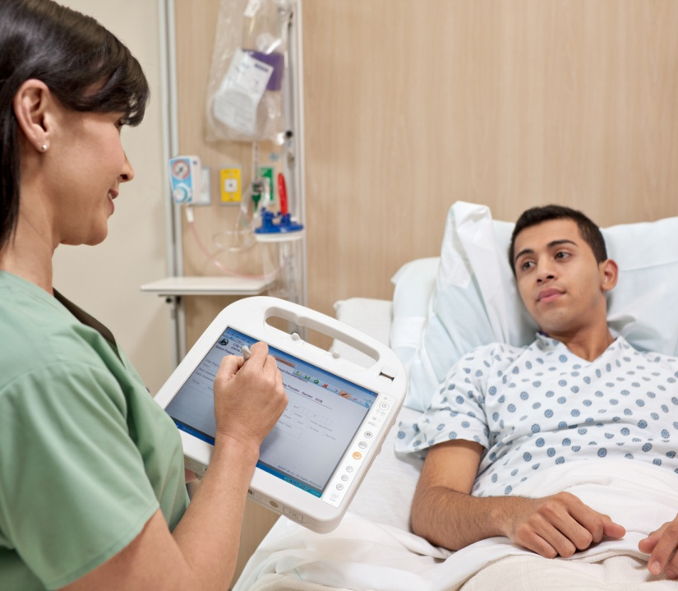
Market Trends
Increasing Medical Device Integration in IT-Centric Environment
Emerging IEC 80001 and MDDS Regulatory Requirements (Compliance)
Patient Privacy and Data Security Growing in Importance
Virtualization and Cloud Computing Gaining Momentum

Slide 22
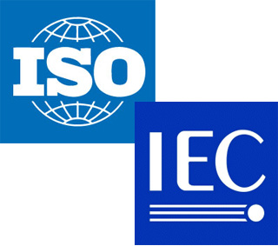
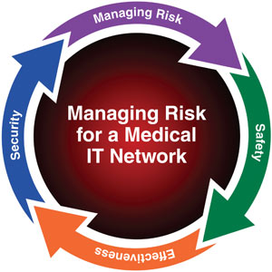
ISO/IEC-80001 Update
International Standard that Applies a Risk Management to Any “General Purpose IT Network” Containing Bio-Medical Devices (Infusion Pumps, Patient Monitors, Nurse Call Systems, etc.)
Creates a New Role within Healthcare of “Risk Manager”
Three New “Technical Reports” or White Papers Published
  Guidance for the Communication of Medical Device Security Needs, Risks and Controls
  Step by Step Risk Management of Medical IT-Networks; Practical Applications and Examples
  Guidance for Wireless Networks
Notes:
International Standard that Applies a Risk Management to Any “General Purpose IT Network” Containing Bio-Medical Devices (Infusion Pumps, Patient Monitors, Nurse Call Systems, etc.)
Creates a New Role within Healthcare of “Risk Manager”
Three New “Technical Reports” or White Papers Published
Guidance for the Communication of Medical Device Security Needs, Risks and Controls
Step by Step Risk Management of Medical IT-Networks; Practical Applications and Examples
Guidance for Wireless Networks

Slide 23
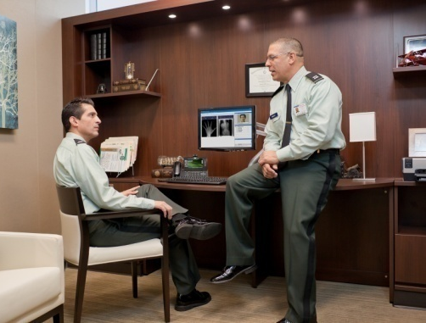

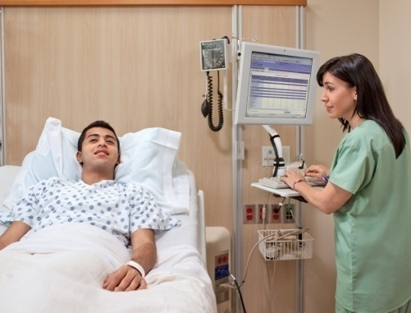

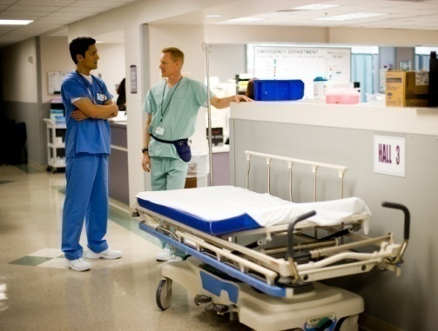
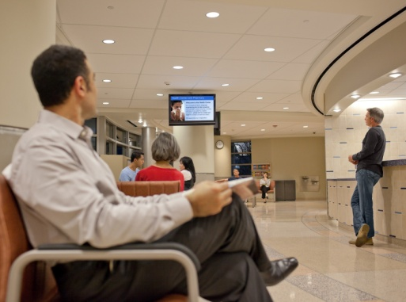
Compliance and Medical Device Management Use Cases
Regulatory and Industry Compliance
Patient Privacy and Data Security
EHR Interoperability
Medical Device Connectivity
Asset Tracking and Patient Tracking
Patient and Visitor Experience

Slide 24
Cisco Connected Health
CARE-AT-A-DISTANCE AND CLINICAL WORKFLOW SOLUTIONS
COMPLIANCE AND MEDICAL DEVICE MANAGEMENT SOLUTIONS
CONTINUING HEALTH EDUCATION AND BUSINESS COLLABORATION SOLUTIONS
Provide Better Care and Wellness
Reduce Costs and
Improve Productivity
Collaborate to Innovate
Care-at-a-Distance
  Cisco HealthPresence™/
  Cisco TelePresence®
  WebEx® for Healthcare
  Expert on Demand
Clinical Workflow
  Cisco 7925 IP Phone
  Context-Aware Healthcare
  Digital Media Suite
Secure Wireless
Medical Data Exchange Solution
Data Center for Healthcare
Context-Aware Healthcare
BioMed NAC
Cisco TelePresence
WebEx for Healthcare
Digital Media Suite
Expert on Demand
Cisco WebEx Social for Healthcare
Cisco Medical-Grade Network Enables Reliable, Seamless, and Secure Health Data Communications Among the Healthcare Community

Slide 25

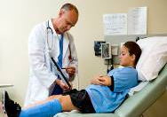
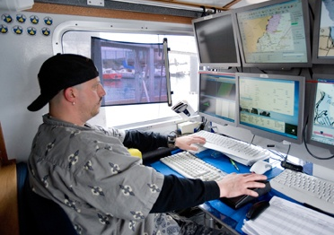

Solution:
Cisco Secure Wireless
Cisco Secure Wireless Extends the Healthcare Network to the Point of Care Without Compromising Network Security and Protects Patient Information, Helping Providers to Comply with Regulatory Requirements
Regulatory
Relief
Coverage and Access
Disaster
Readiness
Hospitality
Services
BUSINESS VALUE
Increase staff productivity
Manage cash flow
Enhance patient experience
Notes:
Cisco Secure Wireless Extends the Healthcare Network to the Point of Care Without Compromising Network Security and Protects Patient Information, Helping Providers to Comply with Regulatory Requirements
It provides:
Regulatory relief
Better coverage and access
Disaster readiness
And Hospitality services
The business values include:
Increase staff productivity
Manage cash flow
Enhance patient experience

Slide 26
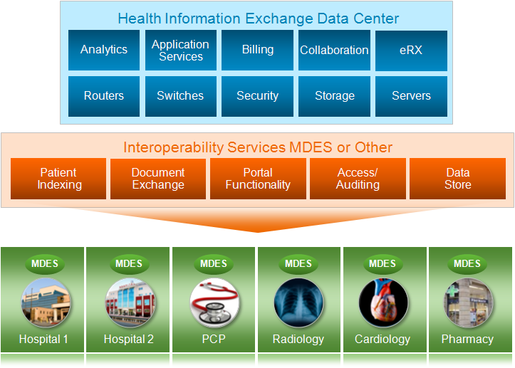
Solution:
Cisco Medical Data Exchange
The Medical Data Exchange Solution Enables Interoperability Between Disparate Systems to Provide a Patient-Centric View of Medical Data
Health Information Exchange Data Center
Analytics
Application Services
Billing
Collaboration
eRX
Routers
Switches
Security
Storage
Servers
Interoperability Services MDES or Other
Patient Indexing
Document Exchange
Portal Functionality
Access/Auditing
Data Store
MDES
MDES
MDES
MDES
MDES
MDES
Hospital 1
Hospital 2
PCP
Radiology
Cardiology
Pharmacy
BUSINESS VALUE
Improved patient care through sharing of patient records across providers
Automated workflows to improve speed and decrease errors
Reduced healthcare costs by minimizing server requirements
Scalability and load balancing through a federated architecture
Notes:
The Medical Data Exchange Solution Enables Interoperability Between Disparate Systems to Provide a Patient-Centric View of Medical Data
MDES is based on open-standards from the global IHE medical data exchange and is an appliance model solution powered by Cisco components that improve network performance and overall security . The Spirit (Tiani) application runs on the Cisco Application Extension Platform (AXP) inside the Cisco 2800 and 3800 Series Integrated Services Routers.
The solution is the interoperability component of the Cisco Medical-Grade Network (MGN). Based on a federated data distribution architecture, patient data is accessed using local systems, and not copied to central systems. Patient Identifier Cross Reference (PIX) profile enables a patient’s records to be indexed across multiple sites. Cross Document Sharing (XDS) framework, enables access to records without the need to copy records to each site. With both PIX and XDS support, MDES improves cares while reducing costs and creates a cost-effective virtual environment for patients’ records. Now data can be stored and accessed without having to copy or manually transport copies to multiple locations
Business value includes:
Improved patient care through sharing of patient records across providers
Automated workflows to improve speed and decrease errors
Reduced healthcare costs by minimizing server requirements
Scalability and load balancing through a federated architecture

Slide 27

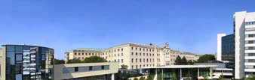

Klinikum Wels-Grieskirchen
Improves Access to Patient Records
CHALLENGE
SOLUTION
Improve quality of care by providing access to patient-centered data
Supply information to authorized personnel where and when needed
Combine complex patient indexes from two different organizations
Medical Data Exchange Solution to provide collaborative tolls for cross-facility communication
Platform for application integration
Application software for tabulating disparate patient data
Enabled standards-based interoperability between disparate systems
Increased staff productivity and efficiency
Created a modernized, flexible, and easy-to-use interface to patient data for doctors and nurses
BUSINESS VALUE
Notes:
27
Klinikum Wels-Grieskirchen is a hospital in the County of Upper-Austria with 1,600 doctors and nurses
The hospital needed to:
Improve quality of care by providing access to patient-centered data
Supply information to authorized personnel where and when needed
Combine complex patient indexes from two different organizations
They choose the Medical Data Exchange Solution to provide collaborative tolls for cross-facility communication. It provided a
Platform for application integration
Application software for tabulating disparate patient data
Klinikum realized business vales as the solution:
Enabled standards-based interoperability between disparate systems
Increased staff productivity and efficiency
Created a modernized, flexible, and easy-to-use interface to patient data for doctors and nurses

Slide 28
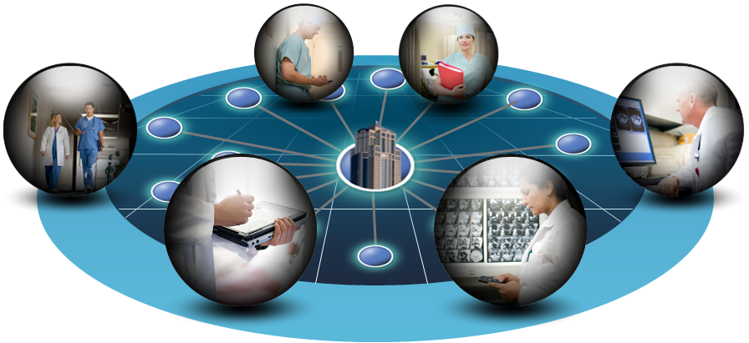
Solution: Cisco Data Center
Virtualization for Healthcare
The Data Center Virtualization Solution Offers a Cost-Effective Approach for Critical Applications Such as Image Management and Electronic Medical Records
Unites Compute, Network, Storage Access, and Virtualization
With Management Simplification
BUSINESS VALUE
Reduces Total Cost of Ownership (TCO)
Increases business agility
Improves energy efficiency
Notes:
IT Organizations Must Weave Together Complex Network, Compute, Virtualization and Management Software.
It’s as if a customer had to buy a car frame from one vendor, an engine from another vendor, wheels and seats and controls from other vendors, them assemble it himself.
Cisco Data Center Virtualization with UCS provides
A single system that unifies
Compute: Industry standard x86
Network: Unified fabric
Virtualization: Control, scale, performance
Storage Access: Wire once for SAN, NAS, iSCSI
Embedded management
Increase scalability without added complexity
Dynamic resource provisioning
Ability to integrate with broad partner ecosystem
Energy efficient
Fewer servers, switches, adapters, cables
Lower power and cooling requirements
Increase compute efficiency by removing I/O and memory bottlenecks
Resulting in real Business Value
Reduced TCO
CAPEX: Up to 20% reduction
OPEX: Up to 30% reduction
Cooling and power efficient
Increased business agility
Provision applications in minutes instead of days
Automation reduces service outages
Just-in-time resource provisioning
Investment Protection
Industry standards-based
Co-exist with existing data center infrastructure
Leverage existing management applications via API

Slide 29
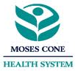
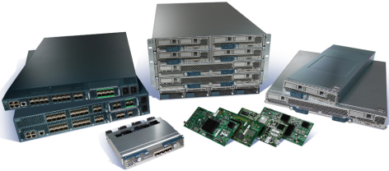
Moses Cone Health System
Deployed Unified Computing Medical System as Part of the Transition to Electronic Medical Records
CHALLENGE
SOLUTION
Adopt electronic medical records
Minimize infrastructure costs
Enable cost-effective growth
Deployed Cisco Unified Computing System engaging Cisco Advanced Services for planning, design, and implementation
Continued using existing storage area networks and Cisco MDS 9000 Multilayer Fabric Switches
Saved US$90,000 to implement 17th server
Reduced time to implement VMware ESX host from 2 days to 1 hour
Saved 96 hours on server configuration
BUSINESS VALUE
Notes:
29
MOSES CONE HEALTH SYSTEM in Greensboro, North Carolina employs 7,600
The were challenged to:
Adopt electronic medical records
Minimize infrastructure costs
Enable cost-effective growth
The chose to deploy the Cisco Data Center Virtualization solution including:
Cisco Unified Computing System engaging Cisco Advanced Services for planning, design, and implementation
And Continued using existing storage area networks and Cisco MDS 9000 Multilayer Fabric Switches
Moses Cone found business value as the solution:
Saved US$90,000 to implement 17th server
Reduced time to implement VMware ESX host from 2 days to 1 hour
Saved 96 hours on server configuration

Slide 30
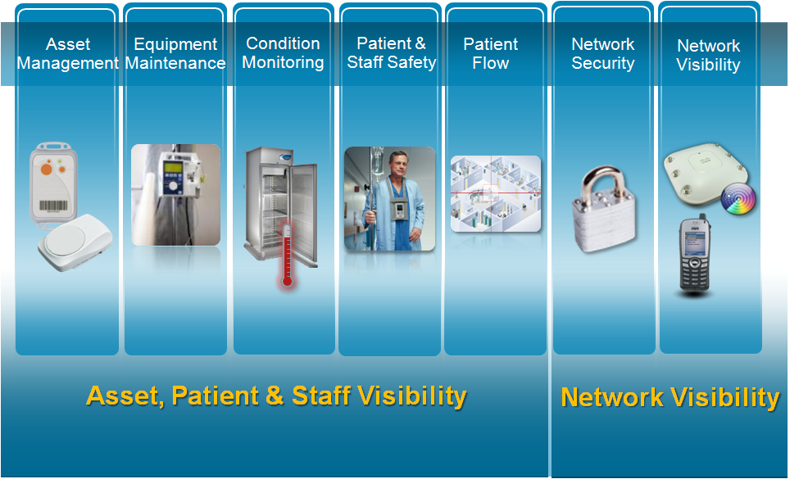
Solution:
Cisco Context Aware
Context-Aware Healthcare Improves Clinical Processes with Real-Time Resource Location Information and Access to Environmental Information to Help Provide an Optimal Patient Experience
Asset Management
Equipment Maintenance
Condition Monitoring
Patient and Staff Safety
Patient
Flow
Network Security
Network Visibility
Asset, Patient, and Staff Visibility
Network Visibility
BUSINESS VALUE
Manage medical equipment, hospital beds, and controlling assets
Issue patient location alerts and cost effectively locate staff
Reduce waste with condition alerts
Manage security and regulatory compliance
Notes:
Context-Aware Healthcare Improves Clinical Processes with Real-Time Resource Location Information and Access to Environmental Information to Help Provide an Optimal Patient Experience
By providing asset, patient and staff visibility and also network visibility, it helps to:
Manage medical equipment, hospital beds and controlling assets
Issue patient location alerts and cost-effectively locate staff
Reduce waste with condition alerts
Manage security and regulatory compliance

Slide 31
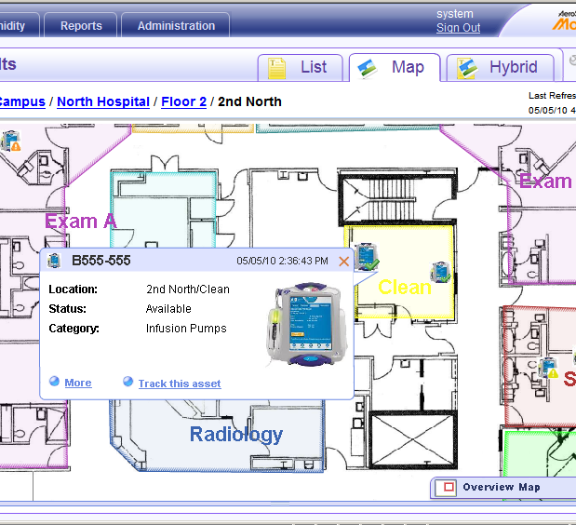

Context-Aware Asset Visibility Applications
Equipment Maintenance
Simplify Preventive Maintenance Through Hospital-wide, Real-Time Visibility of Equipment Location and Status
Available
In Use
Maintenance

Slide 32
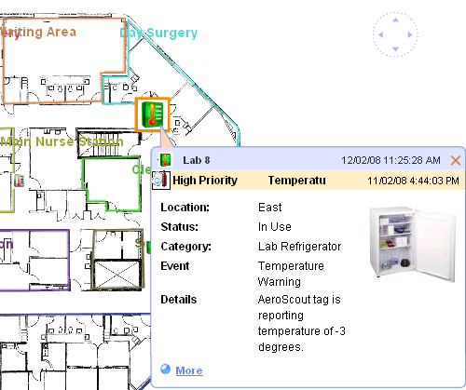
Context-Aware Asset Visibility Applications
Temperature and Humidity Monitoring
Automate Temperature Monitoring of Refrigerators and Freezers Used to Store Blood, Drugs, Vaccines, Food and Tissue Samples, and Provide Immediate Alerts When Out of Range
Automate Humidity Monitoring in ORs, Patient Rooms, Lab and Storage Rooms by Providing and Receive Immediate Alerts When Out of Range
Reduce Spoilage and Improve Safety and Compliance

Slide 33
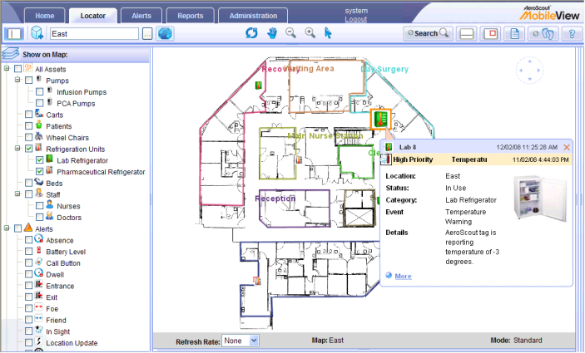
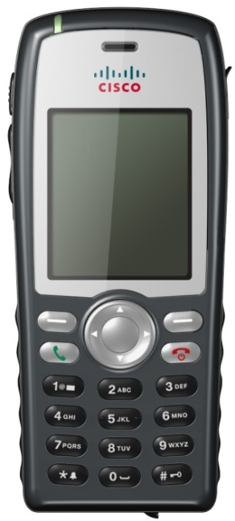
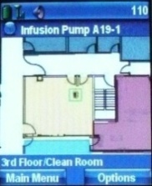
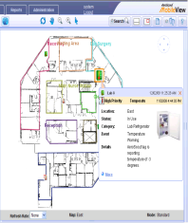
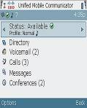
Context-Aware Location on the
Cisco Wireless IP Phone
AeroScout MobileView application
  Visualize, search, and filter assets in map/floor plan or tabular views
  Send notifications and alerts
  Current or historical asset reports, including location, duration, and movement (via web)
Cisco 7925 Wireless IP Phone
  Enhances collaboration for highly mobile healthcare staff, e.g., nurses, orderlies
  Hermetically sealed—Ideal for damp or dusty environments
  Extended battery life to accommodate shared shifts
  Enables integrated services
Event Alerts
Presence
Paging and Push to Talk
Location Tracking
Notes:
Location on the Cisco wireless IP phone. We have integrated the AeroScout Location application MobileView on the Cisco 7925 Wireless IP Phone. The solution offers the ability to visualize search and filter assets either on a map or in tabular view. Alerts can send based on user defined rules. The solution also offers reporting capabilities for current and historical assets, including location, duration and movements.
Earlier this year we announced the Cisco Unified IP Phone 7925. This ruggedized device is designed to enable people in a wide range of workspaces to have access to Cisco Unified Communications services over the premises Wi-Fi network. The 7925 incorporates features that make it ideal for damp or dusty environments where consumer mobile telephones would likely fail, as well as for facilities that offer poor cellular coverage. The 7925 enables access to many of the same applications supported wired Cisco Unified IP Phones including call disposition services, extension mobility for shared workspaces, and screen applications for specific verticals.
The 7925 enables integrated services such as event alerts, presence, paging and push to talk as well as location tracking.

Slide 34
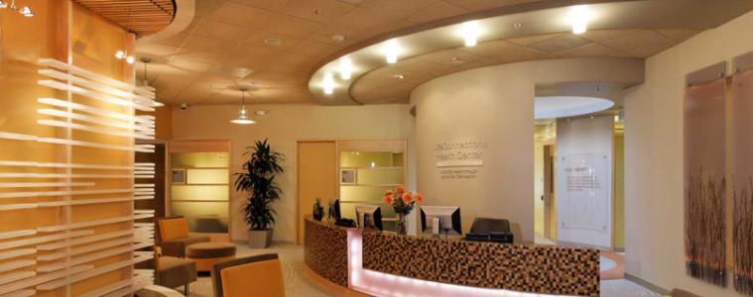
LifeConnections Health Center
Improves Processes, Cost Savings, and Patient Care
CHALLENGE
SOLUTION
The Center is an onsite medical facility for Cisco employees and their families, offering a new model that integrates holistic care with advanced technology
The center had implemented a wide range of mobility services; but temperature monitoring and asset tracking and management remained manual processes
Cisco Context-Aware Solution with the AeroScout Real-Time Location System tracking solution
Saves approximately US$140,000 per year in failure prevention
Prevents loss of expensive medical equipment
Increased efficiency and eliminated human error
Improved drug efficacy, compliance, and patient care
BUSINESS VALUE
Notes:
34
The Center is an onsite medical facility for Cisco employees and their families, offering a new model that integrates holistic care with advanced technology
The center had implemented a wide range of mobility services; but temperature monitoring and asset tracking and management remained manual processes
LifeConnections Health Center implemented the Cisco Context-Aware Solution with the AeroScout Real-Time Location System tracking solution
The solution:
Saves approximately US$140,000 per year in failure prevention
Prevents loss of expensive medical equipment
Increased efficiency and eliminated human error
Improved drug efficacy, compliance, and patient care

Slide 35

Hospital St. Louis (Luxembourg)
Improves Patient Care and Boosts Nurse Productivity
CHALLENGE
SOLUTION
Improve wireless network reliability to support continuous access of digital medical records
Deploy patient tracking solution to prevent disoriented patients from leaving permitted areas
Cisco Unified Wireless Network enables medical practitioners and mobile staff to access records while on the go
Cisco Context-Aware Mobility Solution, with AeroScout MobileView and Wi-Fi–based RFID tags enables:
  Tracking of disoriented patients
  Helps track hospital assets
Simplified network management and maintenance, resulting in crucial time-savings and better IT resource allocation
Facilitated compliance with numerous hospital legal and security requirements
Improved patient quality of care and life and reinforced hospital’s position as technologically advanced healthcare institution
BUSINESS VALUE
Notes:
35
Hospital St.Louis in Ettelbruck, Luxembourg has 765 employees and 91 physicians.
They were challenged to:
Improve wireless network reliability to support continuous access of digital medical records
Deploy patient tracking solution to prevent disoriented patients from leaving permitted areas
They choose to implement the Cisco Context Aware solution providing:
Cisco Unified Wireless Network enables medical practitioners and mobile staff to access records while on the go
Cisco Context-Aware Mobility Solution, with AeroScout MobileView and Wi-Fi–based RFID tags enables:
Tracking of disoriented patients
Helps track hospital assets
The allowed them to realize business value in the form of:
Simplified network management and maintenance, resulting in crucial time-savings and better IT resource allocation
Facilitated compliance with numerous hospital legal and security requirements
Improved patient quality of care and life and reinforced hospital’s position as technologically advanced healthcare institution

Slide 36
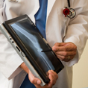
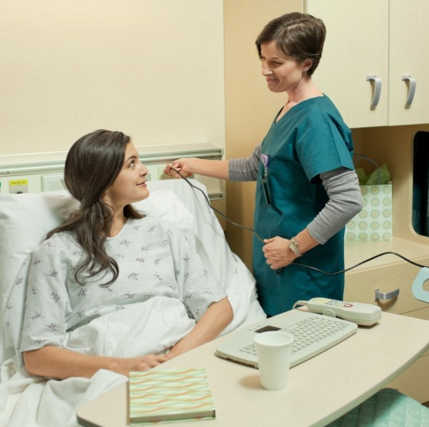
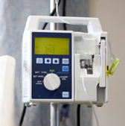
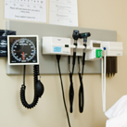
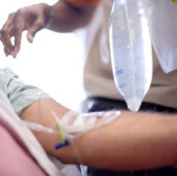
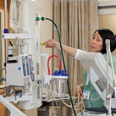
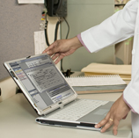
Solution:
Cisco BioMed NAC
Cisco Biomed Network Admission Control (NAC) Is an Effective Way for Hospitals to Automate the Process of Connecting Biomedical, IT, and Guest Devices to the Network, Eliminating a Time-Consuming Manual Process
Securely Connecting Medical or Non-Medical Devices on a Single Network
BUSINESS VALUE
Leverages existing network infrastructure
Reduces overall operational expenses
Improves and optimizes care delivery
Improves patient and staff experience
Notes:
Cisco Biomed Network Admission Control (NAC) Is an Effective Way for Hospitals to Automate the Process of Connecting Biomedical, IT, and Guest Devices to the Network, Eliminating a Time-Consuming Manual Process
The typical setting today includes:
Separate networks for each vendor
Physical separation
Separate administration and management domains
Higher cost of ownership
After convergence to BioMed NAC, hospitals have a:
Converged network
Logical separation
Single administration and management domain
Lower total cost of ownership
The business value this creates includes:
Leverages existing network infrastructure
Reduces overall operational expenses
Improves and optimizes care delivery
Improves patient and staff experience

Slide 37

Hospital Da Luz
Provide Secure Access to Network Endpoints
CHALLENGE
SOLUTION
Acquisition of real-time data for endpoint devices connected to network
Automatic restriction and privileges assignment to users and devices
Reduction of operational overhead expenses
Cisco BioMed NAC Solution
Cisco Catalyst® Switches
(3750 and 560 Series)
Cisco Unified WLAN Infrastructure
(1131 Series access points and redundant WiSM controllers)
Increased security with a network wide access control policy
Increased visibility of all endpoints connecting to network
Increased operational efficiency
BUSINESS VALUE
Notes:
37
Here is an example of how a healthcare provider can be both open AND controlled.
Hospital Da Luz in Lisbon, founded in 2007, is one of the largest, most modern private hospitals in Portugal. They're using a number of Cisco solutions to increase security and efficiency.
They've deployed Cisco switches and a Cisco Unified Wireless WLAN infrastructure. Also, to support a wide range of medical device endpoints, they're using the Cisco BioMed NAC solution, the Cisco Access Control Server, and the Cisco NAC Profiler/Server Collector.
The Cisco BioMed NAC solution, which provides network access control for device endpoints, enables real-time data acquisition. It handles user authentication, assigns privileges, and automatically downloads parameters to the network access devices. After connection, endpoint behavior can be monitored to ensure safety.
The BioMed NAC solution increases security with a network-wide access policy, and increases the visibility of all endpoints connecting to the network. It also increases operational efficiency and hence reduces costs.

Slide 38




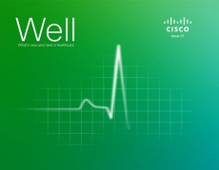
Let’s Stay Connected
Post a comment or photo
http://www.facebook.com/CiscoHealth
Follow us
https://twitter.com/CiscoHealth
Check out the Cisco Healthcare Blog
http://blogs.cisco.com/category/healthcare/
Watch Cisco Healthcare videos
http://www.youtubecisco.com/healthcare
Cisco Health Digital Magazine
http://cs.co/well

