Slide 1
Cisco Jabber + AnyConnect Sales Guide
For Cisco Partner Use Only
October 2012

Slide 2
Selling Jabber and AnyConnect Together
Jabber + AnyConnect
Benefits of Cisco Jabber + AnyConnect
Competitive Positioning
Sales Approach: Targeting, Messaging
Ordering
Additional Resources

Slide 3
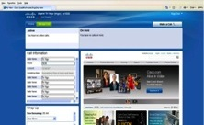
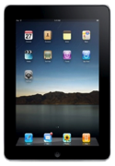
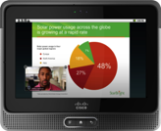
Trends in Secure Connectivity
Users expect anywhere, anytime access
Explosion of devices and mobile apps creates new demands on IT for connectivity and security
Personal apps on business devices exposes corporate network to unwanted traffic
Range of connectivity options
Wi-Fi, 3G/EVDO cards, cellular…not just wired Ethernet
Traditional VPN remote access is limited
End user support, manual process to connect, not always on
PC & Mac
Android & iOS Tablets
Smart Phones
Notes:
Consumer experience influencing employee behavior
Expect anywhere, anytime access to corporate resources
Want to be productive, with a flexible schedule
More mobile and remote workers than ever before
Allowing personal devices exposes corporate network to unwanted traffic and security risk
Need to prioritize business traffic on corporate networks
The challenge of applying security in a borderless network experience has become very multi-dimensional - across devices, applications, and locations. There are more devices accessing applications and data from multiple locations over the internet. While the challenges are the same at the core – Access Control, Acceptable Use Enforcement, Threat Protection and Data Security, the problem has become multi-dimensional in this new environment.

Slide 4
Jabber + AnyConnect

Slide 5
Jabber + Any Connect Secure Remote Access Strategy
Secure access with AnyConnect
Aligns with Cisco’s BYOD strategy
Consistent security experience across broad platforms
Secures multiple mobile applications – Jabber and more
Simple end user experience
VPN On-demand (iOS)
Trusted Network Detection (Windows, Mac, Android)
AnyConnect is a robust security solution
Mature, broadly deployed, diagnostics, multiple security protocols
Notes:
New Plan:
Secure Connect (application-based VPN) no longer planned
Jabber + AnyConnect for Secure Remote Access
Why:
Jabber + AnyConnect enhancements improve experience
What stays the same:
Same licensing, backend (e.g. ASA) and administration
Same security + collaboration story

Slide 6
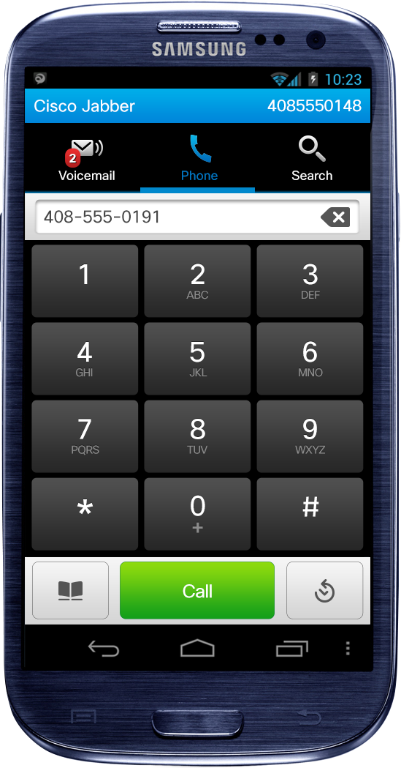
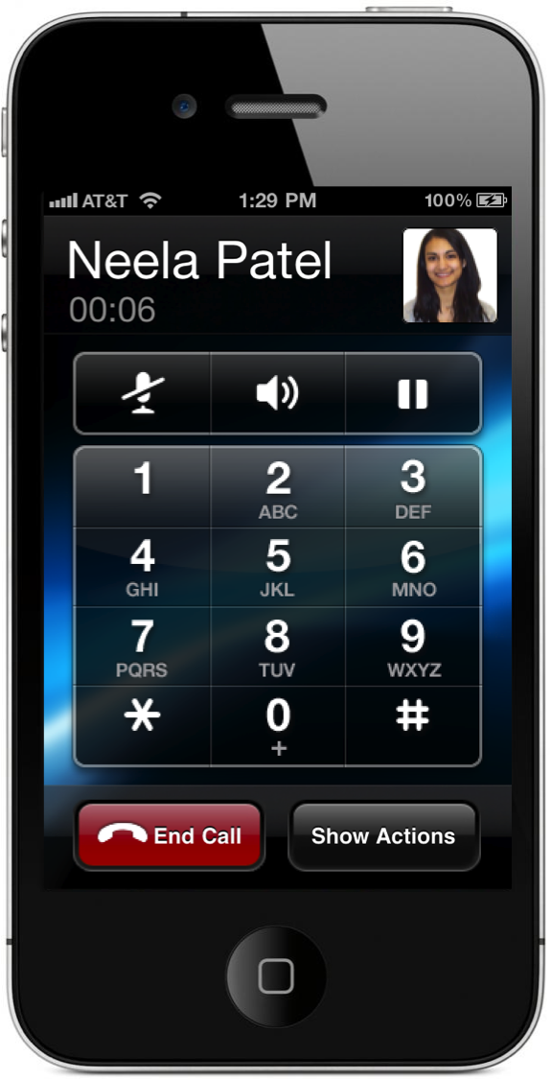
Cisco Jabber + AnyConnect
AnyConnect secures the entire device
Split tunneling can be configured, sending only traffic needed for business on to the enterprise network
Enterprise-grade encryption and authentication
Leverages Cisco ASA security solutions
Configure a near-seamless AnyConnect experience when using Jabber
Trusted Network Detection and VPN On-Demand
Internet
Corporate Network
Cisco ASA

Slide 7
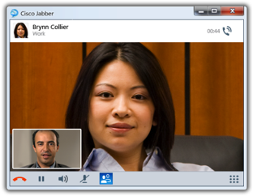
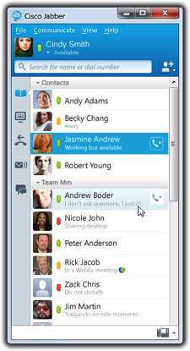
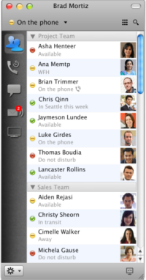
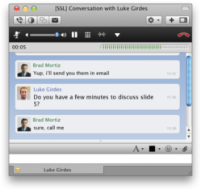
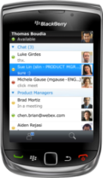
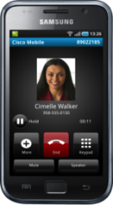
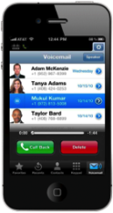
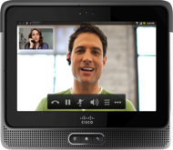
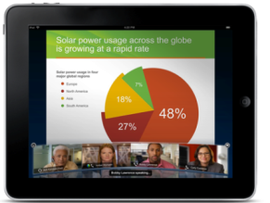
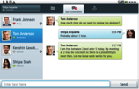
Cisco Jabber -The Power to Collaborate All-in-One UC Application
All-in-one UC Application
Presence & IM
Voice, Video, voice messaging
Desktop sharing, conferencing
Collaborate from Any Workspace
PC, Mac, tablet, smart phone
On-premises and Cloud
Integration with Microsoft Office
Notes:
Cisco Jabber is a UC client application that streamlines communications and enhances productivity with integrated presence, instant messaging, voice and video, voice messaging, desktop sharing, and conferencing capabilities.
Cisco Jabber provides the best user experience across broadest range of platforms, browsers and device. You can use Jabber as a rich client, a mobile client, a web client or a virtualized client on PC, Mac, tablet, smartphones and virtual desktop clients
Cisco Jabber lets you be more productive from anywhere on any device. Find the right people, see if and how they are available, and collaborate using your preferred method to get answers and make decisions faster.
Cisco Jabber provides deployment flexibility. You can deploy with on-premise or cloud-based UC services. You get a consistent experience across platforms, devices and on-premises & cloud-based deployment alternatives so you can choose your preferred options without sacrificing user capabilities.
Cisco Jabber takes advantage of intelligence in Cisco networks and Cisco Unified Communications Manager call control to deliver secure, clear and reliable communications. This results in a greater user acceptance and less risk. Cisco Jabber also integrates with other Cisco Collaboration solutions, including TelePresence video, and it can launch a Cisco WebEx Meeting.
You can also access user status information and click to communicate capabilities directly from Microsoft office applications, without requiring Microsoft Lync or Office Communicator. Protect your important Microsoft investments, Microsoft Office, Outlook and Exchange. .

Slide 8
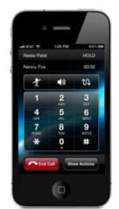
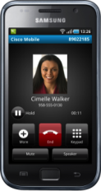
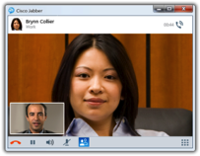
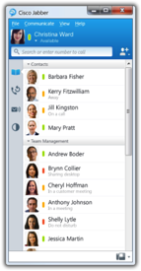
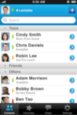
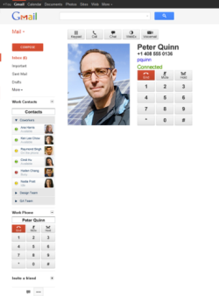
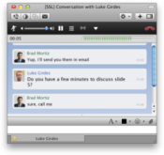
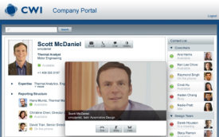
Cisco Jabber Best Experience Across Broadest Range of Platforms & Devices
Win, Mac
iPad
Smartphone
Web
Notes:
Another unique differentiator of Jabber is that it works on such a broad range of platforms, browsers, and devices. You get broad capabilities and a consistent experience across leading platforms and devices, including PCs, Macs, tablets (e.g. iPad, Cius) and smart phones (iPhone, Android, Blackberry).
You get a rich collaboration experience from anywhere and can choose when, how, and on what device to interact. People want flexibility in how they work with a user experience that is intuitive, uncomplicated and consistent across devices. Cisco believes this is accomplished only with a unified architectural approach in which our Collaboration suite in a common user interface hosted on a network that is media-ready. The result is the right communication experience for the task at hand. Providing capabilities that span Presence, IM, voice, video, conferencing across different devices lets users choose the right communications experience for the task at hand.
Consistent user-interface and experience across devices and features, spend more time collaborating and less time learning “how to”. This leads to increased adoption across the collaboration portfolio and better/faster ROI.
By running on a wide range of devices and platforms, Cisco Jabber (and WebEx) lets organizations address new BYOD device ownership models, where employees want to use enterprise apps on their personal devices. Leading organizations support multiple platforms, browsers, and devices because that’s what their brightest and best want.
With the Cisco Jabber Software Development Kit (SDK), you can integrate Cisco Unified Communications capabilities into any web application-easily and quickly. Application developers, customers, and partners alike can take advantage of this powerful SDK to incorporate voice, video, instant messaging (IM), presence, voice messaging, and conferencing capabilities. Use the power of the web browser to connect, communicate, and collaborate within your line of business application or web portal. You'll save time, streamline workflows, and increase workforce collaboration and productivity.

Slide 9
AnyConnect Secure Mobility Client
Industry leading Layer 3 VPN Client +
Enables BYOD – Mac OS X, Windows, iOS, Android
VPN Session protected by hardened ASA firewall
Seamless authentication with Certificates
IPSec / SSL / DTLS / IPv6
Integrated with ScanSafe and Cisco ISE
Largest Installed Base for Remote Access Solution

Slide 10
AnyConnect Secure Mobility Client Architecture Overview
AnyConnect User Interface
Management Head-ends
Services
Interfaces
Service Provider Integration
AnyConnect Platform
Architecture
Head End Devices
Trustsec
&
Cisco
Medianet
Wired switches &
Wireless controllers
NAC
Appliances
ASA Remote Access
ISRs
Web Security
Cloud Web Security

Slide 11
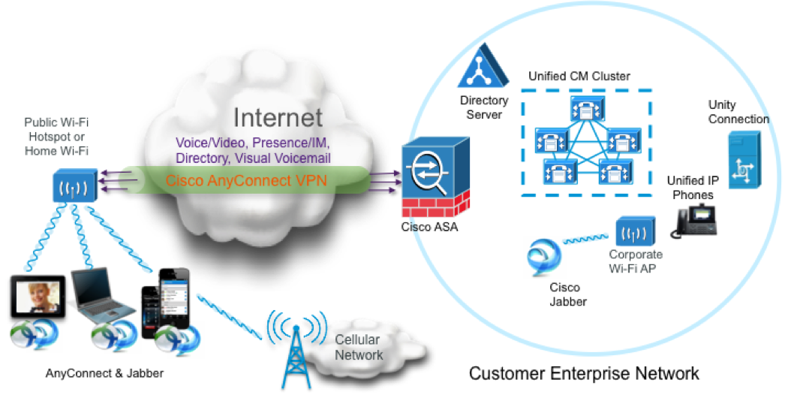
Topology
Best Practices for AnyConnect with Jabber technical deep dive: http://jwray-unix.cisco.com/VPN-Public/Jabber/Jabber-Best-Practices-AC.pptx

Slide 12
Benefits of Cisco Jabber with AnyConnect

Slide 13
Our Best Approach: Jabber + AnyConnect for Secure Remote Access
AnyConnect is a robust solution w/range of secure connectivity options (IPSec, SSL, DTLS)
Platform independence
Provision AnyConnect with 3rd party MDM Solutions
Features independent of transport (Wi-Fi, 3/4G)
Configurable end-user experience
Mobile alliances
Notes:
Same backend setup and configuration on ASA as the discontinued secure connect feature of Jabber – little administrative difference in using AnyConnect
Secure access with AnyConnect
Aligns with Cisco’s BYOD strategy
Consistent security experience across broad platforms
Secures multiple mobile applications – Jabber and more
Simple end user experience configurable for Any Connect
VPN On-demand (iOS)
Trusted Network Detection (Windows, Mac, Android)
AnyConnect is a robust security solution
Mature, broadly deployed, diagnostics, multiple security protocols
Platform Independence - feature breadth across OSs and devices
Consistent collaboration and security features independent of transport (Wi-Fi, 3/4G)
Security included in every mobility solution design
Wide range of connectivity options - IPSec and SSL VPN tunneling, DTLS (voice & video) tunneling
Open environment allows solutions to be natively included and enhanced on wide range of mobile devices
Mobile alliances for better solution integration and experience: Apple, Samsung, RIM, Nokia
Broad Mobile Support
Fixed & semi-fixed platforms
Mobile platforms
Persistent Connectivity
Always-on connectivity
Optimal gateway selection
Automatic hotspot negotiation
Seamless connection hand-offs
Next-Gen Unified Security
User / device identity
Posture validation
Integrated web security for always-on security (hybrid)
Clientless & desktop virtualization

Slide 14
Jabber + AnyConnect Solves Business & IT Problems
User needs:
Simplicity
Access to business apps and collaboration tools anywhere
Freedom of device choice
IT needs:
Accelerate business agility
Provide a superior experience
Manage risk
Keep costs in line
Notes:
New mobile devices have enormous potential to benefit businesses, but they create new challenges for IT.
Users want the flexibility to access their business applications and collaboration tools anywhere, from any device they choose.
To provide a secure, seamless multi-device experience, our customers will need to:
Accelerate business agility, with the ability to rapidly modify operating models and speed rollout of services and applications to new devices
Provide a superior experience by delivering a consistent experience across PCs, tablets, and smartphones, and by supporting today’s anywhere, any device work styles
Manage risk by assuring strict security and compliance, even as unprecedented numbers of new devices connect to the network and mobile employees work in new ways
Keep costs in line by making the most of network investments and reducing complexity

Slide 15
AnyConnect Experience End User perspective
Feature/Benefit | AnyConnect Secure Mobility Client
Sweet spot: use case description | PC, tablet, or smartphone used either exclusively for business or for mixed business & personal use. Single VPN solution across a user’s multiple devices.
Device choice | Windows, Mac, iPad, iPhone, Android
Security control | Always on, user controlled
Enterprise traffic | All app traffic on device traverses through enterprise via a single point of entry
Application experience | Jabber and AnyConnect are separate applications, but with iOS VPN on demand, Jabber will automatically launch AnyConnect. AnyConnect works with internal business applications without special integration or development.
Local resource access | Use split-tunnel approach
Voice calls | VOIP friendly D-TLS
Trusted Network Detection | AnyConnect will automatically connect when outside the trusted network, and disconnect when inside the trusted network
Roaming | Roaming friendly and fast reconnects (i.e. IP address caching)
Marketing Message | Built for the BYOD and Post-PC era. Microsoft attacks with FUD on VPN limitations.

Slide 16
AnyConnect Experience Admin/InfoSec perspective
Feature | AnyConnect Secure Mobility Client
Installation and Administration | Multiple approaches, but easiest is handled through ASA. Separate setup from Jabber app.
Client setup and management | Provisioned through ASA. Single VPN instance, single VPN user account across multiple devices – one setup. SCEP is supported.
Infrastructure | Standard security, encryption, authentication types
Licensing | Requires AnyConnect Essentials or Premium. Jabber has multiple licensing options, separate from AnyConnect.
Branch access | ASA
Protocols | IPsec and SSL (DTLS and SSL) for tunneling. Multiple authentication types.

Slide 17
Competitive Positioning

Slide 18
Microsoft Secure Remote Access
Microsoft Lync includes an application-based VPN
Connects through Microsoft Lync Edge Server
Advantages:
Simple – No need to launch separate VPN application
Only secures Lync traffic
Disadvantages:
Complex – Requires lots of Windows servers in DMZ
Vulnerabilities – Denial of Service, Lots of security holes
Only secures Lync traffic, what about other apps?
Notes:
doesn’t need a VPN – a simple user experience
Edge Server doesn’t protect against denial of service attacks
With multiple Edge Servers, you have put them behind a PUBLIC (non hidden) load balancer, open through the firewall
Lync architecture incredibly complex once all capabilities, security included – multiple servers in DMZ, full of security holes
Addressing requires more complexity and cost
AnyConnect user experience is seamless when properly configured – we can show you how
Need a VPN for secure remote access of non-MSFT apps
Poor experience on non-Windows OS

Slide 19
Limitations in Our Approach
2 Apps needed: Jabber + AnyConnect
Response: Can configure to auto-launch
All or nothing approach – No application-specific VPN
Response: on the engineering roadmap
AnyConnect for Android device support limitations
Response: AnyConnect for Android supports all Android 4.0 (“Ice Cream Sandwich OS) devices
Notes:
AnyConnect for Android requires either OS 4.0 version of Android, a specific variant of AnyConnect from handset partners, or a rooted device
AnyConnect for Android has issues with Trusted Network Detection on Android OS 4.0
AnyConnect can start a VPN tunnel automatically for the user but does not always automatically close the tunnel
Engineering working to overcome

Slide 20
Jabber + AnyConnect vs. Microsoft
Security:
With a VPN-based solution, you have a single point of entry into the corporate network (the secure gateway).
With Microsoft, you have an Exchange Server, a SharePoint Server, and a Lync Server all on the network edge – providing an expanded attack surface for hackers. Imagine the case in which a security vulnerability is found with a particular cryptographic protocol. How many servers do you have to update with a Microsoft solution? With the VPN solution, there is only one.
Cisco's VPN solution supports the most secure cryptographic protocols and standards (IPv6, Suite B, FIPS, etc.). Do Microsoft's?

Slide 21
Jabber + AnyConnect vs. Microsoft
Synergy:
AnyConnect has benefits that go beyond supporting Jabber. AnyConnect provides unsurpassed remote access to corporate assets, which is valuable in and of itself. It is also a springboard for other services, like ISE integration and Web Security.
BYOD and the Post-PC era
Jabber and AnyConnect support multiple devices and operating systems, with a consistent user experience across devices. Microsoft is a great PC experience, but very limited on tablets, smartphones, and non-Windows PCs.

Slide 22
Cisco Drawbacks Microsoft Succeeds in these Situations
Requirement | Microsoft | Cisco
“It just works” – start the app, no password (no 2-factor authentication) | Yes | Can allow this if properly set up, there are a few options (On-Demand VPN, Trusted Network Detection, certificates, etc.)
Peer to peer – no hairpin | Yes | No
Secure only the app, not the entire device | Yes | Very limited, no in most cases
Multiple tunnels – simultaneous secure corporate network & secure cloud access (cloud-friendly) | Yes | No
Notes:
Microsoft is successful with these requirements
1. Just works, no password.
2. Multiple tunnels. (Think corporate access + HCS at the same time - dual tunnels needed - MS model does this - wanted by Kraft as example)
See: https://videosharing.cisco.com/vportal/VideoPlayer.jsp?ccsid=C-413cc0fd-a5ea-4ba5-9050-6ba7b4834730:1#
3. Peer-to-peer (No hair pin - ICE/STUN)
4. No device access, only app access

Slide 23
Sales Approach

Slide 24
Position Yourself to Succeed
Target companies that provide laptops and mobile devices to employees
IT controls the image and applications – comfortable with securing the entire device – easiest conversation for Cisco to have
Pure BYOD companies have concerns with AnyConnect
Want to keep personal/untrusted activity off the corporate network
Want app-based VPN, securing only business network traffic
Responses:
Will you have an app-based VPN for email, voice, IM, sales apps, HR apps…isn’t one VPN easiest?
Untrusted apps in building/behind firewall present same risks as device-based VPN for remote access. Let Cisco help establish BYOD policy and strategy for remote and local access.

Slide 25
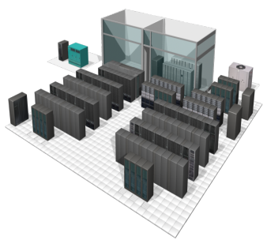
Diverse Remote Access Use Cases
Mobile Worker
Access from laptops, tablets, smartphones
Disaster Recovery
Requires access flexibility to accommodate diverse devices and locations; security remains critical.
Supply Partner
Unmanaged desktop; complex support issues.
Requires limited access to corporate resources.
?
Contractor, Temp
Access requirements vary greatly. Unmanaged or managed computers; access needs to be limited.
Teleworker
Requires consistent LAN-like performance
Remote Access Requirements Vary Greatly by User, Location, Desktop and Other Criteria
Notes:
25
There are many different remote access use cases, which highlight the variety of end-users groups, connectivity options and devices that must be met by a VPN secure remote access deployment.
The ability to offer a single appliance solution to such varied and complex requirements is invaluable to a customer, both from an operational and management standpoint, as well as from a core security standpoint.
Let’s look at these requirements more in detail :
1. Consider for instance the case of a typical remote access user, who may connect from home and require full virtual LAN access to work efficiently. She may then put her laptop on standby and leave for work, use her smartphone during her commute time to check email, stop in a café and use her laptop over a Wi-Fi hotspot to finish an urgent task, then drive to the office and connect her endpoints directly to the corporate network.
2. Another typical example depicts a business partner, who may not have the benefit or be trusted to use a corporate asset for accessing corporate resources and data. He only needs restricted access to few applications and /or to a specific database. Such users typically use their own (partner) company’s laptop to access resources.
3. Yet another example depicts an emergency situation, where a high number of regular employees need to work remotely, without necessarily have been provided with a corporate endpoint for full VPN client access. Business continuity is key to many businesses, and is even outline in some legislation mandates (COOP)
This may occur for instance when a natural catastrophe, a pandemic, a national threat, or a local network outage occurs. Corporate employees would benefit from clientless VPN access to essential work tools and resources such as OWA, RDP, citrix presentation server tools,…By enabling such access, the corporation ensures that its key business functions are resilient, and maintains its productivity.

Slide 26
Targeting: Customer Process Use Cases
Use Case | AnyConnect Solution and Use Case
Intranet access and internal tools | Full access to Web Apps (directory is most used); open intranet links from emails.
Jabber | AnyConnect enables remote collaboration on any device
Virtual desktop | Enable VDI on iPad; access desktop wherever you go
HR/Finance/Sales Approvals | Mobile approvals; respond faster to speed up business processes; use down time effectively when travelling
Salesforce/CRM | Access internally-hosted data within the Salesforce app
Enterprise social software and portals | Read and respond to posts and blogs, interact with colleagues, and participate in discussions while mobile

Slide 27
Targeting: Vertical Customer Use Cases
Use Case | AnyConnect Solution and Use Case
Healthcare | Nurses, techs, admins who stay in a single building or campus are unlikely to need AnyConnect. Doctors, specialists, paramedics are mobile and need AnyConnect. Jabber delivers remote consultation and ability to quickly find expertise.
Finance | Many finance workers travel for client business and need AnyConnect and Jabber for mobile devices to stay connected. Support staff and retail branch workers are often in a fixed location with no need for AnyConnect.
Retail | Most workers remain on the LAN/WLAN with no need for AnyConnect. Use Jabber for in-store mobility, responsiveness
Government/Education | Many gov/ed workers are often in a fixed location with no need for AnyConnect. Yet, mobility is increasing and securing the entire device with AnyConnect is a priority.

Slide 28
Trigger questions to guide the conversation to Jabber + AnyConnect
Do you have mobile workers?
You need a scalable, secure remote access solution that is simple to use
Improve experience through automatic session resumption as users move around through their work day
Enhance security of remote connections for laptops with latest security protocols
Do you support multiple devices and operating systems?
Jabber and AnyConnect deliver excellent multiplatform experience, not just an experience that’s subpar to Windows
How do you support mobile workers and multiple devices?
AnyConnect offers access management to individual device level

Slide 29
Trigger questions to guide the conversation to Jabber + AnyConnect
Are cost savings a consideration in your BYOD/mobile strategy?
Consider cost savings from mobile voice and video over IP
Mobilize your UC/Collaboration investments easily with Jabber
Jabber for everyone – presence & IM for all employees, all devices
AnyConnect licensing done with multiple devices in mind
Are time savings & productivity gains part of your ROI analysis?
Productivity increases by staying connected – IM, Presence, etc.
Faster decision making with click to chat, call, video, WebEx
Faster approvals with mobile access to internal applications

Slide 30
Objection Handling
User Experience: I don’t want to launch a VPN each time I open Jabber
On iOS, admins can configure VPN On-demand to automatically launch AnyConnect when Jabber is used outside the corporate firewall. Trusted network detection can also be used on Windows, Mac, and Android platforms to auto-launch AnyConnect when users are outside the trusted network.
App-specific VPN: I only want to secure the Jabber application, not the entire device
Redirect towards use cases in which customer will need secure access for other business and collab apps. This is where AnyConnect provides significant benefits.
Multiple tunnels: I have a need for support multiple tunnels to secure different applications
At this time, there is no Cisco solution to address the need for multiple tunnels. However, most customers have been satisfied with the AnyConnect single tunnel solution. Additionally, split tunneling can be used to ensure that only data destined for the corporate network goes into the tunnel
Notes:
When properly configured, the VPN user experience is seamless to the end user. Specifically:
By configuring Trusted Network Detection and/or VPN on Demand, or by having Jabber integrate directly into AnyConnect via *URI handlers (iPhone and Android), or the VPN API (Windows, Mac and Android) *the end user never has to launch the VPN separately
By configuring certificate authentication, the user never has to enter separate credentials for the VPN connection
Furthermore, the VPN configuration can support BYOD deployments, in the sense that "Split Includes" can be configured to send into the encrypted tunnel only the traffic destined for the call manager, directory servers, and other devices on the corporate network. Traffic intended for other destinations will not be hair-pinned to a secure gateway.
Also note that with minor code tweaks, Jabber could leverage AnyConnect's URI handler to programmatically specify when a tunnel should be created and destroyed.
Further note that the provisioning of AnyConnect can be simplified through the use of an MDM solution.
For more information, see our Jabber/AnyConnect FAQ.

Slide 31
Security Questions Customers May Ask
If we don’t have certificates, what will be the experience?
User manually launches AnyConnect
Android 4.0 (“ICS”) doesn’t have Trusted Network Detection, what will be the experience?
User manually launches AnyConnect
Why doesn’t Jabber for iPad automatically launch On-Demand VPN?
This is a feature coming to a future release of Jabber for iPad, Timing TBD
I have MDM, how can it help?
Cisco security solutions work with MDM solutions to install apps, provision certificates, and provision VPN profiles
I use a non-Cisco VPN, will it work with Jabber and my device?
It should work, but has not been qualified
Can I use Local Certification Authority on Cisco ASA?
Yes, but not when active/active failover mode is in use, and SCEP is not supported

Slide 32
Ordering

Slide 33
Ordering Overview
Order Cisco Jabber application
License on a per-user basis
Can apply existing Cisco UWL licenses
Order AnyConnect Essentials + Secure Mobility Licenses
License on a per-device basis
AnyConnect Premium licenses not required

Slide 34
Ordering Cisco Jabber
Cisco Jabber sold in 2 ways
User Connect Licensing (UCL) or
Cisco Unified Workspace licensing (UWL) – preferred!
At time of UCL or UWL order, select which client you want – i.e. Cisco Jabber for Android
UC Apps (including Jabber) Ordering Guide http://www.cisco.com/web/partners/downloads/partner/WWChannels/technology/ipc/downloads/ucapps_og.pdf

Slide 35
AnyConnect Ordering Cisco ASA Required
ASA appliance (choose model)
+
SMARTnet support
+
AnyConnect Licenses
(Essentials or Premium)
+
AnyConnect Mobile License
Cisco ASA 8.3
Premium License Is Based on Max Concurrent VPN connections
Essentials, Advanced Endpoint Assessment, and Mobile Licenses Are all based on the ASA Model
Permanent Licenses

Slide 36
AnyConnect Licensing Overview
ASA + AnyConnect licenses are required
AnyConnect license overview
Jabber desktop clients require AnyConnect Essentials license only
Jabber mobile clients require Essentials + Mobile licenses
Essentials + Mobile licenses range from $100-$500 (depending on ASA model)
ASA ranges from $595 to $60,000, depending on number of simultaneous users
 | # Simultaneous users | ASA Model and cost | Essentials License | Mobile license | Total
Example 1 | 25 | ASA 5505 $595 | $100 | $100 | $795
Example 2 | 10,000 | ASA 5585-20 $60,000 | $500 | $500 | $61,000
Detailed Price List: https://tools.cisco.com/qtc/pricing/MainServlet?Request=ShowCurrentPriceSrch >> Product Family >> Cisco ASA 5500

Slide 37
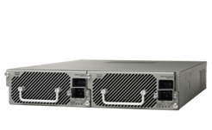
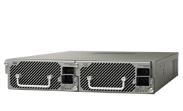
Cisco ASA – Remote Access Security Gateways
Solutions Ranging From The Branch To The Enterprise
ASA 5585 SSP-60 5 Gbps 10K users
ASA 5585 SSP-40 3 Gbps 10K users
Multi-Service (Firewall, VPN, and IPS)
ASA 5585 SSP-20 2 Gbps 10K users
Performance and Scalability
ASA 5585 SSP-10 1 Gbps 5K users
ASA 5555-X 700 Mbps 5k users
ASA 5545-X 400 Mbps 2.5K users
ASA 5525-X 300 Mbps 750 users
ASA 5515-X 250 Mbps 250 users
ASA 5512-X 200 Mbps 250 users
ASA 5505 100 Mbps 25 users
Firewall and VPN Appliance
SOHO
Branch Office
Internet Edge
Campus
Data Center

Slide 38
Additional Resources (Some materials are internal-only and not available to Partners)

Slide 39
Learn More
Cisco Secure Mobility & AnyConnect Technical Deep Dive Presentations (Internal)
Cisco Unified Communications and Collaboration Solutions Design Guide (External)
Cisco AnyConnect Secure Mobility Solution At-a-Glance (External)
Cisco AnyConnect Secure Mobility Client Administrator Guide, Release 3.0 (External)
iPhone User Guide for Cisco AnyConnect Secure Mobility Client, Release 2.5.x (External)
Release Notes for Cisco AnyConnect Secure Mobility Client, Release 3.0 (External)
Release Notes for Cisco AnyConnect Secure Mobility Client, Release 3.1 (External)
AnyConnect and ASA Configuration Required to Support Jabber (Internal IWE Post)

Slide 40
Learn More
Video
Cisco Jabber Anywhere Any Device (on Youtube)
AnyConnect Secure Mobility (on Youtube) (Introduction to Cisco AnyConnect Secure Mobility Solution)
Jabber AnyConnect VPN On-Demand User Experience (Show & Share)
Web/Wiki Sites
AnyConnect & Jabber FAQs (Internal)
ASApedia for iPhone, iPod, & iPad (Internal)
Deploying AnyConnect with Jabber (Internal)
AnyConnect Supporting Architecture Guide (Internal)
ASA VPN Solution RFI/RFP Boilerplate (Internal)
Cisco Secure Remote Access: VPN Licensing Overview (External)

Slide 41
Learn More
ASA CEC Page: (Slide decks) - http://wwwin.cisco.com/stg/products/appliances/asa/vpn-edition.shtml
AnyConnect Cisco.com Page: (data sheets, at-a-glance, product bulletins) - http://www.cisco.com/en/US/products/ps10884/index.html
AnyConnect FAQ Page (External): https://supportforums.cisco.com/docs/DOC-1361
ASA VPN Deployment Guide: http://www.cisco.com/en/US/docs/security/asa/asa80/asdm60/ssl_vpn_deployment_guide/deploy.pdf
AnyConnect VPN Administrator Guide: http://www.cisco.com/en/US/docs/security/vpn_client/anyconnect/anyconnect30/administration/guide/ac02asaconfig.html
AnyConnect Administration for iOS devices: http://www.cisco.com/en/US/docs/security/vpn_client/anyconnect/anyconnect25/administration/guide/ac09_admin_mobile.html
AnyConnect Troubleshooting: http://www.cisco.com/en/US/products/ps6120/products_tech_note09186a00809b4754.shtml
Cisco Live AnyConnect Secure Mobility Overview http://jwray-unix.cisco.com/VPN-Public/CL12Drafts/BRKSEC2050-Kiran-Sirupa-Secure-Mobility.ppt

