Slide 1
Ciscoworks LMS 4.0 A New Paradigm LMS Webinar Series #2
Notes:
An Invigorating Approach to Network Management

Slide 2
Some Webex Tips
All participants will be placed on mute to avoid any unwanted noise during the presentations
If you are experiencing any problems with VoIP Integration, please try dialing in using the WebEx Toll Free phone number sent in the invite
Use the Q and A window to ask questions
If you are having technical difficulties, audio or visual, please use the Q and A window and we will try and fix them
A short survey will be sent at the end of the presentation, please provide your feedback
The presentation will be recorded for future playback and so you can share it with your peers

Slide 3
Agenda
Introductions
What’s new in Ciscoworks LMS 4.0?
Ciscoworks LMS 4.0 Live Demo
Q & A
References

Slide 4
New Features at a Glance
Improved User Experience
Faster Installation
Actionable Global Search
Release Highlights
WorkCenter
Intuitive Getting Started Wizard
Revamped GUI
Modern Standardized Style
Pragmatic
Intuitive
MegaMenu
Consistent Navigation
Quick Access to all the tools
New Technology LifeCycle Mgmt
New Feature LifeCycle Mgmt
Fine Tuned for Operational needs
Parameterized Configuration Templates
Local Detailed RBAC
Basic 3rd Party Support
Functionally Designed MegaMenu for Operational Excellence
Auto Information Retrieval
Quick Access to all the tools
Auto-Monitoring
NAM Integration
Consolidated Event view
Dashboards
Enhanced Troubleshooting
Consolidated Reporting

Slide 5
Ciscoworks LMS 4.0 An Improved User Experience

Slide 6
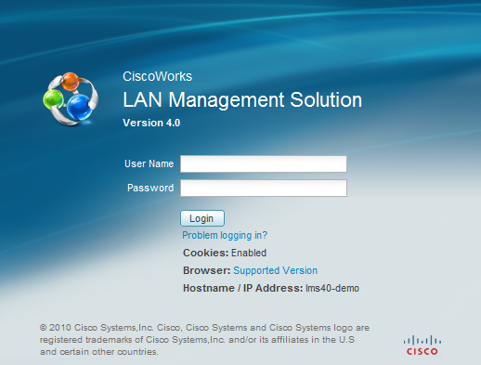
Cut install time in half from LMS 3.x
Single DVD installation
Installation down to 45 mins from 2 hours
Installation includes database as well as the application
New hardware options for Installation
Cisco UCS – B and C Series Chassis
Variety of OS supported for Installation
Windows 2003, 2008
Solaris 10
Virtualization
VMWare 4.x
Solaris Zones

Slide 7
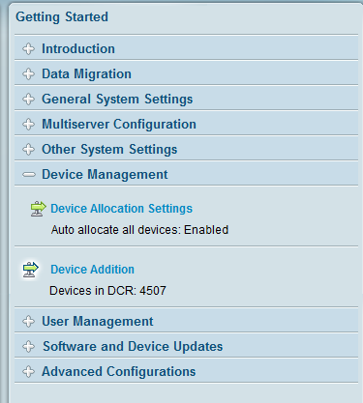
Intuitive Getting Started Wizard
Sure fire way to quickly manage your network
Quickly start using LMS 4.0 with the guided workflow
Takes out the guess work – Configure mandatory items first, and then learn about optional items
Triggers ALL the basic collections automatically

Slide 8
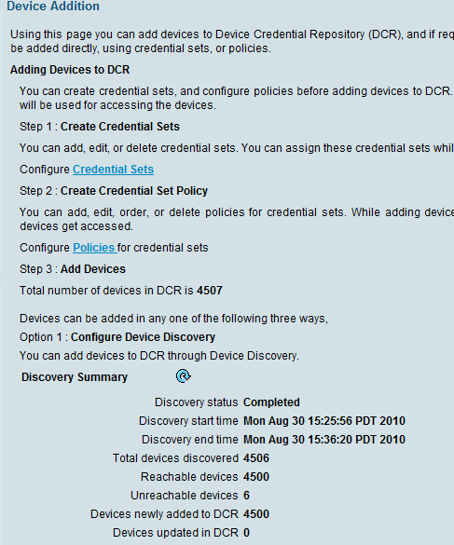
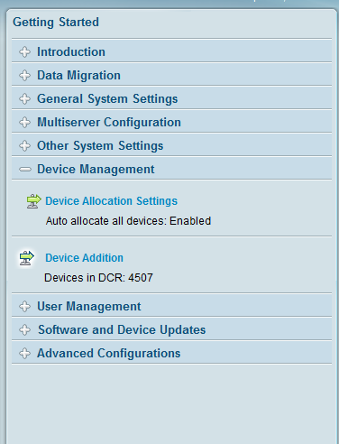
Getting Started Wizard
Eliminates initial application configuration pain points and confusion
See your network in matter of minutes
Allows users to utilize the product in its entirety
One place to make change even after initial configuration

Slide 9
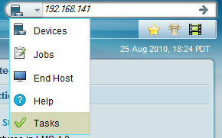
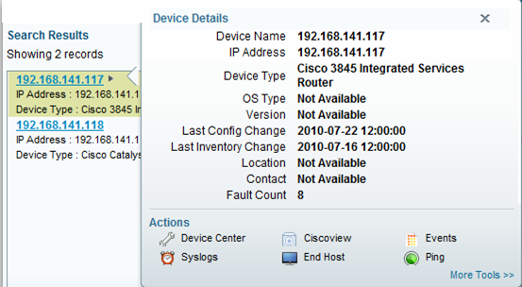
Actionable Global Search
Actionable Search
Global Search field available on all LMS pages
Ability to search on any IP or MAC Address
If you are stuck, help is just a few words away
Actionable Mouse-Overs for more contextual tools!!

Slide 10
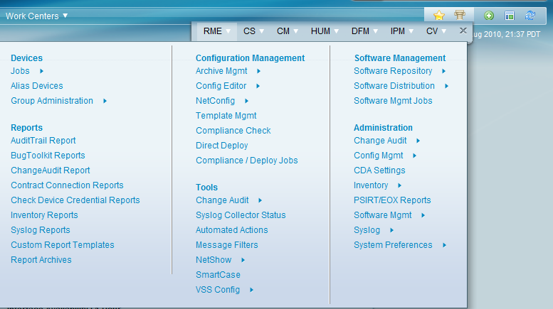
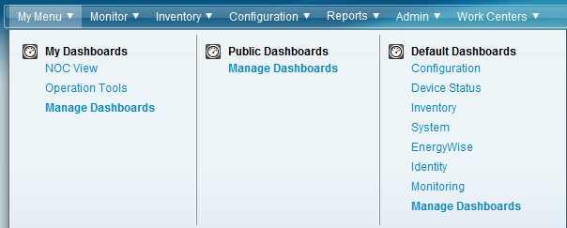
Enhanced User Interface
Consistent Global Menu
Legacy Navigation
MegaMenu

Slide 11
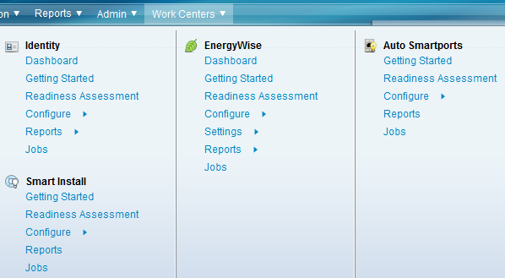
WorkCenter – Simplified Lifecycle Mgmt
Life-Cycle Management
Technology
Energywise
Identity
Feature
Smart Install
Auto Smart Ports

Slide 12
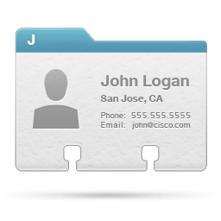
WorkCenters – Consistent LifeCycle
Workcenters
EnergyWise enables you to measure, manage, and reduce the power consumption of network infrastructure and network-attached devices to increase cost savings
Energywise provides a set of management functionalities to simplify and automate the energy management lifecycle
Provision Identity-based Networking Services (IBNS)
IBNS - offers authentication, access control, and user policies to secure network resources and connectivity
Identity
Energywise
Smart Install – plug-and-play configuration and image management feature that provides zero-touch deployment for new switches.
Auto Smartports (ASP) macros dynamically configure ports based on the device type detected on the port.
SmartInstall
AutoSmartPort

Slide 13
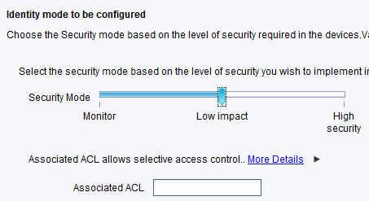
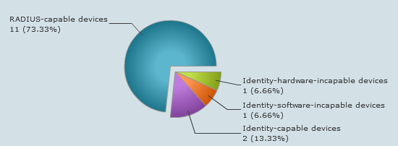
Consistent Life-Cycle Workflow Components
Learn this once and apply latest and upcoming Cisco Technologies and Features effortlessly

Slide 14
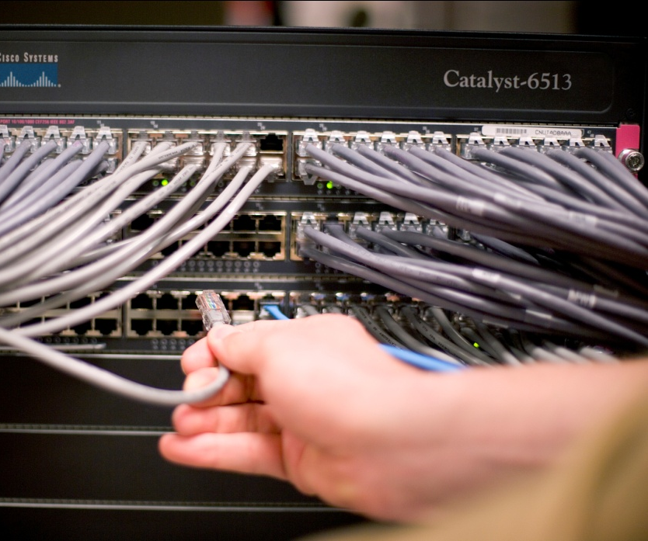
Configuration Templates Manager – Fine Tuned for Operational Needs

Slide 15
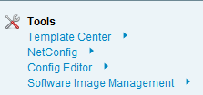
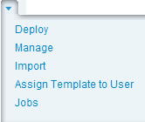
Configuration Templates
Benefits
Operationally Simple
Error Free
CVD Certified
Turnkey Solution
Available out-of-the-box
Eases new device deployment
Easy Workflow
Import
Manage
Deploy

Slide 16
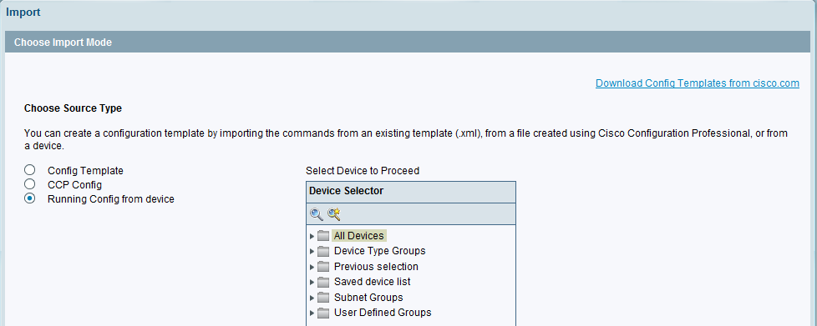
Config Templates – Import Workflow
1
2
From Existing LMS 4.0 Template
3 Ways of importing device configuration
From Cisco Configuration Professional (CCP) Utility
3
Download more templates directly from cisco.com as they are made available.
Raw Configurations from Cisco devices directly

Slide 17
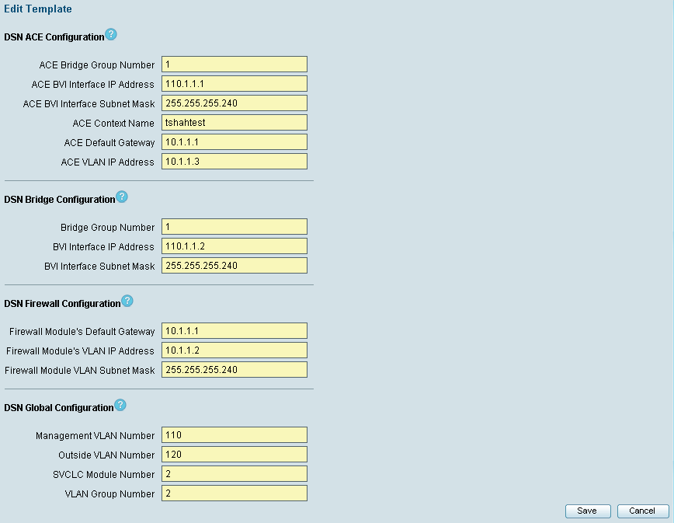
Config Templates – Manage Default Values
This template form is generated automatically.
Edit Defaults allows user to enter in all the default values for a given template.
This helps users to quickly select a template, make minor modifications, and push out the configurations to the cisco device.
Ability to save this with the configuration and ability to clone the configuration allows users to create quick template for each Data Centers or Branches or any such use case.
Assign users to a template for tighter control.

Slide 18
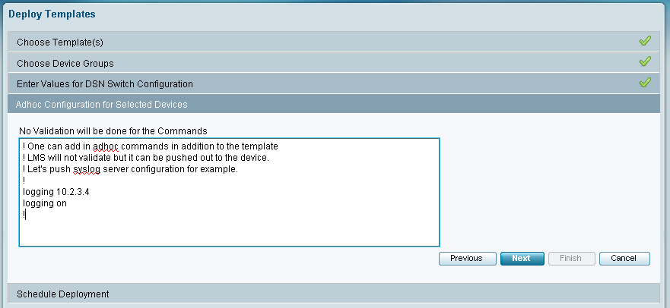
Configuration Template – Deploy Workflow
Add any other adhoc command that may have come up at the last minute.

Slide 19
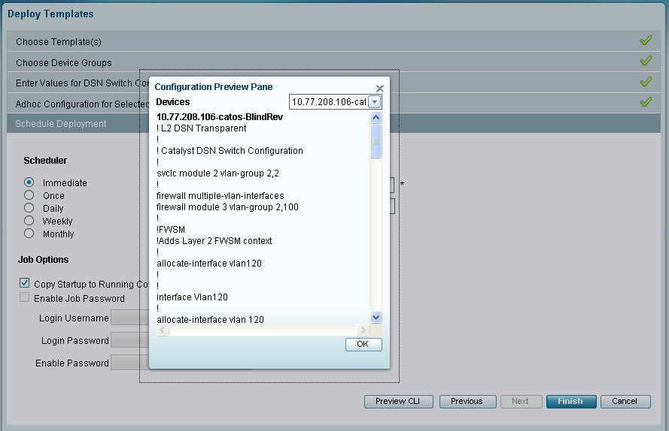
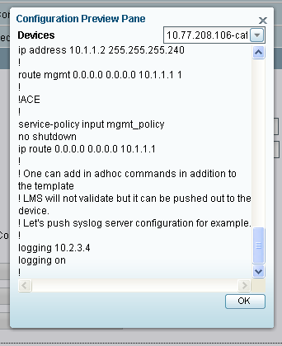
Configuration Template – Deploy Workflow
Preview the CLI before pushing out the configuration changes.
As you can see our adhoc command that were added shows up as well.

Slide 20
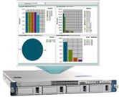
NAM Integration

Slide 21
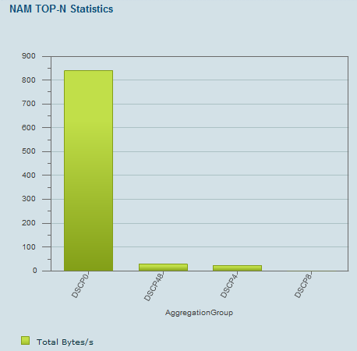
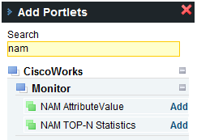
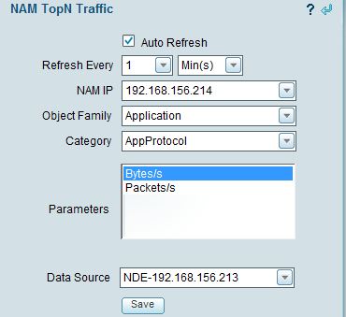
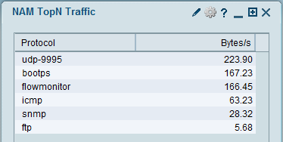
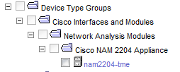
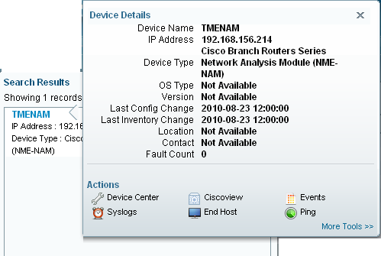
LMS Manages and Integrates with NAM
Add one of the 2 NAM Portlets
Select the data-source to see rich graphs instantly
LMS can manage basic NAMs functions
Monitoring for basic availability
Inventory Management
Config Management
Config Template Supported for NAMs
Reporting just like any other network device including PSIRT and EoL/EoS

Slide 22
AutoMonitoring

Slide 23
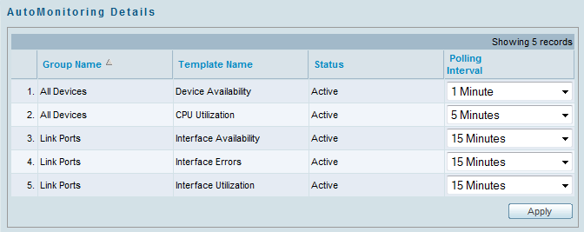
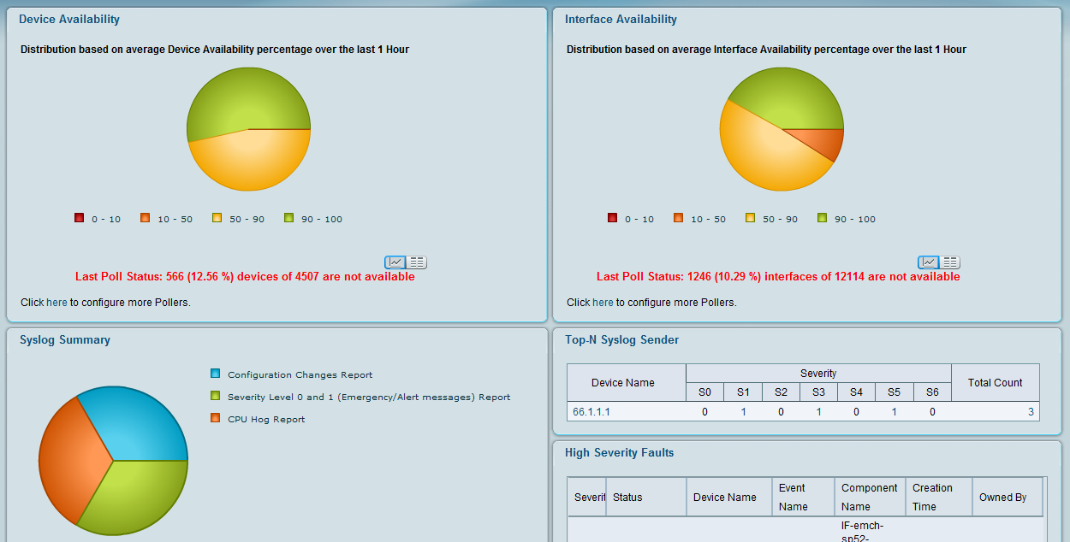
Basic Monitoring Out-Of-The-Box
AutoMonitor parameters pre-defined for best practices for every monitoring category
One place for making changes to existing pollers
Monitoring Dashboard automatically populated once the data is available
Web 2.0 portal for portal customization

Slide 24
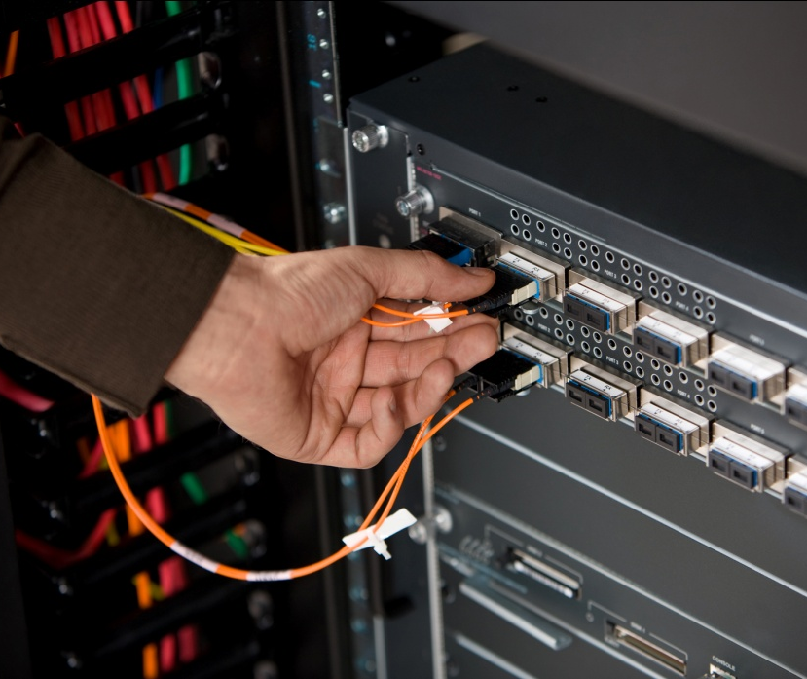
Troubleshooting

Slide 25
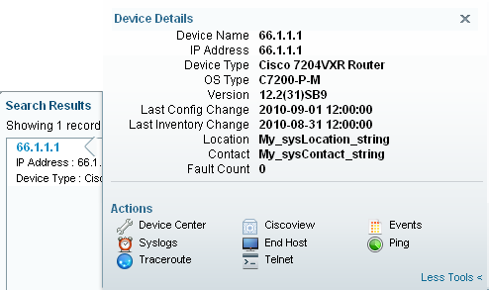
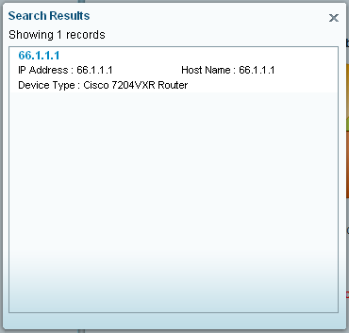
Troubleshooting Tools at your Finger-tips
Get Quick Synopsis of your device:
Last Polled Inventory / Configuration
Type of Device
OS Type/Version
Location/Contact
Basic Tools – 1-Click away
Ping/TraceRoute
Telnet
Syslog/Events
1-Stop /Shop for T’Shooting

Slide 26
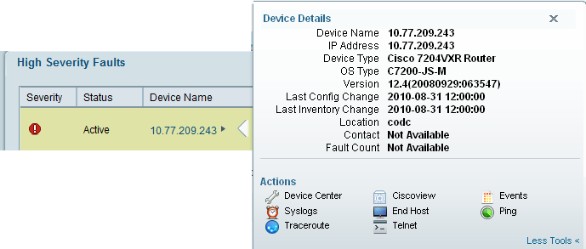
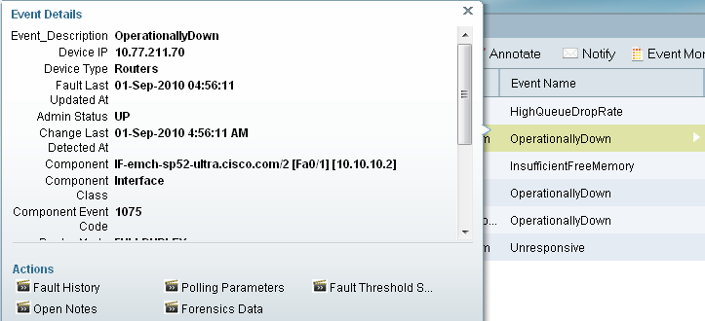
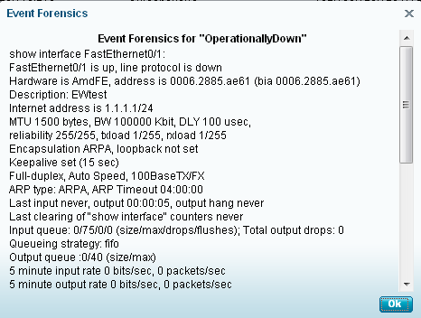
Troubleshooting – Contextual Mouseovers
Instantly see the device information and start troubleshooting

Slide 27
Reporting

Slide 28
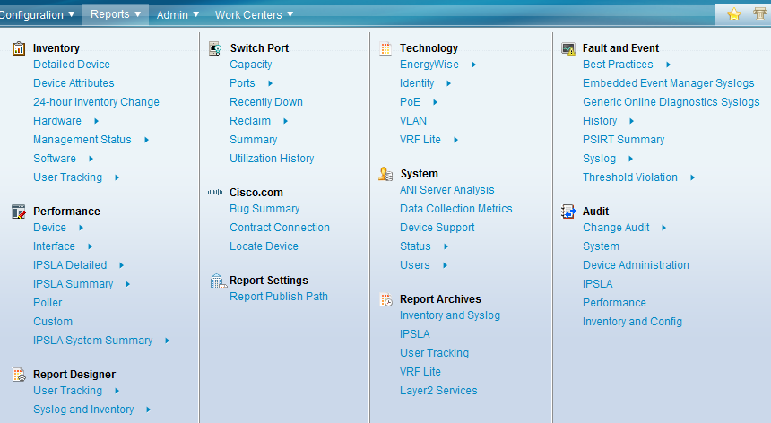
Reporting – ONE place ! ALL reports !!
Easy to find
Neatly Organized

Slide 29
3rd party support

Slide 30
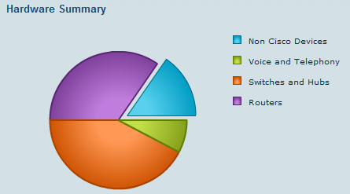
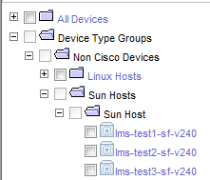
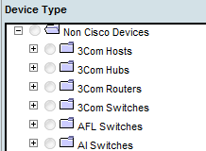
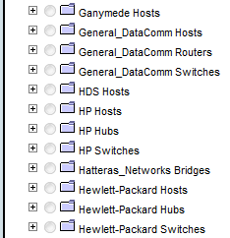
Basic Support for Non-Cisco Devices
& MORE
Notes:
Device Avail. is supported for 3rd party devices.

Slide 31
Summary and Key Takeaways
CiscoWorks LMS provides an end-to-end suite of functionality for managing Borderless Networks end-to-end that improves network availability while lowering Operational Expenditures
LMS 4.0 is a significant new release that introduces major improvements in usability simplifying the deployment and day-to-day management of Cisco platforms and technologies
Intuitive user experience via functional partitioning aligned with the way operators do their job
Out-of-the-box monitoring, troubleshooting and configuration templates provides immediate value
WorkCenters simplify the deployment and management of Cisco technologies

Slide 32
Cisco Advanced Services
Cisco Advanced Services provides complete architecture, design, deployment and optimization services to efficiently deploy LMS 4.0 to meet your needs and quickly get you up and running
Network Management Architecture Review & Roadmap assures necessary tools in place to operate Cisco technologies
Design Services prescribe how LMS 4.0 can be deployed to meet your organization and business requirements
Build Services efficiently deploy LMS 4.0 so you’re up and running quickly
Optimization Services provide ongoing recommendations and support in maintaining your LMS 4.0 investment
Notes:
Text here
Section: Program intro
Timing: class start time
Overview: Initial page
FACILITATOR:
PRODUCER :
32

Slide 33
D E M O

Slide 34
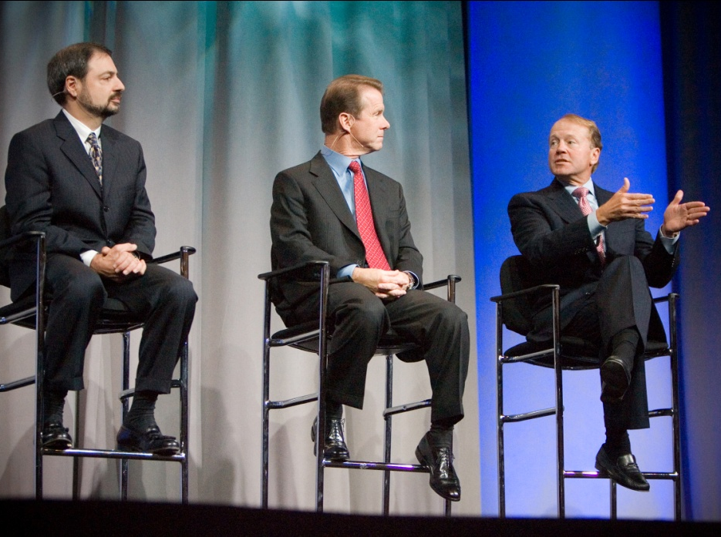
Q & A

Slide 35
For More Information
External Links: LMS Portal: http://www.cisco.com/go/lms LMS Evaluation: http://www.cisco.com/go/nmsevals YouTube link: http://www.youtube.com/ciscoworkslms More Webinars: http://www.cisco.com/web/learning/le31/le46/nmtg_training/LMS_4.0_Webinar_Series_External_Schedule.htm Advance Services: http://www.cisco.com/en/US/products/ps6897/serv_group_home.html
Resources: To enroll in the CiscoWorks Customer Intimacy program send an email to: ask-lms-team@cisco.com
Notes:
35
Closing 1: Thank you for participating in this How to Sell ________ as a Key Part of Borderless Networks session.
The recordings of these sessions will be made available from the <insert library/warehouse location for recordings here> for you to reference as you need.
As I mentioned at the start of the program, please complete the program assessment that follows to receive your Partner Rewards Program points. Your participation will help us identify improvements to be incorporated into future programs.
Closing 2: Thank you for participating in this How to Sell ________ as a Key Part of Borderless Networks session.
The recordings of these sessions will be made available from the <insert library/warehouse location for recordings here> for you to reference as you need.
As I mentioned at the start of the program, please complete the program assessment that follows this module. Your participation will help us identify improvements to be incorporated into future programs.
Section: Program intro
Timing: class start time
Overview: Initial page
FACILITATOR:
PRODUCER :

