Slide 1

For Cisco IronPort Customers
Using the TAC Service Request Tool to Create a Service Request
Notes:
1
Line 1

Slide 2
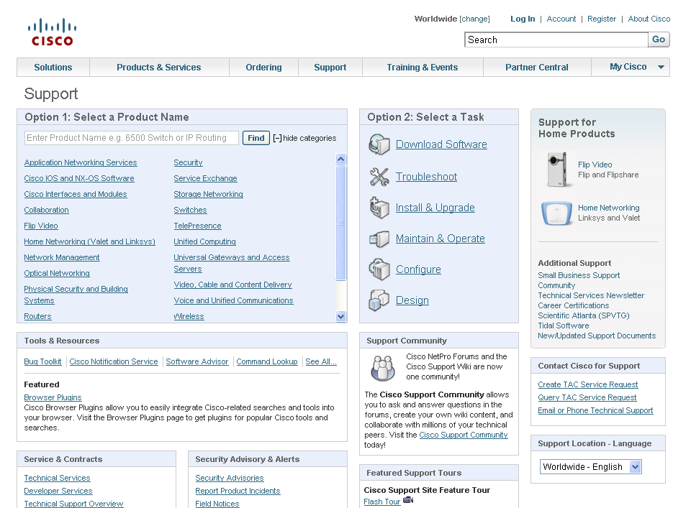

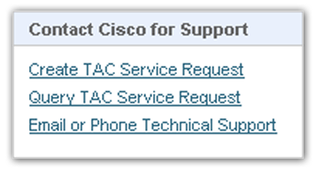
Overview: Creating a Service Request via Cisco.com
To create and submit a Service Request go to Cisco.com and choose “Support”
Choose “Create TAC Service Request “
Notes:
2
Line 2

Slide 3
Overview: Creating a Service Request via Cisco Iron Port Support page
You can also create a Service Request via Cisco IronPort Customer Support page
Get more help, if needed
Choose “Open a Service Request “
Notes:
3
Line 2

Slide 4
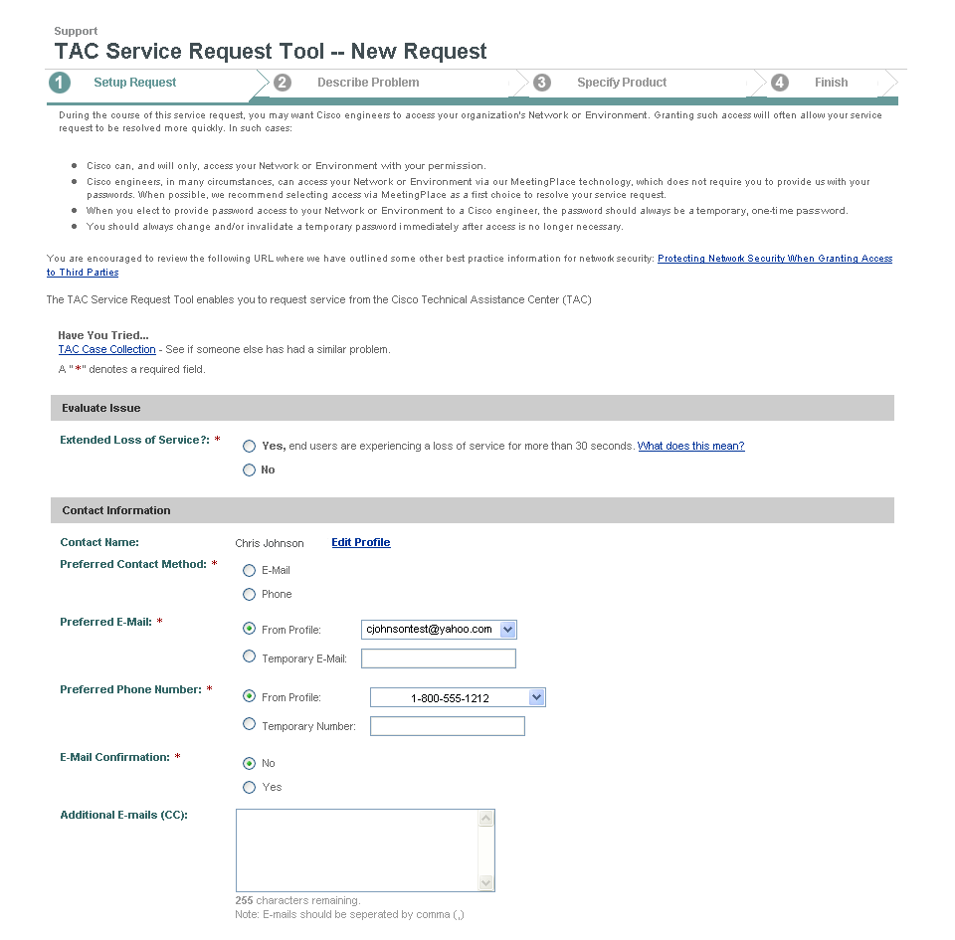
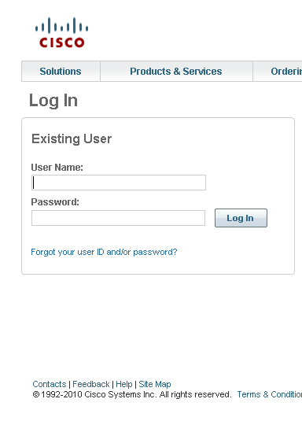
Overview
You’ll be asked to Log In, then directed to the TAC Service Request Tool (TSRT)
Notes:
Line 11

Slide 5
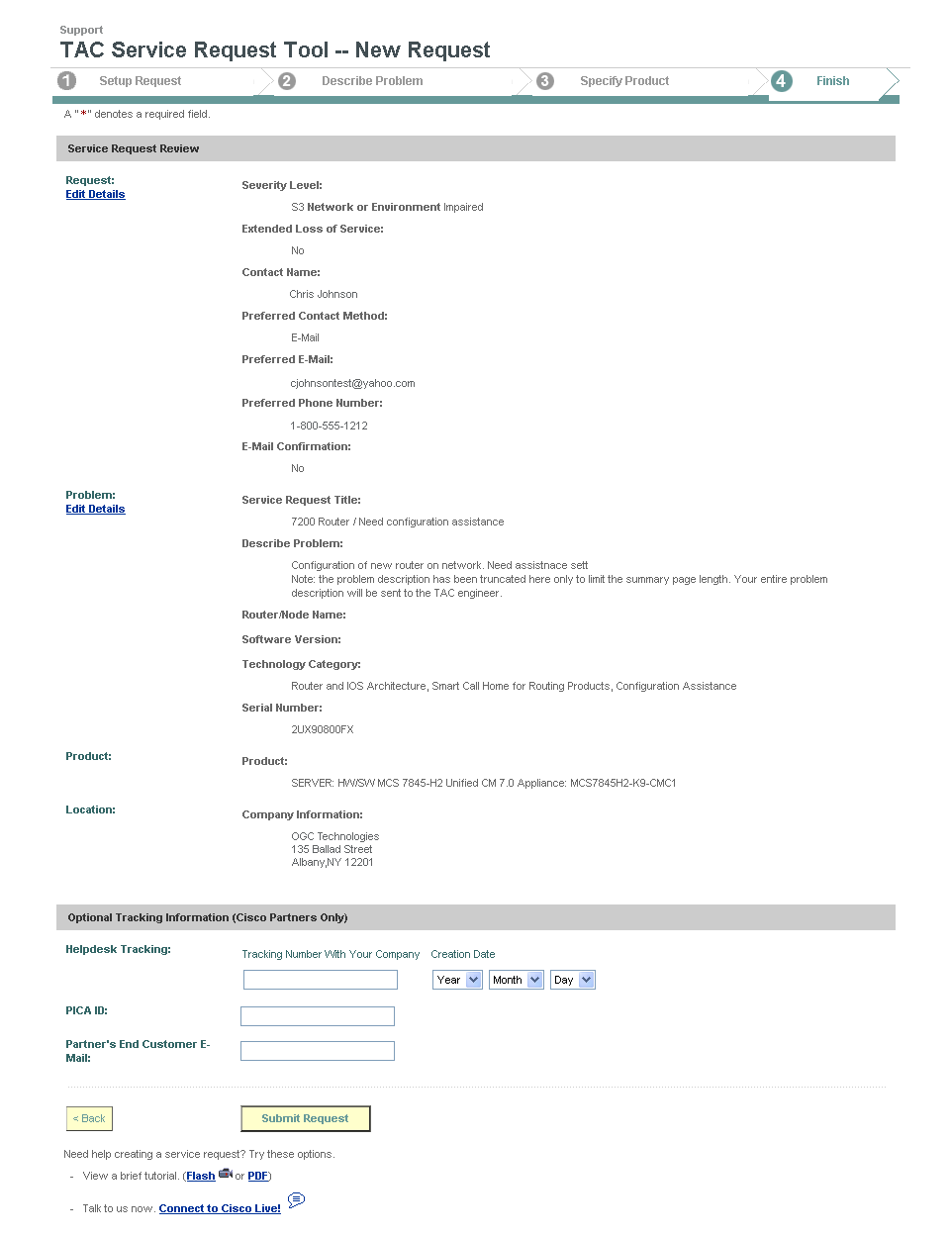

Overview – Before You Begin
Remember
You must have the relevant service contract associated with your profile to create a service request.
Notes:
5
Lines 7 and 8

Slide 6
Overview
The TAC Service Request Tool involves four steps.
Notes:
Line 12

Slide 7
Step 1 – Setup Request
Read about how the service request will be handled.
Notes:
Lines 13 and 14

Slide 8
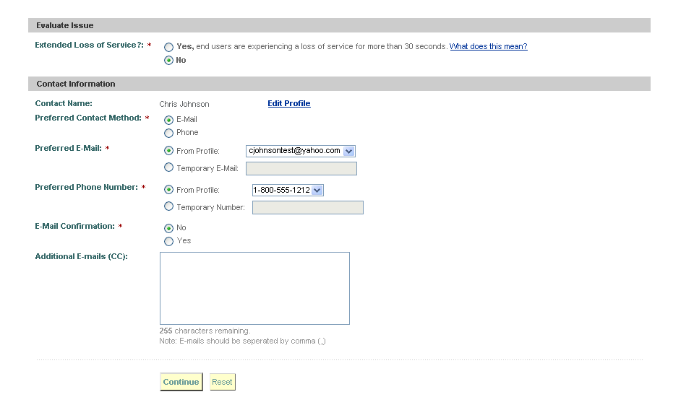
Step 1 – Setup Request
Evaluate the impact of your issue.
Provide your contact information.

Slide 9
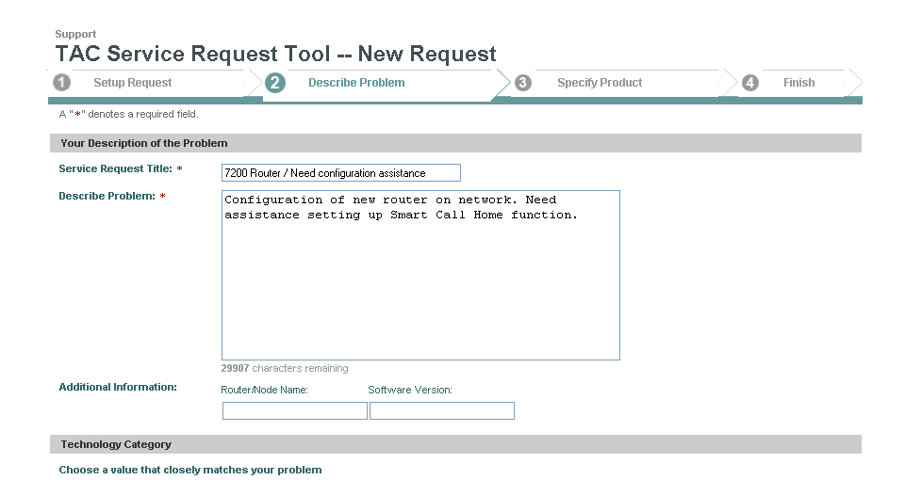

Step 2 – Describe Problem
Enter a title description.
Describe the problem.
Notes:
Line 16

Slide 10
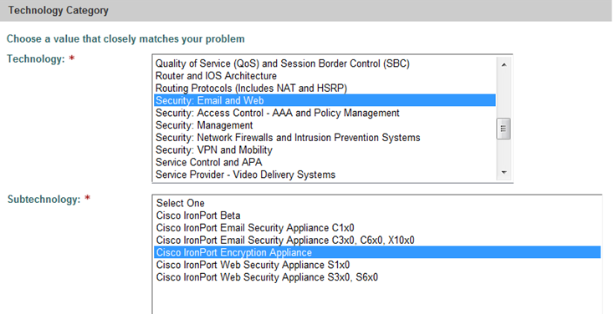
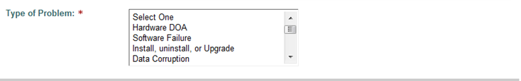
Step 2 – Describe Problem
Select the relevant technology group by choosing either “Security: Email and Web”
or
“Security: Management
Select a Subtechnology group
Select a problem type.
Notes:
Line 17

Slide 11
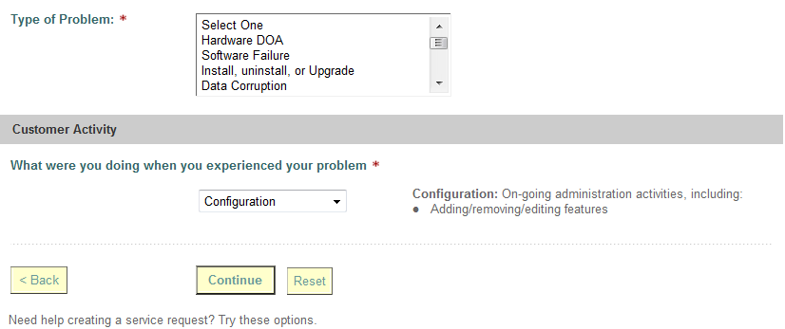
Step 2 – Describe Problem
Use the pull-down menu to select what you were doing when you experienced your problem
Notes:
Line 17

Slide 12
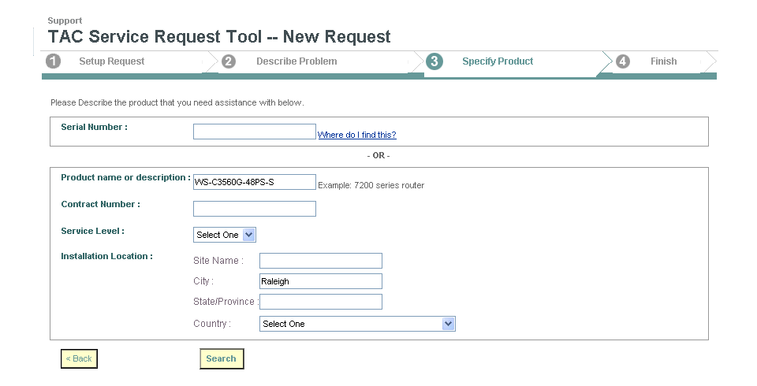
Step 3 – Specify Product: Search for Contract Number
You will not be able to search for your contract using a Serial Number
DO NOT enter a Serial Number (you’ll get an error message)
Search for your contract only in this area.
Search for your contract using any combination of contract number, service level, and/or company name information.
Notes:
Line 23

Slide 13
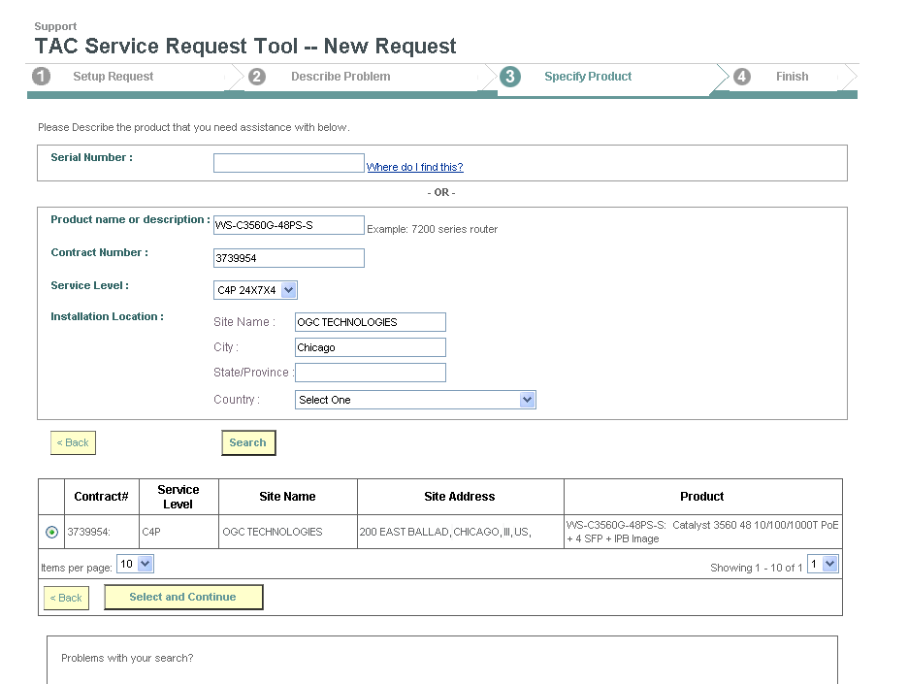
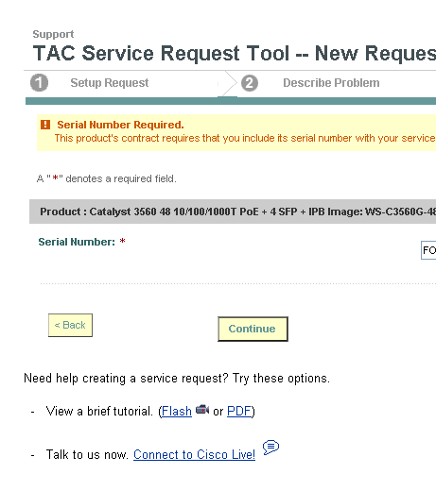
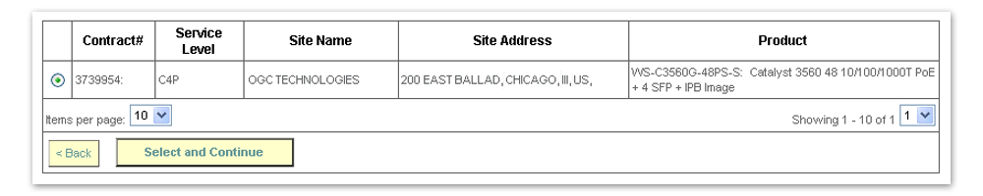

Step 3 – Specify Product
When the search results appear, select a contract.
Notes:
Line 25

Slide 14
Step 4 – Finish
Review your request details, make edits
(if needed), and submit your request.
Notes:
Lines 26 and 27

Slide 15
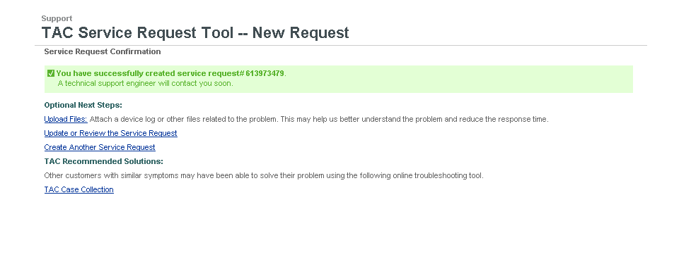

Step 4 – Finish
Receive a confirmation with tracking number, and explore optional next steps.
Notes:
Lines 28 and 29

Slide 16
Step 4 – Finish
Receive a confirmation with tracking number, and explore optional next steps.
Notes:
Lines 28 and 29

Slide 17
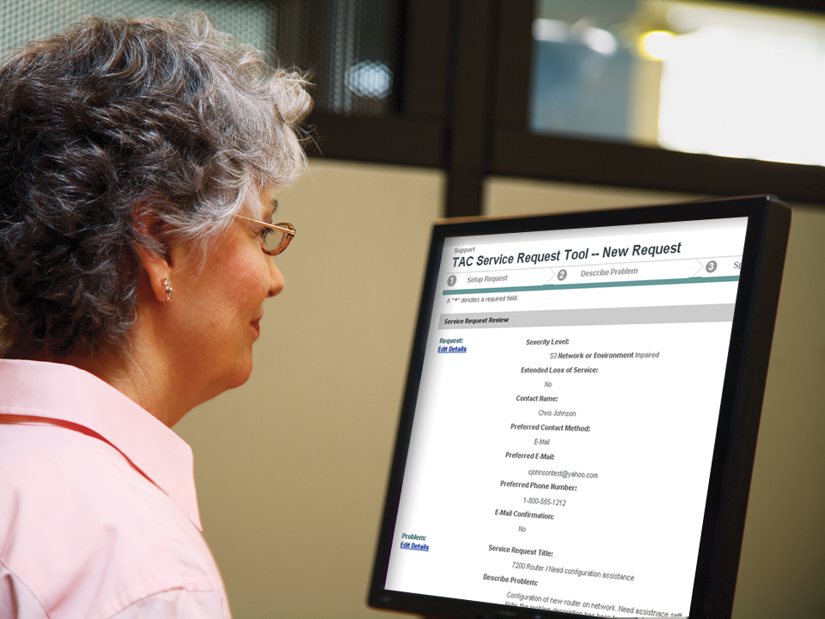
Refer to this presentation whenever you need to create a service request.
Notes:
Line 31
Line 31
Line 31
Line 30

Slide 18

© 2010 Cisco and/or its affiliates. All rights reserved.

