Slide 1
Innovation in Accessibility with Cisco Unified Communications Solution
For more information, contact: accessibility@cisco.com

Slide 2
Cisco’s Commitment to Accessibility
Cisco's vision is to improve the way all people work, live, play, and learn
Cisco is making key areas more accessible to people with disabilities:
- Products
- Websites
- Documentation
Cisco is committed to creating products that meet legal requirements for Cisco and Cisco customers
It's the right thing to do!
“IP enabled technology has the greatest potential to eliminate the barriers in the way that all people live, work, learn and play.”
John Chambers CEO, Cisco Systems
Notes:
Cisco is committed to providing accessible products and solutions, improving the way all people – including those with disabilities – work, live, play and learn.
Cisco has a team of accessibility specialists who are working to make products, Websites and documentation accessible. This team teaches and encourages Cisco employees to design accessible products:
This includes creating design standards, updating product development processes, and providing training to all levels within the organization.
Cisco is committed to creating products that meet legal requirements for Cisco and Cisco customers
Importantly, Cisco recognizes that making accessible products is THE RIGHT THING TO DO

Slide 3
Cisco IP Phone Compliance to U.S. Accessibility Laws
Accessibility Regulations | Cisco IP Phones
Section 508 of the Rehabilitation Act * | Conform
Americans with Disabilities Act (ADA) | Conform
Section 255 of the Telecommunications Act | Comply
Available Cisco Product VPATs can be download via the following URL: http://www.cisco.com/web/about/responsibility/accessibility/legal_regulatory/vpats.html
Accessibility Features of 7900 Series IP Phone http://www.cisco.com/en/US/docs/voice_ip_comm/cuipph/all_models/accessibility/english/user/guide/access_70.html
Notes:
Again, Cisco is committed to creating products that meet legal requirements for Cisco and Cisco customers. These are the 3 core US laws: Section 508, the Americans with Disabilities Act, and Section 255 of the Telecommunications Act.
Section 508 of the Rehabilitation Act
Cisco conforms with accessibility laws and supplies end-user devices that conform and support the U.S. Board's standards as referenced in Section 508.
Section 255 of the Telecommunications Act
Cisco employs common accessibility features in its user devices, documents, and services, and has tested and achieved compatibility with third-party assistive devices. Its networks are compatible with common analog devices from the network core to the individual user.
Americans with Disabilities Act
Cisco complies with the ADA by enabling accessibility and accommodation in public areas and its customers' workplaces, and by implementing reasonable accommodation in its own workplace.
VPATS are available on our Website. If you don’t see a VPAT that you need, please let me know (account manager).
Additional Background Info:
Q. What is a Voluntary Product Accessibility Template (VPAT)? A. The Information Technology Industry (ITI) Council partnered with the U.S. General Services Administration (GSA) to create a tool to help federal contracting and procurement officials fulfill the new market research requirements contained in the Section 508 implementing regulations. The result was the Voluntary Product Accessibility Template, or VPAT, which contains a list of requirements needed for a product to conform to Section 508.
Q. How do I find a VPAT for a Cisco product? A. Cisco product VPATs are listed on the Cisco VPAT Webpage. If you are searching for a product VPAT that is not listed, contact your Cisco account manager or send an e-mail message to accessibility@cisco.com.

Slide 4
Solutions for Individuals with Disabilities
Hearing Impaired / Hard of Hearing (HoH)
Deaf
Low Vision Impaired
Blind
Mobility Impaired
Notes:
Cisco is committed to providing accessible products and solutions, improving the way all people – including those with disabilities – work, live, play and learn.
Cisco has a team of accessibility specialists who are working to make products, Websites and documentation accessible. This team teaches and encourages Cisco employees to design accessible products:
This includes creating design standards, updating product development processes, and providing training to all levels within the organization.
Cisco is committed to creating products that meet legal requirements for Cisco and Cisco customers
Importantly, Cisco recognizes that making accessible products is THE RIGHT THING TO DO

Slide 5
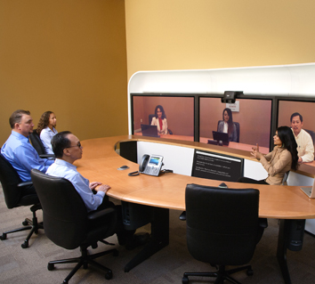
Solutions for the Hearing Impaired and Deaf

Slide 6
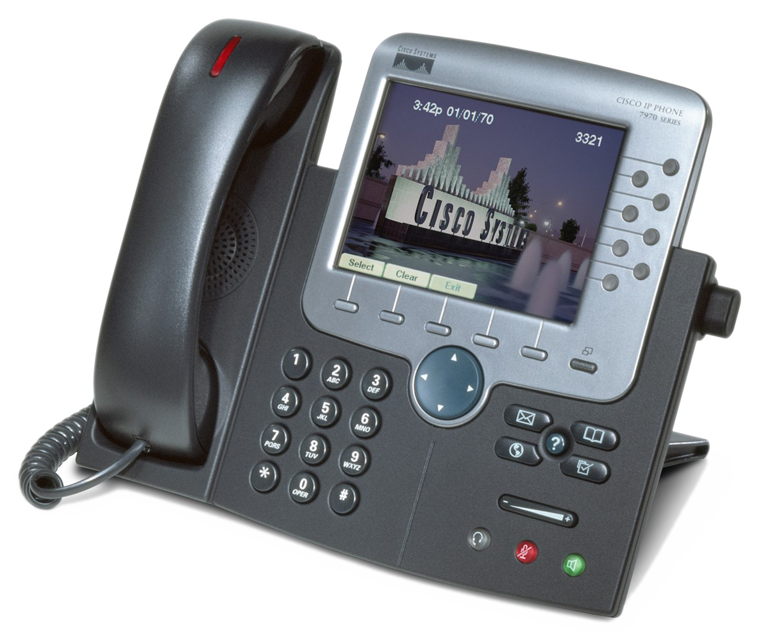
Cisco Unified IP Phone: Accessibility Features for the Hearing Impaired
Ring and message waiting indicator viewable 360 degrees and provide audible message waiting indicator
Integrates third-party accessibility applications using XML
Acoustic coupled TTY
Support
Hearing aid compatible
(HAC) handset
Programmable ring tone, pitch, and volume
Support for inline
amplifiers
Adjustable call volume
with automatic reset
Headset with inline amplifier
Visual notification of phone state
Notes:
This is a great summary of the accessibility features of the Cisco Unified IP Phone for the Hearing Impaired. You can also view this on our Website: http://www.cisco.com/en/US/about/responsibility/accessibility/products/ip_phone_hearing_impaired.html

Slide 7
Support for the Hard of Hearing
All Cisco Unified IP Phones are hearing aid compatible
Cisco Unified IP Phone handset supports magnetic coupling of hearing aid and is hearing-aid compatible
Support for 3rd party amplifier for increased volume range
Example: Walker Clarity CE-100 or W10/W10BP Inline Amplifier
Notes:
All Cisco Unified IP Phones are hearing aid compatible (HAC)
Our phones are FCC part 68 compliant, which includes hearing aid compatible (HAC) compliant.
The phone allows hearing aid to magnetically couple with the receiver on the handset to ensure proper reception of call.
The Cisco Unified IP Phone also works with 3rd party amplifiers for increased volume range (sometimes people don’t think they need – or don’t want – a hearing aid. They prefer to increase the volume)
The Walker Inline Handset Amplifier W10 is an "inline" model that goes works with our existing 79xx handset. It can either be battery powered, or use an AC power wall adapter:
The Walker Clarity CE-100 has been discontinued, and has been replaced by the CE-125. Both models only work via battery power, and are also "inline" amplifier that work with the existing 79xx phone handset.

Slide 8
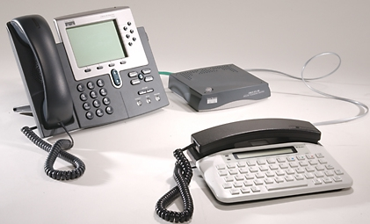
TTY Works Over VoIP
Support both acoustic or direct connect TTY’s from industry leading manufactures (Ultratec / Ameriphone)
Works with Cisco Emergency Responder for E911 services
Enables real-time text transmission over the phone lines
Works with hearing and voice carry over phones (HCO/VCO)
Recommend the VoIP network operate at G.711
Acoustic Coupled
Direct Connect
Notes:
TTY Works over VoIP. Some of our competitors make inaccurate claims that TTY does not work over VoIP – that is simply untrue. You will find a white paper entitled “"TTY & TDD over VoIP: Dispelling the Packet Loss Myth" on our Website. http://www.cisco.com/wwl/regaffairs/images/pdf/Dispelling_the_Packet_Loss_Myth.pdf
Cisco Unified IP Phones support both acoustic coupling and direct connect
___________________________________________________________________
BACKGROUND INFORMATION
Q. Do TTY/TDD work over an IP telephony/voice over IP (VoIP) network? A. Yes. While poorly designed IP networks with packet loss can degrade TTY/TDD performance, Cisco's IP telephony networks provide reliable and robust support for TTY/TDD services when designed with quality of service (QoS), or prioritization, features.
For more information about IP packet loss, see Cisco's white paper entitled "TTY & TDD over VoIP: Dispelling the Packet Loss Myth" (PDF - 42 KB)
http://www.cisco.com/wwl/regaffairs/images/pdf/Dispelling_the_Packet_Loss_Myth.pdf
Q. How do TTY/TDD devices connect to a VoIP network? A. There are two types of connections for TTY/TDD devices: direct connection and acoustic coupling. The preferred method is a direct connection, where a TTY with an RJ-11 analog line option is plugged directly into a Cisco foreign exchange station (FXS) port. A TTY/TDD device can also connect by acoustic coupling, where the phone handset is placed onto a coupling device on the TTY/TDD.
Background information on TTY:
Telephone for the Deaf is called a TTY or TDD
Provides a tool for people who cannot communicate via speech or hearing on the phone
Is a “Real-time” text communication tool
Required to support access to relay operators
Many different types
Acoustically coupled, direct connect, or PC based applications

Slide 9
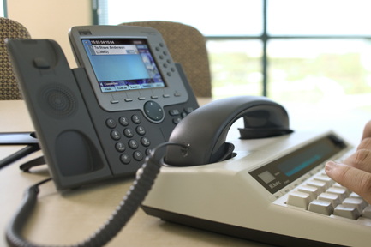
TTY Cisco Unity and Unity Connection TTY Prompt Set for Increased Accessibility
Provides TTY/TDD prompts set for voice mail services
Configurable by selecting a TTY/TDD language on mailbox by mailbox option
Allows TTY users to access voice messages through their e-mail or TTY device
Converts TTY into text and text into TTY Tones
Allows non-TTY users to communicate with TTY users
Allows people without TTY devices to obtain TTY messages
Fast retrieval of messages for TTY users via UM (no dialing into system using 45 baud)
Notes:
Cisco Unity can be configured to work with TTY/TDD machines
Cisco Unity can deliver TTY prompt sets for TTY users. This is similar to what voice users would hear, but transmitted to a TTY device. It allows TTY users to send and receive voice messages to and from anyone in the enterprise.
To help non-TTY users, Unity has tools that plug into MS Outlook that convert the TTY tones into plain text and vice versa. This allows a TTY user to communicate with everyone in the enterprise, even if they don’t have a TTY machine at their desk.
By pulling TTY messages through a unified messaging system, you are decoding over a LAN environment that will take a fraction of a second vs. pulling data through TTY devices at 45 baud.

Slide 10
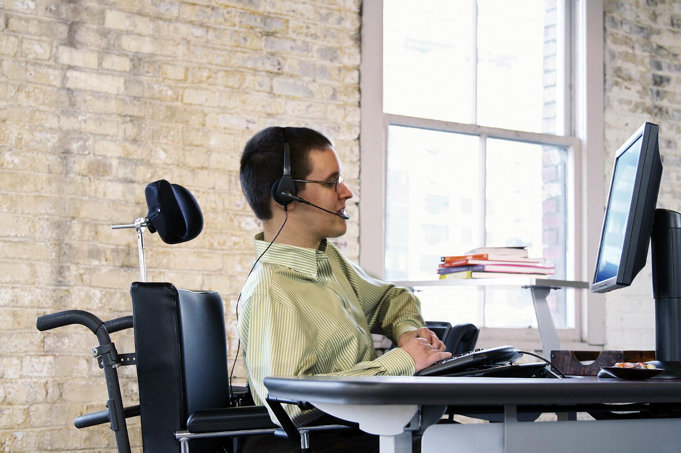
Cisco’s IVR and Auto Attendant
Cisco IVR Systems
Can record TTY prompts for IVR systems playback
Unity and Unity Connection Auto Attendant
Has TTY and voice versions
Notes:
Cisco IVR can be configured to support plain TTY prompts.
Cisco has tools* that will allow you to generate TTY prompts that can be loaded into the Cisco IVR System
These prompts are native to Cisco Unity Auto Attendant
*tools are part of TTY Angel, found on Unity Tools Website.
Technical Notes:
Unity Auto Attendant:
Requires DTMF tones to navigate with TTY
Configurations: two phone numbers are required – one for TTY and one for voice.

Slide 11
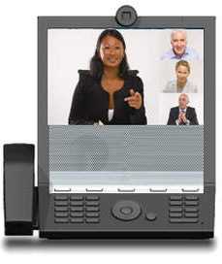
Cisco Video Relay Service Solution (U.S. only)
Diversity and Innovation in the Workplace
Delivery of Video services that can benefit people who rely on non verbal communciations (sign language)
Cisco E20, SIP
Cisco Unified Communications Manager 8.x better
Cisco Unified Border Element, IOS 12.4 or better
VRS – Purple Communications
business@purple.us
www.purple.us/corporations
Notes:
352.staging.purple.us/uploads/docs/PurpleVRS_forE20.pdf

Slide 12
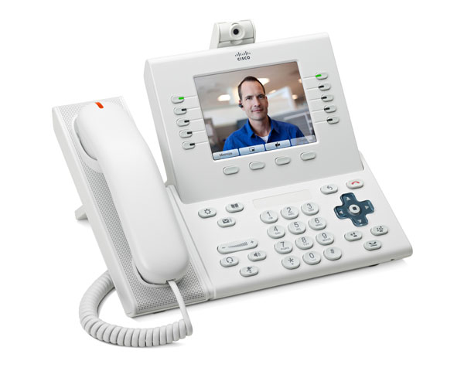
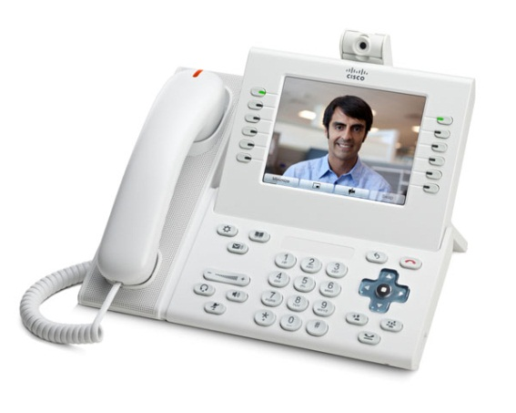
Cisco Unified 9951 and 9971 IP Phones Video Capabilities
Advanced video IP phones allow individuals to communicate (Sign Language, Lip Reading…) through video conferencing
Ad Hoc and MeetMe Video Conferencing requires router DSPs or an MCU (Audio conferencing supported natively)
Standard H.264 video codec support for interoperability with most new videoconferencing systems
W360p video quality
9971: Backlit 5.6” Touchscreen Display, 9951: Backlit 5-inch diagonal display
VRS/VRI Solution with Purple Communications (CUCM & CUBE)

Slide 13
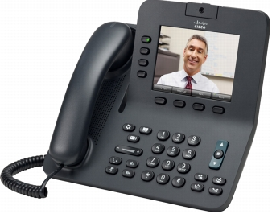
Cisco Unified 8945 and 8941 IP Phones Video Capabilities
Affordable, business-grade, video IP phones allow individuals to communicate (Sign Language, Lip Reading…) through video conferencing
Ad Hoc and MeetMe Video Conferencing requires router DSPs or an MCU (Audio conferencing supported natively)
Standard H.264 video codec support for interoperability with most new videoconferencing systems
W360p video quality
Backlit 5-inch diagonal display
VRS/VRI Solution with Purple Communications (CUCM & CUBE)

Slide 14
Cisco Unified EX60 and EX90 Personal Video Conferencing
Vivid, lifelike 1080p30 video, natural collaboration, and the simplicity of a touch screen interface
Standard H.261, H.263, H.263+ and H.264 video codec support for interoperability with most videoconferencing systems
1080p30 and 720p60 video quality (and subsets)
EX90: 24-in. LCD monitor, EX60: 21.5-in. LCD monitor
Use as PC monitor as well
Not compatible with VRS or VRI
Notes:
http://www.cisco.com/en/US/prod/collateral/ps7060/ps11303/ps11308/ps11327/data_sheet_c78-627494.html

Slide 15
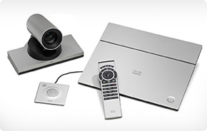
Cisco SX20 Quick Set Quick Set™ Conferencing
Easily turns any flat panel display into a flexible, powerful and sleek telepresence system with standards-compliant 1080p high definition video
Standard H.263, H.263+, and H.264 video codec support for interoperability with most videoconferencing systems
1080p60 video quality (and subsets)
Not compatible with VRS or VRI
Notes:
http://www.cisco.com/en/US/products/ps12153/index.html

Slide 16
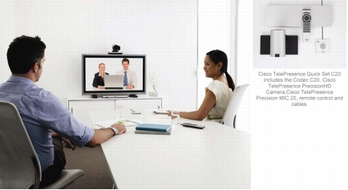
Cisco TelePresence Quick Set C20 Quick Set™ Conferencing
Easily transforms a flat panel display into a 1080p high-definition meeting space
Allows individuals to communicate (Sign Language, Lip Reading…) through Video Conferencing
Standard H.261, H.263, H.263+, and H.264 video codec support for interoperability with most videoconferencing systems
1080p30 video quality (and subsets)
Not compatible with VRS or VRI
Notes:
http://www.cisco.com/en/US/partner/prod/collateral/ps7060/ps11304/ps11333/data_sheet_c78-628621_ps11424_Products_Data_Sheet.html

Slide 17
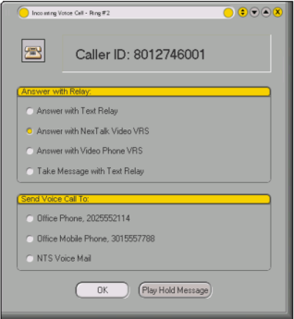
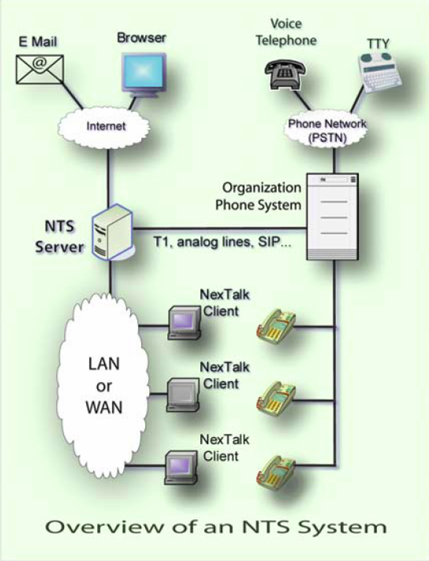
Partner Solution: NexTalk
NexTalk’s application extends non voice communications to every desktop
Ability to provide single number services to support Video Relay, Text Relay, TTY Traffic or even voice services
Seamless TTY coverage across the enterprise
Industry leading technology that can increase enterprise ability to communicate to hearing / speaking impaired community
Can integrate into IVR, Auto-Attendant, Call Center and Unified Messaging to provide seamless service to non voice users
For more information, visit http://www.nextalk.com

Slide 18
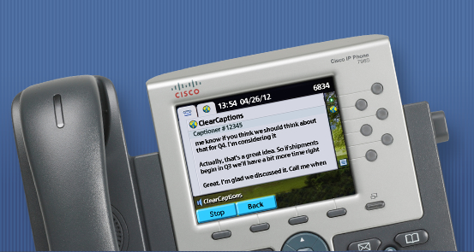
Partner Solution: ClearCaptions
http://www.clearcaptions.com/cisco/
Add free captions to your calls
JTAPI solution that enables Captioning to appear on the Cisco IP Phones (79xx, 89xx, 99xx)
ClearCaptions on your phone call is similar to closed captions on your TV; you can hear AND read what’s being said. This takes the frustration out of hearing on the phone. Instead of asking people to repeat themselves or guessing at what was said, you can read the person’s words which display during your call.
Notes:
Contact: "Frank Endres (ClearCaptions)" <frank.endres@clearcaptions.com>
Solutions for Hear of Hearing (HOH). Scenario: Individual can speak, but has trouble hearing. This HOH individual uses Clear Captions is a phone conversation where they HOH individual can speak to the other person on the phone ,but has a hard time deciphering the audio from the individual they are conversing with. Clear Captions provides text captions for the conversation coming back HOH individual. This phone conversation is actually a 3 way conference call where an translator from Purple is on the call transcribing the audio to text for the HOH hearing person. All phone conversations are private per FCC rulings. The Clear Captions operator and overall service is free for the call, as per the US FCC, Telecommunications Relay Service (TRS) (http://www.fcc.gov/guides/internet-protocol-ip-captioned-telephone-service).
This service is only available in the United States.

Slide 19
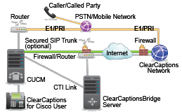
Partner Solution: ClearCaptions (cont.)
Notes:
Contact: "Frank Endres (ClearCaptions)" <frank.endres@clearcaptions.com>

Slide 20
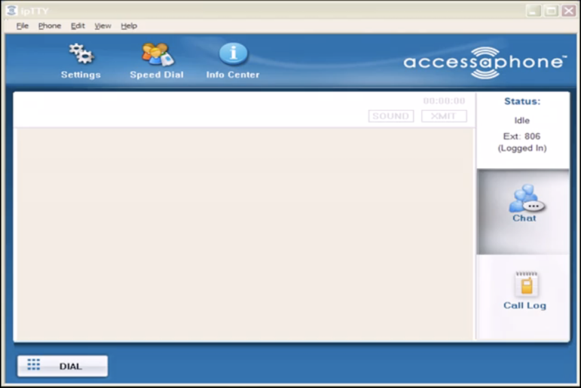
Partner Application Extends TTY Capabilities to Every Desk
accessaphone ipTTY – SIP, Windows app - Tenacity
Eliminates the need for physical TTY device
Provides seamless TTY coverage across enterprise
Soft phone SIP client supports incoming and outgoing TTY traffic from the desktop
No Analog Lines Required
Supports HCO / VCO
Multi-Lined Display
Saves Text Conversation
For more information, visit: http://www.accessaphone.com/index.php/ip-tty
Notes:
accessaphone™ ipTTY includes TTY compatibility, real time text and audio for individuals who are deaf/hard of hearing. accessaphone™ ipTTY helps businesses save money because end users are afforded the opportunity to communicate via TTY using the existing Cisco infrastructure without the need for additional analog lines, modems, or other equipment and barriers traditionally associated with TTY communications. The application communicates through IP and uses standard session initiation protocol (SIP) registered as a third-party SIP endpoint on Cisco Communications Manager. This soft client enables virtually every user on the telephony network to communicate with customer TTY machines, without the need for text relay service. Additionally ipTTY supports audio and real-time-text via RFC 4103; the future in real time text communication.
Partner Contact InformationSusan Chappell: 337.735.9532 or schappell@accessaphone.comDustin Armstrong: 337-735-9506 or darmstrong@accessaphone.com

Slide 21
Partner Application Hosted Solution: Video Relay Interpretation (VRI)
NexTalk® On-Demand (included in “NexTalk Healthcare Suite”) offers a cost-effective and timely solution: VRI (video remote interpreting) access to certified American Sign Language interpreters.
The NexTalk On-Demand VRI application is a state-of-the-art PC-based system that enables deaf and hard-of-hearing individuals to communicate effectively through high-quality, audio-video-text conferencing with a remote sign language interpreter.
NexTalk On-Demand is a cost-effective hosted solution that works within your current infrastructure – there’s no expensive hardware or extensive internal IT support required. End users simply need a desktop or laptop, a standard web camera and microphone, and an Internet connection. It provides the highest quality video and audio available in a VRI offering – even under difficult operating conditions. And this professional, easy-to-use-interface provides auto monitoring and correction capabilities, which frees deaf and hard-of-hearing users to focus on what matters most: effective communication.
For more information, visit: http://www.nextalk.com
Notes:
Partner Contact Information
Vaughn Peterson
NexTalk Inc. Office: 801-274-6001 Mobile: 801-368-5250 OneNbr: 888-825-0562
vaughn.peterson@nextalk.com

Slide 22
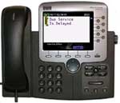
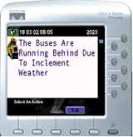
Partner Application Accessible Emergency Notification System
3rd party application works with Cisco Unified Communications Manager and Cisco IP phones
Provides paging and visual notification on the Cisco IP phone in case of emergency
Forces Cisco IP Phone to speaker mode for audible notification
Displays message on Cisco IP Phone screen for visual notification
For more information, visit: http://www.singlewire.com/
Notes:
Version 1.2.3 adds new features including:
Non-urgent, One-time Broadcasts - You can define an audio broadcast as non-urgent, which means that it will start after a delay, giving phones a chance to join the broadcast before it begins. It will send the audio exactly one time.
Improved Recipient Group Detection - InformaCast uses a newly available service for collecting phone information from the CallManager server in order to set up its recipient groups. This interface, available in CallManager 3.2(3) and expected in 3.3(3), is much more efficient than what was previously available, so InformaCast can collect large groups of phones far more quickly and reliably than with previous CallManager releases. It also reduces load on the CallManager. Note: This change means that InformaCast 1.2.3 will not work with earlier releases of CallManager.
More Flexibile Recipient Group Types - InformaCast allows you to define recipient groups based on network subnets, and using powerful regular expressions that provide complete flexibility for advanced configuration.
Preview Recipient Group Members - When defining or editing a recipient group, a new View button lets you examine exactly which phones are included in the group.
Better Support for Redundant CallManager Servers - The CallManager failover support introduced with InformaCast 1.2 has been extended to include the recording of new broadcast audio, as well as the previous broadcast-only failover.
Self-Service Password Change - Users can now change their own passwords.
http://phone-xml.berbee.com/InformaCast_Main.html
http://phone-xml.berbee.com/iptel/doc/InformaCast1.pdf
Minimum Load - CallManager 3.2(2)
Runs on a separate XP server
http://www.singlewire.com/news/2009/07/16/informacast-7-new-release-feature-highlights/

Slide 23
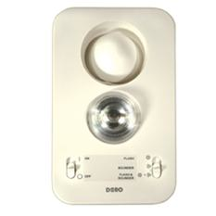
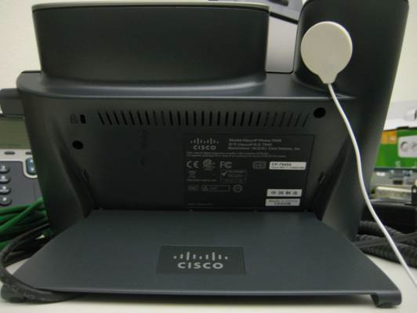
Part Visual Notification Solution Ring Flasher
Extend the visual notification of an incoming call.
This device is a visual (strobe light) and audible (sound alarm) solution controlled by a sound sensor attached to the back of the phone and is activated by the ringing of the telephone.
Most of the ring styles on our phones will activate it, a few will not - so you will want to go through the various ringtones to find which works reliably.
For more information, visit: http://www.connevans.co.uk/store/viewProduct.do?id=1463)
Notes:
Doro RingPlus/Teleflash Ring Indicator (http://www.connevans.co.uk/store/viewProduct.do?id=1463).
Product Specifications :Size of device:
11 cm x 18 cm x 4 cm (~ 4.3 in x 7.1 in x 1.6 in)
Telephone connection lead length: 5m (~ 16.4 ft)
Power supply lead length: 1.84m (~ 6 ft)
This device is a visual (strobe light) and audible (sound alarm) solution controlled by a sound sensor attached to the back of the phone and is activated by the ringing of the telephone. Most of the ring styles on our phones will activate it, a few will not - so you will want to go through the various ringtones to find which works reliably. For example, the default "Chirp 1" will not activate the ringer.
Alternatively, you can use an adjunct FXS port to trigger the strobe ringer - this can come from using the VG224 configured as SCCP ports. You will then run a cable from where the VG224 is to the user's office and terminate it with a RJ-11 jack. This VG224 port will then be configured as a Shared Line with the line on the user's IP phone. This is the solution we have been suggesting and using for the last several years. Here is a link to one analog strobe ringer brand, but most of the products out there will work just fine (http://www.smithgear.com/krn-psf100.html).

Slide 24
Solutions for the Visually Impaired and Blind

Slide 25
Cisco Unified 7975 IP Phone Accessibility Features for the Visually Impaired
Audible message waiting indicator (stutter dial tone) CUCM 6.x
Back-lit LCD screen, with large fonts and programmable contrast
High Contrast visual and audible alert on incoming call
Lock softkeys available
line buttons
Programmable Line Keys (CUCM 6.x)
Integrates third-party
Accessibility applications
using XML
Ability to turn off screen
Support for inline
amplifiers
Large Buttons
Standard Key Layout
Tactile discernable buttons and functions
Audible notification of phone state (mute)
Notes:
This slide shows the key accessibility features for the vision impaired or blind users.

Slide 26
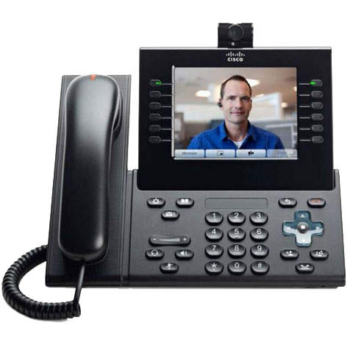
Cisco Unified 9971 IP Phone Accessibility Features for the Visually Impaired
Audible message waiting indicator (stutter dial tone) CUCM 8.x+
Back-lit LCD screen, with large fonts and programmable contrast
High Contrast visual and audible alert on incoming call
Programmable Line Keys (CUCM 6.x)
Integrates third-party
Accessibility applications
using XML
Physical Buttons for Hold, Conference, and Transfer
Standard Key Layout
Large Keys
Tactile discernable buttons and functions
Audible notification of phone state (mute)
Notes:
This slide shows the key accessibility features for the vision impaired or blind users.

Slide 27
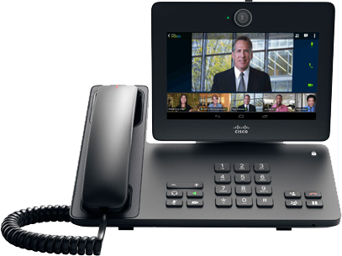
Cisco Desktop Collaboration Experience DX650 Accessibility Features for the Visually Impaired
Back-lit LCD screen, with large fonts and
Audible message waiting indicator (stutter dial tone) CUCM 8.x+
Android Accessibility
Talkback (screen reader
And Explore by Touch
Physical Buttons for Hold, Conference, and Transfer
Audible notification of
phone state (mute)
Standard Key Layout
Large Buttons, Tactile Discernible
Notes:
This slide shows the key accessibility features for the vision impaired or blind users.

Slide 28
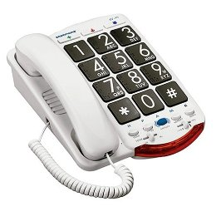
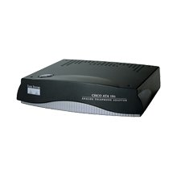
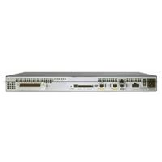
Large Button Phone Solution - Vision
Cisco ATA 186
Clarity Amplified Big Button Phone –
Clarity-JV-35
Cisco VG224
Notes:
Partner Contact Information
Vaughn Peterson
NexTalk Inc. Office: 801-274-6001 Mobile: 801-368-5250 OneNbr: 888-825-0562
vaughn.peterson@nextalk.com

Slide 29
Cisco Unity Connection
Alternate approach to inaccessible PDA, allows ability to “listen” to emails
Provides ability to listen to email via text-to-speech
Enables visually impaired people to check email, on the road or at the desktop
Levels the playing field and increases productivity for blind users
Also great for mobile workforce
Notes:
While sighted users are using their PDA device to get email on-the-run, blind users have not had this luxury. Now, with Cisco Unity, the playing field is leveled between sighted and blind users. Blind users can now “listen” to their emails using Cisco Unity.
EXAMPLE – Department of Education
Don Barrett, a blind employee at the Department of Education, loves the accessibility features of Cisco Unity. Before Cisco Unity, when he traveled, he was not on par with his co-workers – he was unable to respond to urgent messages during the day. While they were able to check their email using their inaccessible PDA devices, Don had to wait until he got back to the hotel room to log on to his computer and read his email using a screen reader (like JAWS).
When the Department of Education rolled out the IP Communications Solution, Don could “read” his email through his voice mail using Cisco Unity. The playing field had been leveled between Don and his co-workers. Don could now respond to urgent messages.

Slide 30
Cisco Unified Communications Manager
Communications Manager 8.x and greater provides the following features:
Audible Message Waiting Indicator. This is a feature that notifies the user through a stutter dial ton that a he or she has a voicemail
Programmable Line Keys (PLK). This feature enables an Administrator to assign call functions to the available line keys on a Cisco 7900 Series IP Phone. Some of the Call functions that can be assigned are: Hold, Transfer, Conference…
Notes:
While sighted users are using their PDA device to get email on-the-run, blind users have not had this luxury. Now, with Cisco Unity, the playing field is leveled between sighted and blind users. Blind users can now “listen” to their emails using Cisco Unity.
EXAMPLE – Department of Education
Don Barrett, a blind employee at the Department of Education, loves the accessibility features of Cisco Unity. Before Cisco Unity, when he traveled, he was not on par with his co-workers – he was unable to respond to urgent messages during the day. While they were able to check their email using their inaccessible PDA devices, Don had to wait until he got back to the hotel room to log on to his computer and read his email using a screen reader (like JAWS).
When the Department of Education rolled out the IP Communications Solution, Don could “read” his email through his voice mail using Cisco Unity. The playing field had been leveled between Don and his co-workers. Don could now respond to urgent messages.

Slide 31
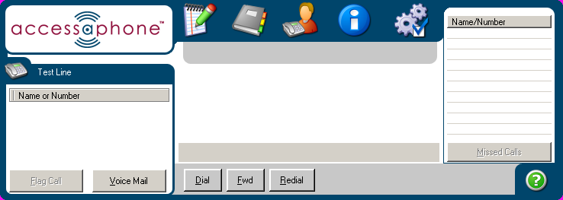
Partner Application: Tenacity's accessaphone (AAP)
AAP is assistive technology for the Cisco Unified IP Phones
For the Vision Impaired - Users who cannot see or have difficulty in seeing the telephone display, the light on the telephone handset, or the telephone’s buttons, arrows, or keys, Access A Phone provides the following (partial listing):
Audible Caller ID with name and number
Audible confirmation of a new voice mail
Audible Call Log
Announcement of Current Calls/Phone Status
Announcement of Who is on Hold
Dialing Shortcuts (Speed Dial, Redial, Dial from Call Log)
High Contrast Display with accessible icons
Keyboard Control of the telephone
http://www.tenacitycorp.com

Slide 32
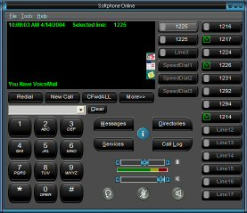
Partner Application: Audio-Assisted Phone for the Visually Impaired
Fully accessible softphone, mimics Cisco Unified IP Phone 7960G
Built in text-to-speech provides ability to access any information on the phone
Keyboard access to all features on the phone
Fully compatible with screen readers such as JAWS
High contrast skins and compatible with screen magnifier software for low vision users
IPblue VTGO-PC Advance Softphone
Notes:
Again, here is an example of Cisco’s open architecture at work
http://ipblue.com/products_vtgo_508.asp
IP Blue has the most accessible softphone on the market:
It has built in text-to-speech
Keyboard access to all features on the phone
It is fully compatible with screen readers
When deployed in conjunction with the Cisco Unified IP Phone 7960G, you can enhance the accessibility of the Cisco Unified IP Phone with features like these:
Provide audible caller ID
Query soft key status
Read speed dial
Determine who is on hold
And many others.

Slide 33
Solutions for the Mobility Impaired

Slide 34
Cisco Unified IP Phone Accessibility Features for the Mobility Impaired
Large display shows the state
of the phone and keys pressed
Large screen to provide easy read phone state and services
Touch screen for
nonbiometric pointing
devices
Ergonomically
designed handset
Well-spaced buttons allow easy operation
Tactile discernable
buttons and functions
Adjustable stand
Large buttons and keys
Keypad on heavyweight
base station
Dedicated headset jack and ability to provide auto-answer function
Built in speaker phone
Notes:
This slide shows the key accessibility features for the mobility impaired users.

Slide 35
Partner Application: Tenacity's accessaphone (AAP)
For the Mobility Impaired - Users who have difficulty in reaching, grasping or holding the telephone handset, or reaching or using the buttons, AAP provides the following built in features (partial listing):
Auto Answer
Compatibility with specialty input devices (Windows based) already familiar to the user – the user can now control their Cisco telephone with the same device used for basic computer input
Hands free control of the telephone (by using a Windows based voice recognition program, such as Dragon Natural Speaking)
Keyboard shortcuts for telephone commands or for dialing (requires less physical exertion)
No timer used for response or data entry
Compatibility with built in Microsoft accessibility features such as the virtual keyboard, sticky keys, and repeat keys
http://www.tenacitycorp.com

Slide 36
Partner Application: Connecting Mobility Impaired Workers
IP blue provides a fully accessible softphone for people with severe mobility impairments
Gives remote workers access to all the benefits of an enterprise communication system offered by Cisco Unified Communications Manager
Increases the productivity of your workers and eliminates barriers of operating an enterprise telephone
IPblue VTGO-PC Advance Softphone
Notes:
In addition to helping the visually impaired, IP Blue also has solutions for people who are mobility impaired.
As we discussed earlier, the IP Blue System is fully accessible through keyboard navigation; it is also compatible with speech recognition software, such as Dragon Natural Speaking. This allows someone who does not have the use of their hands to provide basic voice commands to operate an enterprise-class phone.

Slide 37
Summary
Cisco Unified Communications – communications for everybody, everywhere, anytime – mobile workers, telecommuters, and people with special communications needs
Cisco Unified Communications systems are accessible and conform to Section 508
Converged voice, video and data networks provide the foundation for innovation in accessibility
For more information, visit: http://www.cisco.com/go/accessibility
Notes:
Please visit our accessibility portal for more information on Cisco and accessibility.

Slide 38
ALL
Changing the Way We Work, Live, Play and Learn

