Slide 1
My Shopping, My Way
Are You Ready for the Tech-Shaped Consumer?
Cisco Internet Business Solutions Group (IBSG)
Lisa Fretwell, Jon Stine, Andy Noronha
January 2011

Slide 2
Agenda
Executive Summary
According to the Research
A Significant Opportunity
Achieving the Potential
Source: Cisco IBSG, January 2011

Slide 3
Executive Summary
Consumers’ behavior and expectations are being rapidly shaped by technology
This situation is accelerating retail commoditization
Cisco IBSG research indicates retailers can increase sales, grow conversion rates, and preserve margins by creating “mashops” that combine web-like experiences with the store shopping experience
The research also shows retailers should focus on “calculating shoppers” (56% of population) rather than “extreme shoppers” (11% of population)
Several leading retailers are already creating mashop experiences
To begin, understand the experiences needed to enhance your brand promise, create a technology-based platform to deliver the needed experiences, and reassess / adjust
Retailers that fail to embrace mashop experiences will be more susceptible to commoditization
Source: Cisco IBSG, January 2011

Slide 4
Three Transitions Impacting Retail
Technology Adoption
Generational Impact
They’re Seeking Deals
Mobile shopping clicks with consumers, retailers —Chicago Tribune, 11/10
Bust of the baby-boomer economy: “generation spend” tightens belt —CNBC, 1/10
Shoppers flock back to the mall to hunt deals —The New York Times, 11/10
Gen X and Y pave way to economic recovery —Adweek, 3/10
Black Friday gains, but consumers stay nervous —MSNBC, 12/10
A high-tech edge on Black Friday —The Wall Street Journal, 11/10
Sources: The New York Times, MSNBC, Chicago Tribune, The Wall Street Journal, CNBC, Adweek (all 2010)

Slide 5
According to the Research
1

Slide 6
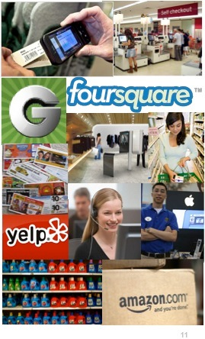
Why Cisco Conducted the “My Shopping, My Way” Shopper Survey
Consumers using more technology to help shop
Tested hypotheses about the future of shopping
Survey goals:
Understand how / why consumers use technology
Learn how technology is shaping consumers’ behavior / expectations
Test delivery of technology-enabled shopping experiences that empower customers
Source: Cisco IBSG, 2010

Slide 7
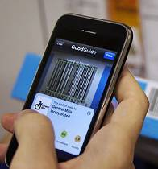
Technology Commoditizing Retail Due to Increased Data Access / Transparency
Calculating Shoppers (56%)
Extreme Shoppers (11%)
Gen Y (32%), Gen X (39%), Boomers/Silvers (29%)
Gen Y (58%), Gen X (30%), Boomers/Silvers (12%)
Deal-seeking time higher than 2 years ago
Deal-seeking time to increase in 2 years
Have used group buying sites
Have used retailer Facebook sites
Have used coupon- sharing sites
Use iPhones / Android devices
66% 73%
51% 61%
23% 42%
31% 56%
33% 60%
18% 65%
Source: Cisco IBSG Research & Economics Practice, 2010. Note: U.S. respondents.

Slide 8
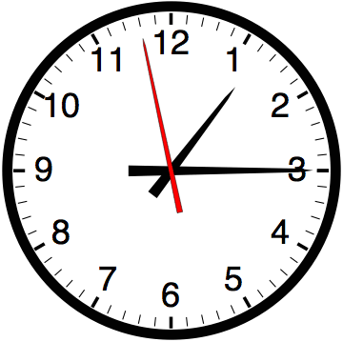
Top Reasons Consumers Use Technology for Shopping
Find lowest price: 63%
Save time: 47%
Find best selection: 26%
Find best-quality product: 25%
Common top reasons for using technology in shopping
Source: Cisco IBSG Research & Economics Practice, 2010. Note: U.S. respondents.

Slide 9
Technology Is Reshaping How Shoppers Make Buying Decisions…
Which of the following are the three most important sources of information that you use to help make buying decisions?
60%
60%
Online reviews more important than in-store employees, traditional media, and social networking
50%
40%
30%
29%
29%
27%
20%
24%
23%
21%
19%
10%
14%
11%
10%
0
Friends / Family
Online professional reviews
Customer reviews (online- only retailer sites)
Data on mfg. sites
In-store product displays
Online reviews (store-based retailer sites)
In-store employees
Print
Customer reviews on blogs, message boards
Customer reviews on social networks
TV
Sample Size = 1,000 U.S. consumers
Source: Cisco IBSG Research & Economics Practice, 2010

Slide 10
…And How They Access Information
What is your experience with using each of the following technologies to look for product or pricing information before you purchase?
Percent of U.S. respondents who “regularly use” or “have tried it”
90%
80%
85%
80%
70%
76%
60%
50%
40%
45%
43%
30%
35%
36%
27%
20%
23%
20%
10%
12%
9%
0
PC at home
Kiosk / touch screen in store
Mobile device at home
Mobile device in store
Sample Size = 1,000 U.S. consumers
Gen Y (18–29)
Gen X (30–49)
Boomers / Silvers (50+)
Source: Cisco IBSG Research & Economics Practice, 2010

Slide 11
A Significant Opportunity
2

Slide 12
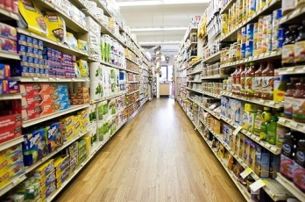
New Technology-Based Shopping Concepts “Mash Up” Virtual / Physical
+
=
“Mashop”
Physical (stores)
Virtual (web)
Mashop Experiences Empower Shoppers in Your Store
Personalized product offers
Shelf-edge access to deep, net-like knowledge
One-click mobile payments
Multi-touchpoint social media customer care
Virtual expert adviser
Source: Cisco IBSG, January 2011

Slide 13
Cisco Technology Can Be “Mashed Up” To Deliver Mashop Solutions
Mashops
Cisco Solutions
Shelf-edge access to deep, net-like knowledge
Cisco Digital Media Suite (DMS) + interactive signage + content distribution network (CDN) + medianet
Personalized product offers
DMS + interactive signage + CDN + Wi-Fi + context- / location-based services
Virtual expert adviser
Cisco TelePresence + Unified Contact Center (UCC) + Cius + medianet
One-click mobile payments
PCI solution for retail + Wi-Fi + POS integration + web
Multi-touchpoint social media customer care
Cisco SocialMiner + UCC + Wi-Fi + context- / location-based services + network + interactive signage
Source: Cisco IBSG, January 2011

Slide 14
Why Shoppers Prefer Mashop Experiences
+
=
“Mashop”
Physical (stores)
Virtual (web)
Physical availability
See, touch, smell
Try it, use it
Human interaction
Peer reviews / ratings
Feature and functionality comparisons
Price comparisons
Detailed product information, specifications, videos
Recommendations
Combined physical / virtual experience
Source: Cisco IBSG, January 2011

Slide 15
Mashops Offer Self-Discovery In the Store To Drive Sales
Information from Web
(55% Interested)
Personalized Offers
(54% Interested)
Virtual Video Adviser
(44% Interested)
Shopper preference
65%: touch screen at shelf
54%: touch screen in aisle
Shopper value
28%: comparative pricing
25%: detailed information
Pilot indications
Shelf-edge conversions: 8%+
Shopper preference
73%: touch screen at shelf
60%: store-entrance kiosk
Shopper value
48%: relevant offers
Pilot indications
Increased traffic from loyalty program participants
Shopper preference
53%: tablet PCs
44%: TelePresence
Shopper value
41%: real expert
28%: convenience
Pilot indications
Cross-channel customers increase 2x, spend 3x
Source: Cisco IBSG Research & Economics Practice, 2010

Slide 16
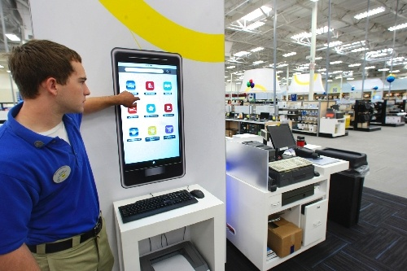
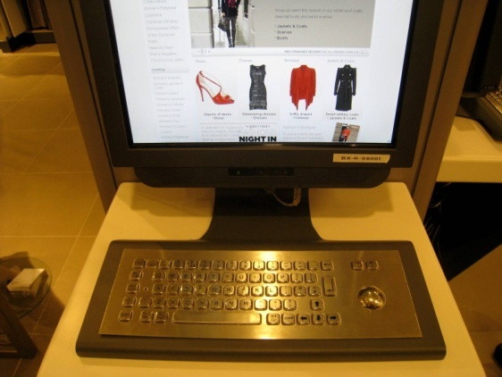
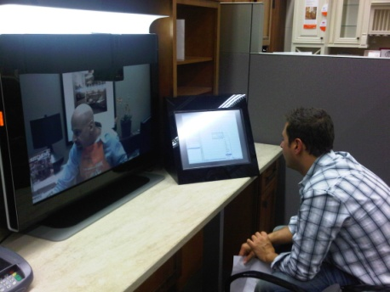
Leading Retailers Already Creating Mashop-Type Experiences
Best Buy Connected Store
Web / physical / mobile experiences in store
Shopper self-discovery
Endpoint options
Cisco IBSG’s View
Shoppers like control / self-discovery
Shoppers get best prices / quality, save time
Pilots show increased sales from conversions, upselling, cross-channel spend
Opportunity to rethink store operating model
John Lewis
Multichannel ordering / multi-endpoint delivery
Store: staff / kiosks / web / contact center / mobile
Home Improvement Retailer
Mashed-up web, physical, video experience
Design services in store
Sources: Best Buy, 2010; John Lewis, 2010; Cisco IBSG, January 2011

Slide 17
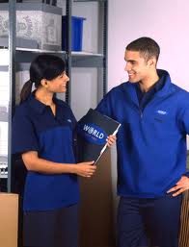
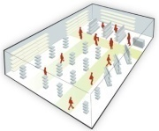
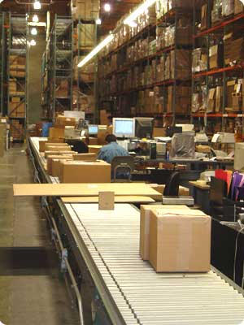
Mashop Solutions Will Drive
New Operational Models
Specialty / Service-Based
Mass-Merchandisers
Labor Productivity
Self-discovery
Multistore experts
Mobile checkout / warranty
Self-discovery
Self-checkout / warranty
Range / Space
Exhaustive / personalized range
Inspirational experiences
Larger range, smaller stores
Virtual ranges at many touchpoints
Smaller stores
Virtual pop-up retail
Buy online, pick up in store
Try before you buy / pick up
Micro slots / same-day delivery
Direct supplier delivery
Multichannel ordering
Multipoint delivery
Fulfillment
Pricing
Dynamic cross-channel pricing
Dynamic cross-channel pricing
CRM
Real-time customer view
Self-managed customer view
Source: Cisco IBSG, January 2011

Slide 18
Achieving the Potential
3

Slide 19
Three Development Phases
Emerging: Shopping Shaped by Technology
Empowering: Technology Ingrained in Shopping
Established: Shopping with Technology
Shopper preference
Self-checkout
Loyalty offers
Price check / lookup
Self-scanning
Web
Product search
Price comparison
Peer reviews
Personalized offers
One-click checkout
Net-like behaviors reach store
Mobile Internet
Location-based services
Comparison apps.
Social networks
Augmented reality
Group consumption
Interactive touch screens
In-store online ordering
Digital signage
Mash up virtual into the physical
Self-checkout
Loyalty offers
Price check / lookup
Self-scanning
Examples
Deep search / finding
Peer reviews / comparisons
Virtual expertise
Personalized, location-based offers
Social customer care
Source: Cisco IBSG, January 2011

Slide 20
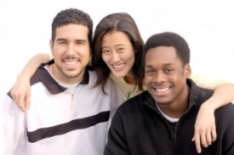
Looking Ahead: Target Demographics Should Guide Your Roadmap
All About Mobility
Shopping Shaped by Technology
Mashop Solutions
Technology Ingrained in Shopping
In-Store / At Home
Shopping with Technology
Now
This year
Gen Y
Now
This year
1-2 years
Gen X
Now
Bypass mobility-centric phase?
1-2 years
Boomers / Silvers
Source: Cisco IBSG, January 2011

Slide 21
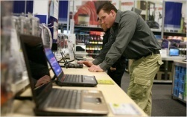
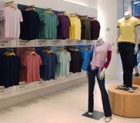
Looking Ahead: Segments / Competition Should Also Guide Your Roadmap
All About Mobility
Shopping Shaped by Technology
Mashop Solutions
Technology Ingrained in Shopping
In Store / At Home
Shopping with Technology
Today’s Baseline
The Store
Self-checkout
Loyalty offers
Price check / lookup
Self-scanning
The Web
Product search
Price comparison
Peer reviews
Personalized offers
One-click checkout
Location-based offers
Personalized offers
One-click mobile checkout
Social customer care
Smartphones
Digital signage
Food
Deep search at shelf edge
Shelf-edge peer reviews / comparisons
Virtual expertise: store, web, on the go
Interactive / immersive experiences
Social customer care
Smartphones
Digital signage
Social media
Nonfood
Source: Cisco IBSG, January 2011

Slide 22
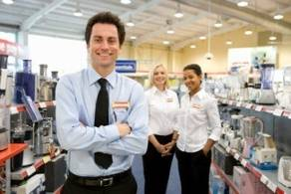
Key Business and Technology Questions To Ask for My Shopping, My Way
1. Brand Promise
2. Customer Experience
What’s the differentiating brand promise?
Where are customers digitally active?
Which net-like experiences will deliver brand promise in stores?
What’s the tech roadmap?
4. Business Value
3. Operations
How can mashop solutions reinvigorate your store?
How can they increase basket size, stock turnover, margins?
How will shopper self-discovery optimize labor allocation?
How can labor be reallocated / optimized?
Which infrastructure improvements will be required?
How will CRM be delivered to all touchpoints?
Source: Cisco IBSG, January 2011

Slide 23
I expect the Internet experience in the store and the store experience on the Internet.

