Slide 1

Taking WAN Edge to the Next Level
Notes:
1
1

Slide 2
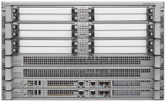


Introducing - ASR 1000 Series Routers
Instant-on
Service Delivery
Business Critical Resiliency
Industry’s Smallest, Most Powerful Routers
Embedded High-Performance Resilient Services
ASR 1002
ASR 1004
ASR 1006
5–10
Gbps
20+ Gbps
20+ Gbps

Slide 3




350 Global Customers in 10 Months and Counting!
Cisco ASR 1000 Series Routers
350
ASR Enterprise Customers
150
75
25
2 Months
4 Months
6 Months
10 Months
Fastest Selling High End WAN Aggregation Router!

Slide 4




New Business Priorities Drive
New WAN Infrastructure
Virtual Workspace and Globalization
Data Center Consolidation
Collaborative
Applications
Security and
Compliance
ASR 1000 Series: Built for Today’s Market Requirements

Slide 5
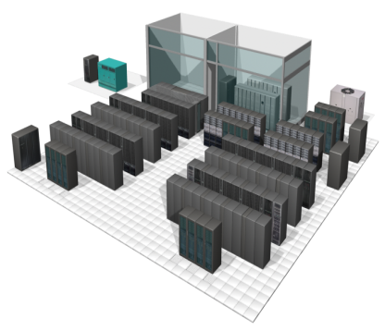
Enterprise New WAN Infrastructure Needs*
Firewall And VPN Services Mandatory Requirements
WAN Optimization Services - A Key Requirement
Increased Bandwidth Requirements And Internet Usage
Manageability and Service Performance Key Criteria
Branch Aggregation Traffic: Most-critical
Telecommuter / Mobile Users Traffic: On the rise
Branch offices
(41%)
WAN
Site-to-Site VPN
Branch Offices
Mobile Users
(15%)
Internet
Remote Access VPN
Headquarters /
Data Center
WAN Edge Router
* IDC WAN Survey, Nov 2007
Telecommuter
Notes:
5

Slide 6





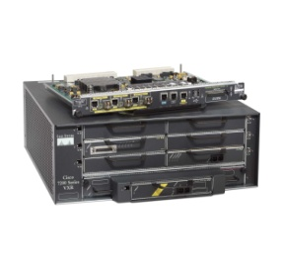
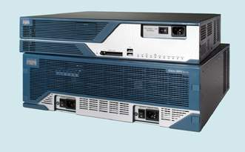

Introducing Cisco Branch-WAN Portfolio
Secure WAN Aggregation
Integrated Threat Control
Application Optimization
New
ASR 1000 with ESP-20G
Catalyst 6500 Series
Cisco 7600 Series
Performance and Services Scalability
ASR 1000 with ESP-10G
ASR 1000 with ESP-5G
or ESP-10G
ASR 1000 with ESP-5G
Modular software,
Consistent LAN/WAN services
Scalable Ethernet services
7200 Series
Highest Capacity, Highly Available, Modular Services
ISR Series
High-performance Embedded Services, Services Flexibility,
Hardware/Software Resiliency, Modular Software
Secure, Reliable, Concurrent WAN Services Aggregation
Routing System with Integrated Services — Security, Voice, Video, Wireless, WAN Optimization
Branch
ASR 1000 Series: Highest Performance Compact Router
Head Office / WAN Aggregation

Slide 7
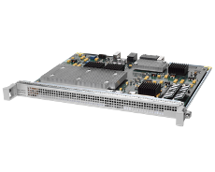
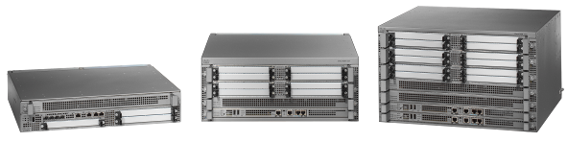
Introducing Embedded Services Processor ESP-20G
Industry’s Fastest Secure WAN Router
ASR 1000 w/ ESP-20G
Benefits
20Gbs Bandwidth, 16Mpps
Wire-speed Multicast, QoS
Netflow Event Logging
Collaborative services over WAN
Video ready WAN
Compliance Requirements
Performance
20G Firewall, 7G IPsec services
Multi-Gig NBAR and FPM
WAN Optimization - WCCPv2
Integrated Threat Control
Prioritize applications
Branch Service Performance
Services
Efficiency
NCM, LMS, and CSM Support
~ 400Watts Power at 100% Load
No service blades or modules
Simplified Network Management
Lower TCO, OpEx Savings
Architectural Flexibility

Slide 8




End-to-End Secure WAN Aggregation Services
Solution
Benefits
Built-in 7Gbps IPsec encryption
Up to 12G non-encrypt throughput
Up to 10,000 IPsec tunnels capable
Remote-access VPN services
Optimized for QoS & Multicast
Instant-on, flexible security services
No trade-off : Security with performance
Tight integration with ISR in branches
Secure video and voice over WAN
ASR 1000
as secure WAN Edge Router
ISR 2800
Small Branch
VPN
Internet
Private
WAN
Site-to-Site VPN
ISR 3800
Big Branch
MPLS
VPN
ISP-1
Remote Access VPN
ISP-1
ISP-1
WAN
ISR 800
Telecommuter
VPN Services: IPsec VPN, DMVPN, MPLS VPN
Notes:
8

Slide 9
End-to-End WAN Optimization Services
Solution
Benefits
Built-in WAN Optimization w/ WCCPv2
TCP Flow Optimization; Traffic redirect
Application specific route selection
Identify, prioritize, limit, or block apps
Enhanced Application Performance
Dynamic Optimization for CRM, SAP etc
Enhanced branch service performance
Meet compliance requirements
ISR 2800
Small Branch
ASR 1000 w/ ESP-20G
for WAN Optimization
NBAR
Internet
Site-to-Site VPN
Private
WAN
ISR 3800
Big Branch
Remote Access VPN
ISP-1
WAN Opt
ISR 800
Telecommuter
Cache Clusters
End-to-End Application Optimization
Notes:
9

Slide 10


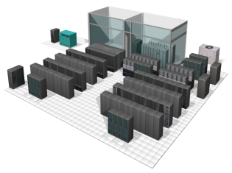
Secure Internet Gateway
Solution
Benefits
20G Firewall and NAT services
2 million HTTP connections
Netflow event Logging - 40k/ sec
Flexible and granular Packet Matching
Control Plane Policing, Rate limiter
Defends enterprise network edge
Scalable access control at edge
Compliance requirements
Rapid first line of defense against threats
Denial of service protection
Public Internet Services
Private
Zone
ISP-1
NBAR, FPM
Site-to-Site VPN
ISR 2800/3800
Branch Offices
IPsec
Zone
Remote Access VPN
ASR 1000 w/ ESP-20G
as Internet Gateway
ISP-2
DMZ Zone
Firewall
ISR 800
Telecommuter
Applications (e.g. Voice, Video)
Notes:
10

Slide 11
Cisco ASR 1000 + ISR Series
A Holistic End-to-End Branch-WAN Solution
ASR 1000 as WAN Router and Internet Gateway
ISR
NAT/VPN
ISR
WAN
FPM
QFP
Hub Site
Branch
ISP
FW
Branch
Branch
End-to-End
WAN
Head-End
Firewall, IPsec
WAAS
CME, SRST, QoS
CSM, Netflow, Event Logging
Security
Application Optimization
Unified Communication
Network Management
Firewall, IPsec
WCCP, NBAR, FPM
SBC, H-QoS
CSM, Netflow, Event Logging
For Customers Who Are:
Increasing
Branches,
Teleworkers
Facing Stringent
Security
Requirements
Consolidating
Data
Centers
Adding
High-Bandwidth
Web 2.0 Apps

Slide 12
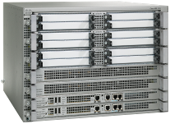
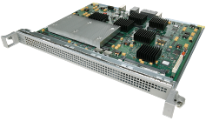
Investment Enhancement Delivered
Original Investment
ASR 1006 Chassis | = | 5%
RP1 Route Processor | = | 4%
ESP-10G Processor | = | 9%
3 SIP Modules | = | 8%
2 10x1 GE SPA & 2 1x10 GE SPA | = | 30%
6 8x10/100 FE SPA | = | 30%
Optics | = | 3%
Advanced Ent. Software | = | 3%
Security + FPI License | = | 8%
Investment | = | 100%
Cisco ASR 1000 Series with ESP-20G
ESP-20G Processor | = | 9%
Upgrade to ESP-20G Forwarding Processor
> 90% of Initial
Investment Is
Maintained!
Doubles the performance for Advanced WAN Services with <10% investment upgrade

Slide 13
Cisco ASR 1000 Series
WAN Aggregation : NHS Lothian
Improved Services at Reduced Costs for Today and Tomorrow
Business Challenges
Business Results
Improve provision of Healthcare
Implement Digital Imaging systems
Increase Green credentials
Quicker diagnosis using digital images
Improved patient security and throughput
Elimination of harmful waste associated with traditional X-Rays
"The ASR 1000 platform with its high-performance embedded services and security has allowed NHS Lothian to deliver state of the art medical imaging to improve the quality of health care provisioning, provide data security, and additionally eliminate the harmful waste associated with the processing and development of traditional X-Rays."
Iain Robertson, Head of IT, National Health Service (NHS) Lothian

Slide 14

Cisco ASR 1000 Series
WAN Aggregation: GarantiBank
Profitable growth through new services
Business Challenges
Business Results
Deploying new customer services
Customer retention and acquisition
Client confidentiality
Increased OpEx
Anytime, anywhere personalized services
Reduced cost through optimization and automation
Reduced risk through adaptable solutions
Green IT - Reduced power, and space
"After upgrading our infrastructure, we had to ensure that communications over our wide area network between our headquarter locations and branch offices, as well was with our customers, was reliable, highly secure and superior in quality. We chose Cisco's ASR 1000 Series for our WAN infrastructure for its future-proof architecture and tremendous investment protection. This platform gives us the ability to support not only our current requirements but also, our vision to unify our voice, video and data networks."
Ilker Sayar , Network Services Manager, GarantiBank, Turkey

Slide 15

Cisco ASR 1000 Series
WAN Aggregation : Lufthansa
Secure, Reliable, Scalable Service Delivery Made Easy
Business Challenges
Business Results
Value-added real-time services
Customer and workforce data security
Worldwide access and coverage
Enhanced customer service reliability
Smoother infrastructure upgrade
Improved access and business efficiency
“We operate IT systems for our customers that are critical for their core business processes. So non-stop operations is an extremely important issue for us. We are witnessing an increased demand on highly secure, scalable, and reliable IT infrastructure services. The Cisco ASR 1000 Series helps us meet those demands. For example, the 'in service software update' feature offers great improvements towards non-stop operations .”
Bardo Werum, VP Cross-Industries and Operation, Lufthansa Systems
Notes:
Customer Testimonial from manufacturing (TI):
Challenges
Reduced time to market requiring collaboration across geographies
Constantly changing environment
Increased reliance on the network as essential platform
Results with ASR deployment
Improved collaboration at gigabit speeds
Investment protection with flexibility and adaptability to address future needs
Highly available network with minimized downtime - unplanned (security) and planned (software upgrades)

Slide 16

Cisco ASR 1000 Series
WAN Aggregation : Texas Instruments
One Innovation Enables Another Innovation
Business Challenges
Business Results
Time to market
Changing business environment
Reliance on network infrastructure
Improved collaboration
Enhanced investment protection
Greater flexibility and adaptability
Resilient network infrastructure
“"For Texas Instruments, the Cisco ASR 1000 Series gives us the assurance we need to manage and secure vastly greater traffic flow at our network edge, while enabling us to focus on what we do best—accelerating the pace of innovation and serving our customers.”
Brian Bonner, CIO, Texas Instruments
Notes:
Customer Testimonial from manufacturing (TI):
Challenges
Reduced time to market requiring collaboration across geographies
Constantly changing environment
Increased reliance on the network as essential platform
Results with ASR deployment
Improved collaboration at gigabit speeds
Investment protection with flexibility and adaptability to address future needs
Highly available network with minimized downtime - unplanned (security) and planned (software upgrades)

Slide 17
Summary
Enabling network growth through ASR 1000 innovation
End-to-end Branch-WAN service delivery with ASR 1000 and ISR Series
ESP-20G provides investment enhancement and operational efficiency

