Slide 1
Employee Resource Groups:
An Overview
Global Inclusion and Diversity

Slide 2
Overview
Understanding Employee Resource Groups
and their value
Models and Governance
Summary

Slide 3
Employee Resource Groups
Overview

Slide 4
Defining Employee Resource Groups
Employee Resource Groups are affinity networks of Cisco employees who share a common interest—forming a worldwide network of multicultural, multigenerational experts committed to realizing
Cisco’s vision through:
Business outreach
Professional development
Recruitment
Notes:
Here are some of the types of events that we offer to help employees identify ways in which they can leverage and benefit from a diverse and inclusive culture…

Slide 5
Business Outreach
  Work with an understanding of business practices &
  processes that allows Cisco to reach markets
  it would have found difficult to reach.
    ERG Example - Conexion in collaboration with Small
    Business Marketing announced a new Spanish SMB website www.cisco.com/go/espanol. This site has allowed Cisco to reach small businesses that otherwise would not have
    worked with us. Averages 3,200 new visitors each month.
  Culture matter experts offer customer perspective that allows for facilitation of business development, while decreasing time to target market areas.

Slide 6
Professional Development
  Gain hands-on leadership experience through ERG leadership, champion initiative, cross-ERG opportunities with mentoring, event participation opportunities and external posts
  On-going education and training opportunities
      ERG Example – Early in Career Network helps new engineers acquire CCNA certification at low cost by tapping internal talent and using Web 2.0 collaborative tools
  Benefit from professional networking with other ERG members, guest speakers, sponsors and the external professional community.

Slide 7
Recruitment
  Focused outreach – Supports Cisco vision to be employer of choice for diverse talent.
      ERG example –Cisco Black Employee Network increased awareness of Cisco consumer offerings and technologies through involvement with middle schools, high schools, and colleges to get students more interested in STEM careers earlier
  Advisors and mentoring programs for members to assist with career development and growth.
    Ementoring program allowing for remote workers to be matched with headquarters on-site mentors.

Slide 8

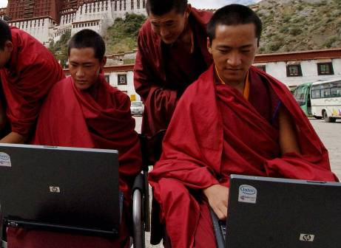





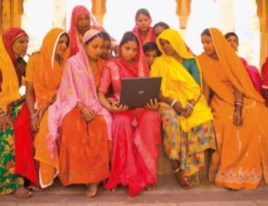


Employee Benefits
Increased Employee Engagement
Additional Growth Opportunities
Business Impact
Unique Affinity
Employee Development
Good for
Employees
Collaboration
Leadership Skills
Community Outreach
Mentoring
Networking
Notes:
I&D’s coalition structure has functional and geographical representation stretching out across the organization…

Slide 9
Employee Resource Groups
ERG Models and Governance

Slide 10




Evolution of ERGs
~ 1000 Employees
Grass Roots
~ 3000 Employees
Formalized
~ 8000 Employees
Business Impact
2004-2006
2005
2010
Notes:
It can impact the bottom line, influencing:
Customer buying preferences
A company’s ability to understand nuanced market forces and drive growth
The level of employee commitment and satisfaction, which can motivate or de-motivate the workforce

Slide 11

Cisco Black Employee Network (CBEN)
US
Europe
Indians Connecting People (iCON)
US
Cisco Asian Affinity Network (CAAN)
US
Cisco Disabilities Awareness Network (CDAN)
Europe
Canada
US
India
APAC
Connected Women Technology Network
(CWTN)
US
12 Employee
Resource Groups
Cisco Hispanic and Latino Network
(CONEXION)
US
Europe
LATAM
In 35 Countries
Connected Women (CW)
US
Europe
India
Canada
Experienced
Influencers (EI)
US
Veterans Enablement & Troop Support (VETS)
US
Middle Eastern Diversity & Inclusion (MEDI)
US
Gay,Lesbian, Bi Sexual Transgender & Advocates (GLBT&A)
US
Europe
Canada
Early Career Network (ECN)
US
APAC
Europe
Notes:
The goal of the slide is to show the geographic location of each employee resource group. We would like a new graphic of the globe since this one have been heavily used
iCon:
US
CDAN:
Europe
US
India
CAAN:
US
Conexion:
US
Europe
Latin America
GLBT&A:
US
Europe
Canada
Experienced Influencers
US
ECN:
US
MEDI:
VETS:
US
CBEN:
US

Slide 12
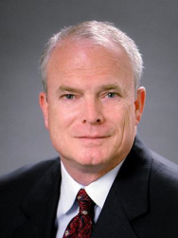
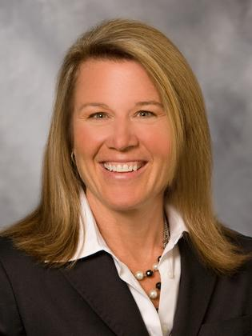


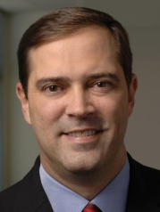
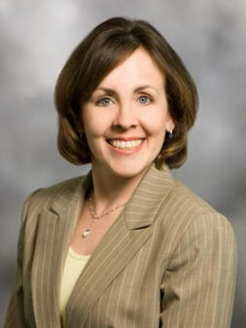




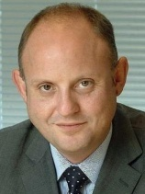



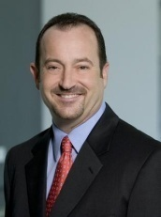
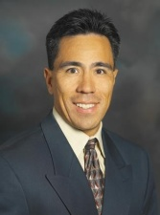



Inclusion & Diversity
Executive Board
Interim Chief Diversity Officer
Chair
Gary Moore
COO
Sandy Hoffman
Facilitator
Talent
CDAN
CWAG
GLBT&A
TBD
HR
Gregory Neal
Akers, GGSG
Duncan Mitchell
Sales
TBD
Chuck Robbins
Sales
Sherri Liebo
Services
Rick Moran
CMO
CAAN
EI
CBEN
MEDI
Tuan Nguyen
Engineering
Kim Marcellis
OPS
Howard Charney
Office of CEO
John Donovan
VP Europe
TBD
Mike Quinn
Services
Rami Mazid
IT
CONEXION
ECN
iCON
VETS
Angel Mendez
MFG
Guillermo Diaz
IT
Nitin Kawale
Sales
Sandeep Vij
Engineering
TBD
Mike Quinn
Services
Pat Finn
US Sales
Notes:
As you can see the Executive Board has representation from across the organization… It’s responsible:
for raising issues to the Operating Board and CEO
setting the overall direction based on company priorities and expectations of the programs

Slide 13
Together We
Summary: ERGs & Cisco

Slide 14

Our diverse thoughts, skill sets, and sources of inspiration provide an abundance of inventive and creative ideas. Fully engaged employees are more committed to their work, less likely to leave Cisco and feel safe to contribute ideas that lead to innovation.
Together We Create.
Innovation
Notes:
Creation is fun, exciting, and exhilarating. The more diverse our sources of inspiration are, the more of an abundance of inventive, creative ideas we have to work with.
Innovation is fueled by highly-diverse teams. Innovation and collaboration happen in environments where it is safe to share new ideas and to be yourself.

Slide 15

ERGs are a worldwide network of multicultural, multigenerational experts committed to realizing Cisco’s vision through collaborative relationships.
Together We Are Brilliant.
Collaboration
Notes:
Working together, in a collaborative environment, we can develop brilliant ideas, products, solutions and services faster and more efficiently than ever before.

Slide 16

Because the members of our ERGs reflect the diversity of our global customer base Cisco is able to create customer intimacy through shared cultural values and generational expertise.
Together We Are Limitless.
Globalization
Notes:
As we realize our globalization strategies and move in to new markets our competitive advantage will come from our local knowledge.

Slide 17

Members experience development opportunities through hands on leadership, exposure to business development and on-going education— creating an employee population that is fully engaged and aligned to the business
Together We Succeed.
Customer Success
Notes:
Before you can really know who other people are, you have to know who you are. Start with self-awareness, then take the next step: learning more about others and appreciating how they’re different from you.
I&D helps us to better understand our customers, which is increasingly more important in a global marketplace
Companies do business with other companies that have shared values. Leverage inclusion and diversity to mutually understand the shared values.

Slide 18

ERGs provide Cisco with a direct channel to reach diverse market segments. By utilizing the knowledge, skill sets and experience of ERG members Cisco has reduced time to market, realized greater customer intimacy and built a talent pipeline.
Together We Are At
Our Best.
Inclusion
Notes:
Having an inclusive culture is about wanting to work together and welcoming diversity of thought.
Celebrating and tapping into a multitude of differences isn’t just limited to Cisco employees. It encompasses our customers and partners, too. By gaining a better understanding of the world—and the differences in its people—we can change the way it works, lives, plays, and learns.

Slide 19
Summary

