Slide 1
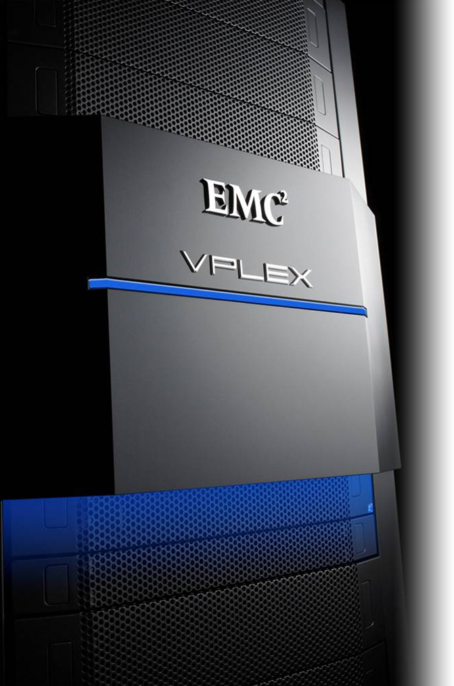
Построение решений высокой доступности и непрерывности бизнеса для VMware от ЕМС
Юрий Латышевский
Технический консультант ЕМС Киев

Slide 2
Рассматриваемые вопросы
Построение высокодоступных виртуальных сред для бизнес приложений
  VPLEX
  RecoverPoint
Построение сервиса резервного копирования для виртуализированых сред
  С высокой степенью изменяемости
  С малыми изменениями данных

Slide 3








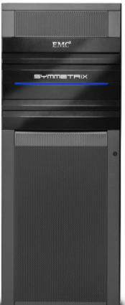


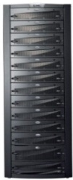
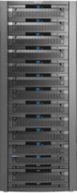





Путь к частному облаку
Развитие виртуализации серверов
vMotion на дальние расстояния
Standalone
Консолидация
Ресурсные пулы
+
Приложение
Приложение
Федерация EMC
Приложение
Приложение
Приложение
Приложение
Приложение
ЦОД A
Data
ЦОД B
Приложение
Приложение
Приложение
Приложение
Приложение
Приложение
Приложение
Приложение
Data
Data
Развитие виртуализации хранилищ
ЦОД D
ЦОД C
Standalone
Консолидация
Ресурсные пулы
Приложение
Data
Эффективное использование ресурсов
Федерация
Приложения и данные
FAST
На расстоянии
Notes:
Very much like server virtualization moved through its phases of development, EMC’s Virtual Storage will deliver new value and levels of cooperation throughout the infrastructure.

Slide 4
Путь к частному облаку
Развитие виртуализации серверов
vMotion на дальние расстояния
Standalone
Консолидация
Ресурсные пулы
+
Приложение
Приложение
Федерация EMC
Приложение
Приложение
Приложение
Приложение
Приложение
ЦОД A
Data
ЦОД B
Приложение
Приложение
Приложение
Приложение
Приложение
Приложение
Приложение
Приложение
Data
Data
Развитие виртуализации хранилищ
ЦОД D
ЦОД C
Standalone
Консолидация
Ресурсные пулы
Приложение
Data
Эффективное использование ресурсов
Федерация
Приложения и данные
FAST
На расстоянии
Notes:
Very much like server virtualization moved through its phases of development, EMC’s Virtual Storage will deliver new value and levels of cooperation throughout the infrastructure.

Slide 5
Путь к частному облаку
Развитие виртуализации серверов
vMotion на дальние расстояния
Standalone
Консолидация
Ресурсные пулы
+
Приложение
Приложение
Федерация EMC
Приложение
Приложение
Приложение
Приложение
ЦОД А
ЦОД B
Приложение
Application
Приложение
Приложение
Application
Приложение
Application
Data
Data
Data
Приложение
Приложение
Развитие виртуализации хранилищ
ЦОД D
ЦОД C
Standalone
Консолидация
Ресурсные пулы
Эффективное использование ресурсов
Федерация
Приложения и данные
FAST
На расстоянии
Notes:
Very much like server virtualization moved through its phases of development, EMC’s Virtual Storage will deliver new value and levels of cooperation throughout the infrastructure.

Slide 6

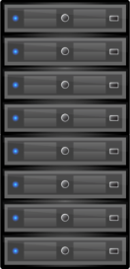



Доступность
ORACLE
SAP
MICROSOFT
Традиционный подход
Кластер+зеркалирование на уровне LVM
Репликация
Режим Active/Passive
Кластер
РЕПЛИКАЦИЯ
Source
Target
Затраты CPU на зеркалирование
Перезапуск приложения после переключения
Удаленная репликация дает RTO > 0
Неудобства
Notes:
High availability is a term that several companies will claim they can deliver. Ultimately, a high-availability solution should protect against a failure and keep an application online. Companies use this to provide near continuous uptime for their critical applications, and automate the restart of an application once a failure has occurred, with as little human intervention as possible. With conventional solutions, companies typically have to choose a recovery point objective (RPO) and a recovery time objective (RTO). But although some solutions offer small RTOs and RPOs, there can still be downtime—and for most companies, any downtime at all can be costly.
VPLEX is a truly differentiated and unique solution for high availability, for all or part of your environment.

Slide 7




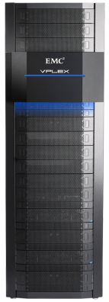

Федеративный доступ к данным
С VPLEX
Site A
Site B
Активные-Активные площадки
VPLEX Metro или VPLEX Geo
DISTRIBUTED VIRTUAL VOLUME
TRANSFER PROTOCOL
VPLEX - активное использование ресурсов на двух площадках
Notes:
With VPLEX you are able to create an active-active configuration, which allows for the active use of resources at both sites. This allows for continuous availability and workload mobility with read and write applications at the second site.

Slide 8




Доступность
ORACLE
SAP
MICROSOFT
Распределенный кластер
VPLEX
WITNESS
Приложения не останавливаются
Active
ACCESSANYWHERE
Active
Данные зазеркалированы и доступны с обеих площадок, каждая с локальной СХД
Поддержание приложения в рабочем состоянии без перезапуска
Высокая доступность данных с RPO=RTO=0
Преимущества
VPLEX
Notes:
With VPLEX, you get true high availability; this means operations continue and data remains online even if a failure occurs. No manual intervention is required, and no recovery or restart is necessary. In fact, within synchronous distances using VPLEX Metro, you can think of VPLEX as providing disaster avoidance instead of just disaster recovery—because there is literally no disaster event from which to recover.
VPLEX a enables stretched clusters with a VPLEX Metro and VPLEX Geo configurations which provide high availability benefits across data centers. The ability to withstand different failure scenarios and to provide automated failover make VPLEX a truly highly available solution.

Slide 9

Почему VPLEX уникальный?
VPLEX позволяет пользователям:
  иметь ту же информацию
  На двух разных площадках
  Доступную в тоже время
  из двух мест
Нет другого продукта с такой функциональностью
Notes:
To make it really simple, VPLEX enables you to have:
The exact same information
In two separate locations
Accessible simultaneously
From both locations
We call this a “Distributed Storage Cluster”. VPLEX is the only technology available today that offers this kind of functionality. The fact that information is simultaneously accessible is key – many products offer remote replication, but the data at the secondary site can not be used at the secondary site simultaneously by the same application. VPLEX offers “access anywhere” capabilities not found in other technologies.
This is all accomplished via a cache coherency model that tracks and records writes dynamically over distance.

Slide 10







Распределенный когерентный кэш
Каталогизированный распределённый кэш обеспечивает когерентно целостность данных по всем энжинам
Engine Cache Coherency Directory
Block Address | 1 | 2 | 3 | 4 | 5 | 6 | 7 | 8 | 9 | 10 | 11 | 12 | 13 | …
Cache A
Cache C
Cache E
Cache G
Engine Cache Coherency Directory
Block Address | 1 | 2 | 3 | 4 | 5 | 6 | 7 | 8 | 9 | 10 | 11 | 12 | 13 | …
Cache A
Cache C
Cache E
Cache G
New Write:
Block 3
Read:
Block 3
Cache Directory B
Cache Directory D
Cache Directory F
Cache Directory H
Cache Directory A
Cache Directory C
Cache Directory E
Cache Directory G
Cache
Cache
Cache
Cache
Notes:
One of the unique characteristics of the VPLEX architecture is its distributed cache coherency. Managing multiple disparate cache devices is nothing new and has been around for a while. However, what is unique is VPLEX’s implementation of distributed cache coherence.
The VPLEX environment is very dynamic and uses a hierarchy to keep track of where I/O goes.
Note to Presenter: Click now in Slide Show mode for animation.
An I/O request can come in from anywhere, and it will be serviced by any available engine in the VPLEX cluster. VPLEX abstract the ownership model into a high-level directory that’s updated for every I/O and shared across all engines. The directory uses a small amount of metadata and tells all other engines in the cluster, in 4k blocks, which block of data is owned by which engine and at what time. The communication that actually occurs is much less than the 4k blocks that are actually being updated.
Note to Presenter: Click now in Slide Show mode for animation.
If a read request comes in, VPLEX automatically checks the directory for an owner. Once the owner is located, the read request goes directly to that engine.
Note to Presenter: Click now in Slide Show mode for animation.
Once a write is done and the table is modified, if another read request comes in from another engine, it checks the table and then can pull the read directly from that engine’s cache—if it’s still in cache, there is no need to go to the disk to satisfy the read. This model also enables VPLEX to stretch the cluster, as we can distribute this directory between clusters and therefore between sites. Overall, VPLEX has minimal overhead, is very efficient, and enables communications to occur simply over distance.

Slide 11

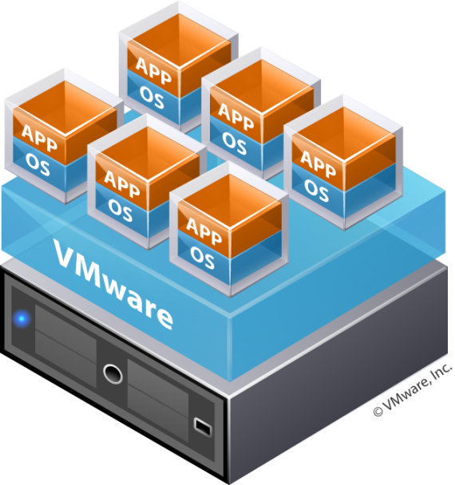
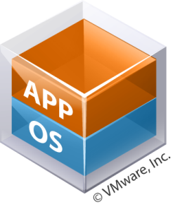
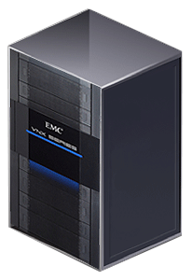
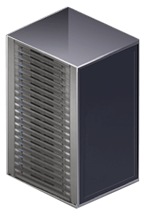
VMware vMotion на большие дистанции
EMC VPLEX для предотвращения авврий
Синхронные дистанции
VPLEX Metro
DISTRIBUTED VIRTUAL VOLUME
FIBRE CHANNEL
Notes:
If customers want to go beyond the walls of a single data center,
EMC VPLEX allows them to use VMware vMotion over distance, allowing for the migration and relocation of VMs, workloads, and data between physical sites, over distance, all non-disruptively.
Today, with VPLEX Metro, this capability is limited to data centers within synchronous replication distance of each other. EMC has announced that we will release the VPLEX GEO product in 2011, allowing this non-disruptive vMotion (and Storage vMotion) to occur over any distance.
Live Migration of VMs, Applications, and Data from data center to data center over synchrounous distance (about 60 Miles or 100KM). All while using Active/Active, heterogeneous storage.
Need to be able to extend the Layer 2 network, and have Fiber Channel connectivity between data centers.

Slide 12




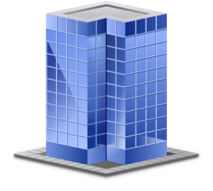

Упрощение ЦОД сетей с Cisco OTV
IP A à IPB
MAC1 à MAC2
MAC1 à MAC2
MAC1 à MAC2
Encap
Decap
OTV
OTV
MAC | IF
MAC1 | Eth1
MAC2 | IP B
MAC3 | IP B
IP A
OTV
IP B
Server 1 Mac 1
Server 2 Mac 2
Соединение меж
MAC1 and MAC2
OTV позволяет сохранить оригинальный IP адрес всем VM который неизменен про перемещении с ЦОД A в ЦОД B
Notes:
Cisco Overlay Transport Virtualization (OTV) significantly simplifies extending Layer 2 applications across distributed data centers. You can now deploy Data Center Interconnect (DCI) between sites without changing or reconfiguring your existing network design. With OTV you can deploy virtual computing resources and clusters across geographically distributed data centers, delivering transparent workload mobility, business resiliency, and superior computing resource efficiencies.
Key OTV features include:
Extends Layer 2 LANs over any network: Uses IP-encapsulated MAC routing, works over any network that supports IP, designed to scale across multiple data centers
Simplifies configuration and operation: Enables seamless deployment over existing network without redesign, requires minimal configuration commands (as few as four), provides single-touch site configuration for adding new data centers
Increases resiliency: Preserves existing Layer 3 failure boundaries, provides automated multihoming, and includes built-in loop prevention
Maximizes available bandwidth: Uses equal-cost multipathing and optimal multicast replication

Slide 13

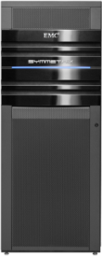

Доступность: VPLEX Witness + Cross-Cluster Connect
ЦОД1
ЦОД2
Подходит для коротких расстояний (<1мс)
Host Multipathing на оба ЦОДа
Меньше сценариев failover для серверов
VPLEX
WITNESS
AccessAnywhere
Active
Active
Notes:
The host cross-cluster connect configuration is a deployment where the host is connected to both clusters in a VPLEX Metro. This configuration provides the unique capability for applications to ride through any storage failure, including disaster-level scenarios affecting entire racks of storage equipment simultaneously.
Note to Presenter: In order to implement the cross-connect capability, the round-trip latency cannot exceed 1 ms and is only supported with VMware ESX servers. Over time, additional host types will be supported.

Slide 14

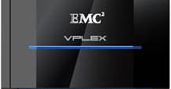
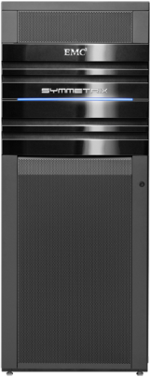

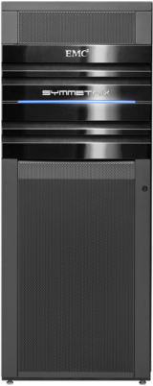

Мобильность: Near-live VM перемещение
Для перемещения на большие дистанции
Site 1
Site 2
Постоянный доступ к данным
Лёгкость рестарта VM
VPLEX
WITNESS
Поддержка асинхронных дистанций
Site 3
AccessAnywhere
(async)
Notes:
For two data centers that are located at asynchronous distances, there are also several advantages of implementing Virtualization along with VPLEX. By leveraging VPLEX Geo along with VMware, migration is possible through the suspension of the VM. A suspended VM enables guaranteed continuous access to the data – no stop / re-start is required. Additionally, the migration of a VM in suspended form consumes less time than the migration of that same VM while being alive (a consequence of the fact that the memory of a suspended VM is not changing). This is an ideal solution for VMware users with separation distances beyond traditional synchronous distances.
The disadvantages of this form of migration is that the VM is offline during the (shorter) migration.

Slide 15
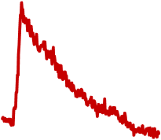
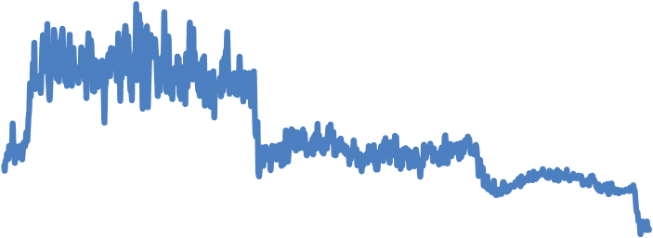
Безшовная мобильность приложений
26 VMs, 26 GB of data, 26 miles
Время для преноса VM
9
8
Storage vMotion
+ vMotion:
2.6 hours
7
6
5
RESPONSE TIME (MS)
4
vMotion с
EMC VPLEX:
9 minutes
3
2
17x FASTER
1
0
0
20
40
60
80
100
120
140
160
RUN TIME (MINUTES)
Notes:
In combination with vMotion, VPLEX moves applications 17x faster than with vMotion alone.

Slide 16
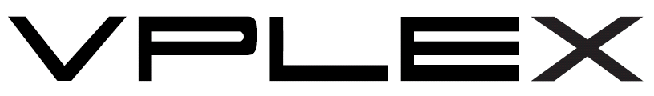
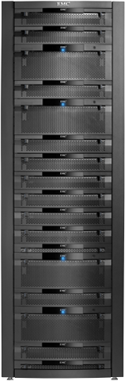
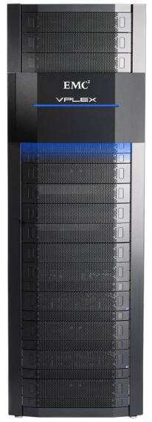








VPLEX линейка продуктов
NEW
VS1
VS2
NEW
VPLEX Local
VPLEX Metro
VPLEX Geo
В центре обработки данных
AccessAnywhere на синхронных дистанциях
AccessAnywhere на aсинхронных дистанциях
Одна, две, или четыре энжины
Notes:
VPLEX Local is designed for use in a single data center, while VPLEX Metro allows you to connect two VPLEX clusters together within synchronous distances and move or share data between them.
A common use case for VPLEX Local includes nondisruptive data mobility between EMC and non-EMC platforms. It allows users to implement VPLEX Local to federate storage arrays and simplify and speed data movement between them. VPLEX Local also provides a way to increase high availability and local storage resiliency for arrays in a single site. VPLEX allows storage to be mirrored across mixed platforms without requiring host resources. Leveraging this capability can increase protection and high availability for critical applications while leveraging a user’s existing storage resources. VPLEX Local can also be used to simplify management of multi-array storage environments, with tools to provision and allocate virtualized storage devices to standardized LUN presentation and management.
VPLEX Metro allows users to move applications over distance and, in combination with server virtualization, enables users to transparently move and relocate virtual machines and their corresponding applications and data over distance. This unique capability allows users to relocate, share, and balance infrastructure resources between data centers. VPLEX Metro also delivers increased high availability and resiliency by allowing users to mirror volumes within and across locations. This provides non-stop application availability in the event of a component failure. VPLEX Metro also allows data to be distributed, shared, and collaborated on across sites. A single copy of data can be accessed by multiple users across two locations. This allows instant access to information in real time, and eliminates the operational overhead and time required to copy and distribute data across locations.
Finally, VPLEX is now able to offer customer support over asynchronous distances with VPLEX Geo. With VPLEX Geo, you can take advantage of AccessAnywhere capabilities between two sites, even if those sites are more than 100 km apart. As we have discussed, VPLEX Geo brings new innovations to the VPLEX family with all of its capabilities, including application and data mobility, high availability, and distributed data collaboration over extended distances.
In June 2011, EMC will also release new VPLEX system hardware—VS2. VS1 will be available until the end of 2011. We will cover the new hardware features later in the presentation.

Slide 17

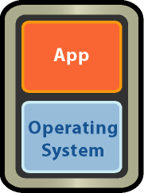



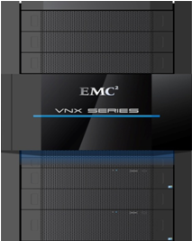
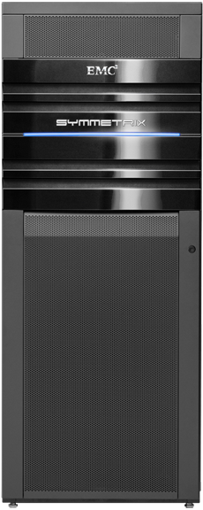




VMware vStorage API для Site Recovery Manager
EMC Storage Replication Adapters для DR
EMC Storage Platforms интегрированы
с VMware SRM
EMC SRAs позволяет автоматический
  D/R Установку
  D/R Тестирование
  Файловер площадки
EMC VSI управляет автоматическим файлбек после восстановления
Продуктив
Резервная площадка
Press In Case
of Disaster
DR Test
EMC Replication
WAN
Notes:
Another area that VMware had opened up for integration is the vStorage API for Site Recovery Manager. This was a huge development, as the lack of an easy integrated disaster recovery solution was a barrier for many organizations’ adoption of VMware for their production environments.
Site Recovery Manager coordinates with vendor-developed Storage Replication Adapters. These Adapters allow for automated set-up and testing of disaster recovery, as well as the automated clean failover from the production site to the recovery site.
The one feature that today’s Site Recovery Manager is lacking is failback. After the disaster is over, failback to the production site is a manual process.
Today, EMC is the only vendor providing an easy mechanism for automating the failback process – all managed from our Virtual Storage Integrator vCenter plug-in.

Slide 18
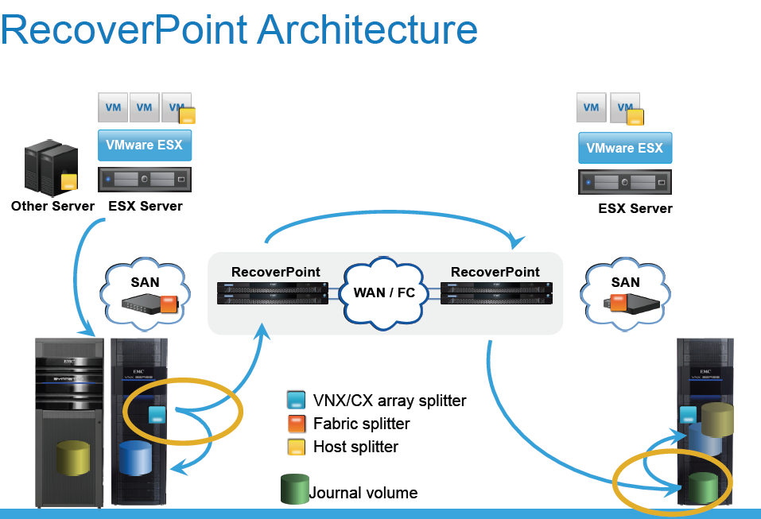
Архитектура RecoverPoint

Slide 19






Непрерывная защита данных средствами RecoverPoint
2a. Драйвер на сервере
1. Три способа зеркалировать ввод-вывод
2b. SAN splitter
3. Хост получает уведомление об успехе
Recoverpoint Appliance
4. ПАК RecoverPoint журналирует каждую транзакцию отдельно
2c. VNX splitter
/ A
/ B
/ C
r A
r B
r C
5. Пишем на резервные тома. Можно на другую СХД на другой площадке
Продуктивные тома
Реплики
Журнал транзакций
Ежемесячный/еженедельный бэкап
Ежедневно снимки
Непрерывная защита
Notes:
This slide describes the data flow from the application host to the production volumes, and how the RecoverPoint appliance accesses the data as part of the CDP process.
(Note to Presenter: Click now in Slide Show mode for animation.) An application server issues a write to a LUN that is being protected by RecoverPoint. This write is split, then sent to the RecoverPoint appliance in one of three ways:
(Click now) The first way is through a host write splitter. This host write splitter resides in the I/O stack, residing below any file system and volume manager, and just above any multipath driver (such as EMC PowerPath). The write splitter looks at the destination for the write packet. If to a LUN that RecoverPoint protects, the write splitter will send a copy of the write packet to the RecoverPoint appliance. It does this by rewriting the target address inside the packet to redirect it to the RecoverPoint appliance’s pseudo-LUN, and reissuing the write down the stack. RecoverPoint/SE only supports a Windows-based host write splitter.
(Click now) The second way is through an intelligent fabric switch-based write splitter, such as the Connectrix AP-7600B with the SAS APIs, or one of the Connectrix MDS-9000 series switches with the SANTap API. The switch will intercept all writes to LUNs being protected by RecoverPoint, and will send a copy of that write to the RecoverPoint appliance. This is not supported with RecoverPoint/SE.
(Click now) The third, and most common way, is through an array-based write splitter, which is supported on VNX series arrays, CLARiiON CX3 arrays with FLARE 26 or higher patch code, and on CLARiiON CX4 arrays with FLARE 28 or higher. Using the array-based write splitter, the array intercepts all writes to LUNs being protected by RecoverPoint, and will send copies to the RecoverPoint appliance.
In all cases, the original write travels though its normal path to the production LUN (Click now). When the copy of the write is received by the RecoverPoint appliance, it is acknowledged back (ACK). This ACK is received by the write splitter (either the host or fabric write splitter), and held until the ACK is received back from the production LUN. With both ACKs received, the ACK is sent back to the host, and I/O continues normally.
(Click now) Once the appliance has acknowledged the write, it will move the data into the local journal volume, along with a time stamp and any application-, event-, or user-generated bookmarks for the write (Click now). Once the data is safely in the journal, it is then distributed to the target replica volumes, with care taken to ensure that write order is preserved during this distribution.

Slide 20
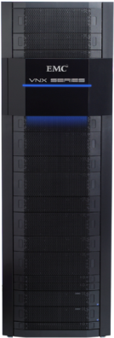








Двух сторонняя локальная и удалённая репликация
Продуктивная площадка
Резервная площадка
Application
servers
RecoverPoint bi-directional
replication/recovery
Standby
servers
Local
copy
Remote
copy
RecoverPoint
appliance
RecoverPoint
appliance
Продуктивные локальные журналы
Fibre
Channel/WAN
Удалённый журнал
SAN
Prod
LUNs
SAN
Symmetrix VMAXe, VNX-, and CLARiiON-based write splitter
Массив хранения
Массив хранения
Notes:
RecoverPoint is a comprehensive data protection solution that provides integrated CRR and CDP, with bi-directional synchronous and asynchronous replication and with concurrent local and remote (CLR) data protection. RecoverPoint allows users to recover applications remotely to any point in time without impact to the production application or to ongoing replication.
RecoverPoint CRR complements EMC’s existing portfolio of remote replication products by adding heterogeneous replication (with bandwidth efficiencies) in synchronous or asynchronous replication environments, which lowers your multi-year total cost of ownership. RecoverPoint CDP—offered as a stand-alone solution, or combined with CRR—enables you to roll back to any point in time for effective local recovery from events such as database corruption.
RecoverPoint ships with utility agents that support the Microsoft VSS and VDI APIs, enabling intelligent local and remote replication for Exchange Server and SQL Server. Other applications, such as Oracle, can be replicated using scripting to the RecoverPoint command-line interface.
Unlike other replication products, RecoverPoint is appliance-based, which enables it to better support large amounts of information stored across a heterogeneous server and storage environment. RecoverPoint uses lightweight splitting technology—on the application server, in the fabric, or in the Symmetrix VMAXe, VNX series, CLARiiON CX4, or CX3 array—to mirror a write to a RecoverPoint appliance that resides outside of the primary data path. Implementing this approach enables RecoverPoint to deliver continuous replication without impacting an application’s I/O operations. If an array-based write splitter is used on the VNX series or CLARiiON, then the iSCSI LUNs hosted by the VNX series or CLARiiON can be used by RecoverPoint.
EMC’s network-based approach to data protection enables certain key functionalities, such as being able to instantly recover data to any point in time, and by leveraging a journal that stores all data changes and bookmarks that identify application-specific events. RecoverPoint makes use of consistency groups, which let users define sets of volumes for which the inter-write order must be retained during replication and recovery. This ensures that data at any point in time will be fully self-consistent. Finally, the RecoverPoint appliance provides advanced bandwidth management, which implements a policy engine that decides how much data should be compressed before sending it across an IP or Fibre Channel link.
RecoverPoint supports major operating systems (including IBM AIX, HP-UX, Linux, OpenVMS, Oracle Solaris, Microsoft Windows, and VMware ESX), supports storage arrays from EMC and other vendors, and can be easily managed from a graphical user interface (GUI) or a command-line interface (CLI). Finally, other EMC products, such as EMC Data Protection Advisor, EMC NetWorker, and EMC Replication Manager provide advanced functionality through integration with RecoverPoint.

Slide 21



Распределённые консистентные группы
Обрабатывают больше операций записи (‘throughput’) чем одно устройство RecoverPoint для асинхронной репликации
Распределяет запись на один LUN запись на много устройств RecoverPoint
Обход узких мест вызванных единственным WAN соединением
Application
servers
Replica
volumes
RecoverPoint appliances:
Primary and three secondary
SAN/WAN
Production volumes
Notes:
This chart shows how a distributed consistency group improves throughput for asynchronous replication.
A distributed consistency group is comprised of a primary RecoverPoint appliance (RPA) and from one to three secondary RPAs. In this example there are three secondary RPAs. The write is split by the write-write splitter and a copy is sent to the primary RPA. The RPA examines the target location of the write to determine which RPA(s) will process the write. It does this by dividing the LUN up into equal-sized sections (shown here using different colored squares). The primary RPA handles its proportion of the sections and distributes the remaining sections, using the Fibre Channel links, to the secondary RPAs. This results in each RPA in a distributed consistency group handling writes to its own section of the LUN, which results in different sections being distributed across a LUN and helps avoid any issues with a single RPA handling all the hotspots. In the event of a failure of the primary RPA, one of the secondary RPAs assumes the role of primary and performs the role of primary as well as its existing role as secondary.
The combined throughput of a distributed consistency group is more then three times that of a normal consistency group. The difference is due to the role of primary in handling its portion of the writes and distributing the remaining data to the other RPAs. A distributed consistency group is supported if the RecoverPoint cluster is made up of GEN3 and/or GEN4 appliances—if there is a GEN1 appliance in the cluster, distributed consistency groups will be disabled.

Slide 22




Уменьшение полосы пропускания = экономия средств
Управление полосы пропускания уменьшает требования к сети и месячные расходы
Включает:
  Дедупликацию
  Компрессию
  Следование одинаковых записей
  Приоритизацию
Необходимая
полоса пропускания
Аренда
канала
Превышение
диапазона
0
1
3
9
15
22
13
24
RecoverPoint использует
7.2 Mb/s
(80% уменьшение)
7.3 Mb/s
$3,000/month
.1 Mb/s
Fractional T3
0
1
3
9
15
22
13
24
$3,000/month
3.7 Mb/s
RecoverPoint использует
3.6 Mb/s
(90% уменьшение)
7.3 Mb/s
0
1
3
9
Fractional T3
15
13
24
22
DS3
реплицированных
36 Mb/s записей
0
1
3
9
15
13
24
40 Mb/s
$10,000/month
4 Mb/s
22
Традиционное копирование
использует36 Mb/s
DS3
Notes:
This slide illustrates the cost savings of bandwidth compression. In this example, RecoverPoint reduces the bandwidth required to replicate changes to the data by up to 90 percent, resulting in a consumption between 3.6 and 7.2 Mb/s, so the replicated data can flow across a fractional T3 network. If you use a different technology that does not achieve this level of compression, the replicated data must flow across a DS3 network, which costs more than three times as much as the fractional T3 and leaves 10 percent unused.
RecoverPoint manages the bandwidth by utilizing five technologies:
Change Deltas: RecoverPoint sends the changes, not the entire data set. If your write-to-read ratio is 1:5 each day, then only 20 percent of your data set will change each day. It is this 20 percent that will be replicated by RecoverPoint and subject to the rest of the bandwidth management technologies.
Prioritization: In the event that RecoverPoint detects bandwidth congestion it will prioritize the replication of the changes by a per-consistency group priority. This will ensure that the most critical replication jobs get the bulk of the resources, including bandwidth resources.
Write-Folding: The larger the RPO for the replicated data, the higher the probability that a subsequent track supersedes an earlier one. This write-folding is a key foundation of reducing the amount of data RecoverPoint has to transmit.
Deduplication: Block-level deduplication is accomplished by using technology from the EMC Avamar deduplication algorithm. This is where all duplicated copies of data are identified and reduced to one instance.
Compression: Block-level compression is accomplished by using multiple algorithms that are controlled by a per-consistency group setting. RecoverPoint uses a lossless algorithm that guarantees that what is compressed can be de-compressed without any data loss. RecoverPoint uses a dictionary approach to build a dictionary of redundant data. The RecoverPoint compression works regardless of the data type. The larger the RPO for the consistency group, the higher the probability that redundant data will be discovered and the higher the level of compression. An RPO of zero will only compress the data in one 512-byte block, while an RPO of greater than zero will be able to compress data across multiple blocks.

Slide 23
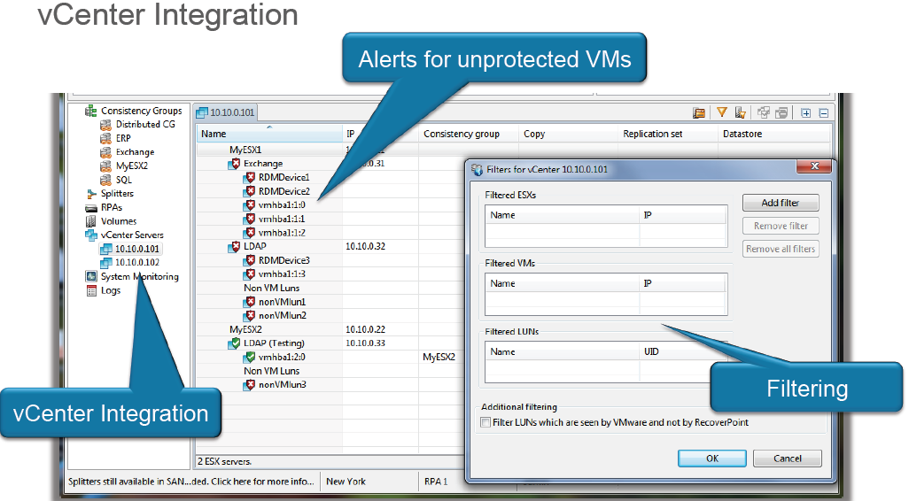
Интеграция с vCenter список и статус всех виртуальных машин

Slide 24

Интегрированное с приложениями резервное копирования средствами дискового массива
EMC Replication Manager для VMware
Интегрировано с приложениями
Exchange
Production
Exchange Copy
Автоматический
Консистентный приложению
Моментальное восстановление VM
Oracle
Production
Oracle Copy
SQL Server
Production
SQL
Server
Copy
Автоматизация
Поддерживает VMware VMotion, DRS, HA, SRM
Notes:
Automation Bullet
Auto-discovery of applications, replication technology, VMware datastores (VMFS/NFS), virtual machines, and their replication configuration during each replica cycle
Application Consistency
Understands how to place applications into proper state for application consistent replicas
VSS for Exchange
VDI for SQL Server and SharePoint
Hot-backup for Oracle
VMware Snapshots for VMFS and NFS datastores
Instant Restore
Application consistent replicas of Exchange, SQL Server, SharePoint and Oracle running on VMware virtual machines
VMFS or NFS datastores containing virtual machines
Point in time restore

Slide 25

Непрерывная защита данных. RecoverPoint
Резервное копирование - Avamar/Data Domain
Ежедневный бэкап: один раз в 24 часа
Внутрисистемные копии данных - TimeFinder/SnapView/SnapSure
Клоны и мгновенные снимки: один раз в 3 часа
Репликация данных - SRDF/MirrorView/Replicator
Межсистемное зеркалирование: восстановление на последнюю переданную транзакцию
EMC RecoverPoint
Постоянная защита: Восстановление на любую точку во времени
Неограниченное количество точек восстановления, «метки» для приложений
(T) TIME
Checkpoint
Pre-Patch
Patch
Post-Patch
Cache Flush
Hot
Backup
Quarterly
Close
Checkpoint

Slide 26

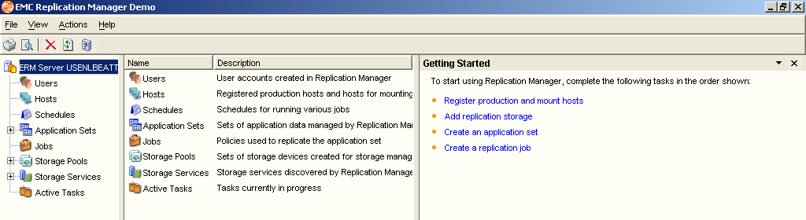

Интеграция с приложениями
EMC Replication manager
Управление администратором MS Exchange
Гарантия консистентности всех контрольных точек восстановления
Интеграция с виртуальными средами
  Vmware
Интеграция с СУБД
  MS SQL, Oracle, DB2
Интеграция с приложениями
  MS Exchange, MS Sharepoint
Поддержка всех распространенных ОС и файловых систем
Непрерывная защита:
восстановление на ЛЮБУЮ точку назад
Time
Check-
point
Pre-
Patch
Patch
Post-
Patch
Cache
Flush
Hot
Backup
Check-
point
EMC VNX

Slide 27
Пример: Мs Exchange 2010
Сценарий | DAG | RecoverPoint
Ежедневное Резервное копирование | Журналы не могут обрезаться во время применения на почтовую базу. Полный бекап может не пройти за окно, если объёмы применения базы большие. RPO и RTO не обеспечены | Репликация на блочном уровне не конфликтует с бекапом
Разрыв связи между площадками | Применение баз развалится и будет нуждаться в рестарте с самого начала Существующая копия базы будет остановлена и начат процесс аккумуляции журналов пока не восстановится канал. База может не смонтироваться при недостаточности места для журналов | Репликация будет в паузе и восстановится после восстановления соединения Будут реплицироваться только изменения что существенно уменьшит требования к каналу Никак не повлияет на Exchange хост

Slide 28
Пример: Мs Exchange 2010
Сценарий | DAG | RecoverPoint
Необходимо реплицировать Exchange Publick Folder | Поддерживает репликацию только почтовых ящиков | Реплицирует всё
Высокая латентность сети между площадками ограничена пропускная способность | Не оптимизирован для работы в WAN. Нет возможности управлять полосой и реплицировать по расписанию Лимит дистанции связан с задержками сети | WAN оптимизация Урезание полосы пропускания Файловер и файлбек со встроенной компрессией
Наличие ящиков версии 2007 | Не поддерживается | Реплицируются как данные так и виртуальные машины всего Exchange

Slide 29
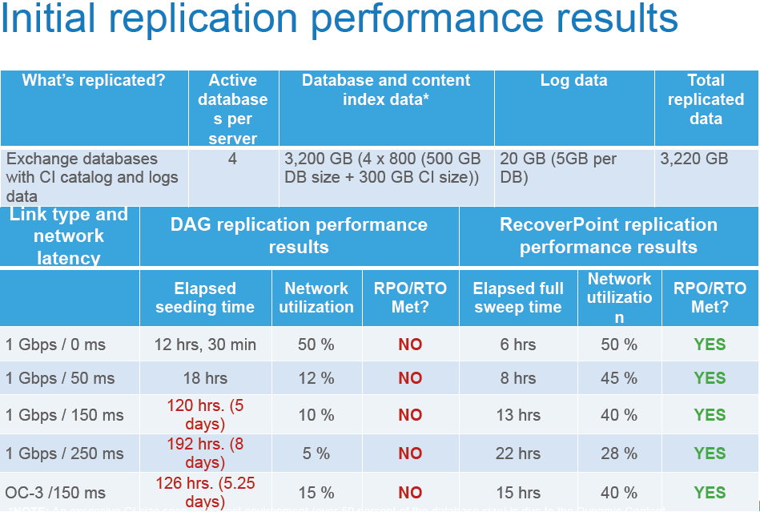
Результаты по производительности при начальной репликации

Slide 30


Как происходит резервное копирование данных?
Notes:
A customer’s environment grows and grows and continues to adopt VMware at a rapid pace. How do customers backup their environment? What about Disaster Recovery? What about Disaster Avoidance? How can EMC help with backup in your virtualized datacenter?

Slide 31
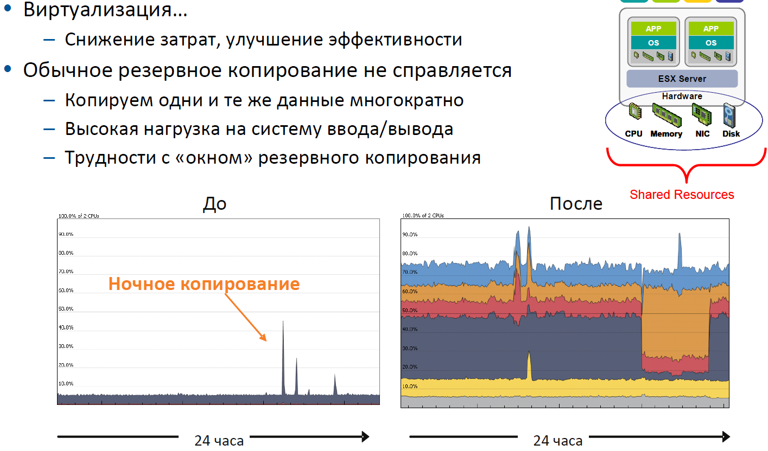
Что изменилось с виртуализацией?

Slide 32
Резервное копирование и восстановление для VMware
Virtual Machines
Sites
Files
85-90%
востановлений
10-15%
Восстановлений
<1%
восстановлений
Notes:
32
EMC Avamar
January 2007
Guest-level Backup involves installing Avamar Agent inside each virtual machine. Backup configuration for this method is no different from that for a physical server. Usually no scripting is needed for this type of backup. Configuration beyond basic client setup might be needed to support a specific application, such as Microsoft SQL Sever, Oracle, or Microsoft Exchange. The main advantages of this are:
Highest level of data de-duplication
Support for backup of applications inside the virtual machines
Support for partial or file level restores
Identical backup methods for physical and virtual machines
No requirement for advanced scripting or VMware software knowledge
Unchanged day-to-day procedures for backup
On the other hand, this is the most resource-intensive backu method. It also does not take advantage of such virtual machine characteristics as encapsulation for doing efficient backups.

Slide 33







Дедупликация ускоряет виртуализацию
Резервное копирование изменённых VMDK файлов без дедупликации слишком дорогое
Повышенная эффективность
Меньший объем системы хранения
Меньше нагрузки на полосу пропускания
Notes:
Deduplication is accelerating this backup transition. It’s changed the economics of disk. It has changed the economics of disk. It improves backup performance, consumes less storage, and allows you to retain backups on disk longer as well as for archiving. And because it is disk-based, it’s also more reliable. And of course it has significant benefits in allowing cost-effective and network-efficient replication.
According to an InfoPro survey, over the last two years, F1000 in-use rates for backup with deduplication have risen from 15 percent to 46 percent.
And although you should know that all deduplication is not created equal (we will talk to you about EMC’s approach to deduplication later), to move beyond a traditional backup approach you need more than deduplication alone.
Note to Presenter: See the footer on the next slide for the title of TheInfoPro survey mentioned here.

Slide 34
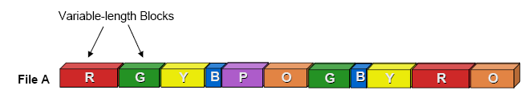
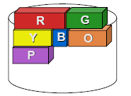
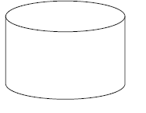

Как работает дедупликация?
Что такое дедупликация?
Алгоритм:
Разбиение потока данных на блоки переменной длины
Компрессия
Вычисление сигнатуры (хэша) для каждого блока
Сохранение только уникальных блоков в сжатом виде
Результат: возможность упаковать 10 TB резервных копий в 1 TB дискового пространства = снижение стоимости хранения, возможен отказ от лент, эффективная репликация и т.п.

Slide 35


Способ: сравнение дедупликации «на лету» и дедупликации после обработки
«НА ЛЕТУ»
Дедупликация перед сохранением
ПОСЛЕОПЕРАЦИОННАЯ
Дедупликация после сохранения
Дедупликация
Сохранение
Дедупликация
Трехкратное увеличение количества обращений
к СХД общего доступа
Беспрепятственное выполнение прочих операций
  Предсказуемость
  Упрощение
Чем больше процессов, тем больше конфликтов использования ресурсов
  Копирование на ленту: слишком медленно для потоковой записи на ленту
  Восстановление: невозможно спрогнозировать выполнение соглашений об уровне обслуживания
  Репликация: длительное время подготовки к выполнению аварийного восстановления
  Дедупликация: только поочередно с резервным копирование или восстановлением
Для решения этих проблем требуется больше административных усилий
Notes:
One of the most conventional alternatives to the Data Domain inline deduplication storage system approach (shown on the left) is by using a methodology known as post-process (shown on the right). In the post-process architecture, data is stored to a disk before deduplication. Then after it is stored, it is read back internally, deduplicated, and written again to a different area.
Although this approach may sound appealing because it seems as if it would allow for faster backups and the use of less resources, it actually creates two problems:
First, a lot more disk is needed to store the multiple pools of data, and for speed, because most of the other vendor’s deduplication approaches are spindle-bound. Because of this, there’s typically a factor of three or four more disks in a post-process configuration than you’ll see in a Data Domain deployment.
Second, it’s just a lot simpler to use an inline approach. If data is all filtered before it’s stored to disk, then it’s just like a regular storage system—it just writes data; it just reads data. There’s no separate administration involved in managing multiple pools—some with deduplication, some with regular storage—and managing the conditions between them. Less administration in the storage system is always better.

Slide 36
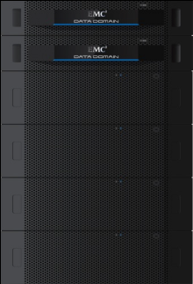
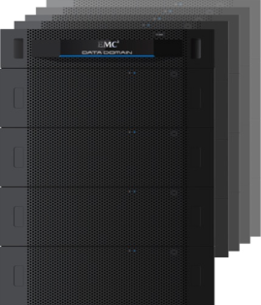
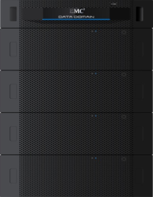
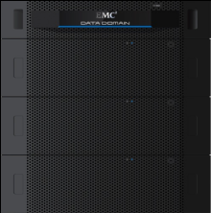
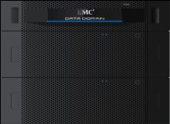
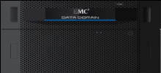



Системы дедупликации «на лету» с самым высоким в отрасли уровнем масштабируемости
Global Deduplication
Array
DD Archiver
Серия устройств
DD800
Серия устройств
DD600
Устройство
DD160
Дополнительное ПО:
DD Boost, DD Virtual Tape Library, DD Replicator,
DD Retention Lock и DD Encryption
 | DD160 | DD620 | DD640 | DD670 | DD860 | DD890 | Global Deduplication Array |  | DD Archiver
Скорость (с DD Boost) | 1,1 ТБ/ч | 2,4 ТБ/ч | 3,4 ТБ/ч | 5,4 ТБ/ч | 9,8 ТБ/ч | 14,7 ТБ/ч | 26,3 ТБ/ч |  | 9,8 ТБ/ч
Скорость (другие) | 667 ГБ/ч | 1,1 ТБ/ч | 2,3 ТБ/ч | 3,6 ТБ/ч | 5,1 ТБ/ч | 8,1 ТБ/ч | 10,7 ТБ/ч |  | 4,3 ТБ/ч
Логическая емкость | 40–195 ТБ | 83–415 ТБ | 0,32–1,6 ПБ | 0,6–2,7 ПБ | 1,4–7,1 ПБ | 2,9–14,2 ПБ | 5,7–28,5 ПБ |  | 5,7–28,5 ПБ
Полезная емкость | До 3,98 ТБ | До 8,3 ТБ | До 32,2 ТБ | До 55,9 ТБ | До 142 ТБ | До 285 ТБ | До 570 ТБ |  | До 570 ТБ
Notes:
Here’s a look at the latest Data Domain product family, including the recently introduced DD160, DD620, and DD640.

Slide 37
Почему EMC Data Domain , а не другие
Data Domain
1,500
Fibre Channel
SATA
1,000
Throughput MB/s
Большинство
вендоров
50
50
100
150
200
Количество дисков
Notes:
This slide shows another way to look at the virtues of being CPU-centric.
As mentioned before, most of the deduplication competitors for backup targets are spindle-bound or disk-bound. It takes so many disk seeks to look up the information to tell whether data has been stored before or not, and to sort out and then minimize the data, that it takes a lot of disk drives or faster disk drives to get the job done.
This slide shows what’s happened in our competitive environment as a result. If they’re using SATA disk drives, most deduplication storage vendors tend to need three or four times as many drives as a Data Domain system to store the same amount of deduplicated data.
In some cases, for example, IBM’s ProtecTIER, storage systems use Fibre Channel drives instead of SATA. This can decrease the seek time, but it comes at a significantly higher cost. Data Domain systems, by being CPU-centric and minimizing disk usage to only what is required to store the actual data, end up having a smaller footprint. This can look like a weakness, but it’s actually a strength.
By keeping the costs down, the Data Domain system is much better structured to compete on a comparison, for example, with a tape library, and its cost per gigabyte.

Slide 38

Надежность EMC DataDomain:
архитектура Data Invulnerability Architecture
Сквозная проверка данных
  Контрольная сумма
  Дедупликация, запись на диск
  Проверка
Вычисление
контрольной
суммы
Проверка
данных
Повторное вычисление контрольной суммы и сравнение
Проверка целостности метаданных файловой системы
Файловая система
Самовосстановление
файловой системы
  Очистка
  Устаревшие данные
  Дефрагментация
  Проверка
Дедупликация
Проверка целостности пользовательских данных
Локальное сжатие
RAID
Проверка целостности распределения
Другое
  RAID 6
  NVRAM
  Снимки
Сквозная проверка данных

Slide 39
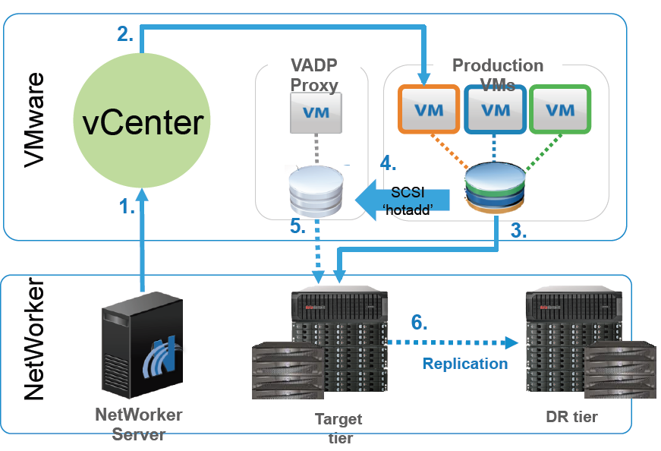
Схема резервного копирования для виртуальных сред
DataDomain обеспечивает скорость благодаря SISL
Networker инициирует резервное копирование
vCenter создаёт снимок виртуальной машины
Затребованы VMX и NVRAM файлы
Прокси конфигурирован с SCSI hotadd
Прокси читает содержимое виртуальной машины, записывает только изменённые блоки на DataDomain
Резервная копия реплицируется за пределы площадки

Slide 40
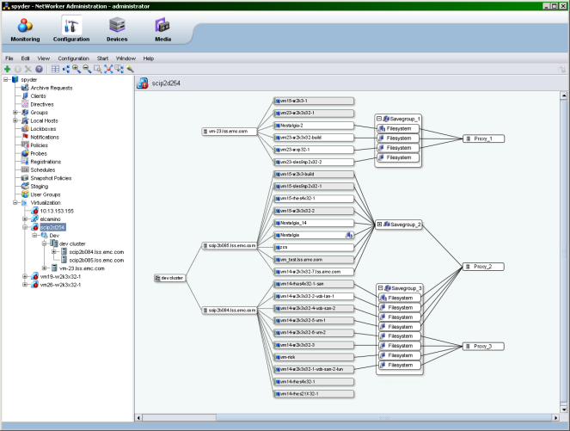
Интеграция с VMware vCenter Server
Визуализация
Отображение взаимосвязи между резервным копированием и виртуальными машинами
Отображение типа защиты
с помощью уникальных значков и индикаторов
Интерактивные элементы для настройки карты и поиска в ней
Упрощенное управление крупными средами VMware
Notes:
Note to Presenter: View in Slide Show mode for animation.
NetWorker 7.5 and higher makes it easier than ever to stay on top of your VMware environment through a new graphical representation of your virtual backup environment. This shows the relationship among NetWorker and the virtual environment, clusters, ESX servers, virtual machines, etc. You can see how clients are configured to run in the various backup groups. This is a great way to see whether adjustments to the environment are necessary.
You can see if virtual machines are being protected at the guest level or through the vStorage API for Data Protection, and interactive controls (zoom, find, filter, etc.) allow you to customize the map to see what you want when you need it. You can also configure directly from the map by right-clicking and launch a configuration wizard. This especially helps simplify management of large VMware environments.

Slide 41
Data Domain Replicator
Новый тип репликации на определенный момент времени
Исходная
система Data Domain
Целевая
система Data Domain
Снимки файловой системы обеспечивают согласование между площадками
в определенный момент времени.
Автоматически выполняется репликация созданных пользователями снимков файловой системы
в систему назначения.
Снимок файловой системы
Снимок файловой системы
MTree
MTree
Exchange
Exchange
MTree
Снимок файловой системы
Снимок файловой системы
MTree
Oracle
Oracle
Снимок файловой системы
Снимок файловой системы
MTree
MTree
SharePoint
SharePoint
Notes:
Specifically, let’s discuss how MTrees enable point-in-time replication with Data Domain Replicator.
Note to Presenter: Click now in Slide Show mode for animation.
MTrees, introduced in DD OS 5.0, are user-defined logical partitions of the Data Domain file system that enable improved granular management of the Data Domain system.
Note to Presenter: Click now in Slide Show mode for animation.
DD OS 5.1 extends this management capability by introducing a new replication type, called MTree replication, that enables users to replicate MTrees between Data Domain systems for point-in-time consistency across sites.
Note to Presenter: Click now in Slide Show mode for animation.
Specifically, MTree replication leverages snapshots to ensure that the destination Data Domain system will always be a point-in-time image of the source Data Domain system. System-generated snapshots occur approximately every 15 minutes and are automatically replicated to provide file-level consistency at the disaster recovery site. Just as shown in this slide, once the MTree snapshot is created, the source system will automatically replicate it to the destination. Users can also create application-consistent snapshots (for example, after completion of a backup), which will also be replicated to a disaster recovery location. These user-defined snapshots enable users to verify that their backup job has been completely replicated to the disaster recovery site.
MTree replication is a periodic process with the following steps:
Source Data Domain system takes a snapshot of the MTree(s), then compares the current snapshot to last snapshot and sends changes to the destination Data Domain system.
Destination Data Domain system will make updated MTrees available for recovery as soon as it receives all changes.
This process will repeat every time a snapshot is created. This can either be a user-defined snapshot for application consistency or an automatic system-generated snapshot at the default 15-minute interval. Note: Replication will not be triggered until previous replication has completed.
Overall, MTree replication further extends Data Domain systems’ market-leading replication flexibility. This new replication type supports all existing replication topologies including one-to-one, one-to-many, many-to-one, bi-directional, and cascaded. No one else offers the flexibility in replication deployment options as Data Domain Replicator.
Note to Presenter: In this release, MTree replication is not available for Data Domain customers using the Data Domain Virtual Tape Library software option or NDMP connectivity.

Slide 42

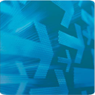
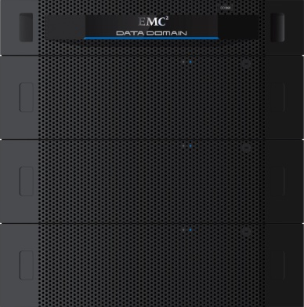
Программное обеспечение DD Boost
Частичное перераспределение процесса дедупликации на сервер резервного копирования или клиенты приложений
  Лицензируемое ПО, которое работает с продуктами портфеля Data Domain
Поддержка большинства существующих программных продуктов для резервного копирования
  EMC Avamar и NetWorker
  Symantec NetBackup и Backup Exec
Ускорение резервного копирования до 50 %
Обработка большего количества резервных копий
с помощью имеющихся ресурсов
  Сокращение общей нагрузки на сервер резервного копирования на 20–40 %
  Уменьшение нагрузки на полосу пропускания LAN на 80–99 %
Возможность управления репликацией в Data Domain из приложения для резервного копирования
DD
Boost
Notes:
In the traditional backup world, backup software is backup software, and storage is storage. DD Boost software distributes part of the deduplication process out of the Data Domain system and onto the backup server. This makes the backup network more efficient, makes Data Domain systems 50 percent faster, and makes the whole aggregate system more manageable. It works across the entire Data Domain product line and supports the majority of the backup market.

Slide 43
График развития систем Data Domain
Масштабируемая архитектура Data Domain SISL ориентирована на использование ЦП
Улучшения с 2004 года
  Пропускная способность: ~ в 175 раз
  Емкость: ~ в 450 раз
Массив
Global Deduplication Array
с двумя контроллерами
5
DD Boost
2014 г. (прогноз)
3
Пропускная способность, ГБ/с
Один контроллер, стандартные протоколы
1,5
0,04
DD200 (2004 г.)
2004
2010
2011
Будущее
Notes:
Due to their unique architecture, Data Domain systems have continued to scale in significant ways. The red line on this slide shows how throughput and addressable capacity have increased over time in the flagship Data Domain system for industry standard data access protocols such as NFS, CIFS, and VTL. However, EMC changed the game with two introductions—Data Domain Boost, represented by the green line, and multi-controller systems like the Data Domain Global Deduplication Array, represented by the blue line, both of which bumped this trajectory onto a whole new level.
The key to this scalability is the Data Domain CPU-centric architecture, referred to as Stream-Informed Segment Layout (SISL), which relies on CPU processing power, rather than disk spindles, to scale performance. This allows Data Domain systems to scale in performance every time Intel introduces a new CPU, versus competitors that rely on disk vendors to increase performance over time. Therefore, the benchmarks shown here are accomplished with the minimum hardware, unlike disk-based competitors who have to add extra disk for performance reasons.
Since 2004, Data Domain systems have increased 175-times in throughput and 450-times in capacity and EMC expects this trajectory to continue over time. Therefore, as CPUs get faster, Data Domain systems can get faster. And as they gets faster, they get bigger and can protect more data on a single system. (Note to Presenter: Therefore, your opportunity to sell Data Domain systems into large enterprise accounts will continue to grow for years to come.)

Slide 44

Ускорение восстановления для VMDK
РЕЗЕРВНОЕ КОПИРОВАНИЕ С ОТСЛЕЖИВАНИЕМ
ИЗМЕНЕННЫХ БЛОКОВ (CBT)
Восстановление измененных блоков
  Между набором резервных копий и виртуальной машиной передаются только измененные блоки благодаря их отслеживанию (CBT)
  Ускоренное восстановление образов
Резервное копирование и восстановление в системы NFS и сети хранения данных, а также из них
Без использования
сети LAN
Прокси-сервер
для образов
ВМ
LAN/WAN
Блоки CBT
Уникальные блоки
СТАНДАРТНОЕ ВОССТАНОВЛЕНИЕ
Без использования
сети LAN
Прокси-сервер
для образов
ВМ
LAN/WAN
Вся ВМ
Вся ВМ
CBT-ВОССТАНОВЛЕНИЕ
Без использования
сети LAN
Прокси-сервер
для образов
ВМ
LAN/WAN
Блоки CBT
Блоки CBT
Notes:
Avamar was the first solution to take advantage of Changed Block Tracking for backup. Only changed blocks are processed for determining unique elements that are then stored for future recovery. Prior to the Avamar 6.0 release, the recovery process simply restored either the full file (if in a Windows OS) or the full VMDK image. Now Avamar tracks the delta of changed blocks to speed the recovery process by restoring only the unique elements required to rebuild the file, folder, or VMDK requested—resulting in faster restores.

Slide 45

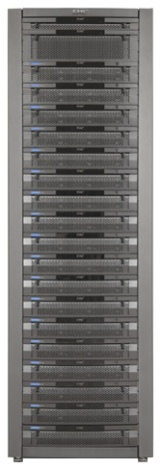




Avamar - решение для защиты Vmware
Интеграция Avamar с прикладным программным интерфейсом VMware vStorage API для защиты данных
Виртуальные машины
Дедупликация одного и нескольких файлов VMDK
Сокращение времени резервного копирования и минимизация времени восстановления путем отслеживания измененных блоков (CBT)
Восстановление на уровне файлов из резервной копии образа (Windows)
Гибкое восстановление на исходную, текущую или новую виртуальную машину
Балансировка нагрузки на прокси-сервере для обеспечения превосходной пропускной способности
Уровень виртуализации VMware
Архитектура x86
Монтирование
Пул ресурсов
Физический сервер
СХД
Avamar
Data Store
Физический сервер
= программный агент Avamar
Notes:
Now let’s look at using Avamar to provide image-level backups, taking advantage of VMware’s vStorage API for Data Protection.
The vStorage API approach involves creating VMware snapshots of a virtual machine, presenting it to a proxy host—which can now be running in another virtual machine—and then backing up the VMDK file from the proxy. Companies like this approach because it moves the backup process away from the virtual machines where their applications are running, which avoids any performance impact to the application.
In this case, you would install the Avamar agent on the proxy host, treat it as the backup client, and run your backups from there to an Avamar Data Store. Because of VMware advancements, including the ability to run the proxy server in a virtual machine and to dynamically “hot-add” volumes to that proxy without physically moving data across the network, Avamar is able to back up large virtual machines in just minutes.
Something to think about when considering backup for Vblocks or other large virtual computing environments with hundreds of virtual machines to protect.
Avamar can load balance jobs across virtual proxy servers to assure that individual proxies are not overtaxed. Jobs can also be directed to available proxies to handle high-priority workloads. This approach helps drive down costs by having fewer proxies to manage.
Avamar can also leverage some new capabilities provided by VMware to only back up changed blocks. This lessens the backup processing that Avamar has to do, and speeds up the backups even further.
And Avamar’s architecture was designed to reconcile daily changed block backups into full instances for recovery. This is different from most backup applications that require at least a periodic full backup. This means Avamar can process the changed blocks identified by VMware into a new full recoverable image on an ongoing basis. As a result, recovery is much faster and more reliable.
One feature that companies really would like is the ability to do one backup, and have the option of a bare-metal restore OR a more granular file-level recovery. Taking advantage of its integrated file system, Avamar can provide this capability—and you don’t have to mount the VMDK in order to do it.
Finally, just as in physical environments, Avamar’s deduplicated replication of protected VMDK files allows for network-efficient disaster recovery—and importantly, great flexibility in how you can restore—either to the original virtual machine or to a new location.

Slide 46
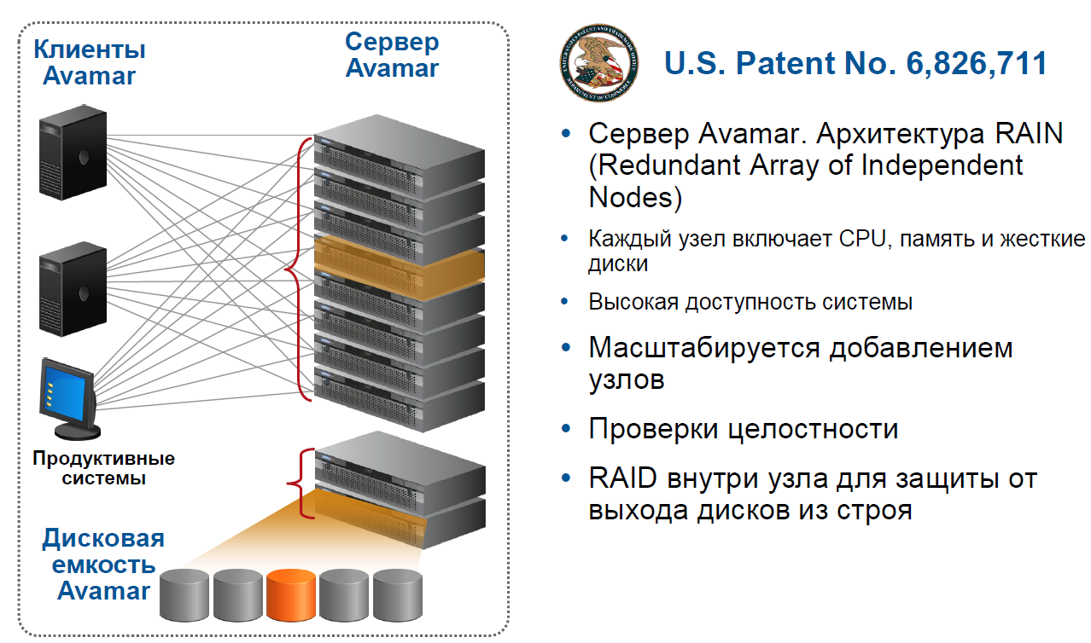
Avamar - Решение для защиты Vmware

Slide 47
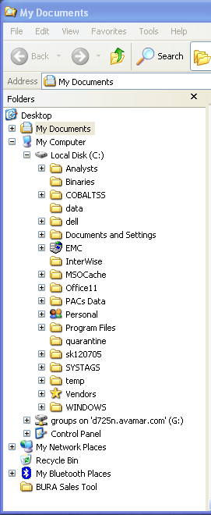


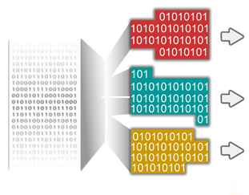
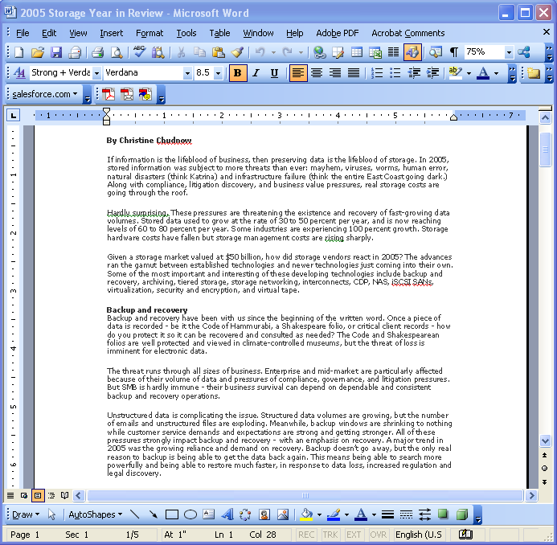
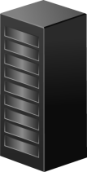
Avamar – как работает глобальная дедупликация?
1
Сравнивает файлы
2
Разбивает на блоки
переменной длины
3
Назначает каждому
блоку уникальный
content id’
Размер блока зависит от типа данных файловой системы средний размер блокаt 24KB .
NO
Algorithm
4
‘is present’?
24 KB

Slide 48



Резервное копирование VMware на уровне гостевой ОС
Агенты Avamar обеспечивают согласованность приложений
Агенты Avamar
Специальный агент приложения на каждой виртуальной машине обеспечивает согласованное состояние «горячего» резервного копирования
Дедупликация в пределах виртуальных машин и между ними
Сокращение конфликтов использования ресурсов и ускорение резервного копирования
Восстановление на уровне файлов в Windows,
Linux и Solaris
Уменьшение расходов благодаря бесплатным агентам
VMware ESX
Notes:
Many companies today continue to choose to backup VMware at the guest level. The main advantages of this approach, as we’ve said, is its simplicity and familiarity. This approach is great for file-level backup and recovery.
In this scenario, the Avamar agent is installed inside the virtual machine. When the backup runs, data is reduced within the virtual machine, and only new unique segments are moved and stored. The key benefit is that because it eliminates the backup bottleneck caused by contention for shared resources, Avamar really helps companies optimize consolidation ratios and get the most out of their VMware investment.
Another benefit is that because operating system- or application-specific agents run in the virtual machine, application consistency can be guaranteed.
And Avamar agents are free. You are only charged for the deduplicated capacity that you consume, so you can deploy agents as you like, which is great for virtual environments where virtual machines tend to come and go very quickly.

Slide 49



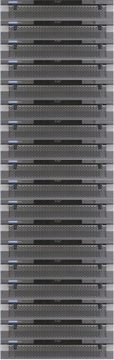

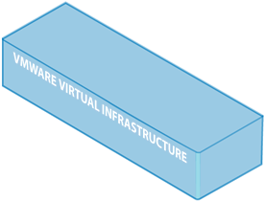


vStorage API с Avamar
Процесс восстановления имиджа VM в новую VM
Scan VM Folders for VM Placement
Scan ESX and Datastores
Recovery VM
VM1
VM2
VM3
Proxy
Virtual Center
VMDK
VMDK
VMDK
VMDK
VMDK
Virtual Switch
Recover VM1.vmx
Out of Place
Recover VMDK Data
VMX
Avamar Сервер

Slide 50


vStorage API с Avamar
Процесс восстановления файла в новое расположение
Recovery VM
VM1
VM2
VM3
FLR Proxy
Virtual Center
Present MC Index
VMDK
VMDK
VMDK
VMDK
VMDK
Admin. Choose Backup to Recover from
Admin. Choose Files and Directories
Virtual Switch
VMDK
Avamar Recovers Directories Selected to VM
FLR Proxy Read in VMDK and Indexes
Avamar Сервер

Slide 51


Гибкое восстановление на уровне образов
НОВАЯ
Три способа восстановить виртуальную машину:
  восстановить данные обратно на исходную виртуальную машину;
  восстановить данные на текущую виртуальную машину;
  восстановить данные на новую виртуальную машину.
Исходная
Текущая
VMware
Измените правила игры: помогите упростить аварийное восстановление с помощью решения Avamar.
Avamar
Data Store
Notes:
Note to Presenter: View in Slide Show mode for animation.
Avamar image-level backups leverage an architecture that includes a native metadata index for each backup instance. Unlike other backup software, which must create a metadata index during or after the backup is complete, Avamar’s native index provides end users with a granular view of image backup content, which can be used to perform file-level recovery without first requiring the image backup to be mounted. In addition, files can be restored to their original location or to an alternative location.

Slide 52

Балансировка нагрузки на прокси-сервер
Кластер VMware
Автоматизация и прозрачность
Упрощение управления
Ускоренное резервное копирование и восстановление
Сокращение издержек
СЕРВЕР ESX 1
СЕРВЕР ESX N
A
Б
Β
Γ
Д
Е
Виртуальный
прокси-сервер
Виртуальный
прокси-сервер
VMware
vCenter
Server
= данные
Avamar
Data Store

Slide 53








Подсчёт загрузки процессов
Лимит производительности виртуального прокси сервера
  Прокси может просканировать - 200 GB/ч
  Прокси может копировать одну машину в одно время
VMware делает
  менее 2 минуты на виртуальную машину
    Создаёт снимок VM относящихся I/O к VM
    SCSI hot-add
  Применяет отслеживание изменённых блоков
    Добавочно необходимо 10% пространства
VMware Image Backup
VMware Virtualization Layer
x86 Architecture
Resource
Pool
Physical server
Avamar
server
= Avamar Software Agent

Slide 54

Отслеживание измененных блоков (CBT)
Быстрее и надежнее
Коэффициент использования ЦП на прокси-сервере ВМ
для резервного копирования образов
При традиционном резервном копировании
ЦП используется на 80 % в течение двух минут
При отслеживании измененных блоков обрабатываются только измененные блоки
При использовании решения Avamar ЦП используется только на 10 % в течение нескольких секунд
1.
2.
80
70
60
50
40
30
20
10
0
Использование ЦП в %
Notes:
Avamar has an architecture that was designed to reconcile daily changed block backups into full instances for recovery, differentiating it from most backup applications that require a periodic full backup. This functionality enables Avamar to process the changed blocks identified by vSphere Changed Block Tracking into a new full image on an ongoing basis. Recovery is faster and more reliable because Avamar always maintains an up-to-date full image. Second, taking advantage of vSphere CBT can greatly reduce backup processing time.
In this example, traditional backup would require 80 percent CPU utilization for two minutes, while Avamar, which leverages Changed Block Tracking and deduplication, will only need 10 percent of the CPU for a few seconds—faster and more reliable.

Slide 55

Avamar - сертифицированная платформа защиты VBlock
Пример защиты 1 000 виртуальных машин
Характеристики прокси-сервера:
два четырехъядерных процессора,
64 ГБ памяти
50 ТБ защищено за 43 минуты
СТАБИЛЬНОЕ
СОСТОЯНИЕ
Notes:
Note to Presenter: View in Slide Show mode for animation.
If you choose a Vblock1 where you can spin up 1,000 virtual machines, how would you deploy backup and recovery to this large environment? EMC did testing with VCE and determined that using a phased-in approach works best.
As seen here on this diagram, on Day 1, 250 virtual machines representing 12.5 TB were set up for backup with Avamar. Avamar took just over an hour (68 minutes) to complete the backup.
On Day 2, another 250 virtual machines were added to the backup policy, which added another 12.5 TB of data. Since the initial 250 virtual machines had already been backed up, then only the daily changes needed to be backed up. In this example, a 6 percent change was assumed (higher than typical environments), which added 0.75 TB to the new 12.5 TB, and this took 79 minutes to complete.
Note to Presenter: You can talk through Day 3 and Day 4 in the same way.
Finally by Day 5, all 1,000 virtual machines were being protected by Avamar.

Slide 56





Avamar Virtual Edition for VMware
Сервер Avamar развертывается как виртуальное устройство
Использование существующих серверов ESX и систем хранения данных (СХД)
Репликация приложений и СХД
Быстрое экономичное развертывание и окупаемость инвестиций
Поддержка VMotion для развертывания и обеспечения гибкости
До двух виртуальных устройств Avamar Virtual Edition for VMware на один сервер VMware ESX для масштабирования
Виртуальная
машина
Avamar
Виртуальная
машина
Avamar
Виртуальная
машина
Avamar
Уровень виртуализации VMware
Архитектура x86
Пул ресурсов
Notes:
Avamar Virtual Edition for VMware is Avamar server software deployed in a VMware virtual machine. Avamar Virtual Edition for VMware is an ideal product for small, medium, or remote offices that have standardized on VMware infrastructure.
Avamar Virtual Edition for VMware provides:
Rapid, cost-effective deployment
Simplified management by virtualizing all aspects of the backup and recovery offering
Lower cost by leveraging shared server and storage infrastructure
Replication in virtual environments as well as between virtual and physical environments for disaster recovery
Rapid return on investment
VMware vMotion support
Scalability with support for up to two Avamar Virtual Edition for VMware virtual appliances per ESX server
Avamar Virtual Edition for VMware runs on top of VMware and can work on any server and iSCSI, SAN, or DAS storage that meets the combined Avamar and VMware specifications. It can replicate between virtual Avamar servers, or to a physical Avamar server such as the Avamar Data Store.
Each Avamar Virtual Edition for VMware virtual appliance supports up to 2 TB of licensed disk storage capacity provisioned to a virtual machine on a VMware ESX server. This provides an effective capacity of up to 70 TB when compared to a traditional backup and recovery solution, and, as you would expect, is VMware-certified. As many as two Avamar Virtual Edition for VMware virtual appliances are supported per ESX server, making it easy to scale when needed.

Slide 57


Результат внедрения Avamar
До …
95 % снижается объем перемещаемы данных
90 % снижается время резервного копирования
50% снижается нагрузка на ввод вывод
95 %снижается нагрузка на сетевую инфраструктуру
80% Снижается нагрузка на процессор
Notes:
Implementing Avamar in backup environments brings dramatic benefits—as much as 95 percent reduction in data moved with deduplication, which results in 90 percent faster backup times. Deduplication results in a 95 percent reduction in disk and network usage as well as dramatic improvements in CPU usage.

Slide 58

Интеграция с VMware vCenter Server
Управляйте защитой данных и хранением состояния виртуальной машины
Просматривайте VMware vCenter Server через GUI Avamar
Автоматически обнаруживайте виртуальные машины и связанные с ними группы
Отслеживайте операций резервного копирования и восстановления в Activity Monitor
Отображайте состояние защиты виртуальной машины («гость», «образ» или «нет»)
Единая точка управления параметрами резервного копирования VMware
Notes:
One of the great values of server virtualization is how much faster and easier it is to stand up a new server implementation. Virtual machines are easy to create, are portable, and can move from ESX host to ESX host automatically.
When new virtual servers can be created in an instant, with a point and a click, how can you assure they are associated with the right backup policy?
Avamar has taken the steps to integrate with VMware’s management tools—particularly vCenter Server—in order to make management of backup and recovery more effective.
With Avamar, you can access vCenter Server directly from the Avamar user interface. New virtual machines are automatically discovered and displayed, so that administrators can apply an appropriate backup policy. Then VMs can be sorted so that their current backup status can be assessed. Administrators can see which virtual machines are backed up (either guest or image) and which ones are not well protected, and then they can make adjustments to correct.

Slide 59

Интеграция с Data Domain
Высокоскоростное масштабируемое резервное копирование Avamar в системы Data Domain
Выборочное резервное копирование и восстановление определенных типов данных в системе Data Domain
  Резервное копирование образов VMware
  Oracle и Microsoft SQL Server, Exchange, SharePoint
Простота управления
  Связывание систем Data Domain с Avamar
  Выбор места назначения данных резервного копирования с помощью политики
  Управление резервным копированием, восстановлением и репликацией с помощью GUI Avamar
Notes:
Avamar 6.0 is integrated with Data Domain systems through Data Domain Boost software. This enables Avamar to send specific data types to a Data Domain system for deduplication and storage. The selected data types include VMware image files (VMDK); Oracle databases; and Microsoft SQL Server, Exchange, and SharePoint.
Avamar also manages the entire environment, both the Avamar Data Stores and the Data Domain systems. This includes backups, restores, and replication—all done through the Avamar graphical user interface (GUI).
Note to Presenter: A DD Boost and DD Replicator license is required.

Slide 60

Схема интеграции с Data Domain

Slide 61



Платформы VCE Vblock Infrastructure Platform
Максимально быстрое обеспечение масштабной виртуализации
Уникальная масштабируемость решения Avamar в средах Vblock
Наиболее быстрая пропускная способность благодаря балансировке нагрузки на прокси-сервер и отслеживанию измененных блоков
Гибкие возможности восстановления
Восстановление «с нуля» для всей инфраструктуры Vblock
  Профили Cisco UCS, файлы конфигурации сети и т. д.
Решение Avamar сертифицировано для использования с Vblock
СЦЕНАРИЙ ИСПОЛЬЗОВАНИЯ
Notes:
Some companies are re-designing their entire data center and moving to a completely virtualized environment. VCE—the virtual computing company—delivers prepackaged infrastructures called Vblocks. A Vblock brings together the best technologies for computing and networking from Cisco, storage from EMC, and virtualization from VMware.
As part of the data center redesign, backup and recovery should now be optimized to protect the VMware environment. Avamar is the industry’s leading VMware backup and solution designed to scale in virtual environments while providing the most-efficient backup and recovery solution. Avamar leverages VMware’s Changed Block Tracking and Proxy server load balancing to enable the faster backup throughput. Avamar also offers flexible restores to the original VM, an existing VM or a new VM.
In addition to protecting the data, Avamar also protects the infrastructure data to enable a bare-metal restore of the Vblock components, including the vSphere SQL database, the Cisco UCS profile, boot information and IP ranges, the external connectivity configuration files, the storage configuration, and EMC Ionix Unified Infrastructure Manager.
Avamar has been tested and qualified with the VCE Vblock in the EMC Integration Lab.

