Slide 1
The Intelligent Branch
EN Perfect Pitch
Mark Krischer
January 2015

Slide 2


VS
[In Retail]
Notes:
Retailers are
Unable to increase shopper dwell time with fast guest wi-fi
Can’t deliver successful omnichannel initiatives
They also have slow to load interactive product catalogs
Ineffective, slow online training

Slide 3


VS
[In Education]
Notes:
Education providers…
Can’t extend learning beyond classroom walls
Unable to deliver HD content to tablets for students
Inability to implement real-time online education systems

Slide 4


[In Financial Services]
VS
Notes:
Banks and insurers can’t…

Slide 5

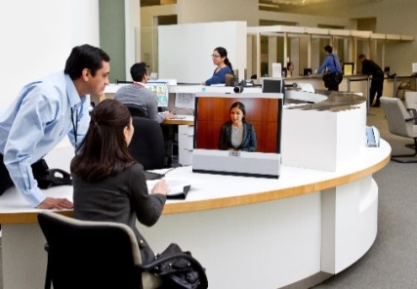

The Business Landscape is Changing
RETAIL
FINANCE
EDUCATION
78%
Of executives state achieving digital transformation in two years is critical*
MIT Sloan Management Review, 2013 Digital Transformation Global Executive Study
Generate More Sales
Customer Loyalty
Improved Learning
Stores
Omni-channel
Tellers
Remote Agents
Books
iPads
New Digital Experiences Make the Network More Relevant

Slide 6



Emerging Demands
Cloud
Applications Are Moving to the Data Center and Cloud
Internet Edge Is Moving to the Branch and User Device
Branch
Increasing Pressure on the WAN
Data Centers
Cloud
Mobility
Video
50
%
of CIOs Expect to Operate via the Cloud by 2015
10x
More Mobile Data Traffic by 2018
80
of Mobile Traffic Will Be Video
%

Slide 7
Digital Innovation Overwhelms the Network
Digital Displays
Omni-channel Apps
SaaS Enterprise Apps
According to Gartner average enterprise bandwidth will increase by up to 50% per year
HD
Guest WiFi
HD Video
Online Training
Branch
Social Media
Social Networking
Mobile Apps
Source: Gartner: How to Cost-Justify WAN Optimization

Slide 8
Digital Innovation Overwhelms the Branch
80%
MORE USERS
Of employee and
customers are served
in branch offices*
Digital Displays
Omni-channel Apps
SaaS Enterprise Apps
73%
MORE DEVICES
Growth in mobile
devices from 2014-2018**
20-50%
Guest WiFi
HD Video
Online Training
MORE APPS
Increase in Enterprise bandwidth per year through 2018***
Branch
30%
MORE THREATS
Of advanced threats will target branch offices by 2016 (up from 5%)***
Social Media
OS
Updates
Mobile Apps
*Tech Target, Branch Office Growth Demands New Devices., 2013 ** Cisco Mobility Landscape Survey, 2014
***Gartner, Forecast Analysis: Worldwide Enterprise Network Services, Q2 2014 Update ****Gartner: “Bring Branch Office Network Security Up to the Enterprise Standard, Jeremy D’Hoinne, 26 April. 2013.

Slide 9
WAN Demands Exceeding Budget
GLOBAL IP
TRAFFIC GROWTH:
IoT
SDN
Increase 3X in the next
Mobility
5 years
Cisco Visual Networking Index, June 2014
Endpoints on the Network
Cloud Computing
Network Complexity Gap
Virtualization
VoIP/Video
LIMITED WAN BUDGETS:
IT Budgets
60% WAN budgets
Building Blocks of IT
will be flat or declining
Nemertes Research, August 2014
Exhibit 2: The Widening Network Complexity Gap
Source: ZK Research, 2014

Slide 10
Application Performance Impact
REVENUE LOSS
EMPLOYEE PRODUCTIVITY
Source: Walmart
Source: Gomez/Compuware
Source: Aberdeen Group
Conversation Rate
Abandonment Rate
Employee Experience
Population %
Conversion Rate
iPhone
31%
30
Decreased effectiveness of IT staff
25
32%
Damage to brand reputation
20
47%
Abandonment Rate (%)
15
Decreased responsiveness to needs
5
50%
0
Lost Revenue opportunity
0-1
3-4
7-8
11-12
>15
0
2
4
6
8
10
12
14
58%
Page Load Time (sec)
Page Load Time (sec)
Decreased employee satisfaction
Employee
Experience
Customer
Satisfaction
Slower pages = lower conversion & higher abandonment rates

Slide 11
Mobile Devices Expect to be Connected
Third-Party Lab Test
Chromebook vs.
Windows 8 Laptop
  Chromebook creates as
  high as 692.2 times more network traffic
  On average, Chromebook creates 152 times more network traffic
Document
Manipulation
Photo
Manipulation
Video
Manipulation
Music
Manipulation
Web
Browsing
Note
Taking
Test
Taking
0.14
10.80
0.27
57.84
2.73
211.29
0.21
145.56
77.39
41.33
6.06
18.30
5.00
8.65
http://principledtechnologies.com/Microsoft/Chromebook_PC_network_traffic_0613.pdf

Slide 12

Branch Scaling Challenges
80–90%
10–20%
Network Operations
Enabling Innovation
0s
10s
100s
1,000s
10,000s
IoE Scale
Complex
and Tedious
Difficult to Provision Applications
Difficult to
Troubleshoot
Slow Deployment
of Services

Slide 13
Branch Requirements
BUSINESS NEEDS
IT REQUIREMENTS
Rising User Expectation
App Performance
Growing Security Attack
Advanced Threat Defense
Faster Time to Market
Agility/Simplicity
Cost Optimization
Operational Simplicity

Slide 14



Different Buyers Have Different Needs
AN INTELLIGENT BRANCH
IS THE BRIDGE
LOB
IT
Personalized Experience
Rich Content Delivery
Application
Agility
WAN Cost Reduction
Application Visibility and Control
Simplification

Slide 15
Transform Your Business
What if your WAN Could….
Improve Your Application Performance
Deliver More Bandwidth for Lower Cost
Pinpoint Application Issues Instantly
Increase WAN Utilization
Hours
1x
Minutes
2x +
Ensure Security Over Any Connection
Automate and Orchestrate IT
Consistent Security Policies
Abstract Network Complexity
Backhaul
Device-by-device
Off-load
System

Slide 16
Architecting the
Intelligent Branch

Slide 17
Intelligent Branch Architectural Elements
Intelligent WAN
Branch Compute
and Storage
Transport Independence
Intelligent Path Selection
Application Optimization
Secure Connectivity
Intelligent
Branch
Distributed Server Virtualization
Local Compute and Storage
Seamless Management
Branch Security Services
Branch Unified Communication
High Performance VPN
Advanced Threat Defense
Policy Enforcement
Voice with Survivability
High Quality Video
Session Border Controller

Slide 18

Intelligent WAN
ISR4000-AX
Transport
Independence
Intelligent
Path Control
Application
Optimization
Secure
Connectivity
Provider Flexibility
Modular Design
Common Operational Model
Load Balancing
Policy-Based Path Selection
Network Availability
Application Visibility
App Acceleration
Intelligent Caching
Scalable, Strong Encryption
App-Aware Threat Defense
Cloud Web Security
SECURE, RELIABLE AND
HIGH PERFORMANCE APPLICATION EXPERIENCE

Slide 19

Branch Unified Communications
ISR 4K ADVANTAGE
Higher multiservice performance
Multi-Core Arch separates signaling from media stream
TDM Gateway
FXO, FXS, and E/M Modules
BRI Modules
TDM Gateway
T1 / E1
Modules
Greater density and scale
Up to 40 T1/E1 terminations
Up to 6000 voice sessions; and up to 2000 SRST seats
Cloud Connector for HCS
DSP Media Services
Conferencing
Transcoding
CME/eSRST
HCS Cloud Connector
Simpler for IT
OIR enabling without downtime
DSPs built into UC cards
SRTP/RTP Internetworking
Individual clock source
Cisco® Unified Border Element

Slide 20
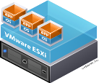

Branch Compute and Storage
Network | Compute | Storage
Store
in a Box
Bank
in a Box
School
in a Box
Clinic
in a Box
SERVER
VIRTUALIZATION
BLADE FORM
FACTOR
SEAMLESS
MANAGEMENT
  Consolidate physical servers to reduce costs
  Improve application uptime and failure recovery time
  Shorten time-to-deployment for new apps
  Eliminate wires, components
  and save space
  Rapidly provision hardware with plug-and-play modularity
  Right-size hardware profile for the lean branch office
  Unified Compute Infrastructure Management with UCS Director
  Centralized provisioning and management across branches
  Separate management domain for network and server teams

Slide 21
Branch Security Services
HIGH-PERFORMANCE VPN
ADVANCED THREAT DEFENSE
NETWORK SEGMENTATION
COLLABORATION SECURITY
Zone-Based Firewall
Sourcefire®
IDS
Web Security
DMVPN
GET VPN
Flex VPN
Integrated
UC Security
TrustSec®
VPN
Up to 1.3 Gbps encryption
Advanced encryption (Suite B)
Integrated crypto without additional hardware
Industry-leading network intrusion detection
Real-time web filtering – Cloud Based (Scansafe) or IronPort on-Premise
Single Policy allowing 80% reduction in policy rules sets
Consistent segmentation across DC, Branch
and Campus
Prevent toll fraud
Firewall aware of voice protocol
Endpoint authentication and traffic encryption

Slide 22
Enabling the
Intelligent WAN

Slide 23













Intelligent WAN
AVC
Internet
CWS
Cloud
MPLS
Branch
Data Centers
3G/4G-LTE
WAAS
Akamai Connect
PfR
Transport
Independence
Intelligent
Path Control
Application
Optimization
Secure
Connectivity

Slide 24






Transport Independence
TRADITIONAL
IWAN
Active/Standby
WAN Paths
Primary With Backup
Active/Active
WAN Paths
Data Center
Data Center
Two IPsec Technologies
GETVPN/MPLS
DMVPN/Internet
ASR 1000
ASR 1000
ASR 1000
ASR 1000
One IPsec Overlay
DMVPN
ISP A
SP V
ISP A
SP V
DMVPN
DMVPN
MPLS
Two WAN Routing
Domains
MPLS: eBGP or Static
Internet: iBGP, EIGRP or OSPF
Route Redistribution
Route Filtering Loop Prevention
DMVPN
Internet
MPLS
Internet
One WAN
Routing Domain
iBGP, EIGRP, or OSPF
Branch
Branch

Slide 25








Transport Independence
Deployment Modes
Dual MPLS
Hybrid
Dual Internet
Internet
Public
Enterprise
Public
MPLS
MPLS+
Internet
Internet
MPLS
Branch
Branch
Branch
Highest SLA guarantees
Tightly coupled to SP
Expensive
More BW for key applications
Balanced SLA guarantees
Moderately priced
Best price/performance
Most SP flexibility
Enterprise responsible for SLAs

Slide 26
Intelligent Path Control
Voice/Video/Critical take less expensive path while policy requirements are met
Cloud
Internet
Data Centers
Other traffic is load balanced to maximize bandwidth
MPLS
Branch
Voice/Video/Critical will be rerouted if the current path degrades below policy thresholds

Slide 27





Intelligent Path Control
Performance Routing
Traffic Classes
Performance
Measurements
ISR G2
ASR1K
MC
Learning
Active TCs
MC
MC
TC Path
BR
BR
BR
BR
BR
BR
Define your Traffic Policy
Learn the Traffic
Measurement
Path Enforcement
Define path optimization policies on the Hub MC
  load balancing,
  path preference, application metrics
DSCP Based Policies
Application Based Policies
Traffic flowing through the Border Routers (BRs) that match a policy are learned Traffic Classes
Unified Performance Monitor
Report the measured TC performance metrics to the Master Controller for policy compliance
Unified Performance Monitor
Master Controller directs BR path changes to keep traffic within policy
Route Enforcement module in feature path

Slide 28
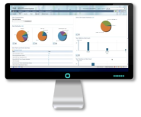
Intelligent Path Control
Performance Monitor
Prime Infrastructure
Partners
Export NetFlow v9 or IPFIX
Metrics Data
Application Recognition
(NBAR2)
Deep Packet Inspection Engine identifying +1000 applications
Metric Collection
(Performance Monitor)
Correlation, Aggregation, Alerts
Flexible NetFlow
Control: QoS, PfR
Path Control
Application Priorization
Application Bandwidth Management
Traffic
Metric Providers
Traffic Statistics
Application Response Time
Media Performance
URL Collection

Slide 29
Application Optimisation
AKAMAI CONNECT
World’s Best Optimization Solution for HTTP Traffic
AKAMAI CACHING AND ACCELERATION
Intranet HTTP Caching
Dynamic OTT
HTTP Caching
Akamai
Connected Cache
Content
Pre-positioning
CISCO WAAS
LZ
Compression
TCP
Optimization
Data
De-duplication
Application Specific Acceleration
Now Supports
Akamai Intelligent Platform | Single-sided Optimization | Secure Direct Internet Access

Slide 30

Application Optimisation
Akamai Connect
Networking Leader
7M+ Router Footprint
(80%+ of branch)
Leader in WAN Optimization, VPN, Firewall and Web Security
IT/Networking Customers
Cloud Services Leader
Global Delivery Platform (154,000 servers)
Leader in Web Acceleration, Content Delivery, Internet Traffic Engineering
Line of Business Customers
Cisco IWAN with Akamai Connect
Complementary Platforms, Technology and Customers

Slide 31
Application Optimisation
Transport and Origin Independence
Transport and Origin Independence
WAN & Direct Internet Access enterprise network topologies
Single or dual sided WAAS deployments
End-user
Intelligent Platform
Akamai Connect integrated into Cisco ISR-AX routers
WAN
Internet
WAAS
ISR-AX+AC
WAAS
Data Center
Branch

Slide 32


Site Specific
Over-the-Top Caching
Internet
Branch User
  OTT Chaching
YouTube Channel
Training Videos
Viral Videos
Network Challenges
Akamai Connect Solution
Video consumes bandwidth
Increased Congestion
Desire to have company YouTube Channel perform well
Cache popular video content
Save bandwidth
Business YouTube channel readily accessible at the Branch

Slide 33






Generic Internet Content
Transparent Caching
Internet
Branch User
  Transparent
  Caching
Generic HTTP Web Content
Network Challenges
Akamai Connect Solution
Guest WiFi constrains bandwidth from critical applications
Large file downloads
Comparison shopping
Cache popular web content
Reduce network congestion
Better WiFi experience
Generic and specific caching rules at the branch

Slide 34



Intranet Applications
Transparent Cache
Data Center WAAS
Any IP Network
Branch User
  Transparent
  Caching
“Intranet”, HTTP/S
Web Content, POS data,
Image files, Retail Catalog
  SSL Handling, Transport Optimization, Deduplication
  and Application Optimization provided by WAAS
Network Challenges
Akamai Connect Solution
Cache POS data at the branch
Reduce Round Trip Time
Reduce Latency
Reduce network congestion
Pre-position content
WAN optimization with WAAS
WAN bandwidth is expensive
Users want instant response
Multiple Omni-Channel apps
Businesses moving to rich media experiences

Slide 35

Off Peak Cache Warming
Prepositioning
Data Center WAAS
Any IP Network
“Intranet”,
HTTP Content
Branch User
  Transparent
  Caching
Internet
Generic HTTP Web Content
Network Challenges
Akamai Connect Solution
Access common high resolution video files at start of normal business hours
Common websites accessed at start of work day
Digital product catalogue displays need to be updated
Cache POS data at the branch
Schedule WAAS device to access list of URLs during non business hours
Allows first access to be LAN speed
Keeps digital displays updated automatically without consuming bandwidth during business hours

Slide 36
Akamaised Content
Akamai Connected Cache
Akamai
Intelligent Platform
Branch User
  Akamai Connected
  Cache
Extranet
HTTP Akamaized Web
Content
  Authentication to Akamai Intelligent Platform
Network Challenges
Akamai Connect Solution
Customer’s own content already cached in the Akamai Intelligent Platform
Last mile access may still be an issue
Users access their own and 3rd party Akamaized content from the branch
Inherit Akamai Edge Server caching rules inside the branch to cache content other caching solutions can not
Utilises the breadth and scale of the Akamai Intelligent Platform
Automatically takes advantages of changes in the Akamai Intelligent Platform – Akamai caching rules

Slide 37
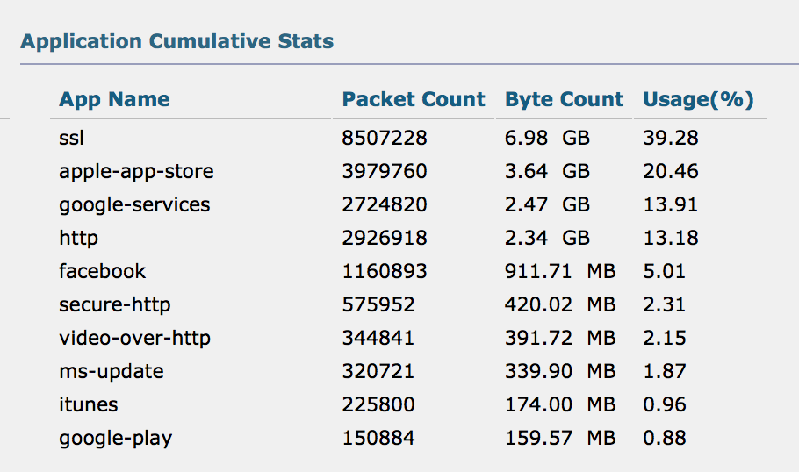
Secure Connectivity
CWS
Web Filtering, Adv. Malware Detection & Threat Analystics
CWS Encapsulated HTTP, HTTPS
Secure Public Cloud and Internet Access
ISR Cloud Connector to CWS datacenters
Cloud
Internet
Data Centers
IWAN Tunnels for HQ/DC Traffic
MPLS
Branch
SECURE BRANCH EDGE
OFF-LOAD CORPORATE WAN
CLOUD WEB SECURITY
Scalable security via DMVPN enforced locally
Firewall/IPS support to protect for external threats
Secure local Internet breakout with encapsulated traffic
Improved application performance at lower costs
Real-time web filtering with Application Visibility & Control
Advanced Malware Protection and Threat Analystics

Slide 38




Secure Connectivity
SECURE BRANCH EDGE
OFF-LOAD CORPORATE WAN
CLOUD WEB SECURITY
Scalable security via DMVPN enforced locally
Firewall/IPS support to protect for external threats
Secure local Internet breakout with encapsulated traffic
Improved application performance at lower costs
Real-time web filtering with Application Visibility & Control
Advanced Malware Protection and Threat Analystics
ISR Cloud Connector to CWS datacenters
IWAN Tunnels for HQ/DC Traffic
WAN1
(IP-VPN)
Private
Cloud
WAN2
(Internet)
Branch
Secure Public Cloud and Internet Access
CWS Encapsulated HTTP, HTTPS
Public
Cloud
Web Filtering, Adv. Malware Detection & Threat Analystics
Cisco
Cloud Web
Security CWS
Internet

Slide 39



IWAN Management
On-Prem Management
Cloud-Based Management
Specialized Management
Cisco Prime
Enterprise and Integrator
Lifecycle Management
Automates Deployment
and Lifecycle Management
Application Aware Network Performance Management
Lifecycle: Simplified deployment and configuration
Configuration – Plug and Play deployment automation
Health Assurance: Improved application delivery
Compliance: Regulatory requirements and best practices
Speed: Eliminates manual building of WANs
Agility: Quick configuration updates and IOS upgrades
Dynamic: Compatible with onePK for app aware WANs
Reduced OPEX: Automated WAN orchestration
Cost Savings: Centralized hybrid WAN management
Integrates with Cisco App Visibility and Control
Monitor and analyze app-level traffic
End-to-end flow visualization
Troubleshoots hop-by-hop to pinpoint source
Fix and verify QoS and App in realtime

Slide 40


IWAN Management Evolution
Capacity Planning, Troubleshooting, Events, Change control
Prime
Cisco IWAN Apps
Partners
Traditional Management Systems
Early
CY2015
IWAN Transport
PKI Automation
PnP
Provisioning
Apps
Security
Intelligent Path Control
Application Experience
Evolution
REST APIs
Cisco Prime
APIC-EM Services (Partial)
PKI
Svc
NetFlow
Svc
Network
Svc
Events
Svc
Inventory
Svc
PnP
Svc
APIC-EM
Device Abstraction Layer
OnePK/Openflow
CLI

Slide 41
Delivering the
Intelligent Branch

Slide 42


Revolutionary Platform Architecture
Built to Delivery the Intelligent Branch
Virtualized + Services Aware Architecture
Appliance like performance
Converged Branch with UCS® E-Series
Integrated compute
Up to 8 cores, 48GB RAM, 3TB HDD
Pay as You Grow
2X Performance with License
4-10X Faster than G2
Best of Breed Security
SourceFire IPS, Scansafe
Cisco ISR
4000
LAN like Performance
Over WAN with IWAN & AKC
ACI for IWAN
Fast IT with EPIC-EM

Slide 43


Best of Interop Networking Winner
Cisco 4451 ISR Converged Branch Infrastructure
Cisco® 4451 with Cisco UCS® E-Series
and SM-X Layer 2/3 Switch Module
“The 4451 is poised to address the gap between networking functions that are fully virtualized and those that are still embedded in dedicated networking devices…transforming a product line that began as a way to connect remote sites to corporate networks and the Internet into a small-scale data centre in a box.”
—Kurt Marko, Best of Interop Judge

Slide 44
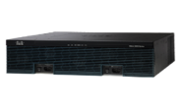

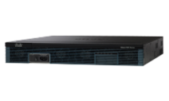

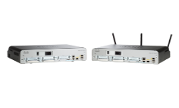
ISR G2 and 4000 Series Platforms
Pricing and Performance
3945E (350 Mbps)
$18,000
3RU
4451 (1 or 2Gbps)
$18,000 to $20,000
2RU
3925E (250 Mbps)
$15,000
3RU
3945 (150 Mbps)
$13,000
3RU
4431 (500 or 1000 Mbps)
$11,000 to $13,000
1RU
3925 (100 Mbps)
$9500
3RU
2951 (75 Mbps)
$7500
2RU
4351 (200 or 400 Mbps)
$8000 to $9500
2RU
2921 (50 Mbps)
$3695
2RU
2911 (35 Mbps)
$2695
4331 (100 or 300 Mbps)
$3300 to $4800
2RU
1RU
2901 (25 Mbps)
$1995
1RU
4321 (50 or 100 Mbps)
$1995 to $2995
1RU
Desktop
1941 (25 Mbps)
$1595
2RU

Slide 45
Hosting Business Critical Application
Network | Compute | Storage
Server Virtualization
  Consolidate physical servers to reduce costs
  Improve application uptime and failure recovery time
  Shorten time-to-deployment for new apps
Store in a Box
Bank in a Box
Blade Form Factor
  Eliminate wires, components and save space
  Rapidly provision hardware with plug-and-play modularity
  Right-size hardware profile for the lean branch office
School in a Box
Clinic in a Box

Slide 46


Compute and Storage Services
CISCO UCS-E180D
CISCO UCS-E160D
CISCO UCS-E140S
CISCO UCS-EN120S
Scalability
Intel 8 Core Processor
8-48 GB RAM
200GB-3TB Storage
3HHD
Intel 6 Core Processor
8-48 GB RAM
200GB-3TB Storage
3HHD
Intel 4 Core Processor
8-16GB RAM
200GB-2 TB Storage
2HHD
Intel 2 Core Processor
8-16 GB RAM
500 GB – 2 TB Storage
2HHD
Feature Richness
Local Compute:
Bare metal or hypervisor
Hypervisor Support:
VMWare, Hyper-V, and Citrix Certified
Network Services: vWLC, vWAAS
Enterprise Applications:
VDI, Physical Security, PoS
Local Storage:
Backup

Slide 47





Security Services
NETWORK / USER
CONTEXT
POLICY MANAGEMENT AND ENFORCEMENT
Who
What
Where
Identity
Services
Engine
When
How
TrustSec
CONSISTENT POLICY ACROSS
WIRED, WIRELESS and VPN

Slide 48
Solving Customer Challenges with an Intelligent Network

Slide 49




Delivering Omni-Channel Retail Solutions
30-40%
38➛6
2-4x
          Reduction in mobile app response time
          Decrease in communications expenses
          Increase in bandwidth utilisation
          SECONDS

Slide 50
“We have put [Cisco IWAN with Akamai Connect] in the Saks Fifth Avenue store that has only 1.5Mbps and we have better performance… than in our head office on Madison Avenue that has a 100Mbps+ connection.”
Retail Customer CTO

Slide 51
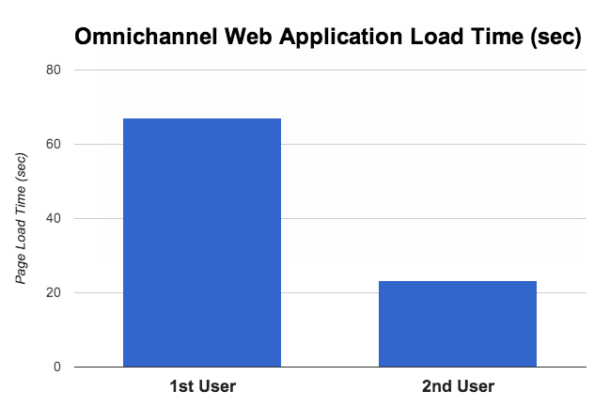
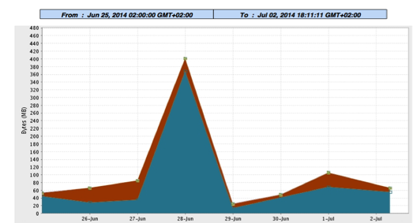
Retail
The Challenge
International rollout of omnichannel Web app as first step of new in-store digital experience strategy
iPads often found in drawers vs sales associates’ hands due to omnichannel application performance issues
WAN bandwidth could not be increased due to location and budget constraints
The Benefits
Objects served out of cache offloaded WAN and improved application performance
Improved performance key driver for employee adoption and expansion of in-store digital experience strategy
65% Load Time reduction
Up to 400MB offloaded from WAN daily

Slide 52
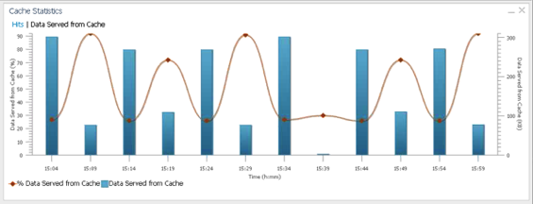
Education
40% Avg. Load Time reduction
The Challenge
Low bandwidth direct to Internet network links at remote branches
Application performance issues due to constrained networks
The Benefits
Objects served out of cache offloaded network links and improved performance
Deferred direct-internet-access link upgrade
Up to 90% of data served from cache

Slide 53
Service Provider
40% Avg. Load Time reduction
The Challenge
Low bandwidth direct to Internet network links at remote branches
Application performance issues due to constrained networks
The Benefits
Objects served out of cache offloaded network links and improved performance
Deferred direct-internet-access link upgrade
Up to 90% of data served from cache

Slide 54
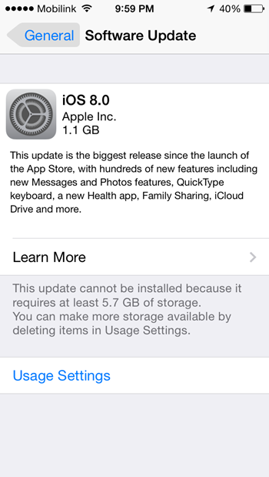
Enterprise
The Challenge
Software and app updates continue to grow, consuming network bandwidth
  iOS 7 Update was ~700MB
  iOS 8 Update was ~1.1GB
The Benefits
Split tunneling ensures updates go direct to CDN, bypassing Enterprise WAN and Data Centre
Cache computer and mobile OS and application updates locally on the branch router
Caching can be configured to continue even if the initial update fails to complete
Updating only 3 iPads resulted in 2.67GB of WAN offload

Slide 55

Customer Success
The Future of Shopping for a Global Luxury Retailer
Challenge
Re-energize customer in-store experience
Improve mobile application performance
Drive customers to highest margin products
80%
Improvement in content delivery
Opportunity
3x
Enable iPad for HD catalog and line breaking
Employee video training
RFID tags drive digital signage
Customer time in store

Slide 56

Customer Success
Increase Bandwidth at a Lower Cost for a Large Bank
Challenge
MPLS WAN Costs
14,000 bank branches worldwide
40%
Opportunity
Enable lower cost connectivity
Enhanced security across broadband
Reduction in WAN costs

Slide 57

Customer Success
Pop-up Sites with Global Resource Management
Challenge
Global temporary work sites across 6 continents
MPLS provisioning too slow
Heavy CAD content difficult to deliver uniformly
Opportunity
6 mos → 1 day
No touch provisioning
Utilize broadband and 4G
Seamless Rich Content delivery
For 160 global sites

Slide 58

Customer Success
Decrease Communication Costs for European Coast Guard
Challenge
Simultaneous Connectivity:
Satellite/Radio and LAN Carrier Services
Meet Strict Government Compliance
Opportunity
30 - 40%
Reliable Connectivity between Ships
and Land for Voice & Data
Exceed Security Standards
Reduction in Secure Telecom costs

Slide 59
Vertical Use Cases - FSI
Business Priorities
Business Benefits
Solution Details
Reduce overall operational and transport costs by running your cloud/mobile banking apps on a right-sized network that simplifies operations, increases reliability, and improves WAN utilization.
Grow revenues and reduce time to market by accelerating the deployment cloud/mobile banking application infrastructure to all your remote branches.
Innovation - deliver new products, services, and applications at all your branches more quickly and efficiently.
Use secure WAN transport for private and virtual cloud access and local Internet path for public cloud and Internet access.
Increase WAN transport capacity without adding circuits or bandwidth.
Improve application performance - right flows to right places.
Optimize app performance and reliability everywhere with Peformance Routing, Application Visibilty and Control and WAAS.
Deliver applications flexibly - use any path - MPLS, Internet, or 3G/4G.
Improve remote app performance, security, and reliability with local threat defense and no backhaul.
Deliver more app performance and security for guest Wi-Fi access at branches
Turn on new SaaS apps quickly and easily with optimal performance.
Deliver demanding apps such as video to branches without adding bandwidth.
Transport independence using any path - MPLS, Internet, or 3G/4G.
Peformance Routing, Application Visibilty and Control and WAAS.

Slide 60
Vertical Use Cases - Retail
Business Priorities
Business Benefits
Solution Details
Improve customer satisfaction and staff responsiveness by dramatically increasing performance and reliability of cloud/mobile applications.
Grow revenue by accelerating the delivery of new customer-facing applications and experiences to all locations.
Acquire and retain customers by improving POS, inventory and other critical application responsiveness throughout all your locations.
Improve customer experiences by optimizing performance and reliability of retail, POS, inventory and video apps across all locations.
Use secure WAN transport for private and virtual cloud access and local Internet path for public cloud and Internet access.
Deliver applications flexibly
Improve remote app performance, security, and reliability with local threat defense and no backhaul.
Optimize app performance and reliability
Deliver demanding apps such as video, POS or inventory to branches without adding bandwidth
Transport independence using any path - MPLS, Internet, or 3G/4G.
Peformance Routing, Application Visibilty and Control and WAAS.

Slide 61
Vertical Use Cases - Healthcare
Business Priorities
Business Benefits
Solution Details
Deliver health services remotely and enable real-time collaboration on new treatments by optimizing performance, reliability and security of cloud, mobile, and video applications.
Improve patient care and experience with faster, more reliable physician and staff access to medical applications and patient data.
Innovation - accelerate the delivery of new services and treatments that improve patient experience anywhere.
Grow practice/revenues by improving doctor and staff efficiency at remote sites.
Deliver telemedecine applications flexibly using any path
Enable physician and staff flexibility with using any path - MPLS, Internet, or 3G/4G.
Optimize medical app performance and reliability.
Deliver demanding apps such as diagnostic imaging and video to remote sites without adding bandwidth.
Connect remote experts and satellite clinics with optimized app performance at lower cost.
Improve remote app performance, security, and reliability with local threat defense and no backhaul.
Transport independence using any path - MPLS, Internet, or 3G/4G.
Peformance Routing, Application Visibilty and Control and WAAS.

Slide 62
Vertical Use Cases - Education
Business Priorities
Business Benefits
Solution Details
Enable anytime, anywhere learning without boundaries by optimizing educational applications and video while simplifying operations and improving WAN utilization.
Address increasing expectations of faculty and students by improving application and video performance.
Connected learning - transform education with collaborative learning applications.
Improve operational efficiency and reduce IT overhead and transport costs with a right-sized network that simplifies operations, increases reliability, and improves WAN utilization.
Prioritize and optimize key apps
Optimize applications for any path
Improve remote app performance, security, and reliability with local threat defense and no backhaul.
Engage more students in collaborative learning by optimizing network traffic for multimedia at remote sites.
Deliver collaborative learning apps via any path
Use secure WAN transport for private and virtual cloud access and local Internet path for public cloud and Internet access

Slide 63
Vertical Use Cases - Manufacturing
Business Priorities
Business Benefits
Solution Details
Increase production efficiency and improve profitability by optimizing application performance and getting real time visibility into asset management, supply chain, and automation systems at remote plants.
Improve profitability and reduce overall operational and transport costs by running production apps on a right-sized network that simplifies operations, increases reliability, and improves WAN utilization.
Improve operational efficiency and reduce downtime by delivering real-time plant performance and quality control metrics from remote sites anywhere.
Deliver applications flexibly
Optimize app performance and reliability
Improve remote app performance, security, and reliability with local threat defense and no backhaul.
Use secure WAN transport for private and virtual cloud access and local Internet path for public cloud and Internet access.
Increase WAN transport capacity without adding circuits or bandwidth.
Deliver demanding apps such as video or CAD to branches without adding bandwidth.
Transport independence using any path - MPLS, Internet, or 3G/4G.
Peformance Routing, Application Visibilty and Control and WAAS

Slide 64
Vertical Use Cases - Transportation
Business Priorities
Business Benefits
Solution Details
Expand cloud/mobile app and video services to new locations and markets more quickly and cost-effectively with "branch in a box" for remote sites.
Innovation - develop new services and processes by connecting remote sites and vehicles with transportation management and other systems, including machine-to-machine capabilities.
Grow budget and revenues by accelerating the deployment of new apps and services to all remote sites.
Improve customer satisfaction and loyalty by dramatically improving staff and customer-facing application performance, and delivering those apps everywhere.
Connect and optimize devices and apps via any path
Prioritize and optimize key apps
Improve remote app performance, security, and reliability with local threat defense and no backhaul.
Turn up new links and new services more quickly and efficiently.
Deliver new apps flexibly via any path

Slide 65







Intelligent Branch Solutions
Lean Branch
Full-Service Branch
Serverless Branch
Data Center/
Cloud
Data Center/
Cloud
Data Center/
Cloud
WAN/Internet
WAN/Internet
WAN/Internet
Branch Office
Branch Office
Branch Office
No local servers
Full reliance on WAN
Simplicity, low cost
No service guarantees
4-5 local servers
Full reliance on WAN except for mission-critical applications
All servers local
No reliance on WAN
Complexity, high cost
Service guarantees

Slide 66
Architectural Advantage
Multi-core Services aware architecture
Powerful compute & storage module
Performance on demand
WAN Cost saving with IWAN Arch
LAN Like Performance over WAN
Reduce Truck Rolls
OS Consistency across campus & WAN : IOS-XE
Deterministic performance
Reduce downtime with OIR
Fast IT with:
Cisco Prime
EPIC-EM
Eco-System Partners : Glue, Live Action etc

Slide 67
Delivering Customer Value
FROM THIS
TO THIS
DELIVERS THIS
Traditional Branch IT
Cisco ISR 4000 With
UCS E-Series
Deployment Costs
Shipping Costs
No additional support costs for UCS E-series
Hypervisor Capital
Hardware Capital
Router
WAN Optimisation
18K
80%
Security
14K
Power cooling
savings
Switch
10K
Wireless
6K
Reduced truck rolls
by spinning a VM
instead of an appliance
Voice
2K
Server
Multiple hardware
vendors
Router + UCS-E
https://express.salire.com/signin.aspx?t=Cisco

Slide 68


Delivering Business Outcomes
UNCOMPROMISED USER EXPERIENCE & MOBILITY
REDUCE COSTS AND COMPLEXITY
IMPROVE SECURITY
Increase Productivity
Maximize WAN Investment
Scale Security
Empowered employees
Instant application response
Ensure quality experience
Off-load WAN to slow costs
Elevate defense at branch
Enable direct Internet Access
Greater Revenue
Automate IT
Advanced Threat Defense
Elevated customer engagement
Increase Dwell time
Meet time to market needs
Eliminate repetitive, error prone tasks
Best of breed defense
99% efficacy

