Slide 1
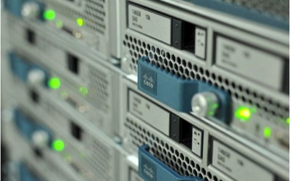
UCS Insider
Januar 2013

Slide 2
Agenda
UCS Überblick
UCS Release 2.1 (DelMar)
UCS Central
Cloupia Management Lösung

Slide 3
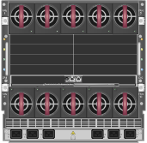

Herkömmliche Bladesysteme
MGMT
MGMT
SAN
SAN
Additional
LAN & SAN Connections
LAN
LAN
Additional
LAN & SAN Connections
Seit mehr als 10 Jahren
  Größere Verdichtung, aber kein neuer Denkansatz
  Mehr Server und Switche als je zuvor
  Mehr Switche pro Server
  Management extern, nicht integriert
Eine Zufallsarchitektur
Resultat: Komplexität
  Viele Managementpunkte
  Schwierig, konsistente Konfigurationsregeln einzuhalten
  Schwierig abzusichern
  Schwierig zu skalieren
Additional Management Connections
Additional Management Connections
Multiple Ethernet Connections
Multiple
SAN Connections
Separate Remote Management per Chassis
Multiple Management Modules

Slide 4
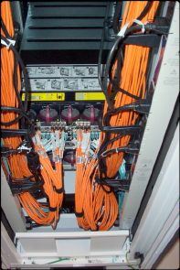
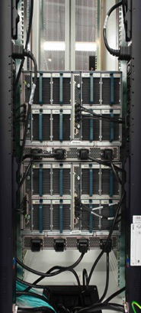
Cisco UCS: Vereinfachung
MGMT
MGMT
SAN
SAN
Additional
LAN & SAN Connections
LAN
LAN
Additional
LAN & SAN Connections
Integriertes Management
Entfernen unnötiger
  Switche
  Adapter
  Managementmodule
Unified Fabric
Strom & Kühlung
  Weniger als 1/3r der herkömmlichen Infrastruktur
  63% offenes Design
  Niedrigstrom- Komponenten
Optimiert für Virtualisierung
  Prozessordichte
  Verhältnis VM/Host
  20% I/O-Verbesserung
Additional Management Connections
Additional Management Connections
Multiple Ethernet Connections
Multiple
SAN Connections
Separate Remote Management per Chassis
Herkömmliche
Blades:
Komplex und teuer
Multiple Management Modules
Cisco UCS:
einfach, optimiert und automatisiert

Slide 5
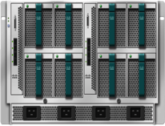
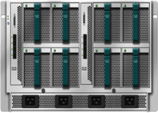

UCS Verkabelung
Bandbreitenoptionen
2x 1 Link
20 Gbps pro Chassis
2x 2 Link
40 Gbps pro Chassis
2x 4 Link
80 Gbps pro Chassis
2x 8 Links
160 Gbps pro Chassis
Notes:
Importantly, this concept and the associated benefits are not just limited to a single rack, but everything that’s connected to the fabric interconnect pair. This makes UCS a highly scalable, well integrated system, with virtualization spanning not just the compute, but the network as well.
Resources can now be dynamically provisioned across the system.
Additionally, it is important to note deploying UCS does not require a forklift upgrade. It fully integrates with existing LAN/SAN environments.
(Transition) Let’s take a look at what makes up a UCS system

Slide 6
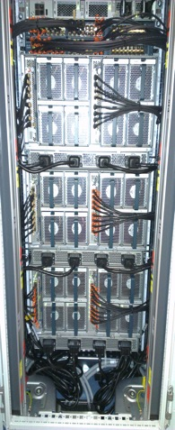
Verkabelung

Slide 7


UCS: schematische Darstellung
Skalierbares Gesamtsystem
Netzwerk + Compute-Virtualisierung
Dynamische Provisionierung von Ressourcen
Management
LAN
LAN
SAN
Notes:
Importantly, this concept and the associated benefits are not just limited to a single rack, but everything that’s connected to the fabric interconnect pair. This makes UCS a highly scalable, well integrated system, with virtualization spanning not just the compute, but the network as well.
Resources can now be dynamically provisioned across the system.
Additionally, it is important to note deploying UCS does not require a forklift upgrade. It fully integrates with existing LAN/SAN environments.
(Transition) Let’s take a look at what makes up a UCS system

Slide 8
UCS Release 2.1
Neue Features

Slide 9
UCS Manager 2.1 Release
Multi-UCS Management
Release 2.1 bringt neben Innovation auch Verbesserungen im UCS Betrieb
Storage
C-series Integration
Operational enhancements
Innovation
Operational Enhancements

Slide 10
Storage features are focused on innovating on the platform
Vereinfachte Topologien
Multi-Hop FCoE
  Einsparungen durch LAN/SAN Konsolidierung
FC Zoning
  Installationen ohne SAN Switche, implizite Konfiguration über Service Profile
Unified Connect
  Kostenreduktion durch Konsolidierung von FCoE, iSCSI und NAS auf denselben Ports und Kabeln
High performance Speicher
PCIe Flash Speicherkarten
  High performance Option für lokalen Speicher auf den Blades

Slide 11
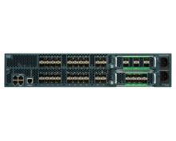
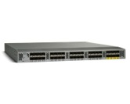

Innovation bei der Integration von C-series Rackmount Servern reduziert Kosten
C-series Integration
UCS 6100 or 6200
Mit UCSM 2.1 nutzen wir den VIC 1225 Adapter um die Topologie für Rackmount Server zu vereinfachen
Vereinheitlichung von Management und Datenverbindung erhöht die Skalierbarkeit pro 2232PP FEX.
Limit 160 Server pro UCS Domain
Nexus 2232
PCIe Adapter
CIMC
OS oder Hypervisor
Mgmt Traffic
Daten Traffic
(LAN and FCoE)

Slide 12
… und Betriebsverbesserungen
“Warum muss ich ein dickes Dokument lesen, um einen Firmware Upgrade durchzuführen? Kann UCSM sich nicht selbst um die Reihenfolge der Updates kümmern ?”
Operational Enhancements
Firmware Auto Install
“Was soll das heissen, ich kann ein Service Profil nicht umbenennen ?”
Service Profile “renaming”
“Ich möchte keinen Call Home Fehlalarm nur weil wir einen Server im Wartungsfenster gebootet haben”
Fault suppression
“Ich würde gerne UCSM upgraden und BIOS und Adapter Firmware auf derselben Version belassen. “
Andere Erweiterungen wie z.B. gemischter Firmware Support für
Server und Infrastruktur

Slide 13
UCSM 2.1 “Del Mar” Release Overview
Targeted 4Q CY12
Storage
1
Multi-hop FCoE
Zoning configuration in UCSM
PCIe Flash – Discovery and support (in progress)
Unified Appliance Port
2
3
4
Single wire management w/ VIC 1225
C-series
5
Operational Enhancements
6
7
Firmware upgrade usability (“Firmware Auto Install”)
Service Profile “renaming”
Fault suppression
Flexible network resource consumption
Privileges documentation
Troubleshooting enhancements
Mixed infrastructure and server pack support
8
9
10
IGMP querying
VLAN Group
(P, V) count optimization
Networking
11
VM-FEX
VM-FEX for Windows Server 8 HyperV (including SRIOV)
12
UCS Central
Support
Support for UCS Central operations
Cisco Highly Confidential
Notes:
Here’s a one page snapshot of the planned Del Mar (UCSM 2.1) software features. This release is currently targeted in the fourth quarter, though you should continue to monitor the savtg site for updates to the target date.
As mentioned in the standard roadmap disclaimer, there is always the possibility that the date shifts or that some features become decommitted.
This release is a software oriented release (in contrast to the UCSM 2.0 releases, which have had a heavy hardware support flavor).
There are several categories of feature concentration at a high level – Storage, C-series integration, Operational enhancements, some Networking features, and UCS Central support.
We’ll not be covering UCS Central itself in this deck.

Slide 14

UCSM 2.1 “Del Mar” Release Überblick
Storage
C-series
Betriebsverbesserungen
Networking
VM-FEX

Slide 15



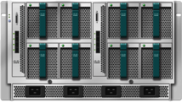
Multi-hop FCoE
Storage
Nutzen
FCoE Storage
End-to-end oder multi-hop FCoE
Einsparungen durch LAN/SAN Konsolidierung oberhalb der Fabric Interconnects
FCoE
FCoE
Details
MDS/N5K/N7K
MDS/N5K/N7K
Zugriff auf einen FCoE Storage, der an einem “upstream” MDS, N5K oder N7K angeschlossen ist
  “Unified Uplink” transportiert Ethernet und FCoE Daten auf demselben Link
Fabric Interconnect im NPV Modus
  Hauptsächlich für VNP (Endgeräte)
  FC Switching Mode und VE Ports noch nicht voll ausgetestet
Blick in die Hardware-Compatibility Liste für unterstützte Konfigurationen
FCoE
FCoE
NPV/EHM
UCS FI
UCS FI
UCS servers

Slide 16

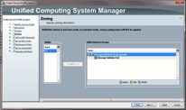
Zoning Konfiguration in UCSM
Storage
Kundennutzen
FCoE Storage
FC Storage
Direkte Anbindung von FC/FCoE Speicher an den FI ohne upstream FC switch
Geringere Kosten für kleinere Installationen
Details
Direktanbindung FC/FCoE Speicher ohne upstream FC switch (im Gegensatz zu Release 1.4 und 2.0 )
FC Zoning enabled mit UCSM
  Zoning support nur im FC switch mode
  FC zoning enabled/disabled pro VSAN
Implizites Anlegen der Zonen
  Müssen nicht manuell erzeugt werden
  Single-initiator-single-target oder single-initiator-multiple-target Zone
Unterstützt mit EMC und Netapp
UCS FI
UCS FI
UCS servers

Slide 17
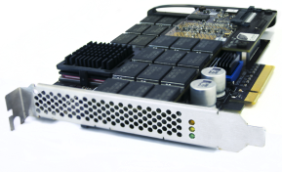
PCIe Flash – Discovery und Support
Storage
Kundennutzen
High performance flash storage in Blades
Support für Anwendungen mit hohen IOPs Anforderungen
Details
Unterstützt in M3
Mezzanine cards* (non-mLOM slot)
UCS Manager will only discover and inventory the cards in this release
Firmware upgrades and pool qualification features will be in a post-Del Mar release

Slide 18
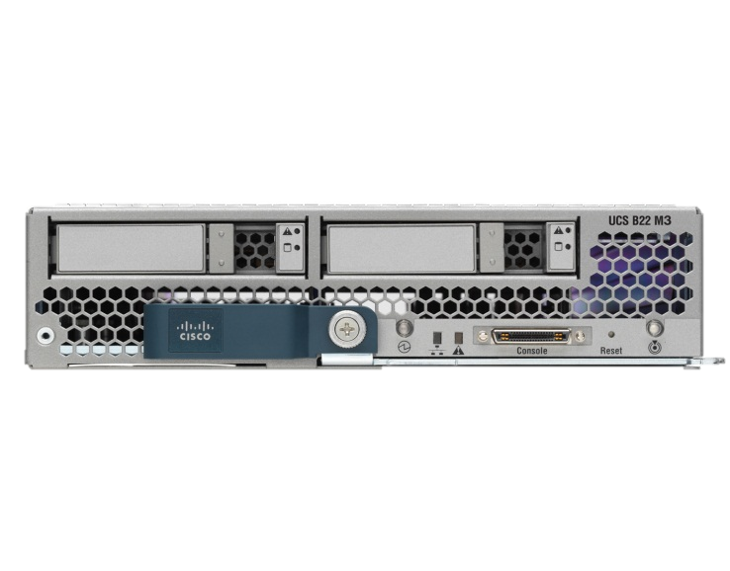
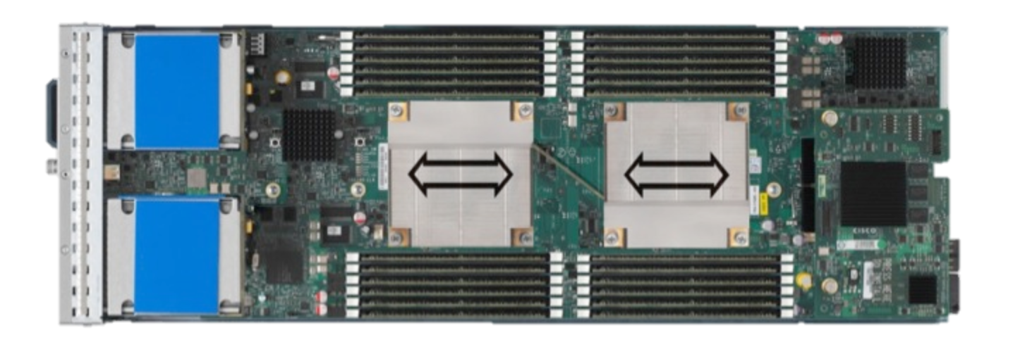
UCS B200 M3
Half width blade form factor
Modular LOM
Slot
Mezzanine
Slot
mLOM Slot: Supports only the VIC 1240
Mezz Slot: Supports VIC 1280 & 3rd party Gen 3 Mezz cards
M81KR *NOT* supported on the M3 (Romley blades)
Connectors to the backplane
Notes:
Moving to B200M3

Slide 19
B200 M3 I/O Block Diagram
Modular LOM and Mezzanine slot
PCIe lanes from each socket
`
Mezzanine Slot
Modular LOM Slot
x16 Gen 2
x16 Gen 2
Sandy
Bridge
CPU # 1
QPI
Sandy
Bridge
CPU # 0
Patsburg
PCH-B
Notes:
B200M3 –
The PCIe design is different that in the previous generation of Intel chipset. In the sandy bridge platform the PCIe bus comes off of the CPU complex directly instead of going to IO Hub. Each socket has a PCIe bus.
The B200M3 has 2 PCIe slots.
mLOM slot that will only take the VIC 1240
Mezz slot that will take the port expander card, VIC 1280 and Gen3 cards

Slide 20
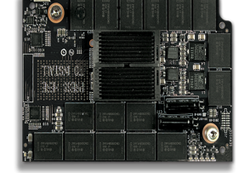
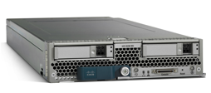
Ucs B-series mezzanine card
365 GB & 785 GB PCI Express Flash
  1.5 GB/s bandwidth
  535,000 IOPS
  15 microsecond latency
B-series M3 blades
  1 card per half-width blade
  2 cards per full-width blade
UCS Manager 2.1 (Del Mar)

Slide 21
Unified Appliance Port
Storage
Nutzen
Storage
File und Block Daten über dasselbe Kabel
Kostenreduktion durch Konsolidierung von Ports und Kabel
FCoE
iSCSI
NFS
CIFS
Details
“Unified Appliance Port”
Eine einzige Verbindung zwischen FI und Speichersystem für FCoE, NFS, CIFS und iSCSI
  Kabel- und Portreduktion
  Anfänglich nur für Netapp
  Einziger Hersteller mit “unified target ports”
  Achtung: Keine Portchannel für Unified Appliance Ports
UCS FI
UCS FI
UCS servers

Slide 22
UCSM 2.1 “Del Mar” Release Overview
Storage
C-series
Operational Enhancements
Networking
VM-FEX

Slide 23
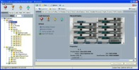


Single wire management
C-series
Customer benefits
Bis zu doppelt so viele Server am gleichen 2232P
Reduktion der Verkabelungskosten bei Integration der C-Series in den UCSM
Unified Fabric für B und C-Series Server
UCS
Manager
UCS 6100 or 6200
UCS 6100 or 6200
Nexus 2232PP
Details
Management und Daten für C-Series Rack- servers über ein einziges Kabel
Benötigt VIC 1225 “Lexington” Adapter
Unterstützt mit C260M2, C460M2 und allen M3 Rack-Servern
Nach wie vor 160 Server insgesamt pro UCS Domain
VIC 1225
Mgmt/Data Connection

Slide 24
UCSM 2.1 “Del Mar” Release Overview
Storage
C-series
Operational Enhancements
Networking
VM-FEX
Notes:
As mentioned earlier, another important bucket of oft requested features are in the Operational Enhancements bucket.
A number of these features are ones that we’re sure you’ve seen customers request previously.

Slide 25
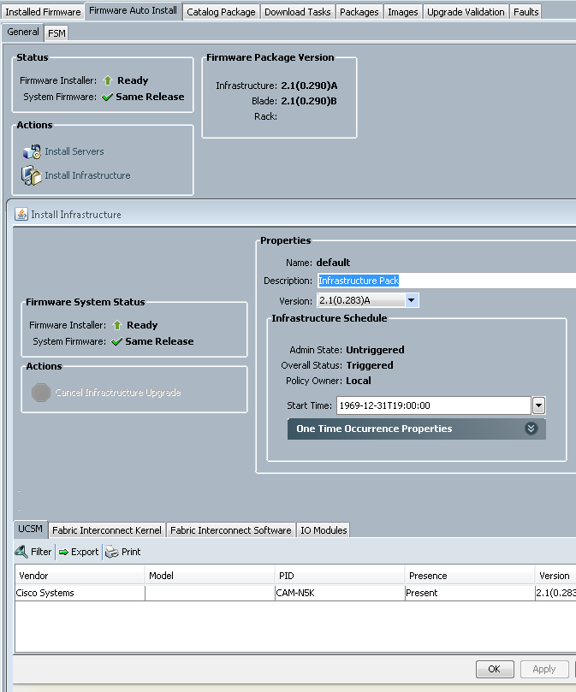
Firmware upgrade usability
(“Firmware Auto Install”)
Operational Enhancements
Customer benefits
Users can utilize a tool to automatically sequence and apply upgrades to each system endpoint, simplifying the process
Feature details
Administrators can utilize a simple wizard-like interface to specify which version of firmware they would like to upgrade either their infrastructure or servers to
Sequencing of firmware updates is handled automatically to ensure the least downtime
Intermediate user acknowledgement during fabric upgrade allows users to verify that elements such as storage are in an appropriate state before continuing the upgrade
Notes:
One of the first and biggest enhancements is in the firmware upgrade space.
With Del Mar we plan to provide an intuitive wizard like interface that allows a user to upgrade either infrastructure or server components.
The feature will automatically sequence and apply upgrades to individual system elements, simplifying the upgrade process (remember those 45 page upgrade documents?).
In addition this feature will offer user acknowledgement break points during fabric upgrades to allow users to verify that elements such as storage are in an appropriate state before continuing the upgrade.

Slide 26
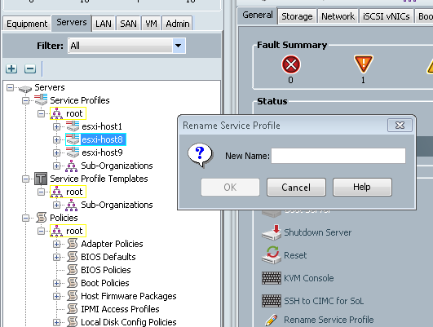
Service Profile “renaming”
Operational Enhancements
Customer benefits
Customers can simplify operations by aligning Service Profile names with their naming conventions
Feature details
Users will have the ability to rename a Service Profile in its current place in the org tree
  Old IDs (e.g., UUID, MAC, WWN) are retained
  New audit logs, events, and faults reference the new name
  Existing audit logs, events, and faults from the original Service Profile remain available under the original name
No server reboot is necessary
Notes:
A second major operational enhancement is service profile renaming.
This will allows users to – shocking – rename their service profiles.
This renaming occurs only in the service profiles’ current place in the org tree.
IDs such as UUID, MAC, etc. will remain the same and no server reboot will be necessary.
There are some things to be aware of – new audit logs, events and faults will reference the new name; old ones will reference the old name.
Also, this renaming is for service profiles only.

Slide 27
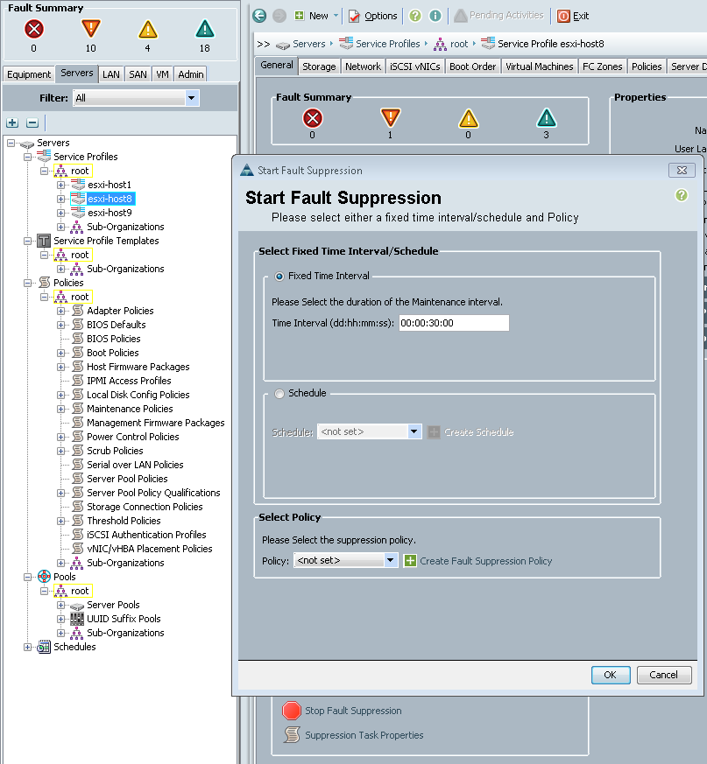
Fault suppression
Operational Enhancements
Customer benefits
Customers can align UCSM fault alerting with their operational activities
Feature details
Fault suppression offers the ability to lower severity of designated faults for a maintenance window, preventing Call Home and SNMP traps during that period
Predefined policies allow a user to easily place a server into a maintenance mode to suppress faults during maintenance operations
User will be able to right click on an SP and opt to place it into maintenance mode
Notes:
Another customer pain point we’ll be helping to address is around fault alerting.
With our fault suppression feature, predefined fault suppression policies for common maintenance tasks such as server maintenance will allow a user to lower the severity of faults that are triggered by a server reboot event.
This prevents call homes from being generated, for example.
The intent is to help raise the signal to noise ratio in our fault reporting.

Slide 28


Networking Enhancements
Operational Enhancements
Customer benefits
Collection of features to increase customer security and simplify network and storage connectivity management
vNIC eth0
Feature details
…
Three features are introduced:
Organization aware VLANs
  Additional security by constraining VLAN access by organization
LAN and SAN connectivity policies
  Separate LAN and SAN connectivity policies describe network and storage resources
New opt-in server admin privilege
  Privilege with ability to manage service profiles, but not network or storage objects beyond ability to consume a LAN and SAN connectivity policy
vNIC ethn
Adapter profile
Identity pool (wwpn, mac)
Network control policy
Network template
Statistics policy
Order
Pin group
QoS policy
LAN connectivity policy
Notes:
Flexible network resource consumption is a relatively opaque name for a collection of three security and connectivity features we are also introducing in Del Mar.
First, we are providing an option for a customer to place VLANs in the org hierarchy. This is a global setting which defaults to the non-org aware behavior we have today.
Second, we have LAN and SAN connectivity policies – a conceptual illustration of this concept is on the right of this page. The idea here is that separate LAN and SAN connectivity policies can describe pretty much all aspects of connectivity on the LAN and SAN side.
Third (and connected to LAN and SAN connectivity policies) is a new restrained server admin privilege with the ability to manage service profiles but not the network or storage objects beyond an ability to consume LAN or SAN connectivity policies; this allows a more fine grained separation of the server and LAN / SAN admin roles.

Slide 29
Additional operational enhancements
Operational Enhancements
Details
Privileges documentation
  New documentation is being provided to explain privileges in detail
Mixed infrastructure and server pack support
  “Del Mar” infrastructure will be officially supported with a set of 2.0 server packs, allowing customers to avoid disruptive server reboots
Troubleshooting enhancements
  “FSM tab” in UCSM is being enhanced to provide more information, aiding in troubleshooting efforts
  Enhancements include an expansion of information displayed, including:
    Expected FSM stage transitions
    Current and prior stage history
IGMP querying
  Feature provides parity with Nexus feature support for multicast
VLAN Group
  Simplified SP configuration, allowing application of a group of VLANs to a vnic in single step
Notes:
There are also a host of smaller operational enhancements being provided with this release.
First, privileges – roles are made up of privileges. With Del Mar we’ll provide, by privilege, a human readable explanation of what tasks are doable by a person with that privilege.
Second, we are offering a limited amount of “mix and match” of infrastructure and server bundles. Starting with Del Mar, a customer can run their infrastructure at the Del Mar level but leave their various server endpoints at various 2.0 levels.
Third, there are some enhancements of the FSM tab in UCSM. Rather cryptic that tab is being enhances to provide more information, such as expected FSM stage transitions as well as current and prior stage history.
The last two networking related enhancements are IGMP querying and support for VLAN groups.

Slide 30
UCSM 2.1 “Del Mar” Release Overview
Storage
C-series
Operational Enhancements
Networking
VM-FEX

Slide 31




VM-FEX for Windows Server 2012 HyperV
VM-FEX
Customer benefits
Customers can consolidate virtual and physical networking infrastructure
Brings high performance I/O to VMs and with host CPU savings
Feature details
Uses SR-IOV to extend physical network all the way to the virtual machines
Provides each virtual machine with dedicated “port” on the physical network
Collection of Cisco UCS VM-FEX and Fabric Interconnect 1 vNetwork Distributed switch
Management via PowerShell and stand alone GUI. UCSM-SCVMM integration in future
Win 8 Hyper-V
vNIC
vNIC
vEth
vEth

Slide 32
UCS Vcenter Plugin

Slide 33
Overview
Cisco UCS vCenter Plug-in is an extension for the vSphere Web Client (5.1).
Enables virtualization administrators to view, manage and monitor various aspects of Cisco UCS Physical infrastructure.
The result is a single pane of glass for Virtual Center users to get both physical and virtual infrastructure information for a given hypervisor.

Slide 34
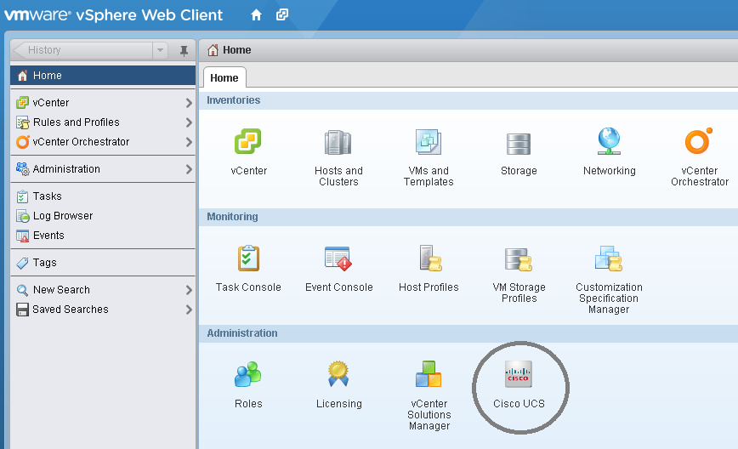
Getting Started
After deploying the plugin, Cisco UCS icon will appear on the home screen, Clicking it, will take the user to the Cisco UCS Management Center.

Slide 35
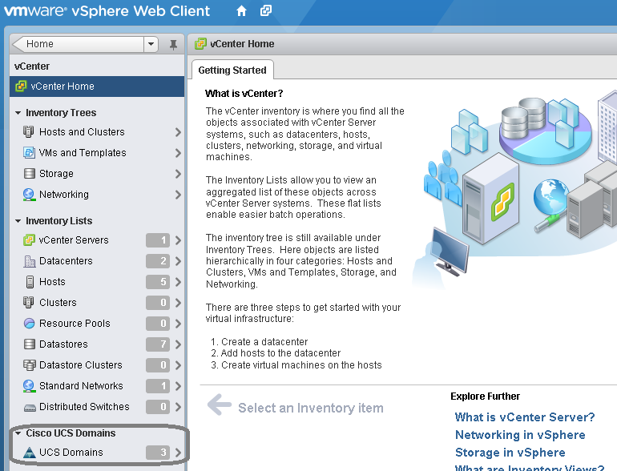
Navigating the UCS infrastructure
“Cisco UCS Domains” extension will be shown under vCenter Home, This extension will list all the registered UCS domains.

Slide 36
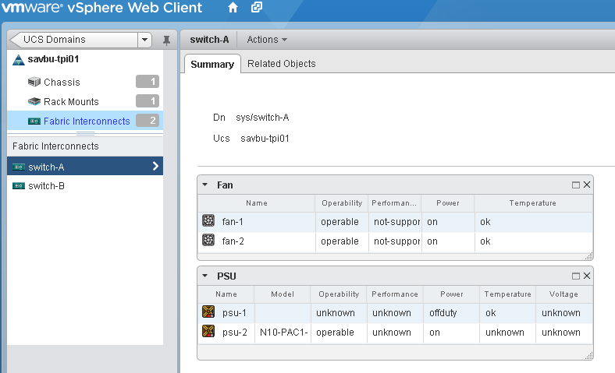
UCS Domain
Each UCS domain will show various physical equipments.

Slide 37
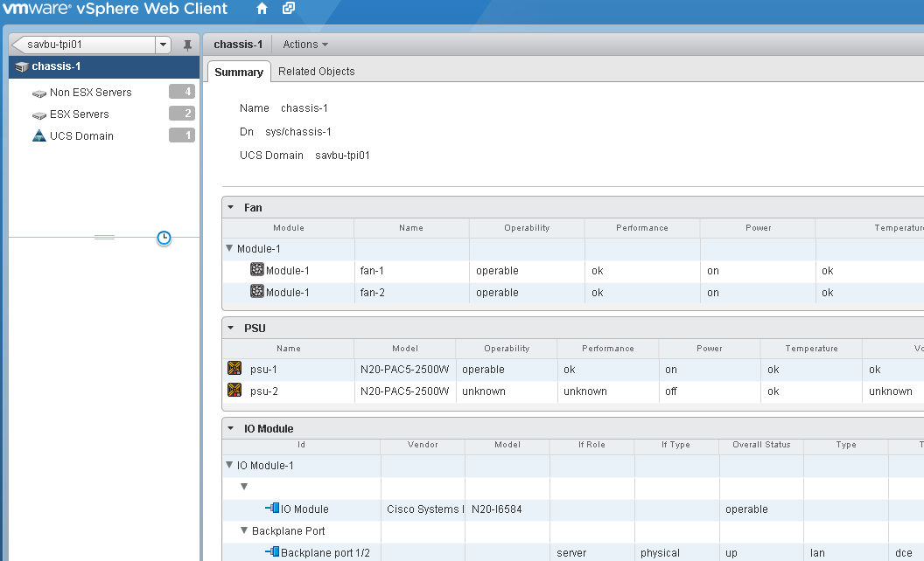
Chassis
Chassis extension shows the number of ESX, Non ESX Blade Servers and chassis summary.

Slide 38
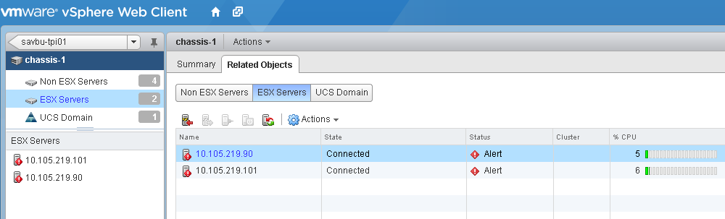
ESX Server Extensions
Plugin detects all the ESX servers and shows under respective chassis.
Each ESX and non ESX servers have 3 extensions to the UI.
  Summary View Portlet.
  Manage View Sub-tab.
  Monitor View Sub-tab.

Slide 39
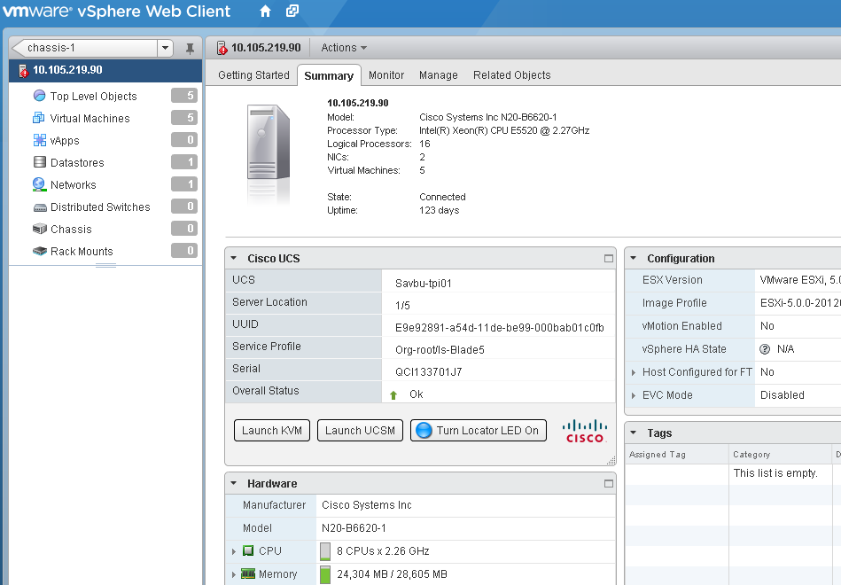
ESX Server Extension – Summary View
Summary view shows basic summary of a server. It also provides features like Toggle Locator LED, KVM console and UCSM GUI Launch.

Slide 40
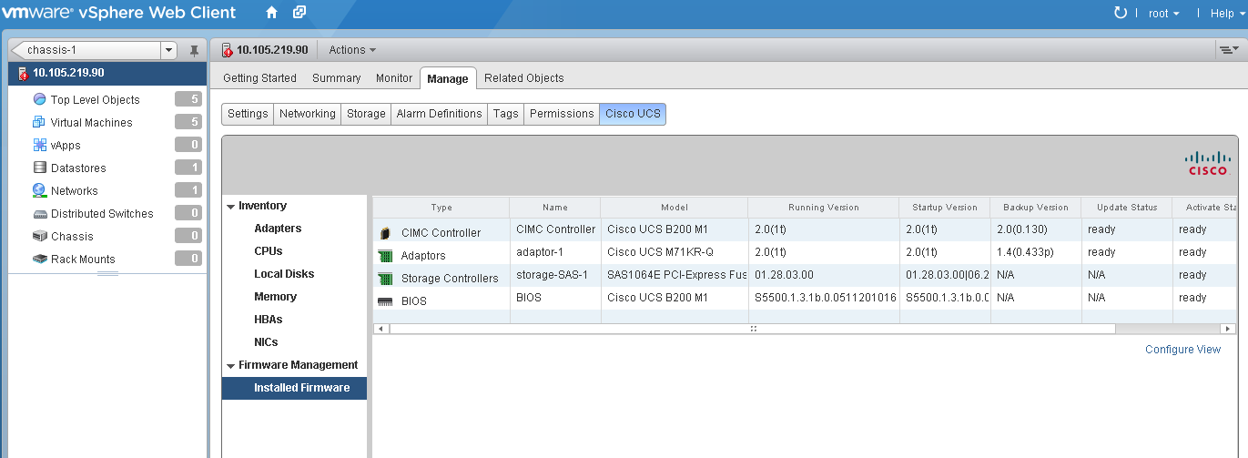
ESX Server Extension – Manage View
Manage view shows the inventory and installed firmware

Slide 41
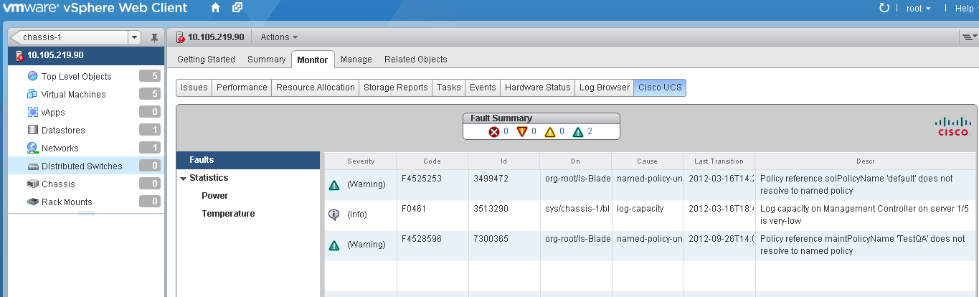
ESX Server Extension- Monitor View
Monitor view shows all the faults, power and temperature statistics.

Slide 42
UCS Central

Slide 43






Compute Capacity: Units of Scale
UCS Central
UCS Manager
Global Datacenters
Single Datacenter
Domain
Server
Chassis

Slide 44

Growth of UCS
Increased Number of Servers, Chassis, Fabric Interconnects, Datacenters
Centralized Management
Simplified Large Scale UCS Deployments

Slide 45
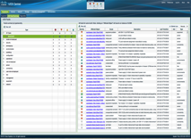
UCS Central Summary
Deployable as an external virtual machine based application
Delivered in two phases:
  Phase 1:
        Inventory, Fault, Log, Event Aggregation
        Global ID Pools, Firmware Updates, Backups and Global Admin Policies
  Phase 2:
    Global Service Profiles, Templates & Policies
    Statistics Aggregation
    HA for UCS Central Virtual Machine with shared storage
Timelines:
    Phase 1 in sync with next major UCS SW Release “Del Mar”
    Phase 2 delivered few months after Del Mar
    Supports UCS deployments in multiple datacenters

Slide 46
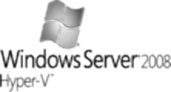

UCS Central Architecture
XML API
IDM = ID Manager
OM = Operations Manager
RM = Resource Manager
PM = Policy Manager
SM = Statistics Manager
UCS Central Virtual Machine Appliance
Cisco.com
IDM
OM
RM
PM
SM
UCS Manager 1
UCS Manager 2
UCS Central Framework
UCS Manager 3
Hardened Guest OS
Storage for
DB, SW
Repository
UCS Manager n
Hypervisor

Slide 47
UCS Manager
Policy Based Management
UCS Manager is the policy manager
End points resolve the policies defined in UCS Manager
UCS Manager
Define Policies
Apply Policies
Resolve Policies
Server
End Point
Fabric Interconnect
End Point
Chassis
End Point

Slide 48
UCS Manager
Policy Based Management
Modeled identical to UCS Manager on how policies work
UCS Central becomes the policy manager
UCS Manager becomes the policy recipient and resolver
UCS Central
Define Policies
Apply Policies
Apply Policies
Resolve Policies
Resolve Policies
UCS Manager 1
UCS Manager 2
UCS Manager n

Slide 49
UCS Central Using UCS Manager
Policy Based Management
Define global policies one time centrally in UCS Central
Use and re-use policies across multiple UCS domains
Consistency, compliance for configurations for a growing UCS environment
UCS Central
Define Policies
Apply Policies
UCS Manager 1
UCS Manager 2
UCS Manager n
Apply Policies
Resolve Policies
Server
End Point
Fabric Interconnect
End Point
Chassis
End Point

Slide 50
UCS Central
Phase 1 Features

Slide 51
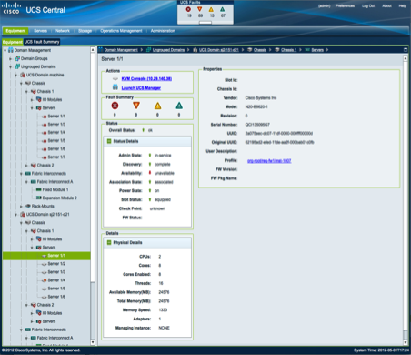
Centralized Inventory
Domains grouped in tree
under the domain groups
Cross launch for UCS
manager or KVM console
Faults on selected resource
Tree view of devices
similar to UCS manager
Equipment status
and details
Global inventory of all components of UCS organized by domain
Refreshes on customizable schedules

Slide 52
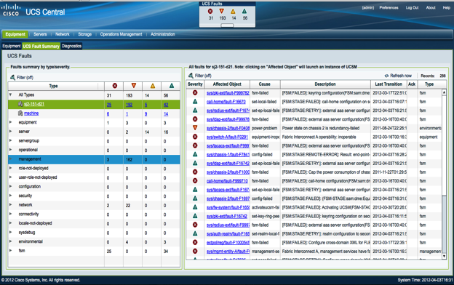
Central Fault Summary
…And Audits, Logs Too
Global Fault
Summary Panel
Fault Summary by
domain and by type
of Fault
Fault detail with cross launch to UCS manager

Slide 53
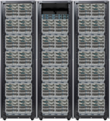
Global ID Pooling
UCS₁
Global Pool
Pool₁
67:6c:6f:62:61:6c:69:64
68:70:73:75:63:6b:73:21
67:72:6f:77:75:63:73:21
75:75:69:64:72:6f:63:6b
62:75:79:75:63:73:21:21
22:6d:61:63:69:64:21:22
27:77:77:6e:66:75:6e:27
UCS₂
UCS Central
Pool₂
66:63:6f:65:62:61:62:79
75:63:73:72:6f:63:6b:73
ID Usage From Both
Local and Global Pools
UCS₃
67:6c:6f:62:61:6c:69:64
68:70:73:75:63:6b:73:21
Pool₃
75:75:69:64:72:6f:63:6b
76:69:63:70:6f:77:65:72
Centralized sourcing of IDs from global pools
Real-time ID usage summaries
Avoidance of ID conflicts among UCS domains
73:76:63:70:72:6f:66:6c
75:63:73:6d:63:6f:6f:6c

Slide 54
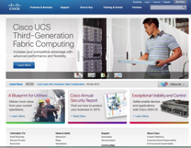
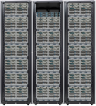

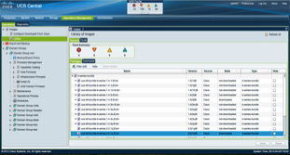
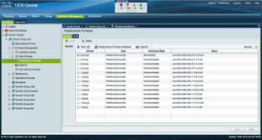
Centralized Firmware Upgrades
Cisco.com
Automated Scheduled
Downloads from Cisco.com
Firmware Auto Install
UCS Central Firmware Library
Global Firmware Policies

Slide 55
UCS Central Domain Groups
UCS Central
UCSM 1
Domain
Group 1
Domain
Group 2
UCSM 2
Domain
Group 3
UCSM 3
UCSM 5
UCSM 6
Domain Group (DG) is arbitrary grouping of UCS domains
Domains can be a part of only one DG at a time
Policies defined in the DG are in effect for all domains in the DG
Domains can move between DGs
DG to DG move for domain can be disruptive depending on new policies
Domain can auto-join DG based on qualification policies at registration
UCSM 7

Slide 56
UCS Central Domain Groups
UCS Central
UCSM 1
London
Production IT
Domain
Group 1
Domain
Group 2
e.g.
Geographic
Domain Groups
UCSM 2
Domain
Group 3
e.g.
Organizational
Domain Groups
UCSM 3
UCSM 5
New York
Engineering IT
UCSM 6
Domain Groups can be created based on operational needs
UCSM 7
Bangalore
Lab IT

Slide 57
UCS Central Domain and Sub Domain Groups
UCS Central
Domain Groups can have up to 5 levels of sub domains
Sub domains have hierarchical relationship with their parent
Easy to manage policy exceptions while administering large number of UCS domains
Domain Group
Europe
Domain Group
US
Sub Domain
Group
New York
Sub Domain
Group
Dallas
Domain Group
Asia-Pacific
Sub Domain
Group
Los Angeles

Slide 58
Global Admin Policies
UCS Domain 1
Global Admin Policies in a Domain Group
Date and Time: NTP, Time Zone
DNS
Remote Access
SNMP
Debug Settings
Call Home
Authentication (LDAP, Radius, TACACS)
Equipment Power and SEL Policies
UCS Domain 2
UCS Domain 3
Registration
Admin Policies are defined at the domain group
Any domain that is a member of the DG inherits policies

Slide 59
Global Admin Policies
UCS Domain 1
Global Admin Policies in a Domain Group
Date and Time: NTP, Time Zone
DNS
Remote Access
SNMP
Debug Settings
Call Home
Authentication (LDAP, Radius, TACACS)
Equipment Power and SEL Policies
UCS Domain 2
Policy Binding
UCS Domain 3
Admin Policies are defined at the domain group
Any domain that is a member of the DG inherits policies

Slide 60

Global Admin Policies in Sub Domains
Domain Group: US Data Centers
Date and Time: NTP, Time Zone
DNS
Remote Access
SNMP
Debug Settings
Call Home
Authentication (LDAP, Radius, TACACS)
Equipment Power and SEL Policies
Sub domain groups inherit properties from parent domain(s)
Easy way to manage exceptions to “master” policies
Exceptions get defined at the sub-domain level
Any domain in the sub-domain has all parent properties +
The local policies defined at the sub-domain level
Sub Domain Group: New York
Date and Time:
Time Zone Eastern
New York
Sub Domain Group: Dallas
Date and Time:
Time Zone Central
Dallas
Sub Domain Group: Los Angeles
Date and Time:
Time Zone Pacific
Los Angeles

Slide 61

UCS Manager Registration
UCS Central
UCSM
UCSM
UCSM
UCSM
At Registration:
Registration initiated by “admin” on UCS Manager
Requires UCS Central IP or DNS name and (optionally) domain group
Secure process through the use of Shared Secret
After Registration:
All policies for the domain group take effect at registration
All resources from the local pools become available in the Global Pools
Bulk Registration:
Registrations can be done through the XML API
Scripts can be written with lists of UCS Domain IP addresses to bulk register

Slide 62
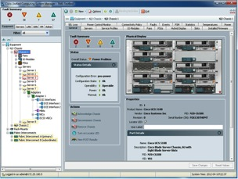
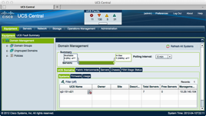
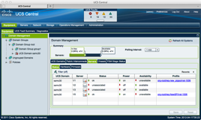
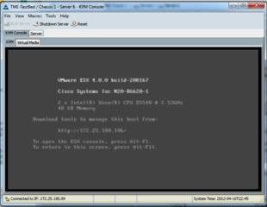
Cross Launch of UCS Manager and KVM
UCS Manager
Server KVM Console
Access to all registered UCS Managers and server consoles from one location

Slide 63
UCS Central
Phase 2 Features

Slide 64
Global Service Profiles and Templates
UCS Domain 1
Global Templates defined in UCS Central
Global templates use global policies
Global Service Profiles derived from Global SP templates
Global Service Profiles can be attached to Global Server Pools and Identifier Pools
Global Server Pools can have members from multiple domains
Global SPs can be deployed to domain of choice manually or through automatic association to a server in a pool
Global Service Profile Template
HR-Apps
Network: HR-VLAN
Network QoS: High
BIOS: Version 1.03
Boot Order: SAN, LAN
Global Service Profile
HR-App1
Network: HR-VLAN
Network QoS: High
MAC: 67:6f:74:75:63:73:21:20
WWN: 00:05:9b:67:6f:75:63:70
BIOS: Version 1.03
Boot Order: SAN, LAN
UCS Domain 2
Global Service Profile
HR-App2
Network: HR-VLAN
Network QoS: High
MAC: 67:6f:74:75:63:73:21:21
WWN: 00:05:9b:67:6f:75:63:72
BIOS: Version 1.03
Boot Order: SAN, LAN
UCS Domain 3
Global Service Profile
HR-App3
Network: HR-VLAN
Network QoS: High
MAC: 67:6f:74:75:63:73:21:23
WWN: 00:05:9b:67:6f:75:63:73
BIOS: Version 1.03
Boot Order: SAN, LAN

Slide 65
Global Service Profiles
Working With UCS Manager
UCS Central
UCS Manager
Globalize
Global Policies
Localize
Local Policies
Global Service
Profile Template
Local Service
Profile Template
Global Service Profile
Local Service Profile
Global Resource Pools
Local Resource Pools

Slide 66
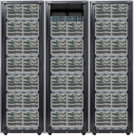
Statistics Aggregation
Limited Storage
and Processing
Capacity on the
Fabric Interconnect
UCS Manager collects large number of statistics
UCS Central provides long term retention of the data
Use of retained statistical data for analysis
Stored in external database—available for external direct access
External Reporting
UCS Central
Limited Internal Reports
Bandwidth
Power
Thermal
SQL
External DB
Oracle, MS SQL Server

Slide 67
Cloupia

Slide 68




Cloupia Snapshot
Company Overview
Solution Overview
Provides Management & Automation Solutions for Converged Infrastructure
Market Leader of FlexPod™ Management & Orchestration
Supports market leading converged infrastructures – FlexPod, VSPEX & Vblock
Founded in May 2009
Shipping Since July 2010
GTM: Channels
3 Locations (US, Hyd- India, UK)
Team: 50+
Single integrated solution across physical, virtual and cloud environments
Cloupia solutions are agent-less, easy to deploy and manage, cost-efficient, and provide a complete on-ramp to next generation cloud and converged infrastructure.
Leading industry analysts refer to Cloupia as the industry’s first “complete solution for converged infrastructure”
Ubiquitous adoption by leading channel partners/VARs, in addition to direct sales to leading enterprises.
Cloud Management
Top 30 Product Launch June 2012
Top 10 Promising Technology Companies
Best of vmworld 2011

Slide 69


Business Challenges
of Data Center Operations and Management
Multiple Element
Managers / Consoles
Disconnected Processes
  Data center infrastructure managed in silos
  Need for strong vendor specific skill-sets
  Manual administration
  High touch operations
Results in →
  Direct increases in OpEx
  Indirect increases in CapEx
  Delays in time to market
  Poor IT responsiveness to service requests
Virtualization
Manager
Plug-ins
Virtualization
Blade
Manager
Compute
5%
Infrastructure Investment
Cloupia reduces these costs
Network
Network
Manager
23%
Application
Investment
42%
Infrastructure Maintenance
Storage
Storage
Manager
30%
Application
Maintenance
*Source: IDC

Slide 70
Cloupia Product Offerings
Cloupia Unified Infrastructure Controller
  Unified Resource Management – Physical, Virtual & Public cloud
  Self-service Management : Self-service Portal/Catalog
  Operations Management : Physical & Virtual
  Unified Converged Infrastructure Management
  Model based Orchestration
CloudIgnite
  Day zero automation of Converged Infrastructure
  Single-Click Support Data Collection
  Validated assessments and compliance
CloudGenie
  Data center management iPad or Android client app
  Self-service VM provisioning/ VM Management
  Admin Dashboards

Slide 71
Converged Infrastructure Management from Day Zero
Day-0
Day-1
Day-2
Day-3
Gather Requirements
Rack-n-Stack
Configure HW
Deploy Virtualization
Partner Best Practices
Add tenants
Migrate or add applications
Deploy Resources via Self-service UI
Monitor performance Trends
Refine policies
Set granular access rules
Release resources
Add capacity
Lifecycle management
CloudIgnite™
(For Partners)
Cisco Unified Infrastructure Controller (CUIC)
CloudGenie™

Slide 72

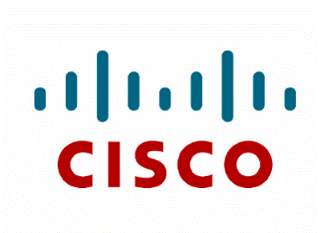





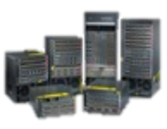


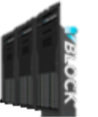







Cisco Unified Infrastructure Controller
End Users
IT Admins
IT Operations
Mobile Devices
CloudGenie
Self Service
Console
Admin
Console
Dashboard
ID & Access Manager
Policy Manager
Resource Pools
OS Provisioning
Database
Event Manager
Physical Infrastructure
Virtual Infrastructure
Compute
Network
Storage
Customer Choice
Self-Service Infrastructure • Policy-Driven • Lifecycle Management

Slide 73
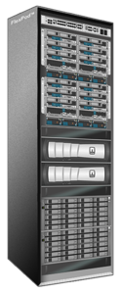



CloudIgnite™
Day-0 Configuration
Enabler for Partners
  To Deliver Day-0 Configuration
  With Consistency
  Accuracy
  Speed
  With Less number of Resources
Based on Best Practices
  Initially derived from CVDs
  Customizable to Partner specific
Single-Click Support Data Collection
  Consistent Reporting back to Vendors
  Reproducibility at a Support Center
Assistance with Run-book generation
Stand-alone App for Windows/Mac Laptops
CloudIgnite Demo Video
Customer
Requirements/
Inputs
CloudIgnite
Partner Staff
Vendor/Partner
Support Center

Slide 74
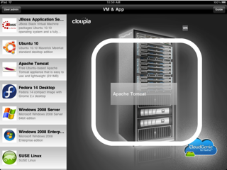
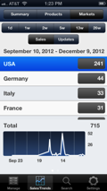
CloudGenie
A mobile based data center client application
Good marketing/pre-sales tool – demonstrates platform extensibility and ease of use
Supported Platforms
  iPad (Apple IOS)
  Android
  iPhone
Key Capabilities:
  VM provisioning
  VM resize
  Datastore resize
  Admin dashboards
  Self-service catalog
CloudGenie Demo Video

Slide 75

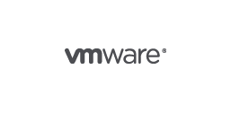







Converged Infrastructure Support
and Vision
FlexPod
VSPEX
Vblock
Other Infrastructure Combinations
Virtualization (VMware/Hyper-V)
Virtualization (VMware/Hyper-V)
Virtualization (VMware)
Virtualization
Compute (UCS)
Compute (UCS/HP/Dell)
Compute (UCS)
Compute
Cisco Nexus
Cisco Nexus
Cisco Nexus
Network
NetApp Storage
EMC Storage
EMC Storage
Storage
Current Support

