Slide 1
思科智能关怀服务介绍
Cisco Smart Care Service
思科服务
智慧助赢未来
王磊 lwang4@cisco.com
左珑 lzuo@cisco.com

Slide 2

挑战：
业务连续性是至关重要的 - 我的网络足够可靠的吗？
如何知道我的投资是有价值的？
是否有一个更精简的方式来管理和规划我的网络需求？
预算很紧，如何可以提高运营效率和节省成本？
很难监控、跟踪到我的网络发生了什么？怎么能保证全方位的服务覆盖？
Notes:
Tip:鼓励客户谈论面临的挑战是最关键的

Slide 3










什么是思科智能服务?
通过智能工具
收集
分析与比较
提供
启用自动化软件
网络诊断数据
思科智能数据库
可执行的建议方案.
+
+
思科智能资本
25年 网络创新及领导地位
600万 客户交流
5千万 上线设备
9万多 专业的技术文档

Slide 4
思科智能服务组合
市场
Remote Managed
Services
大型企业 / 公共部门
Smart Net
Total Care
中型企业
SMARTnet
Collaborative Professional Services
Smart Care
Smart
Foundation
Partner Led Smart Service
小型企业
响应式服务
主动式服务
专业化 / 托管
服务需求
Notes:
Let’s take a look at where the Cisco Smart SMB Services fit in terms of Service Needs and Network Importance.
Service Needs
Both Cisco Smart Foundation Service and Cisco SMARTnet Service are responsive services that provide expert help when a customer’s IT staff encounters a technical issue with a covered Cisco device that they cannot resolve. (SMARTnet Service will add a proactive service feature to its award-winning service with the introduction of Smart Call Home in mid 2007. Smart Call Home will provide proactive diagnostics and real-time alerts on Call-Home-capable devices such as the Catalyst 6500 and MDS9000). Responsive services are well suited to businesses that want to manage their own networks but need responsive support when they have technical issues they can’t readily resolve themselves.
Smart Care Service is a proactive, network-wide service that offers proactive network monitoring, health checkups, diagnostics, and software repairs in addition to technical support for customers’ entire Cisco network in a single contract. Proactive services are ideal for businesses with limited IT staffs or those who a service that to allows their IT staff to operate more efficiently by reducing the time and effort required to keep their network running optimally
Fully Managed Services for SMB customers are available from Cisco for Unified Communications solutions and from Cisco Partners for broad-based networking services. Fully Managed Services are ideal for businesses who want someone else to manage their mission critical networks for them.
Network Importance
Cisco Smart Foundation Service provides cost-effective coverage for important networks by providing live access to troubleshooting support during business hours and anytime access to the Cisco SMB knowledgebase.
Cisco SMARTnet Service provides fast issue resolution of critical to mission critical network issues by providing direct access, anytime (24x7) to Cisco Engineers and premium service options such as 2-hour advance parts replacement
Cisco Smart Care Service provides comprehensive coverage for critical networks, by providing dashboard visibility of network performance and technical support for all of the Cisco devices on the network. Live technical support varies from business-hours to 24x7, and includes NBD advance hardware replacement. (Partners have 24x7 access to Cisco TAC for help resolving technical issues.)

Slide 5


两种独特的服务系列
需要特定的资格要求：认证、专业化、绩效指标
对合作伙伴没有特别的资格要求
思科品牌服务
合作伙伴购买思科知识资本和服务基础架构
思科 交付
+
+
协作型服务
通过合作伙伴销售
合作伙伴无缝融入，然后构建、销售和交付
Notes:
For Cisco Branded Services, with a few minor exceptions, there is no requirement for partners to be able to position those services in the marketplace. Anybody can position our Cisco Branded Services because Cisco is delivering the services, and the partner sells that service to the end user customer.
Collaborative Services are a much higher level of services that embody Cisco deliverables. There are specific requirements that we are leveraging around a framework that dictate which partners have access to which services.
Essentially, the partner purchases the collaborative service, leveraging the Cisco intellectual capital that’s embodied in that service, and then the partner creates their own services and bring them to the marketplace.
Ultimately, the partner drives the actual service experience of the end user by combining what they think is important for that end user with what Cisco can deliver.

Slide 6




思科Smart Care 整合合作伙伴的专业性和增值服务
思科Smart Care是由思科认证的合作伙伴，通过协作式的“partner-led, Cisco-enabled” 途径进行交付的技术支持服务。
Smart Care服务的特色是强强联合，整合思科的智力资本和合作伙伴的专业性和增值的优势以满足客户的需求；
通过网络主动监测、评估和远程修复等功能，提供整合型的网络技术支持，提供全面的网络关怀和网络的持续改善。

Slide 7
安心的服务
思科 Smart Care 服务
主动验证网络的安全性、可用性、可靠性
依托思科由客户信赖的合作伙伴提供交付
基于思科的智力资本与多年的网络专业性
集成合作伙伴的
专长和增值服务
个性化的服务体验，有助于提高网络的运营效率，最大限度地减少经营风险，从您的技术投资获得更多回报
Notes:
2005年，“哈佛商业评论”看智能服务，在他们的开创性论文提到了四项战略时代的智能服务。哈佛定义的智能服务，为那些“使用自动和技术支持的连接和情报，以更有效地提供更高的价值。”
Cisco smart services go beyond the industry definition in three key ways in ways that no one else can:
Cisco’s INTELLECTUAL CAPITAL and unmatched expertise– with 25 years of industry experience with more than 50 million installed devices and 6 million annual customer interactions, Cisco’s network and technology expertise helps customers get the most from their business technology investments
ANALYSIS and CORRELATION of real-time customer data-- personalized, proactive capabilities deliver actionable insight into customers’ networks through automated comparison of customer network data with Cisco intellectual capital to add value to service offerings across our entire portfolio Smart Services from Cisco and partners deliver predictive insight into customers’ networks.
Delivery via a COLLABORATIVE PARTNER APPROACH—by sharing intellectual capital with partners, rather than competing with them, Cisco helps partners expand their businesses, increase revenue, and strengthen customer relationships. Partners integrate Cisco capabilities into their service practices, delivering more value to their customers Together, through smart services, Cisco and our partners help customers predictably manage the health and stability of their networks, to reduce costs, mitigate risk and drive innovation.

Slide 8
Smart Care 功能组成
合作伙伴利用Smart Care协作型服务平台,
构建符合客户个性需求的全新服务体验
Cisco Smart Care Service
单一合同
简化管理
产品告警
主动通知
核心和安全
评估与修复
远程网络监控
语音评估和
质量监控
网络设备配置归档与备份(DR)
智能元素
Cisco IOS 升级和 软件升级
下一工作日/4小时/4小时现场 备件先行更换服务
基础能力
Cisco.com 和 Smart Care 门户站点访问权限
合作伙伴 24 X 7 访问 Technical Assistance Center
Notes:
8
Smart Care is a partner-led service offering, which means partners provide technical support directly to customers. But in the event partners need backup, they can contact Cisco’s TAC 24 x 7.
Smart Care contracts will offer Next Business Day parts replacement with the option to upgrade to 4 Hr
Smart Care partners have access to Cisco.com and a unique collection of network management tools on the Smart Care Partner Control panel.
Last but not least, Cisco IOS updates and upgrades are also included, along with Software Application Support Updates –SAS but not SASU.
8

Slide 9
思科智能关怀服务功能
设备诊断
安全警告
评估
报告
主动通知
灾难恢复
远程监测
24*7 全天候 TAC
NBD/4 小时硬件更换
软件更新
Cisco.com 访问
思科知识
资本 + 智能
服务创新
全球
基础架构
思科
提供
思科智能关怀服务
Notes:
Besides the health check assessment, you are also enabled with our suite of smart capabilities :
Remote monitoring, diagnostics, alerts:
Proactively manage network performance using a secure connection between Cisco and your network to detect issues before they affect business.
Security threat intelligence:
Proactively maintain the integrity of sensitive information and increase network uptime with security intelligence
Engineering and operations specialists:
Receive personalized attention from experts to solve issues quickly
Technical assistance from TAC:
Direct access to Cisco Technical Experts to resolve issues quickly
Globally consistent superior service in more than 120 countries
Online resources and global support community:
Solve issues faster with anytime access to online resources and smart interactions to increase productivity
Automated troubleshooting tools , personalized content and solutions, collaborative Support Wiki, global support community
Hardware replacement:
Maintain network operations with time sensitive delivery of replacement hardware, flexible options
Operating system software updates:
Maintenance, minor and major updates for licensed feature set to enhancing network availability, reliability, and stability
Application software updates and upgrades:
Strengthen availability, functionality, and reliability of applications and increase application functionality with major upgrade releases

Slide 10
独树一帜的服务交付
合作伙伴业务专长
您的托管服务品牌
当地语言
个性化服务解决方案
长期客户关系
垂直行业经验
您的专业技术
应用系统安全
灾难恢复
远程 PC 管理
存储
服务器管理
合作伙伴
提供
思科知识
资本 + 智能
服务创新
思科
提供
合作伙伴的
专长
全球
基础架构
思科智能关怀服务
Notes:
智能关怀服务 provides these benefits for the Channel:
Improved profitability by transitioning to a service-led model with predictable, recurring revenue streams
Increased margins by promoting greater adoption of advanced technologies
Differentiation by complementing traditional support with proactive maintenance services in collaboration with Cisco
Increased customer loyalty through remote monitoring, diagnostics, and repair services that make the reseller an indispensable business partner
A flexible services platform that supports customized add-on services and reseller-branded customer tools
Improved efficiency through web-based remote monitoring and management
Reduced contract administration costs through network-wide coverage contracts

Slide 11
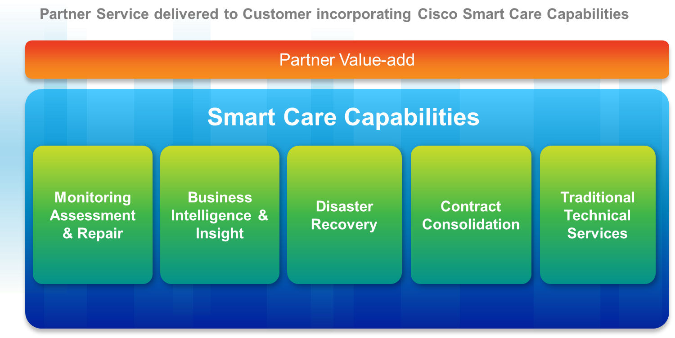


全面提升客户满意度
合作伙伴
业务专长
合作伙伴品牌
合作伙伴
专业技术
通过合作伙伴提供的客户体验
思科智能关怀服务
思科智能关怀服务
客户满意度

Slide 12
思科智能关怀服务定位
在整个网络范围提供包括主动监测和评估在内的技术支持，保障网络安全，使网络保持最佳运行状态
深度
广度
应用/ 解决方案管理
智能关怀服务
主动通知
视频/网真
服务器
远程监测
安全
硬件和软件支持
语音
路由和交换
公司规模
中型市场
大型企业
Notes:
Cisco 智能关怀服务 Service is a collaborative services platform that lets Cisco Certified Partners offer unique and profitable services that are tailored to their customers using Cisco tools, resources, and service infrastructure. Partners provide comprehensive technical support for the entire network, ongoing network monitoring, and proactive maintenance, all under a single customer contract, and are backed by Cisco.
智能关怀服务 provides these benefits for customers:
Increased network visibility by providing information to efficiently manage and continually improve the network
Improved network uptime, security, and performance through ongoing monitoring and periodic assessments
Improved IT staff efficiency by reducing the time and effort that is required to keep the network running optimally
Enhanced employee productivity and responsiveness to customers through improved availability of business applications
Optimized business profitability by helping customers get the most from technology investments
Simplified contract management and maintenance requirements through a single service that covers all Cisco devices
The combined expertise of both Cisco and partners in a single offering

Slide 13

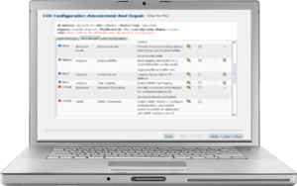

智能关怀服务（Smart Care)工作流程
合作伙伴
思科
客户
反应性支持
技术
支持
硬件
更换
TAC
网络监控/合同管理
合作伙伴增值服务
商业
智能
网络评估
和修复
思科 Smart Care
控制面板
主动维护
网络监控和评估
数据库
设备基本信息
Smart Care
网络设备
Notes:
制作幻灯片：
以下是 Smart Care 服务的工作原理。
此服务的关键是 Smart Care 网络设备。该设备是指安装在客户网络内部的设备。（单击）
使用此设备，合作伙伴可以持续监控网络的运行状况。监控数据将通过思科托管的门户从客户网络安全地传输给客户及合作伙伴。（单击）
利用这些数据信息，合作伙伴能够专业且快速地处理大部分网络问题，从而增强了他们与客户建立的增值合作关系。（单击）
Smart Care 服务还附带提供类似于 SMARTnet 的支持，其中包括部件更换和以合作伙伴为主导的技术支持。当然，所有这些服务均由思科 TAC 专家提供强有力的保障。

Slide 14
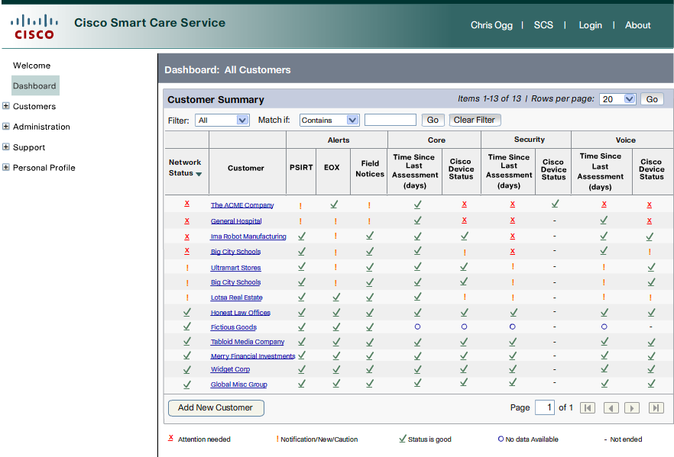
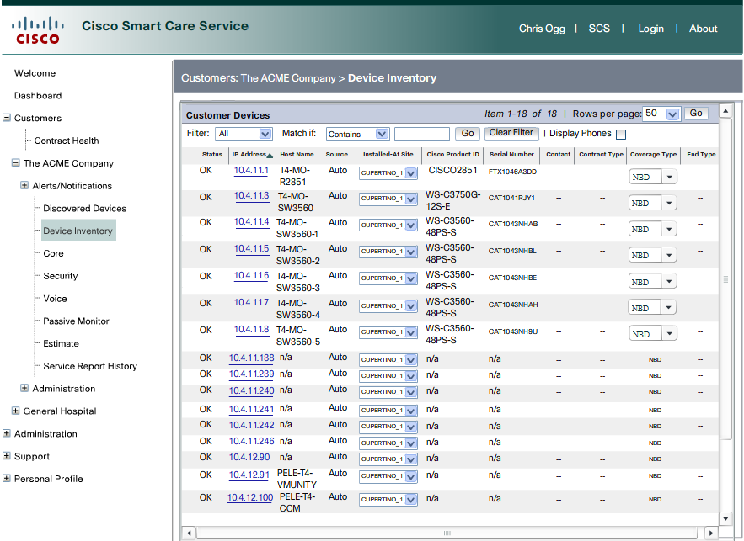
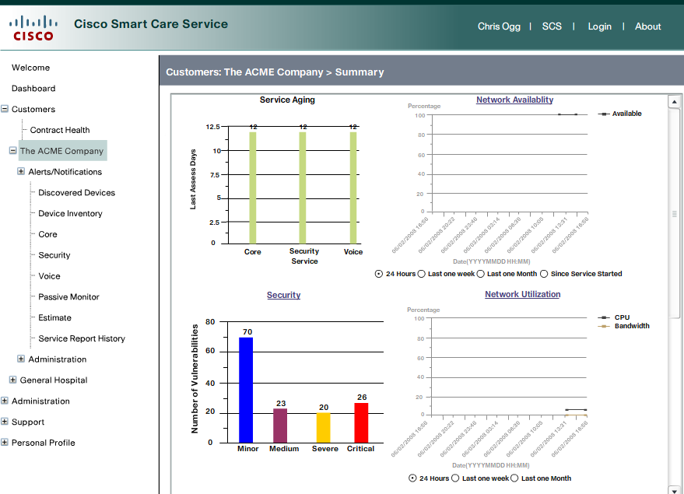
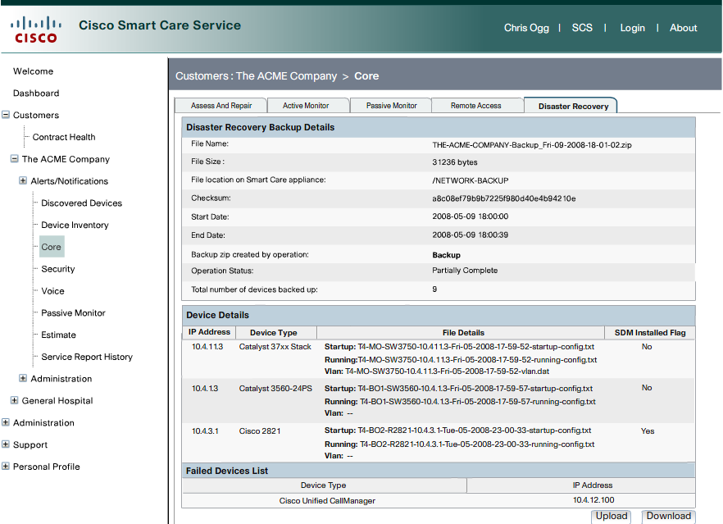
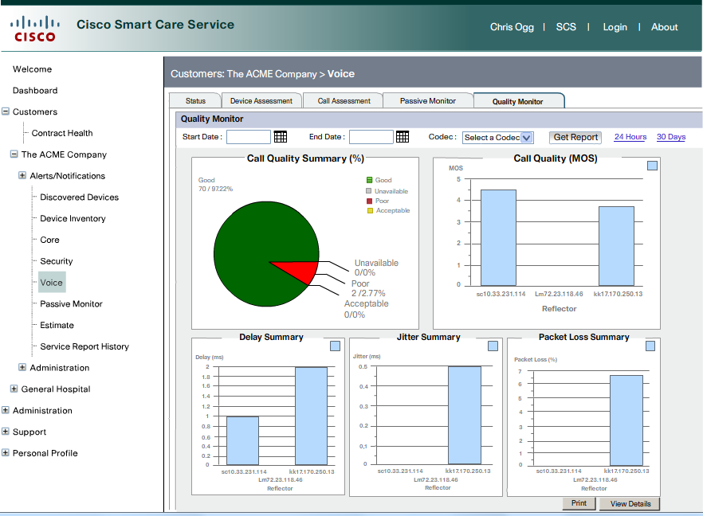
合作伙伴 Smart Care 管理 门户

Slide 15
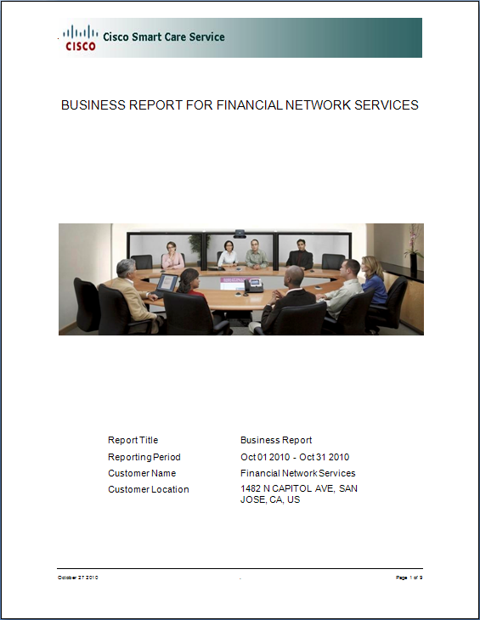
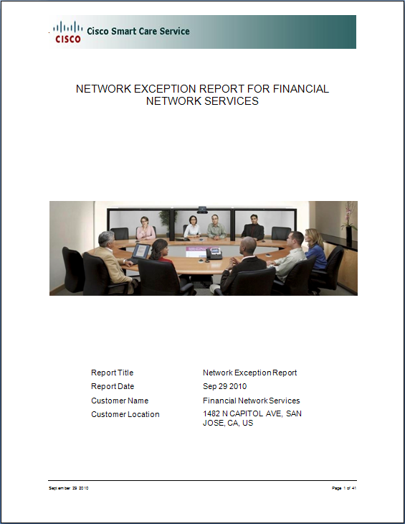
两种类型的报告
Business Report
Network Exception Report
每月
每周
两种报告都支持:
定期自动生成
按需手动生成

Slide 16

合作伙伴通过Smart Care可以
帮助客户摆脱网络管理困境
提高网络的可用性
和可靠性
保持网络持续健康
提供安全的网络通信
省钱
帮助您释放资源以更多关注业务用户的实际需求
提高运营
管理效率

Slide 17
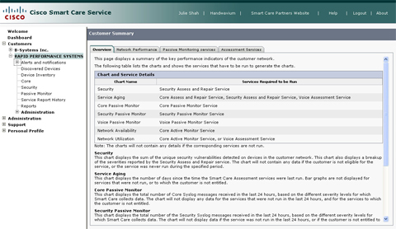
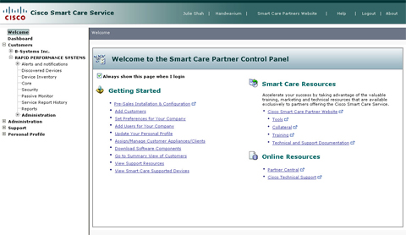
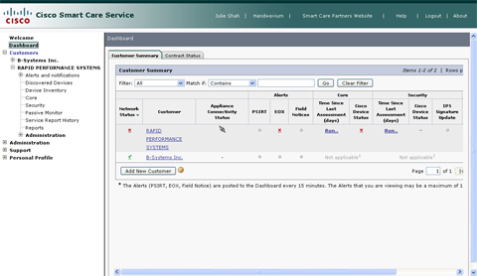
1.10版本发布细节概览
基于SKU报价
基于SKU报价的优点
以SKU为基础 价格操作与策略改变
现存的权重合同模式
缺陷解决与 补丁修正
Project management & technical resources
合同管理的变化
新的服务内容与改变
以SKU建立Quote和订购服务合同
1.9 版本服务等级类型
硬件 & 虚拟机模式 政策和流程改变
Smart Care GSPs
Smart Care 价格List
Notes:
First, here’s the list of 1.9 detail topics we’ll cover.
As we go through these topics, I think you will see that 1.9 is as much about what processes or policies have been removed as it is about any new ones that have been added –
For example, the complex weight-based price banding goes away – and it’s replaced by simplified and predictable SKU-based pricing.
As another example, quotes are no longer generated through the Smart Care Portal – instead, you will enjoy simplified quoting and ordering using mainstream Cisco commerce tools.
So together, the takeaways and additions continue the Cisco strategy of improving ease of doing business for our partners and enhancing the Smart Care offer.
Now let’s get started.

Slide 18
Smart Care 服务级别选项
Smart Care 服务级别
N
P
O
Next Business Day
8x5xNBD
Premium
24x7x4 Hour
Onsite
24x7x4 Hour
Notes:
So here are the Smart Care service level options for SKU-based contracts going forward.
(CLICK) Next Business Day,
(CLICK) Premium,
(CLICK) and Premium Onsite
(CLICK) Notice the abbreviation above each service level: N – P – and O
Keep these abbreviations in mind because they are key to SKU-based ordering and getting the Smart Care service level you need for each device.

Slide 19
联系我们
Smart Services Bureau (SSB)
邮箱: ask-smart-services-cn@cisco.com
电话: 400 810 9995

Slide 20
SSB
如果Smart Care合作伙伴有如下任何问题，可以与思科智能服务支持团队取得联系。
    如何认证成为思科智能服务代理商
    Partner 在注册培训过程中遇到的问题
    Portal的使用及下单过程中遇到的问题
    思科职能服务所包含的设备出现技术问题，需要联系思科工程师
邮箱: ask-smart-services-cn@cisco.com
电话: 400 810 9995
(工作时间：周一至周五 9:00 – 18:00)

