Slide 1
思科 BYOD
智能解决方案
合作伙伴事业部 工程师
吴晓永 wxiaoyon@cisco.com
13922182039

Slide 2

议题
智能解决方案：变化中的工作空间
BYOD 智能解决方案简介
思科技术优势
应用场景

Slide 3

思科智能解决方案：
变化中的工作空间

Slide 4


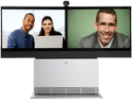























您过去的工作方式取决于…
而您现在的工作方式取决于…
有线
无线

Slide 5



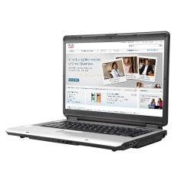

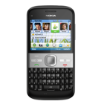




未来的工作空间将更加灵活自由
独立于场所/设备/应用

Slide 6


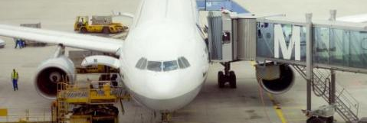
您的工作空间是什么样子的？
让您的工作既高效又高产的一切方式
在办公室里
在旅途中
桌面
公司应用
优化的语音
优化的视频
知识产权
专业知识
协作
互联网
电邮
即时通信
处理
带宽
存储
互联网
电邮
即时通信
语音
视频
生产效率计量器

Slide 7
您的工作空间是什么样子的？
让您的工作既高效又高产的一切方式
在办公室里
在旅途中
桌面
公司应用
优化的语音
优化的视频
知识产权
专业知识
协作
互联网
电邮
即时通信
加工
带宽
存储
无论在何处都能保证工作效率的一致
生产效率计量器

Slide 8

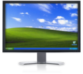
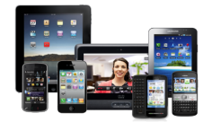







智能解决方案
为思科统一工作空间提供动力
虚拟桌面及企业协作应用
VXI 智能解决方案
本地或基于 Web 的应用
BYOD 智能解决方案
智能网络

Slide 9
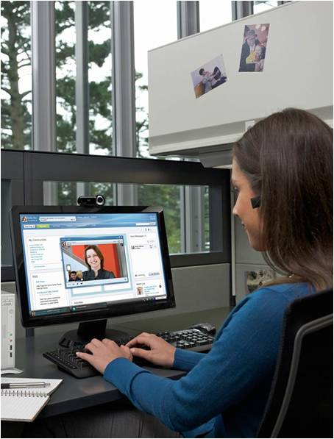

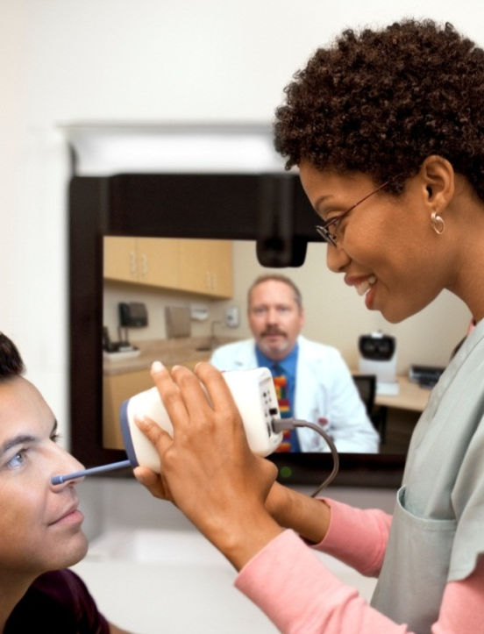
思科统一工作空间
实现个性化工作愿景
思科统一工作空间：
智能解决方案交付框架
思科 VXI
智能解决方案
思科 BYOD
智能解决方案
思科远程专家
智能解决方案

Slide 10

BYOD 只是冰山一角
BYOD
我需要在我的网络上使用 iPad
最终用户
战术
战略
我需要吸引并留住高度重视其设备的顶尖人才
我需要确保员工能够更加灵活高效地工作
CEO
我需要保护知识产权和机密数据
我需要在不影响体验的前提下让用户
使用多种平台
CIO
我需要在不增加成本
或复杂性的前提下支持
多种设备类型
我需要让员工、合作伙伴和
承包商能够对设备进行基于策略的访问
我需要
在多种移动操作系统上启用旧版应用
IT
我需要工作空间策略

Slide 11


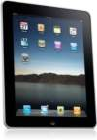






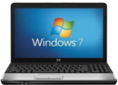



BYOD：全公司范围的项目
合规操作
网络团队
安全操作
终端团队
应用程序团队
人力资源

Slide 12

BYOD 智能解决方案

Slide 13
BYOD 智能解决方案简介
一个网络、一条策略、一种管理方式
  经过验证的“自带设备”解决
  方案
  从规划到实施和支持的统包解决方案
  激发解决方案价值\保护客户投资的综合路线图
  销售推动
  模块化构建块方法
协作应用
工作空间管理
安全移动
策略管理基础架构
核心基础架构

Slide 14


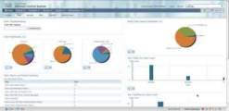
完整的思科 BYOD 解决方案
Paul B
LAN、WLAN 和 VPN 在 Gartner 魔力象限中的领导地位
顶尖技术
融合的策略和管理
移动性
优化的无线体验
主动频谱管理保护的客户端加速和优化的视频
安全
保护运动中的数据
可感知环境的 VPN 和防火墙、基于云的电邮和内容扫描
协作
丰富的跨设备体验
为跨多个移动设备的语音、视频和 IM 使用统一的平台
何人？
何事？
何时？
何地？
何种方式？
身份
服务
引擎
思科
Prime
基础架构

Slide 15
BYOD 智能解决方案组件
WebEx、Jabber
协作应用
移动设备管理 (MDM)
工作空间管理
AnyConnect 自适应安全设备 (ASA)
安全移动
身份服务引擎 (ISE)
策略管理基础架构
有线和无线
思科 Prime 基础架构
核心基础架构

Slide 16
部署方案
淡出列表框和文本
对话框
灵活的选项
协作应用
协作应用
协作应用
工作空间管理
工作空间管理
工作空间管理
安全移动
安全移动
安全移动
策略管理基础架构
策略管理基础架构
策略管理基础架构
核心基础架构
核心基础架构
核心基础架构

Slide 17



您的客户当前
处于 BYOD 频谱图的什么位置？
限制
基本
增强
高级
企业政策
环境要求
进行严格控制
设备类型
仅限公司使用的设备
医院
（示例）
医院扩展了员工对
企业设备（笔记本电脑、iPad 和智能手机）的无线访问权限
IT 要求
网络上人员/设备的能见度
仅可访问公司分发的设备

Slide 18

您的客户当前
处于 BYOD 频谱图的什么位置？
限制
基本
增强
高级
企业政策
环境
需要进行
严格控制
关注基本服务和
轻松访问
设备类型
仅限公司使用的设备
设备类型更广泛，但仅限互联网
  简单访客
医院
（示例）
医院扩展了员工对
企业设备（手提电脑、iPad 和智能手机）
的无线访问权限
医院向病人提供访客访问权限
IT 要求
网络上人员/设备的能见度
仅可访问公司分发的设备
个人设备仅限于公共互联网
限制访问内部站点

Slide 19

您的客户当前
处于 BYOD 频谱图的什么位置？
限制
基本
增强
高级
企业政策
环境
需要进行
严格控制
关注基本服务和
轻松访问
现场/异地
对企业应用进行安全访问
设备类型
仅限公司使用的
设备
设备类型更广泛，但仅限互联网
  简单访客
多种设备类型 +
访问方法
  BYOD 的早期商务应用者
医院
（示例）
医院扩展了员工对
企业设备（手提电脑、iPad 和智能手机）
的无线访问权限
医院向病人提供访客访问权限
医生可在医院或火车上使用个人设备访问某些医院应用
IT 要求
网络上人员/设备的能见度
仅可访问公司分发的设备
个人设备仅限于公共互联网
限制访问内部站点
允许个人设备和公司设备在现场和异地对网络/应用进行粒度
访问

Slide 20
您的客户当前
处于 BYOD 频谱图的什么位置？
限制
基本
增强
高级
企业政策
环境要求
严格控制
关注基本服务和
轻松访问
现场/异地
对企业应用进行安全访问
所有关键应用、
新服务、
完全控制
设备类型
仅限公司使用的
设备
设备类型更广泛，但仅限互联网
  简单访客
多种设备类型 +
访问方法
  BYOD 的早期商务采用者
任意设备、
任意所有权
  创新型组织
医院
（示例）
医院扩展了员工对
企业设备（手提电脑、iPad 和智能手机）
的无线访问权限
医院向病人提供访客访问权限
医生可在医院或火车上使用个人设备访问某些医院应用
医院管理者使用新型协作服务，可获取对应用的完整网络访问权限
IT 要求
网络上人员/设备的能见度
仅可访问公司分发的设备
个人设备仅限于公共互联网
限制访问内部站点
允许个人设备和公司设备在现场和异地对网络/应用进行粒度
访问
确保完整的移动和协同体验

Slide 21

部署场景和思科解决方案
 | 限制 | 基本 | 增强 | 高级
企业政策
环境要求
严格控制
关注基本服务和
轻松访问
现场/异地对企业应用进行安全访问
所有关键应用、
新服务、完全控制
设备类型
设备类型更广泛，但仅限互联网
  简单访客
多种设备类型 +访问方法
任意设备、任意所有权
  创新型组织
仅限公司使用的
设备
医院扩展了员工对
企业设备（手提电脑、iPad 和智能手机）
的无线访问权限
医院向病人提供访客访问权限
医生可在医院或火车上使用个人设备访问某些医院应用
医院管理者使用新型协作服务，可获取对应用的完整网络访问权限
（示例）
IT 要求
网络上人员/设备的能见度
仅可访问公司分发的设备
个人设备仅限于公共互联网
限制访问内部站点
允许个人设备和公司设备在现场和异地对网络/应用进行粒度访问
确保完整的移动和协同体验
采用解决方案
核心基础架构- Wireless&wired
核心基础架构- Wireless&wired
核心基础架构- Wireless&wired
核心基础架构- Wireless&wired
策略管理基础架构-ISE
策略管理基础架构-ISE
策略管理基础架构-ISE
策略管理基础架构-ISE
安全移动-Anyconnect
安全移动-Anyconnect
工作空间管理
-MDM
协作应用-Jabber/Webex/VDI

Slide 22
使用构建块生成使用案例
高级
WebEx、Jabber
协作应用
MDM
工作空间管理
增强
AnyConnect、ASA
安全移动
ISE
有限
和基础
策略管理基础架构
有线和无线
思科 Prime 基础架构
核心基础架构

Slide 23



思科Beyond BYOD主要优势
统一策略
统一网络
统一管理
New
Updated
Updated
Wireless Network
30% faster
IPv6 optimized
Hotspot 2.0
Prime Assurance
Manager
End to end performance
Identity Services Engine
Zero-touch
onboarding
MDM policy
Over-air posture
New
New
AnyConnect
Auto VPN
802.1x
ISE
integration
Updated
Prime Infrastructure
Wired/wireless lifecycle
Services management
ISE integration
Mobile Device Management (MDM) integration
Jabber for iPad, Windows
设备注册及访客服务
统一策略
完美的用户体验
简化IT管理
Notes:
On January 31st, Cisco will announce a strategy and new solutions to address the end-to-end mobility challenge with all the pieces needed to alchemize the chaos of mobile devices into business transformation. Cisco combines a Unified Access network spanning wired, Wi-Fi and cellular, with virtualization and collaboration technologies. This complete solution opens opportunities to transform IT value and company value. New functions include:
Onboard and secure mobile devices in one step: New mobile device provisioning and security, plus enhanced functionality and usability in a single source of policy across all networks to address BYOD and device proliferation security and management challenges
MDM partnerships; ISE 1.1MR, 1.2 Catalyst switch port sensor functions
Maps to Policy & Management layer of architecture
Maps to Onboarding category
Deliver fastest, most intelligent service: fastest and most consistent mobile device speeds on Wi-Fi, within a new mobility architecture designed to meet the demands of device proliferation and “data deluge” – and new, effortless roaming between wi-fi/cellular
AP3600, controller scalability, MSE, VideoStream, ClientLink and CleanAir enhancements, MSAP, 802.11u, plus [trials, partnerships with Samsung and others?] plus [switch/router/SP stuff?]
Maps to infrastructure, plus network services layers of architecture
Maps to “End User Experience” category
Unified service assurance and management end to end: New, more integrated wired/Wi-Fi infrastructure management, with service assurance to simplify administration of the Unified Access network
Prime SAM, Prime Infrastructure, MDM partnerships, integration with ISE 1.2
Maps to Policy & Management layer of architecture
Maps to “Ongoing Ops” category

Slide 24

应用场景

Slide 25

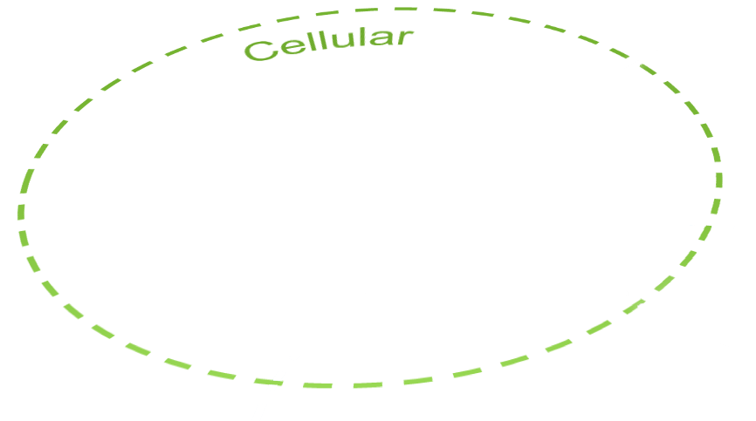
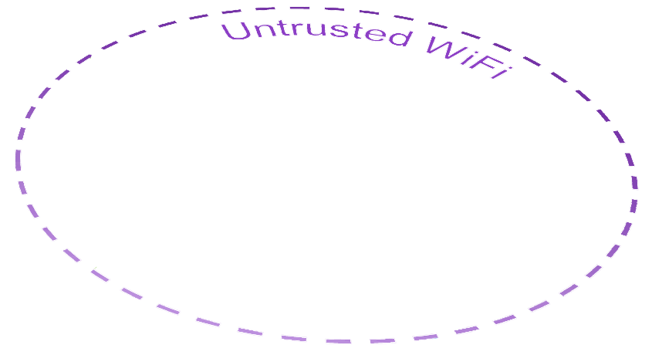
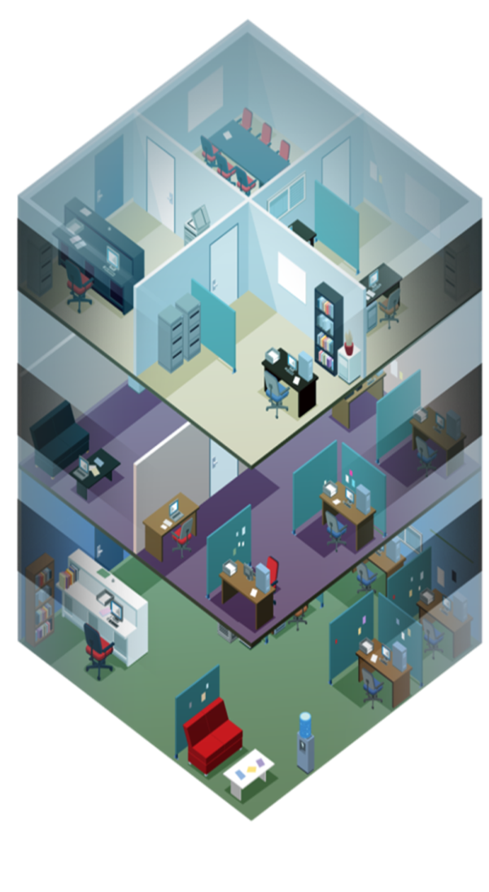


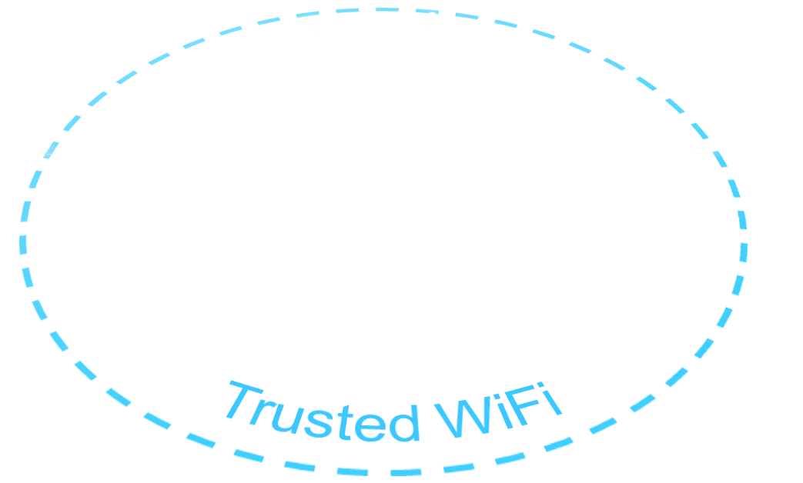
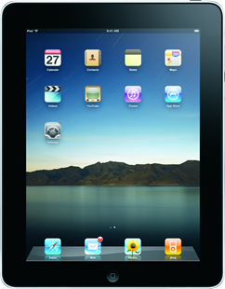
Cisco 超越BYOD使用场景举例
– NG Mobility Workforce
Notes:
What does this all really mean? It introduces a new chasm – the netherworld between trusted enterprise networks, and the wild world of the internet that is accessed while roaming hotspots, 3G/4G networks and home networks. Did you know that employee devices spend a full 50% of connected lives OFF the enterprise network? As never before, organizations must manage the transitions on and off different networks seamlessly, while protecting sensitive information.
But this growth in wireless and mobility can also create new opportunities to increase efficiency and grow your business today. Just how can you take advantage of this market transition?
What I’m going to do today is break it down into a very simple example. Let’s walk through a day in the life of Dr. Jack Thompson, something that is happening right now in hospitals across the country.
[TRANSITION] Let’s see what a true seamless experience should be for Dr. Thompson, and the systems that make it happen.

Slide 26
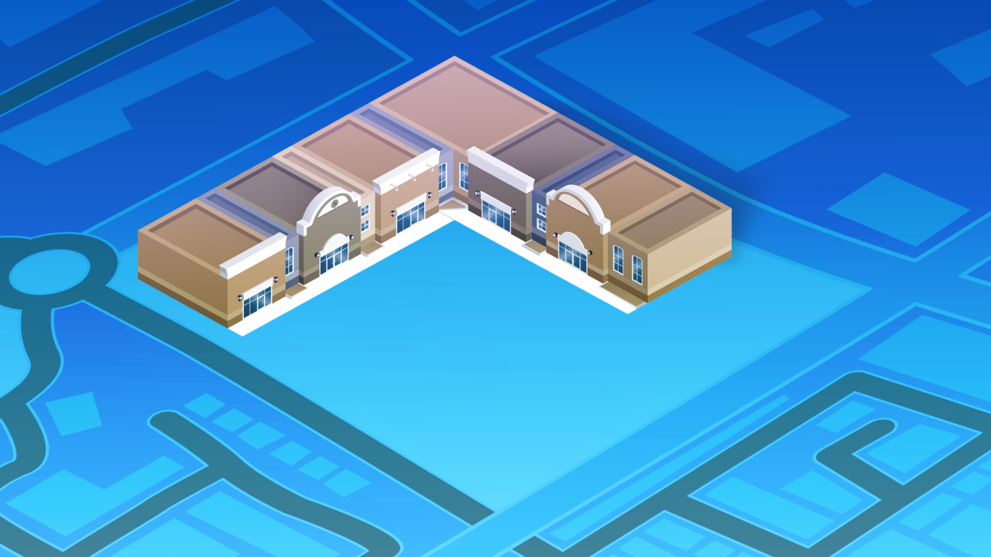

Notes:
Dr. Thompson buys a 3G iPad during lunch, walks back to the hospital and hands his new iPad to IT and says I want to use this for my work. Now what?
[TRANSITION]

Slide 27
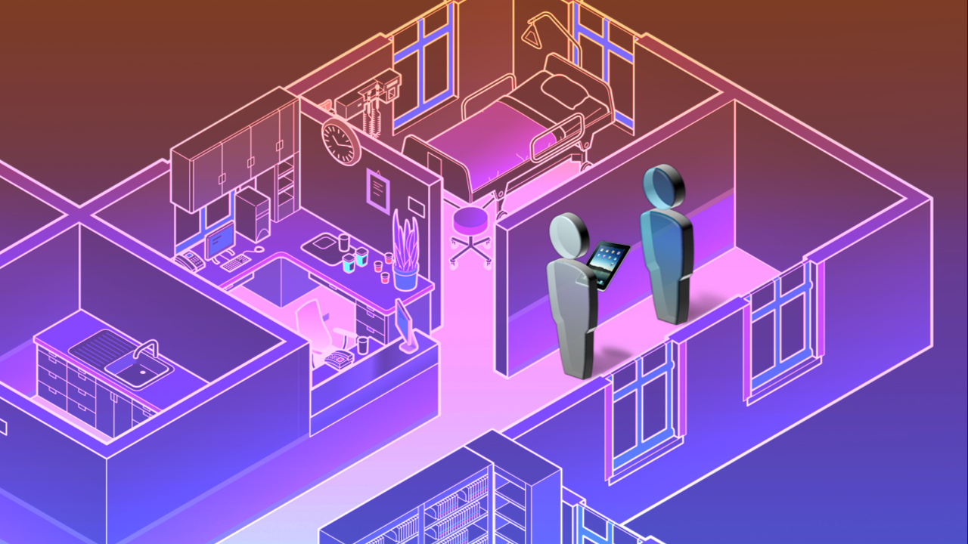


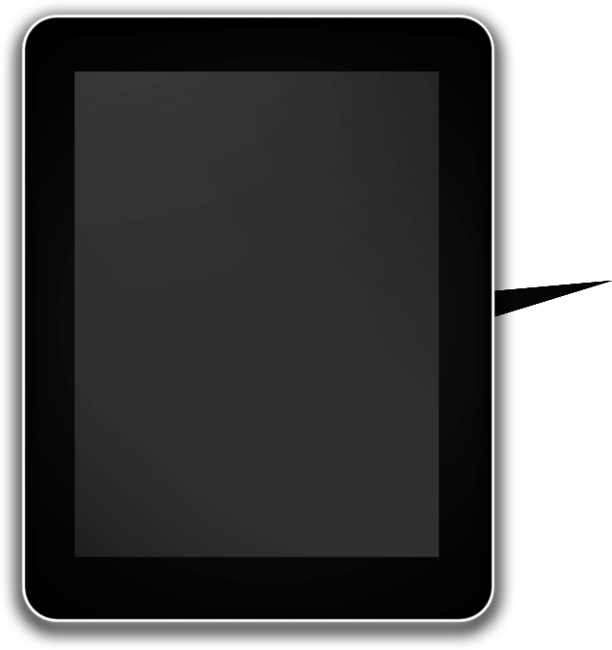




Trusted
WiFi
认证用户
验证设备
应用公司配置
使用企业应用
自动策略下发
Notes:
His IT manager tells him that using his username and password, he can “onboard” the device and the network will apply all the correct policies and approved apps automatically
The IT manager knows the importance of keeping the network secure, and complying with regulations to protect patient data. So things like remote wipe and data loss prevention are critical.
[TRANSITION]

Slide 28



可信
802.11n Wi-Fi
WiFi
Identity-Based Access Control
应用定义的策略基于:
设备类型
用户
位置
应用
Mobile Device Management
WAN Optimization
Service Assurance
Notes:
Luckily, his system can help him apply contextual policies based on things like device type, user or location automatically, without user intervention. We’ve kept it simple for this example, but as you all know you can apply polices based on many more attributes.
That’s it, Dr. Thompson has now on-boarded his new iPad. Keep in mind, to enable this seamless experience the network needs to support certain things: First, you need an 802.11n Wi-Fi network which can withstand the challenges of Mobility including complex RF interference. Second, you need identity-based network control for the contextual policy we just touched on. Mobile Device Management is required for functions such as installing enterprise applications or remote wipe if the device is lost. Last but not least, Make sure you have a management system for the infrastructure and a service assurance manager for visibility into what’s going on in the network, and what you need to do if things start going wrong. If you have branches in the Hospital, WAN optimization will help help keep network resources available.
[TRANSITION]

Slide 29

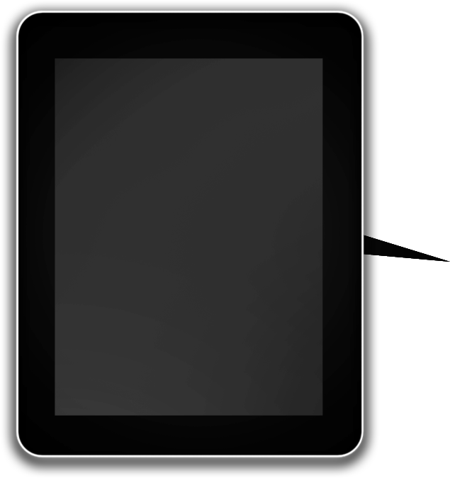
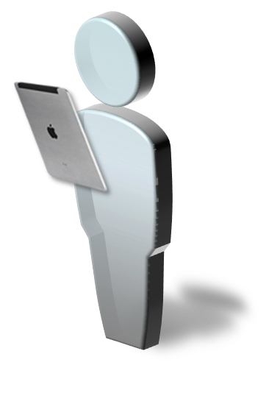


Trusted
WiFi
Access: FULL
No
Yes
电子病历
移动视频应用
邮件
对话软件
Notes:
Let’s get back to Dr. Thompson….
He is now attending to patients in the OR. His contextual policy has been defined from an application perspective such that when he is at work, he has full access electronic medical records, mobile telepresence, email and IM. Again, we are keeping it simple here in terms of applications used. It’s key to note that you can tailor this policy for unique job and regulatory requirements, with the doctor only allowed to access sensitive patient records while in the office due to HIPPA regulations.
It’s now 2 o’clock and Dr. Thompson needs his afternoon coffee, what happens when he leaves the Hospital? [TRANSITION]

Slide 30

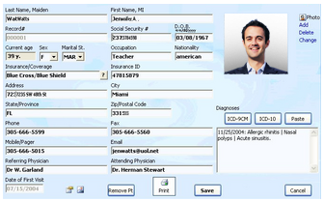
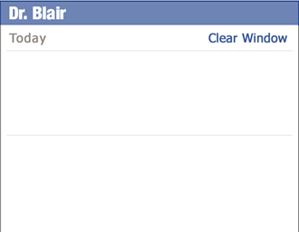



可信
802.11n Wi-Fi
Location
Video Optimization
Spectrum Intelligence
Client Acceleration
WiFi
Identity-Based Access Control
Is Mr. Allen’s lab work ready yet?
Not yet but i will let you know the moment it arrives
Mobile Device Management
Notes:
Doctor goes to OR, pulls up EMR and x-ray images
Communicates with staff via IM
We know that literally billions of devices are pouring onto networks – at hospitals that presents doctors, administrators, patients, and visitors. Each has unique needs, and along with tablets and smart phones, healthcare has specialized medical equipment, and wireless tracking tags, connecting in increasing numbers
A Wi-Fi network must be designed to meet these challenges, these changing device profiles, application profiles, and device density.
Capacity and performance to support the influx of clients
Performance to handle new applications, such as two-way TP with patients, and EMR data housed centrally for a medical group, and application data now residing in the cloud
Acceleration for all client types, even the medical asset tags, slower tablets and smart phones
PROACTIVE protection against wireless interference from things like blanket warmers and light controls
Location tracking for assets and people
Plus, patient data is protected by HIPPA regulations, so IT must carefully govern when and how this can be accessed

Slide 31
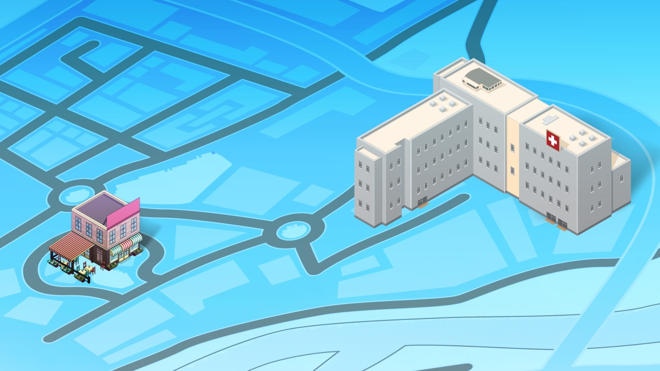





不可信WiFi
Access: 受限
WiFi Hotspot
Notes:
He decides to visit the coffee shop next door, which has a Wi-Fi hotspot. Now, his contextual policy becomes a roaming policy defined by the Hospital. The policy says that Dr. Thompson will not have access to EMR while at the coffee shop, but he will be able to use email, telepresence and IM
[TRANSITION] While there, he gets a paged from his nurse, and gets into a video chat session to have a two-way video chat about his patient.

Slide 32






Hotspot 2.0
802.11n
Wi-Fi
WiFi Hotspot
Web/Email
Security
Identity-
Based
Access
Control
VPN
Collaboration/
UC
Notes:
Of course, behind that video call was infrastructure that made it possible.
[SP WI-FI] What really made this experience work was something called Hotspot 2.0. Let’s take a second, how many of you have heard about Hotspot 2.0? What about the standard 802.11u?
What’s important is this – let’s say the Coffee shop hotspot is being enabled by a Service Provider. Today, when you connect your device you need to enter your credentials and take multiple steps to ensure you can access the Wi-Fi network. With Hotspot 2.0, you have an agreement with the service provider and instantly, securely connect to that network with no user intervention. This really transforms Wi-Fi to the same ease of use as cellular. Once connected, his tablet automatically initiates VPN, to connect him to his trusted network.
Next, the hospital IT department can enforce web content security and email security to prevent malicious attacks on mobile devices. IT can set limits to what can be accessed in public areas, to ensure HIPPA compliance. Again, Identity based policy control is a hallmark of the solution.
[TRANSITION]

Slide 33

Notes:
Doctor goes to his child’s soccer game, still with iPad, on 3G
Again, his VPN has roamed from hotspot to 3G, preventing any interruption or intervention
He has full access to patient data, but his applications have been throttled to prevent overloading the 3G network and to prevent application performance issues
Our doctor pulls up his EMR application, checks for updates on patient status, all is well, watches game with ease

Slide 34









3G/4G
Access: Limited
No
Yes
电子病历
移动视频应用
邮件
对话软件
Notes:
Doctor goes to his child’s soccer game, still with iPad, on 3G
Again, his VPN has roamed from hotspot to 3G, preventing any interruption or intervention
He has full access to patient data, but his applications have been throttled to prevent overloading the 3G network and to prevent application performance issues
Our doctor pulls up his EMR application, checks for updates on patient status, all is well, watches game with ease

Slide 35



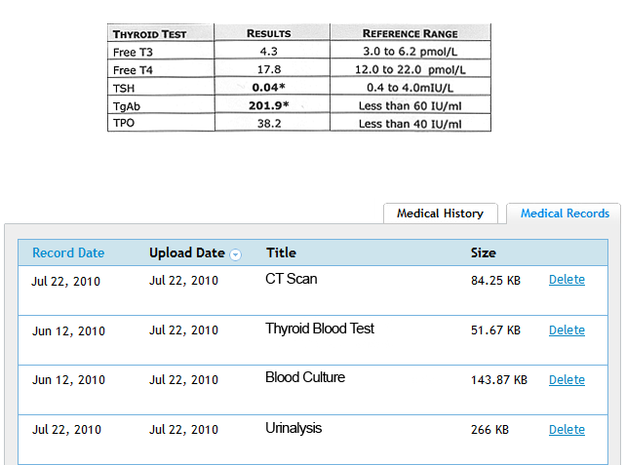
3G/4G
Identity-Based Access Control
VPN
Intelligent
Packet Core
Notes:
Doctor goes to his child’s soccer game, still with iPad, on 3G
Again, his VPN has roamed from hotspot to 3G, preventing any interruption or intervention
He has full access to patient data, but his applications have been throttled to prevent overloading the 3G network and to prevent application performance issues
Our doctor pulls up his EMR application, checks for updates on patient status, all is well, watches game with ease

Slide 36



Trusted
Trusted WiFi
WiFi
Access: FULL
No
Yes
电子病历
移动视频应用
邮件
对话软件
Notes:
Doctor goes home – connects on home Wi-Fi,
He has partitioned access – tunnel back to hospital, and a personal SSID for family access
Doctor calls in on his IP softphone to talk with a colleague about tomorrow’s operations
[TRANSITION]

Slide 37





Bandwidth Priority
802.11n Wi-Fi
Trusted
WiFi
Full Service
Home Router
Collaboration/UC
Notes:
Doctor goes home – connects on home Wi-Fi,
He has partitioned access – tunnel back to hospital, and a personal SSID for family access
Doctor calls in on his IP softphone to talk with a colleague about tomorrow’s operations
Son starts a Call of Duty “Modern Warfare 3” game – but his home router applies QoS and prioritizes this lower than his phone call
His call continues with perfect quality

