Slide 1

All Aboard the Express
Mar 2013
Cisco Business Edition 6000简介

Slide 2
中型市场的趋势

Slide 3
趋势 – 向协作变迁
成长型 企业在协作上的花费增长迅速
销售语音并不足够－混合型/TDM向IP 的转移正在加速
IT 开销 趋于平， 但是在技术上的花费在全球领域迅速增加
协作 = 会议，即时消息/状态，呼叫中心，团队协作
Source: GMV, 2012

Slide 4

Cisco对于中型市场的承诺
发布领先市场的思科协作技术
为中型市场创建 Business Edition (BE) 解决方案产品线
BE 3000 (入门级 UC 平台，小于300用户)
针对中型市场优化/简化统一通信(UC)
对于合作伙伴倾听，互动，协作
BE 6000 （全协作平台，小于1000用户）

Slide 5
Why Cisco ?

Slide 6



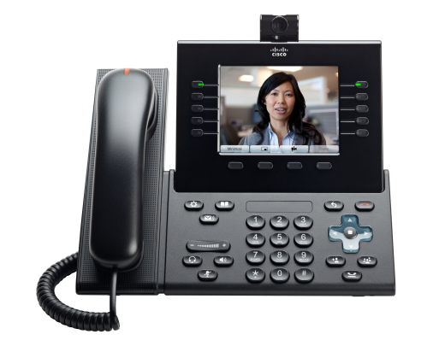



Cisco Unified Communications Manager – 就是答案
世界上最流行的，可信的平台
2012 Gartner Magic Quadrant UC的领导者
130,000 用户
>95% 的财富500强用户在使用思科协作
超过5000用户规模的客户就超过400+多家
超过5000万部话机售出
Notes:
Cisco Unified Communications Manager is now the leading platform for collaboration….

Slide 7
为何思科?
协作驱动ROI,生产力，增长和创新
广泛而多样的协作需求
任何地方
任何设备
任何内容
由思科的Medianet 架构统一支持
  移动, 办公室,
  家里, 旅游
  PDA, 笔记本,
  平板, 台式电脑
  实时的视频，语音，社交媒体，web，即时消息，状态
  无缝的协作在雇员，代理商和用户之间
广泛而多样的协作技术
Notes:
Now, I’d like to transition to the topic of collaboration, but in the context of a hyper-connected world. The proliferation of mobile devices, the growth of video enabled devices, the growth of social networks and the speed in which people can connect in so many different ways are leading executives at your customers to think more and more about a collaboration strategy in their own organizations…for the purpose to drive Growth, Innovation, and Return on Investment.
And, customers will listen to someone that can help them understand how to do just that. In the next 5 to 7 minutes , I’d like to take you through Cisco’s differentiation in Collaboration and how you can use this to your advantage in capturing more of your customers’ I.T. spend.
There are three key areas I’d like to focus on.
What makes Cisco different in how we view collaboration
How our heritage in VOIP is critical and has played success in next generation networks
How Media Net architecture is fundamental for delivering a complete collaboration solution set
(Point #1) Cisco’s differentiation in how we view collaboration, centers around a couple of fundamentals:
Collective brain power, the art of creativity, the human element of communicating goes above and beyond just collaborating through documents and text centric forms of communication such as instant messaging and email.
Just as important are real time elements of voice and video to capture the human factor of collaboration. And this must be accomplished regardless of the device that a person chooses to use. Collaboration in Cisco’s view extends to the concept of virtual experts…connecting that specific subject matter expert and scaling her expertise through the constraints of time and location.
And what’s next? What new types of interactions might we enable, that were unimaginable before?
In order to bring a successful Collaboration strategy to life, you need to think about the network.
Let’s take a look at a couple of examples that highlight our heritage in building the next generation network:
Cisco drove innovation some 14 years ago when we revolutionized the voice market with the introduction of Voice over IP. We were competing with companies that had been in the voice business for 100 years. Cisco changed the voice industry by building revolutionary IP based applications that gave us call-control, voicemail, presence, and other applications. What did we prove for these time sensitive applications? The Network Matters! Because we designed both the Operating System and hardware of our routers and switches we were able to quickly design and deploy new ASIC –based high priority Queuing technology into our products. This ensured the Quality of Service necessary for real time voice traffic. Born out of this: The de-facto standard for intelligent voice networks in the industry.
Second example, Video delivery and virtualization
High Definition video places demands on a network, and typically we think about room based video systems. But, think about the demands that will be placed on your customer’s network when their entire workforce is lit up for Cisco video Jabber. Or, the added bandwidth necessary for video and voice with our new industry-leading VXI Rich Media endpoints.
The question now becomes, is their network ready for these rich video communications?
Enter Medianet…our industry leading solution which builds those same techniques that were so critical with voice and extends it to video and rich media.
[Transition]

Slide 8

全球的IP 电话销售额市场份额
Others 8%
ShoreTel 2%
Aastra 3%
48%
Market Share
Mitel 4%
Alcatel Lucent 5%
Cisco Leads the Market
Avaya/Nortel 31%
Total: $695M
Source: Synergy Research, 4Q’11
Notes:
IP phone is the clearest measure of true IP telephony

Slide 9


行业的领导者…
#1 企业语音
#1 网络会议
#1 统一消息
#1 音频会议
#1 网真
#2 呼叫中心(#1 在美国的 41-200 座席段位)
超过 85% 的财富 500® 正在使用思科UC
全球100,000+ 思科 UC 客户
Cisco Enters the IP Communications Market
Traditional Voice Vendors
Enter the IP Communications Market
1996
1997
1998
1999
2000
2001
2002
2003
…
Notes:
#1 in Enterprise Voice
#1 in Web Conferencing
#1 in Unified Messaging
#1 in Audio Conferencing
#1 in TelePresence
#2 in Contact Center (#1 in US 41-200 agents)
More than 85% of the Fortune 500® are using Cisco Unified Communications
100,000+ Cisco Unified Communications customers worldwide
Over 50 Million IP Phones shipped

Slide 10

议题
什么是 BE6K 解决方案？

Slide 11
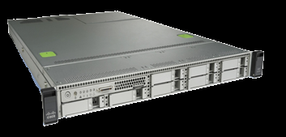

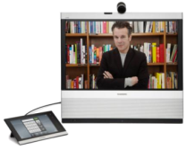
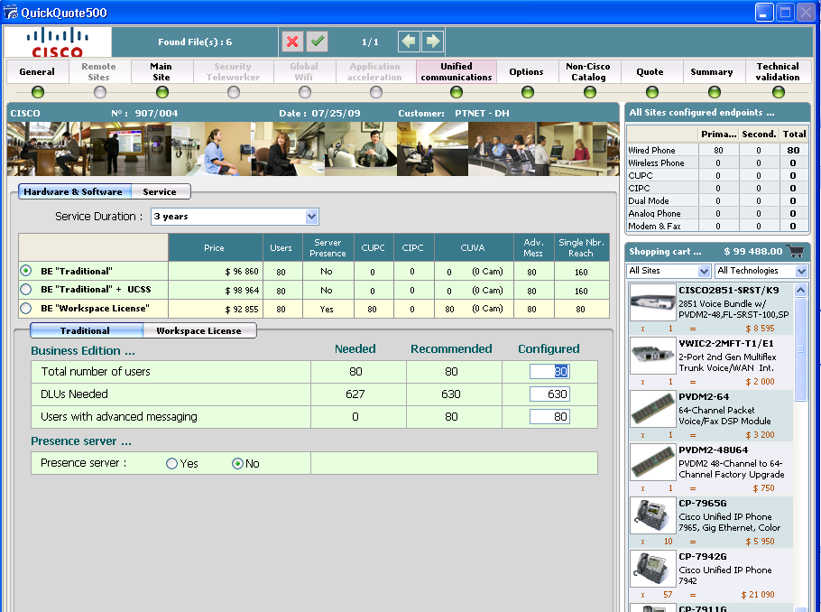

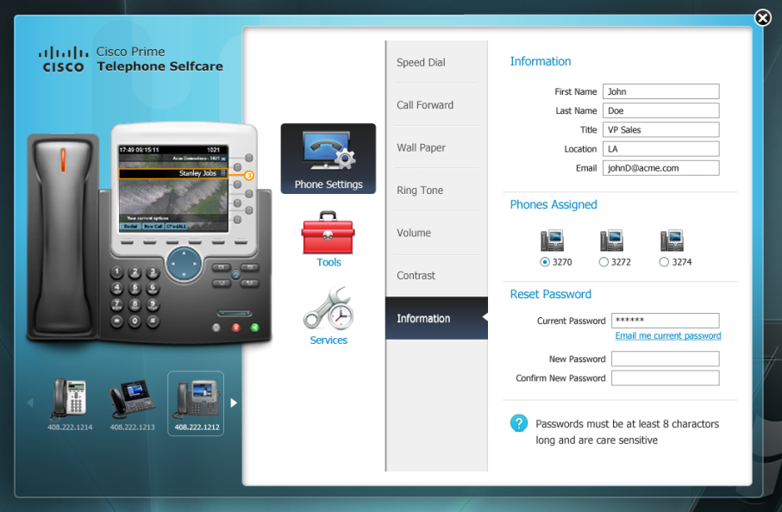
Cisco Business Edition 6000
为成长型企业优化的具有丰富功能，企业级的协作解决方案平台
Business Edition 6000的容量
Business Edition 6000服务器预装系统
Communications Manager
最多1000用户
Unity Connection
最多1000 语音信箱
Unified Presence 或
Attendant Console
最多1000 Jabber用户 或者 25 个Attendant Consoles
Contact Center 与/或 VCS-C 或 CER
最多100 呼叫中心座席
基于VMware ESXi的虚拟化架构
Provisioning Manager
最多50节点
企业级的功能
优化的价格和订单流程
简化配置和管理
Cisco Business Edition 6000

Slide 12
BE 6000 价值主张简述
简化的部署
更多的固有功能
简化的定价和订购
出厂标配软件应用
统一调配管理器 –
简单管理
更多并存选项；
VCS-C
通过 VCS 实现 Legacy H323 视频互操作性
智能语音邮件通知
本地呼叫队列
支持 Jabber SDK 的应用
Cisco Jabber 许可
单个顶级 SKU，用于 UCL 和 CUWL
VCS 入门许可，不另行收取费用
总代理商可储存捆绑包

Slide 13
BE 6000 与 “UC on UCS” 系统对比
Cisco Business Edition 6000 | Cisco UCM ( "UC on UCS”)
为中型成长型企业量身定制 | 大型或巨型企业
最多1000用户 | 可支持800,00 用户
只支持UCS C200 or C220 服务器 | 所有 C-Series, B-Series 服务平台， 主要支持TRC/SPECS
主要应用: UCM, IM & Presence, Unity Cn, CCX, Emergency responder, VCS, UPM BE, CUxAC | 所有统一通讯的应用程序 （ 支持VM)
预先设置硬件, 软件已经存储在服务器上， 用整和在同意服务器上的 Cisco Unified Provisioning Manager来统一设置 | 用各个应用原有的界面，但可以单独购买Cisco Cisco Unified Provisioning Manager 来管理
简化订购，用一个总的产品SKU来引导所需的订购步骤 | 需要用多个SKU分别订购
起始包含有很大折扣和其他软件许可,还 可选择其他促销包： MC, CCX, VCS bundles | 没有起始包折扣。 也没有预先装在服务器上的其他软件许可证
市场定位
系统硬件
软件
安装设置
订购
价钱

Slide 14
BE 6000 与 UC on UCS － 价格对比 (CPL)
基本电话+ 语音信箱 + IM & P + 完全冗余服务器
价格不包括技术支持费用和. CPL书面价格
更多的增值：
  UPM BE (1000 用户许可证，约和$42,000)
  VCS (约和$37,000)
  Webex 会议中心可选包（首先的10或20主叫命名价格比GPL低20％
200 用户： 电话，语音信箱，即时信息 冗余服务器 UC on UCS
Functionality | Price
UCS C220 M3 Hardware | $23,537 x 2
CUWL STD (200) | $136,500
VMware Foundation | $5248 x 2
Per User | $971
200 用户： 电话，语音信箱，即时信息 冗余 BE 6000 服务器
Functionality | Price
CUWL Starter Bundle | $71,390 x 2
Per User | $714
Savings | $51,400 or $257/User
Prices indicated here are list prices. Actual prices may vary.
BE = Business Edition

Slide 15
思科 Business Edition 6000
构架简介
服务与支持
管理与安装设置
用户终端选择
应用程序选择
基本系统

Slide 16

思科 Business Edition 6000
构架部分#1 – 基本系统
思科多个统一协作应用整合在一个服务器
Cisco UCS C Series: C220M3 server
支持最多5个思科统一协作应用程序
支持最多1000用户，50个节点
高可靠性，可以通过第二台思科UCS 或者思科MCS服务器
可自存活分支 (SRST）选择

Slide 17
UCS C220 Server
1RU Square rack mountable
2 quad-core 2.4 GHz E5-2609 processor
4 x 8 GB RAM
4 x 500 GB 7200 RPM SATA disks, RAID-10 configuration
Integrated dual-port Gigabit Ethernet
1 Gigabit Ethernet management port,
Redundant power supply option
UC virtualization hypervisor (VMware Hypervisor 5.X) pre-installed
    2 CPU sockets, 16G of vRAM entitled.
Option to upgrade to UC virtualization foundation with vCenter compatibility.
  2 CPU sockets, 32G of vRAM entited
  Requires services

Slide 18
为何你应该关心?
降低总体运营成本
可扩容性
高可靠性
无需浪费CAPEX
容易定购
Notes:
Ease of procurement: value priced bundles & quoting tools
Reduced install time with factory loaded software (version 9.0)
Simplified Unified Management with embedded Unified Provisioning Manager at no additional cost.
Lower TCO (virtualization on a single server, less cooling, space, … )
High availability with a choice of full or partial redundancy for the applications.
No throw-away CAPEX Investment protection migrating to Cisco Unified Communications Manager

Slide 19
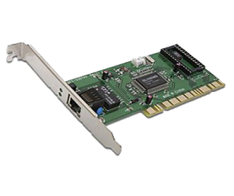

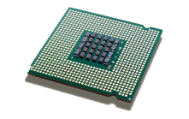
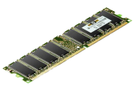
思科 Business Edition 6000
构架部分 #2 – 应用程序选择
全面的功能, 大型企业级的协作应用程序
UC Manager
Unity Connection
IM & Presence or Att Cons
CCX or VCS or Att Console or CER
Unified Prov’g Manager
UCS C220 M3

Slide 20
BE6000 应用软件概况
UC Manager
1000 用户，
1200终端, 50 节点
Unity Connection
1000 语音信箱
IM & P or
Attendant Console
1000 实时信息用户
或 25 电脑话务员
Contact Center Ex
100 联络中心席位
Virtualized with VMware ESXi
VCS
100 traversal and 100 non-traversal

Slide 21
为何你应该关心?
All-in-one 统一协作解决方案
性价比高
保护现有投资
产品成熟，质量可靠
让企业更高效
“BE 6000 surprisingly came well within our budget, and the tools we got were more than what we thought we could afford.” – Jim Phillips, CTO, Stanford Federal Credit Union

Slide 22



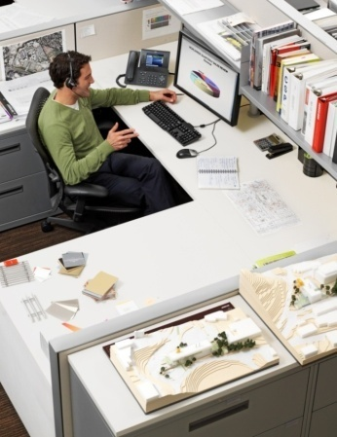
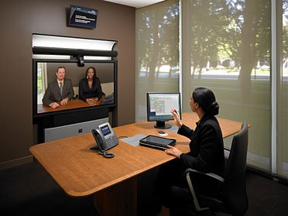
思科 Business Edition 6000
构架组成#3 – 终端
视频, 移动, BYOD … 最新的统一协作感受： 任何地方，任何时间，任何终端
个人视频
IP 电话
Jabber for Mobile
Jabber for Mac/
Win
网真

Slide 23

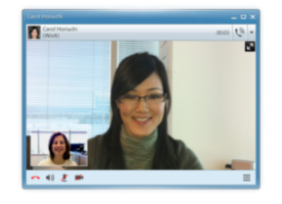
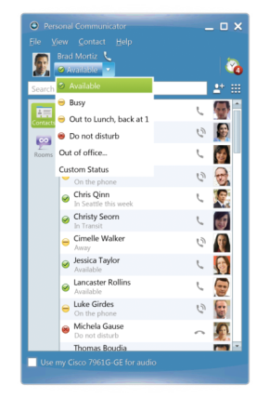
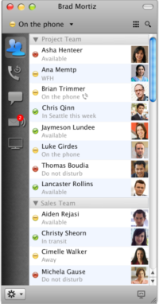
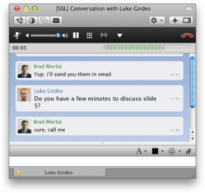
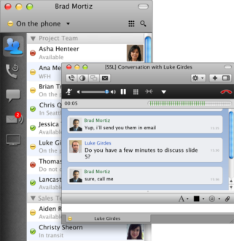
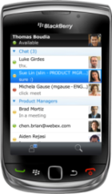
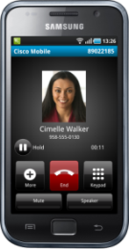
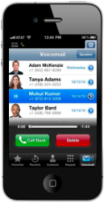
思科Business Edition 6000
思科 Jabber
新的统一通讯客户端软件，让员工更有效率的工作，交流.
Cisco Jabber
包含统一协作的应用程序：
实时短信，在线协作，在线提示
桌面共享，会议，
语音通信，视频通信
全方面统一协作 TBD
PC, Mac, 平板电脑, 智能手机
On-premises 或 云端
与 微软 Office 整合
One-one
One-to-few
Real-time

Slide 24









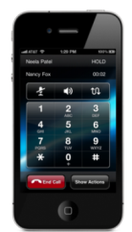
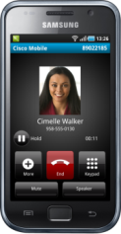
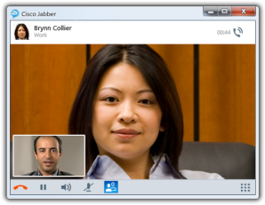
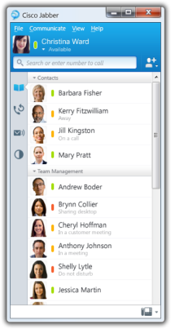
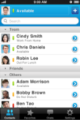
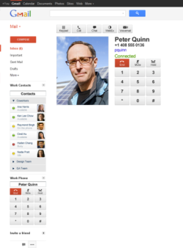
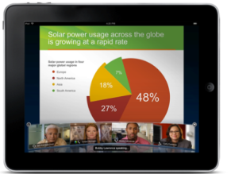
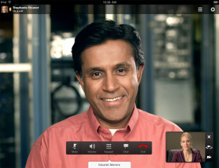
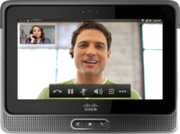

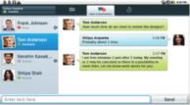

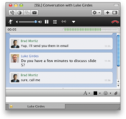
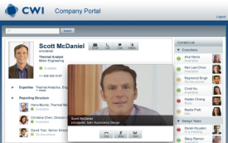
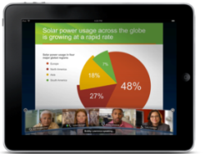
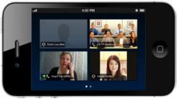
BE6k 和 Cisco Jabber：覆盖最广泛的平台和设备
Win、Mac
iPad、Cius
智能手机
Web

Slide 25
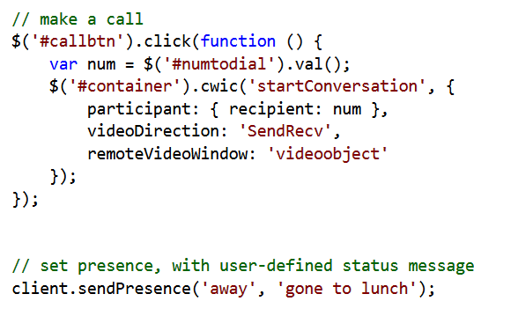


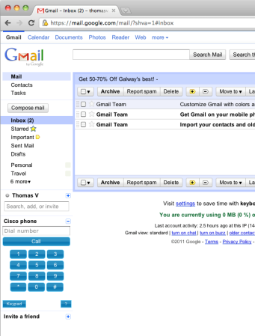
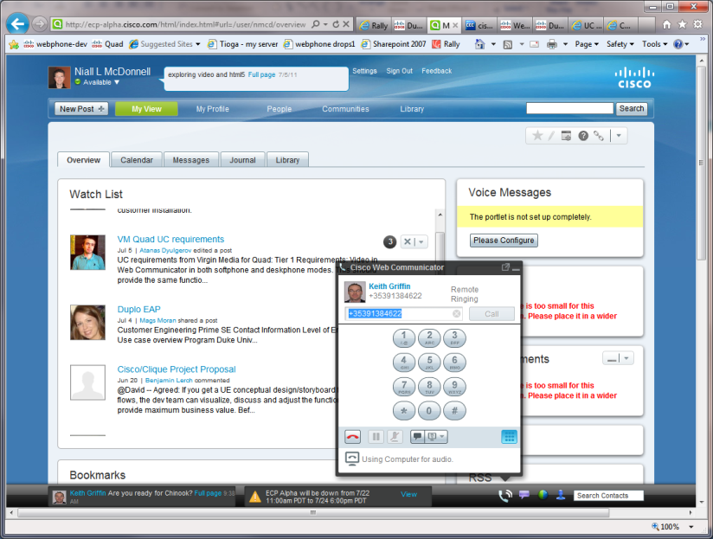
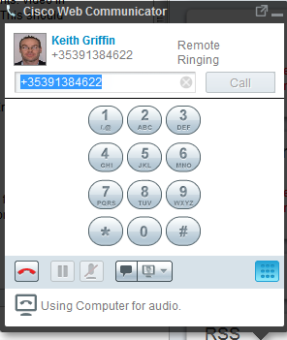



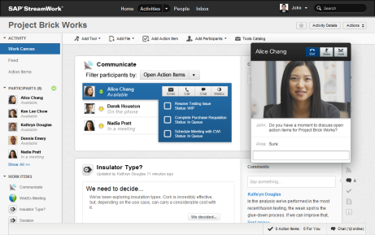



思科 Business Edition 6000 Jabber SDK
统一协作的应用软件开发包
Jabber Web SDK
语音&
视频
即时通讯
语音信箱
会议

Slide 26
为何你应该关心?
视频与语音一样简单
保护在传统视频上的投资
BYOD， BYOA
与企业流程的整合
提高效率, 竞争优势

Slide 27
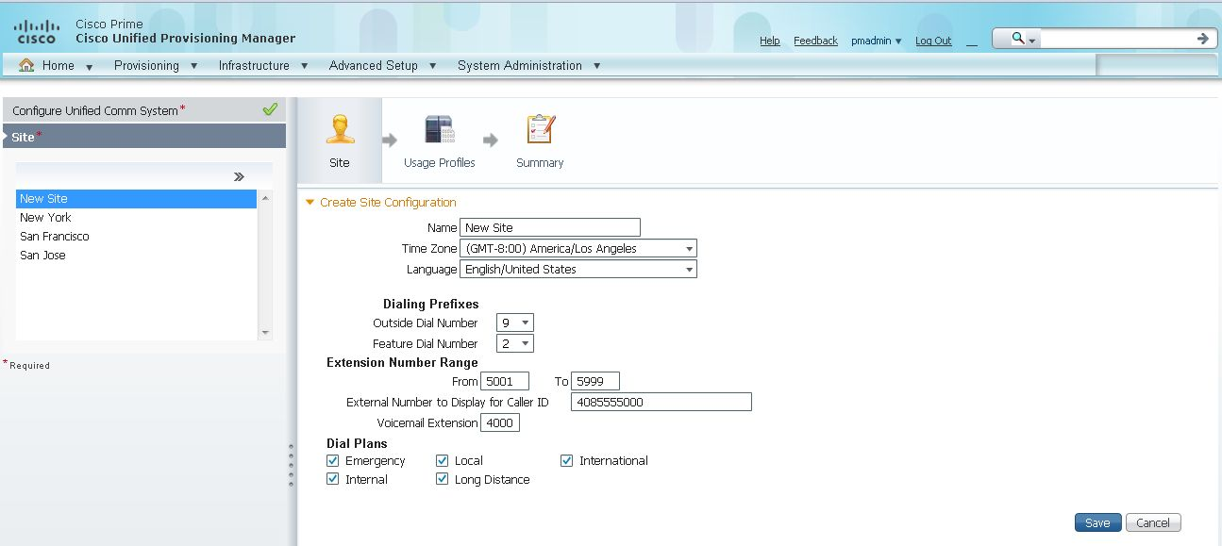
思科 Business Edition 6000
构架组成#4 – 统一管理
Unified provisioning Manager BE － 减少安装时间, 技术支持费用
Provisioning Manager BE
用户自服务
出厂预先设置硬件/预存软件镜像
企业 许可证管理服务 （ELM）

Slide 28
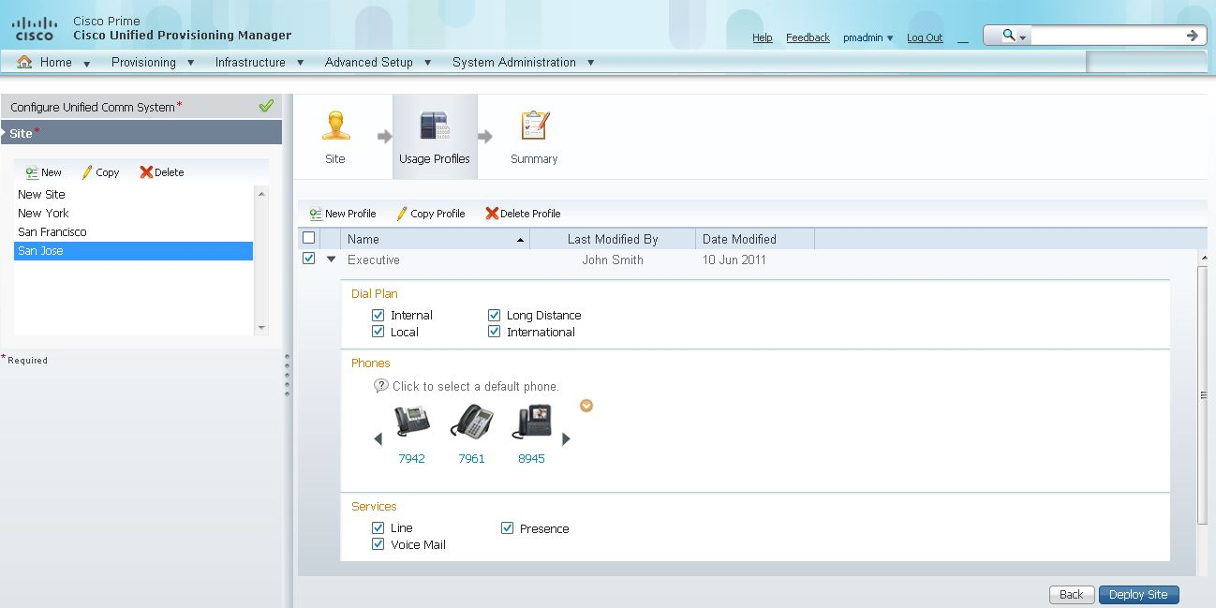
思科 Business Edition 6000
Cisco Unified Provisioning Manager Business Edition
统一管理界面包括用户，服务，即时消息和状态， 语音信箱， LDAP
Cisco Unified Provisioning Manager
统一界面，一次性登陆
简化管理流程，以用户为中心
快速激活服务， < 1 分钟
减少操作失误，可重复使用
不同层次的管理权限
统一用户自管理界面
预先存储的软件，预先设置的1000 UPM 许可证
Simplicity of operation for IT staff and end users
Notes:
UPM software and license is included with every BE 6000 system for no additional charge

Slide 29

Cisco Business Edition 6000
Turn-key Appliance
1) 15 min - Unpack
2) 15 min – hw setup
3a) 15-30 Min – setup bios, firmware, drivers etc
3b) 30-45 min – disk/RAID setup + battery cache
4) 15-30 min – Virtualization hypervisor setup
5) 15-60 min / app - load app/install app (4 worst case – 1-4 hours) 30 mins per app
Factory configuration of hardware and pre-loaded software
Pre-loaded
Notes:
Transcript:
Still in the area of customer interaction, I wanted to highlight the native call queuing, which is not the full-feature Contact Center Express, but it's also a critical feature & functionality to be able to route calls effectively & make sure that the calls end up at the right person & the right employee. So this is, Marc, what you mentioned with regards, I believe, to the Business Editio, which is really a critical functionality that is required in most projects.
Author's Original Notes:

Slide 30
为何你应该关心?
增加客户满意度
减少技术支持费用
减少 TCO

Slide 31


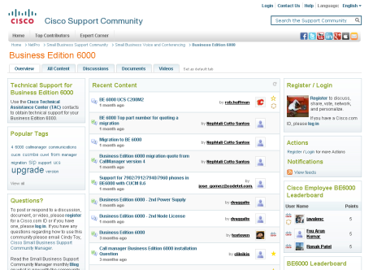
思科 Business Edition 6000
构架组成#5 – 服务与支持
通讯网络对企业至关重要，思科有最好的服务与技术支持
Essential Operate Service and UCSS (UC Software Subscription)
SmartNet Service
Business Edition Support Community
Virtual Engineering and Partner Helpline
PDI Helpdesk, TAC (Technical Assistance Center)
Notes:
ESW: Maintenance and minor software updates and software application support service.
Access to online resources and Technical Assistance Center (TAC) support.
UCSS: Access to major software version upgrades.
Most cost-effective method to acquire upgrades priced on a per user .
SmartNet Service: Advance hardware replacement options.
24 x 7 global access to Cisco Technical Assistance Center (TAC) and onsite resources.

Slide 32
License简介

Slide 33
9.0 版本许可证对比
CPL书面价格
ü
已包括
可选项
l | l | l | l | ✓ | Webex Conferencing
l | l | l | l | ✓ | Webex Social
l | l | l | ✓ | ✓ | Messaging (UCXN)
N/A | N/A | ✓ | ✓ | ✓ | Jabber Mobile
N/A | N/A | ✓ | ✓ | ✓ | Jabber Desktop
✓ | ✓ | ✓ | ✓ | ✓ | Jabber IM/Presence
1 | 1 | 1／2 | 多个 | 多个 | # of Device Support
Analog / Voice | Voice | Video | Video | Video | Device Type Support
1 | 1 | 1 | 1 | 1 | # of User Profile
UCL Essential | UCL Basic | UCL Enh / Enh+ | CUWL Business | CUWL Professional | License Type
$82 | $263 | $441 / $620 | $662 | $1050 | 价格
Deskless Workers | DeskBound Worker | DeskBound Worker | Hybrid Workers | Collab Workers
CPE or Hosted
CPE or Hosted

Slide 34


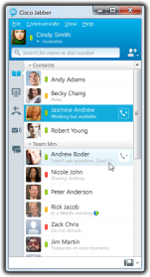
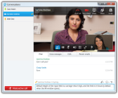












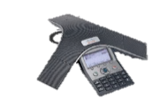

Device Support
TelePresence
Room
Enhanced/Enhanced Plus UCL; CUWL Business; CUWL Professional
Basic UCL
CTS-3000/3200
99xx
Essential UCL
Jabber Desktop
CTS-500/1000/1100
89xx
Jabber Mobile
CTS-1300
Fax
Analog
6911
694x/696x
79xx
EX60 / EX90
Profile Series
3905
6901
6921
Third Party
SIP
7937
Solution Platforms

Slide 35
BE6000总结
－关键信息
Simple,
Affordable,
Scalable
大企业的产品，中型企业与成长型企业的价钱
All-in-one 协作解决方案
快速简化的按装与设置
扩展性强

Slide 36
QPT快速报价工具

Slide 37
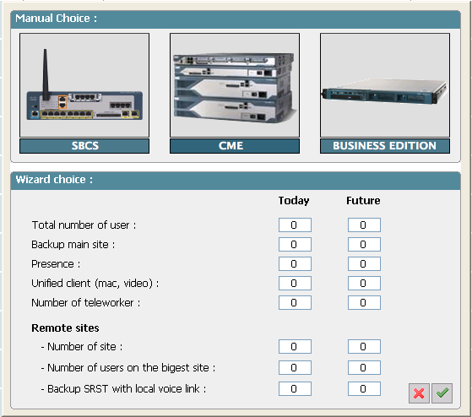
Cisco Quick Pricing Tool（支持中文）
Quick Pricing Tool快速报价工具
销售人员也可以使用
在客户那里就可以生成报价
联接到总代
节省时间
推荐最适用客户需求的两个平台
Includes Cisco Business Edition 6000
www.cisco.com/go/qpt
Now includes Video Endpoints
www.cisco.com/go/qpt
Notes:
Transcript:
pricing tool. And the Quick Pricing Tool now includes the video endpoints as part of your quotation for the Business Edition 6000. So that was something that was important to mention. Note that the Quick Pricing Tool is also available for quoting the Business Edition 3000 that Marc presented earlier on. So a nice place to go for our partners for ease of quotation. And you can export the bill of materials to CCW or to Excel and in different formats. So it's a quite useful tool to be aware of. And it's go/qpt if you want to have more information on that quoting tool.
Author's Original Notes:
The Cisco Quick Pricing Tool (QPT) is designed to help Cisco partners quickly generate a bill of materials and estimate pricing for Cisco solutions addressing the needs of small to midsized customers.
Using a clear graphical interface and user profiles, account managers can easily select products and options without the need for technical assistance.
The Cisco Business Edition 6000 is included in the tool in addition to solutions such as the Cisco Unified Communications 300 Series, Cisco Unified Communications 500 Series & Cisco Business Edition 3000

Slide 38
Thank You for Your Participation!

