Slide 1
CO Transformation
Cisco Knowledge Network
Ravi Ramaswamy - Toby Rees
15th December 2016

Slide 2


Introducing Industry’s First “Network as a Fabric”
Central Office to the Data Center
Lower TCO and Greater Efficiency
  Major US Tier SP adopts Cloud-Scale Networking to transform their COs into next-generation data centers
  New IOS XR capabilities: EVPN, Segment Routing and Model-Driven Telemetry
  Extending IOS XR capabilities to broader Cisco Routing Portfolio: ASR9k, NCS6k
  New NCS Family Platforms: 5501/5502, 5516, 1001
© 2016 Cisco and/or its affiliates. All rights reserved. Cisco Confidential
2
Notes:
I’d like to briefly summarize what I’ll be covering here today:
Cisco is introducing the industry’s first “Network as a Fabric” that spans from the Central Office to the Data Center
Focused on lower TCO and greater efficiency, we’ll discuss:
Major US Tier1 SP as a customer proof point as they’ve adopted Cloud-Scale Networking to transform their COs into next-generation data centers
New IOS XR capabilities: EVPN, Segment Routing and Model-Driven Telemetry
The extension of IOS XR capabilities to the broader Cisco Routing Portfolio: ASR9k, NCS6k
New NCS Family Platforms: 5501/5502, 5516, 1001
So let’s dive in.

Slide 3
Cloud Scale Extends Across Traditional Network
Service Providers Transforming Central Offices into Next-Gen Data Centers
Traditional
Network Operations
Data Center Principles
Cloud-Scale Networking
Central Offices Key Attributes
Central Office Transformation Intentions
Gateway to SP’s customers
1000s of locations
Competitive edge over Web providers:
  Closer to customers (latency, delay)
  Localized services
  Secure environments with controlled power and cooling
  Highly distributed so inherently protected against disasters
HALF
Manual Provisioning
YES
70%
Automation
Total Cost
of Ownership
SW Modularity & Extensibility
Automated services
Simple to scale
Agile, open software
Inflexible SW
TWICE
NO
30%
Performance
Efficiency
Fragmented Topology View and Complex Routing
Top Drivers: NFV/SDN
Visibility
&
Control
Source: Heavy Reading Service Provider Survey, June, 2016
Notes:
Cloud-Scale Networking was introduced a year ago to overcome the limitations of traditional architectures. The limitations include siloed technology, inflexible software, manual provisioning, and fragmented visibility and control. Cisco took data center principles – service automation; simplicity in scale; and agile, open software – and applied them to networking. The result is:
Large-scale automation - using data models such as YANG and OpenConfig to perform provisioning and network changes in minutes versus hours or days with manually-intensive, traditional methods
Software modularity and extensibility - leveraging industry-standard DevOps tools such as Chef and Puppet to deploy services with speed, scale, automation
Visibility and control - deriving streaming telemetry with WAN Automation Engine (WAE) support and Segment Routing Traffic Engineering to optimize and program the network in real-time
Cloud-Scale Networking delivered these capabilities at HALF the total cost of ownership and DOUBLE the efficiency and performance (over five years, compared to present mode of operation).
Now what we’re doing is extending Cloud-Scale beyond the traditional network and into the central office, a pivotal resource for communications service providers. Central offices are actually:
Gateways to service provider customers
Deployed in thousands of locations/points of presence
A competitive edge that communications service providers have over Web providers:
Closer to customers (latency, delay)
Localized services
Secure environments with controlled power and cooling
Highly distributed so inherently protected against disasters
In fact, these service providers are in the process of re-architecting their central offices into next-generation, automated data centers that leverage NFV and SDN. A recent study from Heavy Reading commissioned by Cisco shows that over 70% of service providers surveyed are in the process of or are planning this central office transformation.

Slide 4
Executive Summary
Carriers (Telcos and Cable providers) are using SDN / NFV architectures to transform their COs
Drivers are network simplification, repeatable designs, flexible service delivery, agility, and reduced opex via automation
Design borrows heavily from Web-scale / MSDC architectures
  Leaf / spine CLOS fabric, hw/sw disaggregation, unified forwarding plane, NFV where possible, centralized policy through SDN controllers, leverage open source software, and network automation via NetConf / Yang and streaming telemetry
Efficient underlay and overlay design are key to successful CO Transformation
This presentation explores the value that EVPN and Segment Routing technologies bring to the underlay / overlay design.

Slide 5


Paving the Path to Central Office Transformation
SIMPLIFY
AUTOMATE
VIRTUALIZE
Consolidate number of data plane and control plane protocols
Move network operations
from reactive to
proactive
Speed up service creation with NFV
Efficiency
Agility
Innovation
Notes:
Software defined service delivery
Portable access (any service any port)
Scalable service architecture
Flexible service delivery
Hardware / Software disaggregation
Service / hardware disaggregation
Cloud-Scale Networking helps pave the path to central office transformation by focusing on several key tenets:
- Simplify – by consolidating the number of data and control plane protocols
- Automate – by making network operations more proactive from reactive
- Virtualize – by leveraging NFV for faster service creation
This approach ultimately helps service providers drive greater efficiency, agility, and innovation from the network.

Slide 6

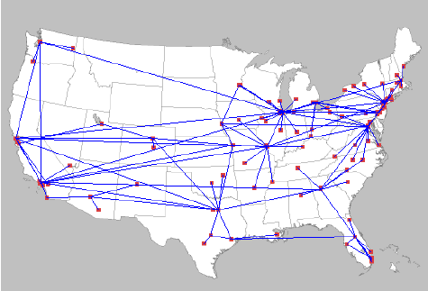
Historical Approach - Silos
LAN & Datacenter
WAN & Central Office
Datacenter Switching
Layer 2
Ethernet
Not NEBs
Service Provider Routing
Layer 3 & MPLS
Ethernet, TDM, others..
NEBs

Slide 7
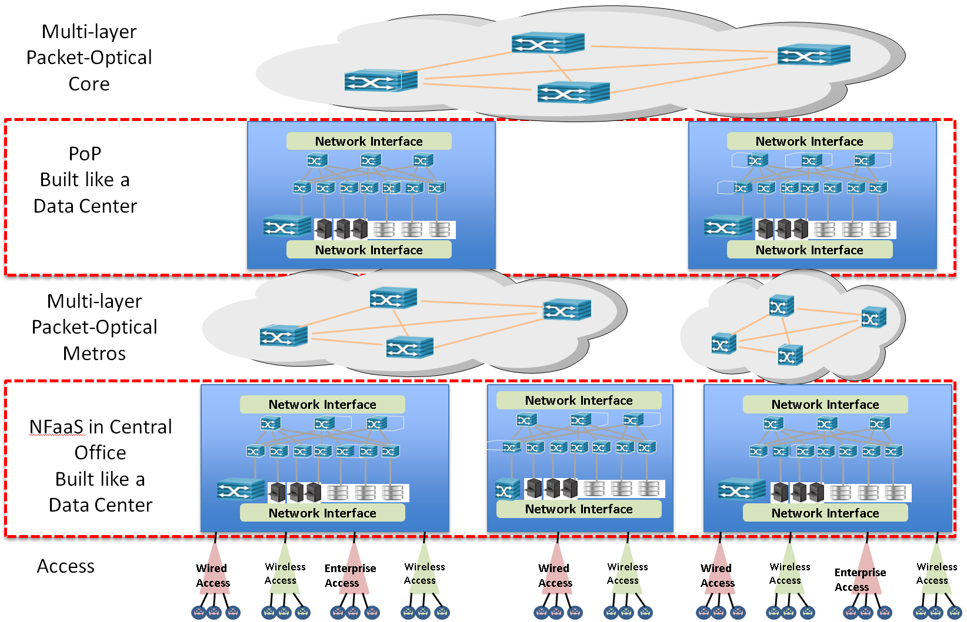



CO as a DC – Removing the Silos
IOS-XR
Service Provider Routing
Layer 3 & MPLS
Dense Ethernet
+ EVPN + SR + Open APIs + Streaming Telemetry

Slide 8
NCS 5500 Value Proposition for CO Transformation
NCS 5500 combined with IOS-XR is an ideal solution for CO Transformation
  Low cost / high density platform supporting key aspects of CO transformation such as IP, MPLS, Ethernet and QoS at scale
Richness of IOS-XR allows optimizations to support multiple use cases on the NCS500
  Core, Edge, TOR, Spine, Cell Site Router
Multiple physical form factors both fixed and modular from 1RU to 13RU systems
NCS5500 builds on the IOS XR mature heritage and provides a complete set of BGP, EVPN, and MPLS / Segment Routing features
IOS XR evolved programmability includes OpenConfig, NETCONF/YANG, JSON, application hosting and Chef

Slide 9
Local NW DC Overlay & Underlay
L3VNF Uplink/Core
VNF Access
Classic service
Infra MGMT
L4-7 VNF
BGP Service
(L3VPN, IA, vBNG)
EVPN VPWS FXC
XoMPLS
L2 + L3 EVPN MPLS
L2 EVPN MPLS
+ Anycast GW
overlay
BGP LU
MPLS-SR
underlay
ISIS / OSPF
Native Ethernet
CO-DC Fabric
Notes:
Core connectivity is Via MPLS over BGP-LU SR

Slide 10

What is Ethernet VPN?
Highlights
EVPN family introduces next generation solutions for Ethernet services
  BGP control-plane for Ethernet Segment, customer MAC learning and IP distribution over MPLS core
  Same principles and operational experience of IP VPNs
Learning on PE Access Circuits via data-plane transparent learning
Standardized at IETF – RFC 7432
Data-plane address learning from Access
Control-plane address advertisement / learning over Core
PE1
PE3
VID 100
SMAC: M1
DMAC: F.F.F
CE1
MPLS
CE3
C-MAC:
M1
C-MAC:
M2
PE2
PE4
BGP MAC adv. Route
EVPN NLRI
MAC M1 via PE1

Slide 11
What’s the big deal ?
Not only a single technology/solution does the job of many existing solutions but it does it better!
Service | Additional Capabilities
E-LAN | Provides All-Active multi-homing Prevents loop for both all-active & single-active even in transient state Ability to do per-flow LB & DF
E-Line | Both single-segment & multi-segment support Discovery & signaling via single protocol – BGP All-active & single-active redundancy support
IRB | both L2 & L3 (on a per flow) for a given VLAN/tenant L3 only mode when needed Inherent support for anycast GW
EVPN MPLS
EVPN VPWS
EVPN -IRB

Slide 12
EVPN VPWS FXC
Resilient “point to point” transport service
Access
CO-DC
MPLS core
Compute
Compute
VF
VF
Business
RR
MPLS Core
Corporate
Residential
CO DC MPLS core
CO DC MPLS core
Ethernet
Mobile 2G/3G/LTE
Ethernet
EVPN FXC/ MPLS SR
MPLS + SR
MPLS + SR

Slide 13
EVPN MPLS + Anycast GW
Integrated L2 + L3 transport L4-7 vNF
CO-DC
MPLS core
Compute
Compute
Compute
.4
.2
.3
VF
VF
VF
MPLS Core
192.168.1.0/24
CO DC MPLS core
CO DC MPLS core
.1
.1
.1
.1
RR
192.168.1.0/24
EVPN MPLS / MPLS SR
L3VPN MPLS / MPLS SR
Broadcast domain
MPLS + SR
L3 VRF
EVPN L3VPN
service exchange point
IRB default GW

Slide 14
EVPN overlay value
Flexible, programmable, dynamic transport service, with embedded reliability and optimization.
Enables simplified access to DC transport for service elements whilst balancing scale and convergence over an MPLS underlay.

Slide 15
Rationale for SR
SR solves Traffic Engineering Requirements for SPs without the complexity of RSVP-TE

Slide 16
SR Overview - IGP
All nodes use default SRGB
16,000 – 23,999
16004
24045
Packet to 5
Steer traffic on any path through the network
Path is specified by list of segments in packet header, a stack of labels
No path is signaled
No per-flow state is created
Single protocol: IS-IS or OSPF
1
2
5
24045
Packet to 5
3
4
16004
24045
Notes:
The basic building blocks or segments can be combined in an ordered list to steer packets on any path within the network. A segment list can contain adjacency segments, prefix segments, or a combination of both depending on the forwarding requirements.
In the MPLS implementation a list of segments is a stack of labels that is imposed on the packets to steer these packets on the specified path.
@
In the example, node 4 advertises a prefix-SID 16004 with its loopback prefix and an adjacency-SID 24045 with its adjacency to node 5
@
Node1 is programmed to push a label stack (16004, 24045) on the packets of a flow.
@
The top label 16004 steers the traffic on the shortest path to Node 4 using all applicable ECMPs
@
and the next label on the stack, 24045, steers the traffic through an explicit interface to the destination node 5.
It is important to highlight that Node 1 does not need to signal the path of this flow, and the state information remains constant in the network, regardless of the number of flows that are steered through this network.
The nodes in the network just execute the segment instructions, they simply forward the traffic based on the label stack.
And to enable this functionality, only a single protocol is needed: IS-IS or OSPF
This slide shows the foundation of how Traffic Engineering is performed with Segment Routing. We will cover more of SR-TE in the subsequent sections

Slide 17
SR Overview - BGP
Best-path to the BGP prefix
BGP prefix-SID
Global Segment
Signaled by BGP
  Extension to RFC 3107
Used in Data Center fabrics that use BGP as an IGP
1.1.1.1/32
16001
12
16001
10
2
4
1
7
13
3
6
5
11
14
DC (BGP-SR)
WAN (IGP-SR)
PEER
Notes:
A BGP-Prefix Segment is a segment attached to a BGP prefix
A BGP-Prefix Segment Identifier (BGP Prefix-SID) steers the traffic along the BGP best-path to its destination
In this example, if packets with top label 16001 are injected in node 12, they will be load-balanced (assuming BGP multi-path is enabled) over the ECMP paths 12-10-1 and 12-11-1
Like it was the case for the IGP Prefix segment, it is a global segment and therefore all nodes in the network can correctly execute the instruction of this segment
BGP was already capable of distributing IP + label information (via RFC 3107). However, a new attribute (the BGP Prefix SID attribute) has been defined in order to signal the BGP Prefix-SID
One of the use cases for this segment are Data Center fabrics that rely on BGP as an IGP

Slide 18
Industry Eco-System
Public references
  Google, Facebook, Microsoft, Yandex, Apple, Amazon…
  Comcast, DT, Orange, BT, Telecom Italia…
Hidden but active participation
  Financial, large enterprises…
Multi-vendor support
Support SR in open source projects
  Linux, OVS, ONF
SR TechField Day Presentations by Walmart, Microsoft Azure, Comcast
  https://www.youtube.com/playlist?list=PLinuRwpnsHacUlfUCrVstvpzURnK_M3iI&feature=view_all

Slide 19
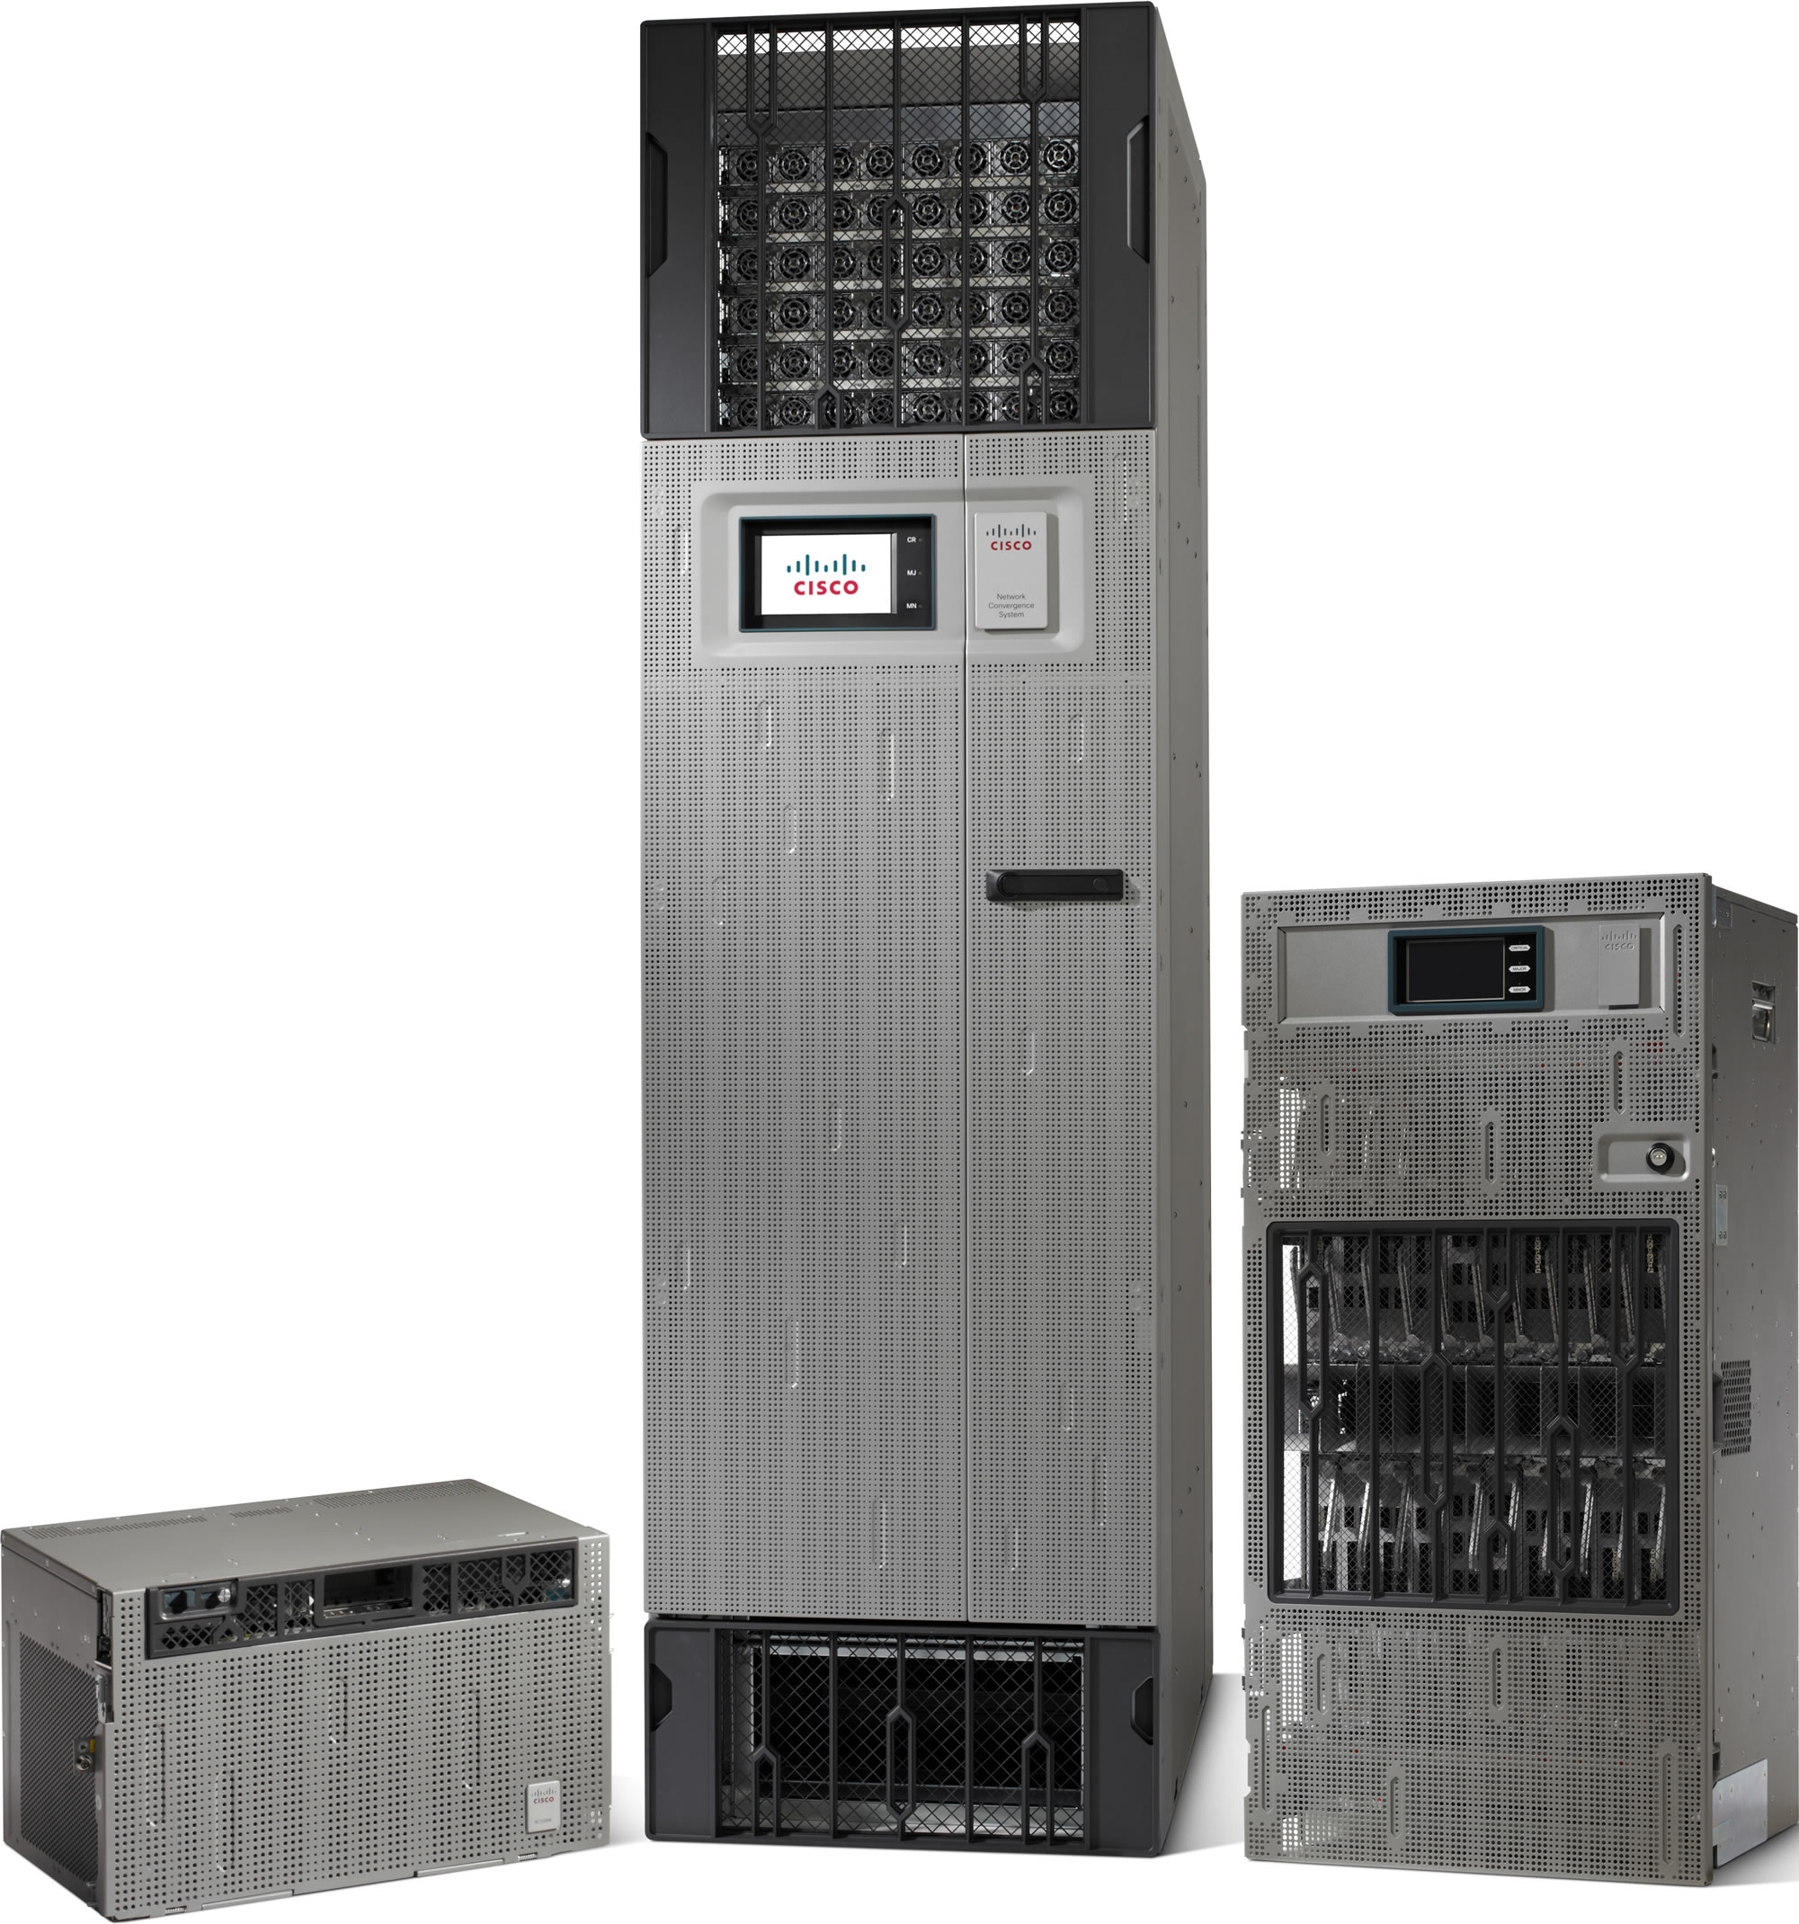

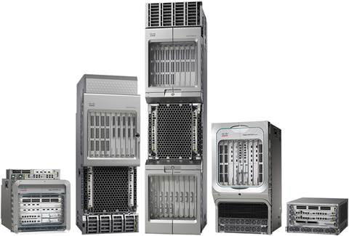
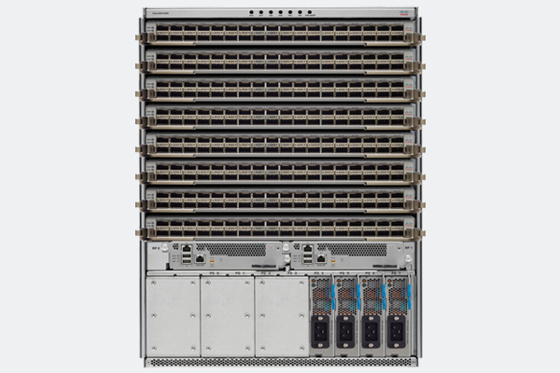
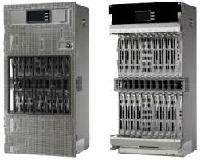



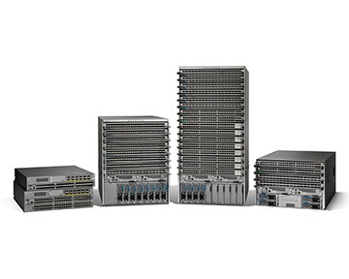
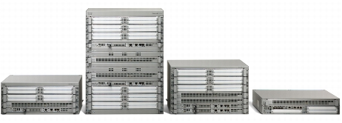
SR and Cisco
IOS XR
NxOS
IOS classic
Linux
NCS6000
CRS-3 / CRS-X
ASR9000
NCS5000
NCS5500
(NCS4000)
ASR900
FD.io
WAE
ODL
(Docker)
(Linux Kernel)
CSR1000v
(XRV-9000)
(NEXUS 7000)
(NEXUS 8000)
NEXUS 9000
ASR1000 / ISR400 / (cBR8)

Slide 20
SR Innovations
MPLS Transport + IW with LDP
Topology Independent IP FRR
Microloop Avoidance
Data Center Fabric
Incremental Use Case Deployment
Traffic Engineering
Demand Matrix
Inter-Domain Policy at Scale
Egress Peering Engineering
Application Engineered Routing
http://blogs.cisco.com/sp/supercharge-your-network-with-segment-routing-innovations
Notes:
IGP extension to program MPLS dataplane
Control Plane is vastly simplified – no need for LDP, RSVP-TE
Leverage existing MPLS hardware; only a software change
Seamless interworking with existing LDP / RSVP-TE based networks
Multi-domain Support (complex to achieve with existing MPLS technologies)
Automated 50msec FRR in any topology and end-to-end – this is HUGE !!
Built-in micro-loop avoidance
Centralized BW Optimization
Drastic reduction in mid-point scale complexities
New Services and network efficiency is possible on an end-to-end basis
Engineer traffic for low latency / jitter, disjointness, resource avoidance
As a flexible architecture, Segment Routing provides INCREMENTAL building blocks to address a RICH set of use cases
An operator can decide what pieces of the SR tool kit to introduce into the network and envision a path forward for more applications
In the slide, we capture a SAMPLE of use cases …
@
Beginning at the top …
Most early deployments target the benefits of network simplification and network protection
@
Moving to the bottom …
Segment Routing addresses a day-1 problem in IP networking … Microloops and how to avoid them altogether
To its side … with Segment Routing, we have automated the collection of the traffic matrix. Today, most operators do not have an accurate traffic matrix which is a fundamental tool for capacity planning and centralized traffic engineering
@
Next … Segment Routing brings innovative solutions to address Traffic Engineering. And it does so in a way that is IP-centric (i.e. equal cost multiple-path aware), simple, and above all scalable
@
Looking at the left hand side, the reach of Segment Routing is NOT limited to the Wide Area Network. It also expands into the data center fabric and peering use cases
@
Segment Routing also tackles the challenging requirement of inter-domain traffic engineered policies at scale
And finally, the ability to support application-specific engineered paths through the network can be realized with MPLS label imposition at the host
Let’s explore some of these use cases in more details …

Slide 21
Topology Independent LFA FRR
7
50msec FRR in any topology
IGP Automated
  No LDP, no RSVP-TE
Optimum
  Post-convergence path
No midpoint backup state
Detailed operator report
  S. Litkowski, B. Decraene, Orange
2
3
16007
pkt
1
4
16007
6
5
pkt
16005
16007
pkt
Notes:
Topology Independent LFA is one of the main drivers behind SR deployments
Its main benefits include:
- Sub 50msec link and node protection with 100% topology coverage; in other words there are no topology restrictions
- With TI-LFA, the backup path is automatically computed by the IGP, no specific tuning is required
- With TI-LFA, one achieves OPTIMAL routing on the backup path. This is possible by always enforcing a backup path that is identical to the post-convergence path
- Because, the backup path is enforced using source routing, there is NO STATE required at the mid-points
- TI-LFA can be incrementally deployed. It’s a local functionality and it also protects LDP and IP traffic.
To understand how TI-LFA works, consider the network on the slide
@
To start, consider the path followed by traffic from node 1 to node 7 along the IGP shortest path – through nodes 2 -3
This traffic uses the prefix-sid of node 7; 16007
In a make-before-break fashion, node 1 precomputes a backup path to protect it against the failure of link 1-2
@
Suppose that link 1-2 fails
@
In sub-50 msec, node 1 enforces the backup path and sends the traffic towards node 7 VIA node 5. To achieve this, the prefix-sid of node 5 (16005) is pushed onto the stack
The traffic thus uses the link 1-6 via node 6 to get to node 5
@
Once at Node 5, the traffic flows through the shortest path towards node 7, via Node 4 - 3

Slide 22
SR-TE Example - Steering Traffic with ECMP
SRTE uses a “Policy” (SID-list) to steer traffic through the network
Policy path can be computed by router or controller
SID list pushed by head-end
Rest of network executes instructions embedded in the SID list
Find a path (1) – (3) that avoids RED link (2) – (3)
2
1
3
5
4
7
100
6
8
9
Default IGP metric: 10
16007
24073
IP packet
Instruction #1: Follow IGP to (7)
Instruction #2: Follow IGP Adjacency (7) – (3)
Notes:
SRTE uses a “Policy” (a SID-list) to forward traffic through the network
If a packet at the head-end is steered into an SRTE policy, then the SID list is pushed on the packet
The rest of the network simply executes the instructions embedded in the SID list
Consider the network depicted on the slide
@
The operator needs to find a path from Node 1 to Node 3 that AVOIDS the Red link 2 - 3
@
Based on the topology information contained in the TE database, a controller or an SR-TE head-end computes a segment list to meet this goal
The algorithm would do so while maximizing ECMP usage and minimizing the required label stack size
In this example, the solution to the problem is to direct traffic towards node 7 (using the IGP shortest path and available ECMPs) and then move traffic over the interface connecting Node 7 and Node 3
@
And to enforce this, only two (2) instructions / labels are required at the head-end
The first instruction of the policy is represented by the prefix-SID of node 7 (16007)
And the second instruction is represented by the adjancency-SID between node 7 and node 3 (24073)

Slide 23
SR-TE Example - Disjointness via Anycast SID
VPNv4: 8.0.0.1/24
NHOP: Z
Goal: steer VPN xyz traffic towards Z over the BLUE plane
MP-BGP
SID: 16111
SID: 16111
16111
16065
IP packet
11
13
A
B
SID: 16111
SID: 16111
12
14
Solution: prepend Anycast SID of the target plane
before the segment of the BGP nhop
SID: 16222
SID: 16222
SID: 16065
21
23
Z
SID: 16222
SID: 16222
22
24
Notes:
Consider a traffic engineering problem that requires traffic in a VPN to traverse the core network over an specific forwarding PLANE; with a plane defined as a set of nodes and links
The slides depicts a network that includes TWO planes:
- The BLUE plane comprise of nodes 11-12-13-14
- And the RED plane comprise of nodes 21-22-23-24
Edge devices, node B and node Z connect to both planes
With the use of the Anycast SID, Segment Routing provides a simple and elegant solution for building the forwarding planes
In this example, all nodes in the BLUE plane are configured with a common anycast prefix (example 1.1.1.111/32) and a prefix-sid of 16111
In the same manner, all nodes in the RED plane are configured with anycast prefix 1.1.1.222/32 and a prefix-sid of 16222
@
Now consider egress PE Z that originates a VPNv4 unicast NLRI 8.0.0.1/32
In addition, Z has been allocated a prefix-SID of 16065
@
The solution to the original requirement can be computed at the head-end (node A) by including two (2) instructions in the SID list
First instruction, follow the IGP’s shortest path to the BLUE plane. This is achieved by using the label 16111
And the second instruction, follow the IGP’s shortest path towards the BGP next-hop - Node Z. This is achieved by pushing the label 16065
@
This way the traffic from A reaches the BLUE plane via node 11
From here, it follows all available ECMPs towards Z

Slide 24

SR-TE Example - Application Engineered Routing
Low-Latency to 7
for application A12
SDN
Controller
Per-application
flow engineering
End-to-End
  DC, WAN, AGG, PEER
Binding SID to steer traffic
Millions of flows
  No signaling
  No midpoint state
  No reclassification at
  boundaries
The network scaling and simplicity is preserved
PeerSID: 147, Low Lat, Low BW
PeerSID: 157, High Lat, High BW
Low-Lat to 4
{16002,
16004}
Binding SID
BSID: 200
12
10
ISIS: 35
Push
{16001,
200
147}
2
4
Low Lat, Low BW
1
200: pop and push {16002,
16004}
7
13
3
6
5
11
14
Default ISIS cost metric: 10
Default Latency metric: 10
DC (BGP-SR)
WAN (IGP-SR)
PEER
Notes:
After covering a good number of Segment Routing use cases, we can now visualize the power of the architecture with Application Engineered Routing
End-to-end policies that start right at the Host (or TOR) traversing the datacenter fabric, wide area or core networks and external peering links
And inheriting the scalability properties of source routing, with:
- No signaling
- No midpoint state
- And no reclassification at network boundaries thanks to end-to-end MPLS data-plane
@
The slide covers a representative network workflow that start with an application requesting a Low latency policy to node 7
@
DC orchestrator conveys requirement to WAN Controller
@@
WAN controller learns WAN topology as well as BGP peering-SIDs towards external node 7
@
WAN controller computes and instantiates a Low latency path to egress router node 4 on DCI router node 1
@
DCI router node 1 programs and assigns a Binding SID for the SR-TE policy
The Binding SID is used as an instruction to steer traffic into a policy
Binding SID also plays other major roles in label stack compression and to stitch policies in different domains
In the example, we use MPLS label 200 as binding-SID
@
WAN controller communicates back to DC Orchestrator the value of the Binding-SID and BGP Peering SIDs
@
Orchestrator configures / instantiates policy at the host (or TOR)
This policy could include a few segments to:
direct the traffic through the DC fabric towards DCI node 1
Map traffic into the WAN policy (using the binding-sid)
Direct traffic to node 7 using the BGP peering session between node 4 and node 7
@
By programing these instructions the traffic will traverse the network end-to-end as desired

Slide 25
Segment Routing Underlay Summary
IGP extension to program MPLS dataplane
  Control Plane is vastly simplified – no need for LDP, RSVP-TE
  Leverage existing MPLS hardware; only a software change
Seamless interworking with existing LDP / RSVP-TE based networks
Multi-domain Support (complex to achieve with existing MPLS technologies)
Automated 50msec FRR in any topology and end-to-end – this is HUGE !!
Built-in micro-loop avoidance
Centralized BW Optimization
  Drastic reduction in mid-point scale complexities
New Services and network efficiency is possible on an end-to-end basis
  Engineer traffic for low latency / jitter, disjointness, resource avoidance

Slide 26
Cisco CO transformation - Takeaway
Builds a modular service plane of virtual and classic network and service functions
Using a standardized, programmable, dynamic transport overlay
Riding on standardized, programmable, application aware, highly available underlay
Using low cost / high performance multipurpose hardware elements optimized for cloud-scale service delivery
Cloud Scale Networking
Central Office
Access
Metro
Core
DC
EVPN
VNF
VNF
VNF
Segment Routing
Compute
Leaf
Spine
Notes:
Web – Appliction drives requreirements – SP – Wide range of applictions / requirements that are customer driven.

Slide 27
“Network as a Fabric” Powered by Cisco IOS XR
Consistent Operational Efficiency and Feature Set Across the Fabric
Data Center Domain
Controller
Central Offices
NCS 1002
DCI
Metro Network Domain
Core Network Domain
Data Center Domain
IOS XR
NCS 5516
Central Offices
NCS 5501/2
NCS 5508
NCS 5001/2
ASR 9K
NCS 6K
ASR 9K
Data Center Networking
Compute UCS
Central Offices
NCS 1002
DCI
Data Center Domain
Notes:
All of this is actually made possible by our IOS XR Operating System. Cloud-scale enhancements to IOS XR we announced one year ago and we augmented since then – ruthless automation, visibility and control, simplification and open innovation - bring you significant operational improvements across your entire network infrastructure.
All the platforms you can see here – in blue our legacy platforms and in green the platforms we announce today – are powered by IOS XR. We are thus offering you the flexibility and agility to deploy the right hardware depending on their place in the network architecture and I want to outline here that the richness of our HW portfolio does not come at the expense of feature sets and operational consistency.
Cisco is uniquely positioned to deliver this “Network as a Fabric”.

Slide 28
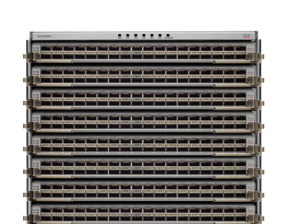
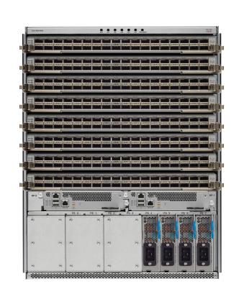



IOS XR Enabled NCS 5500 Product Family
Innovations in Software, Hardware, and System Design
Q1
CY17
Shipping
Now
Shipping
Now
Shipping
Now
NCS 5501
NCS 5502
NCS 5508
NCS 5516
    Fixed 1 RU
    800 Gbps @ 243 W
    Fixed 2 RU
    4.8 Tbps @ 1450 W
    Modular 8 slots
    13 RU (1/3 rack)
    28.8 Tbps @ 7000W
    Modular 16 slots
    21 RU (1/2 rack)
    57.6 Tbps @ ~18000W
*Cisco estimates. All w/ SR optics at typical temps and packet rate
Notes:
All dates are calendar year

Slide 29

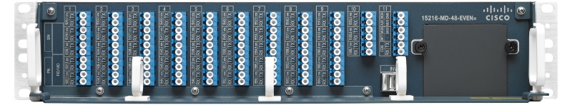
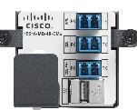
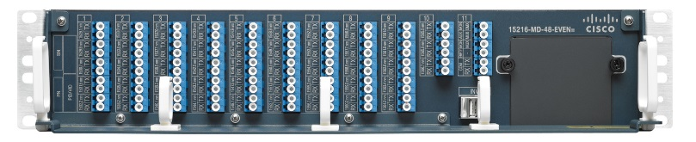
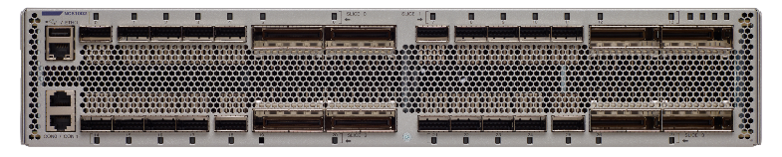

Cisco NCS 1000
Simple, Programmable, Scalable
Cisco NCS 1001
Amplifiers + Protection + Channel Monitoring
IOS-XR
15216-MD-48-EVENE
Cisco 15216 Mux-Demux
96 Channels
Passive
15216-MD-48-ODDE
Cisco NCS 1002
8 250G MXP/TXPs
IOS-XR
250G
Maximize capacity for metro networks at lowest price / bit
Optimized for DC mechanical and environs
Simple to use
Complete automation with fine-grained visibility

Slide 30
Resources
Cloud-Scale Networking:
    http://www.cisco.com/c/en/us/solutions/service-provider/cloud-scale-networking-solutions/index.html
XR Docs:
    https://xrdocs.github.io/
Press Release:
    https://newsroom.cisco.com/press-release-content?type=webcontent&articleId=1809609
Blog:
    http://blogs.cisco.com/news/cloud-scale-networking-finding-common-ground

