Slide 1
Service Function Chaining
Carlos Pignataro, Distinguished Engineer
Paul Quinn, Distinguished Engineer
April 2017

Slide 2
Presentation Agenda
Network Service Insertion Primer
Evolution of Service Chaining
Network Service Header (NSH) Architecture
Network Service Headers (NSH)
NSH Data Plane Setup & Forwarding
NSH Industry Acceptance & Standardization

Slide 3
Network Service Insertion Primer

Slide 4
Service Chaining Primer
Definition / Terminology
NAT
FW
DPI
Malware
Location Services
Ad Splicer
LB
HTTP
Enrich
Etc.
Parental Control
Video Optimizer
Etc.
Network Services
Value Add Services
Services are built to satisfy a particular business need and must adhere to policies that define operational characteristics and access controls / security
Insertion of such services into the network requires utilization of one or more network functions that satisfy the service policy and operational requirements
  Some common examples: firewall, load balancer, DPI, http header enrichment, NAT
Linkage of network functions to form a service is called Service Chaining

Slide 5

Network Service Insertion (Today)
Off-box Service Chaining
WAN
WAN
WAN
WAN
VRF/PBR based
Data-path Inline
Services are built using rudimentary service chaining techniques; accomplished via hop-by-hop switching/routing changes or inline services
  Very complex: VLAN-stitching, Policy Based Routing (PBR), Routing tricks, etc.
  Static: no dynamic, horizontal or vertical scaling, and requires network changes
  Operationally disjoint: no “whole stack” view or orchestration

Slide 6
Network Service Insertion (Today)
Off-box Service Chaining
Service functions are deployed based on physical network topology and physical network elements
  Changes to service functions or ordering within a service chain require network changes
    Example: Firewalls typically require “in” & “out” layer-2 segments; adding new FW means adding new layer-2 segments to the network topology
  Inhibits optimal use of service resources; limits scale, capacity & redundancy

Slide 7
Service Chaining
FW
DPI
* This is appropriate for all transparent services. Non-transparent services present other challenges
VLAN 400
VLAN 100
VLAN 301
VLAN 500
VLAN 300
VLAN 200
VLAN 201
VLAN 201
VLAN 200
VLAN 101
VLAN 500
VLAN 600
COKE-App2
VLAN 101
TOR/(v)switch
TOR/(v)switch
TOR/(v)switch
VLAN 301
COKE-App1
VLAN 100
VLAN 300
PEPSI-App1
VLAN 400
VLAN 600
VLAN stitching overloaded for tenant separation, policy creation, and service chain construction
Service chain ordering or addition of new services requires network topology changes
All traffic flows through all services regardless of need
  Increases load on services and increases configuration complexity

Slide 8
Poll Question

Slide 9
Service Chaining
Observations / Pain Points
Application of service policy relies upon topological information such as VLANs and/or packet re-classification at the service function; increasingly unviable due to scaling, tenancy, and configuration complexity to meet application and policy requirements
  Topological state is often stale leading to suboptimal use of resources
  Service placement is tightly coupled to network topology / traffic paths
  Topology-centric information does not adequately convey information to service functions; forces more granular classification at service functions
In such topologies, *all* traffic passes through each service function regardless of whether the service is required or not
No way to share valuable information between the network and services, or between service functions of a given service chain

Slide 10
Changing Network Service Insertion Landscape
In addition to existing complexities of service deployment, networks are evolving, with physical and virtual workloads and services
  Existing network service insertion techniques cannot remain static and must evolve
  SDN & NFV enabling control / data plane independence and virtualization of network elements
From: | To:
Physical appliances | Virtual & physical appliances
Static services | Dynamic services
Separate domains: physical vs. virtual | Seamless physical & virtual interoperability
Hop-by-hop service deployment | Chain of “service functions”
Underlay networks | Dynamic overlay networks
Topological dependent service insertion | Insertion based on resources & scheduling
No shared context | Rich metadata
Policy based on VLANs | Policy based on metadata

Slide 11
Evolution of Service Chaining

Slide 12
Evolving Service Chaining
Architectural Requirements
Service deployments will be driven by applications / application policy
Services will be built using flexible service graphs rather than linear service chains
These services will adhere to application-centric business policies / requirements
The service elements used to build service chains will be both physical and virtualized
Flexible placement of service elements will require that the coupling of services to the underlying network topology be broken allowing transport agnostic service deployment
Policy distribution through metadata exchange between service functions and the network

Slide 13
Evolving Service Chaining
Service Graphs vs. Linear Service Chains
Flexible service creation through service graphs rather than linear service chains
The collection of service functions in a network form a graph
The graph is composed of possible service function options
  Directed graph
  Weighted graph if required
Vertices: Service Functions
Edges: Overlay connectivity
 | V1 | V2 | V3 | V4 | V5 | V6 | V7 | V8 | V9
V1 | 0 | 1 | 0 | 1 | 0 | 0 | 0 | 0 | 0
V2 | 0 | 0 | 1 | 0 | 1 | 1 | 0 | 0 | 0
V3 | 0 | 0 | 1 | 0 | 0 | 0 | 1 | 0 | 0
V4 | 0 | 0 | 0 | 1 | 0 | 0 | 0 | 0 | 1
V5 | 0 | 0 | 0 | 0 | 0 | 1 | 0 | 0 | 0
V6 | 0 | 0 | 0 | 0 | 0 | 0 | 0 | 1 | 0
V7 | 0 | 0 | 1 | 0 | 0 | 0 | 0 | 0 | 1
V8 | 0 | 0 | 0 | 0 | 0 | 0 | 0 | 0 | 0
V9 | 0 | 0 | 0 | 0 | 0 | 0 | 0 | 0 | 0

Slide 14
Evolving Service Chaining
Example: Business Policy Drives Service Deployment
INTERNET
A service is rendered based on a business policy like …
All traffic between the Internet & web front end servers apply:
  De/Encryption with highest throughput / low latency and least $$ cost
  Copy all “mobile” only transactions to a Big Data analytics system
  Perform the copy at most optimal point ($$ cost & least latency impact)
  Send all traffic through a SLB+WAF & and IDS
Additionally, deploy this policy with other caveats like:
  Service functions are both virtual and physical and vendor neutral
  Compute & service elasticity; compute mobility
Elastic SSL
Elastic LB + WAF
MOBILE
Elastic Copy
Elastic IDS
Elastic Analytics
Elastic WEB FE

Slide 15
Evolving Service Chaining
First Steps
As an initial and transitional step, service chaining may be achieved through overlays that provide topological independence
Tunnel encapsulation choices; VXLAN, GRE, MPLS, etc
FW
DPI
COKE-App2
COKE-App2
TOR/(v)switch
TOR/(v)switch
TOR/(v)switch
COKE-App2
COKE-App1
COKE-App1
COKE-App1
PEPSI-App1
PEPSI-App1
PEPSI-App1

Slide 16
Evolving Service Chaining
Overlay-based Service Chaining
While the use of overlays to create service chains is a good initial step, the technique still suffers from a number of significant drawbacks:
  Configuration complexity
  Limited service chain construction capabilities; Rigid service ordering (e.g. chains but not graphs)
  Must support many overlays, mapping between overlays
  Tenant-ID is not granular enough
  No way to pass “more” information; No common service context
  Limited visibility and audit capabilities
  Per service (re)-classification

Slide 17
Evolving Service Chaining
Network Service Header (NSH) Architecture
As service chaining matures, and to meet all of the requirements of a new service insertion architecture, a dedicated service plane is needed
A Network Service Header (NSH) is introduced to address market needs for service chaining
  Offers new functionality and a dedicated service plane
  The network service header is used to create the service plane
    Provides traffic steering capabilities AND metadata passing
    Provides path identification, loop detection, service hop awareness, and service specific OAM capabilities

Slide 18
Network Service Header (NSH) Architecture

Slide 19
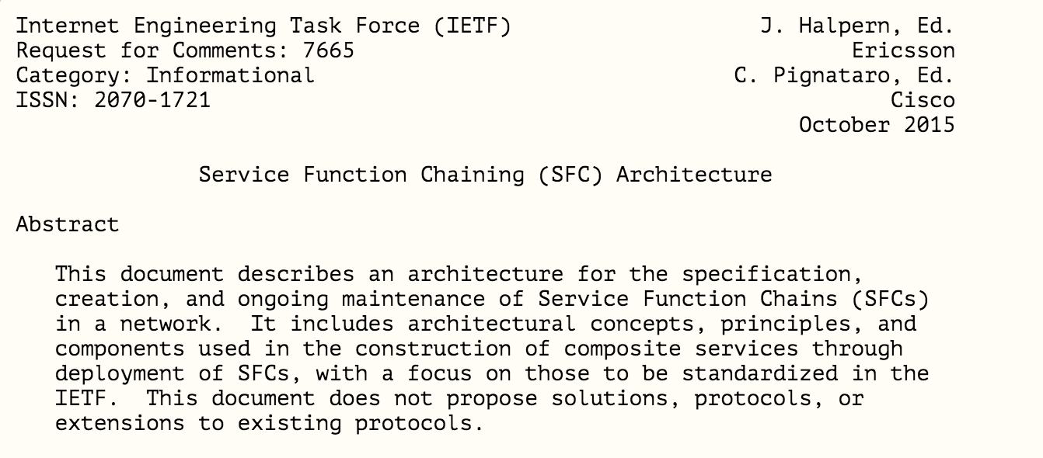

Slide 20
Network Service Header (NSH) Architecture
Core Driving Principles
Support for all service graph topologies; move up the stack from linear service chains
Provide a transport independent and topology agnostic service plane
Remove the need for service functions to participate in a transport / fabric overlay
Simplify service AND network provisioning
Enable a broad range of classification types and sources
Provide clear visibility and OAM to users
Allow the network transport to “do its job” and evolve
Centralized or distributed control plane
Enable metadata conveyance to/from service functions and the network

Slide 21
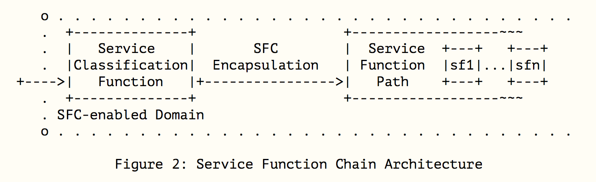
SFC Architecture

Slide 22
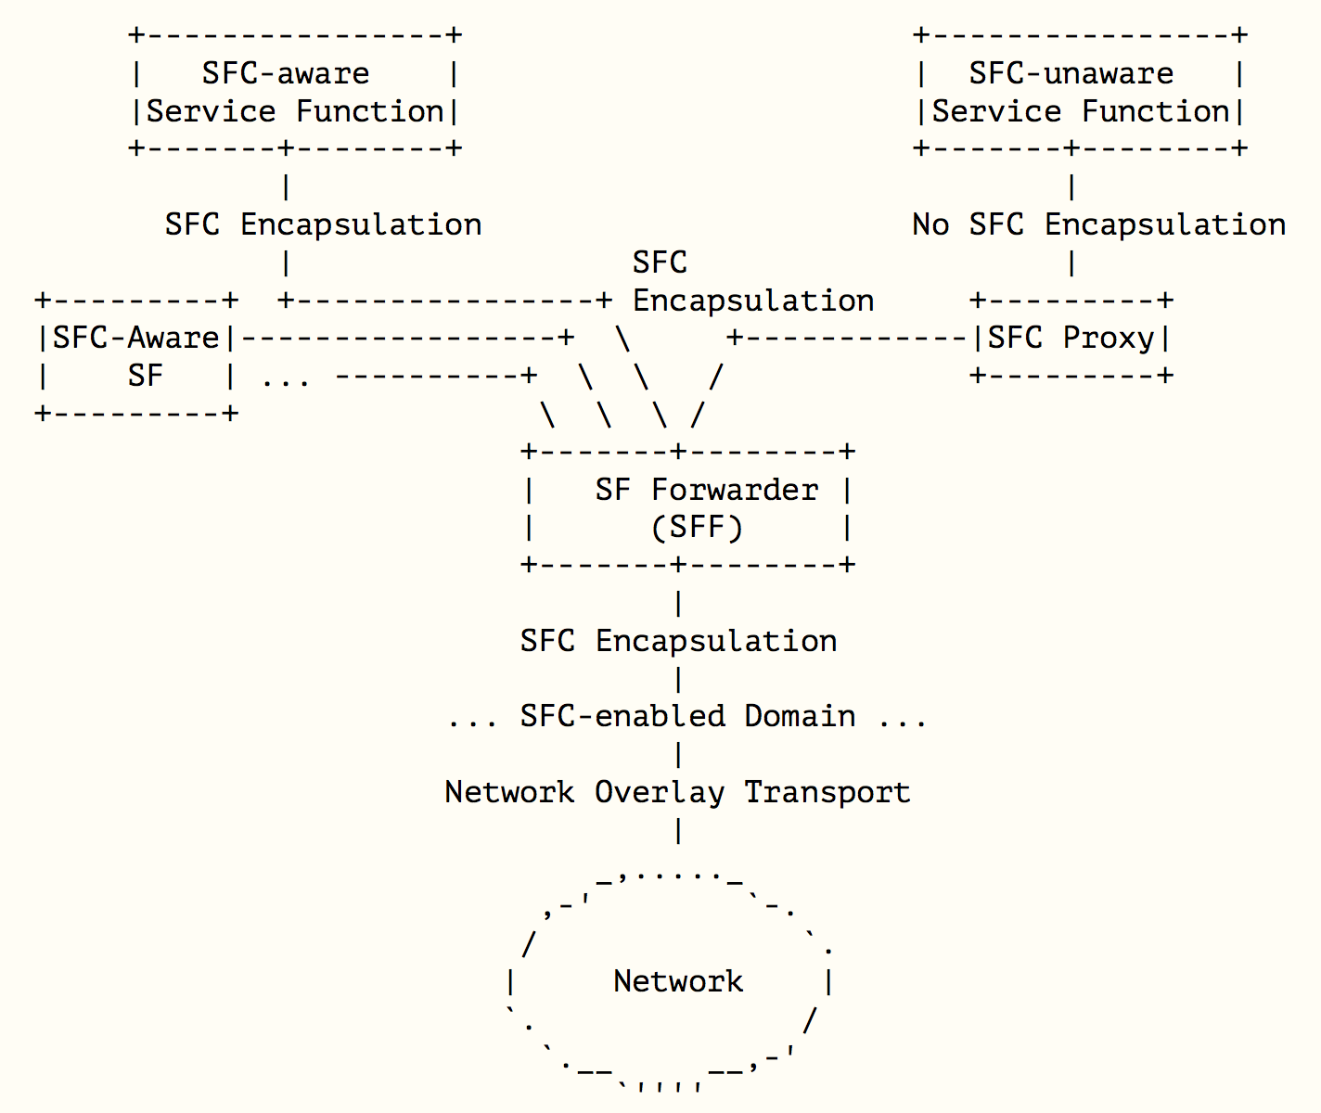
SFC Architecture

Slide 23
Network Service Header (NSH) Architecture
Data Plane Component
Service Classifier
  Determines which traffic requires service and forms the logical start of a service path
Service Path
  A service path is the actual forwarding path used to realize a service chain
  Think of service chain as the “intent”; service path the actual instantiation of the chain in the network
Service Function Forwarder (SFF)
  Responsible for delivering traffic received from the network to one or more connected service functions according to information carried in the network service header as well as handling traffic coming back from the SF
Service Function Proxy
  Component used to process network service headers on-behalf of an attached SF

Slide 24
Service Function Proxy
Support for Participant / Non-Participant Services
Legacy service functions may not have the capability to process packets encapsulated with a network service header
The network service header architecture introduces the concept of a “Service Proxy” that is responsible for processing of the network service headers and mapping to/from service functions
Allows for participant and non-participant services to co-exist and belong to the same service chain
Participant Services
Non-Participant Services
SF
(Physical)
SF
(VM)
SF
(Physical)
SF
(VM)
TOR / (v)switch
Service Function Forwarder (SFF)
Service Proxy

Slide 25
Poll Question

Slide 26
Network Service Headers (NSH)

Slide 27
Network Service Header (NSH)
Data Plane Encapsulation
A Network Service Header (NSH) contains metadata and service path information that is added to a packet or frame and used to create a service plane. The packets and the NSH are then encapsulated in an outer header for transport.
More specifically NSH is composed of a 4-byte base header, a 4-byte service path header, four mandatory 4 byte context headers, and optional variable length context headers.
  Base header: provides information about the service header and the payload
  Service path header: provides path identification and location within a path
  Mandatory context headers: carry opaque metadata
  Optional variable length context headers: carry variable length TLV encoded information

Slide 28
Network Service Header (NSH)
Header Format
0 0 | 1 | 2 | 3 | 4 | 5 | 6 | 7 | 8 | 9 | 1 0 | 1 | 2 | 3 | 4 | 5 | 6 | 7 | 8 | 9 | 2 0 | 1 | 2 | 3 | 4 | 5 | 6 | 7 | 8 | 9 | 3 0 | 1
Ver |  | O | C | R | R | R | R | R | R | Length (6) |  |  |  |  |  | MD Type (8) |  |  |  |  |  |  |  | Next Protocol (8)
Service Path Identifier (24) |  |  |  |  |  |  |  |  |  |  |  |  |  |  |  |  |  |  |  |  |  |  |  | Service Index (8)
Context Headers
Original Packet Payload
Base Header
Service Path Header
Context Header

Slide 29
Network Service Header (NSH)
MD-Type 1 Format
0 0 | 1 | 2 | 3 | 4 | 5 | 6 | 7 | 8 | 9 | 1 0 | 1 | 2 | 3 | 4 | 5 | 6 | 7 | 8 | 9 | 2 0 | 1 | 2 | 3 | 4 | 5 | 6 | 7 | 8 | 9 | 3 0 | 1
Ver |  | O | C | R | R | R | R | R | R | Length (6) |  |  |  |  |  | MD Type 1 |  |  |  |  |  |  |  | Next Protocol (8)
Service Path Identifier (24) |  |  |  |  |  |  |  |  |  |  |  |  |  |  |  |  |  |  |  |  |  |  |  | Service Index (8)
Mandatory Context Header (1)
Mandatory Context Header (2)
Mandatory Context Header (3)
Mandatory Context Header (4)
Original Packet Payload
An MD-Type 1 NSH carries 4 x 4-byte mandatory context headers that are able to carry opaque metadata between service functions and between the network and service functions
Context header allocation is left opaque so that different use cases and market segments can be supported

Slide 30
Network Service Header (NSH)
MD-Type 2 Format
0 0 | 1 | 2 | 3 | 4 | 5 | 6 | 7 | 8 | 9 | 1 0 | 1 | 2 | 3 | 4 | 5 | 6 | 7 | 8 | 9 | 2 0 | 1 | 2 | 3 | 4 | 5 | 6 | 7 | 8 | 9 | 3 0 | 1
Ver |  | O | C | R | R | R | R | R | R | Length (6) |  |  |  |  |  | MD Type 2 |  |  |  |  |  |  |  | Next Protocol (8)
Service Path Identifier (24) |  |  |  |  |  |  |  |  |  |  |  |  |  |  |  |  |  |  |  |  |  |  |  | Service Index (8)
Optional Variable Length Context Headers
Original Packet Payload
0 0 | 1 | 2 | 3 | 4 | 5 | 6 | 7 | 8 | 9 | 1 0 | 1 | 2 | 3 | 4 | 5 | 6 | 7 | 8 | 9 | 2 0 | 1 | 2 | 3 | 4 | 5 | 6 | 7 | 8 | 9 | 3 0 | 1
TLV Class |  |  |  |  |  |  |  |  |  |  |  |  |  |  |  | C | Type |  |  |  |  |  |  | R | R | R | Length
Variable Length Metadata

Slide 31
NSH Context Header Allocation
Example Data Center Allocation Schema
0 0 | 1 | 2 | 3 | 4 | 5 | 6 | 7 | 8 | 9 | 1 0 | 1 | 2 | 3 | 4 | 5 | 6 | 7 | 8 | 9 | 2 0 | 1 | 2 | 3 | 4 | 5 | 6 | 7 | 8 | 9 | 3 0 | 1
D | Rsvd |  |  | Source Switch ID |  |  |  |  |  |  |  |  |  |  |  | Source Interface ID
Reserved |  |  |  |  |  |  |  | Tenant ID
Destination Class / Reserved |  |  |  |  |  |  |  |  |  |  |  |  |  |  |  | Source Class
Service Classification Data
Flag bits: Bits 0-3 are flag bits. The D-bit is used to indicate whether the Destination Class field in the 3rd word is used.
Source Switch ID: An identifier indicating the source device where the original traffic initially entered the service chain.
Source Interface ID: An identifier indicating the source interface where the original traffic initially entered the Service Chain. This identifier is scoped within the context of the Source Switch ID.
Tenant ID: The tenant identifier is used to represent the tenant that the service chain is being applied to.
Destination Class: The destination class represents the logical classification of the destination of the traffic. The D-bit is used to indicate that this field contains a valid Destination Class. D=0 indicates that these bits are reserved.
Source Class: represents the logical classification of the source of the traffic. For example, this might represent a source application, a group of like endpoints, or a set of users originating the traffic. This grouping is done for the purposes of applying policy.

Slide 32
NSH Context Headers
Advantages / Examples
Simpler service implementation / deployment
  SFs that transform packets do not need to re-classify traffic
  Example: NAT. Downstream SFs from NAT rely upon a consistent context value for services rather than re-classification to determine actions
Service to service information sharing
  SFs can pass information to downstream SFs within the service chain
  Example: encrypted vs. clear text data. In the case of an SF such as SLB, the ingress traffic might be encrypted. Post-SLB, clear-text traffic is generated. The SLB node uses service header context to indicate to the next SF information about the data. For instance, the SLB might parse XML and inform a firewall application specifics without the firewall having XML parsing capabilities

Slide 33
NSH Context Headers
Advantages / Examples Cont.
Application of richer service policy
  Service policy application at a receiving SF can use information not known a priori
  Example: edge node (leaf) can imposes application details. A downstream SF – for example a FW – can use the context header for rule application. The FW never needs to classify the application, rather it simply permits/denies based on the context value
  Example: Mobility – a PGW can classify traffic and provide a representation of the subscriber record encoded within the context header. As packets traverse the service path, SFs utilize the header to derive subscriber policy
Leverage data from many sources
  Any and all of the above examples can be combined to provide rich context, derived from many sources along the service path. The network nodes and SFs do not need to participate in the range of policy systems

Slide 34
Network Service Header (NSH)
Industry Acceptance & Standardization

Slide 35
Network Service Header Architecture
Industry Acceptance and Standardization
Cisco driving industry acceptance and standardization within the IETF
  Service Function Chaining (SFC) working group
    http://datatracker.ietf.org/wg/sfc/charter/
  Problem statement, use cases, and architecture WG documents
  NSH through last call:
    https://datatracker.ietf.org/doc/draft-ietf-sfc-nsh/
Also engaged with ETSI NFV, BBF, 3GPP, ONF, ATIS
Various open source development efforts; OVS, OpenDaylight, OpenStack

Slide 36



Where to start?
 | https://wiki.fd.io/view/Project_Proposals/NSH_SFC
 | https://wiki.opnfv.org/display/sfc/Service+Function+Chaining+Home
 | https://wiki.opendaylight.org/view/Service_Function_Chaining:Main

Slide 37
Open Daylight

Slide 38
Poll Question

Slide 39
Initial Status
Released in Lithium, planning Beryllium
Renderers: OVS, OF and REST
Hackathon at IETF-92 through IETF-94
GBP Integration.
Application Identification, SFC Traceroute, Reference Data plane, NSH client test tool, IPTables classifier.

Slide 40
Opendaylight SFC Main Components
ODL SFC implementation components
  Provider
  YANG Models
  UI
  Data Plane
  Data store Listeners and Renderers
    REST
    Openflow
    OVS
https://wiki.opendaylight.org/view/Service_Function_Chaining:Main

Slide 41
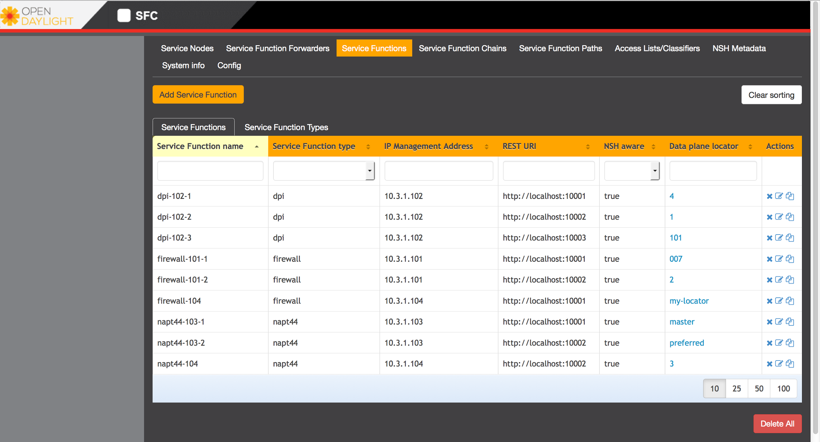
SFC Front End

