Slide 1
How to Deploy and Integrate Cisco SD-WAN
Overview
Chris Lewis
Product Manager– NFV BU Product Management
February, 2017

Slide 2
Agenda
SD-WAN deployment
Integration to existing operations
SD-WAN service customization
Summary of Cisco SD-WAN options for SP
Demo

Slide 3
SD-WAN Deployment

Slide 4
SD-WAN Service Delivery
From Complexity to Simplicity and Automation
FROM WEEKS TO MINUTES
Architect It
Design
It
Where Can We Put It?
Procure It
Install
It
Configure It
Secure
It
Is It Ready?
Automated
Self-Service
On-Demand
Manual
Self-Service
Automated Provisioning
Service
Oriented
Elasticity
(Capacity-on-Demand)
20
Notes:
It’s not just about automating manual processes. It’s also about taking a look at the first few steps in the process and replacing lengthy (days/months) requirements conversations between users and architects with a smart, standards-based service catalog.
Free-up architects’ time
Guide users toward standard configurations/services
The adoption of standards enables automation, accelerates service delivery and improves supportability

Slide 5
Definition: ONUG* (Large Enterprise User Group) has specified 10 requirements for an SD-WAN
 | ONUG SD-WAN Requirements | Cisco
1 | CPE: physical or virtual form factor | ✔
2 | Zero Touch Deployment: agility in provisioning and deployment | ✔
3 | Secure Hybrid WAN: Dynamic traffic engineering across Internet & private WAN based on application policy, and aware of network availability/degradation | ✔
4 | Active-Active Architecture: Sites connect to applications through Internet & private WAN | ✔
5 | High Availability & Resiliency: Optimal for client user experience | ✔
6 | Layer 2 & 3 Interoperability: With directly connected switch and/or router | ✔
7 | Visibility, Prioritization & Steering Applications: Specifically business critical and real-time applications per security, corporate governance and compliance | ✔
8 | Management Dashboard/Portal: By site, Application and VPN performance level | ✔
9 | Controller with open APIs: For access and management, forward specific log events | ✔
10 | FIPS 140-2 Validation Certification: Encryption with automated certificate life cycle management | ✔
*ONUG: Open Networking User Group (Large Enterprises)

Slide 6

SD-WAN Requirements, Visibility
Make The Network Application-Aware
Intelligence & Insights
Detect/Categorize 1000+ applications automatically
No probes or additional HW
Any user, device, wired
or wireless
Facilitates trouble-shooting
Application Categories
Consumer Apps
Voice and Video
File Sharing
Business and Productivity Tools
Social Networking
Software Updates
Instant Messaging
Database
Gaming
Browsing
Email
72
48
36
31
28
24
19
17
12
9
8
“Cisco AVC also makes it easy to see if slow application performance is a result of client network delay or server network delay.”
Browsing
Consumer_apps
Unknown
Net-admin
File-sharing
Voice-and-video
Other
“IT staff gain a 360-degree view of all devices, users, and applications from a single location.”
Notes:
Boxwood: http://www.cisco.com/c/en/us/solutions/collateral/enterprise-networks/application-experience/case_study_c36-727772.html

Slide 7
SD-WAN Requirements, Intelligent Path Control
Increase Application Availability
1
Set app rankings and policies
Business Relevant – High Priority
Business Irrelevant – Low Priority
Default – Medium Priority
Lower operating costs
Full utilization of ALL available bandwidth
Improved application performance
2
Use Internet as the 2nd WAN
Active-Standby
Active-Active
“I want my critical data and voice traffic moving over MPLS, because I have a service-level agreement with my MPLS provider and I can hold him accountable if there’s an outage or slowdown. PfR does that for me, while sending lower-priority traffic like web surfing to DMVPN.”
3
Route app path based on policies
Notes:
IDC SD-WAN Survey Special Report May 2016
Other quotes: “While ensuring uptime for our essential network operations, PfR saves us money and gives us better value for the money we‟re spending on redundant circuits: just what our CIO asked for.” (http://www.cisco.com/c/dam/en/us/products/collateral/routers/asr-1000-series-aggregation-services-routers/farmcreditsvcs_cs.pdf)

Slide 8
SD-WAN Requirements, WAN Optimization
Enhance the Application Experience
Enable Business Initiatives
Mobile Apps
Digital Signage
Optimize WAN bandwidth for better ROI
Accelerate applications over any connection
Store content locally for
instant access
Guest WiFi
Catalogs
Video Conferencing
On-demand Training
Bandwidth
(Mbps)
Latency
(ms)
Result: Louis Vuitton
4
160
Reduced Bandwidth
80%
3x
3
120
Bandwidth natively
          Faster App Response Time
          Greater
          Dwell Time
Bandwidth with IWAN
2
80
Reduced
Latency
App latency natively
1
40
App latency with IWAN
0
0
App Bandwidth
App Latency

Slide 9

SD-WAN Requirements, Secure Applications and Data
Protect the Branch and WAN
Secure Intelligent WAN
Secure any connections
Respond faster to threats and vulnerabilities
Integrated,
all-in-one security platform
Scalability without compromising performance
Meet government and regulatory compliance
“Having the entire security suite at our fingertips has given us agility to enhance our toolbox on the fly. It’s been easy to manage, and we don’t need to worry about whether to add security elements when we order routers or firewalls; they
just come included.”
Secure traffic directly accessing the Internet
Comprehensive threat defense

Slide 10




Customers Asking for a Turnkey Solution
APIs Define Input/Outputs
OSS
SA
Systems
BSS
Security
Turnkey Managed Offer
Existing Services
Infrastructure

Slide 11




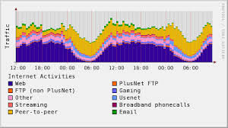





Components of a Managed SD-WAN Solution
Combine to Deliver Basic Orchestrated Service Model
Customized Solution Components Designed for Integration into Service Provider Environments
Service Performance Data
Web GUI for Tenants, Administrators and Operators
Provide the configurations to the network to instantiate or modify the service.
Service specific billing notifications and actions to customer billing systems.
Service health, usage and performance data presented in graphical/tabular format.
Tenant accessible portal used to add/modify/delete services and view other service attributes.
APIs designed to tie into relevant OSS/BSS systems for service specific integration.
Network Orchestrator
Billing Notifications
Service Integration APIs
Service Health/Stats
End User Portal
Ability to integrate with existing systems to enable single sign-on capabilities.
Ability to collect and store service data on a per-tenant basis.
Web based portal available to the operator as well as the administrator.
Model representing the end-to-end service with variables to be used as part of the service offer.
Correlate Service Data
Service Model
IDM Integration
Service Data Storage
Correlate service data across components to make relevant for SP systems and use.
Admin/Operator Portal
Service Correlation
Combination of All Solution Components = Service Offer → It’s what is sold

Slide 12
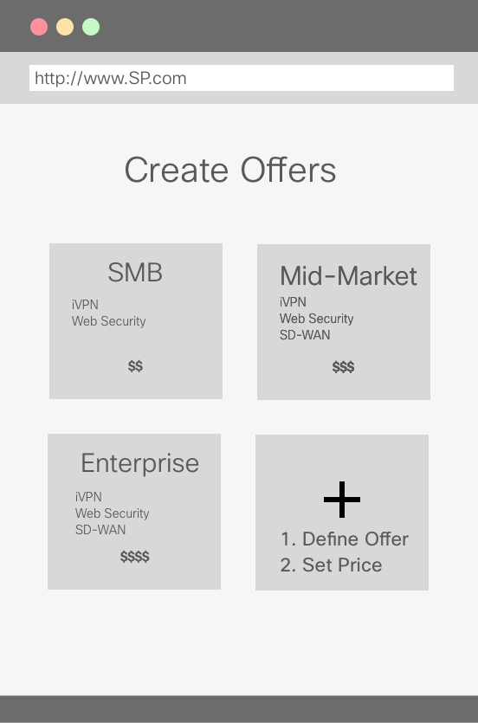
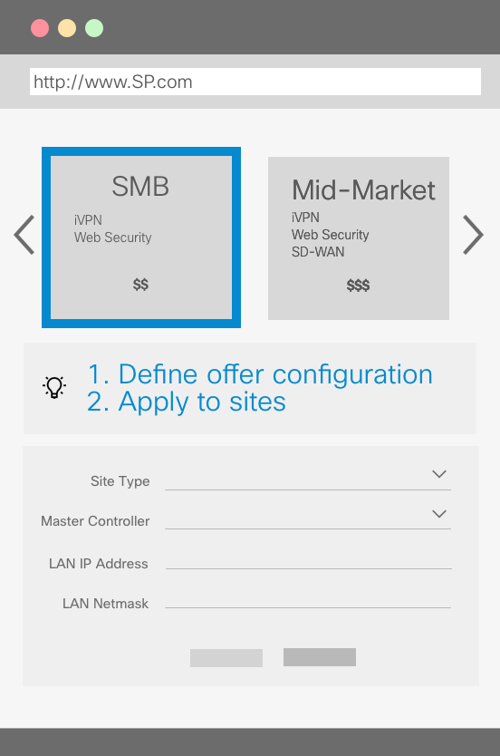


How do they use it – Service Provider
Joe SP Product Manager
Julia SP Operator
  Define Service Catalogue content
  Define Pricing for apps
  Define Default Configuration
  Define Hardware & Defaults

Slide 13
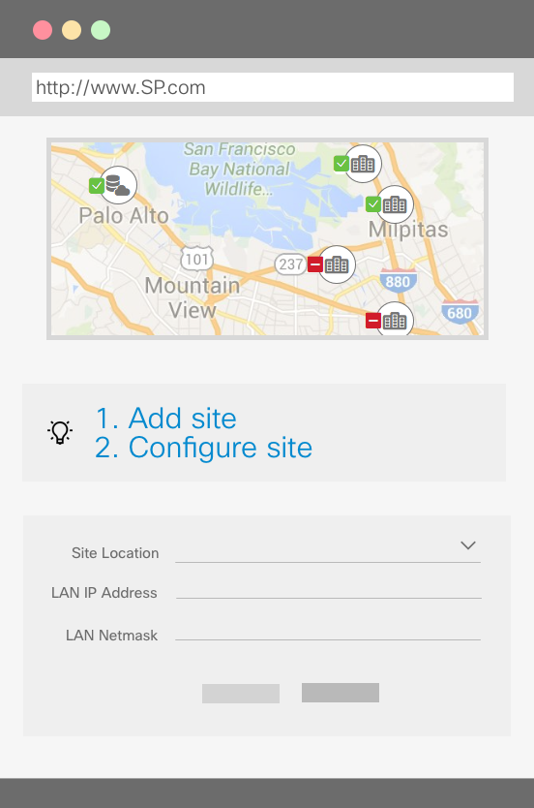
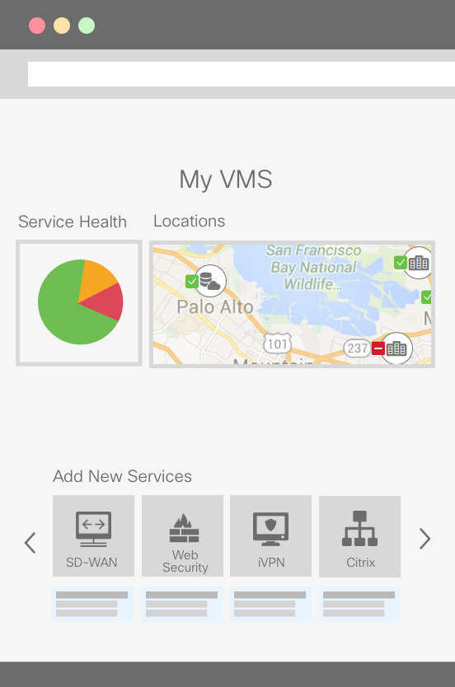


How do they use it – Enterprise Consumer
Mary Enterprise Admin
Mosum Enterprise Site User
  Define Configuration for end-sites
  Manage Remote Locations
  Check site health

Slide 14
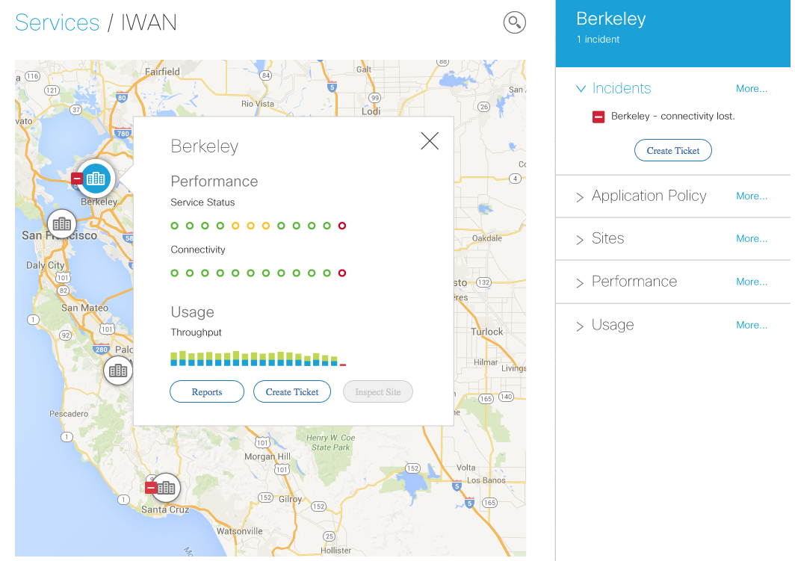
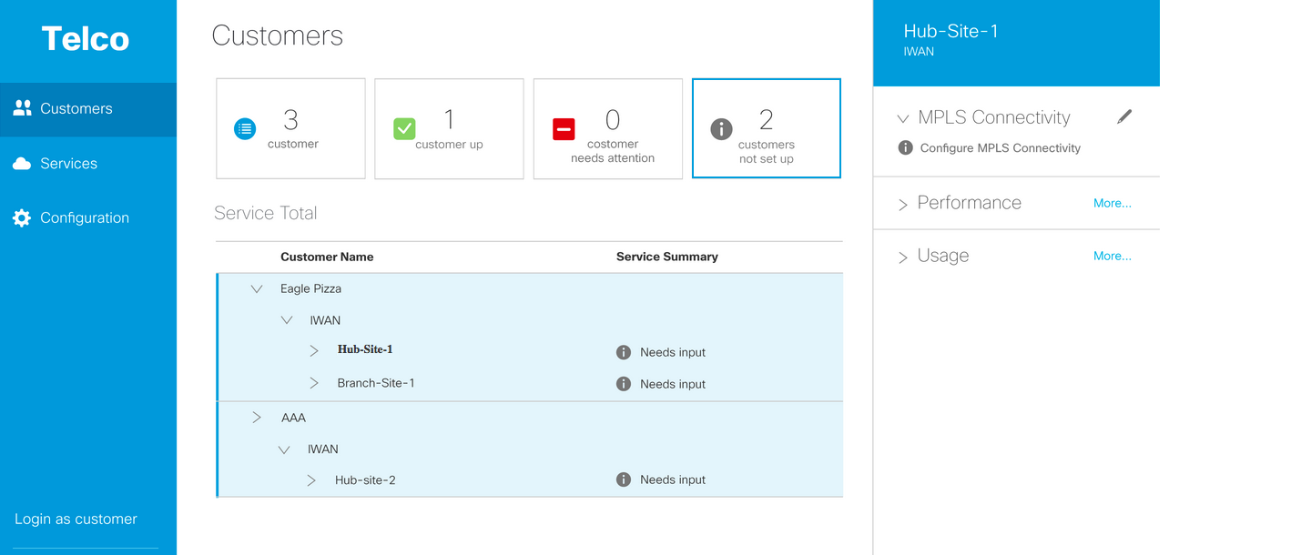









vMS or Meraki Platform
Customer
Self Service Portal
SP Operations
Management Dashboard
Data Collection
Service Orchestration
Network Operations
Customer
MPLS (IP-VPN)
Private
Cloud
Virtual
Private Cloud
Branch
Internet
Public Cloud

Slide 15

What is the target end point?
P3
On boarding
Firewall
Routing
SP Product Offer Manager
End Result:
Composable services.
Both by SP and tenant user
Large x10
VPN
AVC
Tenant Global
Admin
P2
PfR
Small x50
On boarding
P1
Routing
VPN
Firewall
Routing
On boarding
Cisco
Developed
AVC
PfR
VPN
QoS
Service Model

Slide 16
Integration to existing systems

Slide 17

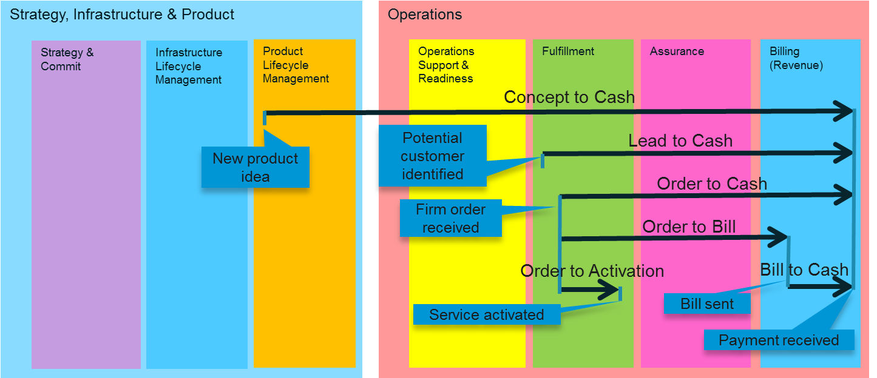
Concept to Cash
Lead to Cash.
From identifying a potential
customer to receiving
revenue from that customer.
Quote to Cash.
From giving a price quote to a potential customer to receiving revenue from that customer.
Order to Cash.
From receiving a firm order for a product to receiving revenue from that order.
Order to Activation.
From receiving a firm order for a product to completing fulfillment of the order.
Order to Bill.
From receiving a firm order for a product to sending the first bill.
Bill to Cash.
From sending a bill to receiving revenue.

Slide 18
Delivering SD-WAN– Who does what?
Function | SP does it | Tenant does it | SD-WAN Provides
Marketing, Sales Pipeline | ☑
Providing quotes | ☑
Credit/blacklist checks | ☑
Tenant onboarding | ☑ |  | RBAC
Equipment shipping | ☑ | ☑ | PnP
Equipment testing | ☑ | ☑
Service Provisioning | ☑ | ☑ | SP Console, Fulfillment BPM NSO + FPs
Upgrades/downgrades/migrations | ☑ | ☑
Monitoring hub/branch status & performance | ☑ | ☑ | Data collection, SP Console, Tenant Portal
Managing traffic flows (NBAR, PfR) | ☑ | ☑
Shared Responsibility

Slide 19
APIs and Standards
Standardized APIs and Languages are required for all touch points
  i.e., points where the SP interacts with the product (integration & development)
Goal: Reduce SP development & integration costs
  Recruiting & training staff, tooling, best practices, development lifecycle.
API standardization covers transport mechanism (e.g., REST) and signatures
  Examples: ETSI MANO interfaces (future); OSS/J (legacy)
Examples: Netconf/YANG, TOSCA/YAML

Slide 20
What Is Cisco Virtual Managed Services?
Automate services end to end
Virtual Managed Services is a software solution platform that can enable a set of highly secure, cloud-based services solutions for automated delivery of business connectivity and applications services cost-effectively, seamlessly, and on demand to customers and partners, for amazing user experiences.
Create new services on demand
Simple, customized shopping portal
Modular tools to match your business
Easy to deploy and maintain
Seamless and highly secure cloud delivery
For enterprise and small business customers
Notes:
Cisco Virtual Managed Services (VMS) is a software solution platform that enables a set of secure end-to-end cloud services overlay solution that enables you to delivers virtual services seamlessly, cost-effectively and on-demand to remote sites, users and businesses. It simplifies and automates both building and delivering new services, such as security, unified communications, video and more to both existing and new customers, either in-house (by enterprise IT to new workers and sites) or for external customer (by providers to enterprises or SMBs), inclusive of SLA requirements.
Additionally it allows for easy on-boarding of new services or third party services with new tools and a simple graphical portal, which is centrally managed in a highly secure cloud, delivering end-to-end visibility and identity, inclusive of permissions, to all end-connections and devices.
Cisco Virtual Managed Services also integrates with existing customer premise equipment, allowing customers to build upon and utilize existing infrastructure. It allows for secure rollouts of new software, updates, services and for-sale offerings quickly and effectively as it eliminates the number of site visits, truck rolls, and IT maintenance, resulting in both OpEx and CapEx savings.
Cisco VMS delivers real-time application and connection performance data, uptime information, cost optimization of workloads and intelligent traffic routing optimized for cost, speed or availability, depending on customer, IT and overall business requirements. End users (such as enterprise IT delivering services to remote sites) or customers and partners (such as enterprises and SMBs) can easily access these services through an end user web portal that allows for management and monitoring of existing services and also makes it easy to purchase and activate new and additional services on-demand at the click of a mouse.

Slide 21
Functionality of the vMS platform
vMS, a multi-tenant managed NFV services platform.
For each tenant, and each service (e.g. IWAN) ...
Configure global service settings
Create and manage Service templates
Set per tenant parameters
Service provisioning notifications (e.g. started, failed, completed, ...)
Device provisioning notifications
Site provisioning notifications
Remote User-related notifications
User Persona for UI and APIs
SP operator / product engineer
Tenant administrator
Tenant user
Trusted SP application
Service Pack
Service Pack
Service Pack
VMS Platform
Order the service
Modify a service instance
Monitor service, site, device status
Monitor service-specific KPIs

Slide 22
Functional Architecture
SP Domain
Product Line
Operations
Fulfillment
Assurance
Billing
Ordering, Problem Reporting
Billing
Service
Catalog
SOM Workflow
Tenant
Service Provider
Service
Creation
Env.
Tenant
Portal
Back-End
SP
Console
NSO
Data
Collector
VMS
Components
Alarms &
Stats
Examples provided
Configuration
Physical Devices
Virtual Functions
Existing SP BSS/OSS
Managed Resources

Slide 23
SD-WAN Service Customization

Slide 24
Reality Around Service Provider Requirements
Different Device Types
vCPE & Physical CPE, New & Brownfield Environments
Fixed Function Pack and User Interface Without the Ability to Customize will not be Successful
Hardware Connectivity Customization
Single/Multiple Links, LAN Variations, Variety of Backup Solutions (DSL, LTE, …)
Configuration Customization
Routing Options, Management Infrastructure Variations, QoS Strategies
Service Evolution is Prevalent
New Technologies = New Service Options and Opportunities for Differentiation
Notes:
Different device types
vCPE, Physical CPE
New / existing
Hardware custom configs
1 Link / 2 links primary links
Different LAN configs
Different backup solutions (none, DSL, 3G/4G)
Software config customization
Static versus routed PE-CE links
Management infrastructure
QoS strategy (only commonality is the application of the policy to the interface)
Services are evolving rapidly
Central / distributed
NFV exacerbates the problem
Some are constraints / some are an SPs USPs in selling the service to the customer
Conclusion: It is extremely difficult to write a fixed FP or UI that deals with every SP requirement.

Slide 25
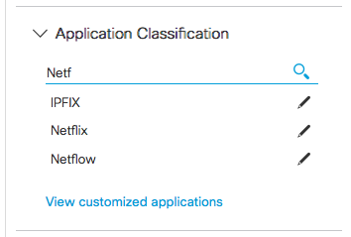
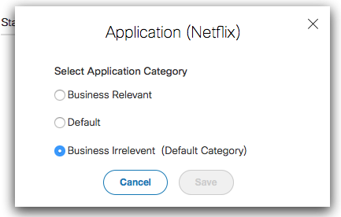
Tenant Application
Classification
User can:
Perform an Application search
Edit the Business Relevance of the Application.

Slide 26
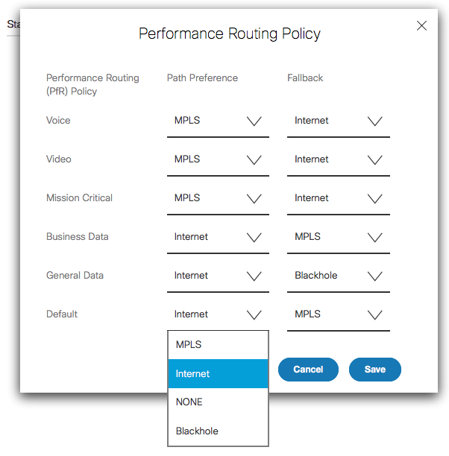
Tenant Routing Policy
User can customize Performance Routing Policy – selecting a preferred path for each traffic type or even blackhole a traffic type.

Slide 27
Extending the Configuration of a Service Pack
NSO creates device template.
NSO can add additional templates
Any configuration expressed in XML works.
Extend
Device Config
Device Config
Templates
Modify

Slide 28
Combining features into offers via branch templates
A generic UX experience supporting multiple offers
  Common flows / functions regardless of service - Map, list, search, manage site, SLA/status
  Branch specifics vary greatly, but in well defined terms.
Customize within this generic UX using templates
  SP’s can customize offer and branch services they show to their tenants.
  Seamlessly integrated into the common UX experience
What does template development mean?
  Describe offer / branch service, input fields, SLA components for UI rendering
Done by different groups
  Cisco engineering : Build a flexible platform (Backend and Frontend)
  Template definition: SP engineering / Third party software developer / Cisco AS

Slide 29
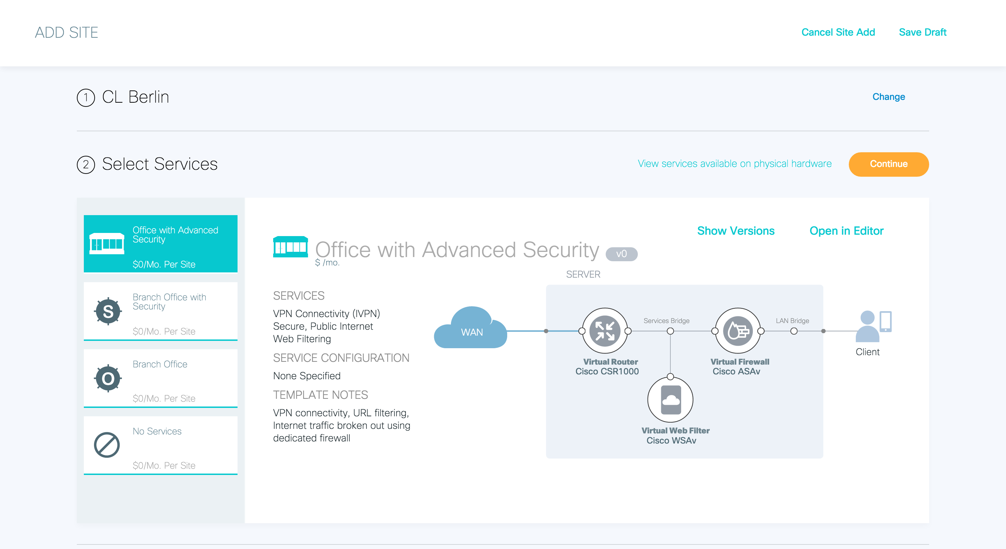
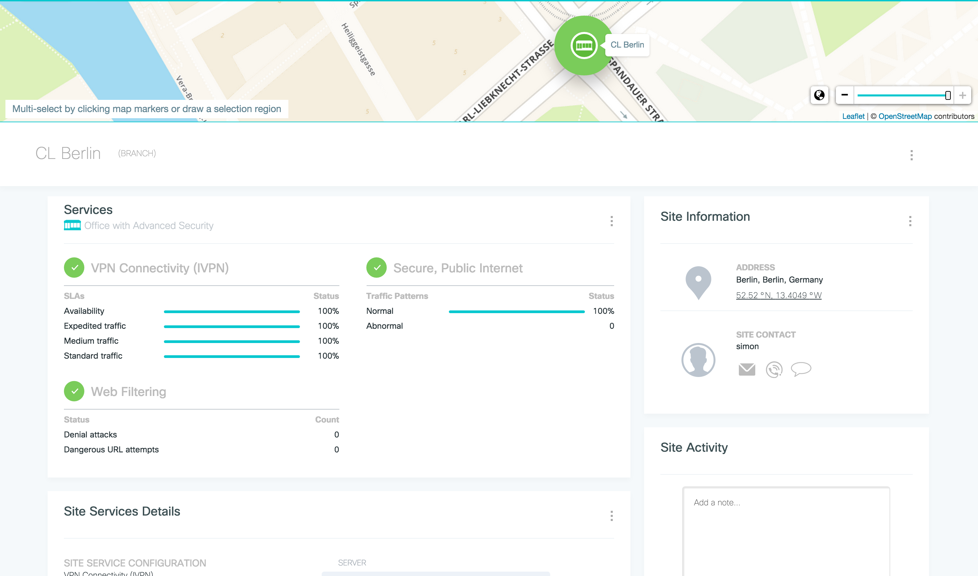
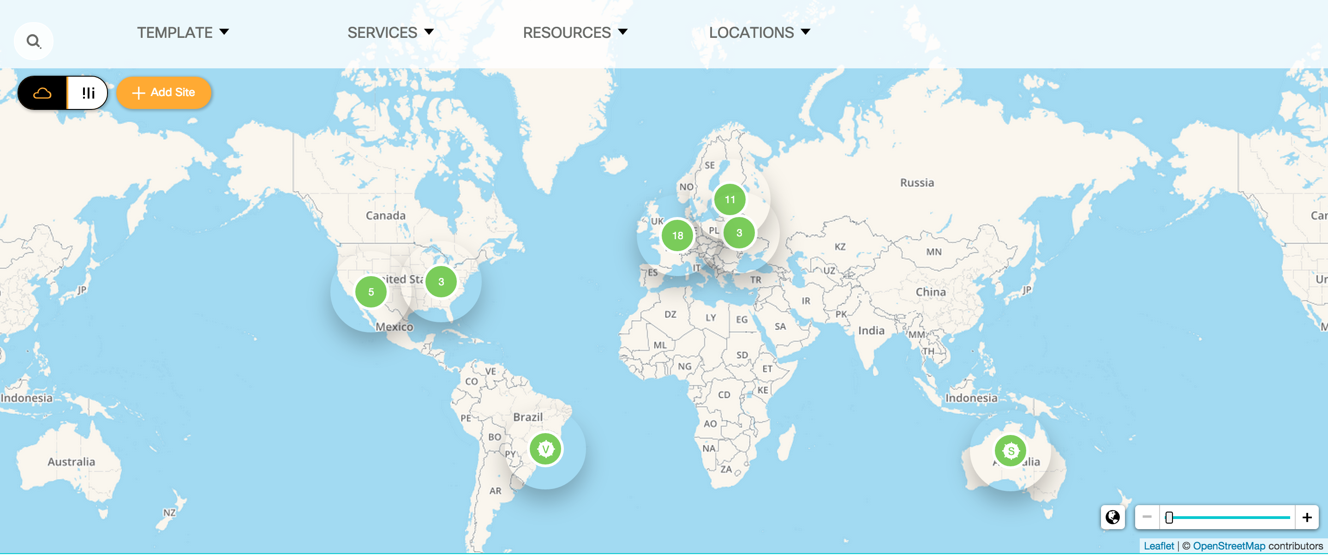
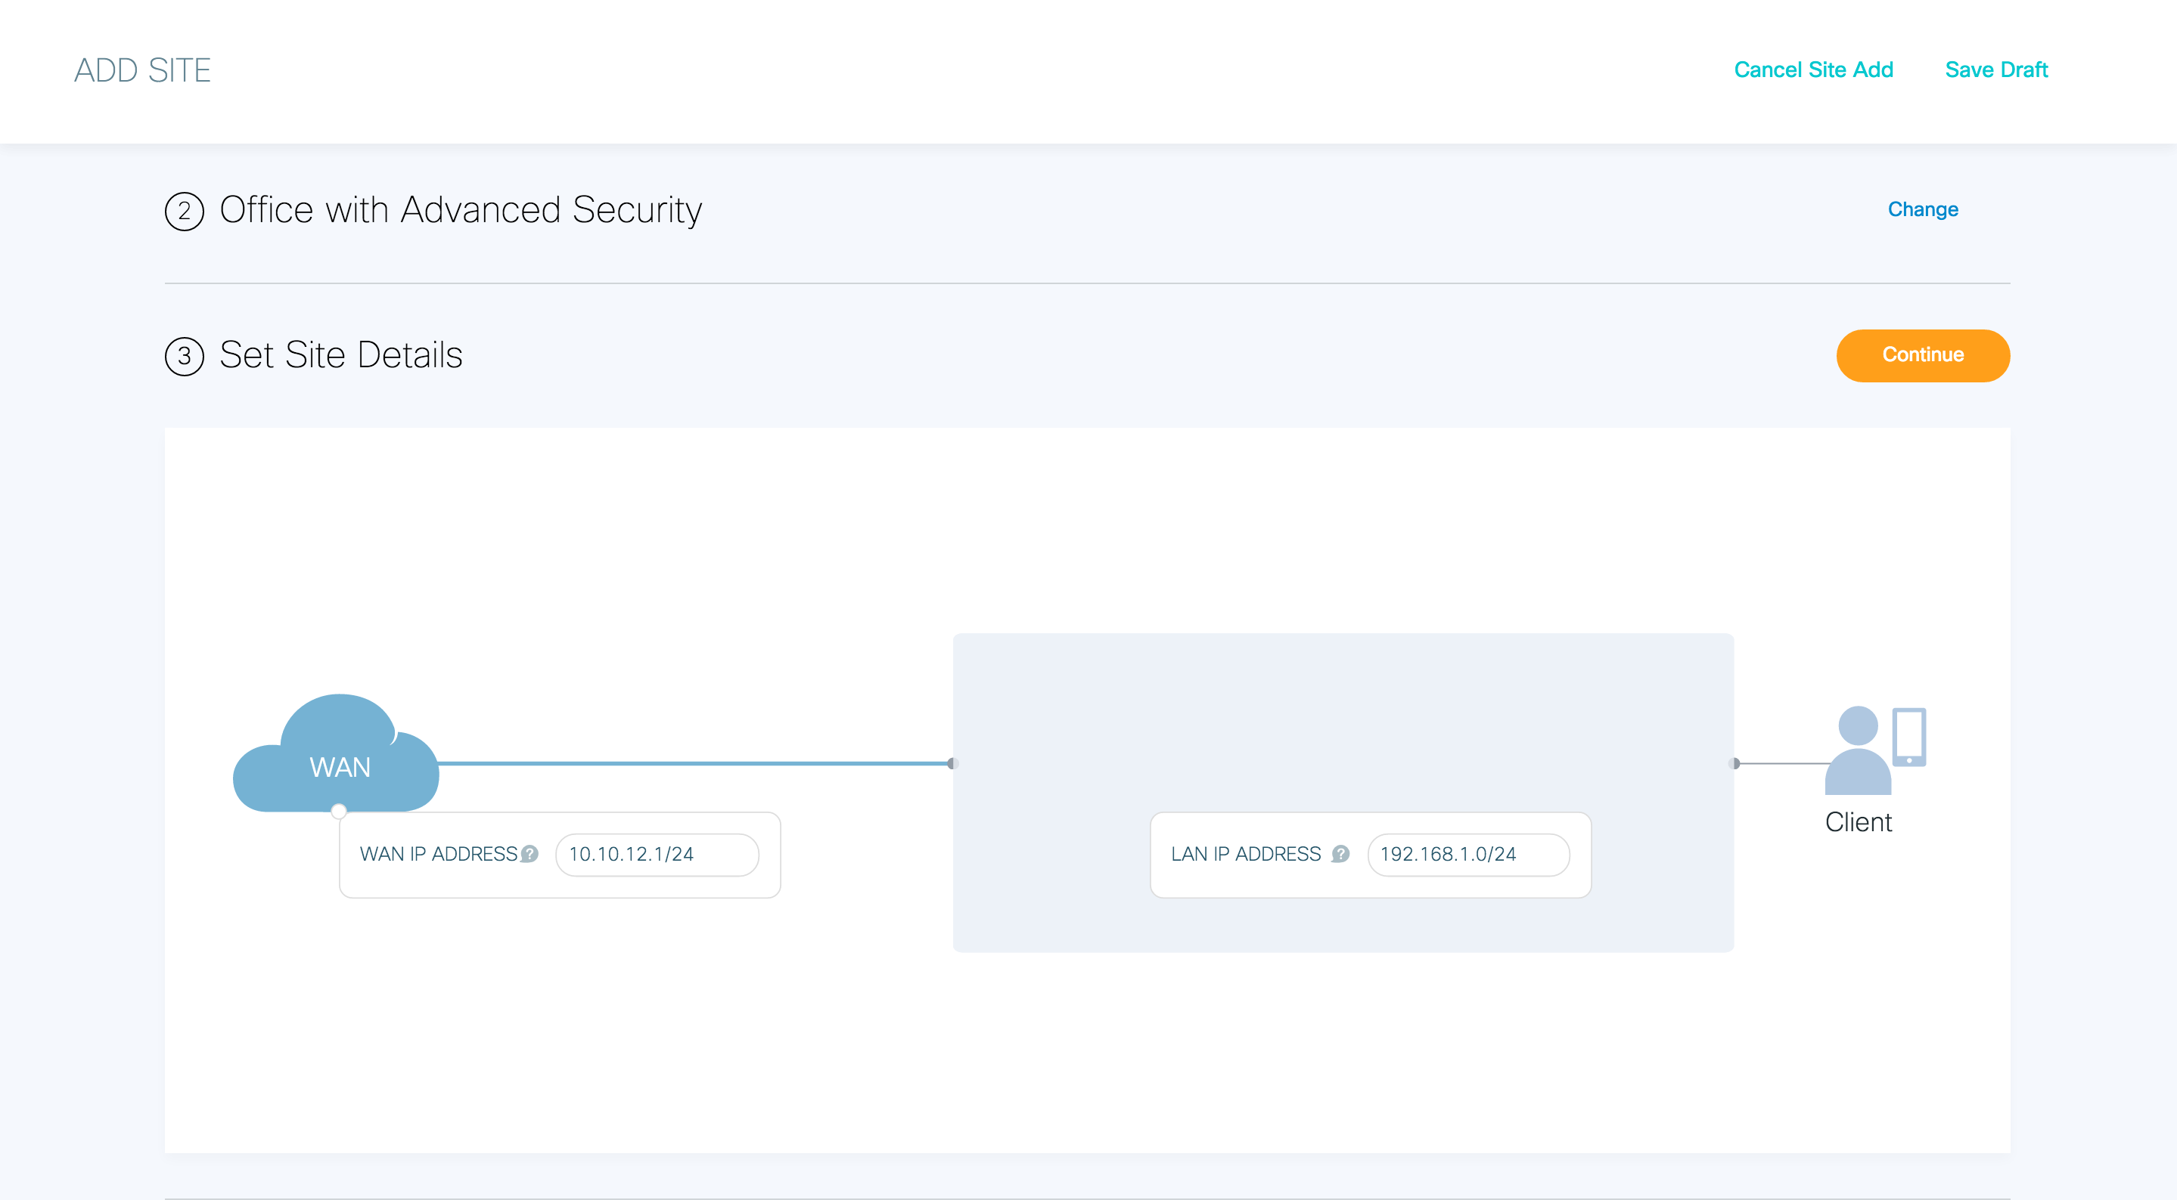
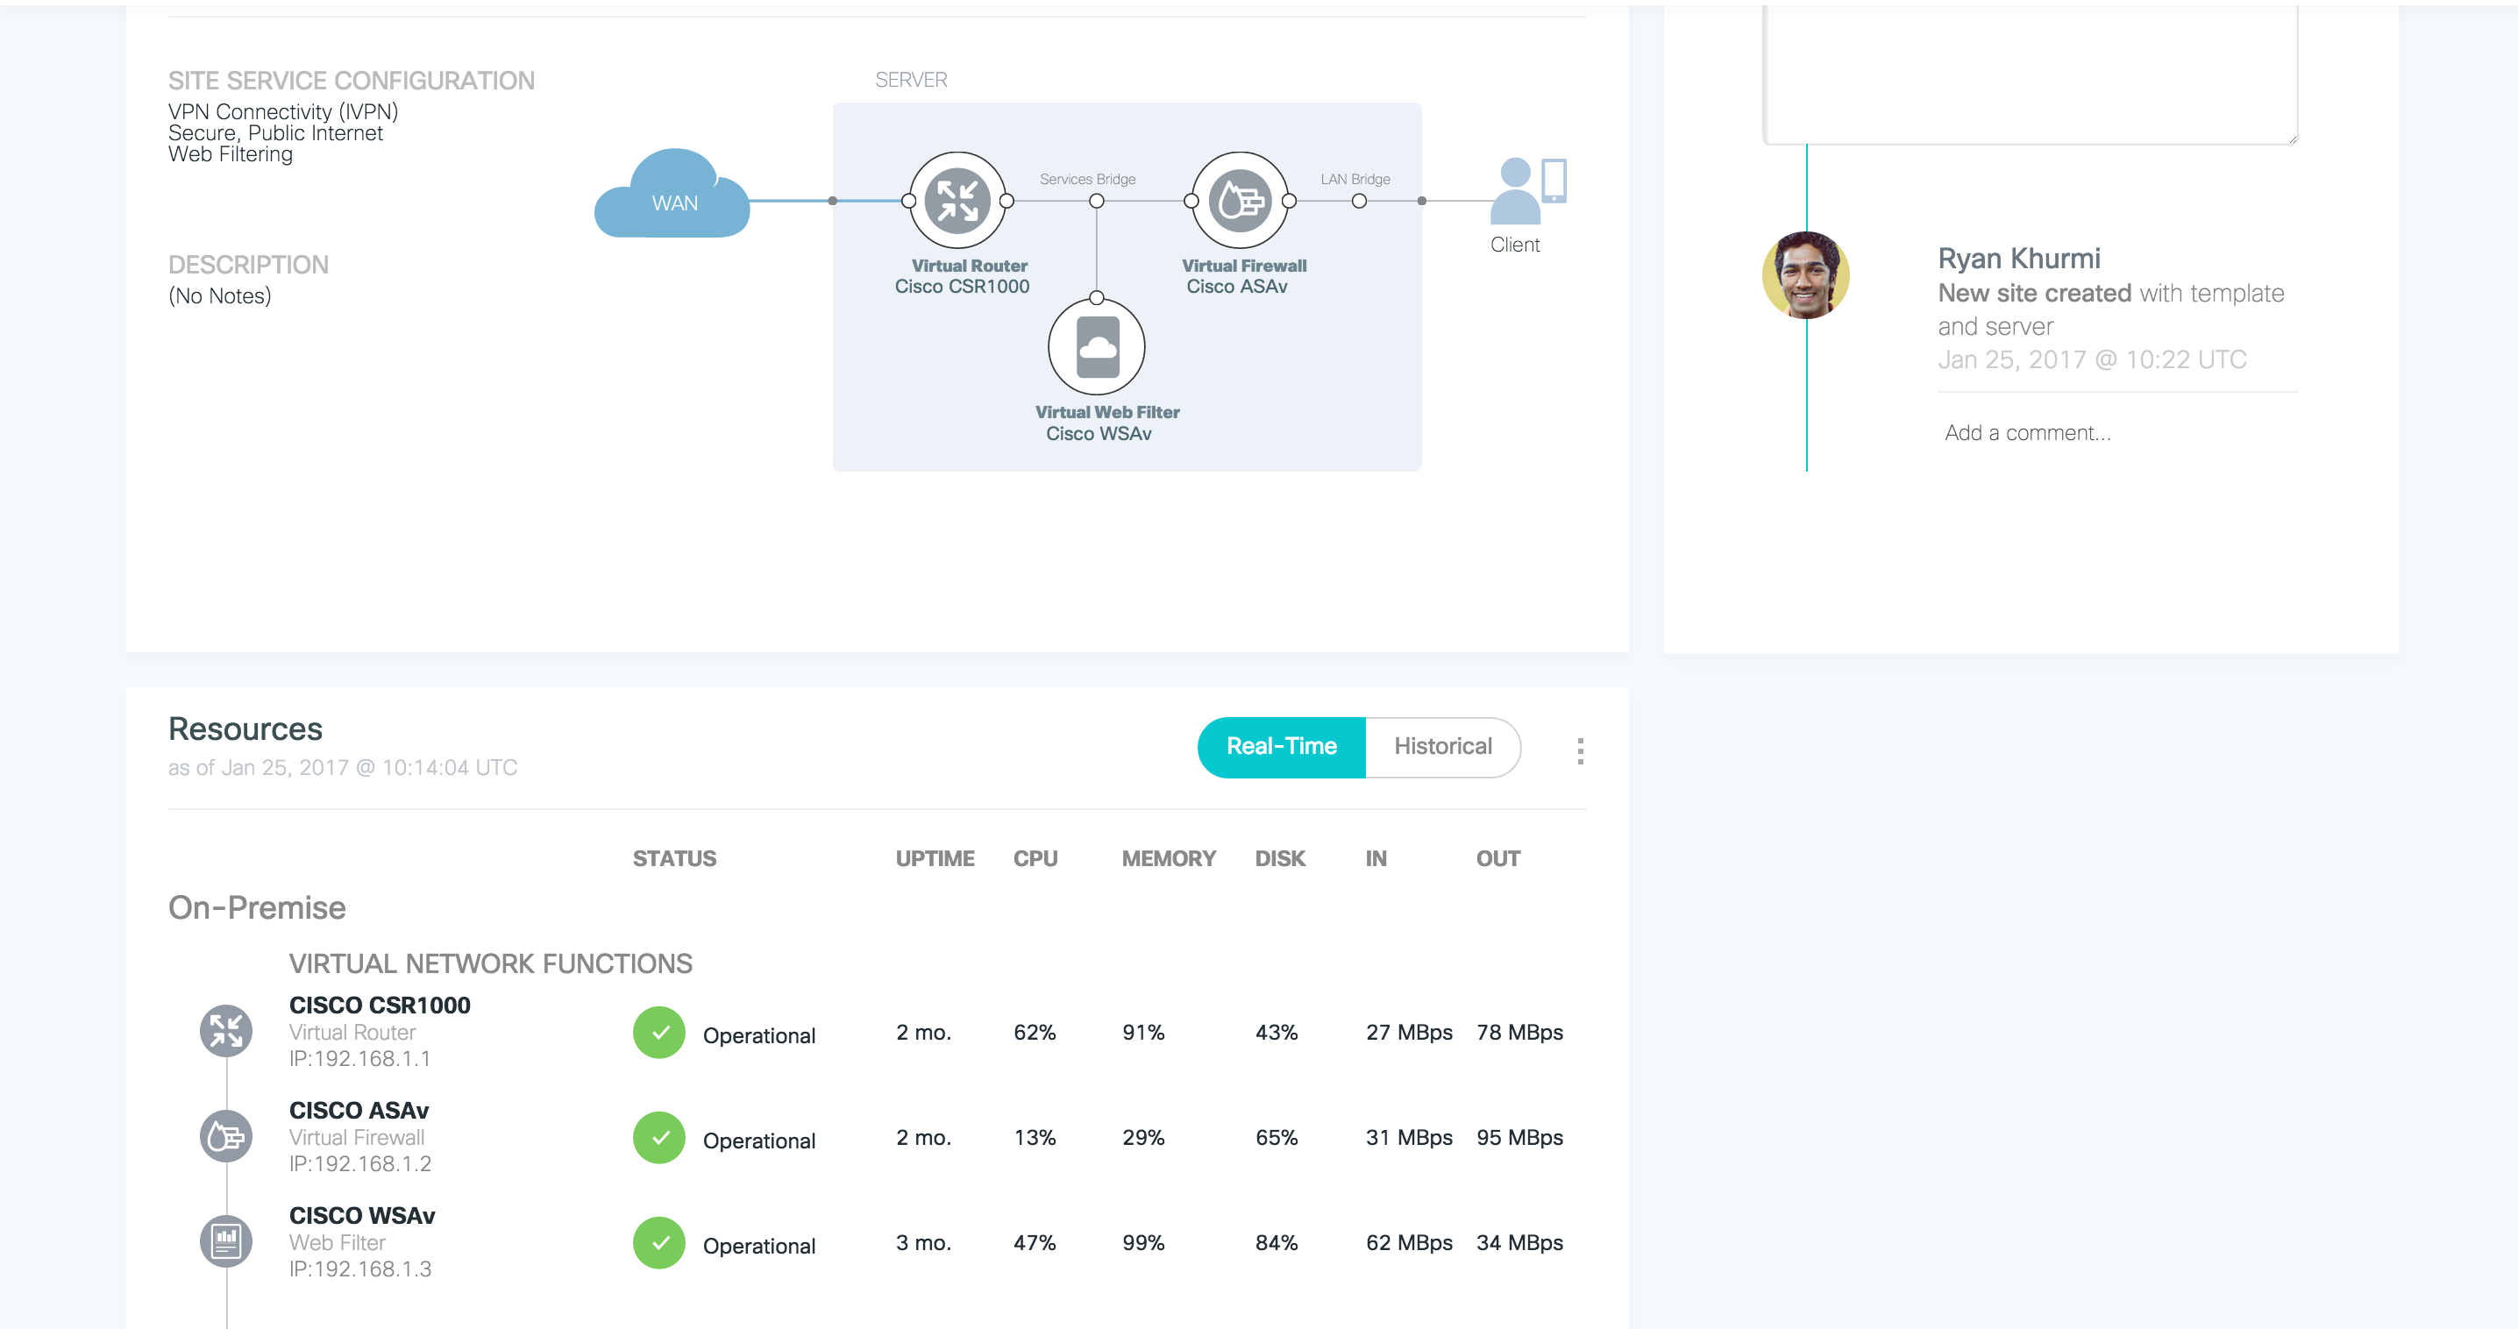

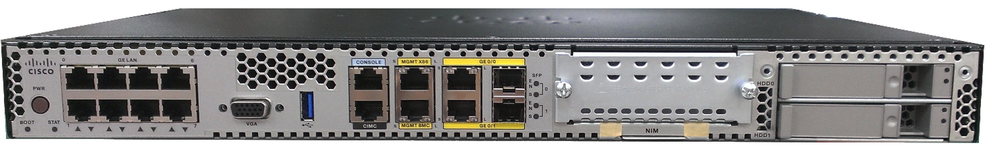
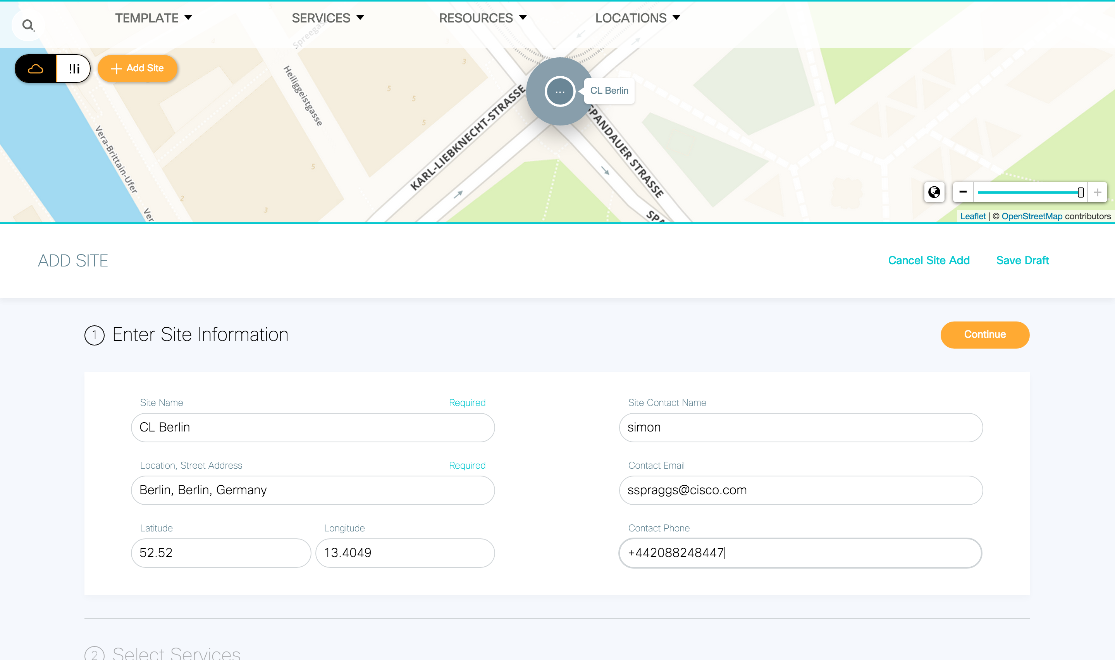
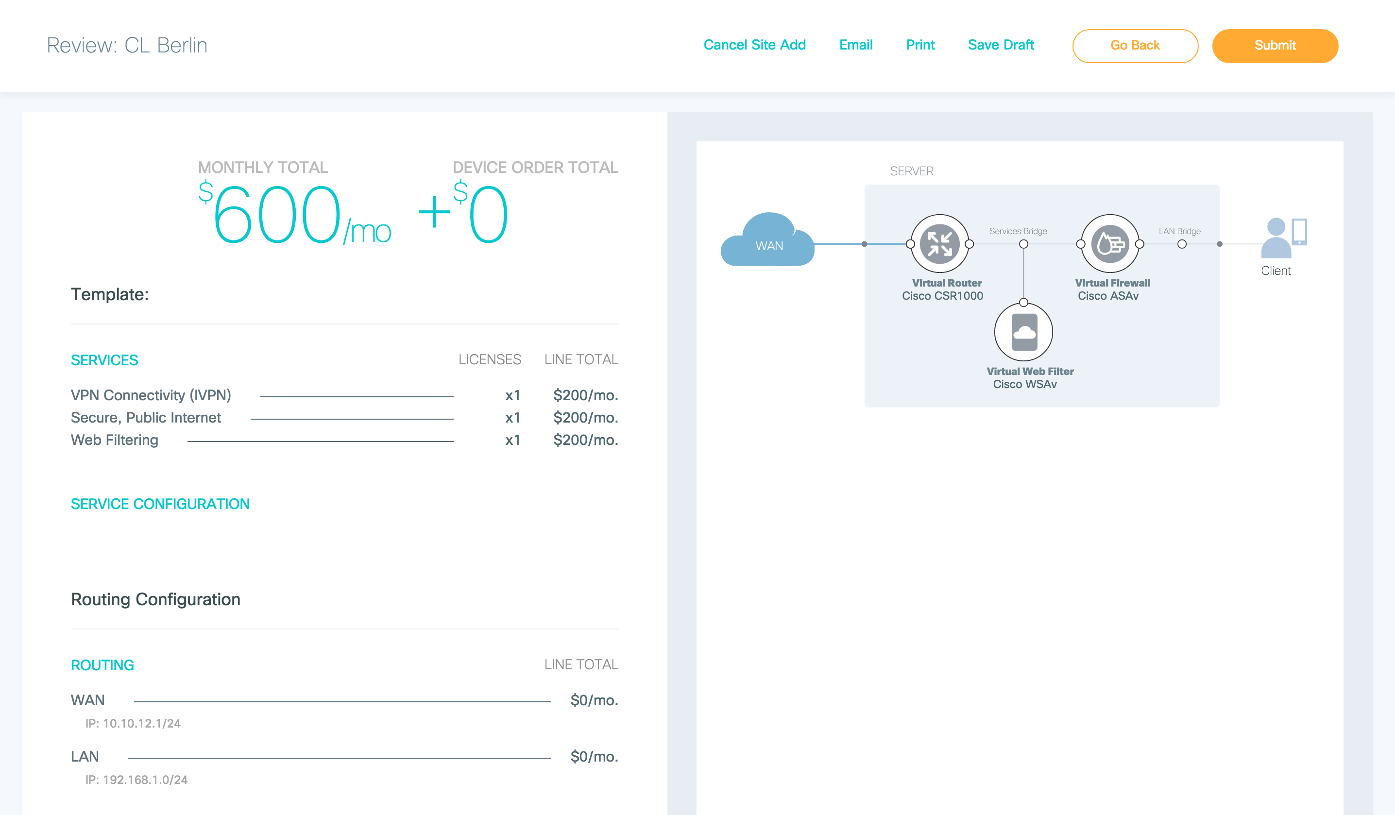
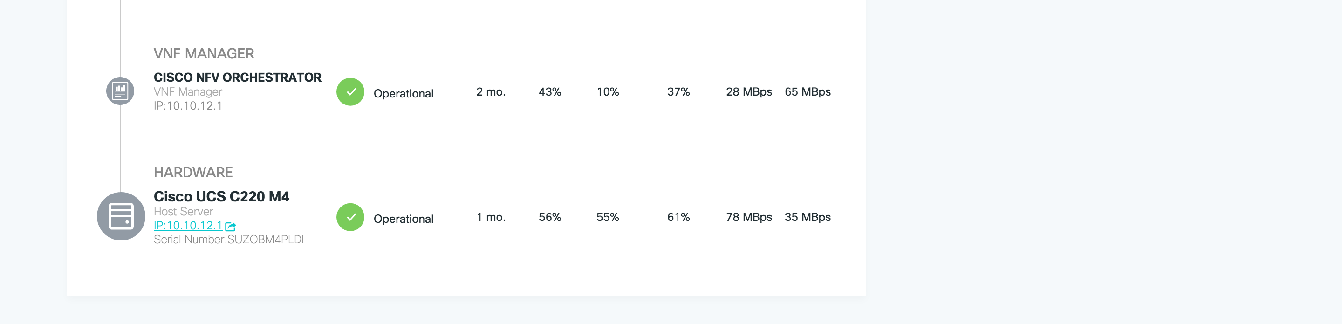
Creating a new branch template
SP can customize to create
new branch services within
basic overall flow
Branch Template
selection
Service chains, VNFs and services
Deployment and site status
User inputs
NSO
Site Details
Order overview
And confirmation

Slide 30
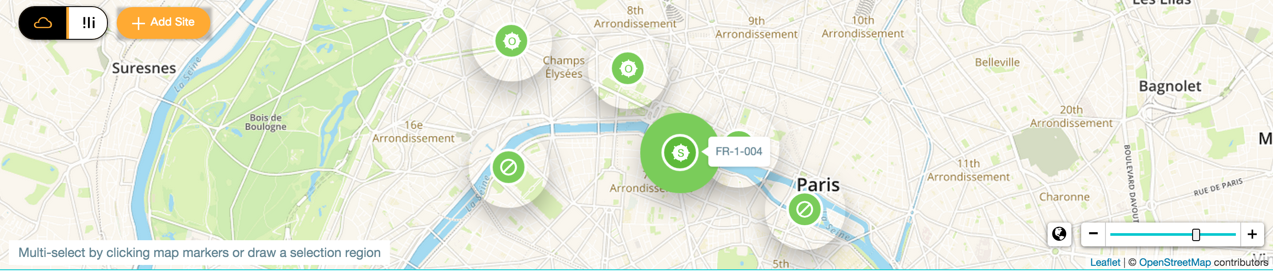
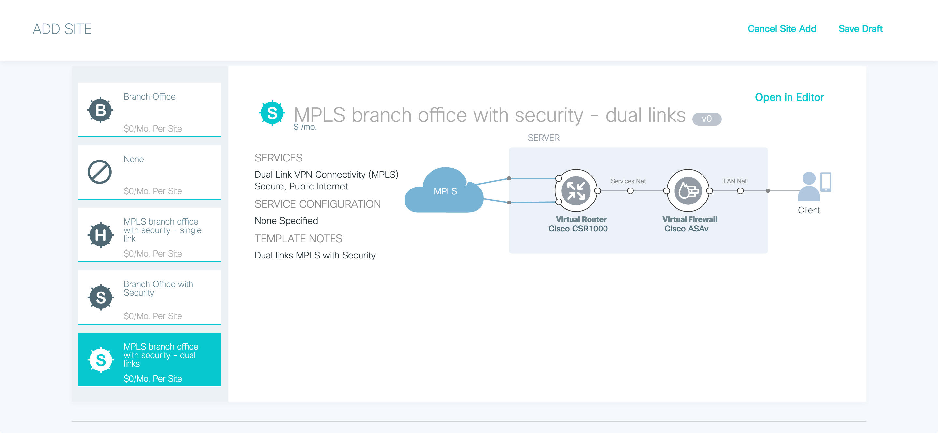
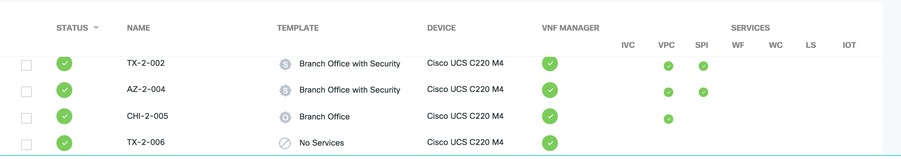
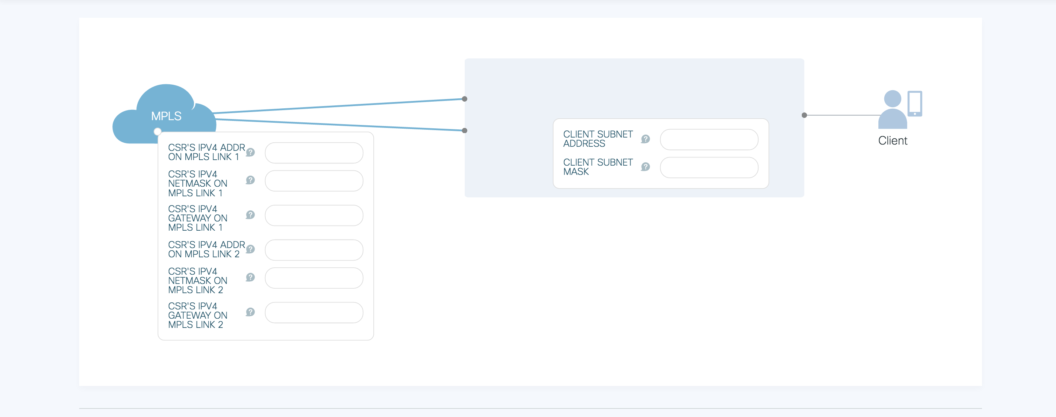
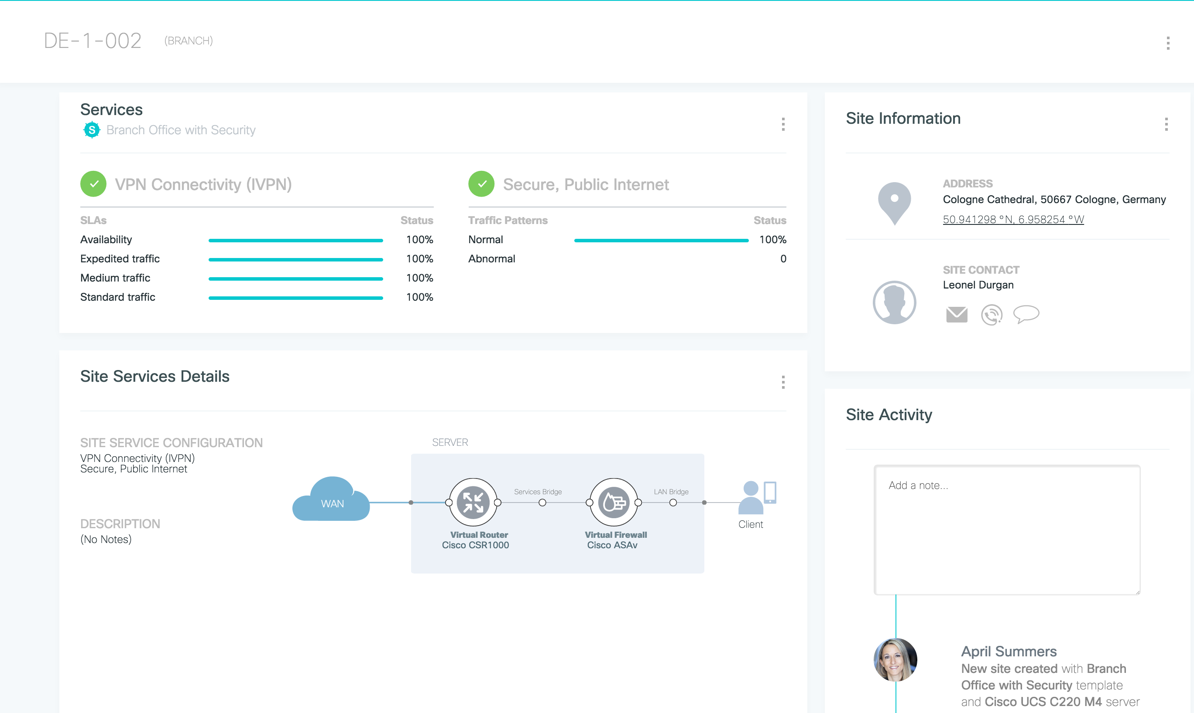
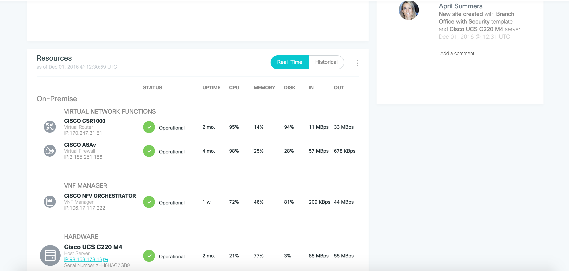
What is a branch template
User Interface
Custom picture, description
Physical – day 1 configs
Virtual – VNFs, day 1 configs
Used when adding a site
Used when editing a service
Site icons in map view
Custom inputs / metadata needed to build site / service
Services in list view
Feed through to NSO, NFVIS, VNFs
NSO
Information in templates impact many aspects of UX
NFVIS
VNF
VNF
Picture, VNFs, KPIs in site drill down view

Slide 31
Summary of SD-WAN options for the Service Provider

Slide 32
Comparing Service Delivery for Cisco SP SD-WAN Solutions
 | VMS (includes NSO) | Meraki
Network Orchestration | ✔ | ✔
SDK for Service Development | ✔ (will extend to UX/UI) | ✔
Call-Home Provisioning | ✔ | ✔
Service Model | ✔
Service Integration APIs | ✔*
Billing Notifications | ✔*
Service Correlation | ✔ | ✔
IDM Integration | ✔* | ✔
End-user Portal | ✔ (limited customizability) | ✔
Service Stats and Health | ✔ (prescribed, custom enhancements possible) | ✔
Service Data Storage | ✔ | ✔
Administrator/Operator Portal | ✔ (limited customizability) | ✔
Multivendor | ✔
Cloud Managed |  | ✔
− Requires custom development and integration
* Requires custom integration

Slide 33
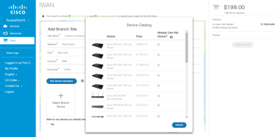
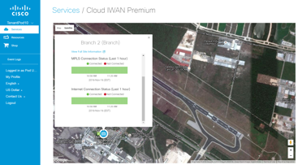
Key Capabilities of Cisco’s Cloud Managed SD-WAN
Both VMS and Meraki
Automated end-to-end SD-WAN Services managed from the Service Provider Cloud
Secure multi-tenant Cloud Managed platform,
simplified orchestration and tenant self-service
VMS SD-WAN with Zero Touch Provisioning (PnP) and validated IWAN Service Packs (NSO)
Rapidly create new monetized services, modify existing services instantly from Cloud
Perfect for distributed customers looking for
lower cost and self-managed SD-WAN options

Slide 34
Demo

