Slide 1
Application Centric Infrastructure
Review and Update
Phil Lowden (plowden@cisco.com)
Consulting Systems Engineer
June 20, 2017

Slide 2
Agenda
Review of ACI
Nexus Cloud Scale Portfolio
Analytics and Automation
VMware Partnership
Forthcoming Innovations
Wrap Up

Slide 3

















































Application Centric Infrastructure
Strong Momentum in the Marketplace
12,000+
3,500+
65+
$3B
Nexus 9K
Customers Globally
ACI
Customers
Ecosystem Partners
Business
Run Rate
ECOSYSTEM PARTNERS

Slide 4
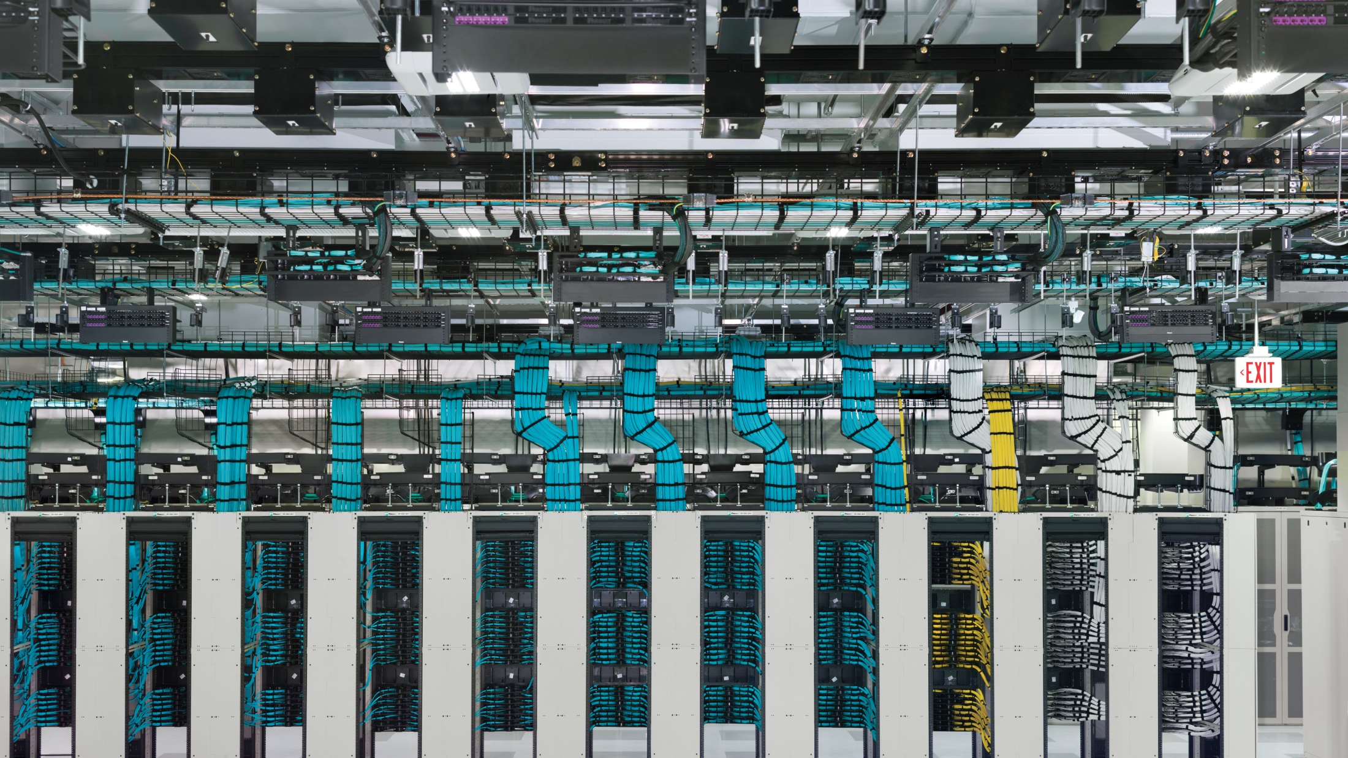
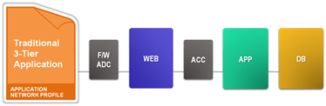
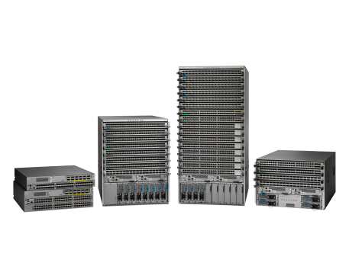
App Agility
Simplification / Abstraction
ACI
Centralized Provisioning and Visibility
Automation and Programmability

Slide 5

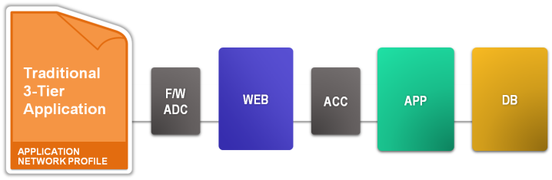
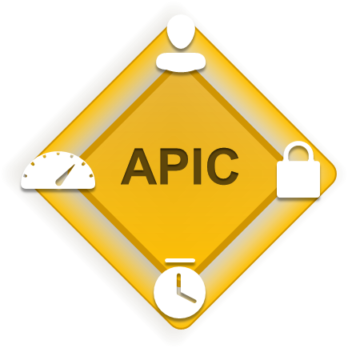
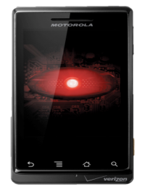
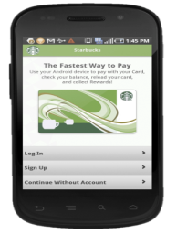
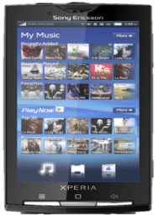

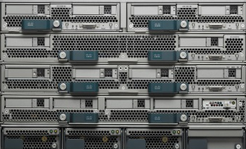
SIM Cards and Application Profiles
SIM Card
Identity for a Phone
Service Profile
Identity for Compute
Application Profile
Identity for the Network
Service Profile
Network Policy
Storage Policy
Compute Policy

Slide 6




Our Vision for ACI: Scale, Security and Full Visibility
Tenant
Application
Health Score
Health Score
78%
96%
Latency
Latency
5 Microsecond(s)
2 Microsecond(s)
Drop Count
Drop Count
25 Packets Dropped
0 Packets Dropped
Visibility
Visibility
16 VMs
Application Delivery
Controller
16 VMs
Application Delivery
Controller
8 Physical
Firewall
8 Physical
Firewall
Physical Networking
Hypervisors
and Virtual Networking
Compute
L4–L7
Services
Storage
Multi DC
WAN and Cloud
    Enabled By Physical and Virtual Integration

Slide 7
Nexus Cloud Scale Portfolio

Slide 8
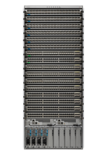




Nexus 9000 Cloud Scale
Fabric Foundation with 2 Year Innovation Advantage
Innovations
64p 100G line rate routing in single chip
Integrated line rate flow capture
Streaming analytics export off chip
Integrated line rate encryption
Resilient Asymmetric Load Balancing
Multi-speed ports
Unified ports—10/25GbE and 8/16/32G FC
Nexus 9500
X9700 EX/FX
Nexus 9300
EX/FX
Nexus 9000 Cloud Scale
Notes:
From Chuck / earnings announcement:
In our Next Generation Data Center Portfolio, our ACI data center switching portfolio revenue grew by 28 percent. We are seeing strong momentum, with customers choosing Cisco for the breadth of our private and hybrid cloud solutions. We are also the only company in the world to offer end-to-end visibility and security for 100G network build-outs.
Most comprehensive switching portfolio on the market
Fast, Intelligent, secure and cost effective
Whether deploy programmable fabric, DevOps model or turn key solution with ACI.
Highlight:
64p 100G line rate routing in a single chip
Streaming analytics export off chip
Integrated line rate encryption

Slide 9
Nexus 9000
The Most Comprehensive Switching Portfolio on the Market
High Speed Fabrics (ACI, VXLAN, Segment Routing, GRID, HPC)
Visibility and telemetry at line rate
Encryption at line rate
Fastest available: 10/25/50/100G
The right price point/ 50% lower system cost
Multi-speed—upgrade when needed/ minimize disruption
Dynamic Fabric Performance Optimization for Cloud Applications
Better reliability
Nexus 9500
X9700 EX/FX
Nexus 9300
EX/FX
Nexus 9000 Cloud Scale

Slide 10
EX And FX Series Cloud Scale Switches
FX Cloud Scale Enhancement
Line Rate Encryption (MACSEC)
Unified Ports (25GbE & 32G FC)
25G Reed Solomon Forward
Error Correction
Nexus 9500
X9700 EX/FX
Nexus 9300
EX/FX
EX Cloud Scale
ACI & NX-OS
10/25/40/100G
Tetration Hardware Sensor
Support for N2000 (FEX)

Slide 11
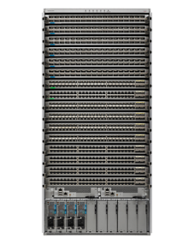

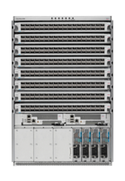

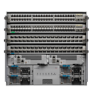






Cisco Nexus 9000 Platform Switches
Density in DC Optimized Footprint
Cisco Nexus® 9500
Cisco Nexus® 9300
16-Slot
25G
48p 10/25G SFP + 6p 40/100G QSFP
Nexus 93180YC-EX
Nexus 93180YC-FX
8-Slot
Q3CY17
10GT
48p 1/10GT + 6p 40/100G QSFP
Nexus 93108TC-EX
Nexus 93108TC-FX
4-Slot
7 RU
7 RU
21 RU
Q3CY17
100M/ 1GT
48p 100M/1GT + 4p 10/25G SFP + 2p 40/100G QSFP
Nexus 9348GC-FXP
Nexus 9508
Nexus 9516
Q3CY17
Nexus 9504
Q3CY17
32p QSFP
32p 40/50G | 24p 40G + 6p 100G
28p 40G + 4p 100G | 18p 100G
Nexus 93180LC-EX
40/50G
48p 10/25G &
4p 40/100G
32p 40/100G
32p 40/100G
36p 40/100G
MACSEC
Q3CY17
64p QSFP
64p 40/100G
Nexus 9364C
X97160YC-EX
X9732C-EX
X9736C-EX*
100G
X9736C-FX
* NX-OS Only

Slide 12

Nexus 9364C 64p 40/100G
Aggregation and ACI Spine
Q3’CY17
100G line rate MACSEC and VTEP-VTEP overlay encryption on 16 ports*
40 MB buffer w/ smart buffer feature
Flexible TCAM templates
1M+ IPv4 routes
VXLAN Routing
Ideal for space constrained fabrics
Support for mixed 1st & 2nd gen ACI leaf designs
Support for mixed 40/100G fabrics speed designs
QSFP28 Connector, Pin compatible with 40G QSFP+
Flexible Speed 64 ports with 1,10,25,40,50,100G
6.4 T full feature L2/3 ASIC
Supported in ACI (Spine mode only!) and NX-OS mode
Note: Roadmap, 16 ports of MACSEC is supported
* future

Slide 13
Analytics and Automation

Slide 14
Why Cloud Scale Silicon?
Innovations
  Tetration Analytics hardware sensors – Flow Table
  “Smart Buffers” – Data Plane Policy + Approximate Fair Drop (“elephant trap”)
  Visibility / Troubleshooting / Embedded Logic Analyzer Module (ELAM)
  Streaming Statistics Telemetry (SSX)
  Encryption
Tight integration between hardware / software / legacy support
  Closely aligns hardware designs with strategic software innovations/directions
  Not burdened by 3rd-party SDK limitations
  No concerns around sharing intellectual property

Slide 15
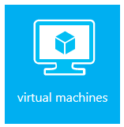

Tetration: Real-Time Analytics
Long-term Forensics and Auditing
Application
Dependency Mapping
Automated Whitelist Policy Generation
Real-time analytics:
<= 10 Minute Actionable Insight
Policy Compliance and Auditability
Policy Simulation and Impact Assessment
NX-OS
Pervasive Sensors: Network and Host
Forensics (example: flow search and flow anomaly)

Slide 16
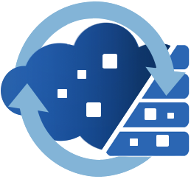
Automate the Migration to ACI or Cloud Center (CliQr)
10101101
01010011
10101010
10001011
App Policy
Tetration
App Level Policy Enforcement / Visibility
Real Time
Self-documenting Network
Data
Network
Policy
Real-time Change Notification

Slide 17
Upgrading QSFP Optics from 40G to 100G
Direct-attach copper
Multimode Fiber
Single-Mode Fiber
Connector/ Fiber | Reach | 40G PID | Price (US List) |  | 100G PID
QSFP cable | 3m | QSFP-H40G-CU3M | $250 | $325 | QSFP-100G-CU3M
MPO-12, 8 Fiber | <100m MMF | QSFP-40G-SR4-S | $1,690 | $1,995 | QSFP-100G-SR4-S
MPO-12, 8 Fiber | < 500m SMF | QSFP-4X10G-LR-S | $5,995 | $1,995 | QSFP-100G-PSM4-S
Duplex, 2 Fiber | < 100m MMF | QSFP-40G-SR-BD | $1,095 | TBD | TBD (mid CY17)
Duplex, 2 Fiber | < 500m SMF | WSP-40GLR4L | $5,995 | <$4,500 | QSFP-100G-SM-SR
Attractively priced 100G optics/ cabling

Slide 18
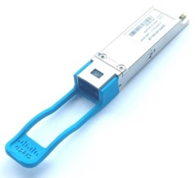

Single-mode fiber for short-reach 100G links
 | Cisco QSFP-100G-SR4-S | Cisco QSFP-100G-PSM4-S
Price | $1,995 | $1,995
Fiber type | Multimode | Single-Mode
Connector type | MPO-12 | MPO-12
100G links support | Yes | Yes
4x25G breakout support | Yes | Yes
Reach | 100m | 500m
Same price for single-mode and multimode short-reach optics!

Slide 19
VMware Partnership

Slide 20
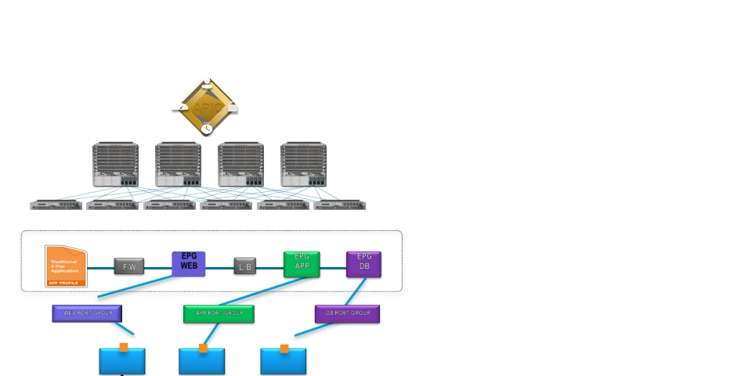
Hypervisor Integration with ACI
▪ Relationship is formed between APIC and
Virtual Machine Manager (VMM)
▪ ACI Fabric implements policy on Virtual
Networks by mapping Endpoints to EPGs
▪ Endpoints in a Virtualized environment are
represented as the vNICs
▪ VMM applies network configuration by placing
vNICs into:
APIC
Application Network Profile
EPG
WEB
EPG
APP
EPG
DB
▪ Port Groups (VMWare),
F/W
L/B
▪ VM Networks (Hyper-V)
WEB PORT GROUP
APP PORT GROUP
DB PORT GROUP
▪ Networks (OpenStack)
▪ EPGs are exposed to the VMM as a 1:1
mapping to Port Groups, VM Networks or
OpenStack Networking.
VM
VM
VM
27

Slide 21
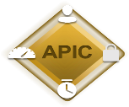



Application Virtual Switch with OpFlex in ACI Fabric
AVS virtual switch implements OpFlex protocol
Network policy communicated from APIC to AVS through N9K using OpFlex
Increased control plane scale through APIC cluster and leaf node
APIC communicates with vCenter server for port group creation
Hypervisor Manager
vCenter
OpFlex
OpFlex
OpFlex
OpFlex
VM
VM
VM
VM
VM
VM
VM
VM
AVS
AVS

Slide 22
Forthcoming Innovations

Slide 23
Terminology
Pod: a Leaf-Spine network sharing common control plane (ISIS, COOP, MP-BGP, …)
    Pod == Availability Zone
Fabric: scope of an APIC Cluster, can be one or more connected Pods
    Fabric == Region
Multi-Pod: single APIC Cluster with multiple leaf spine networks
    Multi-Pod == Multiple Availability Zones within a Single Region (Fabric)
Multi-Site: multiple APIC Clusters (Fabrics) + associated Pods
    Multi-Pod and Multi-Site can be complementary designs

Slide 24






Interconnecting ACI Networks
Deployment Options
Single APIC Cluster/Single Fabric | Multiple APIC Clusters/Multiple Fabrics
Stretched Fabric
Multi-Fabric (with L2 and L3 DCI)
ACI Fabric
ACI Fabric 1
ACI Fabric 2
DC1
APIC Cluster
DC2
L2/L3 DCI
Multi-Pod (from 2.0 release)
Multi-Site (Q3CY17)
Pod ‘A’
L3
Site ‘A’
L3
Site ‘n’
Pod ‘n’
MP-BGP - EVPN
…
MP-BGP - EVPN
APIC Cluster
Multi-Site
Controller

Slide 25
Wrap Up

Slide 26
Review of ACI – Here to stay
Nexus Cloud Scale Portfolio - Architected for the future
Analytics and Automation - Tetration
VMware Partnership – Cisco stands behind our customers
Forthcoming Innovations – scaling and DC interconnect

