Slide 1
Orchestrated Assurance-What is it and why do I need it??
John Malzahn – Host, Senior Manager, Cloud and Virtualization Solutions Marketing, Cisco Systems
Carl Moberg – Technical Director, Cisco Systems
Dr. Stefan Vallin, Director of Product Strategy, Netrounds
May 3, 2017

Slide 2



Today’s Presenters
John Malzahn
Senior Manager, Cloud and Virtualization Solutions Marketing,
Cisco Systems
Carl Moberg
Technology Director, Cloud and Virtualization Group,
Cisco Systems
Dr. Stefan Vallin, Director of Product Strategy
Netrounds

Slide 3
Agenda
1
Architecture for Lifecycle Service Automation
2
Cisco’s NSO Solution and Value Proposition
3
Automated Verification of Service Quality with Netrounds and Cisco

Slide 4
Cisco NSO – Our Industry Leading Automation & Orchestration Platform

Slide 5




Key Market Trend Observations
Changing customer behavior and new expectations
Execution at the speed of software
Rapidly changing business models
Agility, DevOps, NFV, SDN, new services platforms
Everything on demand
New services with a press
of a button
Cloud services, virtualization, programmable networks
New ecosystems and
value chains
OTT Co-opetition
All of this requires successful, flexible automation.
But complexity has destroyed many automation initiatives.
Notes:
Let’s set the stage by talking about the business challenges that operators tell us they’re facing today.
First, we’re seeing changing customer behavior and expectations.
More than ever, customers expect speed. They want to be able to capitalize on new opportunities and enter new markets much faster, responding to changes and competition in real time. All of that comes down to agility, and they’re counting on service providers to help give it to them.
When a customer has a need, they can’t wait weeks or months anymore for an operator to design and deploy a new service for them. They need everything on demand, and the ability to implement new network services with the press of a button.
Along these lines, operators are dealing with rapidly changing business models.
New technology innovations like virtualization, programmable networks, and cloud services are changing the way customers do business, as well as their expectations about how they interact with the companies providing services.
New ecosystems and value chains have evolved in the last few years, and if operators are going to support their customers, they need to be able to participate in them.
In this dynamic environment, you may be competing against some of these “over-the-top” (OTT) service and content providers one day while partnering with them the next.
So on the one hand, you need to develop some of the same kinds of capabilities that OTT providers can deliver. On the other hand, you need an infrastructure that’s open and flexible enough to integrate these capabilities into your customers’ evolving business models.
All of this supports a central requirement: the ability to execute at the speed of software.
A good example is the emerging DevOps model that many businesses are adopting, where developers and network operations teams work closely together across the service lifecycle to take ideas from conception to activation in a few weeks --- or even a few days.
That’s the kind of agility customers want, and they’re looking to a range of new technology innovations—network programmability, NFV, SDN, and others—to achieve it.
But as you know, programmability and NFV—not to mention new DevOps models—are very different from the way network service delivery has happened in the past.
It all comes down to automation.
Ideally, you should be able to use programmable networks and virtualized resources to deliver much faster, on-demand services.
But to do that, everything has to be automated—you can’t rely on lengthy, error-prone manual processes and custom OSS coding efforts to set up, change, and tear down network services.
Automation is not a new goal. But the incredible complexity of today’s environments presents a major roadblock to achieving it.
If you look through the stories of operators and enterprises that have tried to automate and not gotten the results they were hoping for, complexity is the biggest reason.

Slide 6
The Four Pillars of Orchestration
1
2
Orchestration Across Multiple Domains
State
Convergence
3
4
Data Models and Data Model Mapping
Orchestrated Assurance
Foundation for Full Lifecycle Service Automation
Notes:
Third part of four in our “four pillars of orchestration” series.
Last one was one in July on stateful convergence – covering how we need to move from
Complex service interdependencies and hard-coding to
Declarative and automated, repeatable, reliable orchestration
All built on a whitepaper “Architecture for Lifecycle Service Automation:”, comprehensive at 23 pages
Lays out cisco’s vision for automation and orchestration in the evolved programmable network using the NSO software from the Tail-f acquisition
Available on cisco.com
Today, we’re talking about how the rapidly evolving role of service orchestration drives fundamental change in assurance.
This is a seismic shift, and we argue that the current technologies and best practices around assurance will need to be rethought ground-up.

Slide 7
NSO System Overview
Model-driven end-to-end service lifecycle and customer experience in focus
Seamless integration with existing and future OSS/BSS environment
Loosely-coupled and modular architecture leveraging open APIs and standard protocols
Orchestration across multi-domain and multi-layer for centralized policy and services across entire network
Operations
OSS/BSS
Developers
NSO
Service Manager
Package
Manager
CDB
Device Manager
Device Abstraction
ESC (VNFM)
NED
NED
NED
VNF Lifecycle Manager
VNF Service Monitoring
Multi-domain Networks

Slide 8




What You Gain with Cisco Automation
Agility throughout service lifecycle
Full automation
Robust and proven in tier-1 deployments
Industry’s broadest multivendor support
Most scalable service orchestration
ETSI MANO compliant NFVO, VNFM
Relevant in today’s and tomorrow’s networks
Notes:
Let’s review what you gain with Cisco NSO enabled by Tail-f.
First, I hope I’ve demonstrated the kind of agility you can achieve with this solution. That agility extends across the service lifecycle—not just when you implement a service, but when you refine it over its lifetime as well.
We do this through our model-driven approach, with strict YANG-YANG service-to-device mapping, which allows you to model and automate just about any device or service you can imagine.
This is something you’re not going to get with other orchestration solutions, which are based on much less flexible CLI templates that limit what you can model and create a lot of complexity.
Our patented FASTMAP technology enables NSO to render business logic for all of the devices and services in your environment automatically. Which translates to greatly increased speed, and 90% less code that you have to manage.
And our minimum diff engine makes re-deploying and updating service and device models effortless, with no service interruption.
We can support new ways of working, and provide an ideal platform for DevOps environments.
From the perspective of your network operations teams, we give them access to all of the advanced features and functions in their multivendor network devices.
Unlike today, where it’s common to invest in a new physical or virtual device, only to find that you can’t implement all the features you want because your management and orchestration systems are hard-coded and inflexible.
And this has a direct effect on your ability to differentiate, because it means you can offer the most advanced capabilities, as well as create unique bundles with value-added services that your competitors relying on less advanced orchestration can’t support.
We’ve talked about how we can deliver true end-to-end automation, even in complex environments and for complex services.
This is what allows you to give your customers self-service network provisioning on demand.
And it’s what brings your cycle times down from weeks or months to days or minutes.
We discussed how NSO is a robust, proven solution that’s running today in large, Tier-1 operator environments around the world.
And I showed you how we provide the broadest multivendor support in industry, which is so crucial to your ability to automate network services in real-world networks.
Last but not least, NSO is equally relevant in today’s operator environments as well as tomorrow’s.
We can automate the programmable networks of today, and deliver significant improvements in speed, efficiency, and agility.
But we can bring the same benefits to the virtualized and elastic environments of the future as well.
This is so important, because the last thing you want to do is build a silo of new equipment and OSSs on top of an isolated legacy environment.
NSO can help you dramatically improve your agility with your legacy environment right now, and integrate newer NFV and SDN technologies whenever you choose.

Slide 9
Automated Verification of Service Quality with Netrounds and Cisco NSO
Cisco Orchestrated Assurance powered by Netrounds

Slide 10
Orchestrated Assurance
Recap
Cisco Orchestrated Assurance powered by Netrounds

Slide 11

Service Assurance Challenges
Fulfillment and
Assurance disconnected
Sub-optimal activation testing
DO NOTHING
SIMPLE PING
FIELD EFFORTS
$$$
Fear the Great Mapping Machine!
Limited insight of true end-user experience
$$$

Slide 12
Poll Question

Slide 13
Orchestrated Assurance to the Rescue
Fulfillment and
Assurance disconnected
Sub-optimal activation testing
DO NOTHING
SIMPLE PING
FIELD EFFORTS
Orchestrate Assurance
Automated Activation Tests
$$$
Fear the Great Mapping Machine!
Limited insight of true end-user experience
Measure Service Quality with Active Methods
$$$

Slide 14
Which Assurance to be Orchestrated?
Fulfillment and
Assurance disconnected
Sub-optimal activation testing
Orchestrate Assurance
DO NOTHING
SIMPLE PING
FIELD EFFORTS
Automated Activation Tests
$$$
Fear the Great Mapping Machine!
Limited insight of true end-user experience
Measure Service Quality with Active Methods
$$$

Slide 15
I Need a Vehicle, I Have a Vehicle…
What is going to be transported?
Yes, it is blue!

Slide 16
I Need Assurance, I Have Assurance
I just configured a new service – does it work?
Which question needs an answer?
How do I constantly monitor metrics like QoS class performance?
Which devices are faulty?
Which services might be affected?
Where do I have over-utilization?
Active Testing
Classical Assurance
Yes, it can do graphs, reports and alarms!

Slide 17
Poll Question

Slide 18
I Need Assurance, I Have Assurance
I just configured a new service – does it work?
Which question needs an answer?
How do I constantly monitor metrics like QoS class performance?
Which devices are faulty?
Which services might be affected?
Where do I have over-utilization?
This is Netrounds
Fault
Management
(FM)
Service
Impact
(SI)
Performance
Management
(PM)
Active Testing
Classical Assurance
Yes, it can do graphs, reports and alarms!

Slide 19
How to Test and Monitor?
Fulfillment and
Assurance disconnected
Sub-optimal activation testing
Orchestrate Assurance
DO NOTHING
SIMPLE PING
FIELD EFFORTS
Automated Activation Tests
$$$
Fear the Great Mapping Machine!
Limited insight of true end-user experience
Measure Service Quality with Active Methods
$$$

Slide 20
The Missing Piece
Perform activation tests
Test service changes
Monitor from customers’ point of view in real-time
Troubleshoot using automated test sequences
Key requirements
Software-based
Programmable
Multi-layer and multi-domain
Active Testing
Efficient
Operations
Find out the mix of protocols and services
Understand signaling and stateful behavior
Input to traffic throttling
Collecting counters
events, and logs
Passive Probing
Find out if something is broken
Long-term trending
For efficient network operations, all the above have to be combined

Slide 21
Netrounds Active Testing Solution
1. Netrounds Control Center
Multi-Layer
Cisco
NSO
NETCONF/YANG
Programmable API
Web GUI
Management
Smart SFP
Management
Router/Switch
TWAMP / Y.1731
Active Traffic
Active Traffic
eNodeB
Software
Reflectors
2. Netrounds Active Test Agents

Slide 22
Solution Overview
Cisco Orchestrated Assurance powered by Netrounds

Slide 23








NSO Role
Transform a Service Order into:
Resource allocations
NFV life-cycle actions
Device/VNF configurations
Validate from a configuration perspective
Service Order
Service Manager
Device Manager
Network Equipment Drivers (NEDs)
CPE
Metro and Access
WAN
Data Center

Slide 24
Add Orchestrated Assurance from Netrounds
Service Test &
Monitor
Service Order
Service Manager
Device Manager
Test the data plane
Constantly monitor the data plane
Troubleshoot the service
Netrounds
Control
Center
Network Equipment Drivers (NEDs)
CPE
Metro and Access
WAN
Data Center
Netrounds
Test Agent

Slide 25

Designing a Service for Orchestrated Assurance
NSO
Orchestrated Assurance
Configuration
NFV Templates
(Descriptors)
Test
Templates
Monitoring
Templates
Defined in Netrounds,
Triggered from NSO
Optional to deploy Virtual Test Agents (vTAs)

Slide 26
NSO and Netrounds Playing Together
Service order request
Execute Activation Test
- Template reference
Test Templates
Cisco
NSO
Start Monitoring
- Template reference
Monitoring Templates
Netrounds Control Center
Provision Service and Test Infrastructure
Reflector configuration
Virtual Test Agent deployment

Slide 27
Demo Time!
(Supporting presentation material with screen shots)

Slide 28
NSO Assuring the Service

Slide 29

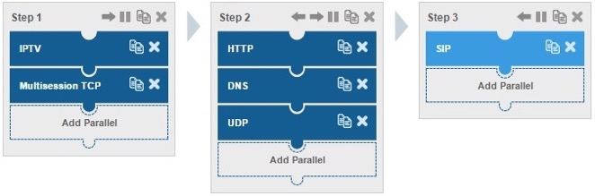
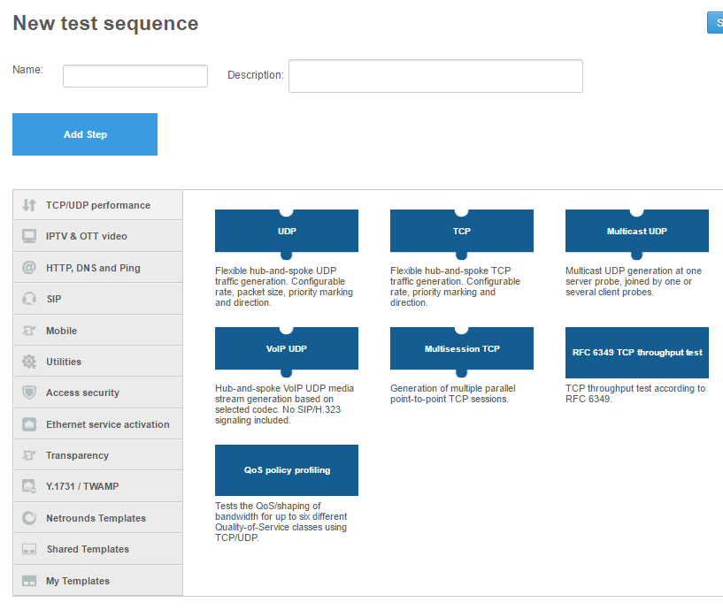
Defining an Activation Test Template
Parallel and sequential steps
Mix of concurrent traffic types and service requests
An activation test is intrusive
Runs for a defined period of time
Test before users are on-boarded
Will customers be happy?
Drag and Drop

Slide 30

Test Types
Network performance
TCP
  Single session, multisession
  RFC 6349 (TCP throughput test)
UDP
  Unicast, multicast
  VoIP UDP with voice quality
QoS policy profiling (TCP + UDP)
IPTV and OTT video
IPTV MPEG
IPTV MPEG inline
IGMP channel zapping time
Cable-TV MPEG
HTTP Live Streaming (HLS)
SIP
VoIP with voice quality
Internet performance
HTTP
DNS
ICMP Ping
Ethernet service activation
CIR validation
EIR configuration test
Traffic policing test
Protocol Transparency (mostly Layer 2)
Y.1731 and TWAMP
ETH-LB, ETH-DM, ETH-SLM
TWAMP and TWAMP Light

Slide 31

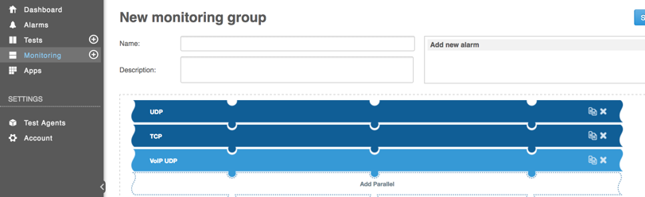
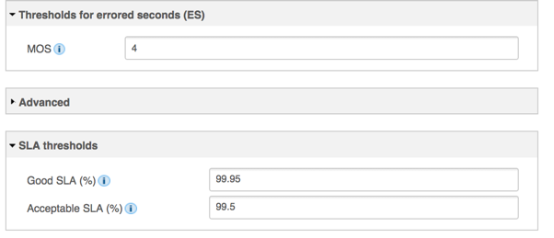
Defining a Monitoring Template
Similar concept as building test templates
Runs continuously
Mix of concurrent traffic types and service requests
Virtually non-intrusive
SLA threshold configuration
Is the customer happy?

Slide 32
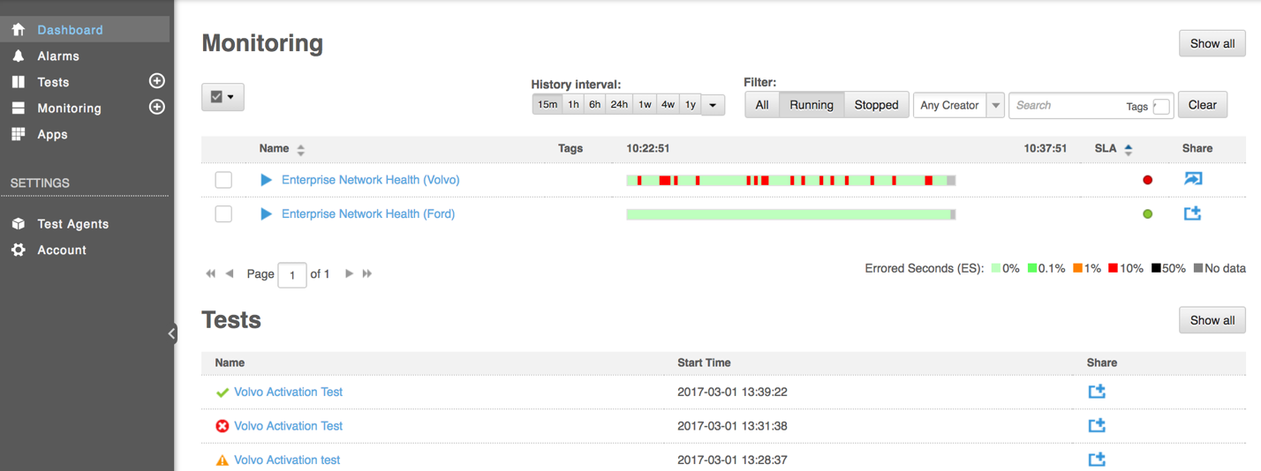
Getting the Full Picture

Slide 33
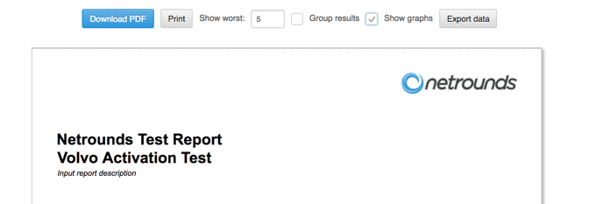
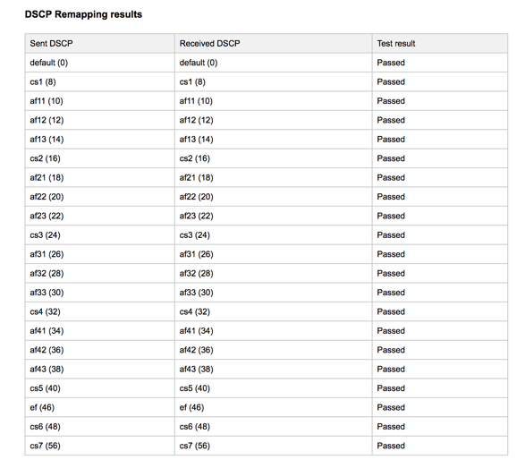
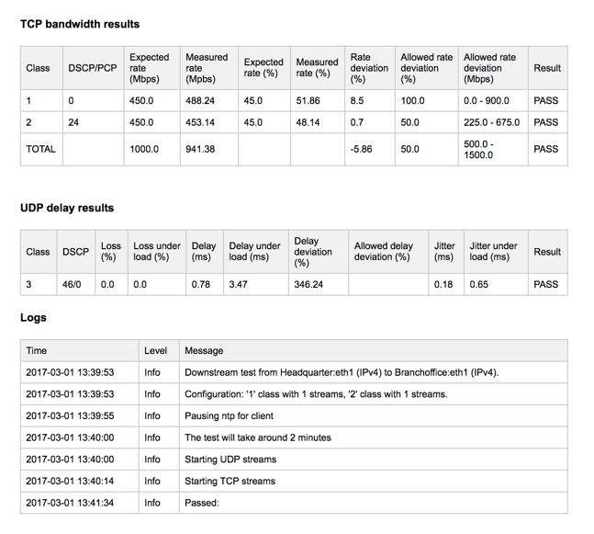
The Activation Test Report

Slide 34
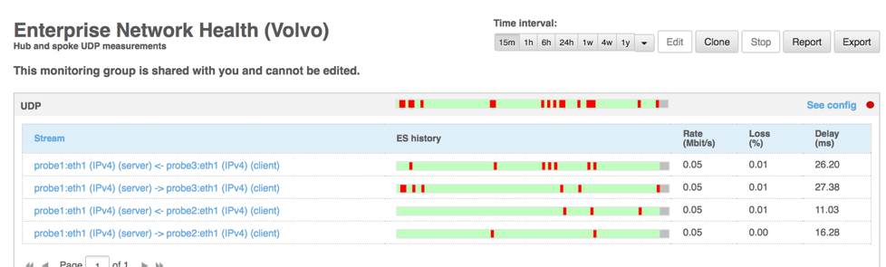
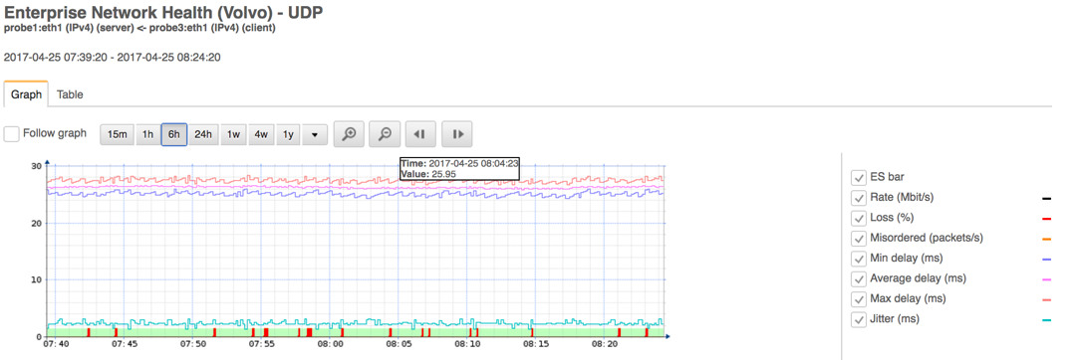
Service SLA and KPI Drill Down
Branch Offices
KPIs

Slide 35
Deployment Options

Slide 36

Start Easily Today
Central Test Head to initiate test sessions
Netrounds
Test Agent
Standards-based reflection (OAM) supported in Cisco equipment and other networking devices
CPE
CPE
Speedtest from browser
Internet services
Customer traffic
Active test traffic
TCP Speedtest over HTML5

Slide 37
Validating Service Chains
VNFs in Data Center
Active traffic using TWAMP
vTA VNF
VNF1
VNF2
VNFx
vTA VNF
Agent-to-Agent Active
Bi-directional L2-L7 Traffic
V
V
Customer traffic
Cisco CPE
(800/1900)
Cisco CPE
(800/1900)
MPLS
Internet services

Slide 38
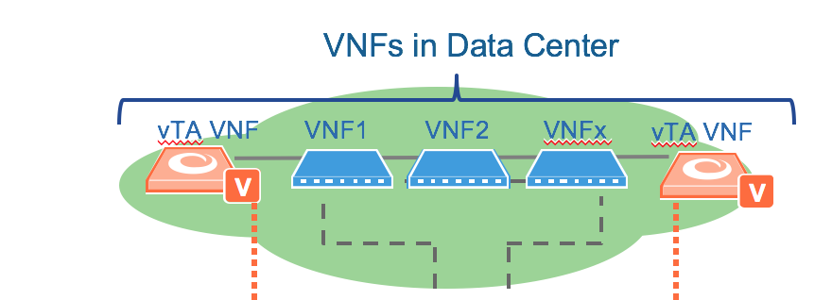
The NSO NSD

Slide 39
Advanced End-to-end Tests with Test Agents
Netrounds Test Agent
Cisco CPE
(800/1900)
Netrounds Test Agent
Cisco CPE
(800/1900)
MPLS
Internet services
Customer traffic
Agent-to-Agent Active
Bi-directional L2-L7 Traffic

Slide 40
Summary

Slide 41
Service Assurance Challenges
Fulfillment and
Assurance disconnected
Sub-optimal activation testing
DO NOTHING
SIMPLE PING
FIELD EFFORTS
$$$
Fear the Great Mapping Machine!
Limited insight of true end-user experience
$$$

Slide 42
Conclusions
Test services end-to-end before onboarding customers
  Where is the birth certificate?
Monitor the services end-to-end with active traffic
  Real-time, end-customer perspective
Test the data plane
  Monitoring the resource counters and events alone is not sufficient
Orchestrate

Slide 43
For more information
Visit:
www.cisco.com/go/nso
www.netrounds.com/see-try/
and contact your Cisco and Netrounds account representatives
Notes:
Thank you for spending time with us today. We look forward to working with you in this fast growing market.
To learn more visit the Cisco and Netrounds sites below or contact your Microsoft and NIL representatives

