Slide 1
Cisco Virtual Topology System
Anant Shah, Sr. Technical Product Manager
May 2017

Slide 2

Agenda
Introduction to orchestration and virtualization
Flexible Overlays with VTS
VTS Key Features
VTS Demo
Cisco Differentiation
Questions?

Slide 3




Service Orchestration velocity hindered by manual network process
Service Orchestration
Compute Orchestration
Network Orchestration
Spine
Spine
Compute is completely Virtualized
Compute Request completed in Seconds
Network is partially Virtualized
Network Change Request completed in days/weeks
ToR
ToR
ToR
Manual Network Change Request
IP Configuration
Firewall Configuration
VLAN configuration
Hypervisor
Hypervisor
Hypervisor
Automated Compute Request
Virtualized Compute
Auto Instantiation
VM
VM
VM
VM
x86 Server
x86 Server
x86 Server
Application and Network Services migration towards virtualization & cloud create requirements for agile & automated networks
Notes:
Cloud enabled Modern day Datacenter
For an application environment or data center to be ready for cloud environment, data center infrastructure should support scale out architectures based on compute and network
The data center infrastructure that includes computes, network and storage should be virtualized and automated
CLOS fabric scales out based on compute and network, to cater to distributed nature of these applications.
Server Virtualization advancements over the last decade has not only helped to avoid high capex by reducing the server footprint in datacenters
but have also have helped to reduce OPEX by enabling automated provisioning of compute nodes in a matter of seconds.
But there are bottlenecks
The network that connects the physical and virtual nodes are not completely virtualized. It has to provisioned manually and it takes weeks/days to complete and are prone to human configuration errors.

Slide 4
Network Virtualization & Overlays
Network virtualization: ability to separate, abstract and decouple the physical topology from a ‘logical’ or ‘virtual’ topology. This logical topology is called overlay networks
MPBGP-EVPN &VXLAN based Overlays
SDN Based Overlays introduces agility and automation to Network Orchestration
Notes:
: Network overlays disassociates applications from physical topology, allowing a transition to cloud based multi-tenanted & scalable networks.

Slide 5
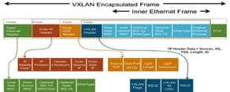

MPBGP-EVPN &VXLAN based Overlays
Overlay Forwarding Table
T1,S1 | MAC, IP Address | P1/2
T1,S2 | MAC, IP Address | VTEP2
T2,S3 | MAC, IP Address | VTEP3
T2,S4 | MAC, IP Address | VTEP4
EVPN
Layer-2 MAC and Layer-3 IP information distribution by Control-Plane (BGP)
VXLAN
Built in multi-tenancy (at scale)
IP routing – proven, stable, scalable
Integrated Routing/Bridging (IRB) for Optimized Forwarding
ECMP – utilize all available network paths
Minimize flooding through ARP suppression
Flexible placement of multitenant segments
Fast convergence upon network failures and host movements
Better utilization of network paths
Security through VTEP peer-authentication
Scalable network domain (16M VNI vs. 4K VLANs)
BGP-EVPN/VXLAN based overlays provides flexibility, manageability, isolation, multi-tenancy, scalability & convergence.
Notes:
Industry standard protocol for multi-vendor interoperability
Build-in multi-tenancy support
Leverage MP-BGP to deliver VXLAN with L3VPN characteristics
Truly scalable with protocol-driven learning
Host MAC/IP address advertisement through EVPN MP-BGP
Fast convergence upon host movements or network failures
MP-BGP protocol driven re-learning and convergence
Upon host movement, the new VTEP will send out a BGP update to advertise the new location of the host
Optimal traffic forwarding supporting host mobility
Anycast IP gateway for optimal forwarding for host generated traffic
No need for hair-pinning to to reach the IP gateway
ARP suppression
Minimize ARP flooding in overlay
Head-end Replication with dynamically learned remote-VTEP list
Head-end replication enables multicast-free underlay network
Dynamically learned remote-VTEP list minimizes the operational overhead of head-end replication
VTEP peer authentication via MP-BGP authentication
Added security to prevent rogue VTEPs or VTEP spoofing

Slide 6


The Realities of Data Center Operations
Operationalizing a New Workload in the Data Center
t=n
✔
Expectations are all of this happens in minutes or even seconds!
Automation Required!
Connect the Workload to the Tenant Network
Configure the TORs with VLAN. VXLAN, VRF
✔
Deploy Tenant Workload
Identify Server Resources, Instantiate Workload
✔
Establish a connectivity maps
Create VRF
✔
Create a Tenant Network
t=0
Allocate VLANS, VXLAN IDs

Slide 7
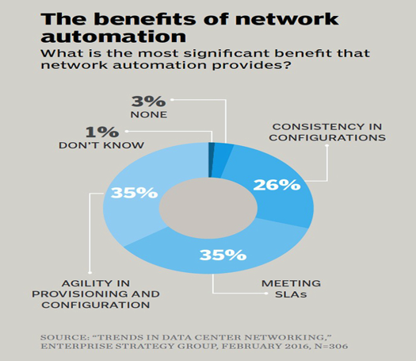
Benefits of Network Automation.

Slide 8


Service Orchestration & Network Overlays/SDN in the data center
Service Orchestration
SDN Controller for automation, programmability and NVE management
Compute Orchestration
Network Orchestration
Network Overlays based Network Virtualization provides flexibility, tenant isolation and allows for resources to be dynamically provisioned
Compute is completely Virtualized
Compute Request completed in Seconds
Network is completely Virtualized
Network Change Request completed in seconds
App
Zone1
Firewall
App
Zone2
App
Zone1
Firewall
App
Zone2
External Network
External Network
NX-API, CLI, YANG
Network
Segment A
Network
Segment B
Network
Segment C
Network
Segment A
Network
Segment B
Network
Segment C
Tenant A – Topology1
Tenant B - Topology 2
Automated Network Change Request
Policy based Configuration
Abstraction & Programmability
Virtualized L2/L3 networks
Automated Compute Request
Virtualized Compute
Auto Instantiation
SDN/Network Overlays provides end to end data center overlay automation orchestrating instant connectivity as applications are turned up or down
VTS

Slide 9
Flexible overlay with VTS

Slide 10

VTS : Realizing the Cloud Enabled Data Center
Flexible, on-demand EVPN/VXLAN based overlays with underlay awareness.
Abstracted & Virtualized
Network As A Service
Support Scale out architectures in terms of network and compute
Scalable
Fabric
Service Aware Overlay
Automation of fabric provisioning for physical and virtual workloads.
Deployment Flexibility, Visibility, management & Troubleshooting
Cisco Virtual Topology System
Policies
Declarative, transactional, granular policies
for instantiation of overlays &
secure connectivity
Orchestration
Scale & Automation Drives Business Success

Slide 11

Cisco Virtual Topology System (VTS)
Open Standards based Overlay Provisioning and Management System
Automated Overlay and Fabric Provisioning
Tighter Integration with Orchestrators
Plugin for openstack
Plugin for VMware
Future for Containers
Embedded Sunstone
Programmable Interfaces
Standard YANG SB Programming
NB REST API
  Simplified Management for Ease of Operations

Slide 12


VTS Architecture – Hardware VTEP
Hardware Switches
Border Leaf
&
DCI
(Integrated or
Separated)
Nexus 3000,9200/9300/5600/7x00 – ToR
DCI Router
DC POD
Virtual Topology
Controller
REST API
Border Leaf
Nexus 9300/9500/5000/7x00– Spine (RR)
NX-API, CLI, YANG
DC Fabric
(OSPF or BGP as the
Underlay Protocol)
ASR9000, Nexus 7x00– DCI
Spine
SPINE
Network Based
VTEPs
LEAF
VMware vCenter
OVS/DVS
OVS/DVS
SR-IOV
Bare Metal
Appliance
(Eg, Firewall)
Bare Metal
Application
Appliance VM
Appliance VM
Tenant VM
Tenant VM
Tenant VM
Tenant VM
Tenant VM
Tenant VM
Tenant VM
Host
Host
Host
Host
Physical Network Appliances

Slide 13

VTS Architecture – Software VTEP
Virtual Topology Forwarder
User space, multitenant, line-rate packet forwarder
Uses Vector Packet Processing technology
Fully integrated with Intel DPDK
Supports VXLAN, can be extended to support MPLSoGRE, L2TPv3, MPLSoUDP, native MPLS, and SR
Programmed by Cisco® VTS using Restconf/YANG
Multi-threaded and 64 bit clean.
Supports both IPv4 and IPv6
VTF
(VM)
Tenant
VM
Tenant
VM
VTF
Tenant
VM
Tenant
VM
ESXi
KVM
vSwitch
vSwitch
vSwitch
vhost-user
REST API
NX-API, CLI, YANG
NIC
NIC
VMware vCenter

Slide 14



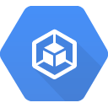
VTS Architecture
Multiple workload types and multiple orchestration systems
Border Leaf
&
DCI
(Integrated or
Separated)
DC POD
Custom Orchestrator
Cisco VTS
DC Fabric
(OSPF or BGP as the
Underlay Protocol)
SPINE
LEAF
vCenter
VTF
VTF
VTS GUI
VTF
VTF
Container
VTS offers a single overlay networking solution for any type of data center workload enabling customers streamline their operational workflows
Notes:
Input two the system is stuff on the left – policies/user-intent + devices and their software/capabilities

Slide 15
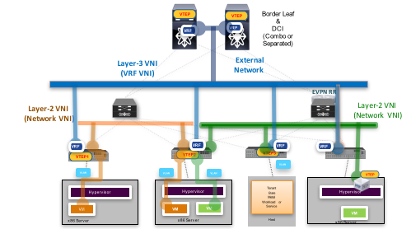
VTS – Flexible Network Overlays
Hardware-Based Overlays
Software (VTF) Based Overlays
Hybrid Overlays
VTS
Hardware VTEP
(TOR Leaf Switch)
Software VTEP
(Virtual Topology Forwarder / Fd.io)
VTS provides architectural and infrastructure independence through a multi-vendor, multi-hypervisor, SW and HW overlay solution

Slide 16
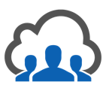

VTS Customer Use Cases
Network-Function
Virtualization
Multi-Tenant
Data Centers

Slide 17
VTS Key Features
Plugin for Openstack and Vcenter
VTF
IPV6 support
Service Extension
  Underlay Service Extension
  Overlay Service Extension
VTS integrate VXLAN with WAN
  GRT,L3VPN,L2VPN,VPLS to EVPN
Multi-VMM
  Trusted vs Untrusted
Open stack Enhancements
Multicast on VTF
AAA
ESI based MH

Slide 18
VTF

Slide 19


IPv6 Support
IPV4 underlay
Dual stack support
Cisco VTS
VTF
VTF
IPv4/
IPv6
IPv4/
IPv6
IPv4/
IPv6

Slide 20
Service Extension
  Template driven feature which allows configuration of Overlay and Underlay configurations via VTS which will eliminate requirement of out-of-band configuration (via CLI)
  Can be attached per tenant/per network.
  Single pane of glass for all your device configurations
  !! Not your underlay manager
    No POAP support
Example of Overlay configuration :
VRF,NVE BGP configuration
Example of Underlay configuration :
Physical Interface configuration, VPC , Definition of Policy Map.

Slide 21
VTS – Integrate VXLAN with WAN
L2 VPN
L3 VPN
VPLS
Legacy DC
EVPN- VXLAN
EVPN- VXLAN
EVPN- VXLAN
DC 3
DC 1
DC 2

Slide 22
VTS – Integrate VXLAN with WAN
MPLS
Internet
RR

Slide 23
VTS – Integrate VXLAN with WAN
For Disaster recovery, High Availability
Integrate EVPN/VXLAN to MPLS-L3VPN

Slide 24





Cisco VTS Operational models
VTS GUI based
VMM Initiated
Multi VMM (VTS 2.5)
VTS
VTS
VTS
vCenter
vCenter
The Network segments are shared across VMMs
Network objects can be created at VMMs or at VTS
Network and Compute groups work in Silos
Port-group and vlan information are exchanged offline as the VMs are attached.
VTS Plugin in VMM initiated workflow.
Network objects creation is initiated in VMM
Degree of Automation

Slide 25


Multi VMM –Merge L2
Horizon
vCenter GUI
ProjectA, N1
TenA, N1
TenantA View
RR
Project A View
Spine
Spine
TenantA View
ToR
ToR
ToR
TOR
Border Leaf
VTEP1
VTEP2
VTEP3
VTEP4
VTEP
VLAN
VLAN
VLAN
VLAN
KVM
KVM
EXSI
ESXI
VM1
VM2
VM3
VM4
x86 Server
x86 Server
x86 Server
x86 Server
DCI
Notes:
Application and Server migration towards virtualization & cloud create requirements for agile and scalable networks. This is driving the current network transition to the SDN. With SDN, there is a migration from intelligent hardware platform components to a more centralized software intelligence. A centralized software helps customers improve their operational efficiencies at cloud scale and also enhance troubleshooting capabilities in the network. This helps the customer better align their network to meet their business goals.
SDN also changes the paradigm on how customer buy products, what features matter in the product. SDN is also shaping a new ecosystem build around SDN applications.
Software Defined Networking and OpenDaylight is transforming how we look at the network. The opportunities it creates are endless, we know some of them and will discuss few in the presentation. What Cisco is doing with OpenDaylight is taking the Open Source SDN Platform and putting capabilities around it to make it the best SDN platform in the market to help you win with customers
The discussion agenda is as above:
[1] What OpenDaylight is from the organization view and the OpenDaylight product
[2] Get into Cisco’s commercial distribution of OpenDaylight -- Cisco Open SDN Controller -- this will sold and supported as any other Cisco product.
[3] How we are enabling developers on the platform. As an open platform it has number of developer and integration opportunities and we are building a developer ecosystem
[4] A quick view of targeted use cases that we see today. Not an exhaustive list but a sample list of use cases we are focusing on initially
[5] Talk about how we are using Open SDN controller in the WAE. An example of an SDN application.
[6] Call to action.

Slide 26
Multi VMM - Merge L3
Router is created using VTS API/GUI
TenantA View
RR
Spine
Spine
ProjectA View
TenantA View
L3 VNI
L2 VNI
L2 VNI
ToR
ToR
ToR
TOR
VTEP
VTEP1
VTEP2
VTEP3
VTEP4
VLAN
VLAN
VLAN
VLAN
KVM
KVM
EXSI
ESXI
DCI
VM1
VM2
VM3
VM4
x86 Server
x86 Server
x86 Server
x86 Server
Notes:
Application and Server migration towards virtualization & cloud create requirements for agile and scalable networks. This is driving the current network transition to the SDN. With SDN, there is a migration from intelligent hardware platform components to a more centralized software intelligence. A centralized software helps customers improve their operational efficiencies at cloud scale and also enhance troubleshooting capabilities in the network. This helps the customer better align their network to meet their business goals.
SDN also changes the paradigm on how customer buy products, what features matter in the product. SDN is also shaping a new ecosystem build around SDN applications.
Software Defined Networking and OpenDaylight is transforming how we look at the network. The opportunities it creates are endless, we know some of them and will discuss few in the presentation. What Cisco is doing with OpenDaylight is taking the Open Source SDN Platform and putting capabilities around it to make it the best SDN platform in the market to help you win with customers
The discussion agenda is as above:
[1] What OpenDaylight is from the organization view and the OpenDaylight product
[2] Get into Cisco’s commercial distribution of OpenDaylight -- Cisco Open SDN Controller -- this will sold and supported as any other Cisco product.
[3] How we are enabling developers on the platform. As an open platform it has number of developer and integration opportunities and we are building a developer ecosystem
[4] A quick view of targeted use cases that we see today. Not an exhaustive list but a sample list of use cases we are focusing on initially
[5] Talk about how we are using Open SDN controller in the WAE. An example of an SDN application.
[6] Call to action.

Slide 27

Multi VMM - Publish
Tenant A, N1
RR
TenantA View
ProjectA View
Spine
Spine
TenantA View
L2 VNI
ToR
ToR
ToR
TOR
Border Leaf
VTEP1
VTEP2
VTEP3
VTEP4
VTEP
VLAN
VLAN
VLAN
VLAN
KVM
KVM
EXSI
ESXI
VM1
VM2
VM3
VM4
x86 Server
x86 Server
x86 Server
x86 Server
DCI
Notes:
Application and Server migration towards virtualization & cloud create requirements for agile and scalable networks. This is driving the current network transition to the SDN. With SDN, there is a migration from intelligent hardware platform components to a more centralized software intelligence. A centralized software helps customers improve their operational efficiencies at cloud scale and also enhance troubleshooting capabilities in the network. This helps the customer better align their network to meet their business goals.
SDN also changes the paradigm on how customer buy products, what features matter in the product. SDN is also shaping a new ecosystem build around SDN applications.
Software Defined Networking and OpenDaylight is transforming how we look at the network. The opportunities it creates are endless, we know some of them and will discuss few in the presentation. What Cisco is doing with OpenDaylight is taking the Open Source SDN Platform and putting capabilities around it to make it the best SDN platform in the market to help you win with customers
The discussion agenda is as above:
[1] What OpenDaylight is from the organization view and the OpenDaylight product
[2] Get into Cisco’s commercial distribution of OpenDaylight -- Cisco Open SDN Controller -- this will sold and supported as any other Cisco product.
[3] How we are enabling developers on the platform. As an open platform it has number of developer and integration opportunities and we are building a developer ecosystem
[4] A quick view of targeted use cases that we see today. Not an exhaustive list but a sample list of use cases we are focusing on initially
[5] Talk about how we are using Open SDN controller in the WAE. An example of an SDN application.
[6] Call to action.

Slide 28
Multi VMM
Accept Network from VMM-Trusted
Create network from VTS and push it to VTS- Untrusted

Slide 29
VTS Customer Use Cases
Network-Function
Virtualization
Multi-Tenant
Data Centers

Slide 30
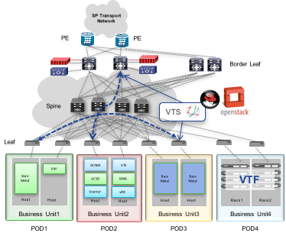
Customer Proof Points
Customer#1
Workload Agnostic Overlay
Support for both VM and Bare Metal Workloads
Versatile
Support for Multiple VMMs (openstack and VMWare)
Dual Stack Enabled
Tenancy based on IPv4/IPv6(dual stack) capable overlay networks
Custom Service Integrated
Redirect select traffic to the services connected to the Border Leaf

Slide 31
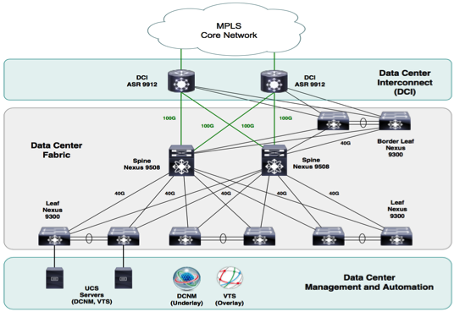
Customer Proof Points
Customer #2
Multi-Tenant
Support Colocation of Tenants in Common Environment
Services
Internet and VPN as Service Offerings
Firewall and Load Balancing within the Fabric
Resilient
Ability to Connect the Same Customers across Multiple Data Centers
Support Bare Metal
Bare Metal attach to Fabric

Slide 32
Customer Proof Point
NFV Customer
Admin Tools
Customer Portal
OSS/BSS
NSO: Network Service Orchestrator
VTS: Virtual Topology System
VTS: Virtual Topology System
ToR: Top of Rack switch
PNF: Physical Network Function
VNF: Virtual Network Function
dVS: distributed Virtual Switch
PE: Provider Edge
REST API
Orchestration & Controllers Layer
NSO
ESC
vCenter
VTS
VTS
Plug-in
Virtual Overlay Networking Layer
BGP-EVPN
MPLS VPN Network
VXLAN
VPN PE
& VXLAN
Gateway
Nexus 9300 (ToR)
Nexus 9300 (ToR)
VLANs
VLANs
VLANs
VLANs
PNF1
dVS
dVS
PNF2
Virtual Infrastructure, VNF & PNF Layer
VNF1
VNF2
VNF1
VNF2
Notes:
1. Building Virtual IP-based overlay network over multiple DC sites to provide virtual networking services offered by current MGW.
This is the Scope of this RFI
2. Building End-user portal through which end users can request add/delete/change network services on-demand.
3. The end-user portal should also be able to configure gateway routers(PEs) connecting MGW network to existing L2/L3 VPN or public Internet.

Slide 33
VTS Demo

Slide 34
Cisco Differentiation
NFV Ecosystem
Full stack NFV solution
Integration with NSO and VNF life-cycle manager ESC
Dynamic service chaining capabilities
Virtual Topology System
(Policy Plane & Control Plane)
Transactional policy models; flag transaction errors & rollback
Architecture to integrate third party network elements
Virtual Topology Forwarder
User space without any kernel modifications
Multi-tenanted, L2/L3 capable including VXLAN & MPLS
Line rate packet forwarder
Network Endpoint
Ecosystems
SW and HW overlays in bare-metal and virtualized environment
N2k-N9k, ASR 9K, and Virtual forwarder support

Slide 35
Cisco VTS : Flexible Overlays with Optimized Routing
Scalable
Large Datacenters
Open
VXLAN/EVPN
VPLS/MPLS-L3VPN
Seamless Integration
Multi-hypervisor
Multyi-VMM
Legacy and physical form factor network services
Containers
Analytics/Visibility
Agility and Automation
Bare metal Workloads
Investment Protection
Service Chaining
Policy Driven
Service
Multi Vendor
Best-in-class devices
Muti-pod
Multi-DC
L2/L3 Overlays
Software based overlays
Switch based Overlays
Virtual Workloads
Over the top Overlays
Infrastructure
Notes:
Investment Protection - VTS supports the entire Nexus portfolio, thus bringing the benefits of automation and operational simplicity to the entire Nexus family.
Faster Network Provisioning - through an automated policy-driven approach across both virtual and physical workloads.
Seamless Integration - through open APIs with cloud orchestration systems like OpenStack and vCenter
Improved Resource Utilization - through the creation of a flexible pool of resources which can be securely allocated and re-allocated on demand maximizing the return on infrastructure investment and reducing capex
Scalability - using standards based BGP-EVPN based control plane to manage VXLAN overlays extending workload placement and mobility diameter seamlessly without compromising performance.
Multi-Vendor support – Extensible to multi-vendor environments by leveraging Cisco Tail-f technology

Slide 36
www.cisco.com/go/vts

Slide 37

Thank You

