Slide 1
Marketing Presentation
Cisco Supply Chain Hybrid Cloud
Marketing Presentation
Speaker Name
Date: 29/05/2015
Speaker Name
Designation
Designation
Date: 00/00/0000
Shanthi Iyer Giri Govindarajulu
Date: 00/00/0000
Sr Director Director

Slide 2
Agenda
CISCO SUPPLY CHAIN
GLOBAL NEEDS
WHAT IS INTERCLOUD FABRIC
SUPPLY CHAIN HYBRID CLOUD
BENEFITS

Slide 3
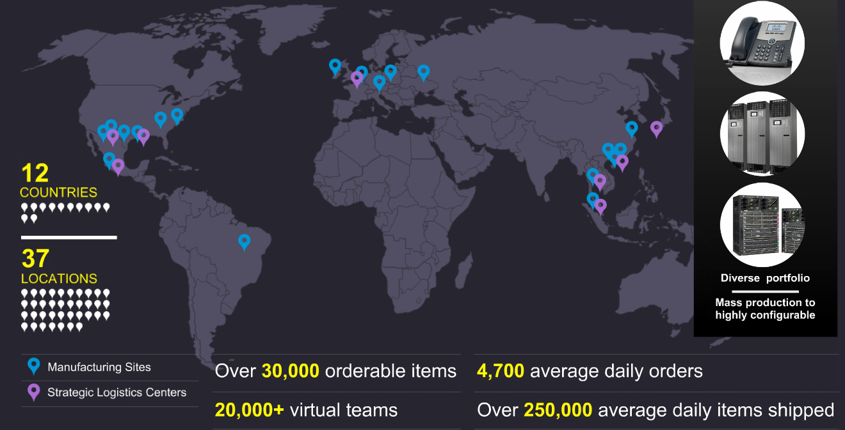
Cisco Supply Chain

Slide 4
Our Vision
Enable Cisco’s success by delivering ADAPTABLE,
INNOVATIVE, and SCALABLE SUPPLY CHAIN SERVICES
that OPTIMIZE CUSTOMER OUTCOMES
FOUNDATIONAL
ADVANCED CAPABILITIES
Risk
Management
Segmentation
Acquisition
Integration
Security
Quality
Excellence
Delivery Excellence
Factory of
the Future
Connected
Supply
Chain
Development
Cost
Excellence
New Product
Introduction
Supplier
Collaboration
Workforce
of the Future
Sales & Operation
Planning
Sustainability

Slide 5
Global Supply Chain Needs
Better Decisions. Quick Corrective Actions
Break Down Information Silos
Informed Decision Making
Manage Growing Data Volumes
Faster Responses to Disruptions
Borderless
Collaboration
Better Customer Outcomes

Slide 6
Intercloud Fabric Value
DC/Private Cloud
Provider Cloud
Cisco Intercloud Fabric
Fixed Workloads
Variable Workloads
Choice
Consistency
Control
Compliance
Freedom to place workloads across heterogeneous Clouds
Security/Networking as an extension of Private Cloud
Unified workload management across clouds
Policy-based deployment/governance in cloud

Slide 7
Supply Chain Usecase
Inventory Visibility
Supply Chain Excellence as a Service
Control Tower Capability in the Cloud to optimize Data Movement and real time Visibility of the Ecosystem to deliver Operations Excellence
Partner Applications that are available for Ecosystem to Use when Needed for real time Packout Status of Inventory

Slide 8
Supply Chain Hybrid Cloud
Arravo
Jive
Big Data and Analytics
Provider Clouds
Provider Clouds
(Data/Appln./VM)
Collaboration and Video
SCaaS
(Data/Appln./VM)
Core
Security
WebEx
Enterprise Cloud
(Data/Appln./VM)
HANA aaS
Provider Clouds
Partner Private Clouds
IOE aaS
DRaaS
Intercloud Fabric

Slide 9
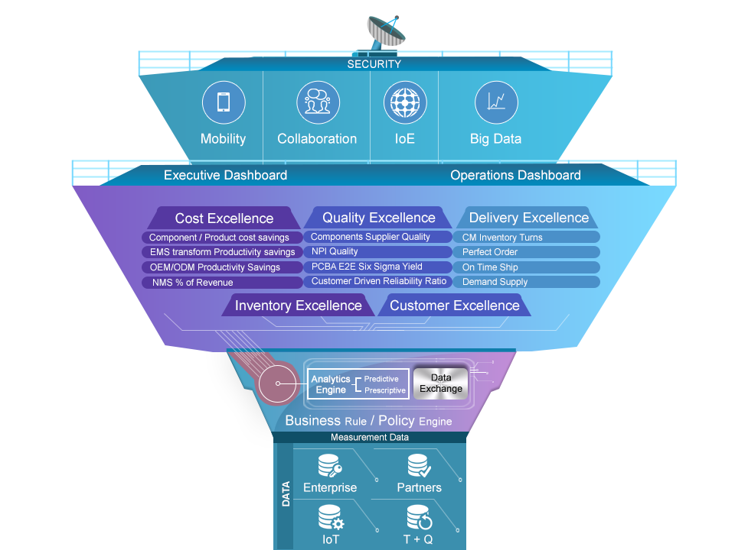
SC Excellence as a Service

Slide 10
Demo
Click here

Slide 11
Business Value
FLEXIBILE
Choice of Provider and Data across Ecosystem
REAL TIME
Significant Reduction in Data transfer time
VISIBILITY
Data Driven decision making. Alerts & Notification
PREDICTIVE
Analytics and data prediction for Adaptive Supply Chain
IoE
Enable IoE capabilities for Connected Warehouse and Smart Factories

Slide 12
Benefits
Benefits
Infrastructure
Business
Flexible Public Cloud choices (AWS, Azure and CCS)
Multi Hypervisor support (VMWare, KVM, Hyper-V, EC2)
Migrate resources between Private & Public clouds
Capacity Augmentation
Reduced Total Cost of Ownership
Optimal Utilization of Ecosystem Resources
Flexible
Workload Freedom
Secure
Security Ownership
Data Sovereignty
Compliance
Create a protected ICF shell in the public cloud
Secure Connection with enterprise & public cloud
Create trusted VMs in Public Cloud
Secure Cloud Shell
Real Time Data Driven Supply Chain
Process Optimization
Alerting and Predictive Analytics
Enables shift to OPEX vs CAPEX DC Model
Management of Infra resources through Prime
Experience
Improved User Experience

Slide 14
Thank you

