Slide 1
Enabling Hybrid IT
Cisco Intercloud Fabric
Saravan Rajendran
VP/GM, Cloud Networking and Services Group
May 28, 2015

Slide 2
Navigating Pace of Change
TECHNOLOGY TRANSITIONS
Cloud
Mobility/Video
New Breed of Apps
Internet of Things
Big Data and Analytics
EVOLVING ROLE FOR IT
Growth and Productivity
New Business Models
User Experience and Expectations
Security and Regulatory Compliance
Globalization
INCREASING BUSINESS DEMANDS
Notes:
Script from “Gold” deck
Today’s companies are being asked to adapt to the constantly evolving business implications of globalization, new business models, globalization, and regulatory compliance, just to name a few, and at each turn, IT must accommodate fast-moving transitions in technologies such as cloud, mobility, video, and big data.
To keep up with the rapid pace of change, IT organizations must evolve to bring relevance to the business and promote IT initiatives that support strategic business objectives. This transformation is more critical than ever, because in this age of the Internet of Everything, the pace of these changes is only accelerating.
Line-of-Business (LOB) leaders are acutely feeling this pressure. Sensitive to the need to innovate and capitalize on opportunities swiftly, they are gaining influence when it comes to budgets and are ready and able to bypass IT and leverage external solutions if necessary, creating “shadow IT” initiatives.
To meet these challenges and deliver solutions at the speed and agility required by the business, a new model for IT is required – one that is fast and drives innovation…that enables a hybrid IT approach where IT looks both inside and outside the business for the right services with the right consumption models that will support the business.
By assuming this role of “broker of IT services;” IT can align their initiatives with business objectives; and make their organization more operationally efficient when it comes to investments, more effective at managing security and levels of risk, and more innovative at revealing new revenue streams and business models.
To remain relevant to the business, IT must become a “change agent” and be perceived as a true strategic enabler.
And more and more organizations are turning to hybrid clouds to capitalize on the accelerating pace of change.
Original Script:
Across most industries, today’s business landscape is characterized by a number of disruptive forces—competitive, macro-economic, and operational. The new normal is defined by a continuous need to innovate and change.
In the face of these increasing market and competitive pressures, LOB leaders have been playing an increasingly important role in driving requirements for IT solutions and services. What’s more, LOBs now have a greater ability to access IT solutions outside the traditional enterprise IT value chain, creating “shadow IT” initiatives.
In response, IT organizations are looking for ways to retain their leadership, control, and at times, even relevancy. They are faced not only with shadow IT, but also many other pressures—including the consumerization of IT, multiple and simultaneous technology transitions, skill-set gaps, and proliferation of regulations and data.
More in general, IT organizations are being pushed to go beyond their traditional focus on operational effectiveness and management controls. They are now expected to support strategic business objectives and enable business growth while also harnessing new technology trends, leading to innovation and new customer experiences.
To remain relevant to the business, IT must become a “change agent” and be perceived as a true strategic enabler.

Slide 3














From Cloud Builders to Service Brokers…
BUSINESS
demands
drive LOBs to launch
NEW SERVICES
with Shadow IT
IT must offer faster
VALUE CREATION
As a “broker”
of IT Services
Buy or Build
NOW!
Up to10X
More
Discovered Cloud Services
Notes:
(after you show slide, say) CIOs need to transition from being builders to service orchestrators – here is how we will enable them to do it. Source: ‘Impact of Cloud on IT Consumption Models’ Cisco study in partnership with INTEL, Aug 2013
Each Cloud is Custom
Built with No Consistent APIs

Slide 4
The CIO’s Challenge
5-10X
Cloud services typically purchased without IT involvement (Cisco)
Visibility
90%
Percentage of IT expenditures spent outside of IT budget by 2020 (Gartner)
Cost
50%
Global 1000 companies that will have customer data stored in the public cloud by 2016 (Gartner)
Risk
Notes:
Cloud Sprawl is creating Shadow IT Challenge
Three vectors of concern for the CIO.. – this is a KEY CIO Slide. If there is only one slide to use, this is the money slide!
Visability, Cost and Risk
All about technology is consumed

Slide 5

Cisco Intercloud
Notes:
1:49

Slide 6






World of Many Clouds
SaaS
Hybrid
Public
Private
Private
Cloud
Notes:
Global scale out with our partners
Platform that Cisco builds out for the future and for our ISVs on top of that
Allude to CCS (to be covered by Faiyaz)

Slide 7



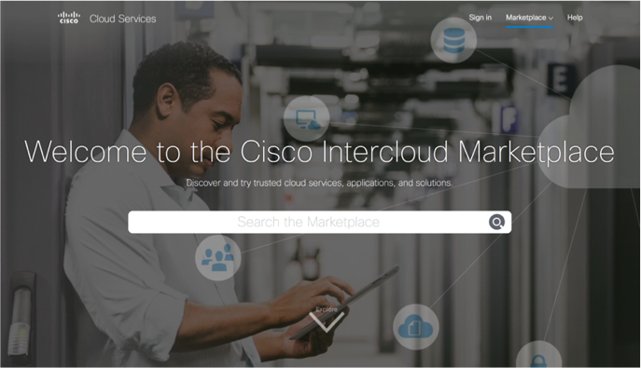


Imagine the Possibilities
SaaS
SaaS
Hybrid
Public
Private
Public
Private
Private
Cloud
Notes:
In the world of many clouds, how do you drive unification?
At Cisco, our approach is to provide a single pane of glass to manage your on-prem, SaaS and public cloud services
Seamless access to the world of many clouds with policy and automation

Slide 8




Working on this tonight
Seamless Workload Migration
Intercloud Fabric
Financial
CRM
Network
Policy
Security
Policy
Customer
Employee
On-Premise
Public Cloud
Notes:
Global scale out with our partners
Platform that Cisco builds out for the future and for our ISVs on top of that
Allude to CCS (to be covered by Faiyaz)

Slide 9

The Intercloud
The globally connected network of clouds
Enterprise
Private
Clouds
INTERCLOUD
Intercloud Providers
Intercloud Services
Intercloud Alliance
Public
Clouds
CIMK v1.0
Notes:
The Intercloud is a globally connected network of clouds. Built by Cisco and our partners, the Intercloud gives our customers a nearly unlimited choice of cloud infrastructure and applications with the compliance and control they need to connect to the cloud with confidence.
The Intercloud includes Enterprise Private clouds with Intercloud Fabric and ACI to make them Intercloud Ready. Intercloud Providers – Cisco Powered Services Providers who are adding Cisco Intercloud Technologies (Cisco Intercloud Fabric (ICF), Application-Centric Infrastructure (ACI), OpenStack, and the Cisco ONE Enterprise Cloud Suite) to their cloud services to create Intercloud Services. Cisco and the other Intercloud Alliance Partners deliver rigidly standardized services from a common infrastructure.

Slide 10











Internet
Intercloud
Islands of Isolated PC LAN Networks (1990s)
The Internet
World of Cloud Islands (2000s)
The Intercloud
Intercloud
Each Cloud is custom
built with no consistent APIs
Connected for application
acceleration with Open APIs
Multiple LANs using
multitude of protocols
Connected using Industry
Standard IP protocol
IP Based | Open Standards
Web-scale | Automated | Open, Secure, Hybrid
Notes:
We know how to fix this
We’re going to do for cloud what we did for data. You couldn’t move data between the networks – they weren’t connected. Cisco unified those worlds
The world of cloud today is a world of isolated clouds. There’s no workload or data portability.
“Amazon is hotel California – you can never leave, and that data is staying there”
Our vision is to connect all these clouds together into the Intercloud - whether private, public , or hybrid through technology and innovation
Intercloud is going to connect these clouds together in the same way we connected data together.
No one cloud model or single cloud approach, such as the massively scalable clouds from Amazon, Google or Microsoft will win alone in this space

Slide 11
The Intercloud
Customer Value
Enterprise
Private
Clouds
CHOICE
    Cloud the way you need it
COMPLIANCE
        Manage risk locally
        and globally
with…
INTERCLOUD
and…
CONTROL
Across services, in every location
Intercloud Providers
Intercloud Services
Intercloud Alliance
Public
Clouds
CIMK v1.0
Notes:
Cisco and our partners enable Choice with:
Flexible consumption and deployment models
Cloud automation integrated at the customer’s pace
Hundreds of trusted providers and partners
Workload placement regardless of hypervisor
Thousands of ready-to-consume, proven services and integrated applications
Choice helps customers to:
Improve their strategic allocation of IT budget
Enhance their ability to better align IT and business requirements
Accelerate their time to market to capture new revenue opportunities
Expand their markets
Cisco and our partners enable Compliance by:
Providing security solutions and services to protect users, data, and workloads; enable visibility, secure connections, and advanced threat protection
Enabling secure workload portability and placement across private and public clouds
Offing cloud services from data centers located around the world with local and regional hosting
Providing validated architectures and an ecosystem of proven Intercloud Providers and Resellers
Compliance helps customers to:
Manage their exposure to risk from
Network and data security threats
Integration of private cloud resources into public clouds
Industry and government compliance regulations
Maintaining multiple, point-to-point business and financial relationships with cloud providers
Cisco and our partners enable Control by
Unifying service and capacity management
Controlling placement and secure portability of workloads
Assuring application performance with application-centric policies that “follow” the workload
Leveraging service catalogs to allow IT to easily broker services for the business
Leveraging integrated application data from across multiple clouds
Control helps customers to:
Lower costs through operational efficiencies
Enable IT to assume the role of service broker to better partner with the business
Minimize risk with flexible capacity management, consistent security policies, control of sensitive information, and multi-vendor support
Deliver a consistent user experience

Slide 12
The Intercloud
Three Strategic Elements
Enterprise
Private
Clouds
PARTNERS
INTERCLOUD
TECHNOLOGY
Intercloud Providers
Intercloud Services
Intercloud Alliance
SERVICES
Public
Clouds
CIMK v1.0
Notes:
Cisco is helping to orchestrate the key elements needed to making Intercloud a reality. Technology: Cisco Intercloud Enabling Technologies – solutions that are purpose built and multi-use (ACI) for the Intercloud. Partners: Technology (SW/HW) providers adopting Cisco Intercloud Enabling Technologies to ensure their solutions and services contribute to the growth of Intercloud. Services: The core of the Intercloud. Currently more than 60 cloud providers are in the process of building the next-generation of Intercloud Services. These services are designed to address customers’ need for choice with compliance and control.

Slide 13
The Intercloud
Partners: Cloud Service Providers
INTERCLOUD
PROVIDERS and RESELLERS
INTERCLOUD
ALLIANCE
60+
Partners
Enterprise
Private
Clouds
Offer Intercloud
Services with workload portability and global policy management
Strategically Aligned Cloud Partners
INTERCLOUD
Cisco Intercloud Stack
Standardized package of integrated software and hardware for Intercloud Services
CISCO
POWERED
SERVICES PROVIDERS
Intercloud Providers
Intercloud Services
Intercloud Alliance
160+
Partners
Public
Clouds
Offer 240+
Cisco Powered cloud services
CIMK v1.0
Notes:
More that 160 partners have deployed 240+ cloud services around the world through with Cisco Powered. These providers are the foundation for the Intercloud with many becoming Intercloud Providers.
Intercloud Providers (and Resellers): This role offers Intercloud Services, which include Cisco Intercloud Enabling Technologies (Cisco Intercloud Fabric (ICF), Application-Centric Infrastructure (ACI), OpenStack, and the Cisco ONE Enterprise Cloud Suite).
Intercloud Alliance Partners are an invitation only subset of these providers. They deliver standardized cloud services from the Cisco Intercloud Stack. By having identical infrastructure, Intercloud Alliance partners offer seamless workload portability between their clouds.

Slide 14





















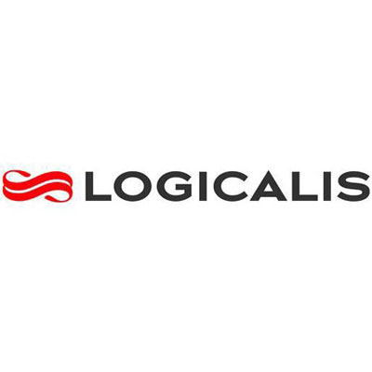




























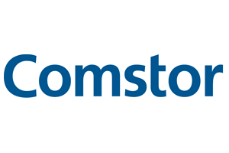


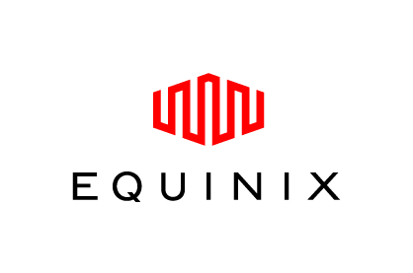
60+ Global Intercloud
Partners
as of 4/28/15
Notes:
Partners announced to date
LOIs
Alliance Partners – Telstra, Deutsche Telekom,
Others – BT, PT/Oi, America Movil
Intercloud Providers (signed/approved MOUs)
AMER – CGI_FEC, Cirrity LLC, Dimension Data, iLand, LightEdge Solutions Inc, Longview Systems, Viawest, Vital Support Systems\OneNeck, WiPRO Limited, Netelligent, ONX Managed Services, Peak 10, Quality Technology Services (QTS), Quest, Super-Server LLC/Proxios, Dimension Data, NWN
AMER-LATAM - O4IT, Dualtec, CPM Braxis S.A./Capgemini , SONDA
EMEAR - Adapt Services LTD (UK), ANS Group PLC (UK), Belgacom\Proximus (Belguim), Freudenberg IT SE & Co - FIT (Germany), LLC CTI (Russia), Logicalis (UK), QSS (Bosnia & Heregovina) Steria Limited (UK), Sungard Availability Services (UK), Telefonica (Spain), Seacom/Pamoja (Africa), Netcast (Serbia)
GC - City Cloud Technology (CCI), Troila Technologoy Development, Yunnan Nantian Electronic Information
APJ - Ethan Group (Australia), Infront Systems PTY limited (Australia), ITOCHU Techno-Solutions Corp - CTC (Japan), LG CNS (Korea)
Resellers/Aggregators/Builders
Comstor, CDW, Ingram Micro, Accenture, Presidio, Forsythe, Tech Data, Word Wide Technologies
Technology Partners
Redhat, Johnson Controls, Equinix, NetApp, VCE

Slide 15




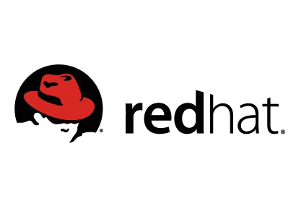








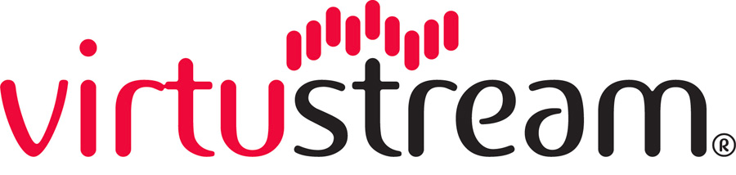

60+ Global Intercloud Partners
350+ Data Centers
50 Countries

Slide 16
The Intercloud
Partners: Technology and Software Providers
Enterprise
Private
Clouds
INTERCLOUD
SOFTWARE PROVIDERS
INTERCLOUD TECHNOLOGY PROVIDERS
INTERCLOUD
ISV Partners
with Intercloud Ready software solutions
Intercloud Ready integrated
infrastructure for private
and public clouds
Intercloud Providers
Intercloud Services
Intercloud Alliance
INTERCLOUD
SOFTWARE TOOL DEVELOPERS
Public
Clouds
Puppet, Chef…
CIMK v1.0
Notes:
Intercloud Technology partners deliver Intercloud Ready software and hardware for private and public clouds. These offerings include Cisco Intercloud Enabling Technologies or are delivered by an Intercloud Provider.

Slide 17
The Intercloud : Services
Partner Intercloud Services
Cisco Intercloud Marketplace
Cisco Intercloud Services
Enterprise
Private
Clouds
Infrastructure as a Service
Spark
Desktop as a Service
Energy Management
Disaster Recovery as a Service
INTERCLOUD
Connected Analytics for Events
Cloud Cell Architecture for SAP HANA
Extended Patient Care
Video & TelePresence as a Service
Intercloud Providers
Intercloud Services
Intercloud Alliance
Service Grid
Unified Communications as a Service
Service Delivery Platform Exchange
Contact Center as a Service
Public
Clouds
CIMK v1.0
Notes:
Intercloud Services from our partners and Cisco are services delivered from Cisco and partner data centers and have one or more Cisco Intercloud Enabling Technologies (Cisco Intercloud Fabric (ICF), Application-Centric Infrastructure (ACI), OpenStack, or the Cisco ONE Enterprise Cloud Suite) as a part of the service.

Slide 18
The Intercloud
Technology: Cisco Intercloud Enabling Technologies
CISCO INTERCLOUD
FABRIC FOR BUSINESS
Enterprise
Private
Clouds
CISCO INTERCLOUD FABRIC FOR PROVIDERS
INTERCLOUD
CISCO ONE ENTERPRISE CLOUD SUITE
CISCO APPLICATION CENTRIC INFRASTRUCTURE
OPENSTACK
Intercloud Providers
Intercloud Services
Intercloud Alliance
Public
Clouds
CIMK v1.0
Notes:
Cisco Intercloud Enabling Technologies are purpose built for the Intercloud (example: Cisco Intercloud Fabric) and are multi use (Example: ACI). These technologies underpin the Intercloud and provide performance, reliability, security, and scalability. With Cisco’s Application-Centric Infrastructure (ACI) businesses gain agility and visibility of network capabilities up through the application layer. Cisco Intercloud Fabric seamlessly enables workload portability between clouds. Standards like OpenStack assure interoperability and application portability. The Cisco ONE Enterprise Cloud Suite product portfolio consists of the following tools:
Cisco Prime Service Catalog: Use a graphical approach to joining application elements with business policies and governance that can be consumed from a modern store-front portal.
Cisco Intercloud Fabric for Business: Get consistent, highly secure hybrid cloud connectivity and workload mobility.
Cisco UCS Director: Reduce data complexity and increase IT flexibility with unified infrastructure provisioning and management.
Cisco Virtual Application Container Services: Rapid provisioning of virtual network services delivered with Cisco UCS Director infrastructure containers.

Slide 19


Journey to Intercloud

Slide 20

Get Started Today:
Journey to Becoming Digital through Cloud
4
3
Build a
DevOps Model
2
Manage Cloud Services through the Intercloud Marketplace
1
STEP
Build a Secure Hybrid Cloud Platform
Discover True
Cloud Usage

Slide 21

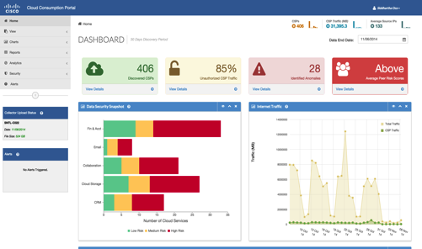
Cisco Cloud Consumption as a Service
STEP
1
Gain Complete Visibility of Cloud
Discover the clouds
Analyze traffic by application category
Risk Assessment Analysis
Utilizes Cisco Security Analytics

Slide 22

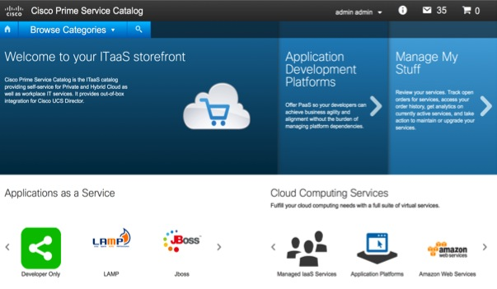
Build a Secure Hybrid Cloud
STEP
2
SHIPPING!
Cisco ONE Enterprise Cloud Suite
Control
Security
Policy
Compliance
Visibility

Slide 23
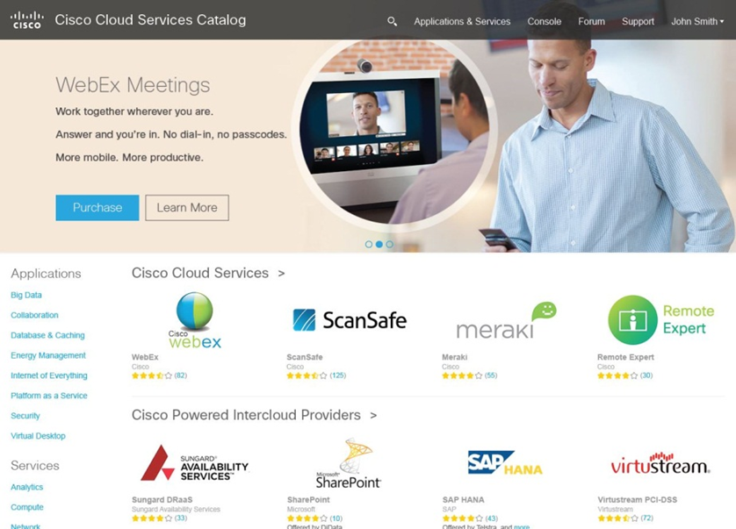

Cisco ONE Enterprise Cloud Suite
Hybrid-Ready Private Cloud
Infrastructure assurance, 3rd party billing, resource management
Modern Self-Service Portal and Catalog
Out-of-box application templates
Stack Designer
Intercloud
Services
Integrated Infrastructure Management
Hybrid Cloud Connectivity
Virtual Network Services
UCS-based Integrated Infrastructure
Multi-Vendor Compute, Network, Storage, and Virtualization
Intercloud Providers
Notes:
Cisco Enterprise Cloud Suite provides hybrid cloud capability and access to additional resources, such as Cisco Cloud Services, Cisco Marketplace, or services available from Cisco Certified Service Providers.
NEED MORE INPUT FROM SME ON THIS SLIDE

Slide 24

Intercloud Fabric

Slide 25
Cisco Intercloud Fabric
Foundational Technology – on Ramp to Intercloud
CISCO INTERCLOUD
FABRIC FOR BUSINESS
Enterprise
Private
Clouds
CISCO INTERCLOUD FABRIC FOR PROVIDERS
INTERCLOUD
Intercloud Providers
Intercloud Services
Intercloud Alliance
Public
Clouds
CIMK v1.0
Notes:
Cisco Intercloud Enabling Technologies are purpose built for the Intercloud (example: Cisco Intercloud Fabric) and are multi use (Example: ACI). These technologies underpin the Intercloud and provide performance, reliability, security, and scalability. With Cisco’s Application-Centric Infrastructure (ACI) businesses gain agility and visibility of network capabilities up through the application layer. Cisco Intercloud Fabric seamlessly enables workload portability between clouds. Standards like OpenStack assure interoperability and application portability. The Cisco ONE Enterprise Cloud Suite product portfolio consists of the following tools:
Cisco Prime Service Catalog: Use a graphical approach to joining application elements with business policies and governance that can be consumed from a modern store-front portal.
Cisco Intercloud Fabric for Business: Get consistent, highly secure hybrid cloud connectivity and workload mobility.
Cisco UCS Director: Reduce data complexity and increase IT flexibility with unified infrastructure provisioning and management.
Cisco Virtual Application Container Services: Rapid provisioning of virtual network services delivered with Cisco UCS Director infrastructure containers.

Slide 26
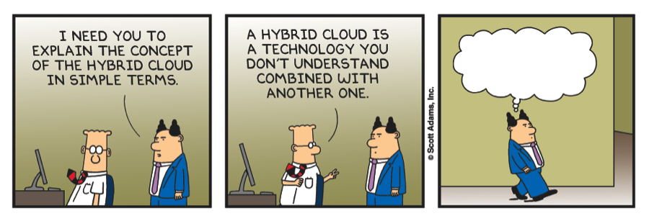
What is Hybrid Cloud?
Now how do I boil that down for the executives…?
Source : Vmware vDilbert Twitter Competition

Slide 27










Why Hybrid Cloud?
Striking the perfect balance
control
scale
security
speed
data sovereignty
economics
Hybrid
Private Cloud
Public Cloud
Notes:
That brings us to the third innovation powering the intercloud – intercloud fabric which is the foundational technology for Cisco’s Intercloud as well as Cisco’s Hybrid Cloud Solution.
Factors influencing them to go to the public cloud vs private cloud

Slide 28
Hybrid Cloud ROI: Buy the Base, Rent the Peak
Total Monthly Cost of 200 VMs:
100 Sustained, 100 Variable
Expensive for Fixed,
Cost Effective for Variable
Same Cost Structure for Fixed and Variable
Fixed in Private, Variable in Public:
35–50% TCO Reduction
Notes:
Customers have two options:
Buy for peak capacity- here they need to spend capex upfront (Flexpod example: $25K/month)
Rent- here they pay opex but it adds up over period of time(AWS example: $22K per month)
Ideal solution is to buy for base capacity (e.g. FlexPod) and rent for peak (e.g. AWS). Intercloud makes this possible by providing seamless connectivity and workload mobility across two environments, which has not been possible so far.
Hence in the example, customer can use FlexPod for base capacity ($12,500 per month) and AWS for peak + Intercloud ($2K) reducing their total cost from model 1 ($25K) and model 2 ($22K) to $14K per month.

Slide 29





Cisco’s Hybrid Cloud Approach
No Vendor Lock-In
Expanding Cloud Provider Ecosystem
Any Hypervisor to Any Provider
Heterogeneous Infrastructure
Customer
Open
Choice
Cisco
Intercloud Fabric
End-to-End Security
…
Unified Workload Management and Governance
Workload Mobility Across Clouds
Notes:
Cisco Intercloud Fabric is a highly secure, open, and flexible solution that gives you complete freedom in workload placement, based on business needs. It applies the same network security, quality of service (QoS), and access control policies in public clouds that you enforce in the data center. And as capacity is added, there is no demarcation between internal and external clouds.
Key features include:
Self-service consumption of hybrid resources with end-user and IT portals
Workload provisioning and bidirectional migration
End-to-end security with consistent policy enforcement
A single point of management and control for physical and virtual workloads
A choice of cloud providers and hypervisors
Workload Mobility
Get the freedom to create workloads in public clouds and to migrate workloads across heterogeneous private and public clouds. The Intercloud Fabric includes automated image conversion to your desired cloud format.
Networking
Layer 2 network extension from private to public clouds helps ensure application transparency. Gain switching, routing, firewall, and Network Address Translation (NAT) capabilities.
End-to-End Security
Get highly secure cryptographic connectivity from private to public clouds and security for data in motion within public clouds. Also, get zoning capability for workloads within public clouds.
Management and Visibility
Gain VM monitoring across public and private clouds and automated VM migration across heterogeneous clouds.
Automation and APIs
Use programmable APIs to manage VM lifecycles, and automatically create your workload catalogs.

Slide 30




Cisco Intercloud Fabric
ENTERPRISE DC / PRIVATE CLOUD
PROVIDER CLOUDS
Intercloud
Fabric for
Providers
Intercloud Ecosystem
vSphere
Intercloud Fabric for Business
Hyper-V*
End User and
IT Admin Portals
EC2 APIs
Openstack/KVM*
Secure Extender Network, Compute & Storage
Azure APIs
CloudStack/Xen*
* Available in subsequent releases

Slide 31

Cisco Intercloud Fabric Architectural Details
Intercloud Fabric Provider Platform
End User and IT Admin Portal
Workload and Fabric Management
End Users
IT Admins
Intercloud Fabric Director
Intercloud Fabric
for Providers
VM Manager
VM
VM
Intercloud
Fabric Services
Intercloud Fabric
for Business
VM
VM
Intercloud Fabric Secure Extender
(Secure Network Extension)
DC/Private
Cloud
Provider Cloud
Intercloud Extender
Intercloud Switch
Notes:
Intercloud Fabric Director – Single pane for glass providing administrator and end-user self-service portal through a web-based interface
Intercloud Fabric Secure Extender
Intercloud Extender – Virtual Machine in enterprise data center to provide secure connectivity to the Intercloud Switch in provider cloud
Intercloud Switch – Virtual Machine in provider data center, has secure connectivity to the Intercloud Extender in enterprise cloud and secure connectivity to the Virtual Machines in the provider cloud.
Intercloud Fabric Services – Virtual zone-based firewall and virtual router services running in the provider cloud
Intercloud Fabric Provider Platform – Only required for Provider Edition to enable service providers without public APIs to integrate with Intercloud Fabric

Slide 32
Cisco Intercloud Fabric Director Features
IT as Cloud Broker
Admin Portal
Policy-based
Cloud Management
Self-service
End User Portal
Choice of workload placement
End Users
IT Admins
VM Manager
Intercloud Fabric Director
Open
Open API for integration with other cloud management platforms
Intercloud Fabric
for Business
VM
VM
Intercloud Fabric Secure Extender
(Secure Network Extension)
DC/Private
Cloud
Notes:
Single Console for management of hybrid cloud workloads
Administrator portal and self-service user portal
administrators can set up a catalog of virtual machine templates that users can select from and self-provision.
Users can create Virtual Machines from template in catalog in a few clicks or Migrate Virtual Machines to public cloud
Authentication and access control
Users with pre-defined user types and permissions provide role-based access-control
Open
This is the primary graphical user interface for using clouds. But we also offer APIs for integration with other maangment systems, enabling choice and flexibility
Security
User groups and provide multi-tenancy support
Workload Placement Policies
Administrator creates catalogs to be shared with specific users/user groups
Policies to restrict placement of workloads based on max/min number of VMs in a VDC

Slide 33
Cisco Intercloud Fabric Secure Extender Features
Flexible Application Reachability
Enterprise IP Address or Provider IP Address
Network & Security Services
Inter-VM firewalling and routing
Intercloud Fabric Director
Secure Layer 2 Extension to Cloud
Extend VLAN/VXLAN with TLS Tunnel
VM
VM
Intercloud
Fabric Services
Intercloud Fabric
for Business
Intercloud Secure Extender
Intercloud Extender
Intercloud Switch
Provider Cloud

Slide 34
Key Use Cases for Hybrid IT
Enabled by Secure Enterprise Extension to Cloud
IT
Capacity Augmentation
  Dev/Test
  Shadow IT Control
Managed peaks with no
changes to application
Keep data local while
extending web or app
Access to Enterprise
Tools and Data
Bring Back Workload
for Production
Secure use of public clouds
Control costs with consolidation
Public clouds as extension
of enterprise IT

Slide 35


Salvation Army: Secure Dev/Test in Public Cloud
Problem
Public Cloud
Rapid deployment of applications and services is extremely important and challenging on very limited budget
Too difficult to manage/operationalize & properly enforce secure hybrid IT
VM
VM
VM
VM
Solution
ICF Shell
VM
Single plane of glass to manage virtual environment across multiple cloud providers
Better control and troubleshooting of workloads running in cloud
Enterprise template running in cloud with access to enterprise services
Developers accessing public cloud through Enterprise portal
VM
VM
VM
Business Outcomes
Enterprise Portal
Usergroup1 Portal
  Enable array of cloud providers without duplication of effort
  Meet Enterprise security & compliance policies mandates across private / public cloud resources
VM
Usergroup2 Portal
Enterprise DC
“One word to think of Cisco Intercloud Fabric is choice – cloud provider & hypervisor. I get one pane of glass across provider clouds in an easily manageable interface and I don’t have to hire a cast of engineers to develop that for me.”
Randy Haan, Director of IT Infrastructure, Salvation Army
Notes:
user portal concept into dev/test use case

Slide 36
Intercloud Fabric Enabling Capacity Augmentation
Marketing Company Needs Resources to Run Time Sensitive Web Campaign
Need More Capacity to Support Marketing Campaign
Capacity
Seamless Hybrid Cloud
DC/Private Cloud
Select Workload
Provider Cloud
Elastic Capacity
Secure and Policy Driven
No data migration necessary
Create Workload in Cloud
Size to Match Demand
Notes:
Support new Web applications that have variable resource requirements.
•
Deploy applications in a cost-effective and scalable environment.
•

Slide 37
Cisco Intercloud Fabric Value Proposition:
Secure Extension & Workload Mobility
DC/Private Cloud
Provider Cloud
Cisco Intercloud Fabric
Consistency
Compliance
Control
Choice
Security/Networking
as an extension of
Private Cloud
Enforce existing compliance policies
Policy based workload management
across clouds
Freedom to place
workloads across heterogeneous Clouds
Notes:
Inability to Access Resources Across Any Cloud, with Security and Ease
U need worry about application compatibility or service provider lock-in

Slide 38
Cisco ONE Software Suites
Intercloud Fabric is part of the Enterprise Cloud Suite
Data Center
WAN
Access
Advanced Security
Threat Defense
for Data Center
Threat Defense
for WAN
Identity Services
for Access
Advanced Application
Data Center
Fabric
Enterprise
Cloud Suite
WAN Collaboration
Campus Fabric
Advanced
Mobility
Services
Foundation
for Networking
Foundation
for Compute
Foundation for WAN
Foundation for Switching
Foundation for Wireless
Foundation
Networking
Compute
WAN
Switching
Wireless
Notes:
Here are the actual software suites
Data Center Networking
The foundation for networking suite enables IT to Build a Scalable, Resilient and Efficient Data Center Network. We saw in the previous slide what all the foundation contains. So we won’t go into them again.
The data center fabric, which is the advanced layer, Enabls highly secure converged LAN-SAN multi-tenant data center networks
Data Center Compute
Foundation for compute provides Unified compute for UCS-based and multi-vendor compute environments
New Enterprise Cloud Suite enables Self-service provisioning and lifecycle management of hybrid cloud & supporting infrastructure. We will be talking more about this in upcoming slides.
Moving to WAN
Foundation for WAN provides Intelligent WAN to Connect branches & campus over any connection - secure and cost optimized
WAN collaboration enables Integration of Voice And Video Across Branch And Campus For Productivity
Moving to Access
Access switching
Foundation for switching enables IT to Connect, secure & manage users & devices with an intelligent network
Campus fabric includes advanced features to Deliver scaled, optimized & resilient network infrastructure for mission critical operations
Access wireless
Foundation for wireless provides Business-class Wireless Access for Employees & Customers
Advanced mobility services allows Customized Value Creation Via personalized Wireless Experience
Advanced Security layer builds on the foundational security that is present in each of the foundation and certain advanced suites. It provides functionality like Advanced Malware Protection, Intrusion Prevention Systems

Slide 39
Cisco Intercloud Fabric Offers
Smart Pack
Cisco ONE for Data Center
Cisco Intercloud Bundles with UCS
A la carte
SKU’s
Software only
Software only
Software + Hardware + Cloud IaaS
SKU based Advanced Services – DIY or Cisco Led
Annual Subscription with Product and Technical Support in a single SKU
Metered on Active Hybrid Cloud Units

Slide 40
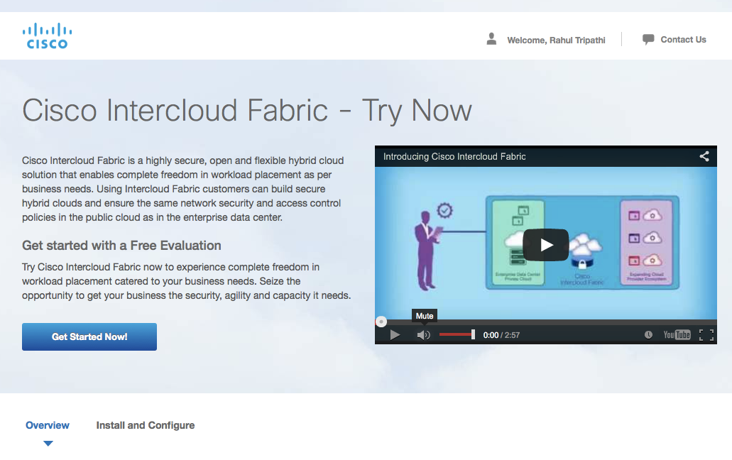
Try and Buy - 60 Day Free Eval
https://buildprice.cisco.com/IntercloudFabric

Slide 41
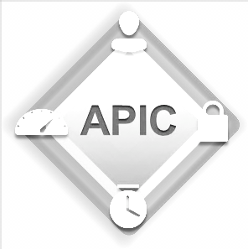
Application Centric Infrastructure
Automation
Application Centric
Infrastructure
Physical & Virtual
Open & Secure
Notes:
We solve our customers’ complete problem:
Physical, virtual & container worlds intertwined
customer benefits through better visibility via a single pane of glass
positive business outcome of reduced management time and operating expenditures
Open ecosystem
Embedded security
Security embedded in the architecture gives customers the benefit of secure multi-tenancy, thus lowering risks.

Slide 42
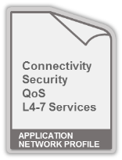

Application Centric Infrastructure (ACI)
Network Automation
WEB
APP
DB
f/w
ADC
ADC
APIC
Physical Networking
Hypervisors
and Virtual Networking
L4–L7
Services
Multi DC
WAN and
Cloud
Storage
Compute
Notes:
ACI is all about a highly programmable infrastructure with policies defined on a per application basis.
Let’s take the example of a 3 tier application with web/app and DB tiers.
The policy for this whole application is defined as a single unit with connectivity, QoS, Security and L4-7 services aspects.
The policy is enforced in the infrastructure and automated using the APIC controller for physical and virtual work loads, across L4-7 services from Cisco as well as partners, including the Storage tier as well as extending the policy over DCI to WAN.
Thomas will go over ACI in more detail at the TechExec Session later today …

Slide 43
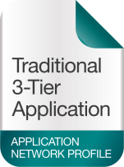





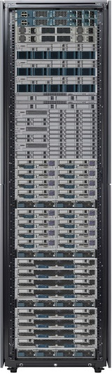
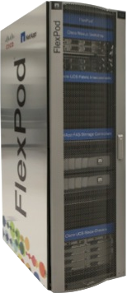
Common Policy and Workload Mobility
Across All Deployment Models
ACI drives consistent policy across all deployment models
PRIVATE
MANAGED
HOSTED
PUBLIC
Intercloud Fabric enables workload mobility with choice, consistency, control and compliance

Slide 44
Summary

Slide 45


Private/Hybrid/Public Cloud Offers
Flexible Deployment options to match Financial, Organizational & Data Locality Needs
Build ----------------------------------------------------------- Buy
  We can help you
  build your own
  We can manage some or all of it for you
  We can deliver highly secure
  Cloud-based outcomes
Internal Private Cloud
Managed Private Cloud & Managed Services
Hosted Private Cloud
Public Cloud
Hybrid Cloud with Intercloud Fabric
Ownership
Customer
Cisco / Partner
Management
Customer
Cisco / Partner
Location
On-Prem
Partner
Notes:
Deliver Integrated Applications in a Hybrid Cloud
iPaaS for application integration & API management
platform for multiparty support collaboration, enterprise B2B & service exchanges
Can you use the same change management processes across your hybrid cloud, or are each unique depending on the provider? Core services & capabilities will probably differ greatly in a hybrid environment as a web-scale public cloud environment is inherently built differently than most any private cloud.

