Slide 1

Workforce Experience
Building Next Gen Workspace
Marketing Presentation
Marketing Presentation
Speaker Name
Faraz Aladin
Speaker Name
Designation
CTO – Enterprise Solutions Office
Designation
Date: 00/00/0000
Date: 29/05/2015
Date: 00/00/0000

Slide 2

A new workspace that
improves engagement & productivity

Slide 3
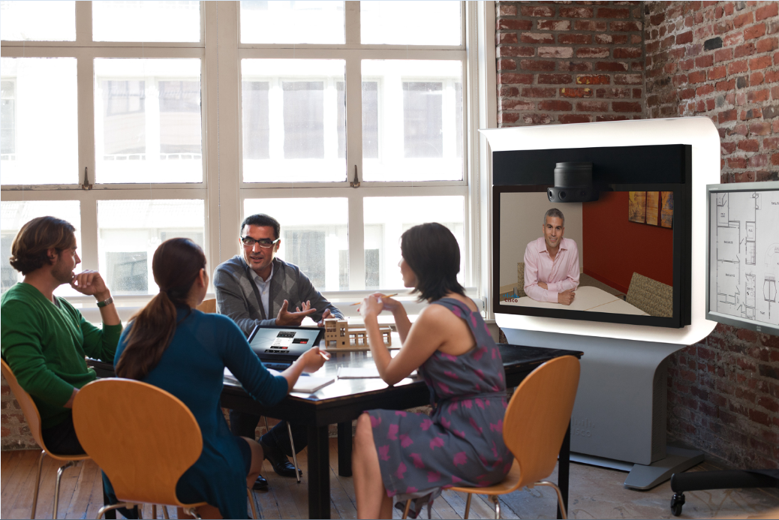
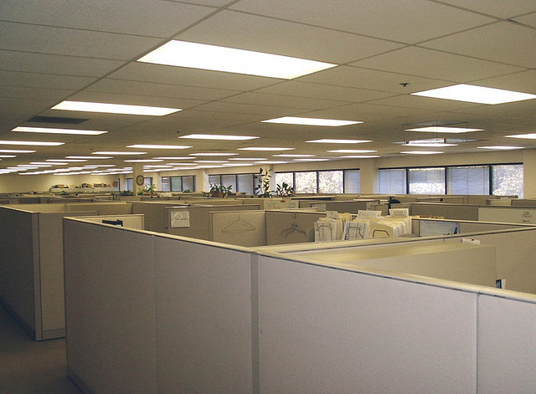


The Employee Today
VS
The Workplace Today
The 21st Century Employee tethered to the 20th Century Cubicle

Slide 4
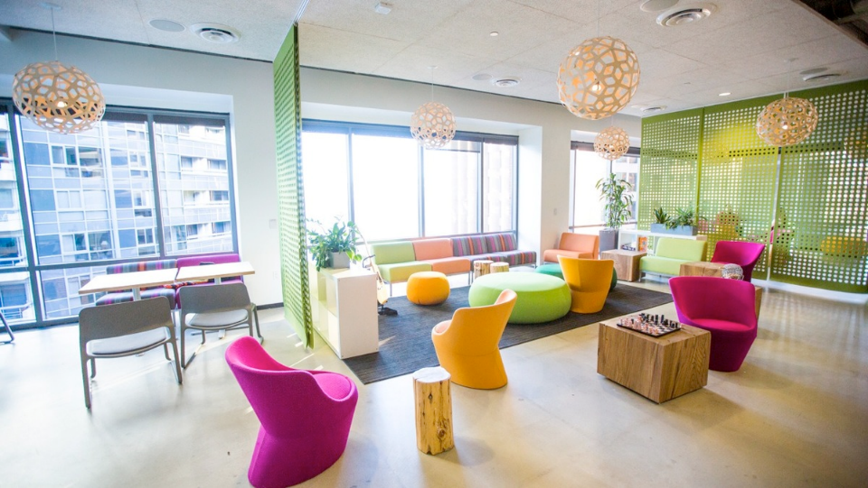
The Changing Workforce Experience…
Notes:
Based in San Francisco, New Relic is a software analytics company that makes sense of billions of metrics across millions of apps.

Slide 5
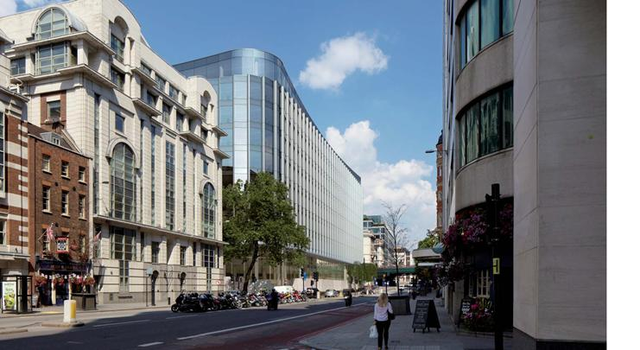
…It’s Not Just for Start-ups

Slide 6
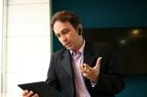
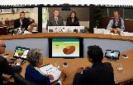

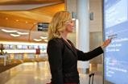

The Workplace is being Reimagined, as well as How and Where People Work
Devices
Collaboration
Demographics
Consumerization
Work Life
15 billion connected devices by 2015 and growing
2 networked devices per capita: 2015
Connecting not just people but machines (2 billion by 2015)
Workplace more distributed than ever
Higher collaboration needed for geographically dispersed teams
Bi-generational workforce driving change
Need to retain existing aging talent innovatively
Need to provide solutions for all workers based on preference
Consumerization of IT driving new product innovations
IT applications and services are more socially aware and end-user friendly
Interplay between professional and personal lives
Balance is key to talent attraction and retention
Notes:
$1000 is the avg cost of rent per employee per month (HK trebles) @ 50% the observed utilization of corporate office space

Slide 7

What Line of Business Leaders Care About…
Develop
Our
BRAND
EMPLOYEES
Customer Experience Officer
Public Relations
CEO
INVESTMENTS
Develop
Our
Maximize
Our
Human Resources
Corporate Real Estate
Finance
IT
Product Development
CIO
Notes:
We understand what our customers what, but we MUST align to their needs
There are universal needs outside the CIO that applies across industry – business view
Its all about understanding how we sell to the business

Slide 8
They Seek SOLUTIONS Related to These NEEDS
Develop
Our
Employees
Develop
Our
Brand
Maximize
Our
Investments
Employee Engagement
Workplace Optimization
Mobile Workforce
Attract Talent
Skills Development
Customer Loyalty
Revenue Growth
Sustained Competitive Advantage
Decrease Operational Costs
Increase Efficiencies
Enhance Security
Do More With Less
Notes:
The conversation shifts to relating our customers outcomes to the language of Cisco
Customers are trying to address regulatory standards, protect their Brand such as retailers
There are IT challenges too as business imperatives is not about just LOB
Establishes a common taxonomy from within we can sell
Improve Real Estate utilization
Attract/retain current and future talent
Skills development and transferring institutional knowledge
Gaps in innovation/ responsiveness

Slide 9

Workforce and the Individual
Me
My team
My initiatives
and tasks
My partners
and customers
My workplace functions
  Using a personal phone for work to prevent carrying two devices
  Parent working from home and going to local branch office for a short meeting
  Engineer collaborating with her team to design an aircraft part
  Sales manager running a weekly call with a geo-separated team
  Product manager locating experts to review application prototypes
  Physician viewing schedule for the day and optimizing his schedule
  Procurement manager sharing contract documents with supplier
  Portfolio manager polling customers to identify unmet needs & product opportunities
  Nurse logging the time for the week and picking shift hours
  Sales person booking conference room in a remote office for a customer meeting
Collaboration
Communication
Secure Connectivity

Slide 10


Workforce Experience Capabilities
Safe, Secure Workplace
Flexible Work Environments
Pervasive and Connected Digital Workplace
Flawless, Effective Meetings
Modernized, Branded Workspace
Accelerated incident awareness and faster response time
Deliver appropriate information to relevant personnel for better employee assistance
Create workspaces that encourage collaborative working practices
Secure access to the right resources from anywhere
Simplify workflow and improve productivity by directly integrating to the applications that you use most often
Optimizing experiences for the changing workforce
Reduce employee travel, real-estate costs, and environmental impact by meeting virtually
Impactful experiences across devices
Leveraging the workspace as a brand element
Attract and retain talent with optimized experiences from their device
Notes:
What Capabilities are you looking to deliver?

Slide 11















IP Convergence of Workplace Services
High Voltage A/C
BACnet
Cloud Management and Analytics
Coax
PBX
Experiences
1995
2005
Late 2000s
2010
2015
Data
Network
IP Telephony
IP Cameras
Building Management Systems using
low-voltage PoE
Smart
Lighting with
low-voltage PoE
OpEx
Notes:
Beginning: Many separate lines and protocols, but what line did they converge onto? The data network. Why? Easiest to install Cat6 cable and you get software control of all aspects of the service: power, data, and control.
IP Telephony: Voice integrated into software for collaboration productivity and unified communications.
IP Cameras: Simplified bandwidth, storage, access for video information. No longer limited to just what’s on recent tape for surveillanc.e
Building Management: Central management across multiple buildings. For example, at Cisco our facilities team manages all 300 of our worldwide buildings from just 4 operations centers. When you connect your building management to the network, you break free of having to control each building from inside.
Smart Lighting: Control from anywhere, easier to deploy.
Overall: Lower OpEx, and better People Experiences…enabled by Cloud Analytics on the data and central management of these services

Slide 12

Every User Is A Buyer, Is an Influencer
HR
Employee engagement
Operations
Flexibility,
efficiency
Workplace Mgt
Flexibility,
productive environment
Engineering
Faster Innovation
Workforce Expectations
IT
Security, flexibility, network
availability
Finance
Analytics, compliance
Sales
Proactive
experiences across devices
Marketing
Generating awareness and
leads
xxx
© 2014 Cisco and/or its affiliates. All rights reserved.
Cisco Confidential
12
Notes:
The point of the slide is to connect to key outcomes that different departments across the customer would be looking to address for successful outcomes.

Slide 13
Change to Business Outcomes
Customer
Experience
Workforce
Experience
IT Transformation
Business Operations Innovation
Increase Customer Loyalty,
Drive Sales, and Deliver Continuous Operational Improvements
Increase Innovation, Productivity and Satisfaction by Providing Workers a Better Experience
Transform to deliver agile IT outcomes and reduce risk
Digitize and Improve Connected Operations, Facilities and Supply Chain Management
Key Buyers
Chief of Sales and Marketing
Head of Customer Engagement
CIO
General Management
Human Resources
Workplace Management
CIO
Head of IT Infrastructure
CFO
Operations Leaders
VP of Manufacturing
VP of Procurement
Notes:
Ensure using Practice language.
Customer Experience
$4.5B shift to Omnichannel
$7.9B Digital Branch and Retail Innovations
Mobile Device Revolution (1.3B to 3.2B by 2017)
Workforce Experience
Represents over 40% of global tech spend
Companies are cutting sq. ft/ employee in half
Mobility, Video and Security are key enablers
IT Transformation
>70% of IT budgets supporting legacy apps
Cloud spending >$100B, growing double digits
Technology expenditures moving out of IT control
Business Operations Innovation
Changing customer requirements
Volatile economic conditions
Wider geographic dependencies
Why is it different this time?
Customer-in perspective (guiding principles)
Cisco Sales motion – how pull partner closer to that
Tie back to main stage – partner evolution, partner of the future

Slide 14



Workforce Experience – Alignment across functions
GENERAL MGT
IT EXECUTIVE
REAL ESTATE/WPR
Maximize worker productivity and retention, while keeping employees safe and satisfied
Provide workers the tools and services they need to be productive, collaborative and secure, anywhere on any device
Optimize the physical workplace for maximum efficiency, effectiveness and safety
Driving to a common workforce experience that resonates with the changing expectations of the digitally connected workforce

Slide 15


Which workforce trends are influencing your company?
Cost of real estate
and occupancy utilisation
Distributed workforce & need access for multiple smart devices access from anytime, anyplace anywhere
Increasing push for sustainable energy efficient workspace
Changing workplace patterns to enable of agile work culture
  Next generation talent attraction and retention
Notes:
$1000 is the avg cost of rent per employee per month (HK trebles) @ 50% the observed utilization of corporate office space

Slide 16

Enabling Capabilities and Outcomes through Validated Business Offers
Enable
Digital Workspaces
Create Flexible and
Branded Work Environments
Business Video
Tech-enabled Workspace
Deliver Flawless, Effective
Events, Meetings and Training
Mobile Workspace
Workspace Management Tools
Collaborative Knowledge
Business Conferencing
Secure BYOD
  Increase innovation, productivity and satisfaction by
  providing workers a flexible, secure and collaborative
  work environment anywhere work needs to get done

Slide 17
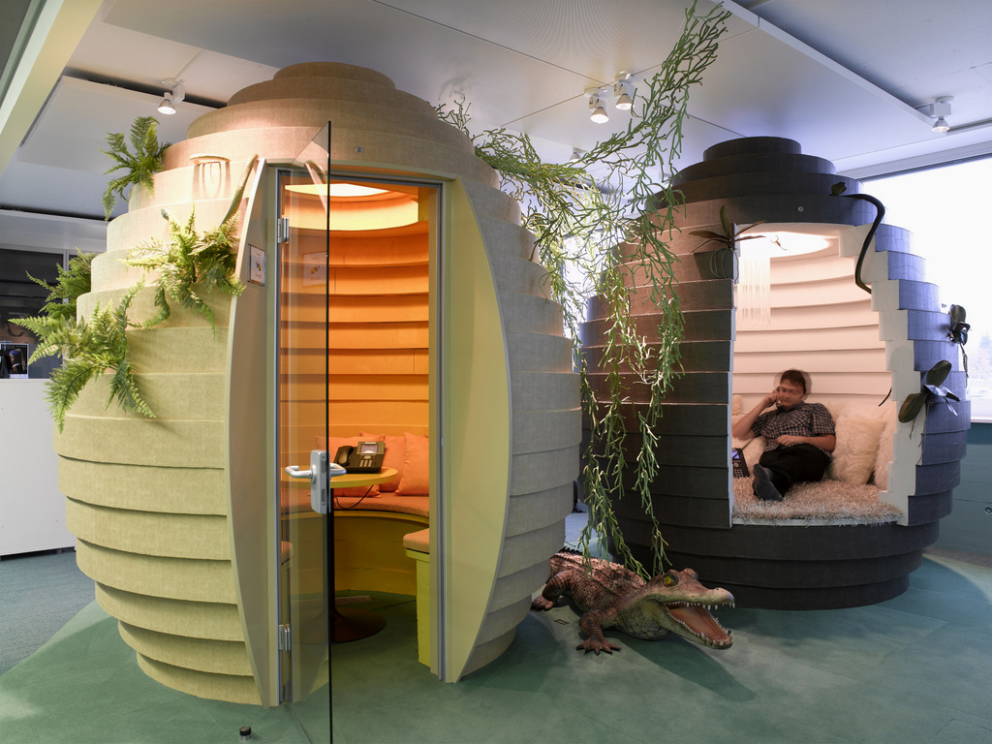
Create Flexible and Branded
Work Environments
Enable
Digital Workspaces
Create Flexible and
Branded Work Environments
Deliver Flawless, Effective
Events, Meetings and Training

Slide 18
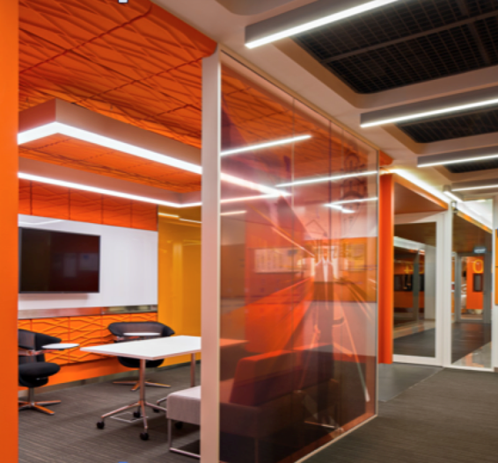
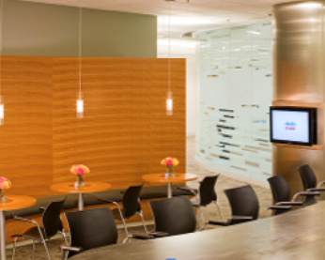
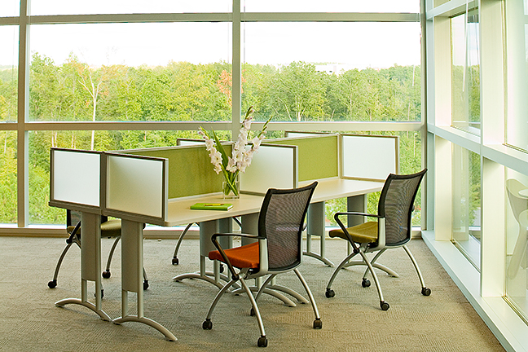
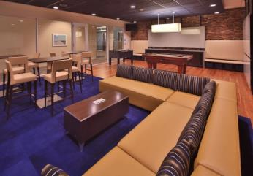
A New Design Paradigm - Activity-based Working (ABW)
Creating a variety of workspace experiences
that are aligned to the activities being performed

Slide 19
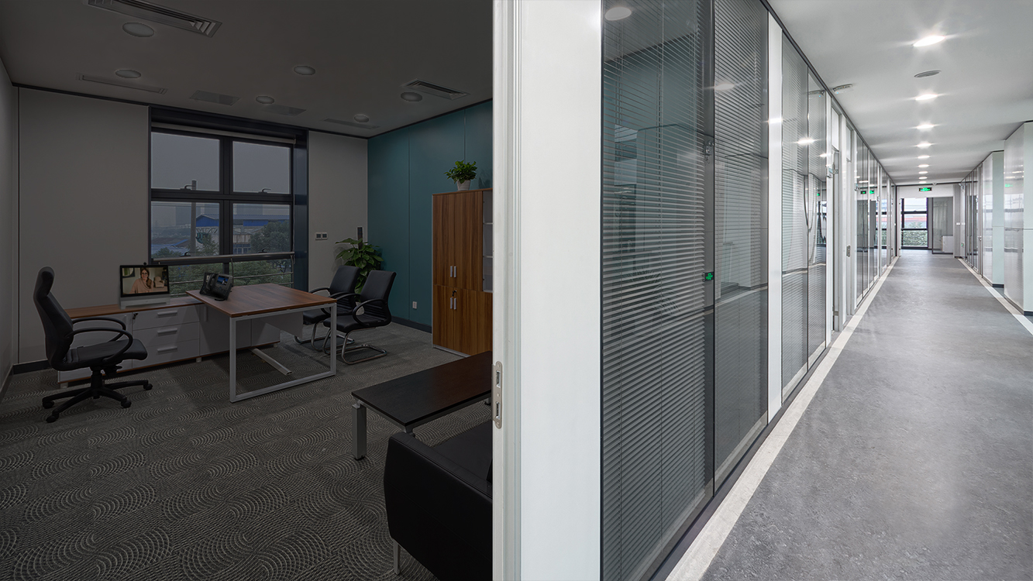
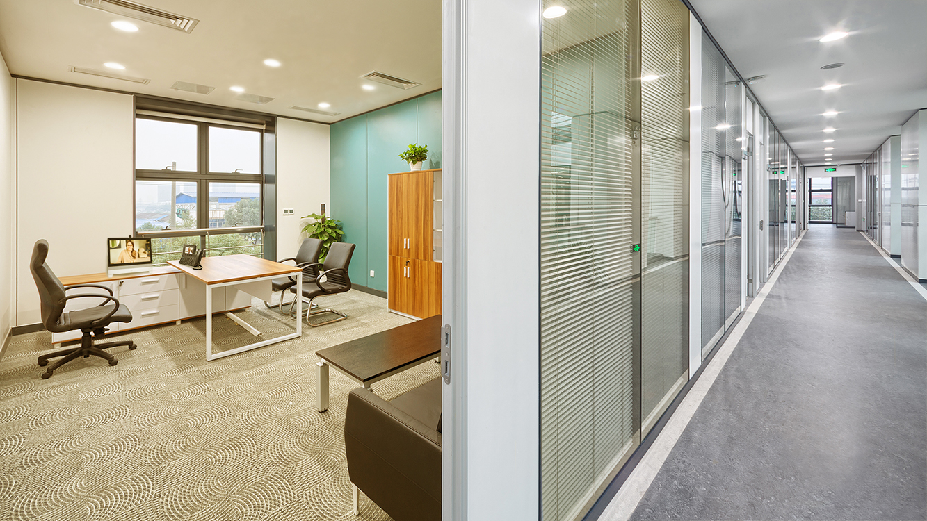

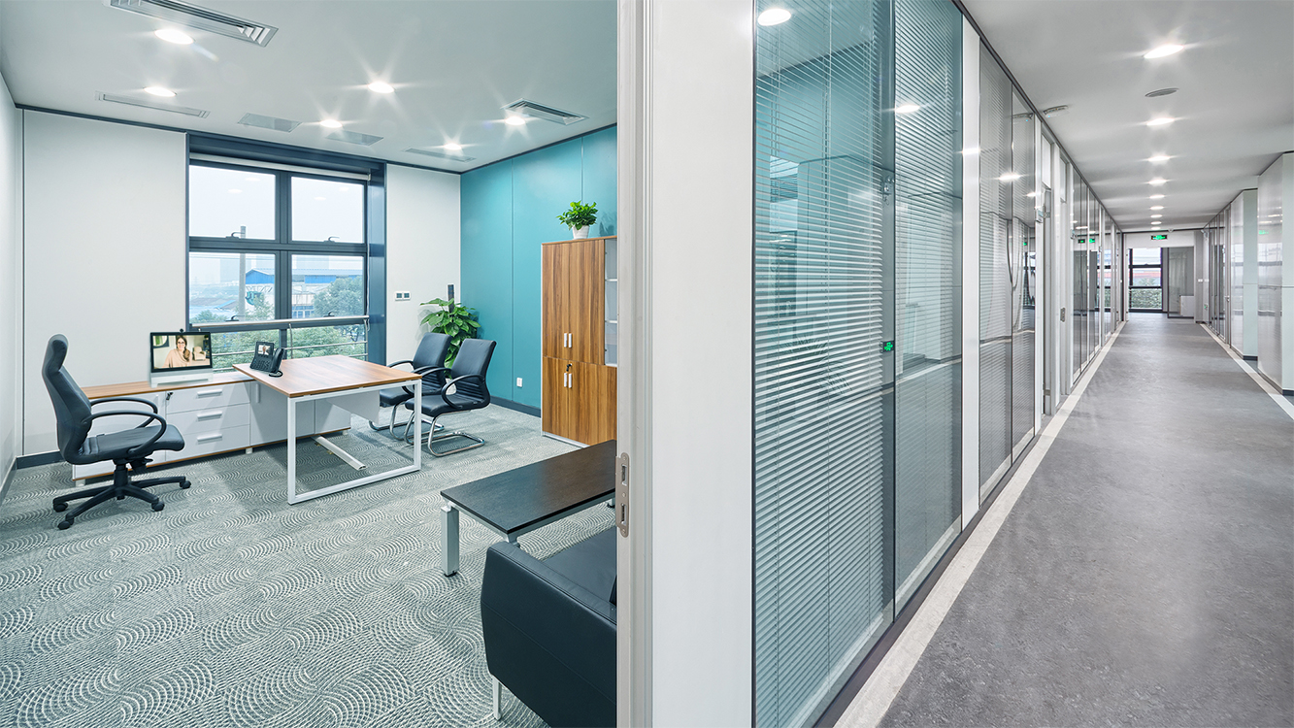
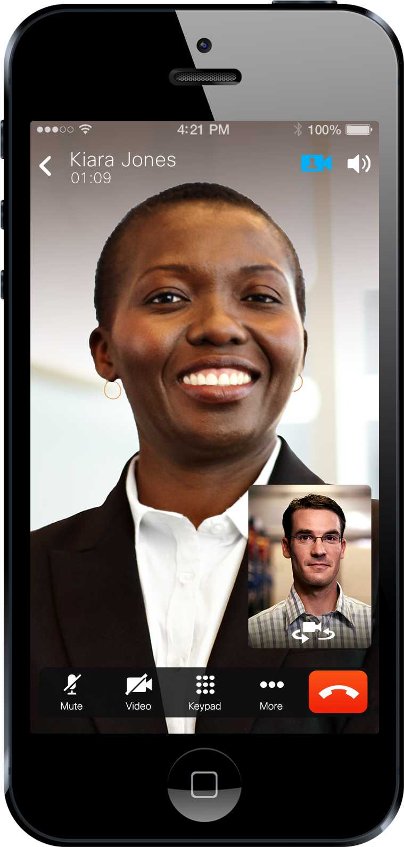
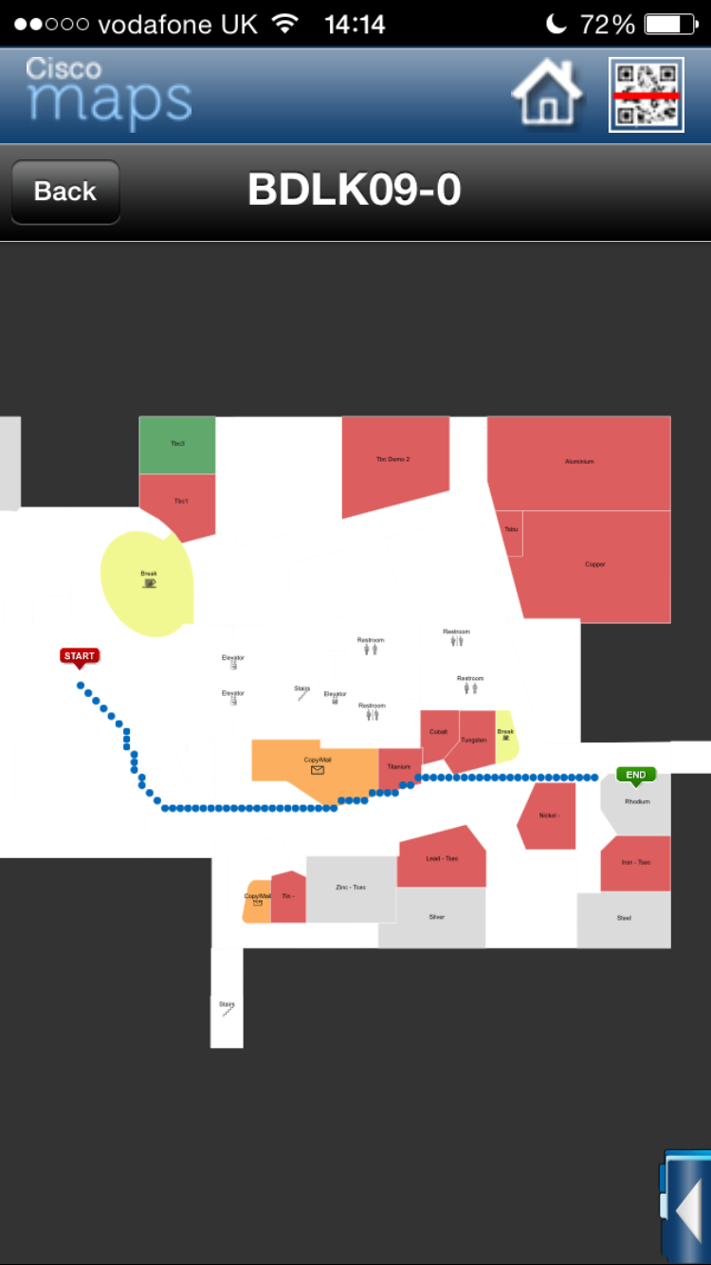
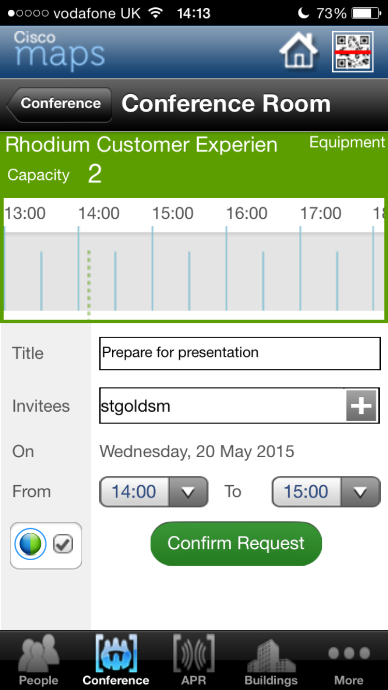
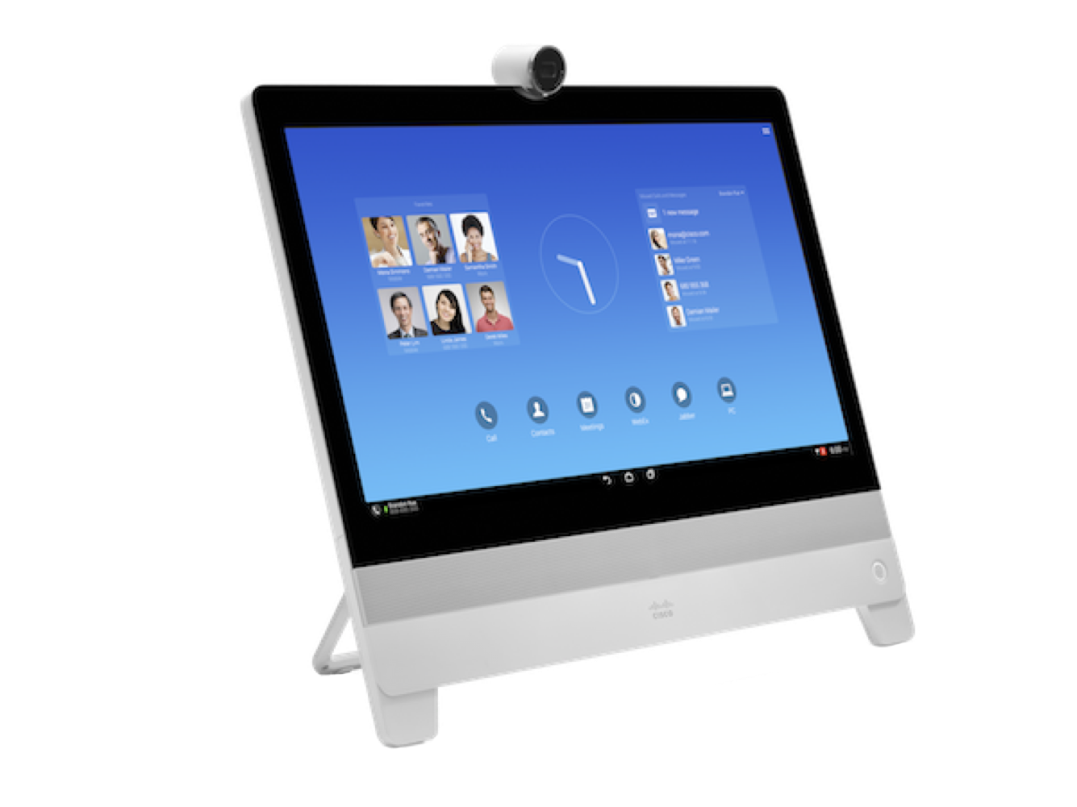

Enable
Digital Workspaces
  Dynamic Workspace Allocation
Create Flexible and
Branded Work Environments
Deliver Flawless, Effective
Events, Meetings and Training
  Reserve
  Locate
  Experience
Temperature
Color
Blue
68°
74°
Intensity
High

Slide 20
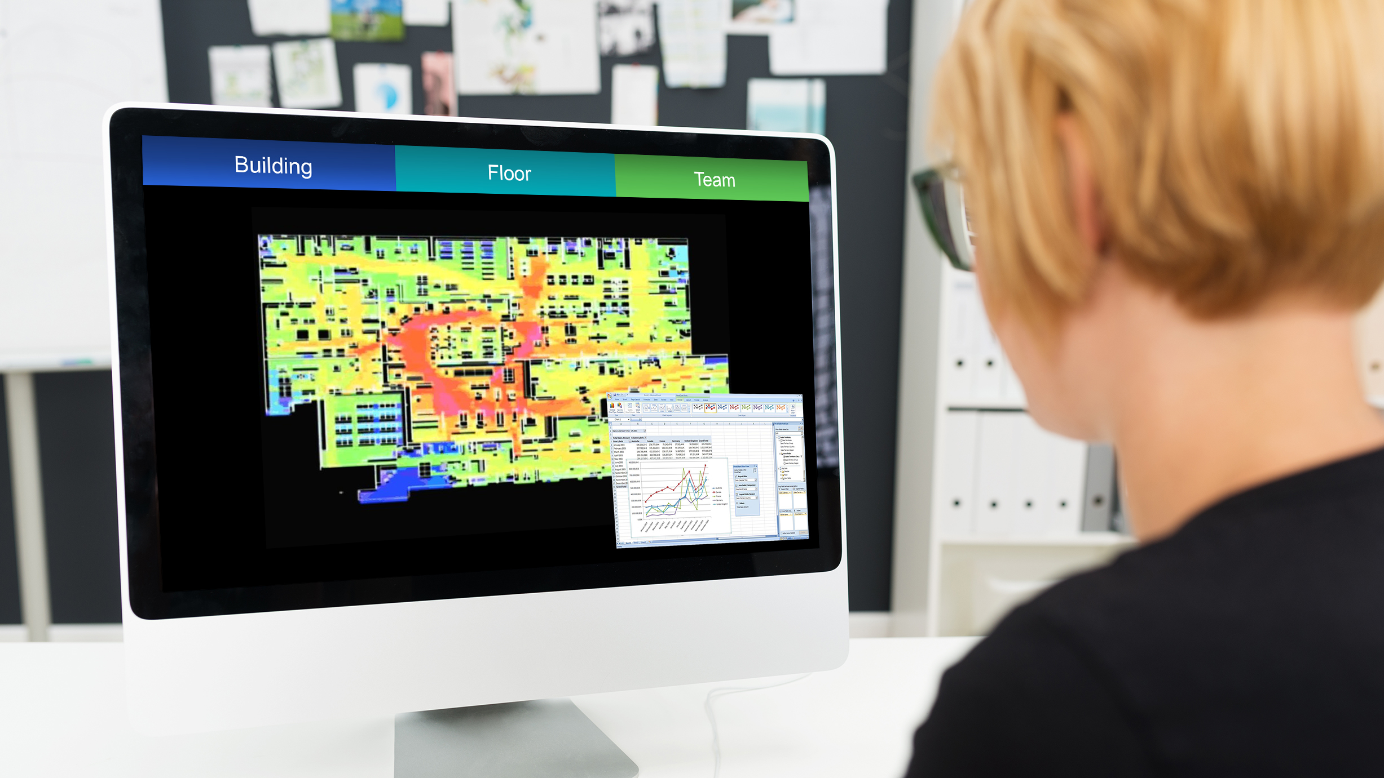
Enable
Digital Workspaces
Create Flexible and
Branded Work Environments
Deliver Flawless, Effective
Events, Meetings and Training
Workplace Analytics
Occupancy and Utlization
Dwell Times
High Traffic Areas
Secure Area Violations
Notes:
When paired with the Cisco MSE, you can extend these capabilities to detect, locate, and mitigate rogue devices over the air as well.

Slide 21
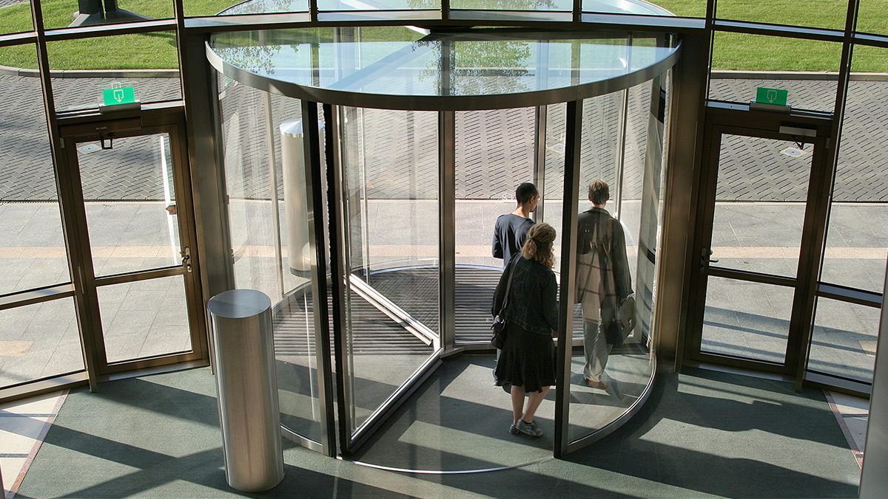
Enable
Digital Workspaces
Create Flexible and
Branded Work Environments
Deliver Flawless, Effective
Events, Meetings and Training
Keep Employee Safe
Emergency Notifications
Employee Location
Dispatch and Incident Response
Notes:
In times of emergency, the notifications on digital signage and IP phones that are configured as part of Emergency Notification can be life saving.
•Cisco Smart+Connected Emergency Notifications (Smart+Connected EN)—Complements existing emergency alerting and evacuation systems by displaying the notifications and exit routes on the digital signage in times of an emergency. Also sends audio and text notifications on the IP phones during a crisis.
InformaCast Advanced Notification is a full-featured emergency notification solution that enables people to reach an unlimited number of Cisco IP phones, speakers, cell phones (with InformaCast Mobile Service) and other devices with text and live, ad-hoc, pre-recorded, or text-to-speech audio.
At present, 17 different radio channels are available to the Cisco IPICS installation. In addition to the security and safety teams, Cisco Workplace Resources (WPR), the Cisco facilities management team, leverages IPICS—allowing WPR employees in Raleigh, NC to communicate with their East Coast dispatch center in Boxborough, Massachusetts.
Emergencies have already proven the unique capabilities of Cisco IPICS. Recently, a natural gas leak at a Raleigh construction site required the evacuation of the entire Cisco Raleigh campus, including its SFOC. During this major emergency, San Jose-based SFOC dispatchers took over dispatch for East Coast operations. Meanwhile, facilities and emergency managers in the United Kingdom and in several locations in South America communicated directly with the Incident Commander in Raleigh. Similarly, when a burst water pipe flooded one of the San Jose headquarters buildings, managers in Raleigh and Boxborough, using different radio systems, could be patched in to assist with the response. The bottom line? As long as the Cisco network is up, global communication is both possible and highly efficient.
Heart attack

Slide 22
Create Flexible and Branded
Work Environments
Enable
Digital Workspaces
Create Flexible and
Branded Work Environments
Deliver Flawless, Effective
Events, Meetings and Training
Workforce | Facilities | Organization | IT
Richer Experience Better Productivity Safer Environment Health and Wellness | Lower Real Estate Costs Reduced Service/Energy Costs Real Estate Utilisation Insights Keep Workers Safe | Optimised Space Utilisation Better Workforce Experience Use Office as a Brand Environmental Responsibility | Integration to Existing Systems Maximise Current Investments Enabler to the Business Management and Control
Notes:
The ability of fluorescent lamps to suppress melatonin in humans
In a 2014 study conducted by Global WorkPlace Solutions (GWS) and CoreNet Global, 75 percent of those surveyed said that when seeking a new position, it's important that a potential employer support health and wellbeing. Once in the job, more than half (57 percent) said they would be likely to stay longer if their employer valued health and wellbeing.

Slide 23
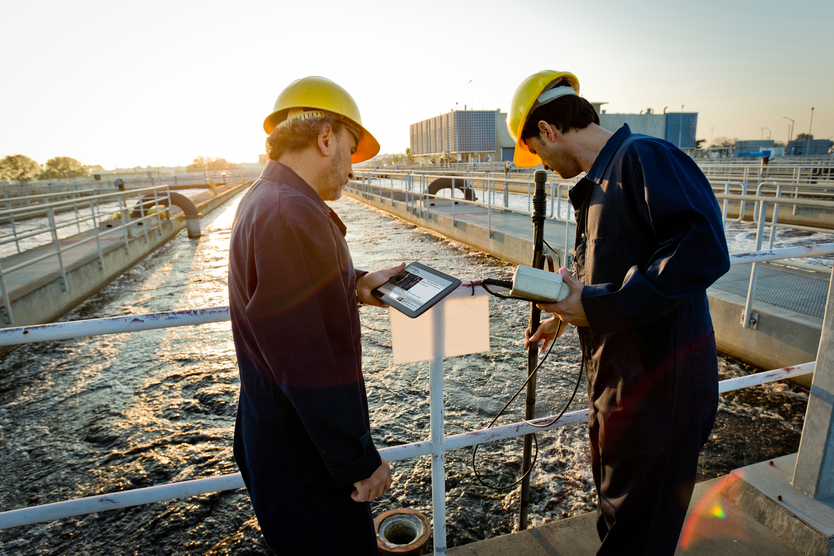
Enable Digital
Workspaces
Enable
Digital Workspaces
Create Flexible and
Branded Work Environments
Deliver Flawless, Effective
Events, Meetings and Training

Slide 24
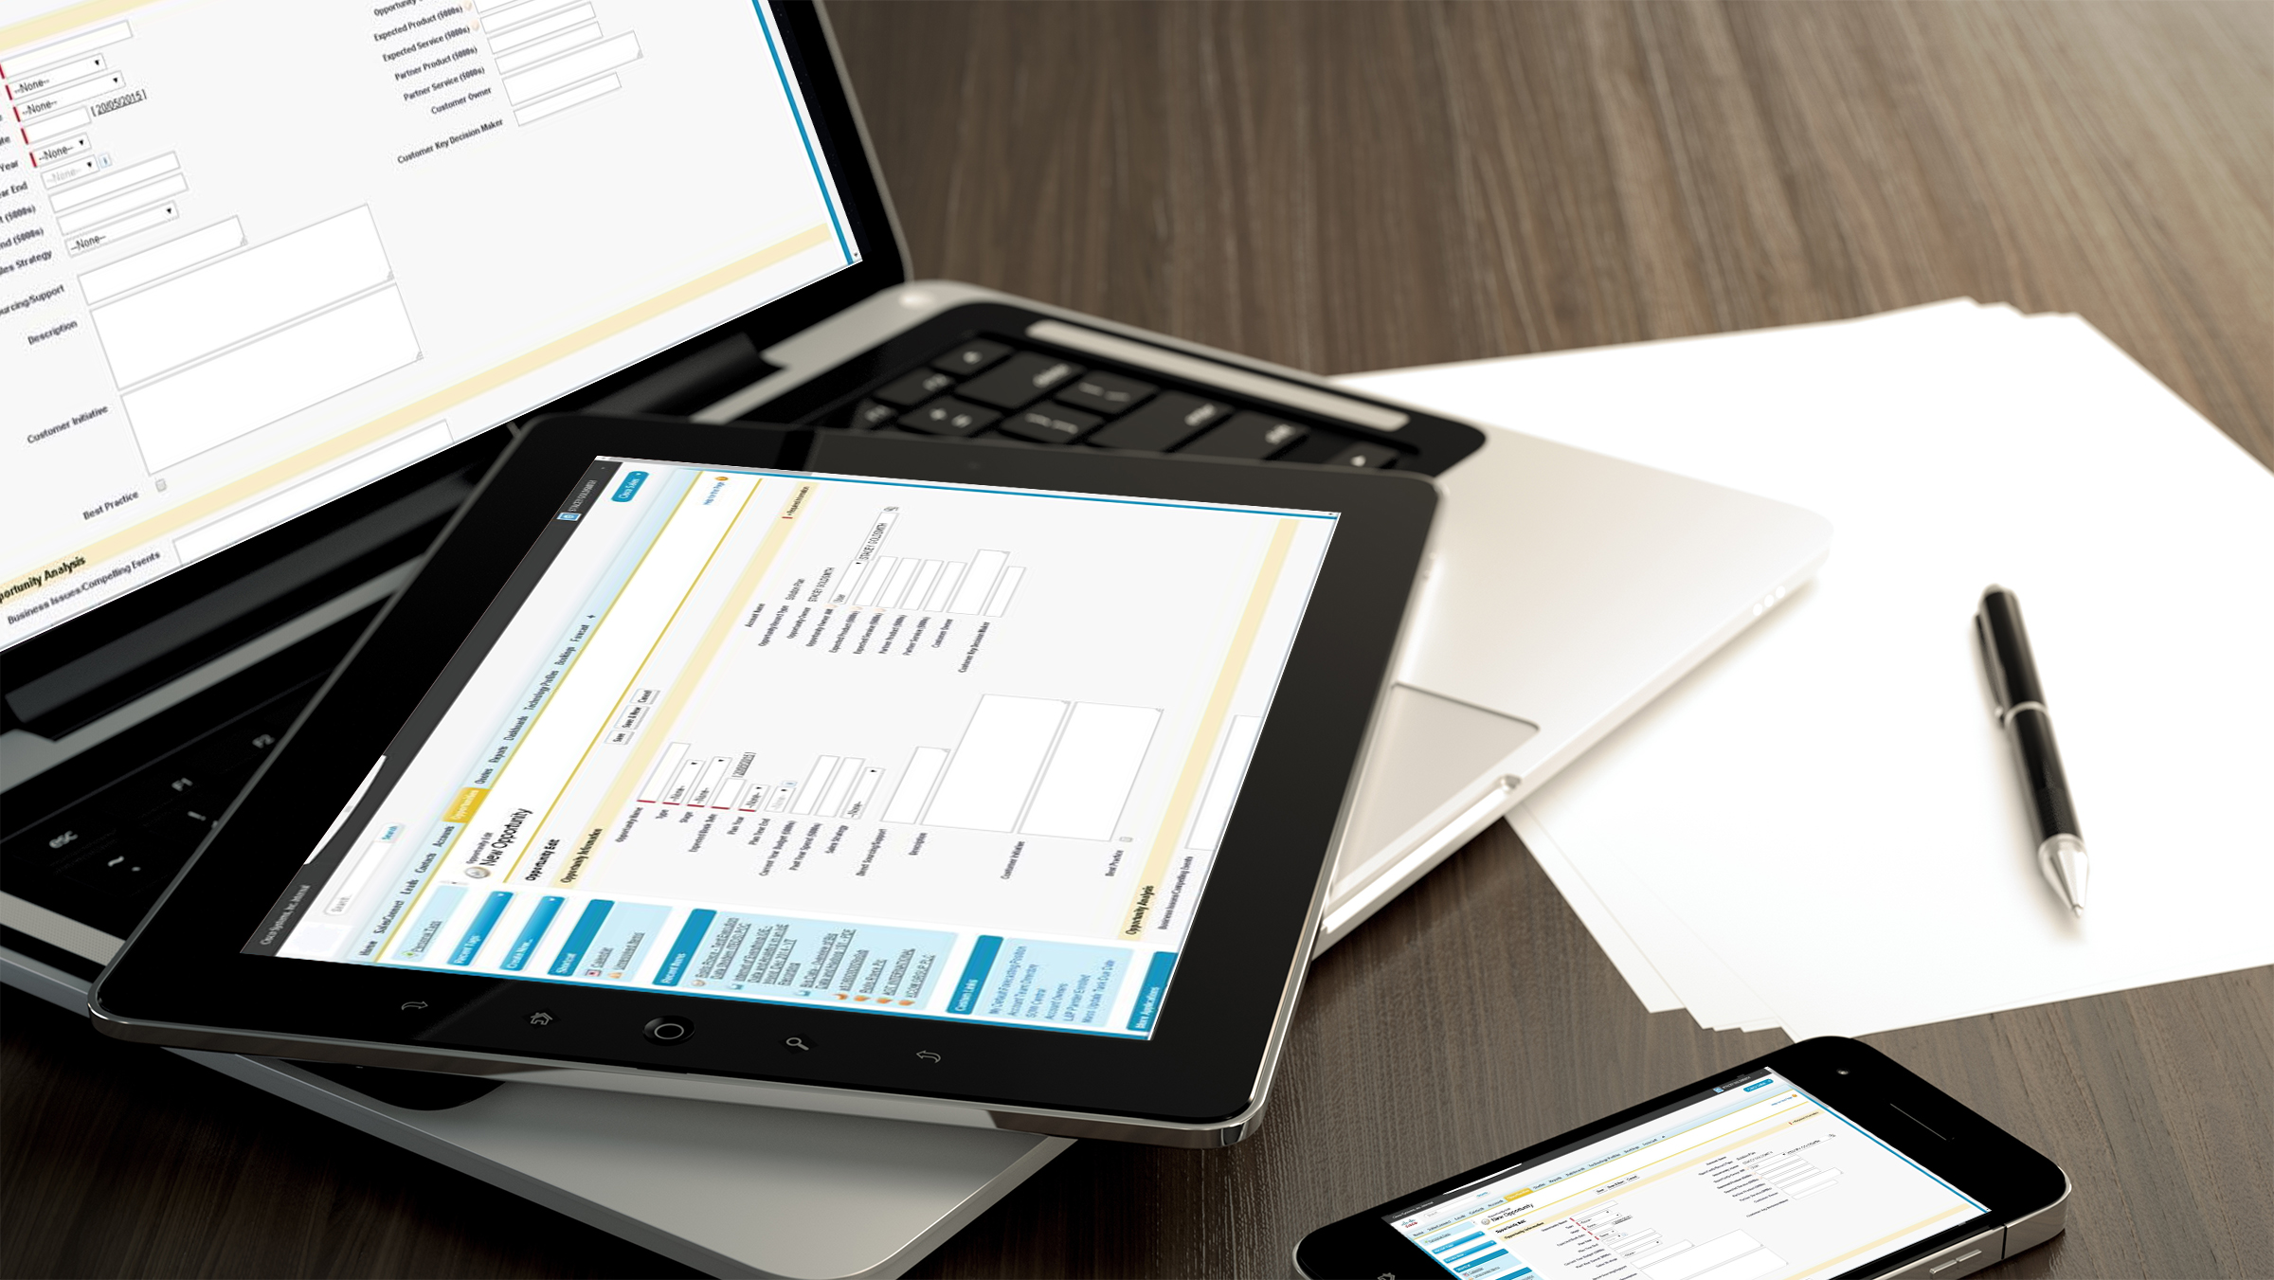



Enable
Digital Workspaces
Create Flexible Branded
Work Environments
Secure Access to Information and Resources
Deliver Flawless, Effective
Events, Meetings and Training
On the Move
From the Workplace
On Any Device
Notes:
Sub-optimized Real Estate utilization: 40% average occupancy

Slide 25
Enable Digital
Workspaces
Enable
Digital Workspaces
Create Flexible and
Branded Work Environments
Deliver Flawless, Effective
Events, Meetings and Training
Workforce | Line of Business | Organization | IT
Reduced Commute Time Choice Work / Life Balance Consumer Experience | Mobility Increased Productivity Faster Response Times Better Collaboration | Workplace Space Optimisation Reduce Cost Increased Employee Productivity Recruit Best Talent | Operational Simplicity Integrated Multi-level Security Increased Control Reduced Risk

Slide 26
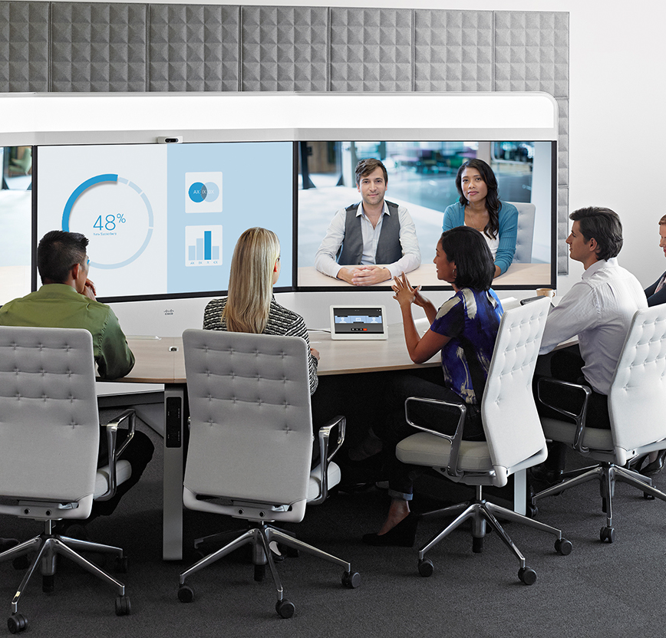
Deliver Flawless,
Effective
Events, Meetings and Training
Enable
Digital Workspaces
Create Flexible and
Branded Work Environments
Deliver Flawless, Effective
Events, Meetings and Training

Slide 27






Enable
Digital Workspaces
Create Flexible and
Branded Work Environments
Deliver Flawless, Effective
Events, Meetings and Training
From Pocket to Boardroom
Best Experience for the Capabilities You Have

Slide 28
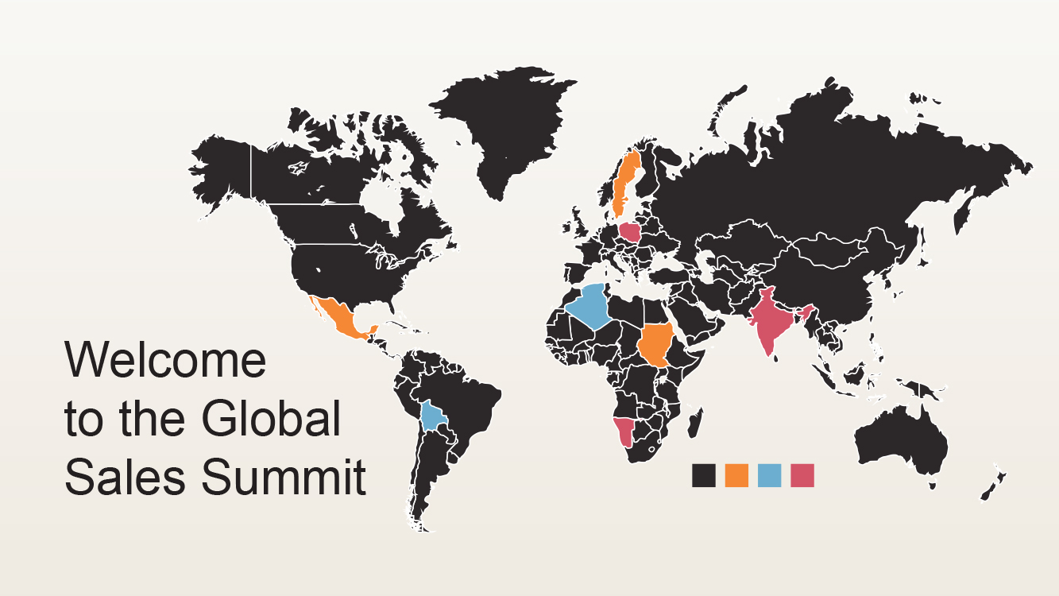





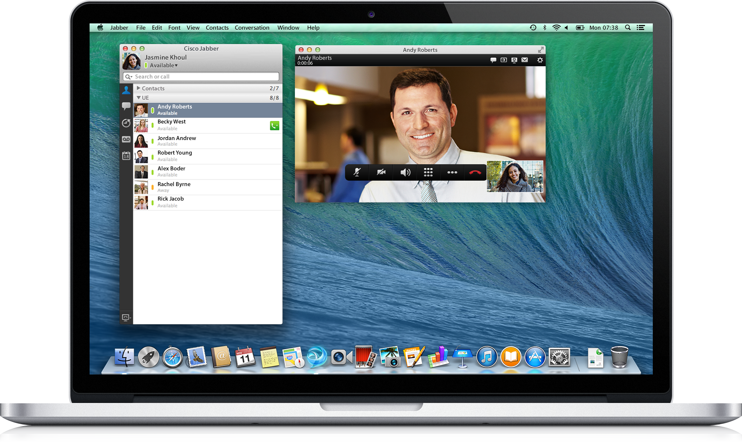
Enable
Digital Workspaces
Create Flexible and
Branded Work Environments
Deliver Flawless, Effective
Events, Meetings and Training
Virtual Events
On any Device
Internal and External
Audience Engagement

Slide 29
Deliver Flawless,
Effective
Events, Meetings and Training
Enable
Digital Workspaces
Create Flexible and
Branded Work Environments
Deliver Flawless, Effective
Events, Meetings and Training
Workforce | Line of Business | Organisation | IT
Reduce/Eliminate Travel Time Choice of When and Where Keep Up-to-date Sense of Inclusion | Engage with Customers Persistent and Reusable High Quality Production Real-time and Post Event Metric | Travel and Expense Reduction Broader Reach Engaged Employees Environmental Responsibility | Fast and Reusable Deployment Maximise Existing Investments Technical Reassurance

Slide 30
Enabling Capabilities and Outcomes through Validated Business Offers
Deliver Flawless, Effective
Events, Meetings and Training
Enable
Digital Workspaces
Create Flexible and
Branded Work Environments
Create Flexible and
Branded Work Environments
Enable
Digital Workspaces
Business Video
Mobile Workspace
Tech-enabled Workspace
Workspace Management Tools
Collaborative Knowledge
Business Conferencing
Secure BYOD
Deliver Flawless, Effective
Events, Meetings and Training
Smart + Connected Personalized Spaces/Meetings
Physical Security and Access Control
IPICS
Location-based Services
Project Workspace
Connected Lighting
Smart Lockers
Virtual Town Halls
Collaborative Knowledge
Collaboration Meeting Rooms
WebEx
TelePresence
SocialMiner
Global Virtual/Hybrid Meetings
SPARK, Jabber, Social Tools
Voice & Video Call Control
Video End Points
IP Phones
Unified Access
Intelligent WAN
Remote/Guest Access
Policy Control
Connected Analytics

Slide 31
















Partnering to Ensure Customer Success
Key Stakeholders (Corporate Real Estate, HR and IT)
Adoption Management/
Optimization
Portfolio Analysis/
Rationalization
Executing
Assessing
Implementation
Business Analysis/ Business Case
Construction/
Build out
Work-style Analysis
Readiness Assessment/
Gap Analysis
Planning
Space Design
Tech Arch Development
IT Functional Requirements

Slide 32


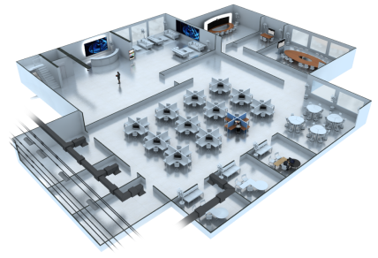


Smart + Connected Workplace
Digital Signage &
Guest Services
Workplace Analytics
Ubiquitous Wi-Fi
and BYOD
Intelligent Video Collaboration
Smart Spaces
Unified Network Access
Security & Identity Services
Personal Collaboration
Energy Management

Slide 33






















Architectural Elements
Head Office / Data Centre
Cloud
Additional
Apps
Smart Connected Apps
Applications
TMS
Prime
Apps
S+C
Federation
IM and Presence
Expressway-E
Unified CM
Internet
DMZ
Expressway-C
Mobile Workers
Call Control
TS
Conductor
Unified
Access
ISE
MPLS WAN
IGW / IWAN
APs
IGW / IWAN
Conferencing
Core
Edge
PSTN
Remote Sites
Endpoints

Slide 34




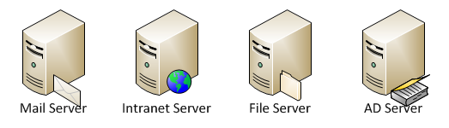














Smart Spaces Solution Technology Architecture
Application & Middleware
Database
Administrator Console
Cisco MSE
Mediation Layer
Content Management
Cisco CUCM
Cisco -TMS
Dimming Controller
HVAC Controller
Audio Visual Controller
Wi-Fi Access-Point
Air-Conditioning
Jabber
IP-Phones
Lighting
Audio-Conference
Telepresence-System
Blinds
Projector
Projector-Screen

Slide 35
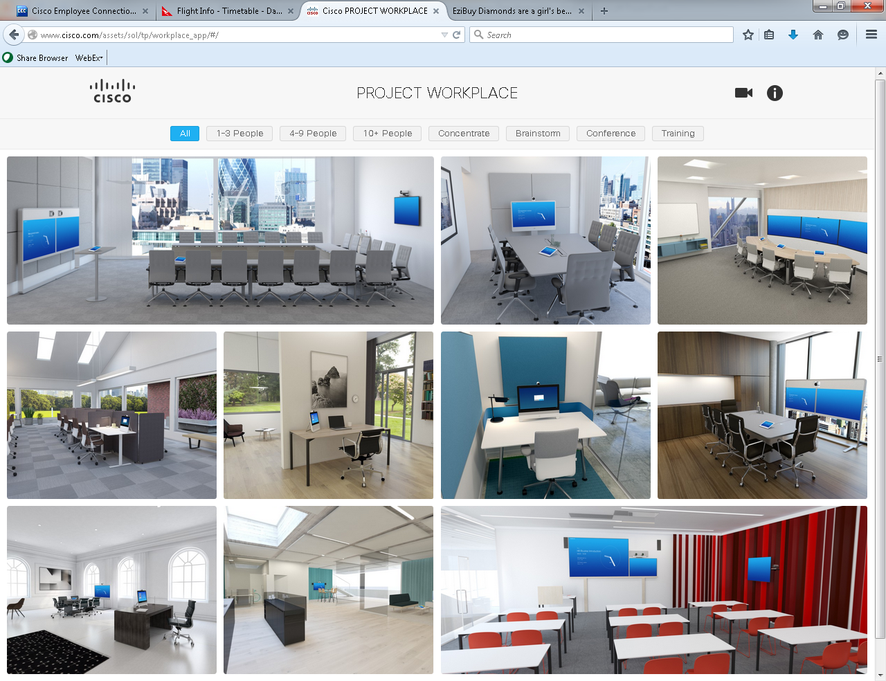

Slide 36
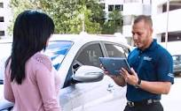
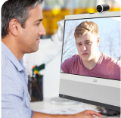
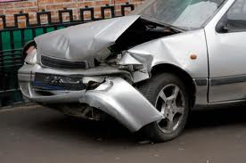
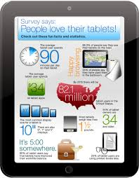

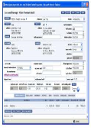

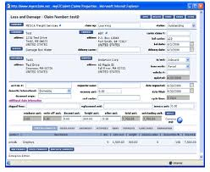



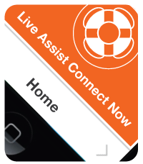
Connected Claims – FCR Support Use Case
Challenge
Use Case Scenario
New FCR needs support and access to SME resource while in the field at a claims site
Live video chat with SME is enabled with 2-way video share, co-browse, document share…
SME provides interactive support, relevant documents & web links to FCR
Business Impact
New FCR has question and clicks to connect with an SME or manager while
on-site of a claim
SME can conferences in other parties via voice/video as needed
Body Shop
Road Side Assistance
Other
New FCRs are able to “hit the street” earlier in on-boarding process
SMEs or managers can provide support virtually
Accelerated claims processing with increased accuracy
Enhanced customer experience
FCR shares video & details of claim with SME in
real time
Streamlined process drives efficiency, accuracy & customer experience
Notes:
Policyholder and Claims Interaction
An existing customer is involved in an Auto accident.
The customer accesses their insurance ID card from their mobile application on smart phone and receives “what to do next” steps to direct them…
Customer clicks on “connect now” button and launches video/voice interaction with claims contact center representative.
Contact center representative is able to identify client by the insurance id card information embedded in the smart phone app.
Contact center rep .can also see location of client pop up on map from mobile device GPS.
Contact center rep. asks “Mr. Jones is everything ok, how can we help?”
Customer responds, “I’m ok, but my car is not, I’ve been in an accident”.
Contact center provides real time interaction and support with customer at crash site including…
Steps to capture crash site and damage via video which is shared with claim rep.in real time
Brings in a 3rd party Emergency Road Service provider to coordinate towing of the vehicle which is not drive-able.
Identifies several body shops nearby that can be selected for repairs so the car can be towed directly to the shop to expedite repairs.
Brings in the 3rd party body shop to interact with the customer via voice/video.
Brings in a 3rd party rental car provider who will arrange to have a rental brought to the site so the customer can have access to a car while their vehicle being repaired.
Contact center representative pulls updates the client’s agent of accident occurrence and all steps taken.
Customer is so amazed by the claims process he does not accept offers to save and switch to other carriers and stays with insurer longer. He also tells others about his great experience via social media and personal referrals.

Slide 37

Business Outcomes
Increasing Productivity AND Reducing Costs at Cisco
30%
50%
82%
Reduction in office space
Reduction in chargeback per employee
of employees say communications have improved
16%
$584M
80%
Reduction in development cycles
Reduction in travel costs
Increase in employee satisfaction
Notes:
Rob and Hans, these are stats and background we have, pulled from various other presentations.
Most of these numbers are from 2007.
Reduced office space
30% is a per person number
Related stats:
Individual workspace cost avoidance: 60%
$4k to outfit a cube (not including PC, phone) – down to $1600/seat
Facilities cost avoidance: 37%
IT capital spend reduction (when in a primarily wireless environment):
Equipment & cabling: 40-50%
IT equipment rooms: 40-50% overall space reduction (which is 1-2% building sq.ft.)
Furniture cost reduction in new projects: 32%
2. Reduced chargeback per person
The WPR price per person (Legacy Environment) was $5,162 / year (I assume this was recovering costs). And the CCW price was $2,596 / year. (ditto)
We have 79.6K people housed; 25% of them are in CCW environments. That makes it around 20K people in CCW worldwide
Conclusion: So the cost saved by CCW might be said to be: $(5162-2596) x 20,000 = $51.3M/year
And if we expect to migrate another 5% each year, that makes another potential $12M/year savings added to the $51M/yr savings.
(April? 2007 survey but still being used by WPR)
3. Communications have improved
Source: Employee Surveys. Key question was if interaction with coaches, peers and members of other organizations improved. This is important because of the duality between innovation and failure – you can’t have one without the other. Employees are a lot more willing to take risks in their careers if they believe they have a strong social safety net. Knowing lots of people, and being known, ensures that you should not have a tough time finding a new project to work on if your current fails. This “Reputation as Safety net” is the secret behind Hollywood and Silicon Valley – two industries prone to either innovation or failure, not a coincidence that they are named after physical locations. One of the huge problems in most industries, but especially in technology, is that people don’t fail quick enough!
4. Reduced development time
This comes from survey with managers that migrated to new Connected Workplace sites. While we have seen a large increase in user employee satisfaction and over 30% cost reduction per employee in Corporate Real Estate, we are doing these projects to enable the new Cisco Culture. By ensuring that a diverse set of employees are actually working together at the office, that they can fail quickly and are spending most of their working time working instead of airport and airplanes, we are more productive – go figure!
5. Travel avoidance
Source: Cisco Travel. These are old numbers (I think we stopped collecting them in 2011), but they should be yearly savings and no reason to assume they are not valid anymore, quite the opposite. This was the business case for deploying Telepresence globally. We got very close to eliminating all of travel for internal meetings, and significantly reduced the need for traveling to expose talent and expertise with customers and partners. This number does not count the huge amount of time and productivity captured as well.
6. Increased employee satisfaction
Source: Employee Surveys. Key question was if employees prefer the new type of Activity Based Working (choosing the location of work based on tasks) that we created with Connected Workplace. This is important as we can’t force our top talent to come to the office, but we can build an office where people want to come. With it, we have both entry-level and senior employees at the office, sharing culture, knowledge, best practices and everything that we need to be the Cisco of the future. Without it, our top talent and executives are not attracted to our offices and knowledge and culture transmission struggle – Low retention rates for existing employees and high time to proficiency for new hires.
Other background:
70% of the time employees save in commute avoidance they give back to Cisco.
2-3% reduction in voluntary attrition rate saves Cisco over $75M per year to replace these employees
Not going between buildings saves time and dollars
As of 2014, about 26% of Cisco (20K people) are using CCW.

Slide 39


Thank You

