Slide 1
Background
INTERNAL
Event: Cisco Connect, Bangalore. Mobility track, 1.5 hours
Date: 28th May 2015.
Presentation: 30 mins – 10-15 slides
Audience: Target 75-80 SP Customers, ~25 for Mobility Track. Mix of BDM and TDM.
Cisco Objective: We want to bring in the business outcome plus technology roadmap for the industry as a whole in this session.
Domains of interest: Access HetNet, PaCo, Analytics (MIQ), NFV/Orchestration
Key objectives:
  Thought leadership on Mobile Data business and technical trends in the Indian context
  Continue to position Cisco as the technology leader and local partner
  Position NFV as ready and VoWiFi as a market disruptor

Slide 2
Strawman
INTERNAL
Title: Mobile Internet Insight
Global trends impacting Mobile Network evolution (OTT, IoE, NFV, HetNet) – 3 slides
Local Indian context (VNI) – 2 slides
Network Evolution Enablers – 1 slide
What’s new in Cisco Mobile Architecture (MWC view) – 1 slide
  HetNet – Universal Smallcells, SON, Analytics – 1 slide
  VoX – 1 slide
  Virtualized Packet Core – 1 slide
  Telco Cloud – 1 slide
Summary – 1 slide

Slide 3

Defining Virtual Mobile Services
Business Drivers and Technology Enablers
Marketing Presentation
Marketing Presentation
Dirk Wolter
Speaker Name
Speaker Name
Designation
Managing Director, Mobile Architecture, APAC
Designation
Date: 00/00/0000
28 May 2015
Date: 00/00/0000

Slide 4

Introduction: Business Transitions
New
Business Models
New
Competitors
New
Financials
Flexible, usage-based pricing
Direct, In-direct and Pass through
IoT/IoE
Global market reach over the top (OTT)
Reduced barriers to entry
Accelerating pace of innovation
Faster RoI
Predictable OpEx
Start-up innovation
Agile Dev-ops
Strategic Options: 1. Smart Utility 2. Platform provider/enabler 3. Diversified player
Notes:
Where do we see the Indian SP’s in respect to the 3 Options today and in the future?

Slide 5







Top-line Challenge
Manage Value Migration and Capture New Opportunities
Erosion of Traditional Services
New Services
>1Billion
5B MoU, +220%
OTT VoIP Users
VoWiFi exceeds VoLTE by 2018
800M, +75%
$10B, +49%
WhatsApp Users April 15
On-line Video
-$40B
$43B, +27%
Lost SMS revenue to OTT in 2014
Cloud Services
1,000
50 Billion
Apps added to Android every day
Connected Devices by 2020
Sources: ABI, IDC, In-Stat, Insight, Ovum, Parks, Screen Digest, Strategy Analytics, Cisco
Service Innovation needs Network Agility
Notes:
Indian context on the new services
New Services way more agile. VoWifi is a global trend – it adds value – service continuity across any network

Slide 6
Bottom-line Challenge
Operating Costs Reducing Margins
Indian MNO CAPEX & OPEX as % of Revenue
Network complexities contributing to OPEX growth:
  Legacy technologies
    Multiple-vendors, multi-OS
    Purpose-built hardware hardwired
    Multiple points of failure
Increasing provisioning and management costs
Slow to introduce: New capacity and services
OPEX
EBITDA
CAPEX
Source: GSMA Intelligence, 2015
Need to reduce Operational expenditure
Notes:
Asian Benchmark:
OPEX Margin = 75%
EBITDA Margin = 40%
CAPEX Margin = 20%
Operating margin, also referred to as operating profit margin, = EBIT is one measure of the company's profit level. It is shown as a percentage of total sales revenue with all costs of doing business factored into the equation except for taxes, interest, profit or loss from investments, and any extraordinary gains or losses from events outside of the company's regular business dealings, such as selling real estate or buildings. Costs included in figuring the operating margin include wages and benefits for employees and independent contractors, administrative costs, the cost of parts or materials required to produce items the company sells, advertising costs, and depreciation and amortization. Examining the operating margin helps companies analyze, and hopefully reduce, variable costs involved in conducting their business.
EBITDA is commonly considered more closely related to net profit margin, because the net profit provides the base number from which EBITDA is calculated. Net profit is the bottom-line calculation for a company's profitability, as it includes all of the company's costs and expenses, including taxes, interest, and one-time or extraordinary expenses, figures that are not included in the calculation of operating profit. EBITDA represents the net profit amount with taxes, interest, depreciation and amortization added back to that amount. Thus, EBITDA includes both items usually categorized under net profit (taxes and interest) and items usually categorized under operating profit (depreciation and amortization). The EBITDA figure is helpful in comparing the net profitability of different companies by factoring out of the comparison decisions related to financing and accounting.

Slide 7





India Mobile Data Traffic Drivers
In the next 5 years
More Mobile Users
2014
2019
590 Million
896 Million
Mobile Momentum Metrics
More Mobile Connections
2014
2019
915 Million
1,200 Million
Faster Mobile Speeds
2014
2019
1.0 Mbps
2.9 Mbps
More Mobile Video
2014
2019
36% of Traffic
65% of Traffic
Source: Cisco VNI Global Mobile Data Traffic Forecast, 2014–2019
Notes:
5/26/2015 9:27 AM
7
There are four key mobile data traffic drivers from our perspective:
More mobile users: Number of global mobile users will grow from 4.3 billion (59% of global population – 7.2 billion) in 2014 to 5.2 billion (69% of global population – 7.6 billion) in 2019.
More mobile connections: By 2019, we forecast that there will be 11.5 billion total mobile-ready devices/connections, including 3.2 billion machine-to-machine connections. Mobile devices are growing faster than the mobile subscribers that use them.
Faster mobile speeds: Mobile network connection speed is key enabler for mobile data traffic growth. More speed means more consumption and we project mobile speeds (including 2G, 3G and 4G networks) to increase 2.4-fold from 2014 to 2019 (1.7 Mbps to 3.96 Mbps) last year: 2013 to 2018 (1.4 Mbs to 2.5 Mbs)
Rich media/apps: Once mobile subscribers get connected, they want the best experience they can have and that generally means rich media. Specifically, we’re talking about mobile video, which will make up 72% of mobile data traffic by 2019 up from 55%.
Those are the drivers, now let’s get to the data...

Slide 8

India: Mobile Device Growth by Type
By 2019, Smartphones Will Attain Largest Share to Reach Nearly 54%
6% CAGR 2014–2019
Millions of Devices
* Figures (n) refer to 2014, 2019 device share
Source: Cisco VNI Global Mobile Data Traffic Forecast, 2014–2019
Notes:
28% Smartphone is APAC average, developed market >60%
→ Data tsunami still to come! Massive potential for data growth from device transition to Smartphone (sub50USD).
The overall share of non-smartphones will decline from 64% of all mobile connections in 2014 to 31% in 2019. The biggest gain in share will be M2M (6% of all mobile connections in 2014 to 23% in 2019) and smartphones (28% of all mobile connections in 2014 to 42% in 2019). The highest growth will be in M2M (CAGR of 42%) and tablets (CAGR of 28%).
Laptops and Other Portables declined in their share of total devices and connections;
Other portables: This category includes e-readers, handheld gaming consoles, digital media adapters, digital cameras and camcorders, digital photo frames etc.

Slide 9
India: Mobile Data Traffic Growth / Apps
Video to Account for 66% of Mobile Data Traffic by 2019
13x (67% CAGR) 2014–2019
Petabytes per Month
* Figures (n) refer to 2014, 2019 mobile data traffic share
Source: Cisco VNI Global Mobile Data Traffic Forecast, 2014–2019
Notes:
How does this compare to APAC: 10x / Korea 6x
Here’s a break-down of how we forecast mobile subscribers to use mobile networks.
Because mobile video content has much higher bitrates than other mobile content types, mobile video will drive much of the mobile traffic growth through 2019. Of the 24.3 exabytes per month that we forecast to cross global mobile networks by 2019, 17.4 of those exabytes will be due to mobile video.
Here’s a breakdown of the mobile video contributions to overall mobile data traffic by year based on the current forecast:
2012: 50%
2013: 52%
2014: 55%
2019: 72%
In 2012, mobile video actually represented more than half of global mobile data traffic (for the first time ever), indicating that it’s having a immediate/current impact on traffic today, not just for the future forecast.

Slide 10

India: Mobile Data Traffic Growth
In India, 3G will still support >50% of Mobile Traffic in 2019
Exabytes per Month
Source: Cisco VNI Global Mobile Data Traffic Forecast, 2014–2019
Notes:
3G continues to grow and will remain the largest contributor over 5 years
This chart shows the traffic share by network technology. 4G already accounts for the largest share (45%) of mobile data traffic today, and by 2019, 4G will grow to represent over two-thirds of all mobile data traffic.
In North America, 4G already accounted for 70.5% of Mobile Traffic in 2014.

Slide 11

India: IP Traffic by Local Access Technology
Mobile Traffic Grows 3.8x Faster than Fixed Access
34% CAGR 2014–2019
Petabytes per Month
Source: Cisco VNI Global Mobile Data Traffic Forecast, 2014–2019
Notes:
Mobile growing faster than fixed, Wifi is growing faster.
Wifi includes also home wifi
For those who are familiar with our VNI research, you’ll know that we do not include wi-fi in our mobile data projections; since wi-fi access originates from a fixed connection—hence we use the terms “fixed/wired” and “fixed/wi-fi” on this chart and in our report. Here are the results of our fixed/wi-fi projections:
• In 2014 Wi-Fi traffic is about 11 times greater in volume than mobile traffic, though mobile does have a higher growth rate, such that in 2018 Wi-Fi will be about 4 times greater than mobile.
• Fixed/wi-fi traffic will grow at a CAGR of 26% between 2013 and 2018, compared to a 11% CAGR for fixed/wired traffic, and a Mobile CAGR of 61%.
• Here’s a key milestone projection: By 2017, fixed/wi-fi traffic will surpass fixed/wired traffic.
This projection validates an important trend—network users don’t want to be tethered; there’s a preference for mobile networking when it’s available.

Slide 12





Network Evolution Enablers
RAN Diversity
“5 Bars” Service
By the most cost effective access,
Scaling traffic by 16x (5 years)
Internet of Things
Virtualisation
Lower TCO
Increase Agility
Capture Business
Opportunity of the
Internet of Everything
Notes:
We saw business outlook for next 5 years – what does this mean for the network?
5G vision….
IoE – what do we see as key examples for India?
LPWA = Low Power Wireless Access
MANO = ETSI NFV Management and Orchestration

Slide 13
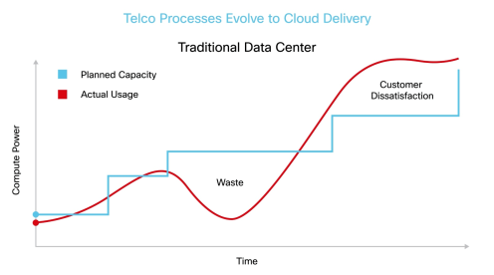
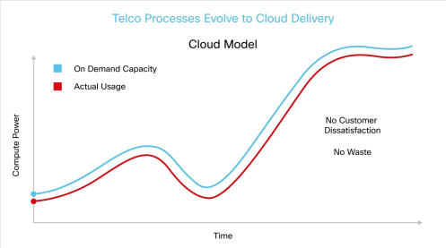
Business Evolution Depends on Virtualisation
Virtualization enables:
It affects many aspects of your business:
Faster TTM: Agility and flexibility
Lower TCO
  Resources optimization
  Common platforms/data center
New Revenue Opportunities: New XaaS use cases
Just in time procurement – on-demand scaling
DevOps innovation – start-up culture
Cloud services value chain – revenue share
Operational automation
Notes:
There’s a clear need to use virtualization and orchestration to expand services faster, grow your business, and move into new markets. But historically, this has not been easy.
When mobile operators have tried to build out on-demand computing services in the past, they’ve either built out too early to monetize their investment right away or (more often) built out too late to handle demand. Look at when the iPhone first came out in the marketplace. It took years to build out capacity to meet that demand.
Based on the Cisco VNI data we’ve just seen, there will be approximately 2 billion new devices on the mobile network by 2018. Most of these
devices will be machine-to-machine connections in the Internet of Things. So they’ll require a much more flexible network that can scale with millions of new connections. And again, these are different types of connections that require very little data but a huge amount of signaling. So you won’t just need to scale capacity. If you really want to meet demand for these services fast, you’ll need to be able to spin up new packet core elements extremely quickly. Ideally, with a network that’s intelligent enough to invoke new packet core services automatically.
But the upside of doing this is significant.
Virtualizing the packet core gives you the critical agility and flexibility you need. It lets you move into new business models and markets and roll out new services much faster.
It lets you optimize your network resources by scaling them in real-time with demand and reallocating them as needed. If a customer needs more resources for an hour, the network automatically spins up those resources. And when demand falls below a certain threshold, the network decommissions those resources so they can be used somewhere else.
It lets you use common platforms instead of dedicated hardware to run packet core services—whether that’s Cisco UCS blades or commodity x86 servers in the data center.
Embracing virtualization affects areas across your business.
It changes your purchasing behavior, because you can scale on demand, instead of needing months to expand services.
It lets you use a common data center for all of your mobile services (depending on the regulatory framework in which you’re operating).
It lets you take advantage of network function virtualization to make your network more flexible and easier to provision.
It empowers you to operate in the cloud services value chain as efficiently, and with the same kind of speed, as pure-cloud competitors.
But once again, to do any of this, you need end-to-end orchestration and automation for cloud service delivery.

Slide 14
Considerations for Virtualization
CPU
Variable CPU / FPGA / NPU
High
Distributed: Lots CPUs + NPUs
Mobility
Management
(MME)
Small Cell
GWs
OSS/BSS, IMS
& Policy control
Appliances, GiLAN
(L4-L7)
Mobility
GWs
Current Scope for Virtualisation
Distributed: CPUs + Lots of NPUs
Wire-line GWs
CPU
Reqs
Backbone, Metro and DC switching
Distributed: SoC
Macrocell Radio
Business CPE
Centralized:
CPU + NPU
Smallcell Radio
Home CPE
Low
0
10Mbps
100Mbps
1Gbps
10Gbps
100Gbps
1Tbps
10Tbps
100Tbps
1Pbps
Notes:
The 3rd dimension of consideration is architecture complexity. In the past the architectures that have many interfaces and often multi-party components have been very slow to implement and hence impeded rapid service delivery, for example IMS, Small Cell Cores, and Gi-LAN Services. Hence these are are focus for virtualisation in the form of pre-integrated SW in the SPs cloud.

Slide 15












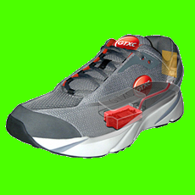

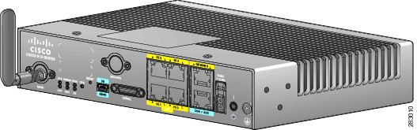
Cisco Mobile Internet Architecture
Voice & Messaging
Enterprise
M2M
NEW
Unified Data Center
vIMS
Hosted Collaboration Suite (HCS)
IoT Cloud Connect
NEW
Services
NEW
Telco Cloud
Universal Monetization Architecture
Policy (PCRF), Orchestration (NFV), Abstraction
Mobility IQ
Analytics
Virtual Packet Core
(VPC)
NEW
Network
ASR5000 Series Packet Core
2G, 3G, LTE, WiFi, Femto, inline Services
IP/MPLS
Backbone
ASR900 & 9000 Series Unified Mobile Backhaul
TDM, ATM, IP, GE, 10 GE, L3VPN, etc
Intelligent
Universal RAN Orchestration
Wi-Fi SON ANDSF 3G, LTE cSON
Access
HetNet
NEW
Universal Small Cells
Macro Cells
Any G / Any Vendor
Wi-Fi APs, Femto, dSON
Heterogeneous

Slide 16








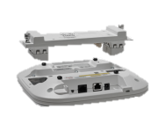
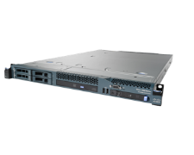



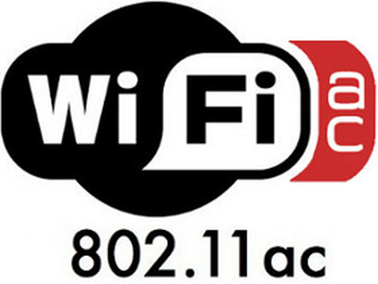
Cisco Universal HetNet Architecture
NEW
Cisco
Policy Suite
SON Suite
Mobility IQ
Analytics
NEW
USC8000 Series
Large Enterprise Small Cells
Cisco 8000 Series USC Controller
Cisco ASR Series
or vHetNet Core
Small Cell Gateway
3G/4G
Core
Cisco Universal
Small Cells
NEW
Mobility
Services Engine
Cisco USC 5000 Series for Aironet 3600/3700
Physical or Virtualised
Internet
NEW
Cisco Aironet
Wi-Fi Indoor & Outdoor
Wireless Controller
Cisco 8510
Wireless Access Gateway
Cisco ASR 1000
Cisco Prime
Provisioning
Management
Notes:
Virtualization in the context of deploying new services rapidly.

Slide 17
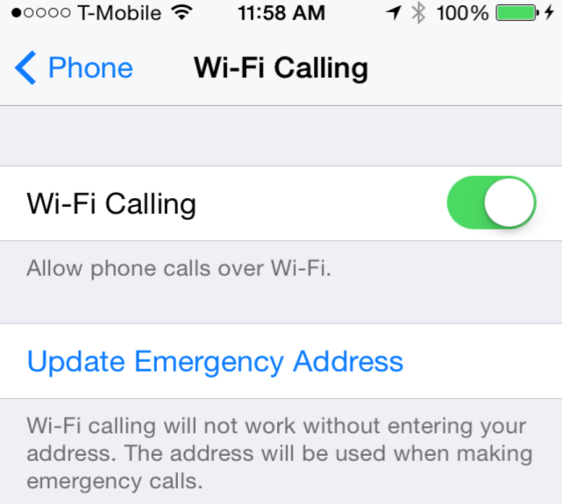
Voice over WiFi
Addressing indoor coverage holes
Requires | Device (Client App or OS) | Network
Secure Connectivity | iWAN (Interworking Wireless LAN, IPsec) | ePDG (Evolved Packet Data Gateway: Terminate IPsec to connect UE to EPC)
VoIP Call Management | IMS/SIP | IMS/SIP
Started with US Cable Operators, but now MNOs
T-Mobile, USA offers VoWiFi
      http://newsroom.t-mobile.com/issues-insights-blog/welcome-to-wi-fi-calling.htm
  iOS 8 brings Wi-Fi calling for iPhones on T-Mobile
3, UK launches VoWiFi app
        http://www.mobileworldlive.com/three-uk-adds-vowifi-momentum-app-launch
EE, UK plans VoWiFi to boast indoor coverage
  “The aim of VoWiFi is to improve in-building coverage. Calls will be automatically routed via WiFi, for instance in a user’s home or office, where there is an absence of cellular coverage.”
  http://www.mobileworldlive.com/ee-launch-volte-2015-polishes-voice-credentials
  http://www.telegraph.co.uk/technology/news/11519179/EE-launches-WiFi-Calling-to-combat-poor-reception.html
Sprint prioritizes voice-over-Wi-Fi over VoLTE
  Four Sprint devices with the client pre-loaded. When the user connects to a WiFi hotspot, calls are automatically routed to the Wi-Fi network until the user leaves the area.
  http://www.rcrwireless.com/article/20140328/carriers/sprint-prioritizes-voice-over-wifi/
  .
Notes:
VoWifi has become a global trend
Everything Everywhere (EE) is a mobile network operator and internet service provider company headquartered in Hatfield, United Kingdom. It is the largest mobile network operator in the UK, with around 28 million customers. It operates under the EE, Orange and T-Mobile brands and currently only offers its services within the UK. EE is a 50:50 joint venture between Deutsche Telekom and Orange S.A., formed in 2010 through the merger of their respective T-Mobile and Orange businesses in the UK.

Slide 18


Cisco WiFi Calling Telco Cloud Solution
NFV Based VoX Solution
Enterprise collaboration
and PABX
IMS
VoLTE Core
HCS
VNF
ISC
VNF
vIMS
Mobile
Telco
Cloud
SIP – Control plane
HSS
Rx
SWx
3GPP AAA
PCRF
PSTN
VoIP SIP
Client
VNF
VNF
SWm
Gx
WiFi/
Internet
SWu
Client
IPSec
ePDG
PGW
MGCF
MGW
VNF
S2b
VNF
Smartphone
VoIP – User plane
Cisco VoWiFi Solutions
ePDG: Base on proven StarOS multi-service platform (ASR5000 series / Virtual) | VoX TAS/IMS: Cisco Telco Cloud and UC/HCS Solutions
3GPP AAA: Cisco Prime Access Register | Carrier-grade Wi-Fi Access: Field proven for HD Voice experience
Notes:
Here is an example of a new Mobile service enabled with virtualisation. Because of the increased time to market and lower up front investment required we are seeing many SPs deploying VoWiFi as a market tactic.
All building blocks in the virtualized world are just SW – not appliances.

Slide 19



Cisco IoT Cloud Connect
2G/3G/LTE/CDMA Network
Enterprise M2M Applications
APIs
Data Abstraction
VPN
Virtual Packet Core
VPN
Portal
Billing
IoT Cloud Connect
  Built from ground up with M2M-tuned features
  Complete stack of M2M management platform functions
  Consumption based commercial models
  Flexible deployment models to suit various environments
  Speed to Market: Launch in 6 months
  Framework to expand revenues beyond connectivity
COLD
Resolving Operators’ Challenges in Internet of Things
Notes:
Access NW and Enter prise NW are just VPN’s into the Cloud
Here is an example of how we can help Operators lower the cost of providing IoT / M2M connections (contact Yasir Quereshi for more info on IOT Cloud Connect solutions)
Service offered by Cisco – a company with a global reach and experience with SPs
Cisco global Enterprise reach
Cisco’s enterprise leadership enables brokering new business relationships between SPs and enterprises
Variety of business models possible
IoT Thought Leadership
M2M Platform integrated into Cisco vertical IoT Solutions
Integrated with variety of Cisco devices
Echo-system of partners
Variety of business models
Flexibility of billing platform allows for M2M tailored rate plans and billing options
Single interface point hiding business arrangement complexities
Support for Multiple Access Technologies
GSM, LTE, CDMA
Global Connectivity
Worldwide roaming agreements
Purpose designed M2M Platform
Cost effective
Ease of device on-boarding and management
Ease of adding new customers with
Device analytics
Leveraging Cisco market leading Packet Core
Rich feature set for M2M applications
Pre-integrated with Cisco packet core
Virtualized environment
Simple integration with existing SP infrastructure
2 integration points only
Integrated Application Enablement
Accelerates application development with uniform interface for Time to Market
Scaling and performance
Internet scale database infrastructure (billing) and data service architecture (AerCloud), virtually limitless capacity at fraction of traditional database costs

Slide 20
Summary
Business drivers require Agility and Operational optimisation
In India, Smartphones and Video drive growth in connections and traffic
Network requirements have 3 interrelated themes:
RAN Diversity
Virtualisation
Internet of Everything
Cisco is transforming networks today with:
Universal HetNet -> Lowers TCO and improves speed to market
Virtualised platforms for new services including VoWi-Fi and IoT/M2M

Slide 21

Q&A

Slide 22













Introduction: The Evolution of Mobile Technology
1980 | 1990 | 2000 | 2010 | 2020 | 2030
 |  |  |  |  |  | Voice Digital Data IP IoE
R&D
1G – TACS. AMPS
R&D
2G – GSM/GPRS/EDGE. DAMPS/CDMA
R&D
3G – WCDMA/HSPA. CDMA1x/EVDO
R&D
4G – WiMAX. LTE/LTE Advanced
?
R&D
5G – …

Slide 23
India: Mobile Data Traffic Offload*
31% of Mobile Traffic to be Offloaded by 2019
Petabytes per Month
*Offload includes traffic from dual-mode devices (i.e., supports cell & Wi-Fi, excl. laptops) over Wi-Fi/small cell networks
Source: Cisco VNI Global Mobile Data Traffic Forecast, 2014–2019
Notes:
Much mobile data activity takes place within the user’s home. For users with fixed broadband and WiFi access points at home, or for users served by operator-owned femtocells and picocells, a sizeable proportion of traffic generated by mobile and portable devices is offloaded from the mobile network onto the fixed network.
The volume of offload traffic is a function of many variables: smartphone penetration, dual-mode share of handsets, percentage of home-based mobile Internet use, and percentage of dual-mode smartphone owners with Wi Fi fixed Internet access at home.
As a percentage of total mobile data traffic (including laptops and M2M modules), mobile offload increases from 46 percent in 2014 to 54 percent in 2019. Without offload, Global mobile data traffic would grow at a CAGR of 62% instead of 57%.
As a percentage of mobile handset and tablet data, 54% of traffic will be offloaded from smartphones by 2019, compared to 51% at the end of 2014, 70% of traffic will be offloaded from tablets by 2019, compared to 69% at the end of 2014, through dual-mode devices or femtocells. You can see that for handsets and tablets, the percentage of traffic offloaded remains relatively flat over the forecast period. While in developed regions the offload factor steadily rises throughout the forecast period, this growth is offset by a decline in offload percentage in many developing countries and regions. The declining offload factor in developing markets is due to a decreasing number of mobile data users with Wi-Fi access at home.

Slide 24






Introducing Cisco Mobility IQ
Unlocking the Power of Visual Network Knowledge
NEW
Network Operations Experience
Network IQ
Marketing Experience
User IQ
Managed Services Experience
Business IQ
Mobility IQ
on Cisco Cloud Services
ISV
3rd Party Apps
Data Sources
EMSP Connectors
Aironet/Meraki
Connect Analytics
MSE/WLC/PI
HetNet Core
SON
On Premises
SP Wi-Fi
3G, LTE
Notes:
As an extension to our Universal Wi-Fi and Connected Analytics portfolios, we are introducing Cisco Mobility IQ, a new solution that unlocks the power of Visual Network Knowledge to transform customer experiences.
Mobility IQ is the first SP cloud service hosted in the yet to be announced Cisco Mobility Intercloud Marketplace. It provides Service Providers with:
Real-time window of visualization into network, user, and business intelligence across Wi-Fi, 3G, and LTE
The ability to understand their networks better to improve operational excellence, expand value to their business customers through end user insight, and help insight for strategic growth
Mobility IQ leverages and derives insights from SP Wi-Fi resources including Aironet, Meraki, Connected Analytics, Mobility Services Engine/Connected Mobile Experiences, wireless controller, and Prime Infrastructure solutions as well as 3G and LTE resources including virtualized HetNet, SON, and the ASR 5000 Series.
It also has northbound and southbound APIs to enable ISVs and 3rd party applications as well as other data sources or EMSP connectors.

Slide 25
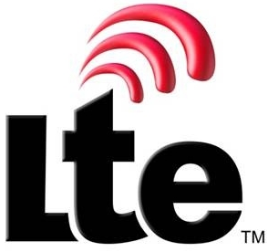









Cisco Telco Cloud for Mobility
Cross-Domain Network Services Orchestrator
MVNO
VoLTE
VoWiFi
HetNet
PMB
M2M
Cisco Telco Cloud
Tail-f based
Service
Profile
Orchestration Engine
VNF Manager
Cisco Validated Design
- Virtualized/Orchestrated
Architecture/Solutions
Evolved Services Platform
Open APIs
Open Multi-vendor Capability
- 3rd Party VNF and Manager,
OpenStack/VMware, ETSI MANO
vIMS
vPCRF
vMPC
vEPC
vGiLAN
vDPI
3rd Party
VNFs
Open APIs
vWLC
HeNB
GW
ePDG
Media
Optimize
NAT/FW
SON
Virtualized Network Functions
Single Operational Model
- Integrates IT and Telco
Operations Models
Open APIs
Virtualized Infrastructure
/ Manager
Physical
Network
Simplified Commercial Model
- Evolution to SaaS
(Own, Lease, PAYU, Hosted)
Compute
(UCS)
Storage
Network
Private
Public
InterCloud
Evolved Programmable Network
Operational Model
Operational Efficiency
Accelerate TTM
Enable New Biz Models
Provides Agility
Leverages NFV/SDN
Services (VoLTE, M2M, etc.)
Hosting, MVNO, SaaS

Slide 26

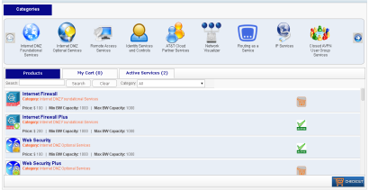





Use Case: Virtualized IaaS for M2M
Cisco Virtual
Packet Core (VPC)
Cisco Virtual Network Functions
Mobile Service Portal
43%
TCO
Savings
Policy
Workflow
Catalog
Up to 84% OPEX
SON
Management
Resource Orchestration
Open Daylight
Packet Core
Cisco Evolved Services Platform
5 Year TCO to provision & maintain a new M2M service (5M growing to 16M devices)
Cisco VPC with Orchestration, vs
Traditional Packet Core and mgmt processes.
Network
Storage
Compute
Cisco Evolved Programmable Network
Notes:
Virtualized Mobile Internet use case with unified subscriber management incorporated. This one is based primarily on Cisco Virtualized Packet Core (VPC) and a host of technologies across the mobility and SP portfolio. We’ll look at how deployment of virtualized mobile internet solutions accelerates entry into new markets such as Private/Premium Mobile Broadband for on-demand events such as political conventions or major sporting events.
Today Mobile Internet services require dedicated physical resources in the Operator NOC. Some of these resources can scale down for smaller deployments however to avoid operational complexity and jeopardizing reliability to their core business, operators prefer to use dedicated systems for new market opportunities such as PMB or M2M. For these new opportunities which might include a temporal network to support 100,000 users with voice and data for a week, a near turnkey network that can be rolled in on a truck is preferred.
With Virtual Mobile Internet, services are turned up rapidly using both EPN and ESP. Physical resources such as routing are set up for Compute and Network functions. Evolved Services Platform capabilities including Service Broker, Orchestration, and Virtual Functions are turned up in the SP Cloud/Data Center for virtualization, orchestration, and automation:
Quantum Virtualized Packet Core (QvPC) is the industry’s most complete, fully virtualized evolved packet core
Quantum Services Platform (vGi-LAN) for dynamic service chaining
Prime NSC, part of the Orchestration Software Suite provides the control, orchestration, and automation of services
Unified Subscriber Management to facilitate and enforce common policies across the wireless and wired network
Quantum SON ensures quality and coordination between the macro and small cell network.
The result of this deployment: 43% potential TCO savings for the Mobile Operator over five years compared to a competitor present mode of operation. The automation that comes from virtualization and orchestration plays a significant role in these savings.
They can also realize an 84% savings in OpEx, particularly through reduced operational complexity and reduced manual processes.
References:
QvPC is currently shipping, with lab trials at China Mobile and NTT DoCoMo.
Thales is a live pilot for Public Safety LTE. Given it is a private network you can say it’s a live reference.
Eircom Ireland and Osnova Russia nothing are deployed as trials.
QvPC case:
- Comparison was btn Cisco QvPC+Orchestration vs E/// SSR8020, without orchestration
- OPEX gains mainly thanks to Orchestration which brings a lot automation
- 5yr TCO model based on M2M, number of subs 5M (Y1) - Y5 (16.1M)

Slide 27
VoWiFi Launches & Business Case Drivers
MNO | Launch/ Planned | Use Case/ Adoption | International Roaming Allowed? | Pricing | Business Case Driver
 |  |  |  |  | Grow Subs | Retention | Revenue | Cost to serve
Freedompop, USA | Jan-15 | WiFi first, LTE MVNO. Indoor/Outdoor. |  | $5/month unlimited VoWiFi | ✓ |  | ✓
Republic Wireless, USA | Jan-15 | WiFi first, LTE MVNO. Indoor/Outdoor. |  | $5/month unlimited VoWiFi | ✓ |  | ✓
Cablevision, USA | Feb-15 | ISP. Indoor/Outdoor Wi-Fi only voice. Roaming. | Y | $10/month VoWiFi Plans | ✓ |  | ✓
T-Mobile, USA | Sep-14 | Indoor coverage, VoLTE/WiFi mobility. Roaming. 6.6M calls per day. | Y | Unlimited voice bundles (3G/LTE/WiFi) | ✓ |  |  | ✓
Scratch Wireless, USA | Nov-14 | WiFi first, LTE MVNO. Indoor/Outdoor. Roaming | Y | WiFi Free, $2 24h cellular pass | ✓
Sprint, USA | Apr-15 | Indoor coverage and Roaming voice. | Y | Zero rated in minute bundles | ✓ |  |  | ✓
Verizon, USA | Q3-15 | Indoor coverage, voice & video |  | TBD |  | ✓
AT&T, USA | Q3-15 | Indoor coverage, voice. VoLTE/Wi-Fi mobility |  | TBD |  | ✓
Google Project fi, USA | Q3-15 | WiFi first, LTE MVNO. Indoor/Outdoor. Roaming. | Y | $20/month | ✓ |  | ✓
Rogers Wireless, Canada | Q3-15 | Indoor coverage. | N | Counted in minute bundle |  | ✓ | ✓
Bell Mobility, Canada | Q3-15 | Indoor coverage. | N | Counted in minute bundle |  | ✓ | ✓
H3, UK | Jul-14 | Indoor coverage and Roaming voice. | Y | Counted in minute bundle |  | ✓ | ✓
EE, UK | Apr-15 | Indoor coverage, voice | N | Counted in minute bundle |  | ✓ | ✓
Orange, France | Q3-15 | Indoor coverage. VoLTE/WiFi mobility. | N | Counted in minute bundle |  | ✓ | ✓
SwissCom | Q3-15 | Indoor coverage. |  | Counted in minute bundle |  | ✓ | ✓
Smartone, Hong Kong | Feb-15 | Roaming. Coverage/quality. | Y | Prem plans free. Others US$1/ day |  |  | ✓
Tier 1, Thailand | Aug-15 | Indoor coverage. |  | TBD |  | ✓
Telstra, Australia | Q4-15 | Indoor coverage. VoLTE/Wifi mobility. |  | TBD |  | ✓
Singtel, Singapore | Jun-15 PoC | Indoor coverage. VoLTE/Wifi mobility. |  | TBD |  | ✓ |  | ✓
Tier 1, India | Q4-15 | Indoor coverage. |  | Counted in minute bundle | ✓ |  | ✓ | ✓
Asia Europe North America
Notes:
References
http://www.telecompetitor.com/freedompop-wi-fi-service-offers-unlimited-voice-text-data/
https://republicwireless.com/wifi-calling/
https://gigaom.com/2015/02/18/optimum-freewheel-review/
http://www.t-mobile.com/offer/wifi-calling-wifi-extenders.html
http://www.scratchwireless.com/pad/s/wi-fi-calling/
http://support.sprint.com/support/article/FAQs_about_Sprint_WiFi_calling/173e331f-8423-453e-93cb-4688f6a91f67
http://www.techlicious.com/blog/iphone-6-wifi-calling-carrier-plans-actiontec-underwritten-story/
http://www.techlicious.com/blog/iphone-6-wifi-calling-carrier-plans-actiontec-underwritten-story/
http://www.mobileworldlive.com/google-unveils-project-fi-mobile-service
http://www.three.co.uk/Discover/Three_inTouch
http://www.express.co.uk/life-style/science-technology/569311/iPhone-6-Models-EE-Mobile-Network-Wifi-Calling-iOS-8-3
https://lteconference.wordpress.com/2015/05/14/exclusive-interview-volte-is-here-but-what-is-next-pierre-francois-dubois-vp-at-orange/
https://www.magicload.ch/en/network-provider/switzerland/183-swisscom-voice-over-wifi
http://www.smartone.com/en/services_and_apps/roaming/st_wifi_calling/service.jsp
http://www.whistleout.com.au/MobilePhones/News/Telstra-hints-5G-VoLTE-and-calls-over-WiFi
http://info.singtel.com/about-us/news-releases/singtel-enhance-customer-experience-trial-ericsson-lte-broadcast-and-wi-fi-ca

