Slide 1
Cisco NFV Infrastructure
Carrier Grade NFV
Phil Lowden, plowden@cisco.com
Data Center Consulting Systems Engineer
December 14, 2016
v. 2.0

Slide 2
Agenda
Why Network Function Virtualization (NFV)?
What is NFV Infrastructure (NFVi)?
Cisco’s NFVi Strategy
Cisco’s NFVi Services
Cisco’s NFVi Third Party Assessments
Cisco’s NFVi Benefits
References

Slide 3
Why Network Function Virtualization (NFV)?

Slide 4

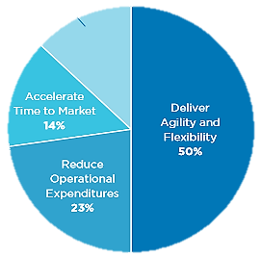
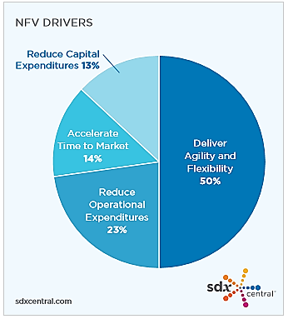



Service Provider Challenges
Solve operational agility to drive business agility into new markets
Grow new revenue
and markets
Increase operational agility
Reduce operating expenses
Source: SDxCentral 2016, Mega NFV Report, NFV drivers

Slide 5
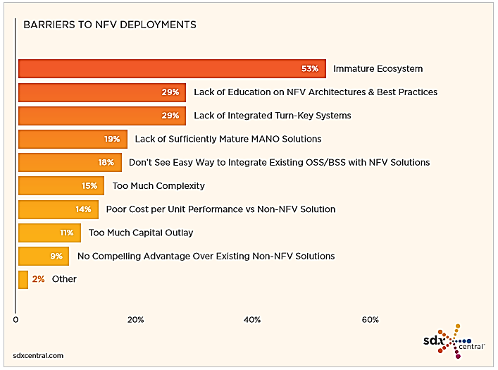
Barriers to NFV deployments
MANO: Management and Orchestration
Source: SDxCentral 2016, Mega NFV Report

Slide 6


Simplification Paramount to Transformation
Open Source
Reduce Network Appliances, Siloes
Simple
Operations
Automate Service Creation
SDN
NFV
Avail Self-service Personalization
Managed
Services
Highly Available Infrastructure
Mobility
Video
Security
Converged Infrastructure

Slide 7
What is NFV Infrastructure (NFVi)?

Slide 8
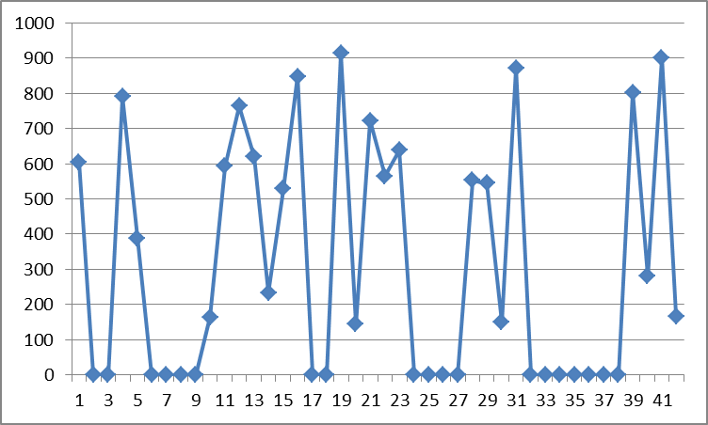

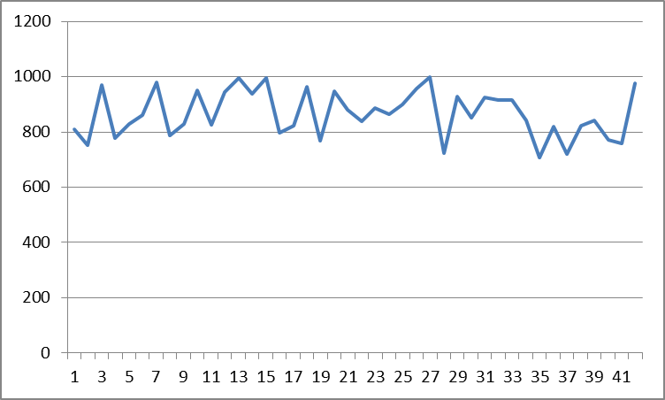
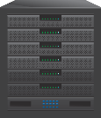
NFVI Tailored for Your Business
Similarities
Multi Tenant architecture
Automation and Orchestration
Assurance
Redundancy and Disaster Recovery
Bursty Traffic
Traditional IT
Differences
VNF requires Carrier Class SLA
VNF needs Lower Ratio on Spine/Leaf bandwidth oversubscription
VNF requires Higher Throughput
Higher Throughput
VNF Design
NFV requires Optimized Infrastructure Design

Slide 9


Network Functions Virtualization Infrastructure
ETSI and OPNFV view
NFV
MANO
OSS / BSS
NFVO
Orchestration and Management
Virtual Network Functions
EM 1
EM 2
EM 3
VNF-M (VNF Managers)
VNFM
Compute Virtualization Control
Storage Virtualization Control
Network Virtualization Control
VNF 1
VNF 2
VNF 3
NFVI
Virtual Compute
Virtual Storage
Virtual Network
Compute
Storage
Network
Virtualization Layer
VIM
Hardware Resources
Infrastructure
Compute
Storage
Network
NFVO: NFV Orchestrator
VNFM: VNF Manager
VIM: Virtualized Infrastructure Manager
ETSI: European Telecommunications Standards Institute
OPNFV: Open Platform for NFV

Slide 10
Cisco’s NFVi Strategy

Slide 11

Cisco NFV Infrastructure
Foundation For Service Providers’ Network Transformation
Service Availability
High Availability, Performance, Throughput,
Security and Scale distributed from Branch to DC
Simplified Operations
Single Pane of Glass, Single Point of Ownership
OpenStack Lifecycle management
Workload Agnostic
Modular, NFV optimized
Leveraging OpenSource

Slide 12





Cisco NFV Infrastructure Solution
Leading Industry Partnerships
Easy Access to Support
Integrated Design and Validation
Certified
Joint go to market
High and predictable Performance
Hardware and Software
Single Point of Contact
Cisco NFV Infrastructure
Virtualized
Compute
Virtualized
Storage
Virtualized
Network
VIM
Management
Assurance
Automated Installer
SDN Controller
Installer
Compute
Cisco UCS
Storage
Network
Cisco Nexus
GUI
Cisco NFV Software for OpenStack

Slide 13
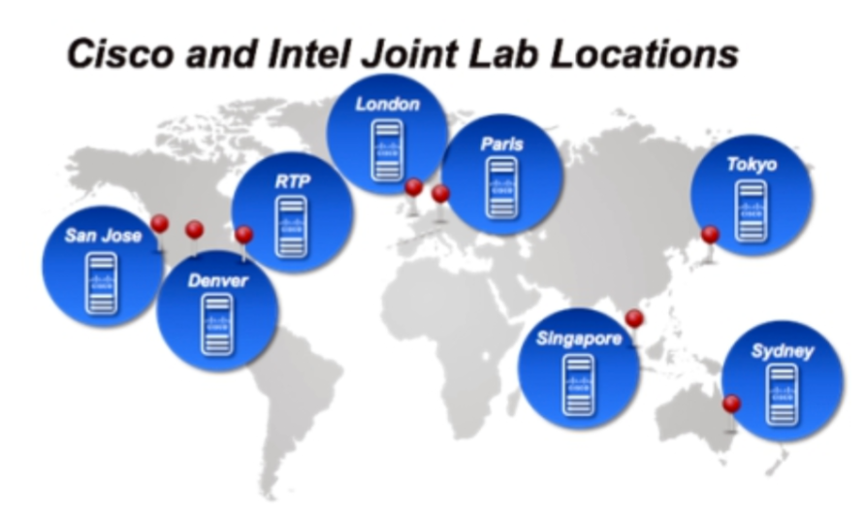
Cisco Intel NFV Quick Start
http://www.cisco.com/c/dam/en/us/solutions/collateral/service-provider/network-functions-virtualization-nfv-infrastructure/cisco-intel-nfv-quick-start.pdf

Slide 14
Cisco NFV Infrastructure
Components
High Scalable and High Available
Carrier Grade design
Cisco Nexus, Cisco UCS
Infrastructure
Based on Open Standards
Simplified Management and Operations
Cisco NFV Software for OpenStack
(incl.: OSP, CEPH, RHEL (Red Hat), KVM)
Software
Designed for High performance
Modular and Validated
Cisco SDN Controller
Optimized Design

Slide 15
Comprehensive Cisco NFV Architecture
Virtual Network Functions
NFV-O
Resource Orchestration
Network Services Orchestrator
3rd party
VNF Manager
ESC
…more than 100
Cisco NFV Infrastructure
Virtualized
Compute
RH KVM
Virtualized
Storage
RH CEPH
Virtualized
Network
VPP
VIM
RHEL OSP Openstack
Management
Assurance
Automated Installer
SDN Controller
Installer
Compute
Cisco UCS
Storage
Network
Cisco Nexus
GUI
Cisco NFV Software for OpenStack

Slide 16
Cisco’s NFVi Services

Slide 17

Services for your Network Transformation from Cisco, Today
Solution Design and Deployment
Solution Optimization & Support
De-risk Network Transformation
Turn key deployment
Solution Integration
Operations Transformation
Faster Time to Market

Slide 18
NFV Services Portfolio Framework
Future
Today
Today
TRADITIONAL
End to End Strategy Workshop
End to End Service Delivery Architecture incl Service Virtualization
End Customer Experience
P2V Migrations
Value Add - Future
MANAGED
NFV Program Management
Solution Upgrade Adoption
VNF Certification/ On-boarding
Solution Integration & Customization
Agile Sprint
S/W Dev
(Day 2+SoW)
Service Topology Variations
Strategy Workshop
Program Management
SP Operations Transformation
OSS Integration
Performance & Validation Testing
Acceleration Adoption Services
Custom Optimization
Value Add - Today
Quick Starts
Design & Deployment
Optimization
Base Portfolio
Advise
Implement
Optimize

Slide 19
Cisco’s NFVi Third Party Assessments

Slide 20



Tested Solution…
EANTC Validating Cisco’s NFV Infrastructure Solution
Phase 1: NFV Solution Agility
Phase 2: NFV Infrastructure
Phase 3: NFV Multi Vendor Interoperability
✔
Carrier Grade High Availability, HW and SW
NFV Ready High Performance
Simple Operation with Single Pane of Glass
✔
✔

Slide 21
Cisco NFV Infrastructure
Measured High Performances
  Real-life Scenarios
    Feature-rich configuration
  Carrier Grade Operations
    High availability, easy
    provisioning and
    service monitoring
  High Performances
    Up to 100x improvement of performance
  Use Cases
    Virtualized applications
    for video, Mobility and
    managed services
“EANTC witnessed a number of Cisco tools complementing OpenStack that are designed to improve the consistency of deployment, simplify the high availability options and improve operational checks.” Lightreading

Slide 22



Cisco NFV Infrastructure
Part of the Cisco Open Network Architecture
Mobility Services
Video Services
Managed Services
Other Services
Applications
Evolved
Services
Platform
Service Broker
Management and Orchestration
(MANO)
Catalog
of Functions
Service
Profiles
3rd Party
3rd Party
3rd Party
3rd Party
Virtual
and Physical
NFV
Infrastructure
VIM
Evolved Programmable
Network
Compute
Storage
Network

Slide 23
Interoperability Testing
The Participants (partial list)
- NFVi vendors
  Alcatel-Lucent CloudBand
  Cisco NFVi
  Huawei FusionSphere
  Juniper Contrail
VNFs vendors (12 vendors)
  Alcatel-Lucent
  Cisco ASAv (virtual firewall), CSR1000v (virtual router)
  Hitachi vMC (virtual mobile core -- consisting of EPC components MME, SGSN, SCGW, uEPC)
  Huawei VNE (virtual router)
  Juniper vMX (virtual router), vSRX (virtual firewall)
  Metaswitch Perimeta vSBC (virtual session border controller)
Source: http://www.lightreading.com/nfv/nfv-tests-and-trials/exclusive!-nfv-interop-evaluation-results/d/d-id/719675?page_number=2

Slide 24

Interoperability Results
“In fact, the success rate -- 25 of the 39 combinations tested, or 64%, passed -- was "a great result," noted EANTC managing director Carsten Rossenhövel.

Slide 25
Cisco’s NFVi Benefits

Slide 26

Cisco NFV Infrastructure
Value Proposition
Designed for High Service Availability
Validated
Design
Simplified and Automated Operations
Open and Workload Agnostic
Carrier Grade
Package
Lifecycle
Support

Slide 27
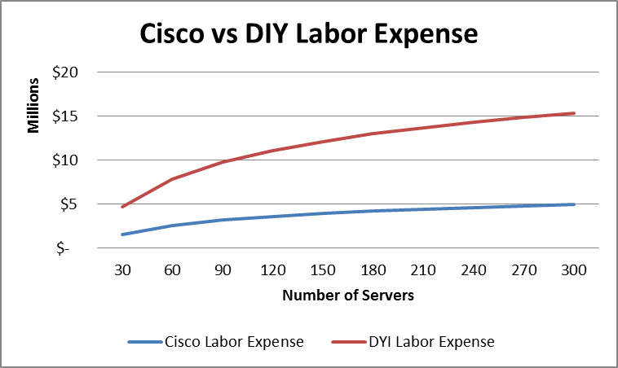
Benefits of Cisco NFV Infrastructure
Cisco NFV Infrastructure up to
40%
TCO Savings over Do It Yourself NFVI
Cisco NFVI
DIY
Main differentiators
Service Velocity: time to deploy reduced to 3-4 weeks
Automated OpenStack Installation and Upgrades
Lower Risk of Service Outages
Source: Cisco based on 103 case studies

Slide 28
Scaling with Business Needs
Carrier Grade
Performance,
Availability,
Security
Easy to
Manage
POD Delivery
2
3
Half Rack
Full Rack
Modular POD
Configuration
Pre-integrated
and
Validated
1
4
Extensions
6
5
Compute Expansion Module
Storage
Expansion Module
Advanced
Services
delivery
Single Point
of Ownership
NFVI
Branch Solution

Slide 29
References

Slide 30
References
Cisco Landing Page: http://www.cisco.com/go/nfvi
NFV Interop Evaluation Results: http://www.lightreading.com/nfv/nfv-tests-and-trials/exclusive%21-nfv-interop-evaluation-results/d/d-id/719675
ETSI: http://www.etsi.org/
OPNFV: https://www.opnfv.org/

Slide 31
Questions?

Slide 32


