Slide 1
クラウドベースのセキュリティ管理
Meraki MX Update / Cisco Defense Orchestrator
セキュリティ事業
佐藤徹也
Date: 7/1/2016

Slide 2

アジェンダ
Meraki MX Update
0. 概要
Meraki MX Update
  IWAN
  MX65 / MX65W
  AMP
ロードマップ、他
Cisco Defense Orchestrator
Cisco Defense Orchestrator とは
CDO 機能概要
デモ
ロードマップ、他
Notes:
What is unique about how CDO was created and introduced to the market?
Talk about the benefits to the cisco direct and partners alike.

Slide 3
Meraki MX Update

Slide 4
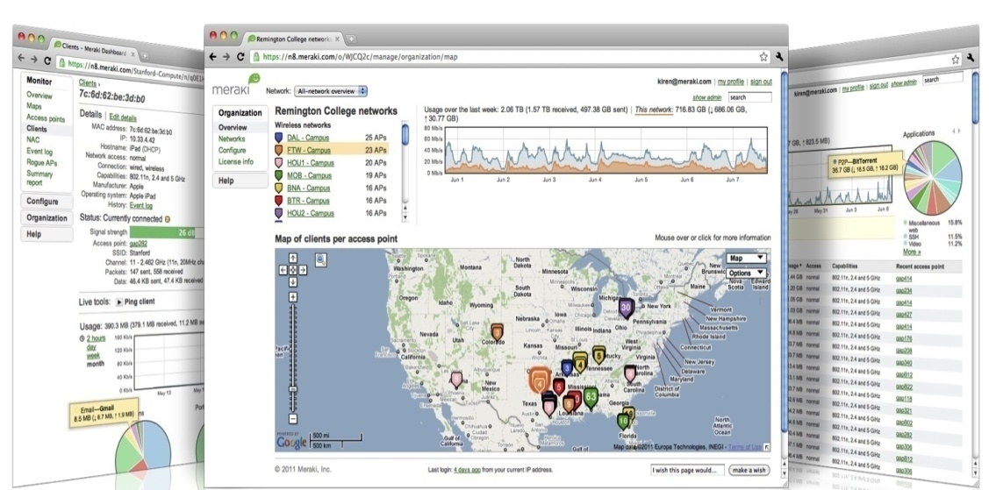
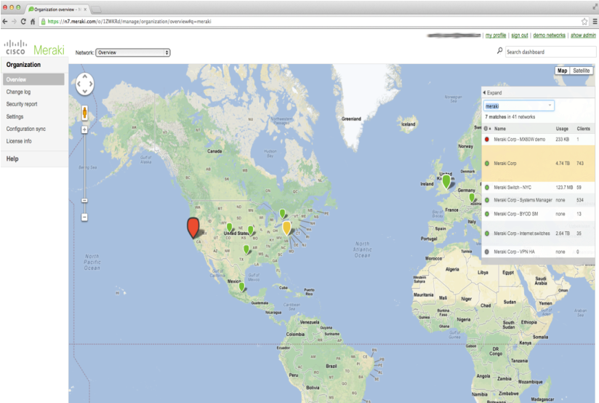
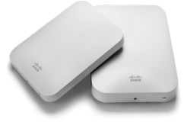



Cisco Meraki：製品サービスと特長
あらゆる機能を備えたクラウドマネージ型ネットワーキング ソリューション
  ワイヤレス、スイッチング、セキュリティ、MDM
  総合的なハードウェア、ソフトウェア、クラウド サービス
クラウドマネージ型ネットワーキングのリーダー
  シスコで最も急成長を遂げているポートフォリオの 1 つ
  年間成長率 100 % 以上
  世界中で数千万台のデバイスが接続
技術革新に対する実績
  ガートナー社のマジック クアドラント
  InfoWorld Technology of the Year
  CRN Coolest Technologies
ワイヤレス LAN
エンタープライズ セキュリティ
アクセスとアグリゲーション
スイッチング
モバイル デバイス
管理
Notes:
- Meraki was founded in 2006 by a research team from MIT. The research team built a large-scale network that was completely managed over the web. At that time, it didn’t have a name but today we refer to this technology as Cloud Networking.
Cloud Networking is now a rapidly growing industry, and Meraki is leading the charge on Research and Development as well as customer adoption.
We expect to see explosive growth here at Meraki with the additional investments and backing of Cisco, and do not expect any changes to our product pricing, licensing.

Slide 5
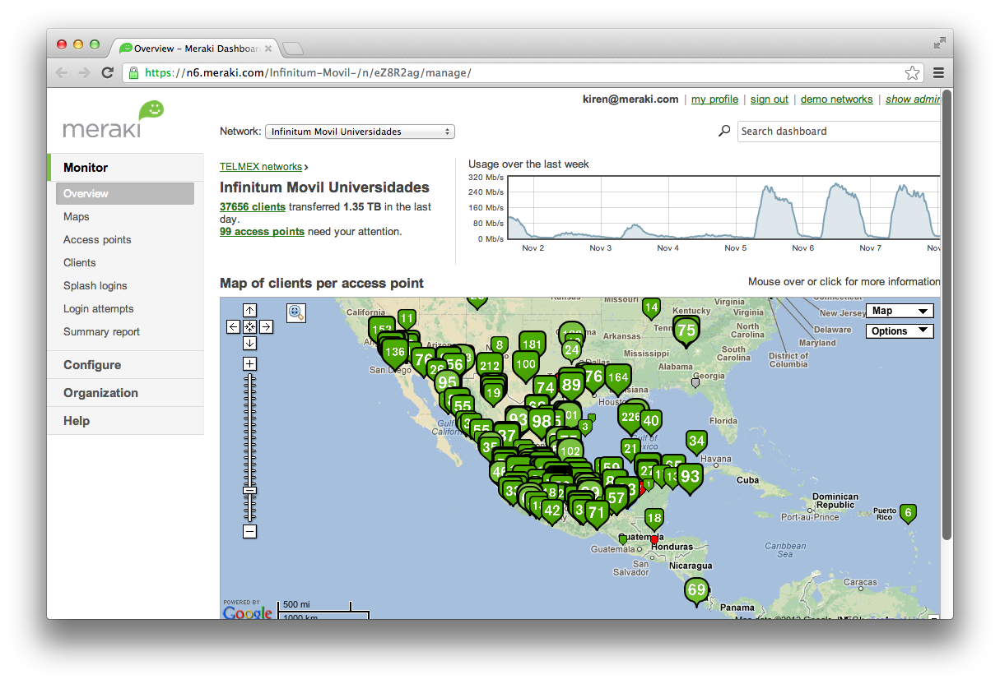
マルチサイト管理に対応
Telmex
全国展開するホットスポットと 3G オフロード ネットワーク
Next Retail
イギリス国内に 550 店舗を展開
Motel 6
ホテルの客室 70,000 室に導入
Jeffco 学区
生徒数 80,000 人の学区（100 校以上）
10,000 台以上のデバイスを運用する環境で実証済み
Notes:
The cloud infrastructure is totally scalable – here are just a few examples of some of the larger scale deployments but we’ve also been proven in over 10,000 device deployment

Slide 6
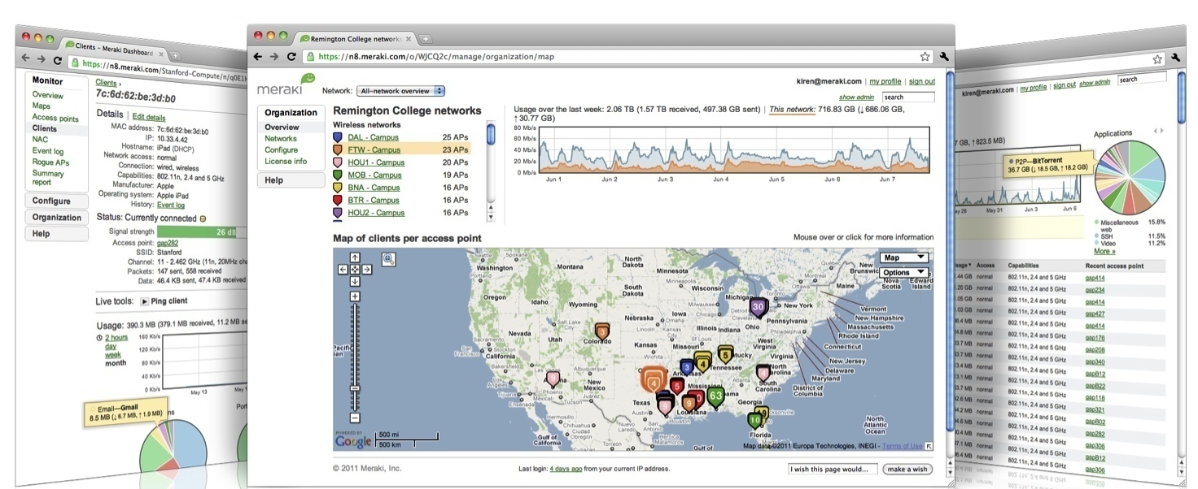

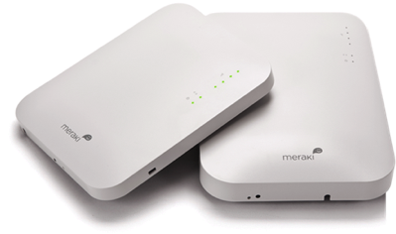
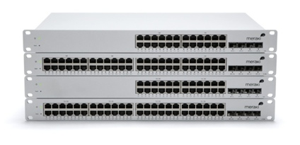
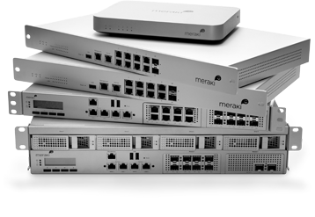

Meraki
世界初、エンタープライズ向けクラウド管理によるネットワークシステム
Cisco Meraki MC
クラウド管理電話
Cisco Meraki MR
ワイヤレス LAN
Cisco Meraki MS
イーサネットスイッチ
Cisco Meraki MX
セキュリティアプライアンス
Cisco Meraki SM
モバイル デバイス管理
Notes:
Meraki – 世界初、クラウド管理によるネットワークシステム

Slide 7
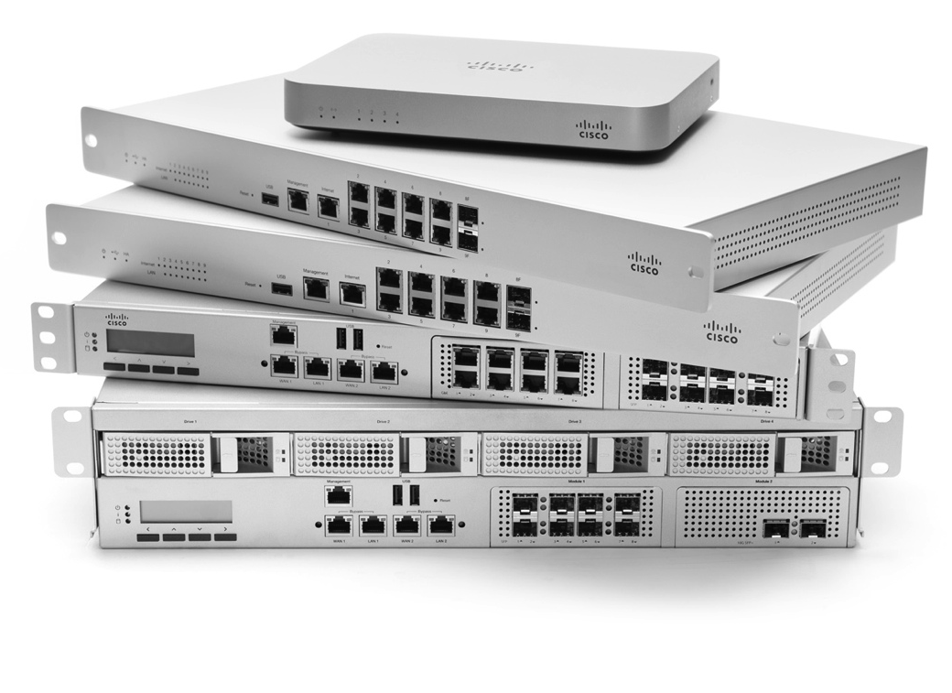

MX セキュリティ アプライアンス
主な機能
ゼロタッチのサイト間 VPN
NG ファイアウォール
コンテンツ フィルタリング
WAN リンク ボンディング
侵入検知と防御
小規模ブランチから大規模キャンパスやデータセンターを対象とした6 種類のモデル
1 つのアプライアンスにネットワーキングとセキュリティを完備

Slide 8
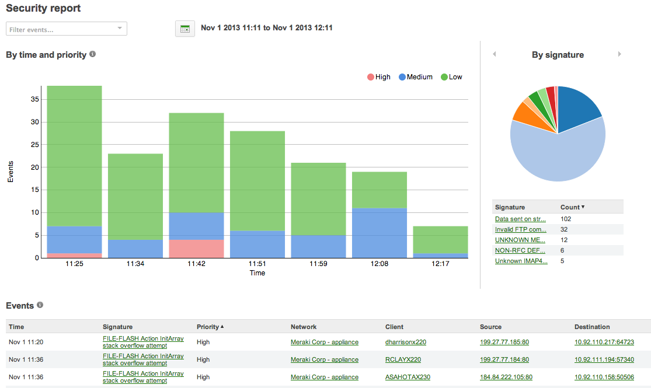
Meraki MX セキュリティ機能
侵入検知 / 防御 | Snort IDS / IPS, 日々更新
コンテンツフィルタリング | BrightCloud – 40 億URLs, リアルタイム更新
ジオロケーション | 国地域による通信制御
アンチウィルス / アンチフィッシング | Kaspersky AV 1時間毎更新
PCI コンプライアンス | PCI 3.1 certified cloud-based management
Security Reports

Slide 9
Meraki MX ライセンス
Enterprise ライセンス
Advanced Security
ライセンス
ステートフルファイアウォール
サイト間 VPN
ブランチルーティング
リンクボンディング ファイルオーバー
アプリケーションコントロール
ウェブキャッシング
WAN オプチマイゼーション
クライアントVPN
All Enterprise features, plus
コンテンツフィルタリング
アンチウィルス-アンチフィッシング
侵入検知 / 防御

Slide 10
Meraki MX アップデート

Slide 11

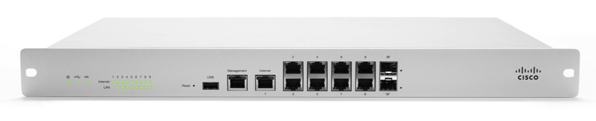
MX IWAN 機能
デュアルアクティブ:
Active-active VPN
Active-active VPN & MPLS
Policy-based routing (PbR) :
プロトコル、サブネットソース、デスティネーションなどでアップリンクを自動的に選択。
WAN 1
Secure VPN tunnel (active)
Latency / loss > threshold
WAN 2
Secure VPN tunnel (active)
Latency / loss < threshold
ダイナミックパスセレクション:
メトリック(latency やロス)を元に最善な VPN トンネルを自動で選択
Based on L3 / L4 categorization, this data normally travels out WAN 1 (PbR), but MX detects optimal path is WAN 2 based on latency / loss on WAN 1
Data

Slide 12
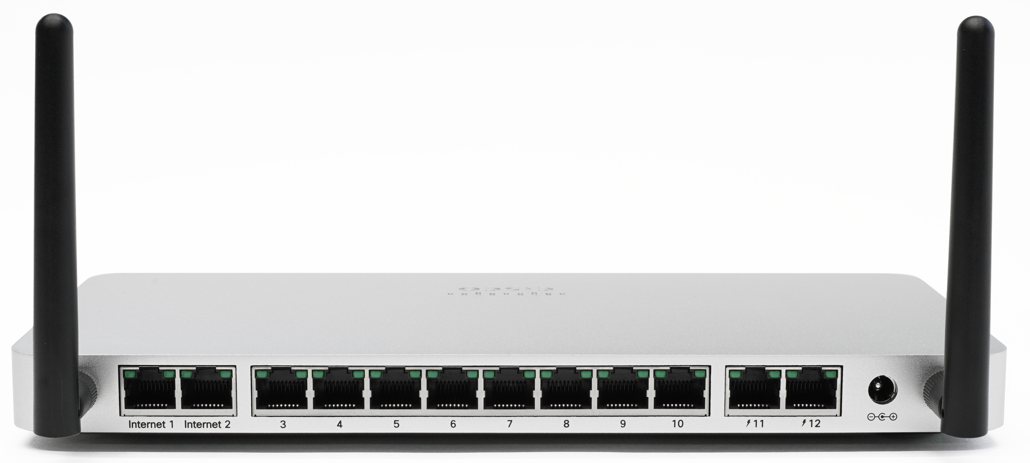
MX65 / MX65W – Branch in a box
特徴
802.11ac with ~3dB the MX64 power (2x signal amplitude)
802.1x 認証
2 WAN 専用ポート
8 LAN スイッチポート
2 LAN PoE+スイッチポート (60W total)
Plus standard MX 機能
Full UTM feature set
Ready for IWAN
主にブランチやテレワーカー向け

Slide 13
AMP on MX
AMP: Advanced Malware Protection
ファイルの継続検査
マルウェアDBは随時更新
  マルウェアファイル 1.7 億 クリーンファイル 3.56 億
  解析する１日あたりのマルウェアサンプル数 150万
  AMP を利用する全デバイス数 160 万台
  １日あたりのクラウド問い合わせ数 14 億
AMP レトロスペクティブでの検知もアラート
ライセンスは、MX Advanced Security に含まれていて追加費用なし (MX60 も含む)
AMP ThreatGrid への動的ファイル解析は、追加ライセンス必要 (FY17 Q1 予定)
Notes:
170 million 170 x 1000000 170,000,000

Slide 14

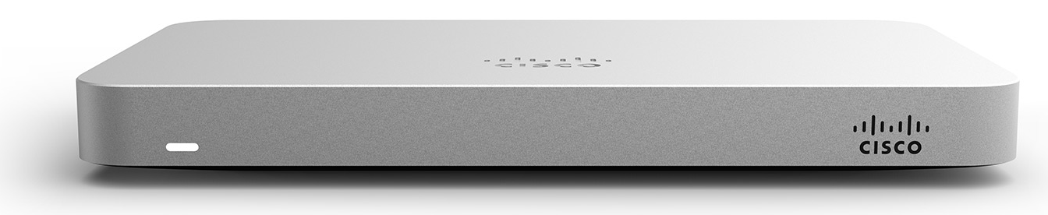
MX AMP の構成
AMP
ファイルハッシュ値
問い合わせ
インターネット
AMP Connector
ThreatGrid Connector
ファイルの送信
ThreatGrid

Slide 15
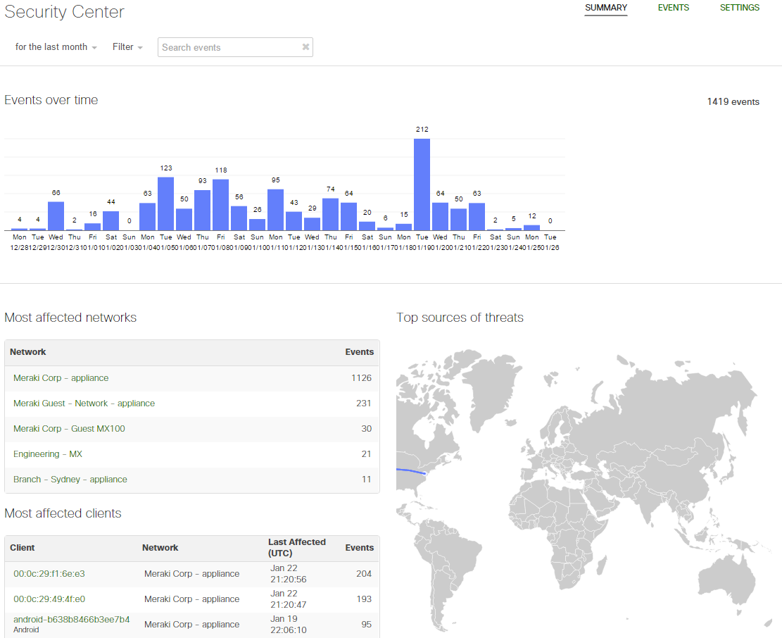
Security Center (Security Reports を変更)
すべてのセキュリティ関連のイベントが一箇所に。
クライアント、ネットワーク、脅威、リモートソース毎に可能
感染した可能性があるクライアントやネットワークを素早く特定可
複数またがる脅威も素早く可視化

Slide 16
Meraki MX セキュリティ機能 – New -
侵入検知 / 防御 | Snort IDS / IPS, 日々更新
コンテンツフィルタリング | BrightCloud – 40 億URLs, リアルタイム更新
ジオロケーション | 国地域による通信制御
アンチウィルス / アンチフィッシング | AMP w/ ThreatGrid
PCI コンプライアンス | PCI 3.1 certified cloud-based management
Security Center

Slide 17
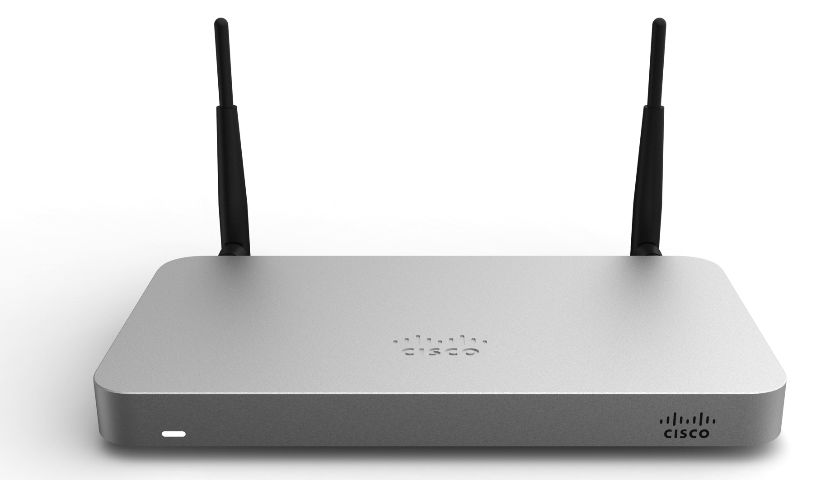
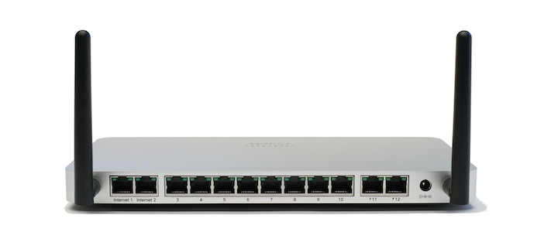


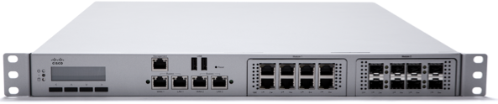
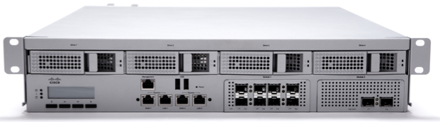
The 2016 MX ファミリー
UTM = all features enabled
対象
特徴
スループット
値段(USD List)
スモールブランチ(~50 clients)
11ac wireless (MX64W)
250 Mbps (FW)
200 Mbps (UTM)
$595/$945
MX64/64W
スモールブランチ(~50 clients)
PoE+, dual WAN, 802.11ac
250 Mbps (FW)
200 Mbps (UTM)
$945/$1,245
Z1
MX65/65W
テレワーカ(1-5 users)
Dual-radio wireless
FW スループット: 50 Mbps
中規模ブランチ(~200 clients)
SFP ポート
500 Mbps (FW)
300 Mbps (UTM)
$1,995
MX84
中規模ブランチ/
スモールキャンパス(~500 clients)
750 Mbps (FW)
650 Mbps (UTM)
SFP Ports
$4,995
MX100
大規模ブランチ/キャンパス(~2,000 clients)
電源冗長
モジュラーIF
SFP or SFP+ (with modules)
1 Gbps (FW)
1 Gbps (UTM)
$15,995
MX400
電源冗長
モジュラーIF
SFP or SFP+ (with modules)
All devices support 3G/4G
キャンパス/
VPNコンセントレーラ
(~10,000 clients)
1 Gbps (FW)
1 Gbps (UTM)
$31,995
MX600

Slide 18
ロードマップ、その他..

Slide 19
今後の予定
AMP インテグレーション(ベータ)
ThreatGrid インテグレーション (FY2017 Q1 予定)

Slide 20

Cisco Meraki の無料体験サービス
お客様のネットワークで Meraki をお試しください。
無料でテクニカル サポートをご利用になれます。
  無料のお試しは meraki.com/eval まで

Slide 21


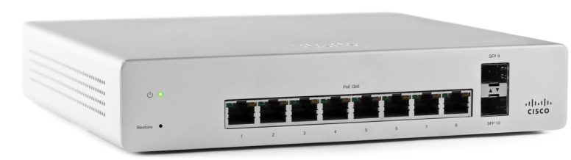
次のステップ
Merakiの Web サイトやブログをご覧ください
リスクフリーで評価いただけます
meraki.cisco.com/blog
Meraki 担当者にご連絡を！
meraki.cisco.com/eval
meraki.cisco.com/contact

Slide 22
リソース
https://meraki.cisco.com/mx
https://meraki.cisco.com/lib/pdf/meraki_whitepaper_mx_sizing_guide.pdf
http://cs.co/talkmeraki (Google Community)
https://meraki.cisco.com/ja/form/demo デモアカウント
Coming soon – MX / ASA positioning and sales guide

Slide 23
Meraki MX Update まとめ
IWAN, AMP/ThreatGrid や新しい MX について
今後の予定
Meraki のコンタクト
Notes:
Session Key Objectives(Objectives)– Best Practices:
Every presentation should contain a Key Takeaways slide at the beginning and end of the presentation highlighting what the audience will get out of the session. Key Takeaways help identify what the learner will be able to do or know, after listening to your presentation. Key Takeaways/objectives are statements that contain action verbs and criteria statements. Basically, a good way to think about it - is each objective should be able to finish and flow from the lead in sentence on the screen.
For example,
At the end of the session, the participants should be able to: Understand, Identify, Explain, Design, something from your presentation, when completing this slide, you are basically letting them know, what they should be able to do.
A Best Practice is to limit this slide to three to five Key Takeaways/objectives that tell the audience what they will be able to do or know after they see the presentation.
Fill this template out by asking yourself; what are the critical main points of this session that a VT member should go and redeliver to their region/team? Those critical main points should become your key takeaway bullets on screen.
PLEASE DELETE YELLOW TEXT BOX, and the words REQUIRED and “TEMPLATE” and sample red text upon completion.
Outcome should be behavioral:
Can they Articulate a message
Can they Deploy the solution

Slide 24
Q&A

Slide 25
Cisco Defense Orchestrator
A Cloud Based Policy Management Solution

Slide 26


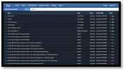


Cisco Defense Orchestrator (CDO) とは
Cisco Defense Orchestrator
シスコセキュリティプロダクトを、
クラウドで管理するソリューション
Notes:
I’d like to introduce Cisco Defense Orchestrator, a cloud-based policy management solution for Cisco security products.

Slide 27

「次世代」ソリューションを簡単に管理
Cisco Defense Orchestrator で ASA, ASA with FirePOWER Services OpenDNS* のポリシーを、ひとつのコンソールで簡単に管理
*Support for OpenDNS is currently in beta
Notes:
Using Defense Orchestrator means you don’t have to be an expert in every Cisco security device and service in order to leverage their capabilities. Defense Orchestrator makes it easy to take advantage of the next-gen capabilities these offerings deliver.
With Defense Orchestrator, security policy for the ASA, ASA with FirePOWER Services and OpenDNS is managed through a single interface. Defense Orchestrator translates your rulesets into language recognized by each of those technologies, so that you don’t have to manage security policy for each tool separately.
From one location, you can manage security policies across all of these Cisco security devices and services. And as you add more Cisco security products, you can still systematically maintain a strong security posture.

Slide 28
セキュリティポリシーマネージメント
Cisco Defense Orchestrator シンプルに全セキュリティポリシーを管理
変更管理: 変更によるデバイスやセキュリティサービスへの影響を可視化
Cisco Defense Orchestrator
オーデット: ポリシーなどの解析で問題を直ぐに特定可能
Change Impact
Modeling
Object & Policy
Analysis
デバイスオンボーディング
オフラインインポート
直接デバイスから検出
セキュリティポリシー管理
レポート
モニタリング: レポートや OOB 通知により、ポリシー変更や効果を全体的に把握
最適化: パフォーマンスを最適化する為のセキュリティポリシーの調整
OOB 通知
Notes:
Defense Orchestrator helps you orchestrate security policy management from one place.
You can onboard Cisco devices across distributed locations securely, either online or offline. It’s easy and painless and your data is encrypted and secure every step of the way.
Once your devices are connected, Defense Orchestrator helps you orchestrate all four aspects of security policy management – through change management, auditing, optimization and monitoring.
In terms of Change Management, you get visibility to change impact across affected Cisco security services and devices. You can visualize and orchestrate how changes affect global security posture using change impact modeling.
In terms of Auditing, you gain policy awareness and identify issues. You have the ability to compare and edit duplicate, unused, and inconsistent configurations by conducting object and policy analysis.
In terms of Optimization, you can adjust Cisco security policy rulesets to optimize performance based on insights from change impact modeling. You can also easily apply revised policy configurations across all Cisco devices.
And last, for Monitoring, you can track policy implementation and activity across all impacted Cisco security services and devices through aggregated reports and out-of-band notifications.

Slide 29

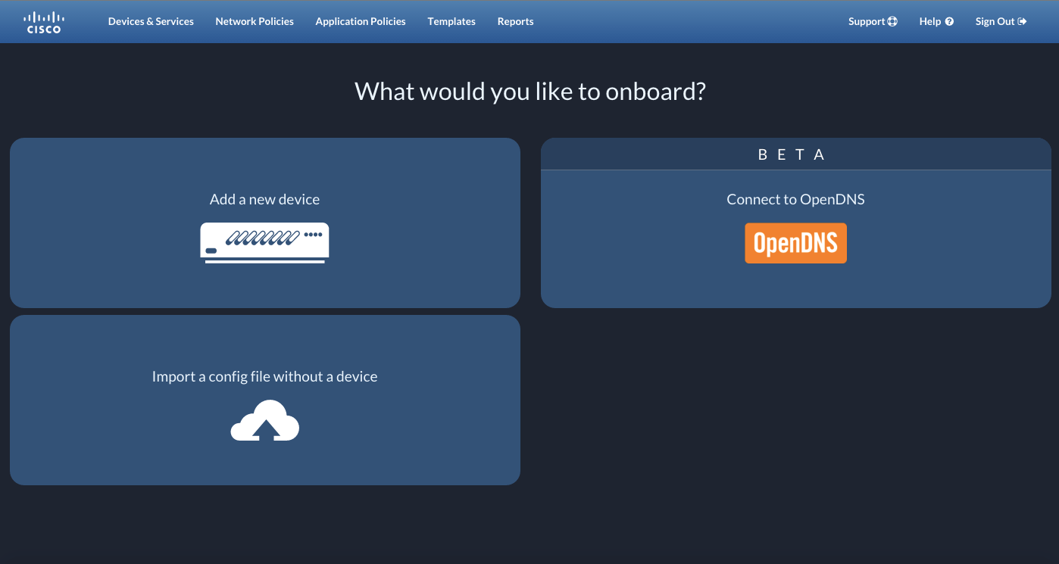
オンボーディング
シンプルなインターフェイスで登録
２種類の接続形態
Cisco Defense Orchestrator
お客様ネットワーク
Secure
Data
Connector
Secure
Data
Connector
1
インターネット接続
2
インタ〜ネット接続なしSecure Data Connector
Notes:
Onboarding devices is easy, and managing security should be, too.
Get started with our simple onboarding interface.
If you’re onboarding with a device, Defense Orchestrator supports ASAs, as well as ASAs with FirePOWER Services.
And connecting to Cisco Defense Orchestrator is simple, regardless of whether you choose to onboard in the cloud or on your own premises.
T: Once you’re onboarded, then the real fun begins. [CLICK]

Slide 30
Search – 簡単にどのポリシーがどこで適用されてるかを可視化
F
a
c
e
b
o
o
k
www
www
www
www
www
www
www
www
www
“Facebook” 検索結果
www
www
www
www
www
www
www
www
www
www
Facebook. com | Domain/IP | OpenDNS | 15 Block 13 Allow
Facebook Chat | Application | FirePOWER | 15 Block 13 Allow
Facebook Games | Application | FirePOWER | 20 Block 15 Allow
Social Networking | URL Category | FirePOWER | 10 Block 10 Allow
www
www
www
www
www
www
www
www
www
www
www
www
www
www
www
www
www
www
www
www
www
www
www
www
www
www
www
www
www
www
Searching 5024 records
www
Notes:
Seeing how many policies and objects are sitting in Cisco Defense Orchestrator can be daunting. You’re probably managing thousands of policies and objects.
If you want to know how a particular object is interacting in different locations on different policies, the last thing you want to do is manually sift through all of your device information.
The simple search-based management feature allows you to do just that. Simple search-based management provides you a single-pane view across all of your Cisco security devices. Simply search by policy, object, ACL name, and/or network name to find exactly what you want to know.
We know you’re busy and we know that managing security can be tedious and time consuming. Cisco wants to make managing security simple, so we made it as easy as a web search.
T: And what you can do once you find what you’re looking for can make a big impact on your security posture. [CLICK]

Slide 31
ポリシーやオブジェクトを効果的に分析
重複を検知し修正してファイアウォールを最適化
Policies
Quickly see
Duplicate Objects
Duplicate
Object 1
Object 1
Inconsistent
Object 1
Rename Policy
Unused
Edit Policy
Notes:
Now that you have devices in the Defense Orchestrator environment, you are able to interact with all of your Cisco security devices to ensure that your security posture is sound.
Let’s say you have 5 branches, including your headquarters, and you need to make sure they’re secure. Defense Orchestrator enables you to see where you have duplicate policies and gives you the option to either rename them if they are in fact protecting your infrastructure, or to edit the policies to remove any overlapping instructions.
Removing duplicate policies and objects from your network helps optimize your firewall. By removing duplicate properties, your firewall doesn’t spin its wheels trying to protect your system in multiple ways using the same policies and objects.
T: Cisco Defense Orchestrator also enables you to spot inconsistencies within your network. [CLICK]

Slide 32
ポリシーやオブジェクトを効果的に分析
不整合の修正
Quickly see
Inconsistent Policies
Policies
Quickly see
Duplicate Policies
Policy 1
Objects
1
2
3
Policy 2
Objects
1
2
3b
Duplicate
Policy 1
Duplicate
Policy 1
Inconsistent
Policy 1
Rename Policy
Unused
Edit Policy
Notes:
Defense Orchestrator not only lets you see where inconsistencies exist, but it lets you dive into the details and see exactly where they reside.
The detailed view within Cisco Defense Orchestrator allows you to easily remediate any anomalies in your network.
T: You can also confidently identify policies and objects that are being used in your network. [CLICK]

Slide 33
ポリシーやオブジェクトを効果的に分析
未使用のポリシーを自動検出、削除
Quickly see
Inconsistent Policies
Quickly see
Unused Policies
Policies
Quickly see
Duplicate Policies
Policy 5
Duplicate
Policy 1
Objects
1
2
3
Policy 1
Objects
1
2
3b
Policy 6
Inconsistent
Policy 7
Inconsistent
Delete Policy
Unused
Edit Policy
Notes:
Unused policies and objects just take up energy and space in your system. When these unused policies and objects take up memory space, it slows down your entire system, weakening your security performance.
Defense Orchestrator automatically identifies which policies and objects are going unused. This enables you to confidently remove any unused policies, with the knowledge that your security posture will not be impacted by these changes.
T: Cisco Defense Orchestrator helps you set up your security policies right the first time. [CLICK]

Slide 34
テンプレート
テンプレートを用いて、新規ブランチなどに簡単にセキュリティポリシーを展開可能
Security
Policy
本社
支社
Security Policy Template
✓
x
支社
x
✓
新支社
Notes:
With Defense Orchestrator, setting up security at a new branch is as easy as copy and paste.
You can build security policy templates that help you apply consistent security policy across your entire business. The good news is, you don’t have to build your templates from scratch. We make creating security policy simple by giving you a place to start.
[Click 1] With Defense Orchestrator, you can easily modify preconfigured security policy templates by simply selecting or de-selecting the parameter attributes you want to adjust. This provides a simple and dynamic way to achieve advanced protection. Instead of manually configuring each and every Cisco device, you can use a single standard template over and over that gets applied to your existing headquarters and branch locations.
[Click 2] As your business expands, the security admin can apply the same security policy template to the new locations.
With this one-to-many approach, you can simplify the overhead of setting up and managing several locations.

Slide 35
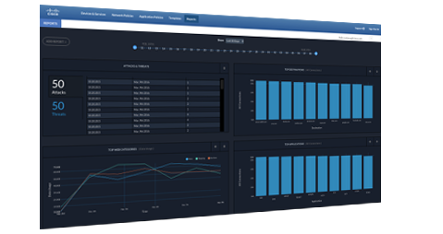
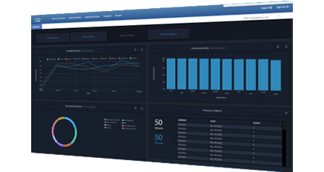
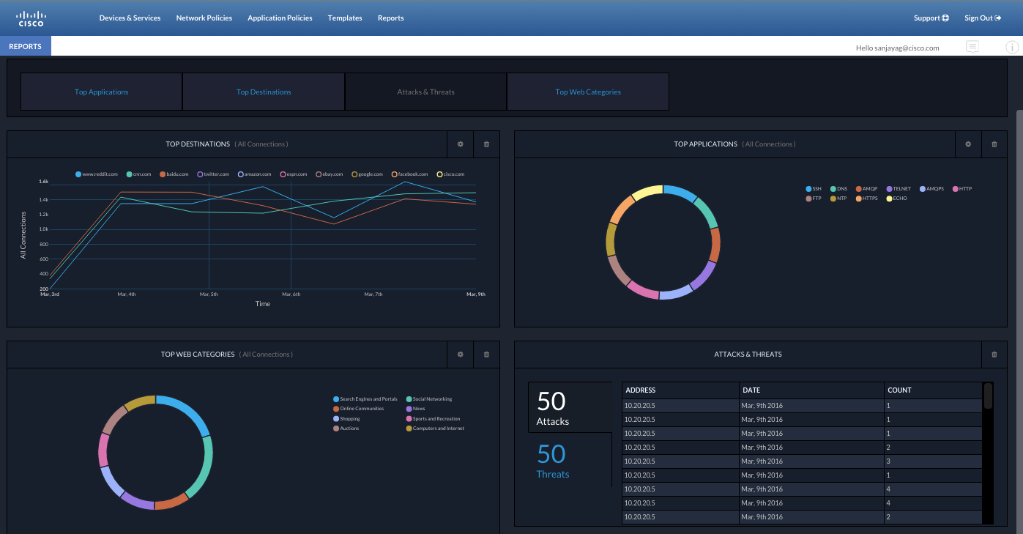
レポート – ネットワークセキュリティ全体での可視化
全ネットワーク基盤のパフォーマンスを分析
Layer-7の可視化
ネットワークの傾向を、レポートの上位の宛先、アプリーケション、URL カテゴリから、簡単に可視化可能。
Notes:
These reports help you analyze the performance of your entire Cisco infrastructure. They grant visibility into Layer-7 and identify trends within your network, enabling your organization to gain a stronger, more consistent security posture.
T: But let’s see what this looks like in reality. [CLICK]

Slide 36
CDO でお客様の課題を解決
FW (ASA) では
  ポリシー監査: 既存環境の設定やマイグレーションの際の問題を監査
  ポリシー最適化: ルールの分析し不必要なものをクリーンナップ
  ポリシー変更管理: ポリシーを統合的に管理、他から変更がある場合も検知
Firepower Services による Layer 7 セキュリティをシンプルに
  IPS ルール
  より高度な脅威の防御
  アプリケーションルール
整合性を保ち、ネットワーク全体のセキュリティを強化
  Cisco セキュリティ製品のポリシーを集中管理
  本社、支社など場所に関係なく同等のセキュリティポリシーを管理
Notes:
We make managing policy a simple and consistent effort!
Lets enable your client to evaluate the current state of the security policy structure today. Identify potential issues that could be simply nuisance (duplicates/unused), but could also be a vulnerability (inconsistent objects)! Once we identify, lets position them to remediate and optimize from a central location across all ASAs. Now that we have a solid foundation, lets move to a more proactive policy management state. Add new rules or make changes centrally and push them across one or groups or all platforms! Ensure that you are notified when a policy has been changed out of band! Lets remain consistent and proactive!
Every client wants layer 7 protection….not every client wants or can handle the complexity. We want to simplify the experience of managing Firepower services to include AMP, URL and IPS. Those customers that need/want the deep level of analytics and the goodness of Firesight, sell it!! The number 1 goal: increase NGFW marketshare!
Lastly….end to end policy management improves your clients overall security posture. Lets make it simple and consistent!

Slide 37
デモ

Slide 38
ロードマップ、その他

Slide 39
CDOの これまで と これから!
プロジェクトスタート
(Lockhart)
日本価格表
掲載予定？？
7/11 @ Cisco Live ラスベガス
2/29 @ RSAカンファレンス発表 US Only
FY15 Q1
FY16 Q3
FY16 Q4
FY17 Q1
FY17 Q2
FTD
ASA 5500-X
Series Firewalls
ASA with FirePOWER Services
OpenDNS*
FirePOWER Threat Defense
* OpenDNS は、現在ベータ
Notes:
In the beginning…..Project Lockhart is an internal development group that created CDO from scratch. Coding up to launch was about a 15 month investment….alot done very quickly! We are an agile shop which operates on weekly sprints which equals weekly updates to features, bug fixes or new product support. Cisco is an innovator and this is proof.
Phase 1: DONE! Defense Orchestrator was introduced at RSA on 2/29 as a controlled launch. This means that Defense Orchestrator team we will directly work with you folks on identified opportunities to ensure they meet the defined criteria and ultimately manage to success. Ensure positive experience by controlling the sweet spot
Phase 2: Test and fine tune a Repeatable Sales Process in advance of full launch: This is through the channel as well as the Cisco core sales team. Goals: (20) closed deals, (3) Reference Customers, and Meaningful Customer Usage (mgt of 20 devices)
Phase 3: Tier 1 Launch at Cisco Live – Vegas
Phase 4: Scale sales and continue to develop!

Slide 40

Cisco Defense Orchestrator まとめ
シンプル
セキュリティポリシーと次世代防御の管理を合理化
効率的
管理範囲を拡大
効果的
複雑なことなしでよりよいセキュリティを実現
Notes:
Introducing Defense Orchestrator: Leveraging Defense Orchestrator, your clients are able to simply and consistently manage security policy across multiple Cisco security devices from the cloud. (3) design principles we kept in mind as we built this solution was to keep it simple….make it efficient and to be effective.
Simple: You can streamline security policy management and next-gen defense,
Efficient: Extend the reach of your current resources
Effective: Most security tools add management complexity. This is one of the only tools that will actually reduce the complexity and improve your security at the same time.

Slide 41
リファレンス
CCO
http://www.cisco.com/c/en/us/products/security/defense-orchestrator/index.html

Slide 42
Q&A

Slide 44
CDO: サポートデバイス as of Jun/29/2016
Internal
Product | ASA SW Version | Firepower on ASA SW version | Firepower Threat Defense SW version
ASA 5505, 5510, 5520, 5540 | 8.4 and later | NA | NA
ASA 5506X, 5508X, 5516X | 9.2.2 and later | 5.4.1 or later | 6.1.x and later
ASA 5512X, 5515X, 5525X, 5545X, 5555X | 9.2.2 and later | 6.0.0 or later | 6.1.x and later
ASA 5585-XX | 9.2.2 and later | NA | NA
Firepower 4110, 4120, 4140, 4150 | 9.6.x and later | NA | 6.1.x and later
Firepower 9300 | 9.6.x and later | NA | 6.1.x and later

